Slide 1
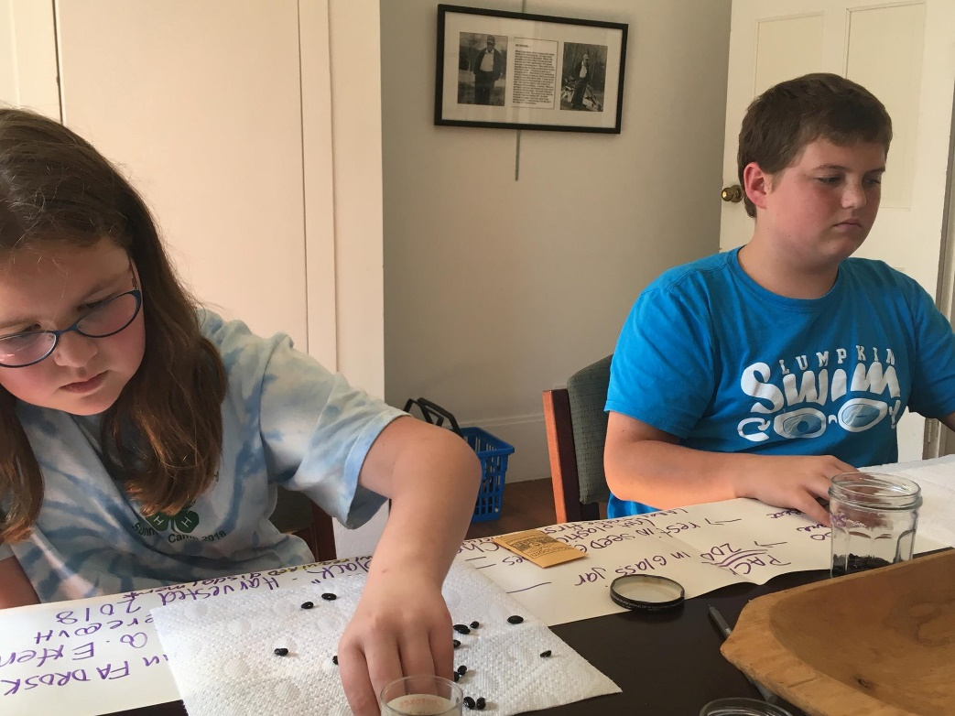
Seed Saving in the School or Community Garden
Rosann Kent, UNG (Rosann.Kent@ung.edu)
Becky Griffin, UGA (beckygri@uga.edu)
Ashley Hoppers, UGA (aahoppers@uga.edu)
Amanda Tedrow, UGA (atedrow@uga.edu)
Special thanks to the students of UNG for the photographs showing their enthusiasm for seed saving!
This presentation is part of a Seed Saving Initiative, a joint venture between UGA and UNG funded by an Urban Ag grant.

Slide 2
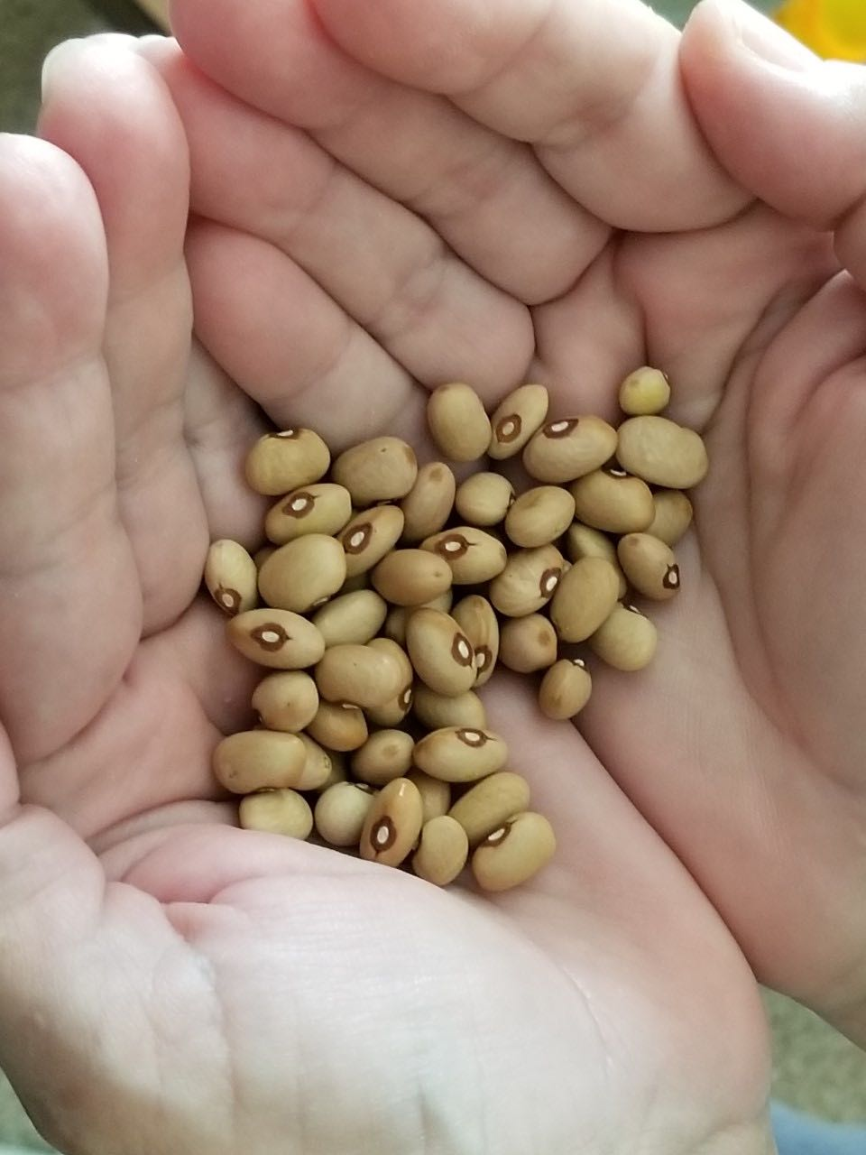
Why Save Seeds?
To preserve biodiversity – variation at the genetic and species level
To build community – seed sharing
To save money – no need to purchase seed
To continue cultural traditions – and build new ones
As an important part of agricultural heritage – landrace and heirloom seeds
As an exercise in botany – physiology, genetics, distribution, classification, etc.

Slide 3
University of North Georgia’s Appalachian Studies Center
hosts the
Saving Appalachian Gardens and Stories Project
This model could be used in areas of cultural diversity, Native Peoples studies, and historical population pockets.
https://ung.edu/appalachian-studies-center/saving-appalachian-gardens-stories.php
Notes:
An important part of the seed saving initiative at UNG is collecting the stories behind the seeds. When they are gifted a seed type they ask the history of the seed. Who grew it? Where was it grown? What dishes are made with this seed? What is the history of the seed? These stories are cultural heritage.

Slide 4
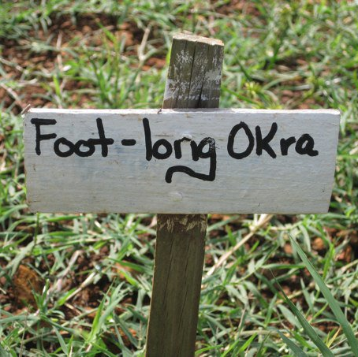
Which seeds should I save?
Heirloom (over 50 years old) or open-pollinated varieties
Seeds from disease and insect free plants
Seeds from a plant that tasted well or produced well
Do NOT save seeds from hybrid varieties – this seed will typically not produce plants or fruits that are like the parent plants

Slide 5
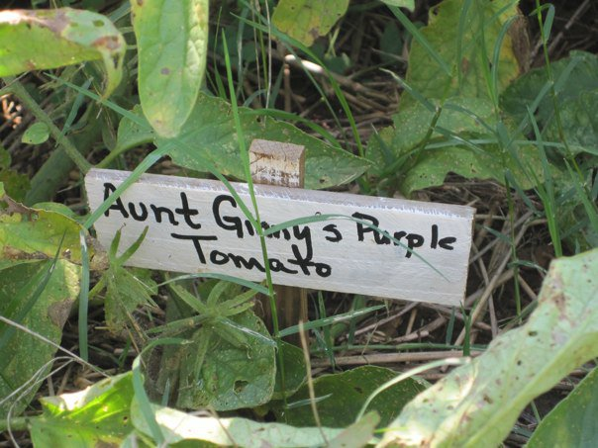
Basic Seed Saving Knowledge
Know your plants’ lifecycles and pollination requirements
Understand plant isolation to prevent unintended pollination
Recognize the best time to harvest seeds for saving
Learn how to prepare and store your seeds

Slide 6
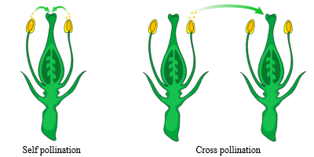
Know Your Plants
Do they self-pollinate? easiest
Do they cross-pollinate? harder
By wind, bird, or insect

Slide 7
Understand Plant Isolation
Crop | Scientific Name | Pollination | Isolation Distance
Bush Bean | Phaseolus vulgaris | Self | 10 ft.
Runner Bean | Phaseolus coccineus | Self, insects | 800 ft.
Lettuce | Lactuca sativa | Self | 10 ft.
Spinach | Spinacea oleracea | Wind | 3200 ft.
Tomato | Solanum lycopersicum | Self, insects | 10 ft.
Isolation distance is the minimum space between VARITIES of seed to ensure that the seed you save is pure. For example, there should be at least 10 feet between “Provider” bean variety plants and “Jade” bean variety plants to ensure the resulting seeds are pure.
www.seedsavers.org/site/pdf/crop_chart.pdf
Notes:
For a small garden space, like a school or community garden, you may consider only growing the variety of seed that you want to save because of limited space.

Slide 8
Recognize When to Harvest Seeds Physiological vs Market Maturity
Physiological Maturity
Market Maturity
Notes:
Physiological maturity is when the plant seeds are reproductively mature. Market maturity is when the seeds are ready to sell for human or animal consumption. To save seed you are looking for physiological maturity. Notice how the seed pods are full and the shells are dry and crisp.

Slide 9
Learn How to Prepare and Store Your Seeds Three Methods of Seed Saving
1. Dry
Beans
Okra
Corn
Greens
Sunflowers
Milkweed
2. Wet
Pumpkins
Squash
Melons
3. Fermentation
- Tomatoes
Notes:
https://extension.uga.edu/content/dam/extension/programs-and-services/school-gardens/documents/4-Historical-Finding-Gathering-and-Saving%20Seeds.pdf
https://site.extension.uga.edu/cherokee/2016/10/saving-seeds-the-power-of-the-past-and-promise-of-the-future/

Slide 10
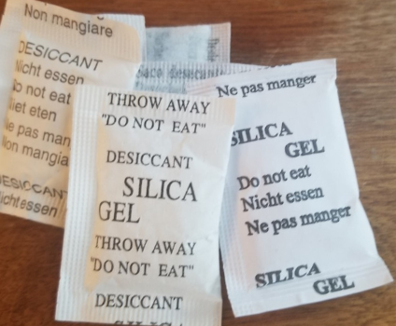
Seed Saving Equipment
Glass jars and lids – several sizes
Rubber bands or twine
Paper plates – not plastic
Sharpies to label plates
Old pillowcases – to separate seed from shells or plant debris
Desiccant - save from shoe boxes and vitamin bottles

Slide 11
Seed Saving Equipment (continued)
Plastic dish tubs, strainers & pitchers or milk jugs
Shallow pans with lip
Knife, spoons, or scoops
Fan
Coin envelopes
Seed screens – can be purchased or made

Slide 12
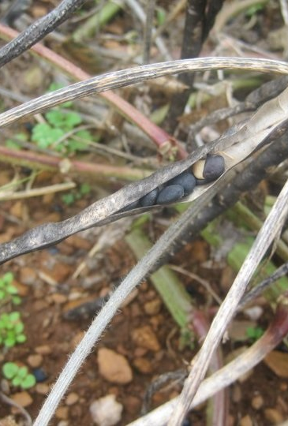
Be selective in saving
Don’t save everything!
Don’t save diseased seeds.
Don’t pick up seeds or pods from the ground.
Watch for birds & weather!
Save a little along the way.
Save at the right time!

Slide 13
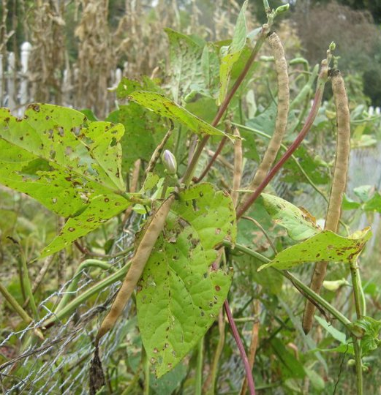
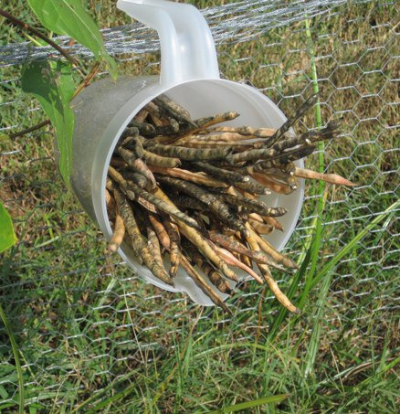
Dry Seed Saving: Snap Beans
Notes:
Leave beans on the plant until physiological maturity – dry, crisp

Slide 14
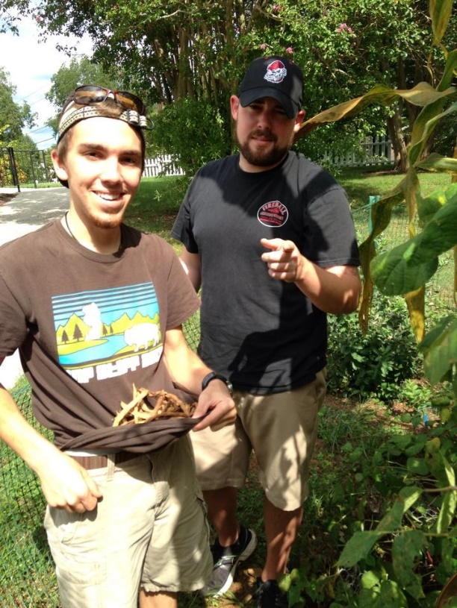
Leave beans on the plant until they show physiological maturity.
Ensure that the seeds are fully dried with shells dry and crisp.
Choose seeds are healthy looking and disease-free.

Slide 15
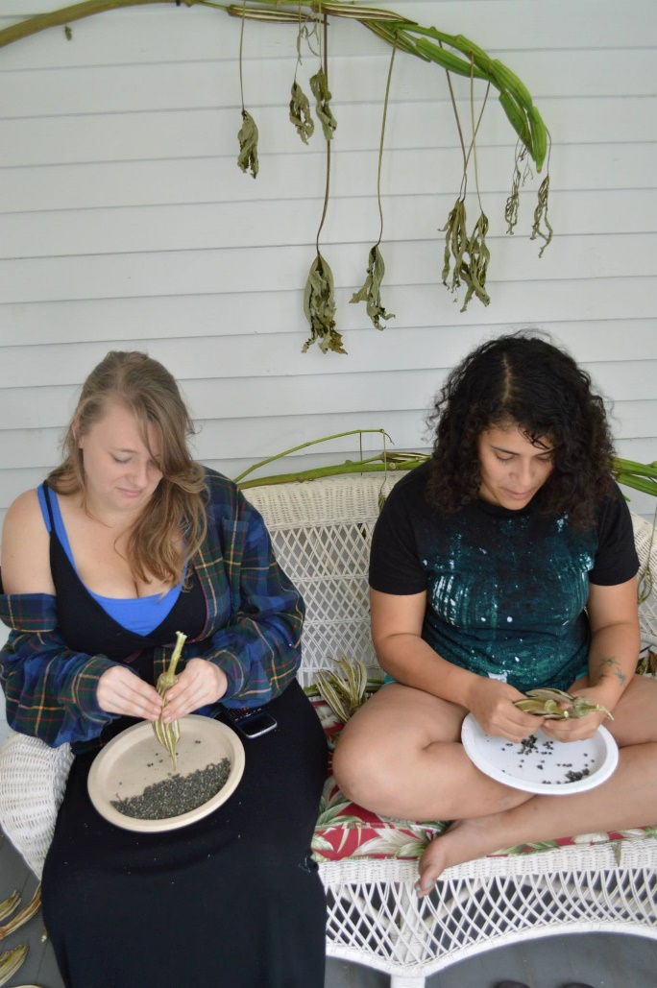
Separate the beans from the shells.
Place seeds on labeled (with seed name and date) paper plates for final drying.
Put in a dry, undisturbed location.

Slide 16
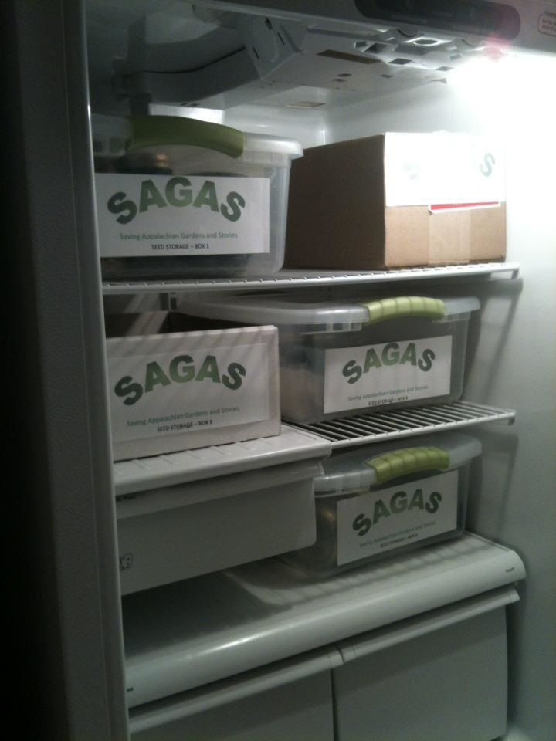
For storage, place seeds in an airtight container.
Use a desiccant (save it from shoe boxes or aspirin bottles) to keep seeds dry.
Label all containers with seed types and date.
Store in a cool, dark place.
Store this way for 3-4 years.

Slide 17
Wet seed saving: Melons

Slide 18
Be aware that these fruits can be difficult to open.

Slide 19
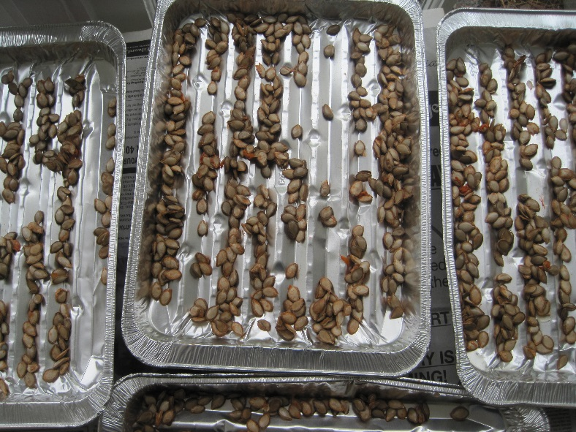
Dry the seeds by stirring and turning frequently. A fan may be helpful. Dry the seeds even more, remembering to label them.

Slide 20
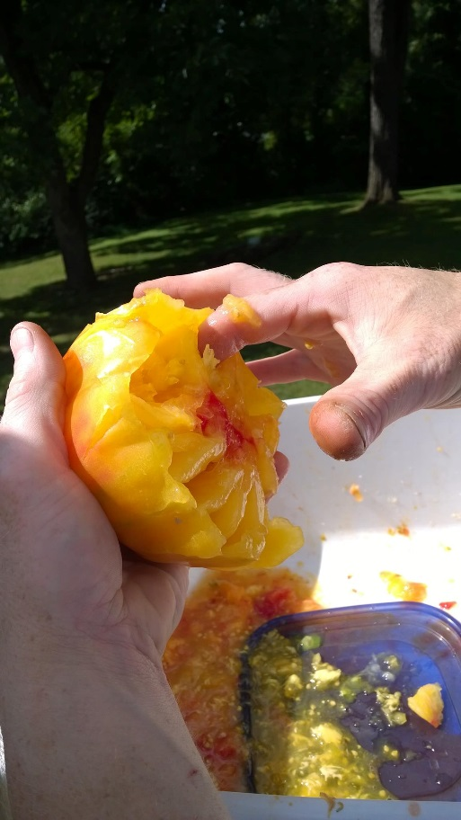
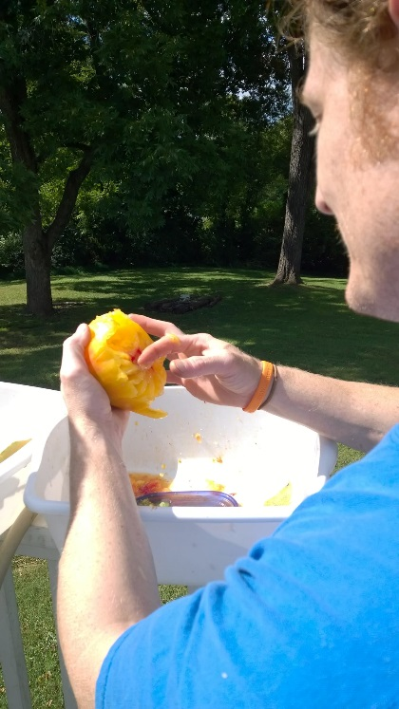
Fermentation: Tomatoes

Slide 21
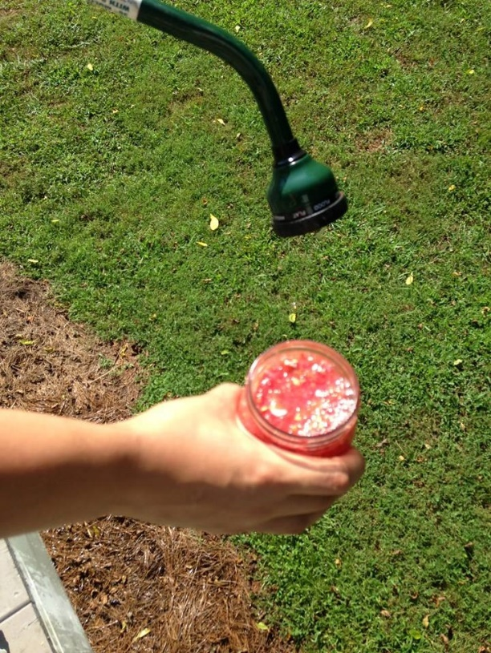
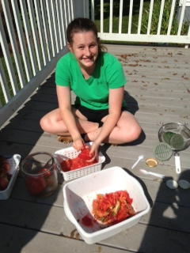
Save your best tomatoes.
Mush the pulp with water.
Put in a jar.
Cover with screened lid or cheese cloth secured with rubber bands or twine.

Slide 22
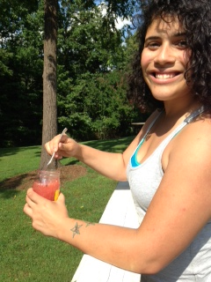
Wait for the stinky smell of fermentation. This could take several days to a week depending on the temperature.
Remove the top layer of pulp and floating seeds.
Rinse the seeds.

Slide 23
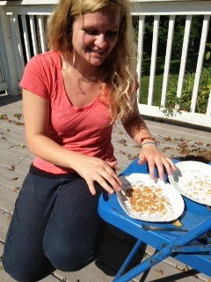
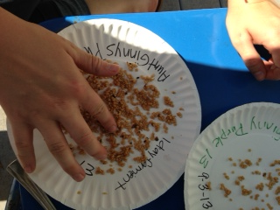
Spread seeds on labeled paper plates.
Protect from weather.
Stir and move seeds around daily until dry.

Slide 24
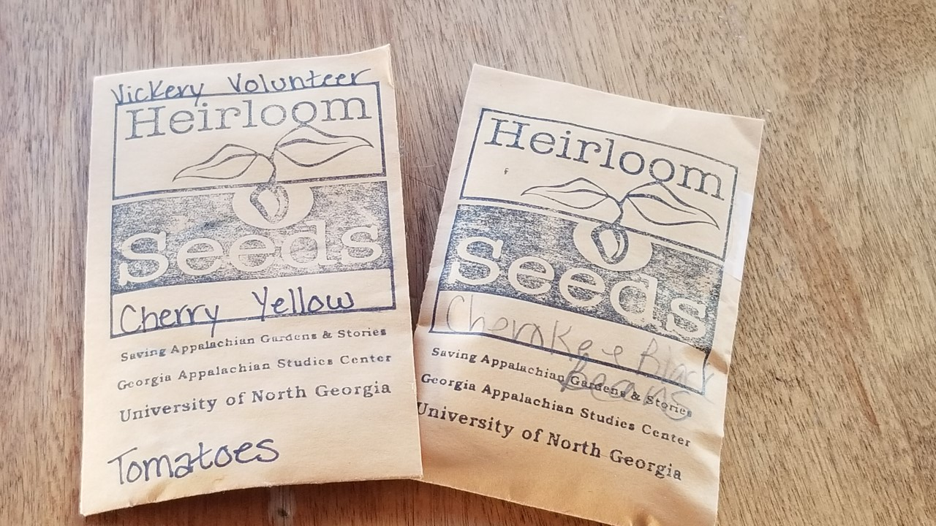
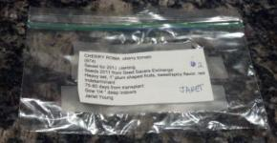
Seed Storage Containers Remember the goal is to keep the seeds dry.
Plastic storage bags
Paper envelopes – coin envelopes are easy to purchase
Glass jars

Slide 25
Where to Store Seeds
Good: Cool, dry, and dark place—closet or cupboard
Better: Airtight containers in refrigerator
Best: Dry to 5 to 7% moisture content by weight; store several degrees below freezing
Don’t worry - not many of us can be this precise!
Freezing does not harm them and can greatly extend their lifespan if done properly!
Notes:
If you cannot remove most of the moisture, do not freeze the seeds, 32-41 degrees will slow down enzyme activity. Reduce the temp fluctuations as much as possible
Ashworth, Seed to Seed KM

Slide 26
Seed Storage Facts
Viability decreases in storage.
Rate of decrease varies with each variety depending on the initial quality of the seed going into storage.
Each variety must be periodically regenerated to maintain a healthy, viable seed stock.

Slide 27
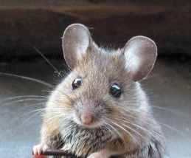
Stored Seed Issues
Temperature variation
Moisture fluctuation
Insects
Animal Pests
Notes:
Each 1 percent reduction in moisture
(between 5 and 14 percent) doubles the storage life of the seeds.
Source: Wheeler, Success With Seeds
High temps will dry out the seeds and may damage the embryo, thereby reducing germination in some species.
Fluctuations in temperature or moisture levels of stored seeds lowers the seeds' longevity, causing loss of viability and vigor or even seed death. High temps will dry out the seeds and may damage the embryo, thereby reducing germination in some species.
Seeds air-dried during humid weather require additional drying with desiccants such as silica gel before final storage. Most seeds benefit from drying with silica gel if they are to be stored for very long. Place equal weights of silica gel and seeds in a well-sealed jar for 7 to 8 days. Then transfer the dried seeds quickly into airtight storage jars and place in a freezer, refrigerator or other cool, dark place.
A common problem with stored seeds is mold or mildew resulting from incomplete drying before storage. Dry your seeds thoroughly before storing them (though drying them to 0% moisture will of course cause their death). If seeds sweat on insides of jars during storage, they are too wet and must be dried further in order to store successfully. At this point, the use of a desiccant is a good idea. Don't tarry, because damp seeds will mildew quickly. Again, the silica gel absorbs excess moisture.

Slide 28
How Long Will My Seeds Last?
Long lived (> 5 years - in general) : Brussels sprouts, cabbage, cauliflower, celery, cucumber, eggplant, lettuce, melon, radish, rutabaga, spinach, squash, and turnip
Medium lived (3-5 years - in general): Bean, beet, broccoli, carrot, leek, pea, pepper, pumpkin, and tomato
Shorter lived (1-2 years - in general) : Corn, onion, parsley, parsnip
Notes:
Ref -UMaine Cooperative Extension, Bulletin #2750 KM
28

Slide 29
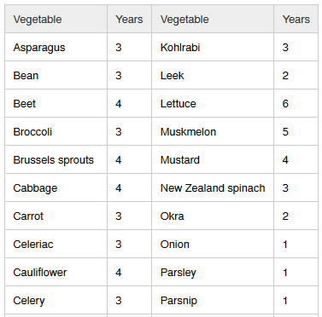
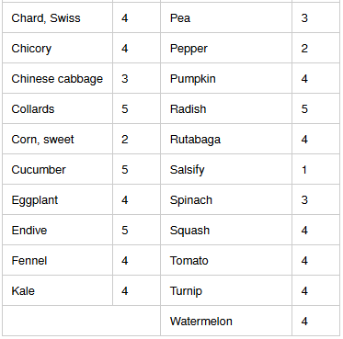
How Long Will My Seeds Last?
Notes:
https://hortnews.extension.iastate.edu/1999/4-2-1999/veggielife.html

Slide 30
In summary, to ensure seed saving success:
Do your research. Know your plants and their pollination situation.
Aim for viable seeds. Practice isolation distances and do NOT save seed from hybrid plants.
Harvest seeds at physiological maturity.
Prepare and dry seeds accordingly.
Store seeds properly.
Label EVERYTHING.

Slide 31
Seed Saving in the School or Community Garden
Rosann Kent, UNG (Rosann.Kent@ung.edu)
Becky Griffin, UGA (beckygri@uga.edu)
Ashley Hoppers, UGA (aahoppers@uga.edu)
Amanda Tedrow, UGA (atedrow@uga.edu)
Special thanks to the students of UNG for the photographs showing their enthusiasm for seed saving!
This presentation is part of a Seed Saving Initiative, a joint venture between UGA and UNG funded by an Urban Ag grant.

