Slide 1
What to Plant in Your School Garden James Morgan, CEC, Dougherty County
One of the UGA Extension School Garden Team’s series of presentations.

Slide 2
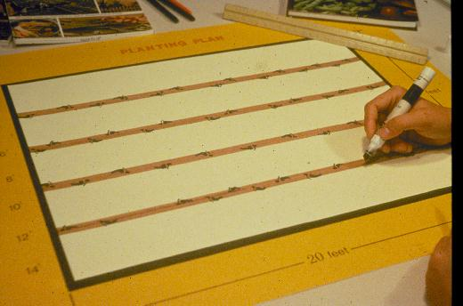
Notes:
The most successful garden is a well-planned garden. Most garden problems are more easily prevented than solved once they occur. Plan the garden in advance of planting to reduce problems and to make the most of your efforts. Decide what crops to plant, how much of each to plant and where and when you will plant before you begin. Even your first vegetable garden can produce a winning harvest if you will take the time to make a plan and follow tried-and-true methods of planting and care.

Slide 3
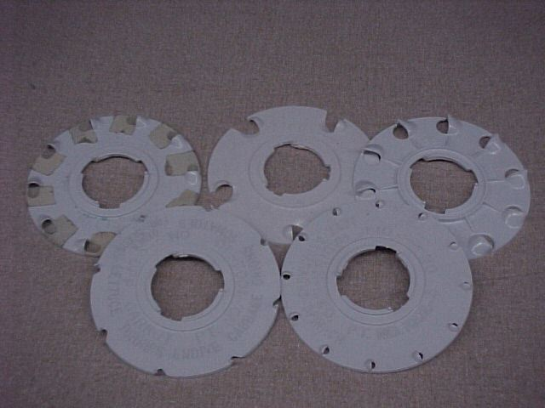
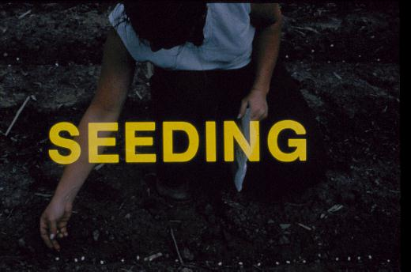
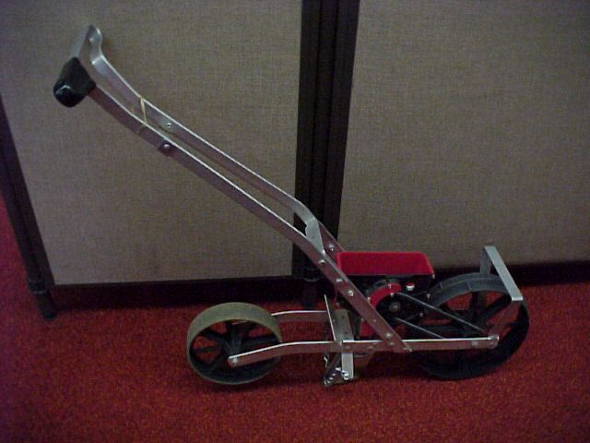
Notes:
(Seeding) Many gardens are planted by direct seeding. Always use fresh, disease-free, western-grown seed. Inexpensive seeders can be used in larger gardens. Various seeding plates are available for different sized seed.

Slide 4
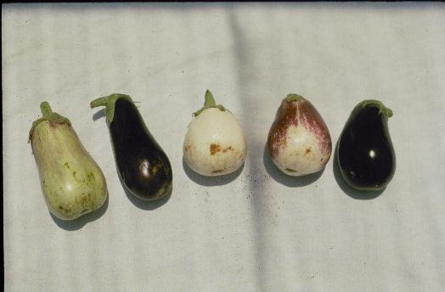
Notes:
(Poor Eggplant) Avoid bargain seed. Such seed may germinate poorly, be off-type such as these eggplant shown in this slide, and yield poor quality produce.

Slide 5
Notes:
Many popular vegetables can be grown from seed. Proper soil preparation and planting depth is important for successful germination.

Slide 6
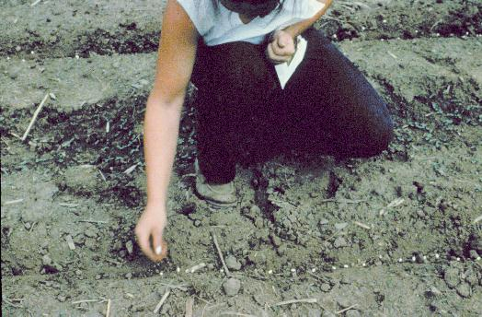
Notes:
(Seeding) Large seeds are easy to sow. Smaller seed can be mixed with sand before sowing, or sown onto a piece of tissue laid in the rows. The tissue makes the seeds easier to see but will decompose rapidly without causing a problem. Some seeds are available in gels or tapes to make sowing easier.

Slide 7
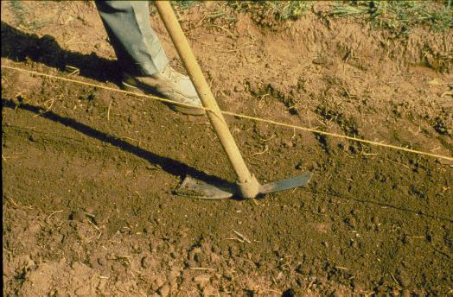
Notes:
(Seed covered) Refer to the seed packet or Extension literature to determine how deeply to plant the seeds, as depth varies with the type of seed. Cover seed well and firm the soil around the seed by pressing the soil down lightly with a garden tool.

Slide 8
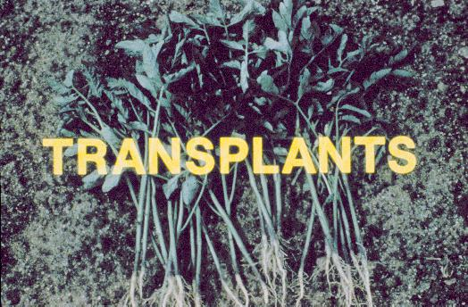
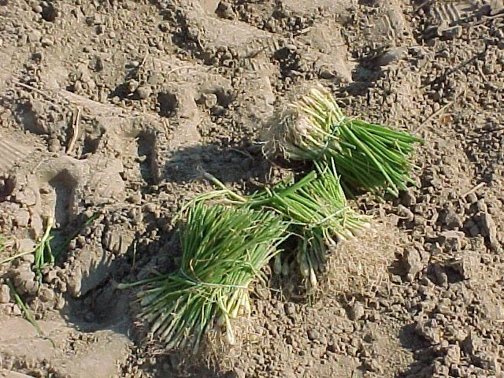
Notes:
(Transplants) Many gardeners prefer to use transplants instead of seed, especially for cabbage, broccoli, tomatoes, and peppers. Transplants are easier to establish and produce earlier crops than direct seeded crops. Although bareroot transplants are still available, transplants grown in soilless mixes are by far the more popular now.

Slide 9
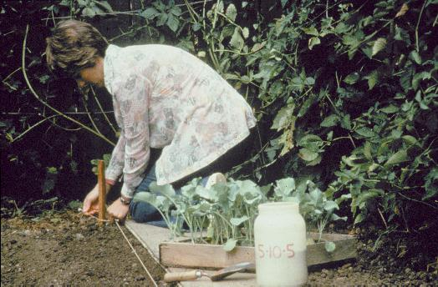
Notes:
Transplants are young plants that have been started from seed indoors or in plantbeds four to eight weeks earlier. Transplants can be bought at local garden centers or grown at home.

Slide 10
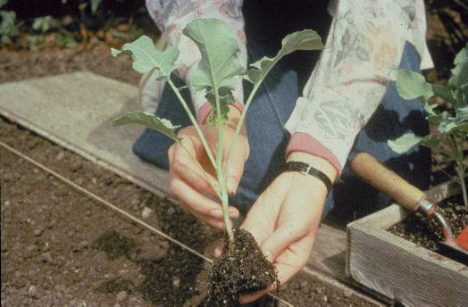
Notes:
This heavy, stocky transplant is an ideal size for planting. It will recover quickly from the shock of transplanting and resume growing.

Slide 11
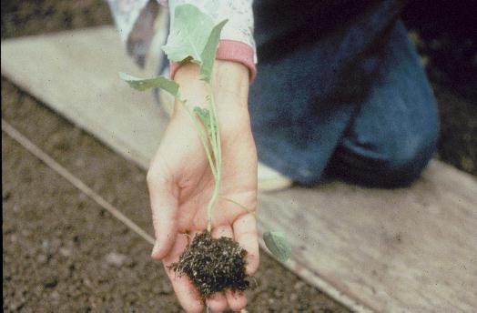
Notes:
Avoid buying leggy plants that have been neglected by the grower and may not grow properly.

Slide 12
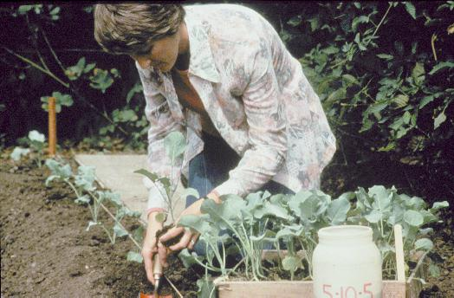
Notes:
(Transplanting into the garden) Seedlings should be transplanted into the garden ideally on a cloudy, windless day. Small plants should be handled by the leaf; larger transplants can be handled carefully by the stem. Follow Extension office publication recommendations for spacing. For example, cabbage and broccoli plants should be spaced 10" to 12” apart in the row.

Slide 13
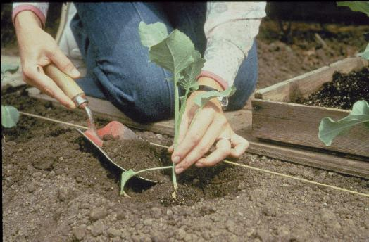
Notes:
Transplants should be set so the garden soil comes up to approximately the same level as in the container in which the plant was grown, except for tomatoes, which may be planted deeper.

Slide 14
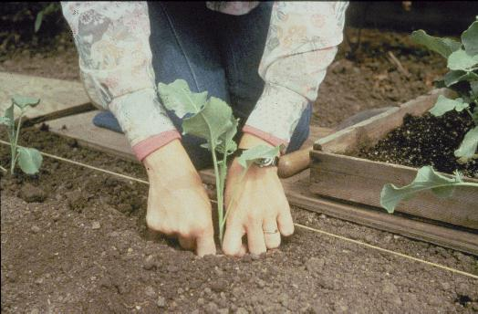
Notes:
Firm the soil around the roots after planting This keeps plants from toppling over and growing crooked. Also, it helps to remove "air pockets" from around the roots, which may cause wilting.

Slide 15
Notes:
(Cool season vegetable) Because of its usually mild winters, cool season crops are grown in the deep South from late summer through spring.

Slide 16
VEGETABLES GROWN FR0M VEGETATIVE PORTIONS
Asparagus
Irish potatoes
Onions (sets)
Rhubarb
Sweet potatoes
Notes:
Several important cool season vegetables can be grown vegetatively, that is by planting vegetative parts instead of seed or transplants

Slide 17
Notes:
(Cool season vegetable) Because of its usually mild winters, cool season crops are grown in the deep South from late summer through spring.

Slide 18
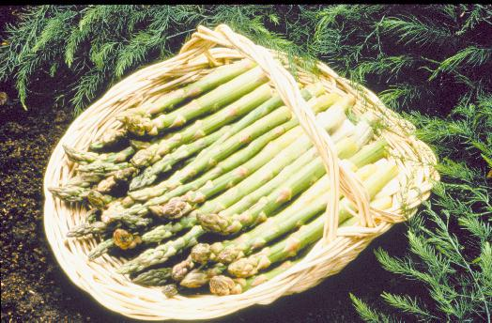
Notes:
(Asparagus) Let us take a look at some of the more common cool season vegetables grown in Georgia gardens. Asparagus is one of the few perennial crops that we grow in the garden, and should be placed where it can remain for several years. Keep asparagus from the middle of your garden because you cannot plow it with the rest of the garden. Asparagus normally is started from rooted one year old crowns. There are also newer varieties available from seed that are also male sterile, thus not producing seed. Don't cut the spear during the first year; let the spears grow and develop a strong root system.

Slide 19
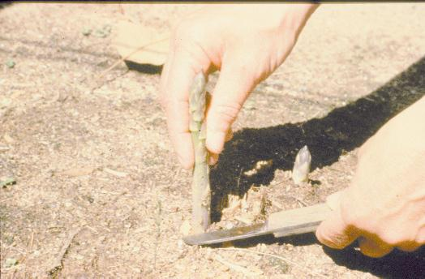
Notes:
(Asparagus) Spears can be harvested for approximately 2 weeks in the second year. Harvest for 4 weeks the third year. The harvest should never exceed 8 weeks in any year. Cut spears when they are 4 inches long. Asparagus is a heavy feeder and will respond to heavy rates of fertilizer and to organic matter if added at the time the crowns are set. A good mulch should be used around asparagus for weed control. Thc tops of the asparagus plant are called ferns, and the ferns that develop after the harvest should be allowed to grow until late fall or winter until the tops turn completely brown. At that time they should be removed and composted.

Slide 20
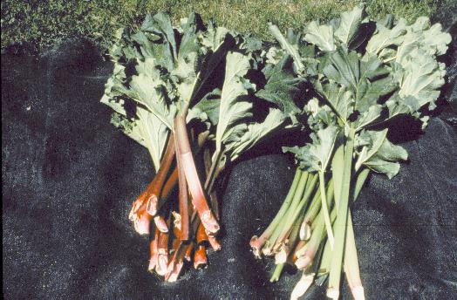
Notes:
(Rhubarb) Rhubarb, commonly grown in the North, can also be grown in the Southern garden.

Slide 21
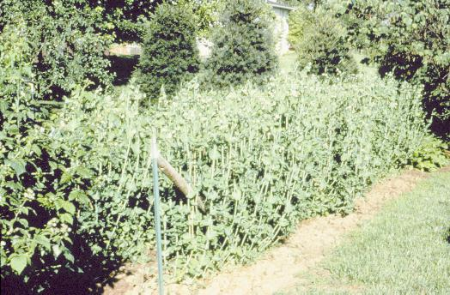
Notes:
(English Pea Pod) English peas are one of the earliest crops you can plant. They can be planted in the garden as early as the soil can be worked in the spring. Peas will germinate and come up when soils are quite cold and will stand a considerable amount of cold weather and even light frost.

Slide 22
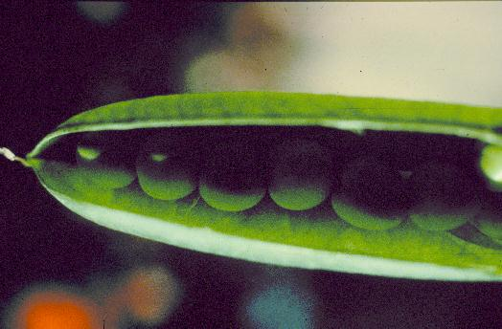
Notes:
There are different types of English peas. Some varieties have wrinkled seeds while others are smooth. The wrinkled seeded peas have a sweeter taste than the smooth seeded peas, which are starchy. Another distinction for English peas is that some varieties are determinate or low growing and others are indeterminate or tall growing. A real improvement in the English pea occurred a few years ago when edible podded types were developed. These include snap peas and snow peas.

Slide 23
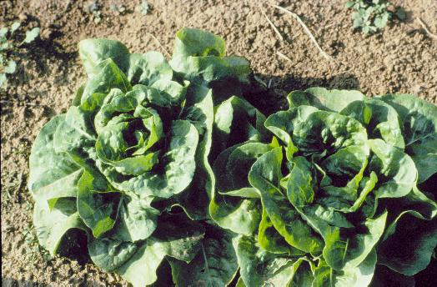
Notes:
(Leaf lettuce. Red Sails) Early spring is the ideal time in the deep South to plant lettuces. While iceberg lettuce is not recommended, many leaf lettuce varieties grow well in cooler spring temperatures. (Buttercrunch) Unusual lettuces and lettuce-like greens such as mesclun, a French lettuce mix, and buttercrunch, shown here as a nearly heading cultivar, add variety to the salad bowl.

Slide 24
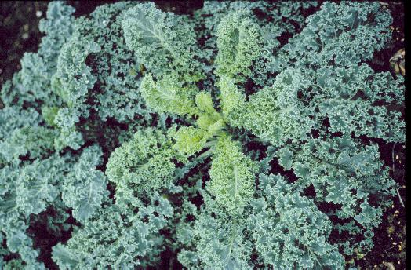
Notes:
Siberian Kale) Siberian Kale is a coarser green high in vitamins and tasting much like collards. Siberian Kale and its curly leaf cousins are both edible and decorative in the garden.

Slide 25
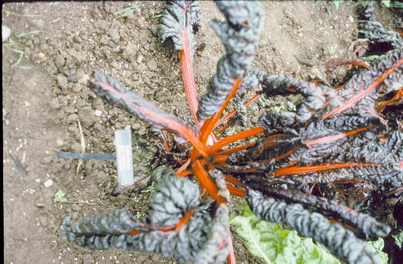
Notes:
(Red Swiss chard) Red Swiss chard, like kale, is most often eaten cooked. A beautiful plant, it is sometimes used in the landscape as well as the vegetable garden

Slide 26
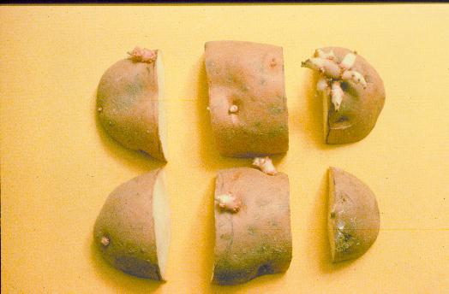
Notes:
(Irish Potato Seed) Irish potatoes should also be planted early. Irish potato plants will be damaged by frost but can be planted two to three weeks before the last frost date in the spring. In cutting seed potatoes, be sure there is a growing point or an eye on each piece that is cut. They should weigh approximately 1-1/2 ounces each. The seed piece provides the reserve of food supply that will grow the plant until the roots form. Potatoes should be planted 4-5 inches deep. Pull soil to the plants as they grow until 8 to 10 inches of soil is mounded over the seed piece.

Slide 27
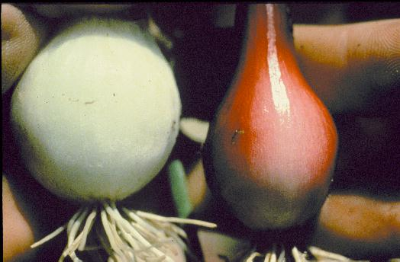
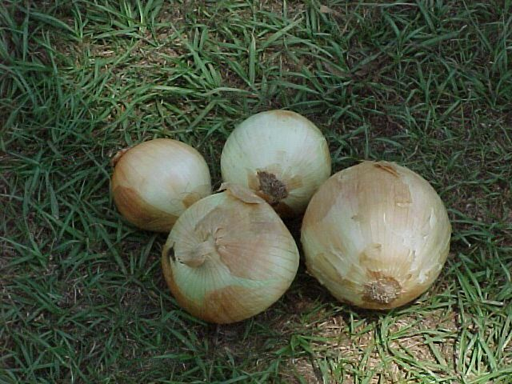
Notes:
(Two Onions) Onions should also be started early in the season. They will tolerate a considerable amount of cool weather. Onions come in yellow, white or red varieties. You can start these from plants, from sets, or from seed. Onions planted in the fall and grown over the winter often make the largest onions such as Vidalia onions.

Slide 28
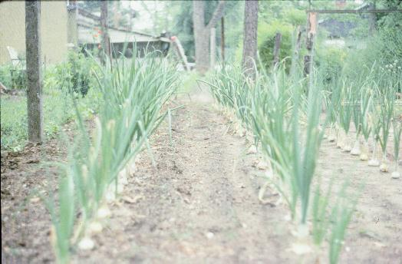
Notes:
(Onion Bulb) Onions generally grow at or near the surface of the ground. Onions that are direct seeded will have more of their bulb exposed compared to those from transplants or sets.

Slide 29
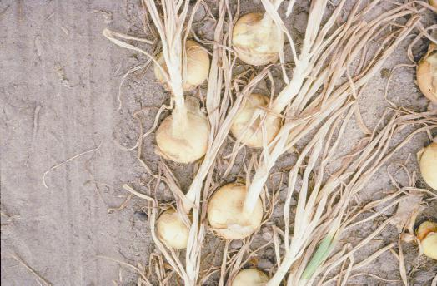
Notes:
(Dug Onions) The best way to store onions is to start pulling them out of the ground when the tops are about 50% dead. Let the onions air cure for a day or two in the garden, protecting them from direct sun. Cut the tops off 1/2 inch from the top of the bulb. Place the bulbs in a mesh-type bag and hang it in a cool, well ventilated, darkened area.

Slide 30
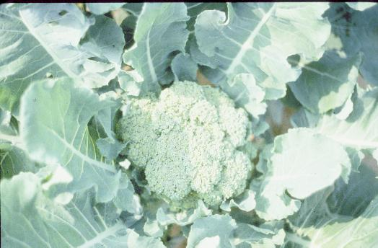
Notes:
(Broccoli Head) Another cool season crop that does well in Georgia is broccoli. Broccoli will tolerate some light frost if the plants are well conditioned. Here is the central head of the plant. Cut heads before any of the blooms start to open up. About 4 inches of stem should be cut along with the head. Once you cut the central head, side shoots will develop in the axis of the leaves and these also can be harvested.

Slide 31
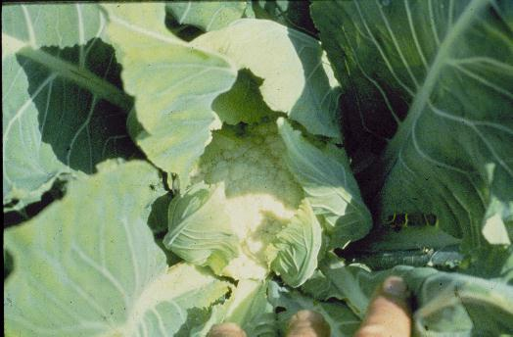
Notes:
(Cauliflower) Cauliflower has a reputation for being difficult to grow. Actually it will grow well if attention is paid to time of planting, nutrition, and water requirements. Tying leaves over the budding head keeps the curd from darkening. Self-blanching varieties are not usually entirely successful.

Slide 32
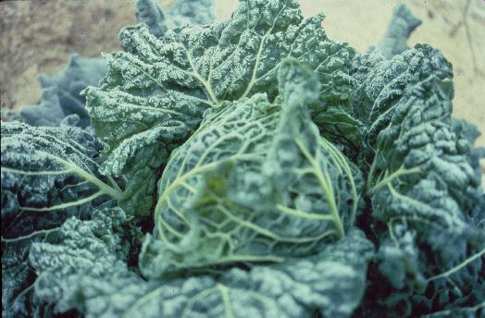
Notes:
(Cabbage) Cabbage is a cool season crop and should be planted when the nights are fairly cool and days warm but not hot. It should be side dressed with nitrogen as it grows, Cabbage, broccoli, collards and turnips also have a high requirements for boron. Supply it in the fertilizer or apply it as side dressing of 2 teaspoons of Borax detergent per 100 foot of row. This can be dissolved in water and poured over the row.

Slide 33
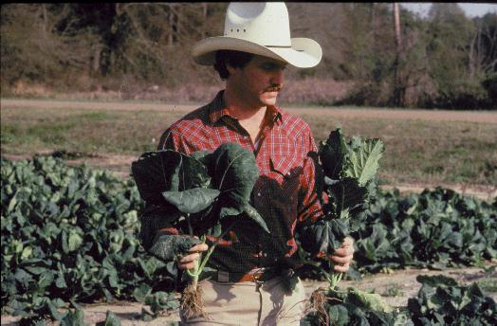
Notes:
(Collards) Collards are grown for their foliage and can be started from transplants or direct seeded. Set out transplants while weather is cool, spacing plants 12 inches apart in the row. If you want to cut collards fairly small, then the seeding rate can be increased, growing a plant every 6 inches in the row.

Slide 34
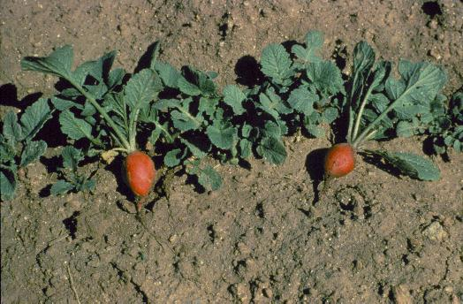
Notes:
(Radish) Radishes are one of the most quickly maturing vegetable crops that you can grow in the garden. About 28 days is required from the time you plant the seeds until they are ready to harvest. Once the radish becomes mature, it gets old rapidly, so stagger plantings every week to 10 days to assure a new crop all season.

Slide 35
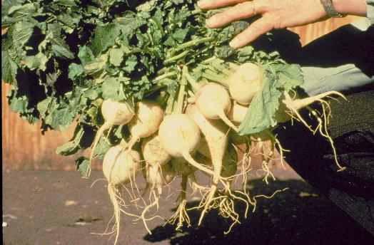
Notes:
(Turnip Greens) Turnips can be grown for greens or roots. In north Georgia you may have better results growing turnips for greens as a spring crop and growing the turnips for roots as a fall crop.

Slide 36
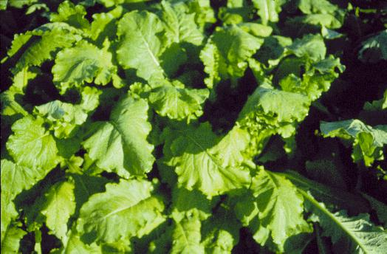
Notes:
(Mustard Greens) Mustard greens are often grown together with turnip greens as many fine Southern cooks use them interchangeably.

Slide 37
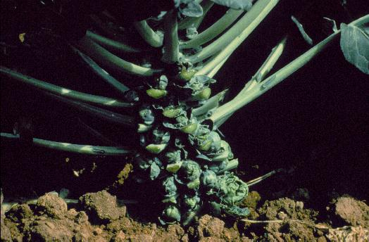
Notes:
(Brussels Sprouts) Brussels sprouts taste a lot like cabbage. The small sprouts are produced in the axils of each one of the leaves. You can keep Brussels sprouts more productive if you prune the leaves off from the ground up to where the sprouts have been harvested. This forces new buds out further up in the top of the plant.

Slide 38
Any Questions?
Notes:
Any questions?
Review QUESTIONS
Name 2 important criteria in site selection for a vegetable garden?
Why is planning and record keeping so important to successful gardening?
What is the difference between succession planting and rotation?
Name 3 warm season and 3 cool season vegetables for Georgia.
Why are legumes so important to soil fertility?
What part of the vegetable cauliflower, snap bean, cabbage, and watermelon are harvested?
Name a perennial vegetable crop?
What is the final step in producing a quality transplant?

