Slide 1
Integrated Pest Management in the School Garden Karol Kelly
One of the UGA Extension School Garden Team’s series of presentations.

Slide 2
Integrated Pest Management (IPM) in School Gardens
Prevention
Early Detection
Correct Identification of Problems
Proper Selection of Control
Proper Implementation and/or Application

Slide 3
“If one asks for success and prepares for failure, he will get the situation he has prepared for.” Florence Scovel Shinn
Notes:
Beginning with and maintaining healthy plants is key to resisting pests in the school garden. Start with the right plant in the right spot and continue with proper water and fertilization. An ounce of prevention goes a very long way in gardening!

Slide 4
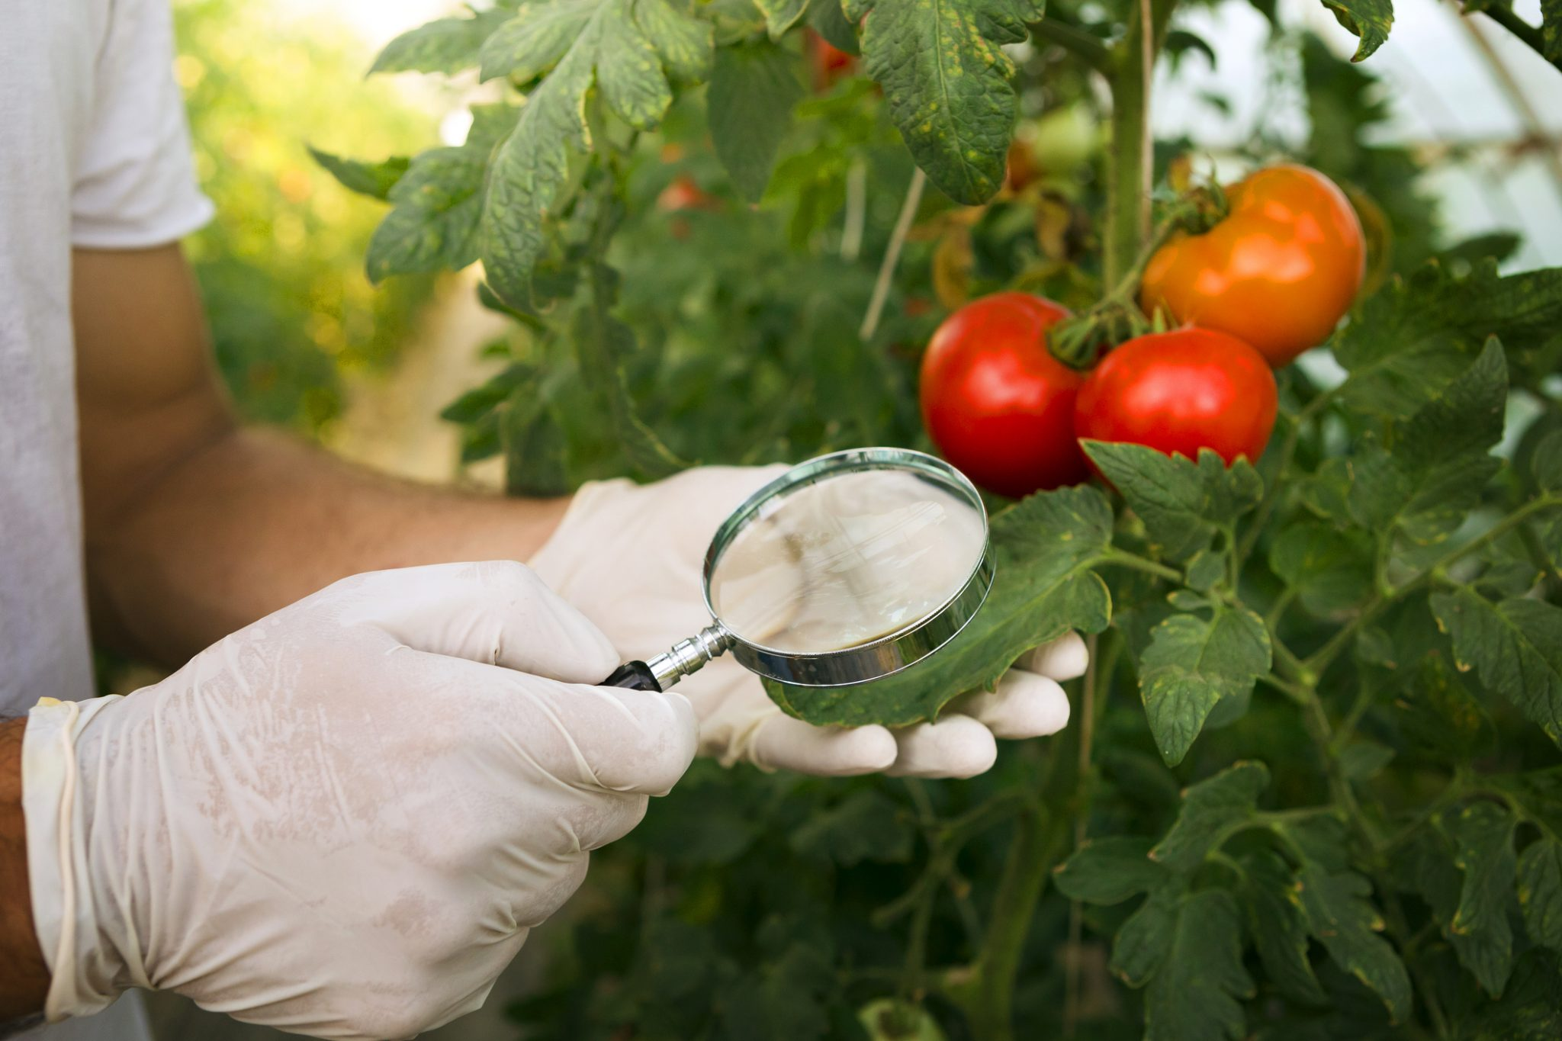
Scouting & Early Detection
Notebook
Sticky traps
Hand lens 10x or better
White paper on clipboard
Tweezers
Sample jar
Resources
https://www.aces.edu/
Notes:
Keep a record of the observations you make when monitoring your plants and of the pest management methods you have tried. Records can help you manage landscape plant problems during the current growing season, evaluate management methods, and predict problems in the future. Insect traps are a continuous monitoring device. They catch a wide variety of pest species in their mobile stages of larvae and adult. Both crawling and flying insects can be caught. The data from the catches can be used to give information on the pest, an indication of their numbers and seasonal cycles and where they congregate. Sticky traps may also trap beneficial insects as well. A hand lens or magnifying glass will help you to get a close look at insects. A hand lens or magnifying glass will help you to get a close look at insects. Beat a branch over a clip board with a sheet of white paper then use the hand lens to identify the insects and count them. Tweezers and a sample jar will come in handy when you need to save the pest for future identification. A preservative like rubbing alcohol will keep the specimen intact. Reference books are helpful though you don’t need to carry an entire library with you, just choose one or two that you find yourself using over and over again. Scouting and keeping records and samples are great ways to engage your class. Even if you don’t have all of the answers for what you are seeing, observation skills are fundamental building blocks.

Slide 5
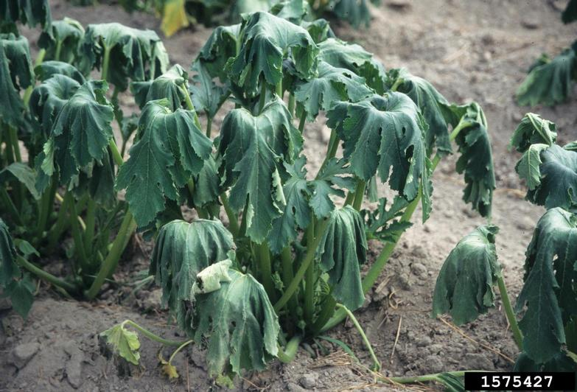
So you have a problem, now what?
Too much water?
Too little water?
Insect at base of plant?
Disease (bacteria, fungus, virus)?
Notes:
As soon as your routine scouting turns up a problem, it is time to start figuring out what is causing problems in the garden. To the untrained eye, it is often difficult to know what is going on with a plant. Practice and experience in the garden will let you begin to understand what plants are prone to what problems in your school garden.

Slide 6
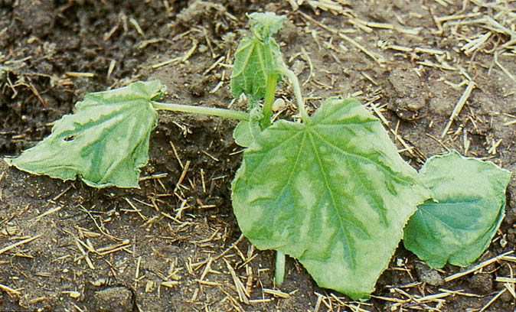
A Pest Problem to Solve? Not So Fast…
Disorders or abiotic problems only involve two factors: the plant and the environment
Nutrient issues
Drought
Overwatering
Herbicide damage
Cold damage
https://aggie-horticulture.tamu.edu
Notes:
Often we have some degree of control of disorders in the garden. For the plant on the slide, damaged by a late cold snap, the problems could have been prevented by planting a little later in the season. No action is necessary – wait to see if the plant will recover or consider replanting.

Slide 7
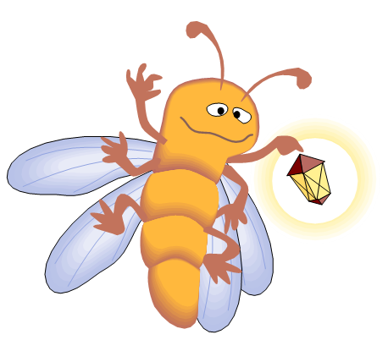
In general, a ‘Pest’ is defined as something that…
Competes with humans, domestic animals, or desirable plants for food or water
• Injures humans, animals, desirable plants, structures, or possessions
• Spreads disease to humans, domestic animals wildlife, or desirable plants
• Annoys humans or domestic animals
Most organisms are not pests!

Slide 8
Types of pests
Continuous pests (weeds, ants)
Sporadic, migratory, or cyclical pests (white flies)
Potential pests (don’t normally require control; you may have an occasional wayward squirrel picking tomatoes)
Notes:
• Continuous pests that are nearly always present and require regular control (ticks & fleas on pets)
• Sporadic, migratory, or cyclical pests that require control occasionally or intermittently (white flies)
• Potential pests that do not require control under normal conditions, but may require control in certain circumstances.
Pest pressures vary with environment – last year pressure from fungal disease was low because of drought.

Slide 9
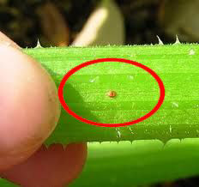
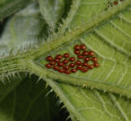
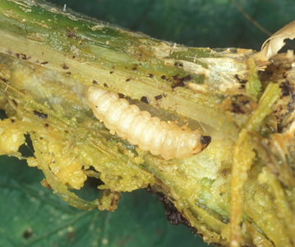
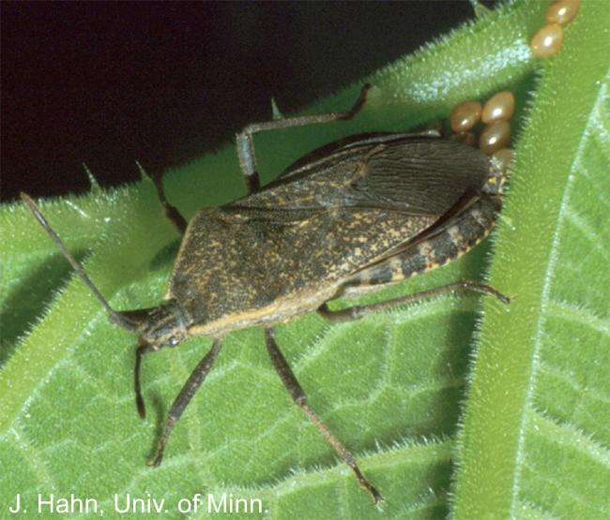
Things to know about pests: Physical features, including development
Squash plants BEWARE!
Squash vine borer
Squash bug
Notes:
The different stages of the squash bug and squash vine borer life cycle can look quite different. For the squash bugs, f you observe the eggs on the leaves early in the season, they can simply be wiped off before damage even begins. And, it might be easier to spot the brightly colored squash vine borer adult to realize that damage is imminent.

Slide 10
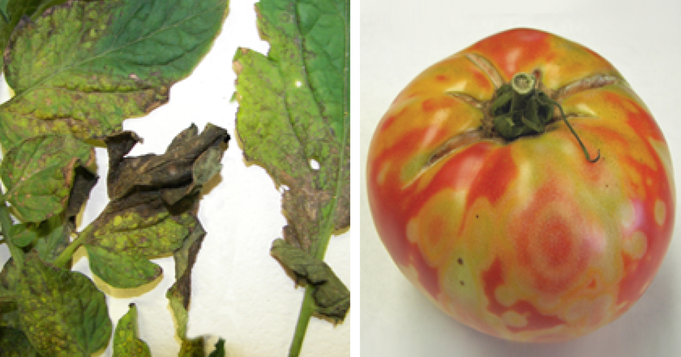
Things to know about pests: Damage Caused
https://extension.sdstate.edu/tomato-spotted-wilt-virus
Notes:
Tomatoes are prone to a number of disease issues – often making it difficult to diagnose problems from leaves alone. However, the circular discoloration on the tomato fruit is a tell tale sign of Tomato Spotted Wilt Virus or TSWV. The virus is spread from plant to plant by a small insect and is difficult to control. It is best to start with varieties that are noted as having TSWV resistance. Once the fruit has developed with these symptoms, it is too late for action.

Slide 11
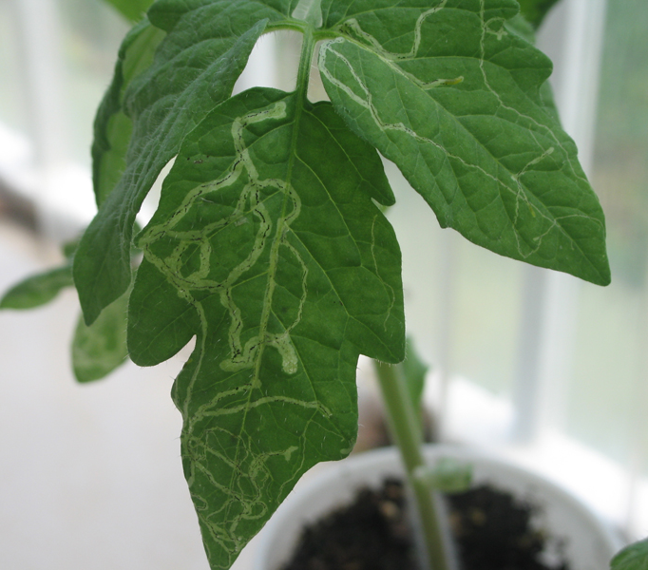
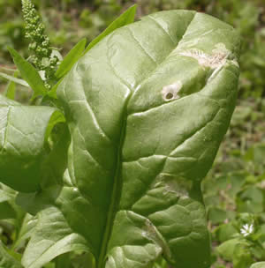
Other things to know about pests: Does problem have to be controlled?
https://vegento.russell.wisc.edu/pests/vegetable-leafminers/
https://ag.umass.edu/vegetable/fact-sheets/leafminer-beet-spinach
Notes:
Control a pest only when it is causing or is expected to cause more harm than is reasonable to accept. Decide what injury level is acceptable. Is the damage actually affecting the health of the plant? Some degree of leaf miner damage might on a tomato (right) plant might be fine for your program – but, probably not excessive leaf miner damage to spinach (left)

Slide 12
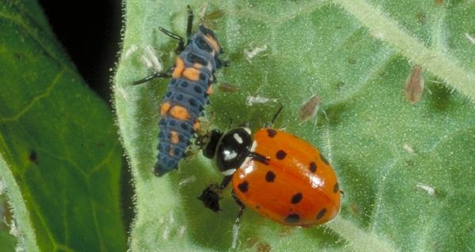
Other things to know about pests: How can they be controlled?!?!
https://entomology.ca.uky.edu/ef105
Notes:
Pictured are two different stages of the lady bugs life cycle – adult and nymph. The are shown in close proximity on the leaf to aphids – which they love to feast on.

Slide 13
When diagnosing vegetable problems, be ready to accept the fact that:
Things are very rarely black & white
There probably WILL NOT be one easy solution to remedy your problems
Even a short term ‘fix’ will likely require a long-term solution
Notes:
Plant problems generally do not happen overnight. It takes a while for most problems to develop to a critical point – so, there will likely be some different layers to the solution as well.

Slide 14
Solving pest problems
After identifying pest:
Determine pest control goal
Know what control tactics are available
Evaluate the benefits and risks
Choose most effective and least harmful strategy
Implement each tactic in the strategy correctly
Observe local, state, and federal regulations
Keep a record
Notes:
Solve pest problems:
• identify the pest or pests and determine whether control is warranted for each,
• determine pest control goal(s),
• know what control tactics are available,
• evaluate the benefits and risks of each tactic or combination of tactics,
• choose a strategy that will be most effective and will cause the least harm to people and the environment,
• use each tactic in the strategy correctly,
• observe local, state, and federal regulations that apply to the situation
Keep records

Slide 15
Pest Control Options for School Gardens
Host resistance
Cultural control – rotation, cultivation, thinning, etc.
Mechanical control – fences, traps
Sanitation – clean transplants, decontaminate equipment
Biological control
Chemical control
Notes:
Unfortunately, natural controls often do not control pests quickly or completely enough to prevent unacceptable injury or damage. Then other control measures, or applied controls, must be used. Those available include: host resistance, cultural control, mechanical control, sanitation, chemical control, and biological control

Slide 16
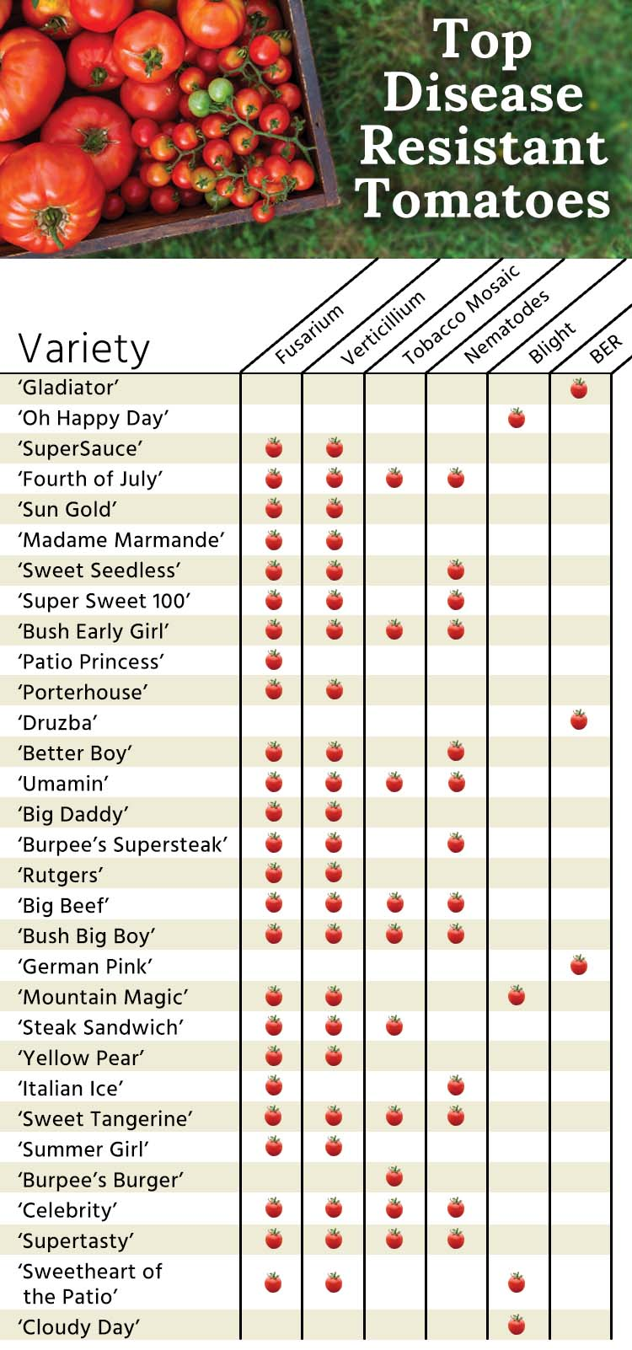
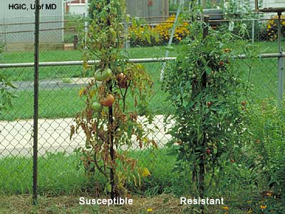
1. Host Resistance
Burpee.com
Host prevents pest from completing life cycle
Host is more vigorous or tolerant
Host is more difficult to attack
https://extension.umd.edu/
www.ces.ncsu.edu
http://msucares.com
Notes:
Host resistance—Some plants, animals, and structures resist pests better than others. Some varieties of plants, wood, and animals are resistant to certain pests. Use of resistant types, when available, helps keep pest populations below harmful levels by making conditions less favorable for the pests.
Host resistance works in three ways:
1. Chemicals in the host repel the pest or prevent the pest from completing its life cycle.
2. The host is more vigorous or tolerant than other varieties and thus less likely to be seriously damaged by pest attacks.
3. The host has physical characteristics that make it more difficult to attack.

Slide 17
2. Cultural Control
Alliaceae | Brassicaceae | Cucurbitacae
Chives Garlic Leeks Onions | Broccoli Brussel sprouts Cabbage Cauliflower Collards Lettuce Mustard Radish Rutabaga Spinach Turnip | Cantaloupe Cucumbers Melons Pumpkins Squash
Fabaceae | Solanaceae | Misc.
Beans Peas | Eggplant Peppers Potatoes Tomatoes | Lettuce Corn Spinach Okra Carrot
Prevent or suppress an infestation by: altering the environment, behavior of pest, or condition of host plant
Notes:
Cultural control—Cultural practices sometimes are used to reduce the numbers of pests that are attacking cultivated plants. These practices alter the environment, the condition of the host plant, or the behavior of the pest to prevent or suppress an infestation. They disrupt the normal relationship between the pest and the host plant and make the pest less likely to survive, grow, or reproduce. One common cultural practice is crop rotation. The chart above demonstrates which vegetables belong to which families to allow the use of different families in a given spot for subsequent seasons. This prevents the buildup of insect and disease pressure for a given family.

Slide 18
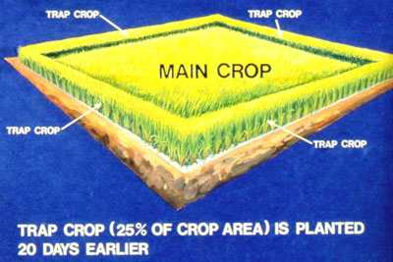
Cultural practices
Cultivating soil
Varying time of planting or harvesting
Planting trap crops
Adjusting row width
Pruning, thinning, & fertilizing plants
forages.oregonstate.edu
Notes:
Common cultural practices to control pests include rotating crops, cultivating the soil, varying time of planting or harvesting, planting trap crops, adjusting row width, and pruning, thinning, and fertilizing cultivated plants.

Slide 19
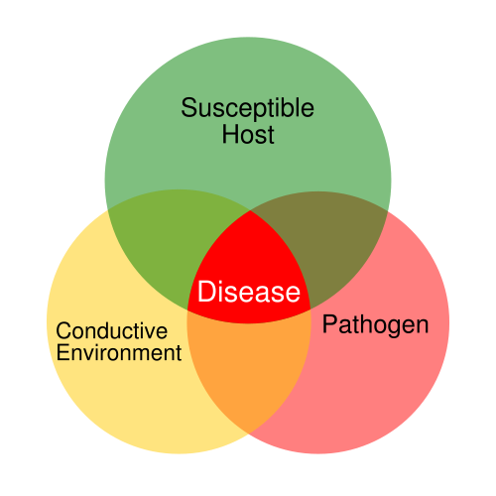
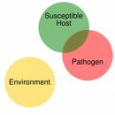
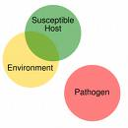
Cultural practices – understanding the disease triangle
Notes:
For diseases to occur, 3 factors must be present – a susceptible plant, conductive environment, and a disease organism (bacteria, fungus, or virus)
If all of these factors are present, disease results; if one or more of the factors is not present, then disease does not occur. Methods of disease control can be thought of as modifying the disease triangle by reducing or eliminating one of the corners of the triangle. For example, if you use resistant varieties in your garden (as we talked about earlier), you are eliminating the "susceptible host" and can thus reduce or prevent disease. Similarly, for some diseases, by removing diseased plant material, you can reduce or eliminate disease because you are eliminating the pathogen. Finally, the part that you’ll have the most control over in your garden is to reduce or eliminate a "favorable environment" for disease. This could include things like proper watering and fertilization.

Slide 20
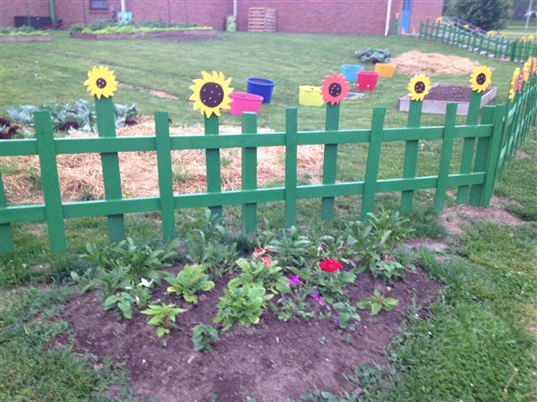
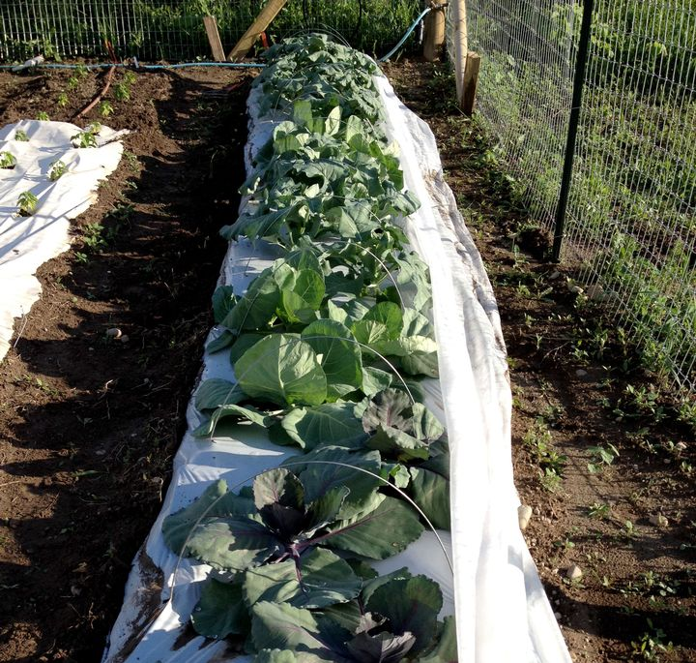
3. Mechanical (physical) control
Notes:
Traps, screens, barriers, fences, and nets sometimes can be used to prevent the spread of pests into an area. Row covers will work to suppress pest populations for things such as flea beetles and cabbage worms by preventing adults from laying eggs on plants. Another ‘disorder’ a garden fence will prevent is school gardens getting trampled by eager feet running outside.

Slide 21
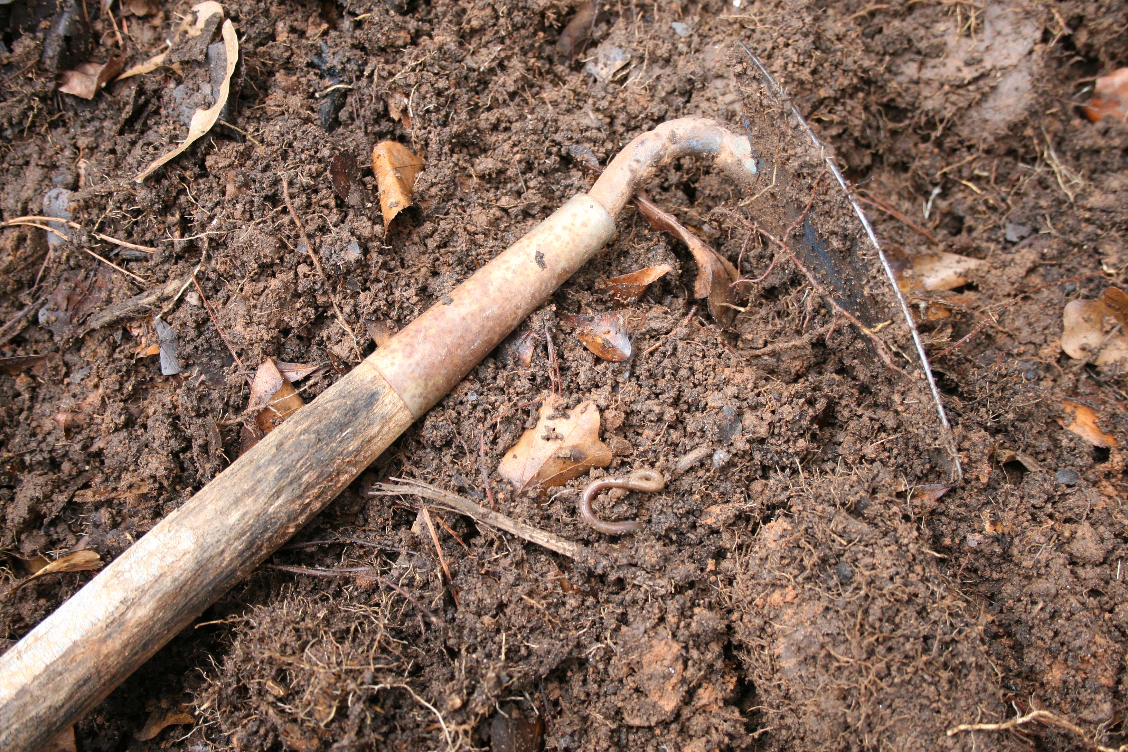
4. Sanitation
Remove crop residues
Use mulches
Decontaminate equipment
Notes:
Sanitation—Sanitation practices help to prevent and suppress some pests by removing the pests or their sources of food and shelter. Garden pests can be removed by improving cleanliness, eliminating pest harborage, and increasing the frequency of garbage pickup. Carryover of agricultural pests from one planting to the next can be reduced by removing crop residues.
Other forms of sanitation that help prevent pest spread include using mulches, pest-free seeds or transplants and decontaminating equipment, animals, and other possible carriers before allowing them to enter a pest-free area or leave an infested area.

Slide 22
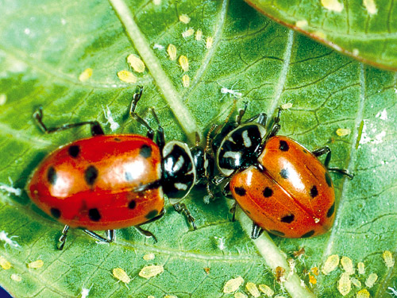
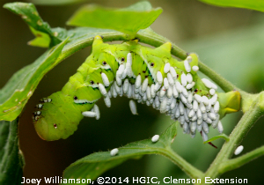
5. Biological control
The use of natural enemies to control pests
Notes:
Biological control involves the use of natural enemies — parasites, predators, and pathogens. It will not likely be practical to purchase organisms to release in the garden. However, recognizing and encouraging the forces of nature at work will help. If the back of a leaf is covered with aphids, but there are ladybugs present, it will likely not be necessary to worry about controlling the aphids (right). Tomato horn worms are a common pest in many gardens. When spotting one covered with small white ‘growths’, learn to recognize that these are actually eggs laid by a parasitic wasp (left). These are good to see in your vegetable garden.

Slide 23
6. Chemical control
Whether considering organic or traditional pesticide, these products are chemicals used to destroy pests, control their activity, or prevent them from causing damage.
Whether organic or traditional pesticides are used, the products can be dangerous if the label isn’t followed.
If needed apply insecticides late in the day to avoid killing honey bees.

Slide 24
6. Chemical control
Work with your team to decide if you want to restrict all chemical use or allow on a limited basis, after hours without children around
Certain instances, such as fire ants in beds, make it necessary to consider this as an option on occasion.
Chemicals use should be your last resort in any garden situation.

Slide 25
Georgia Pest Management Handbook
Internet search for ‘Georgia Pest Management Handbook’
Click on ‘Home and Garden Edition’; then search either ‘Vegetables’ or ‘Organic Strategies for the Garden and Home Landscape’
Site contains cultural and chemical recommendations
Notes:
The Georgia Pest Management Handbook gives current information on selection, application, and safe use of pest control chemicals. The Handbook has recommendations for pest control on farms, around homes, urban areas, recreational areas, and other environments in which pests may occur. Cultural, biological, physical, and other types of control are recommended where appropriate. Recommendations are based on information on the manufacturer's label and on performance data from Georgia research and Extension field tests. Because environmental conditions and methods of application by growers vary widely, suggested use does not imply that performance of the pesticide will always conform to the safety and pest control standards indicated by experimental data. This publication is intended to be used only as a guide. Specific rates and application methods are on the pesticide label. Refer to the label when applying any pesticide.

Slide 26
Other Resources
Your local county agent and the UGA labs and specialists who support us can answer any garden-related question with science-based information.
Leave the ‘google’ searches to that co-workers you don’t like!

Slide 27
Activity
Use your newly found ‘Georgia Pest Management Handbook’ link and explore what organic pesticides are available to treat fire ants.
Notes:
Answer – Spinosad – bait granules (page 98); page 99 goes on to say there are two forms of Spinosad – an organic and non-organic form; liquid forms are toxic to bees until dry – so, apply late in afternoon when activity has decreased

