Slide 1
Garden-Based Learning
Integrating the Garden into Classroom Learning
Alicia Holloway
One of the UGA Extension School Garden Team’s series of presentations.

Slide 2
Defining Garden-Based Learning
“instructional strategy that utilizes the garden as a teaching tool”
Desmond, D., Grieshop, J., & Subramaniam, A. (2004). Revisiting garden-based learning in basic education. Rome: Food and Agriculture Organization of the United Nations.

Slide 3
What is your “why” for Garden-Based Learning?
Notes:
There are many reasons “why” teachers participate in school gardens. Ask teachers what their “why” is. Your why will help guide you on how this should fit your curriculum

Slide 4
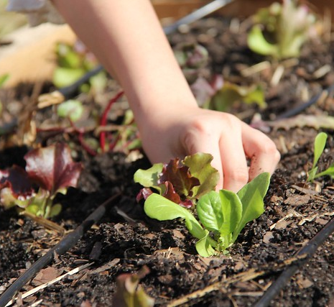
Why?
Engaging students
Hands-on/Experiential learning
Real-world application
STEAM
Agriculture awareness
Healthy living
Sustainability
More!

Slide 5
What is our current and desired curriculum involvement in the school garden?
School garden is integrated into a variety of curriculums, cafeteria, and school culture. All students participate in the school garden, and many classrooms or grade levels use the garden weekly, including after-school programs.
Garden is utilized by some classrooms or grade-levels frequently and integrated in the curriculum
Garden is used as a teaching tool by a few classrooms 1-5 times per year
Garden is weedy, neglected, and underutilized
Garden is utilized primarily by an after-school program
Notes:
This is a great opportunity to get participants up and moving around. You can ask them to stand along a wall with one end representing a neglected garden and the other end representing a fully developed and functioning program that affects most of the students in the school. Ask them to identify where their school garden it now, and where they would like it to be. This is a good to see where people are and where they would like to be. Or just use show of hands.

Slide 6
Gardening in the era of standards-based education and accountability
Notes:
The reality of education is that you (teachers) are responsible for your content and for your standards. Using school gardens in your classroom doesn’t necessarily mean you are teaching gardening, it means you are teaching your content through the lens of the school garden. We can’t ignore our standards in the discussion of integrating curriculum, but there are many teachers throughout elementary, middle, and high school that use their garden as a tool to teach a variety of required content areas.

Slide 7
Classroom vs. After-School Club
Classroom | After-school club/Extended Learning Time
Available to all students | More content flexibility/chance to go in depth
Increase student engagement and understanding of content | Easier to utilize students for garden chores/use of pre-made garden curriculum
Notes:
Where/when the school garden is being utilized during the day makes a difference in what curriculum is used. Some schools have opportunities for extended learning time where students have a short class lasting only a few weeks. Other schools get additional mileage out of the school garden through after-school programs.

Slide 8
Connecting the Content in the Garden
Biology:
•Life cycles
•Plant Parts
•Plant Needs
Earth Science:
•Soils
•Seasons
Social Studies:
•Georgia Washington Carver
•Thomas Jefferson
Notes:
There are lots of places in the curriculum that are a natural fit for the garden.

Slide 9
Connecting the Content in the Garden
Math:
•Area – (of garden, raised beds)
•Volume – (raised beds, mulch, etc)
•Garden math – calculating needed seeds, plants, etc
•Measurement
•Graphing – yields
Notes:
There are lots of places in the curriculum that are a natural fit for the garden.

Slide 10
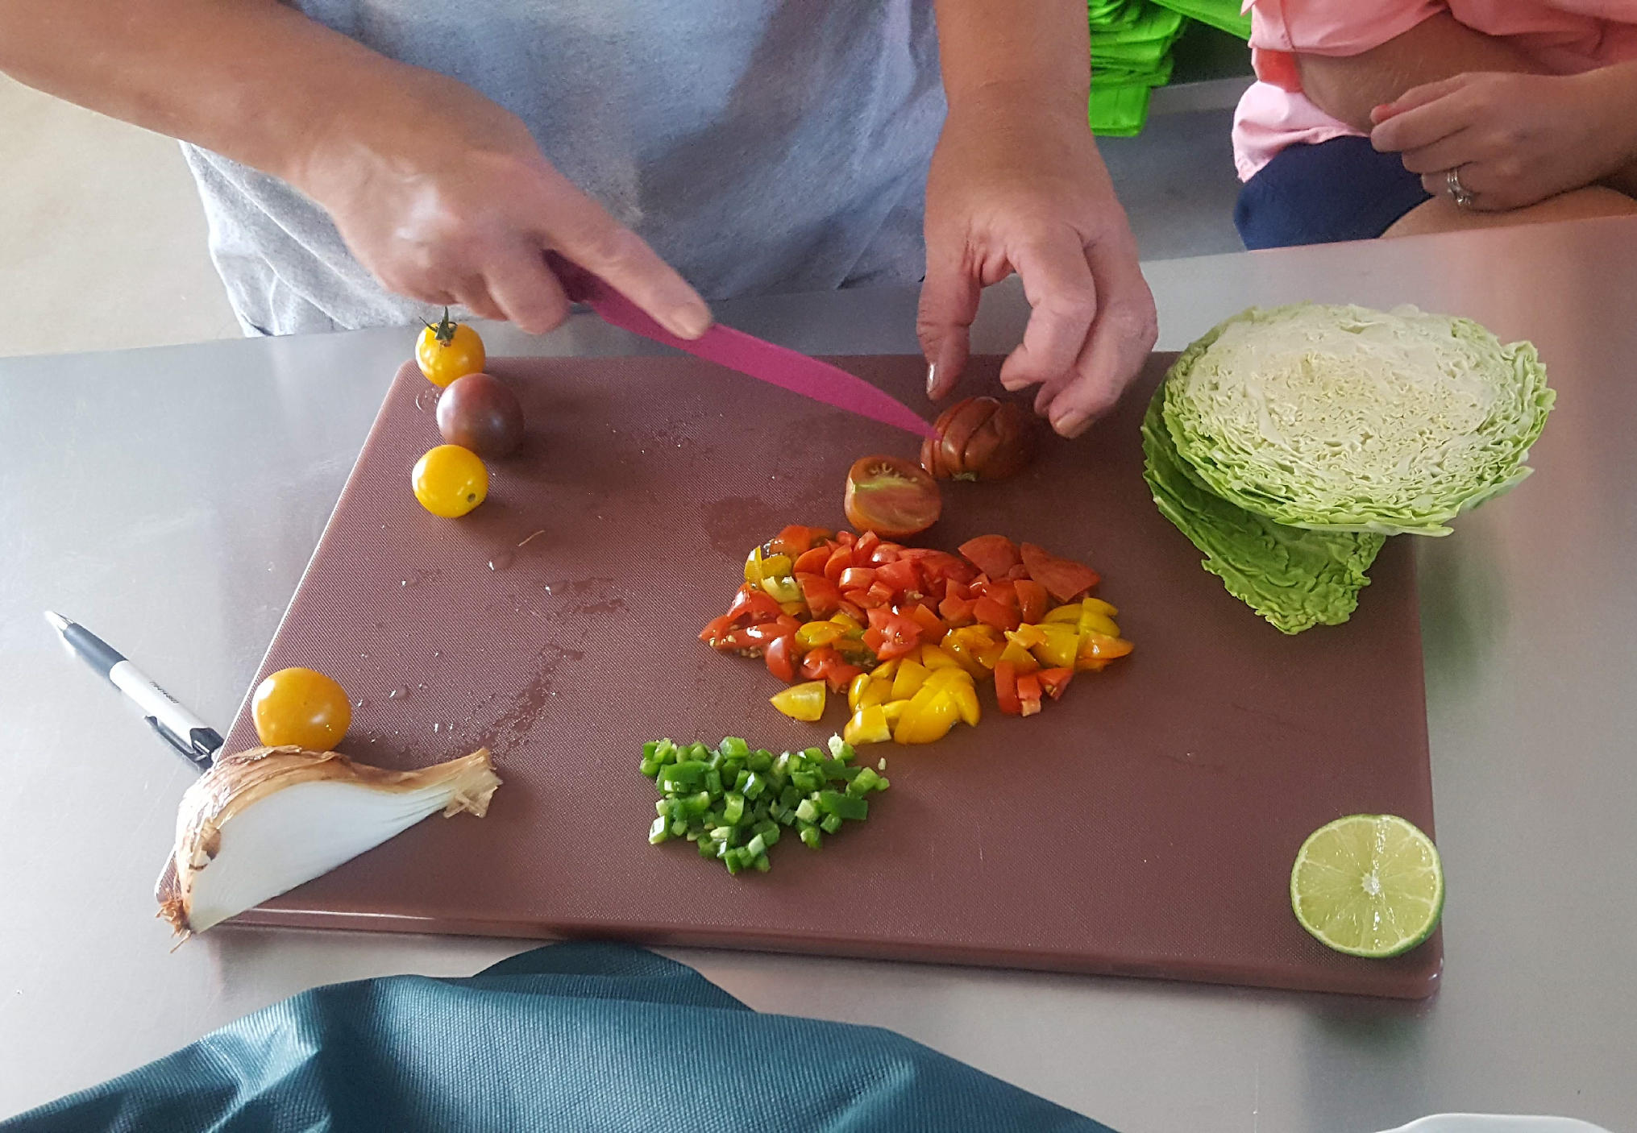
Connecting the Content in the Kitchen
Math:
Ratios
Measurement
Graphing taste-tests
Social Studies:
Food as it relates to culture and geography
Science:
Physical and chemical changes
Notes:
Don’t forget to utilize opportunities to use garden produce to help teach content!

Slide 11
Out of the Garden Box: teaching through the garden lens
Mathematics: Word problems based in agriculture or gardening content
English Language Arts: Garden related reading passages, journal topics
Sustainability/Social Issues: Use the garden as a jumping off point to discuss the food system, environmental issues, or hunger/poverty issues
Art: Sketch in the garden or use elements from the garden as still life, make dyes and paints from plants or soil
Notes:
Not all curriculum is directly related to the garden, but you can infuse garden-based learning by teaching multiple subjects through the garden lense.

Slide 12
Out of the Garden Box: Hidden Content
Students pay attention to how you talk about the garden! As a teacher you are modeling behaviors and values beyond the curriculum you are teaching.
In the garden we:
Grow and eat healthy food (nutrition)
Learn where our food comes from (agriculture awareness)
Learn how to protect and enhance the environment (sustainability)
Move our bodies and get exercise (healthy living)
Notes:
Students pay attention to you! Don’t underestimate the value in the hidden content in the values and behaviors you model and discuss in relation to the garden

Slide 13
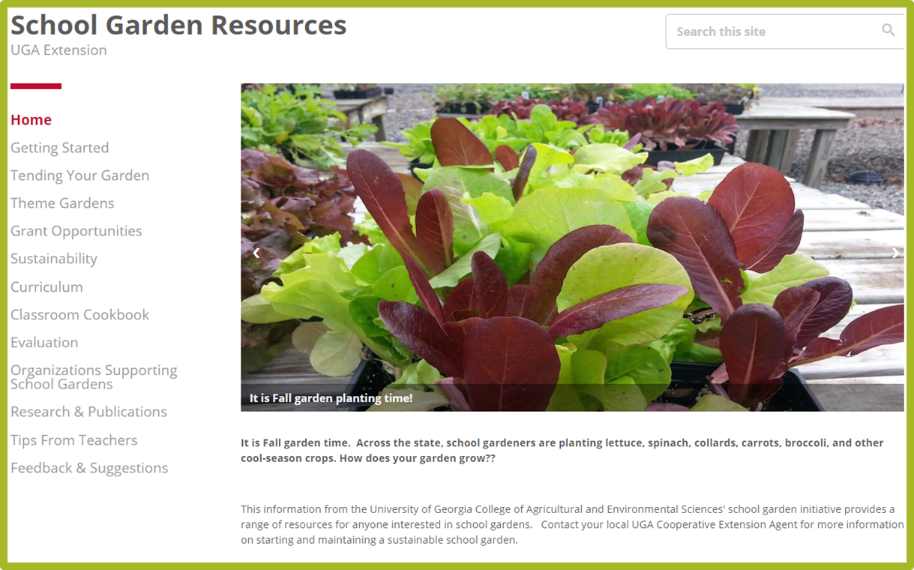
Resources
UGA School Garden Resources
Garden Earth Naturalist
Junior Master Gardener
Life Lab
Notes:
UGA School Garden Resources – Extension website that homes a number of school garden resources. The most relevant to this discussion is the curriculum page, that has a collection of lesson plans from a number of sources categorized by grand and standard (GPS)
Garden Earth Naturalist – This is a curriculum that would excellent for an after school program – developed by Georgia 4-H, the Museum of Natural History, and the UGA Botanical Gardens
Junior Master Gardeners – Another good after school program curriculum
Life Lab – A garden based learning program based in Santa-Cruz California. They have some free curriculum online, but also several useful books

Slide 14
Opportunities for Engagement
Farm to School Month
Georgia Organics
Georgia Hands-on School Garden Day – Georgia Department of Agriculture, Ag Awareness Week

Slide 15
Garden “celebrations”
January 6th – Bean Day
Last Saturday in January – National Seed Swap Day
March 11th – Johnny Appleseed Day
March 26th - National Spinach Day
March 28 – Weed Appreciation Day
April 22nd – Earth Day
National Zucchini Bread Day
May 29th – Composting Day
June 6th – National Gardening Exercise Day
June 16th – Fresh Veggies Day
June 17th – Eat Your Vegetables Day
July 8th – National Blueberry Day
August 3rd – National Watermelon Day
August 8th – Sneak some Zucchini onto you Neighbor’s Porch Day
August, third Saturday – National Honey Bee Day
September 3rd – National Peanut Day
October, 1st Wednesday – National Kale Day

Slide 16
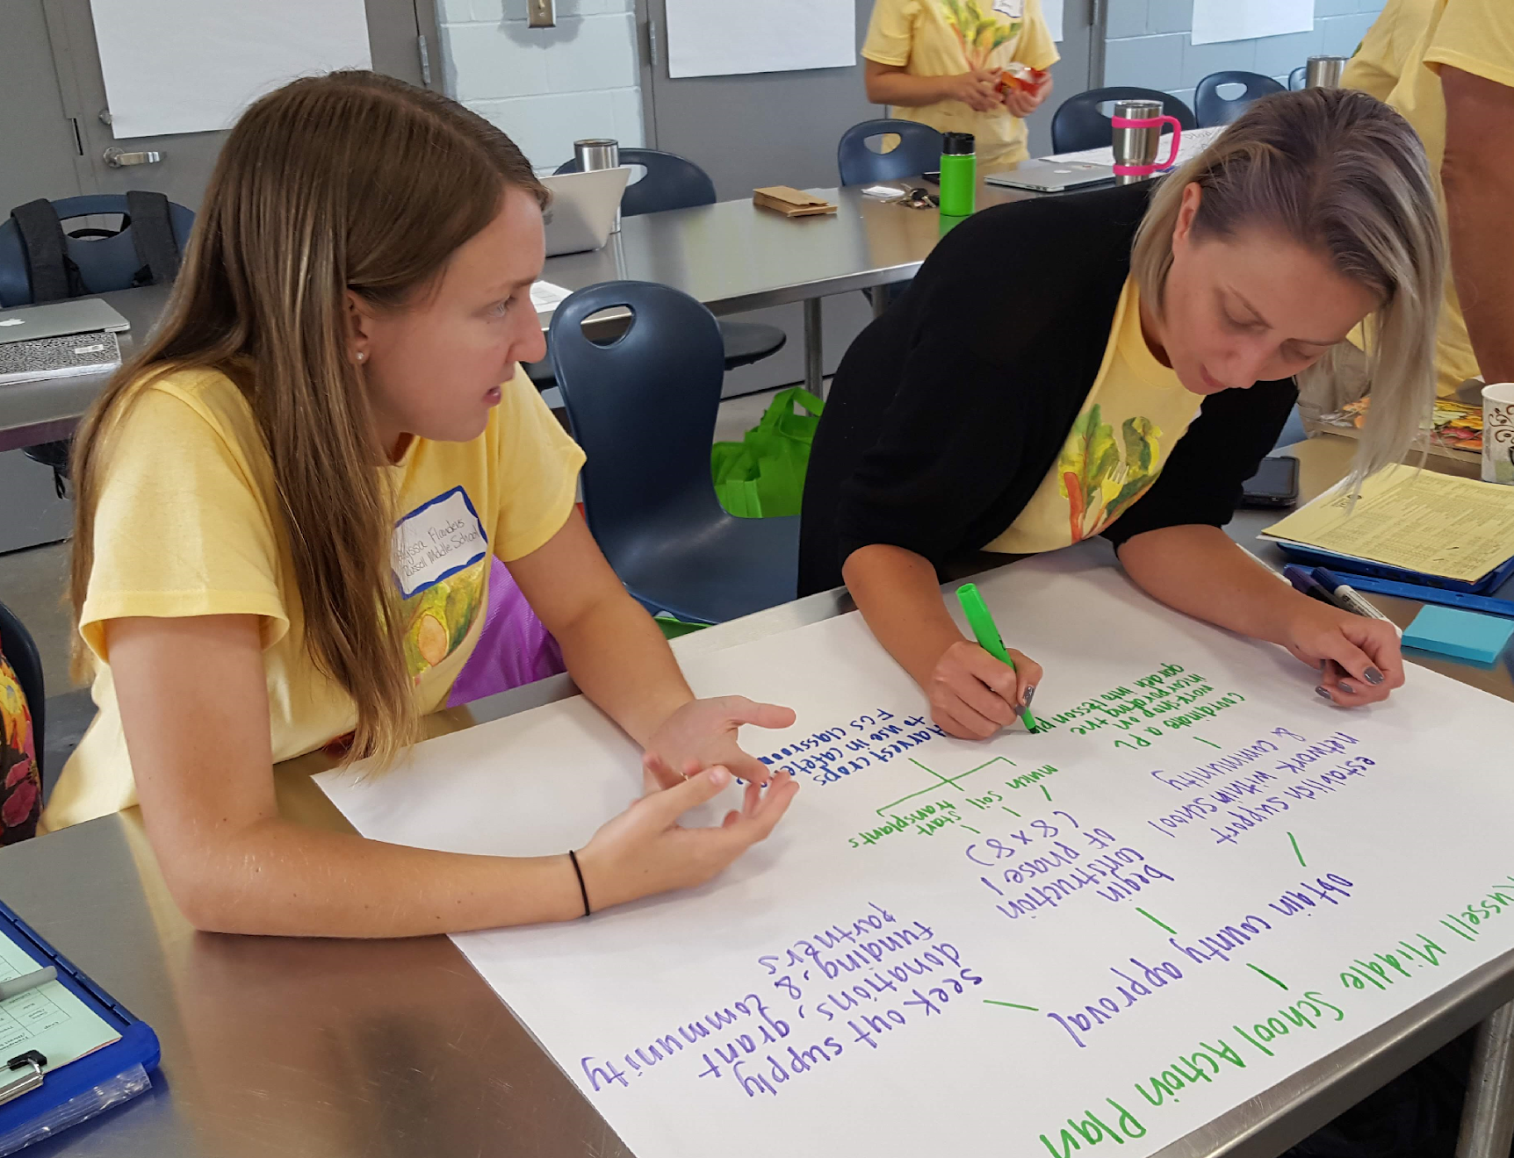
Think. Pair. Share. Take a minute to brainstorm answers to the questions below. Then discuss your answers with a partner. Be prepared to share with the group!
What unit can you teach in the garden this year? (if possible, list more!)
What is one lesson or activity you can do in that unit?
What is one lesson outside that unit you can teach utilizing the garden?

Slide 17
15 Activities with 15 Bean Soup
Notes:
See activity guide for instructions

