Slide 1
What is Possible
in the School Garden Becky Griffin
One of the UGA Extension School Garden Team’s series of presentations.

Slide 2
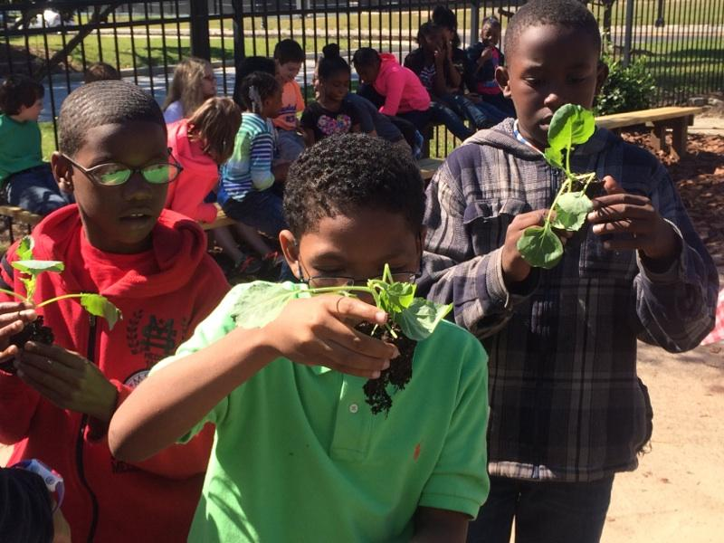
School gardens are as varied in scope and design as the school community. This presentation will look at some examples of what is possible in the school garden to inspire your school garden journey.

Slide 3
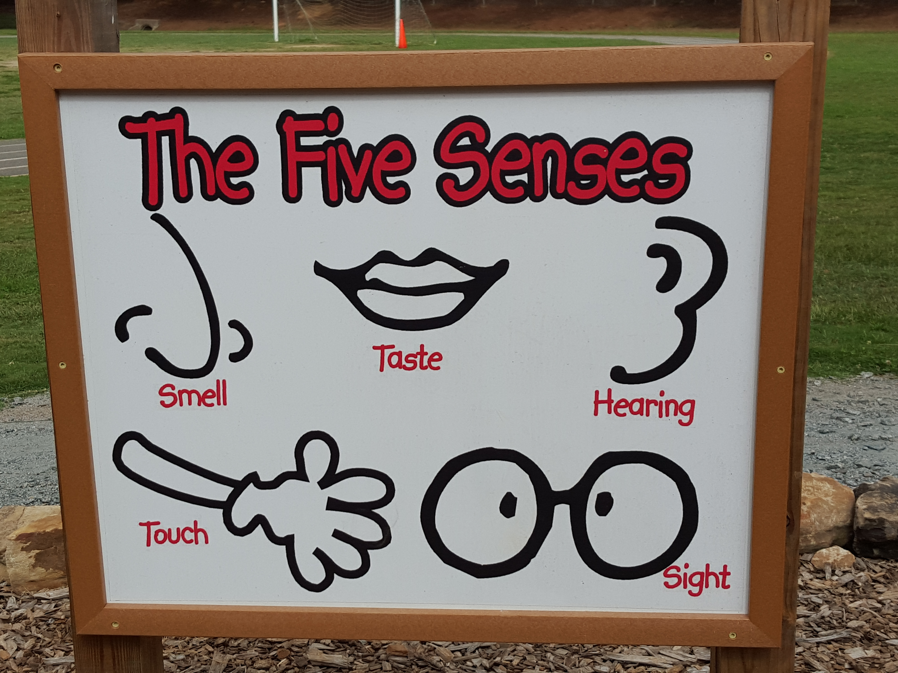
Notes:
Kindergartners at one elementary school are introduced to the school garden at the Sensory garden. It is important to get students into the garden early so they are used to being outdoors and learning what behavior is expected of them.

Slide 4
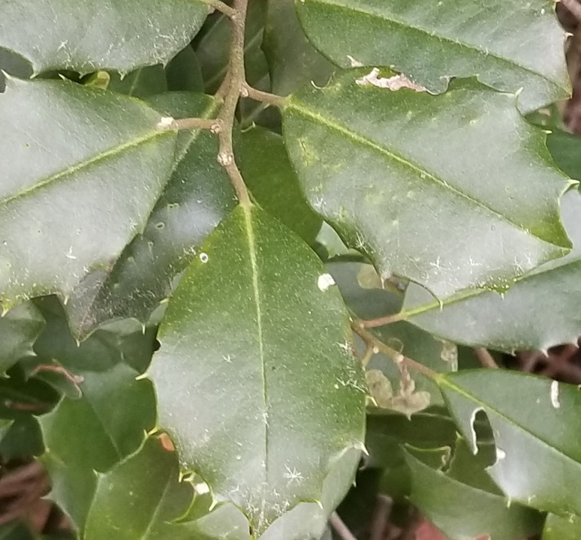
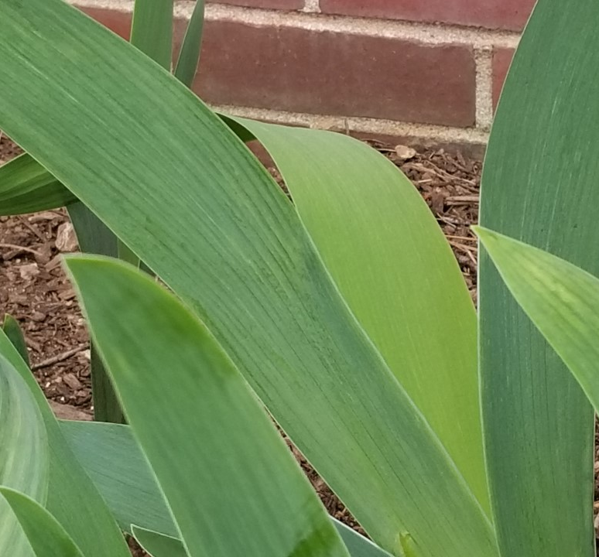
Students are encouraged to (carefully) touch the prickles of holly bushes and to feel the smoothness of an iris leaf. They listen to the rustle of money plant and oats as the wind blows.

Slide 5
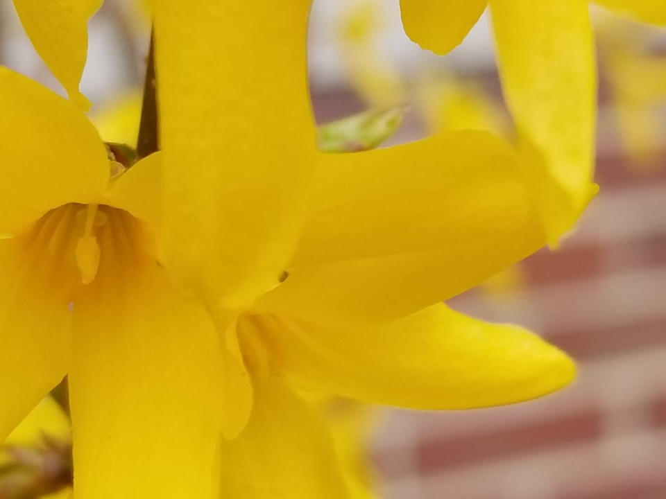
They smell flowering plants and examine the details of the plant flowers. Herbs are grown to be tasted.

Slide 6
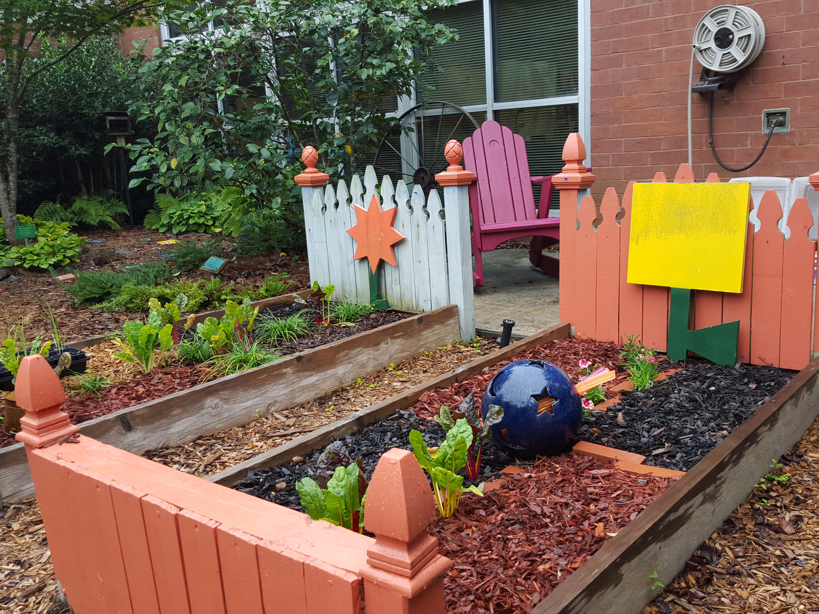
This garden space at Ford Elementary School is exciting to the young students because of the artful garden beds.
Notes:
Ford Elementary

Slide 7
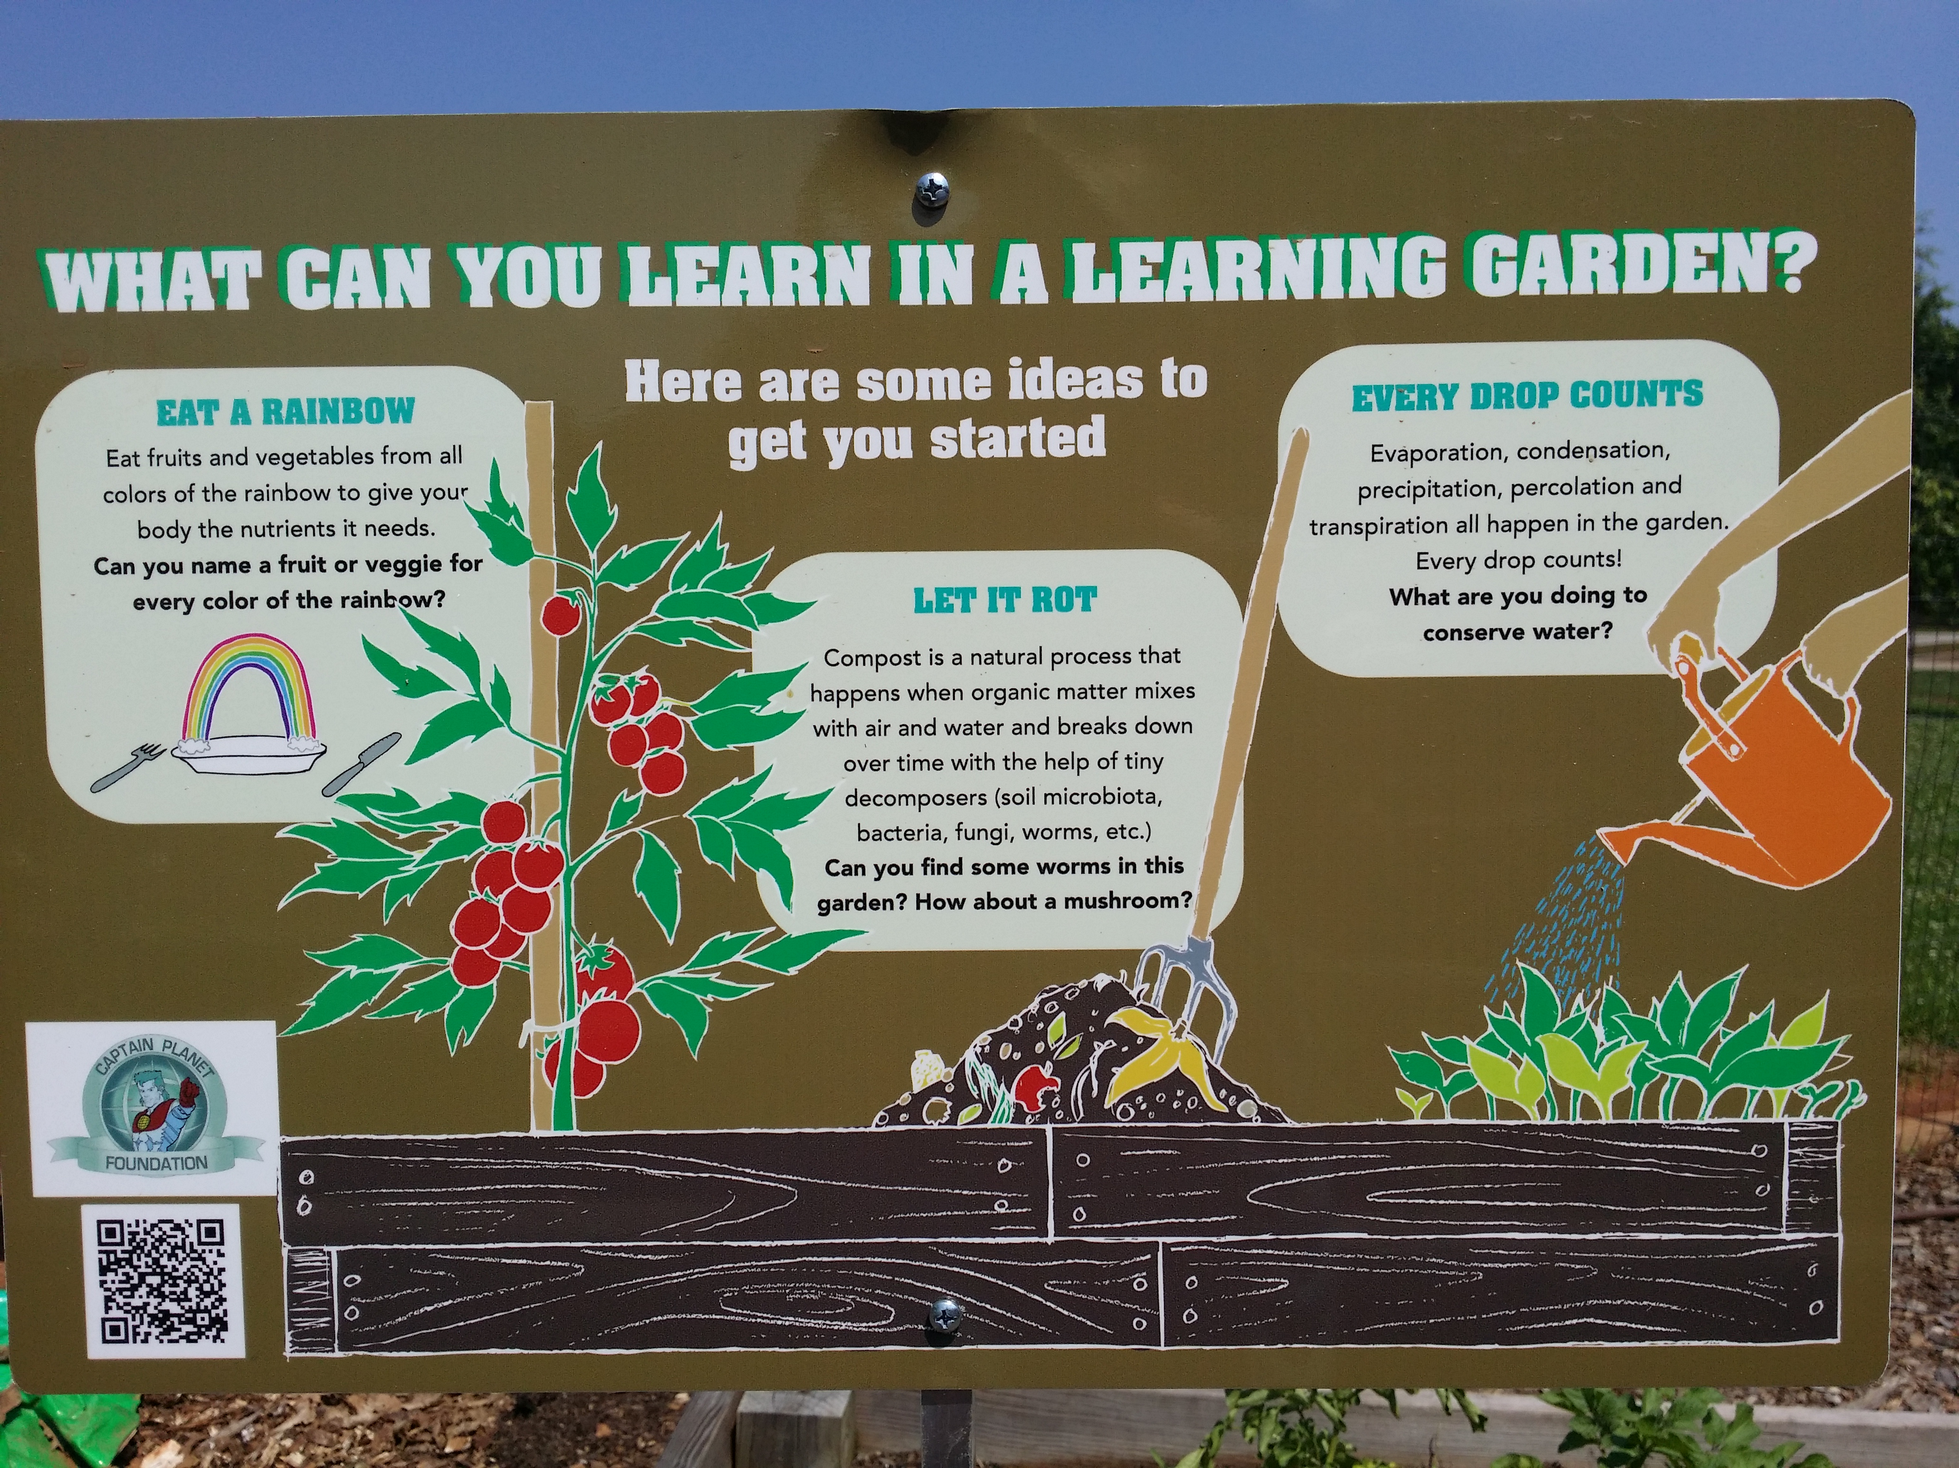
Notes:
Signage is important in the garden. It helps teacher feel at ease when teaching in the garden and they are great educational tools. Grants are often used to create weather-proof signs.

Slide 8
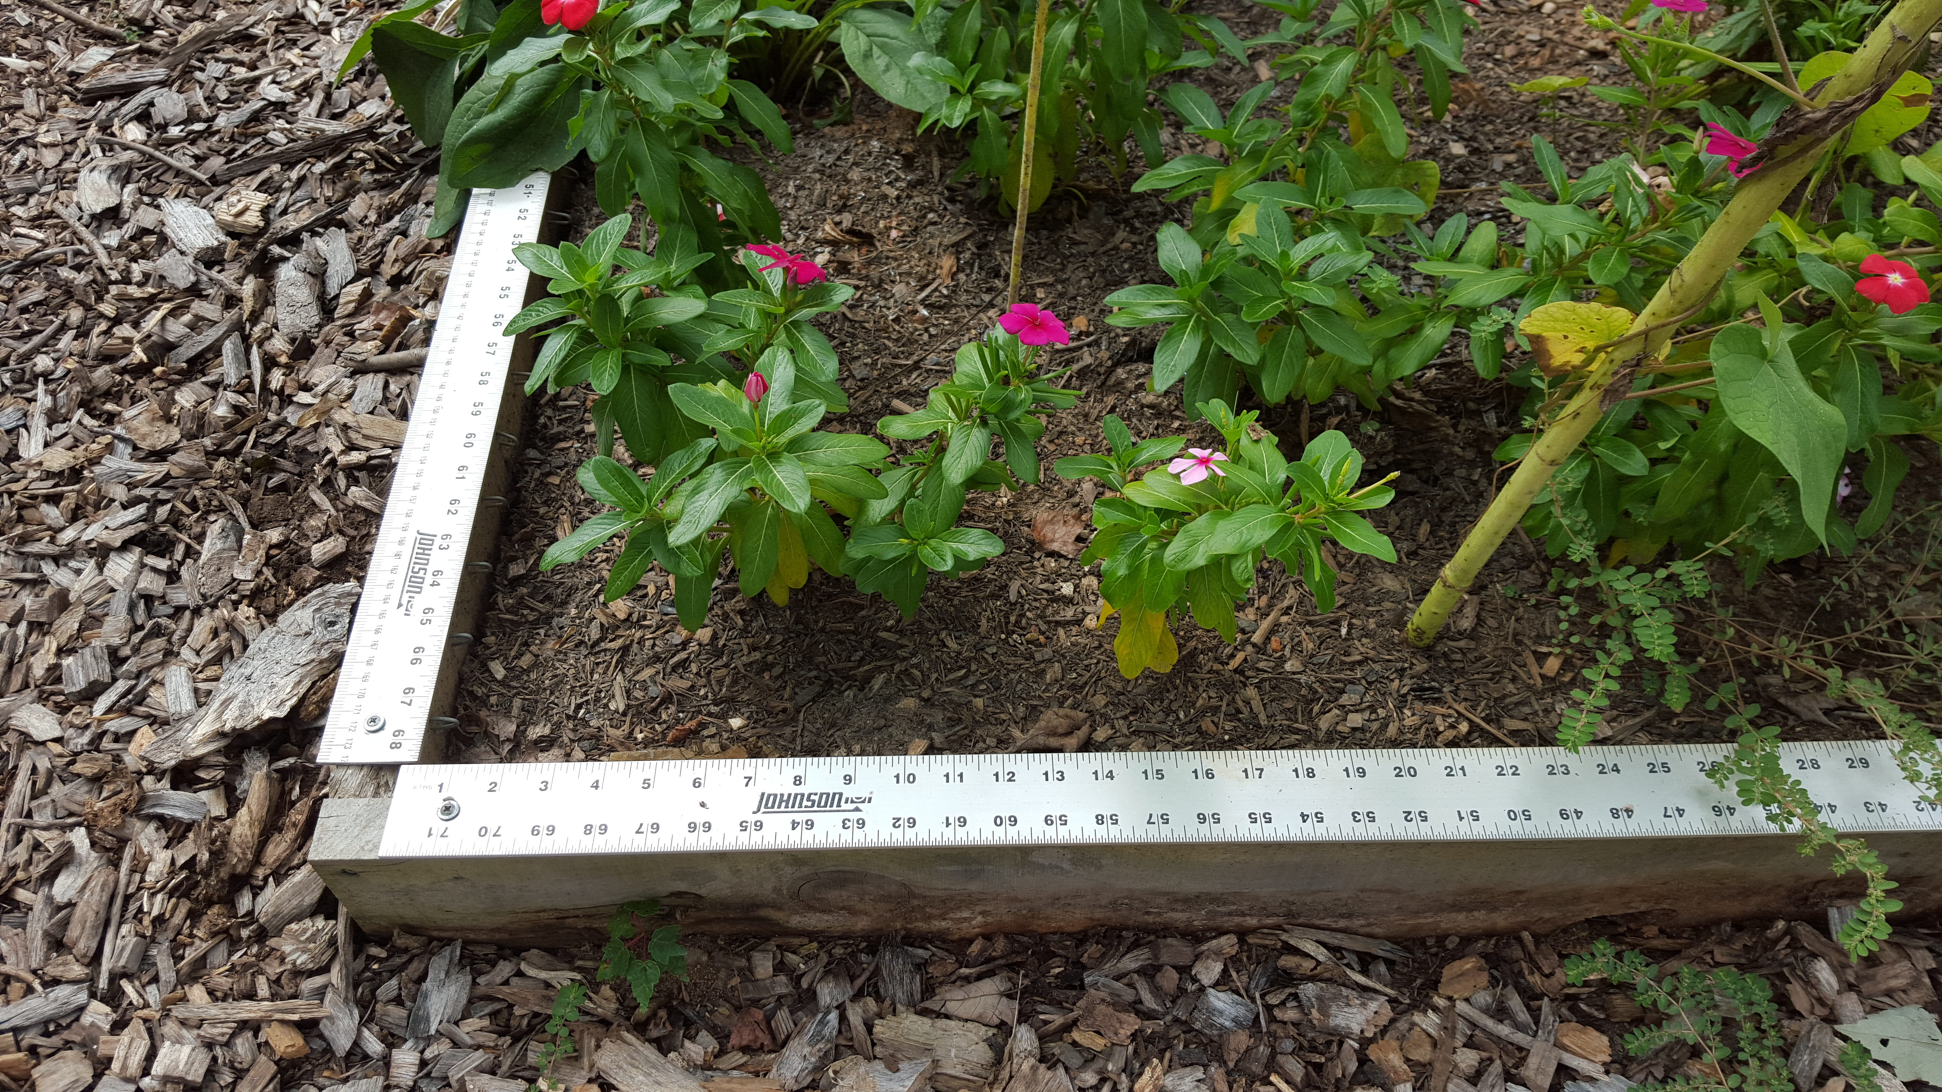
A math teacher from Due West Elementary School lined his garden beds with weather-proof architectural rulers. Now students can determine number of flowers per square inch or number of pounds of produce per square foot.
Notes:
Due West Elementary Math Garden

Slide 9
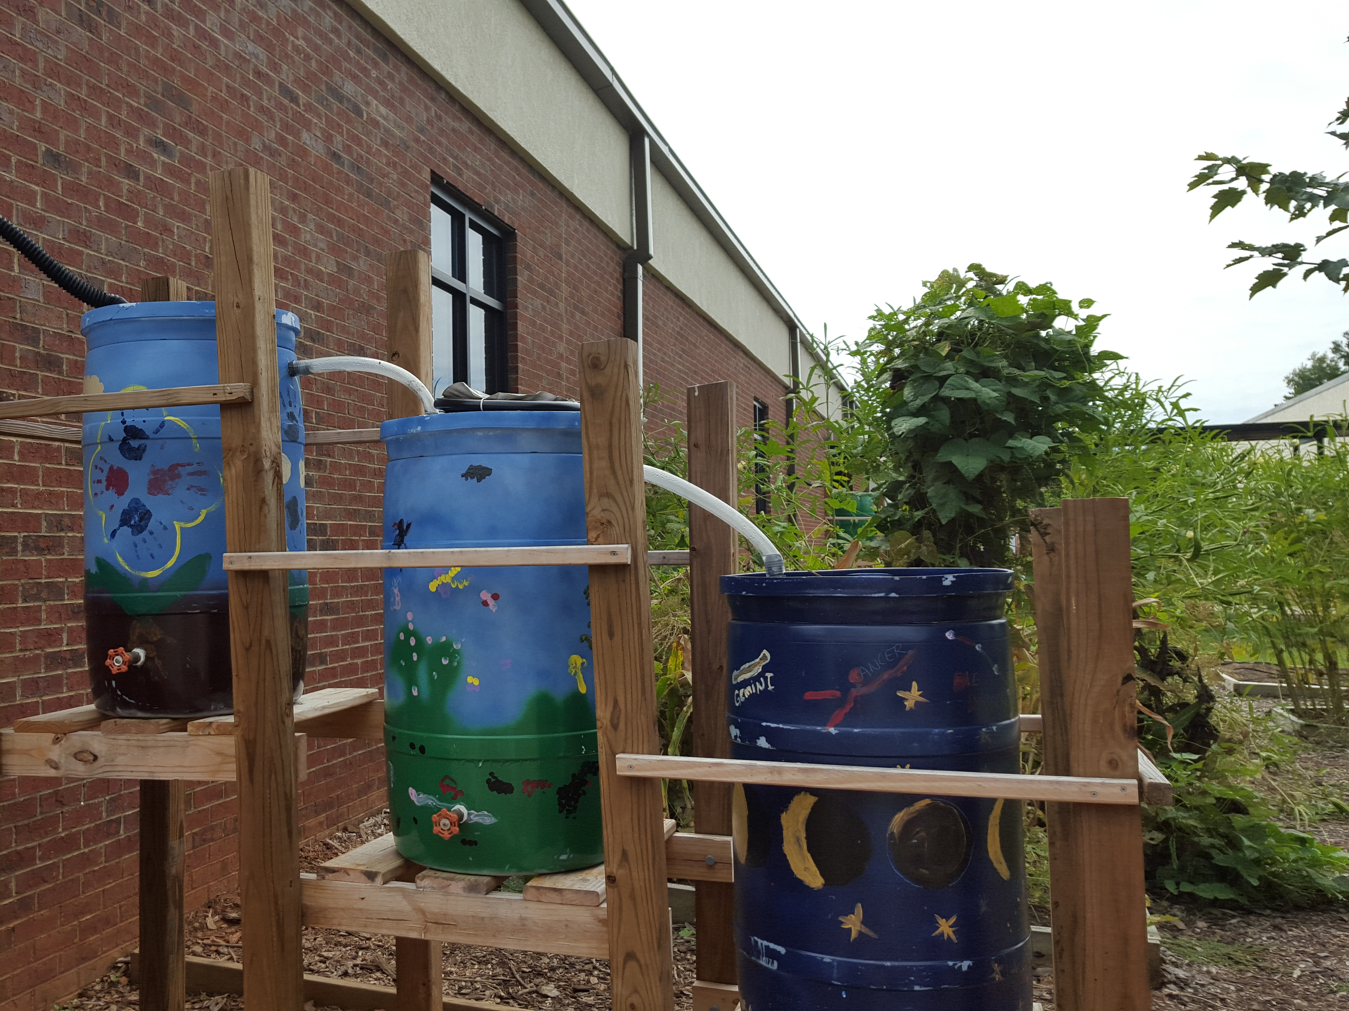
Partnering with the local water authority, fifth graders created this watering system to provide filtered water to the fourth grade garden beds.

Slide 10
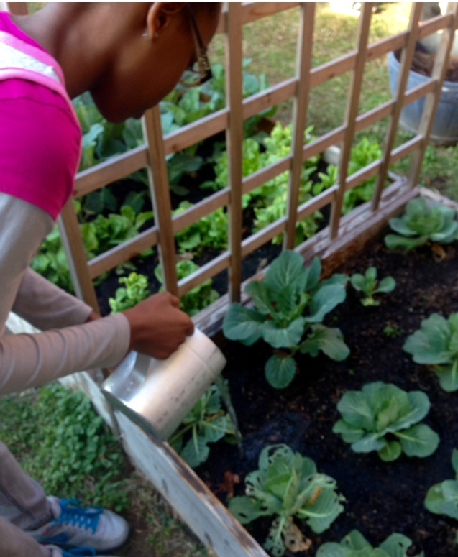
In Bibb County, students study the scientific method and experiment with water quantities, soil types, and plant varieties to determine what makes for the best food harvest.

Slide 11
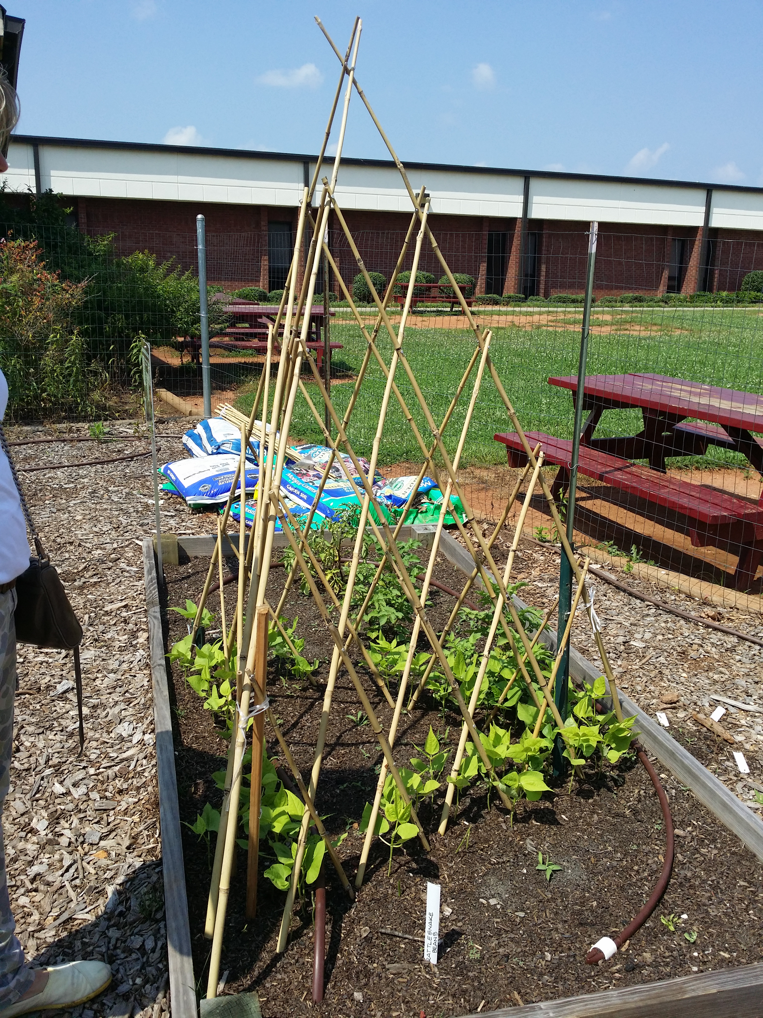
School gardeners can work with their school nutrition staff to hold taste tests of food grown in the garden.

Slide 12
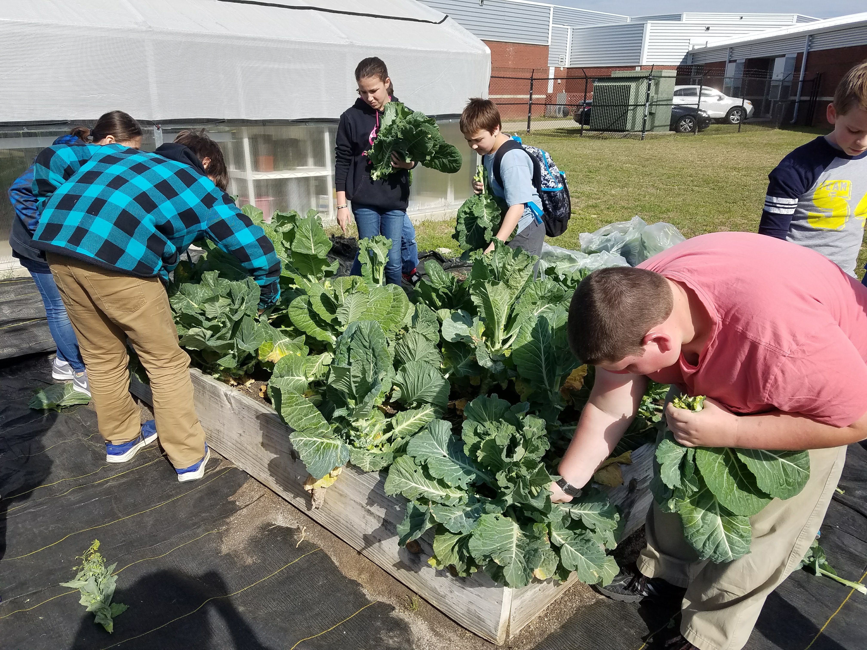
Food gardens are also used to teach agronomy, marketing, and business skills. Older students often grow food to sell at farmers markets.

Slide 13
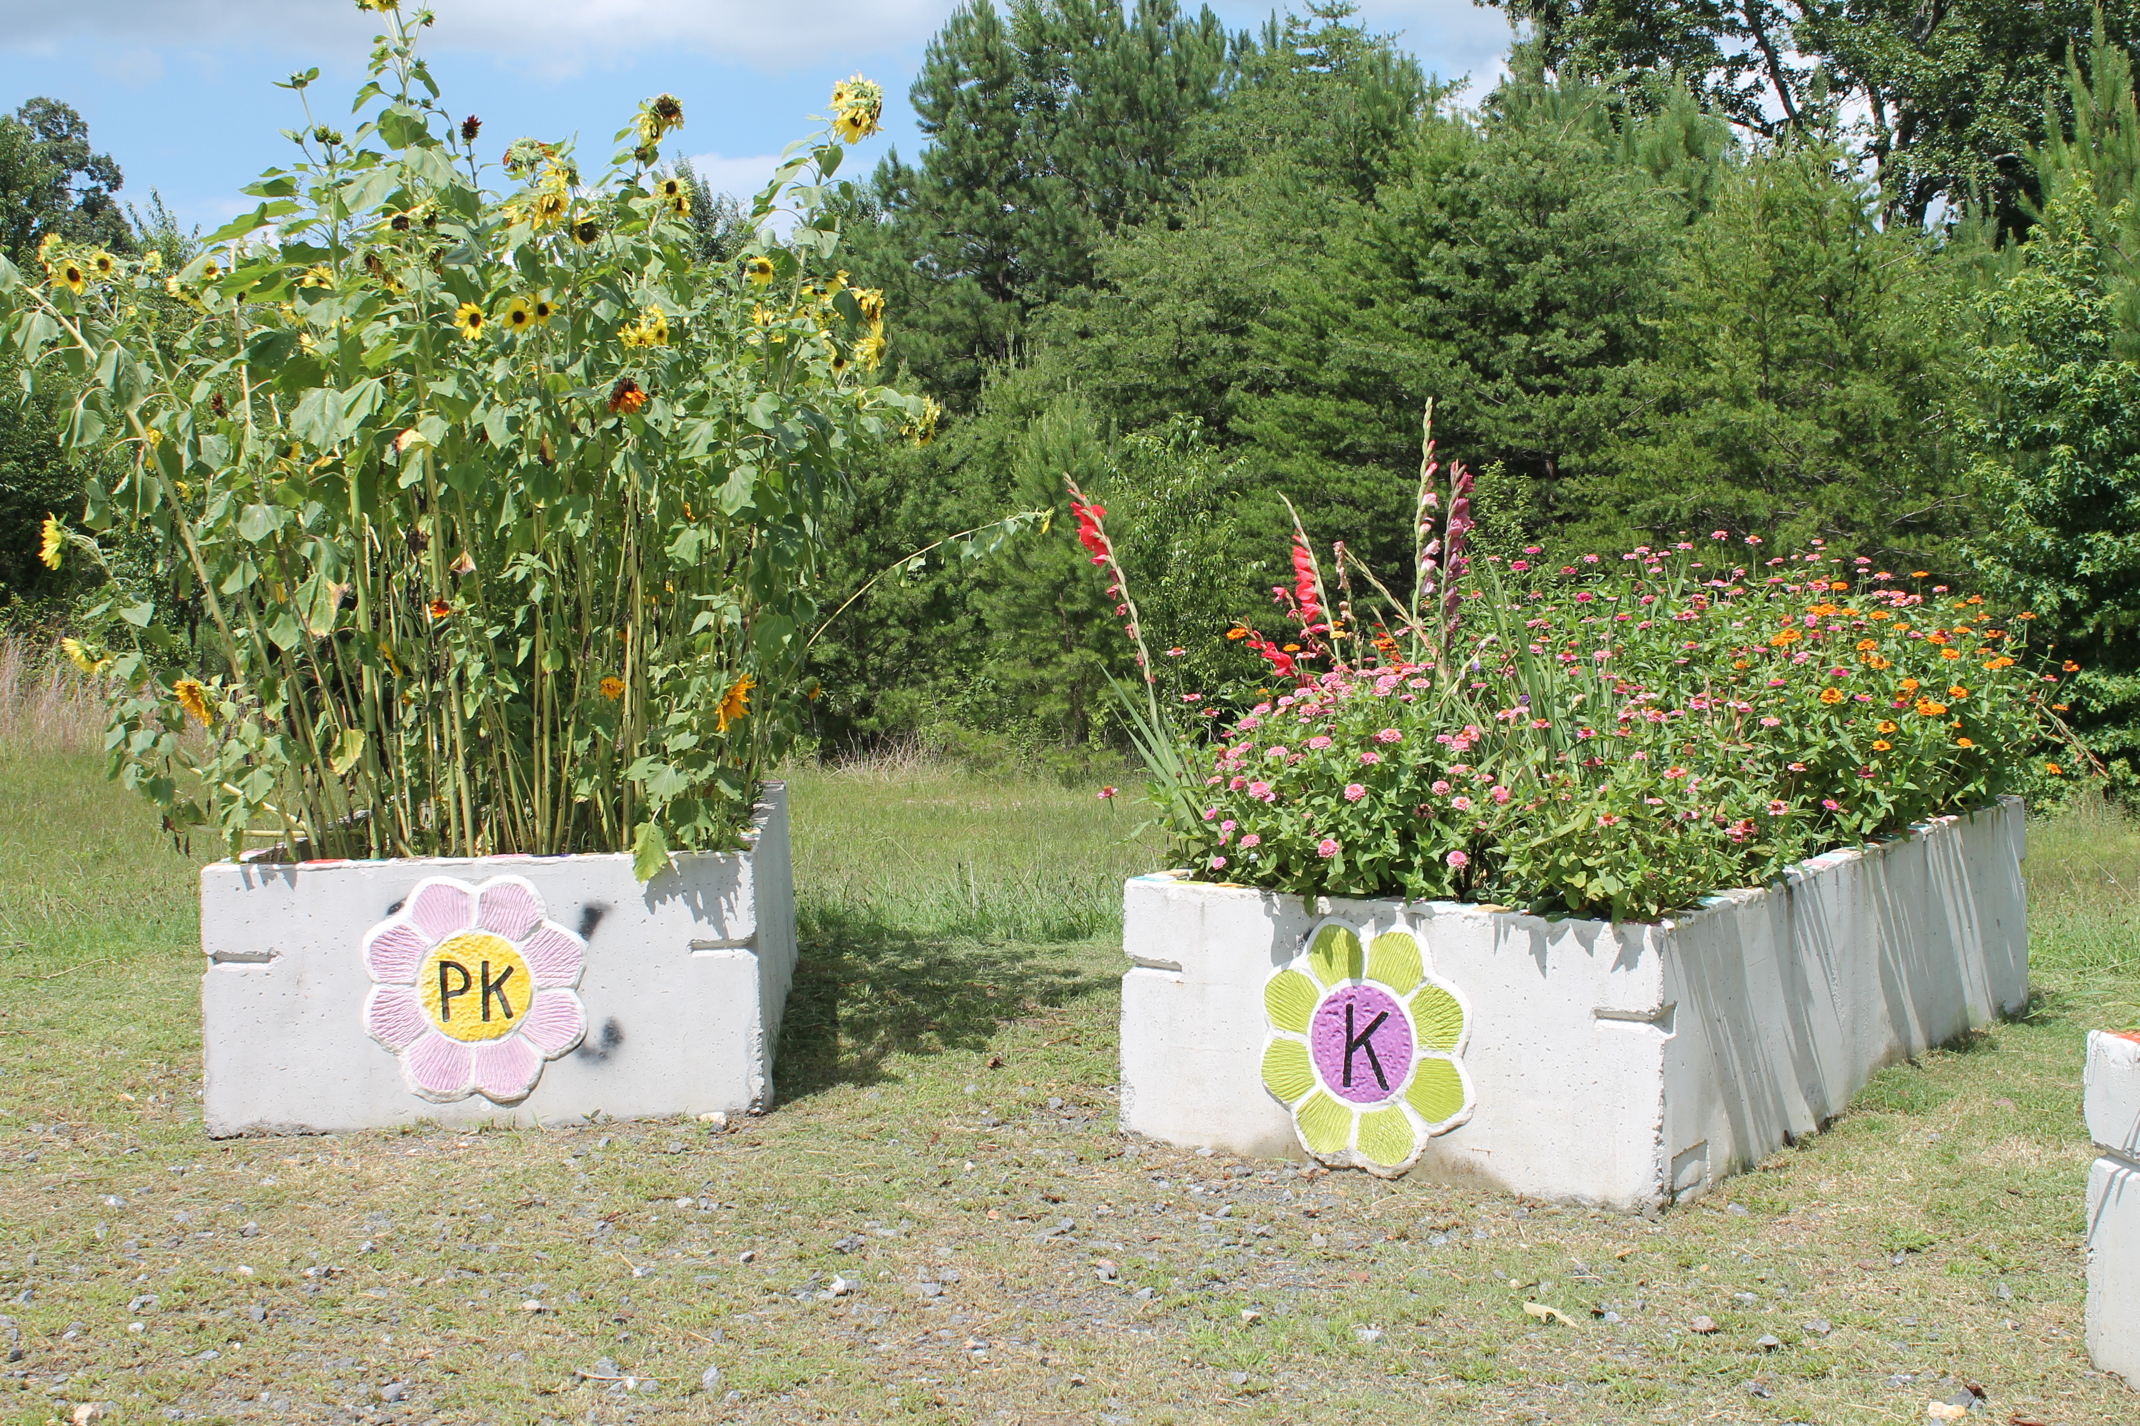
Start small and use the resources you have (including personnel and garden labor) wisely. This is from a school in Chattooga County.

Slide 14
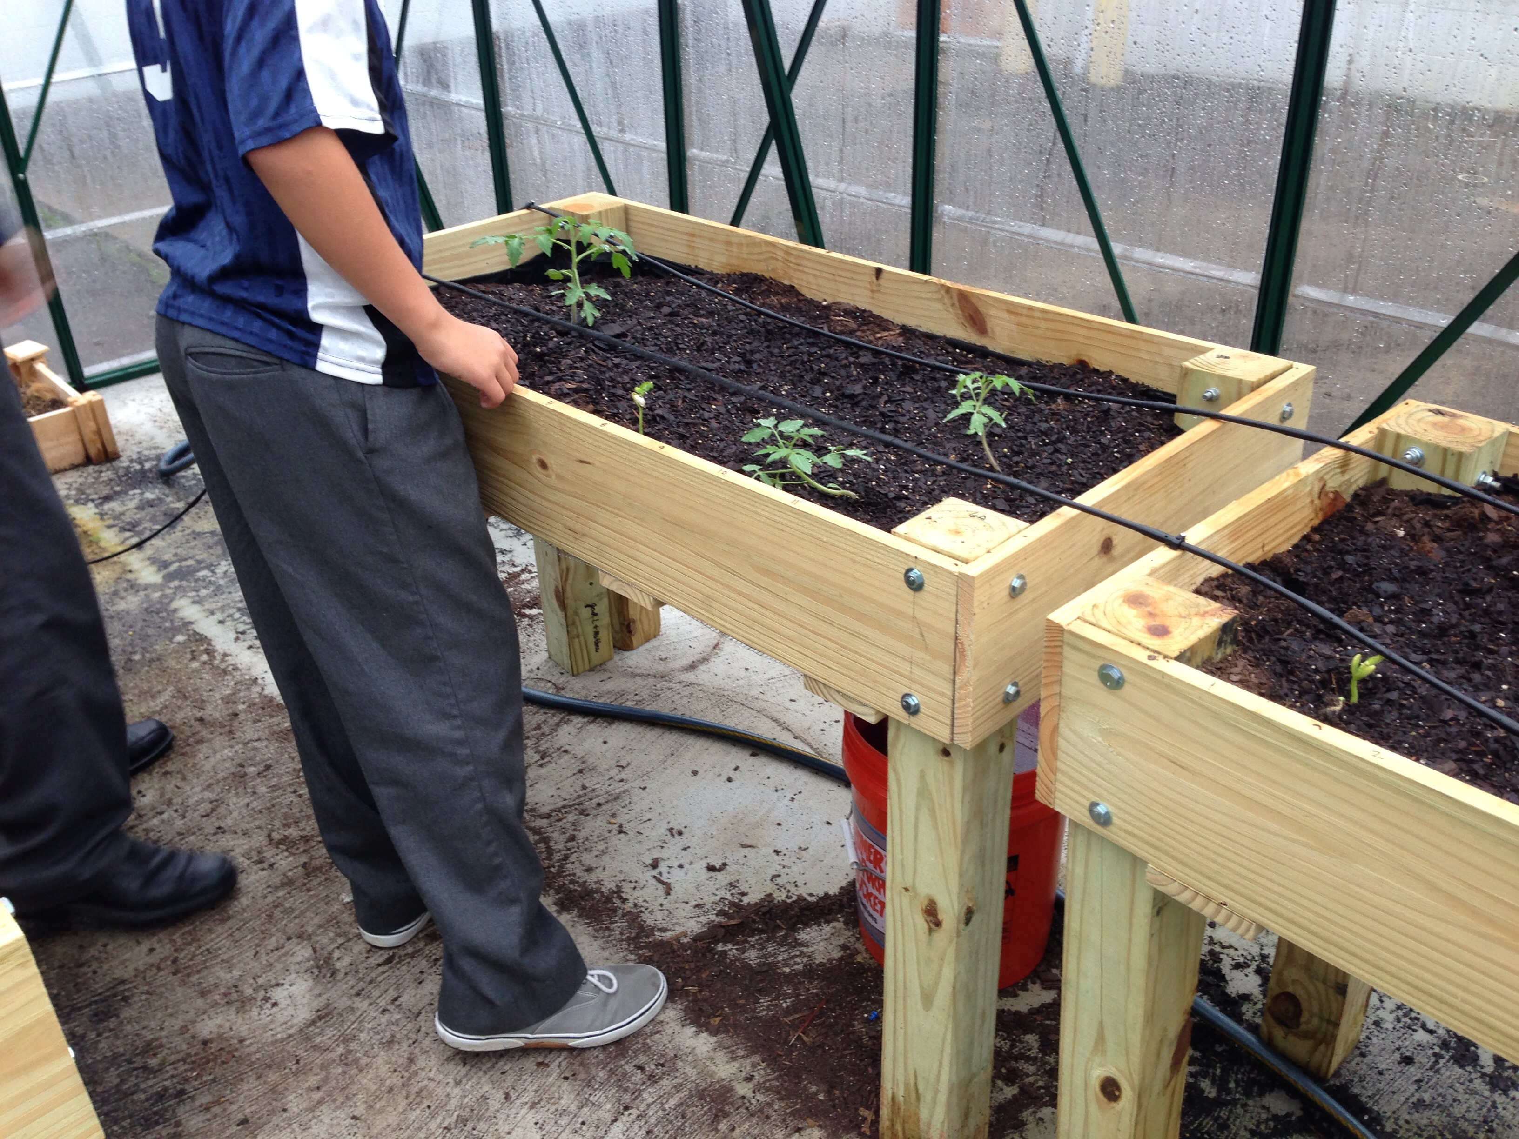
Notes:
A lack of space should not deter a school from having a garden. This school in metro Atlanta had no green space so the teachers got creative and designed this indoor space.

Slide 15
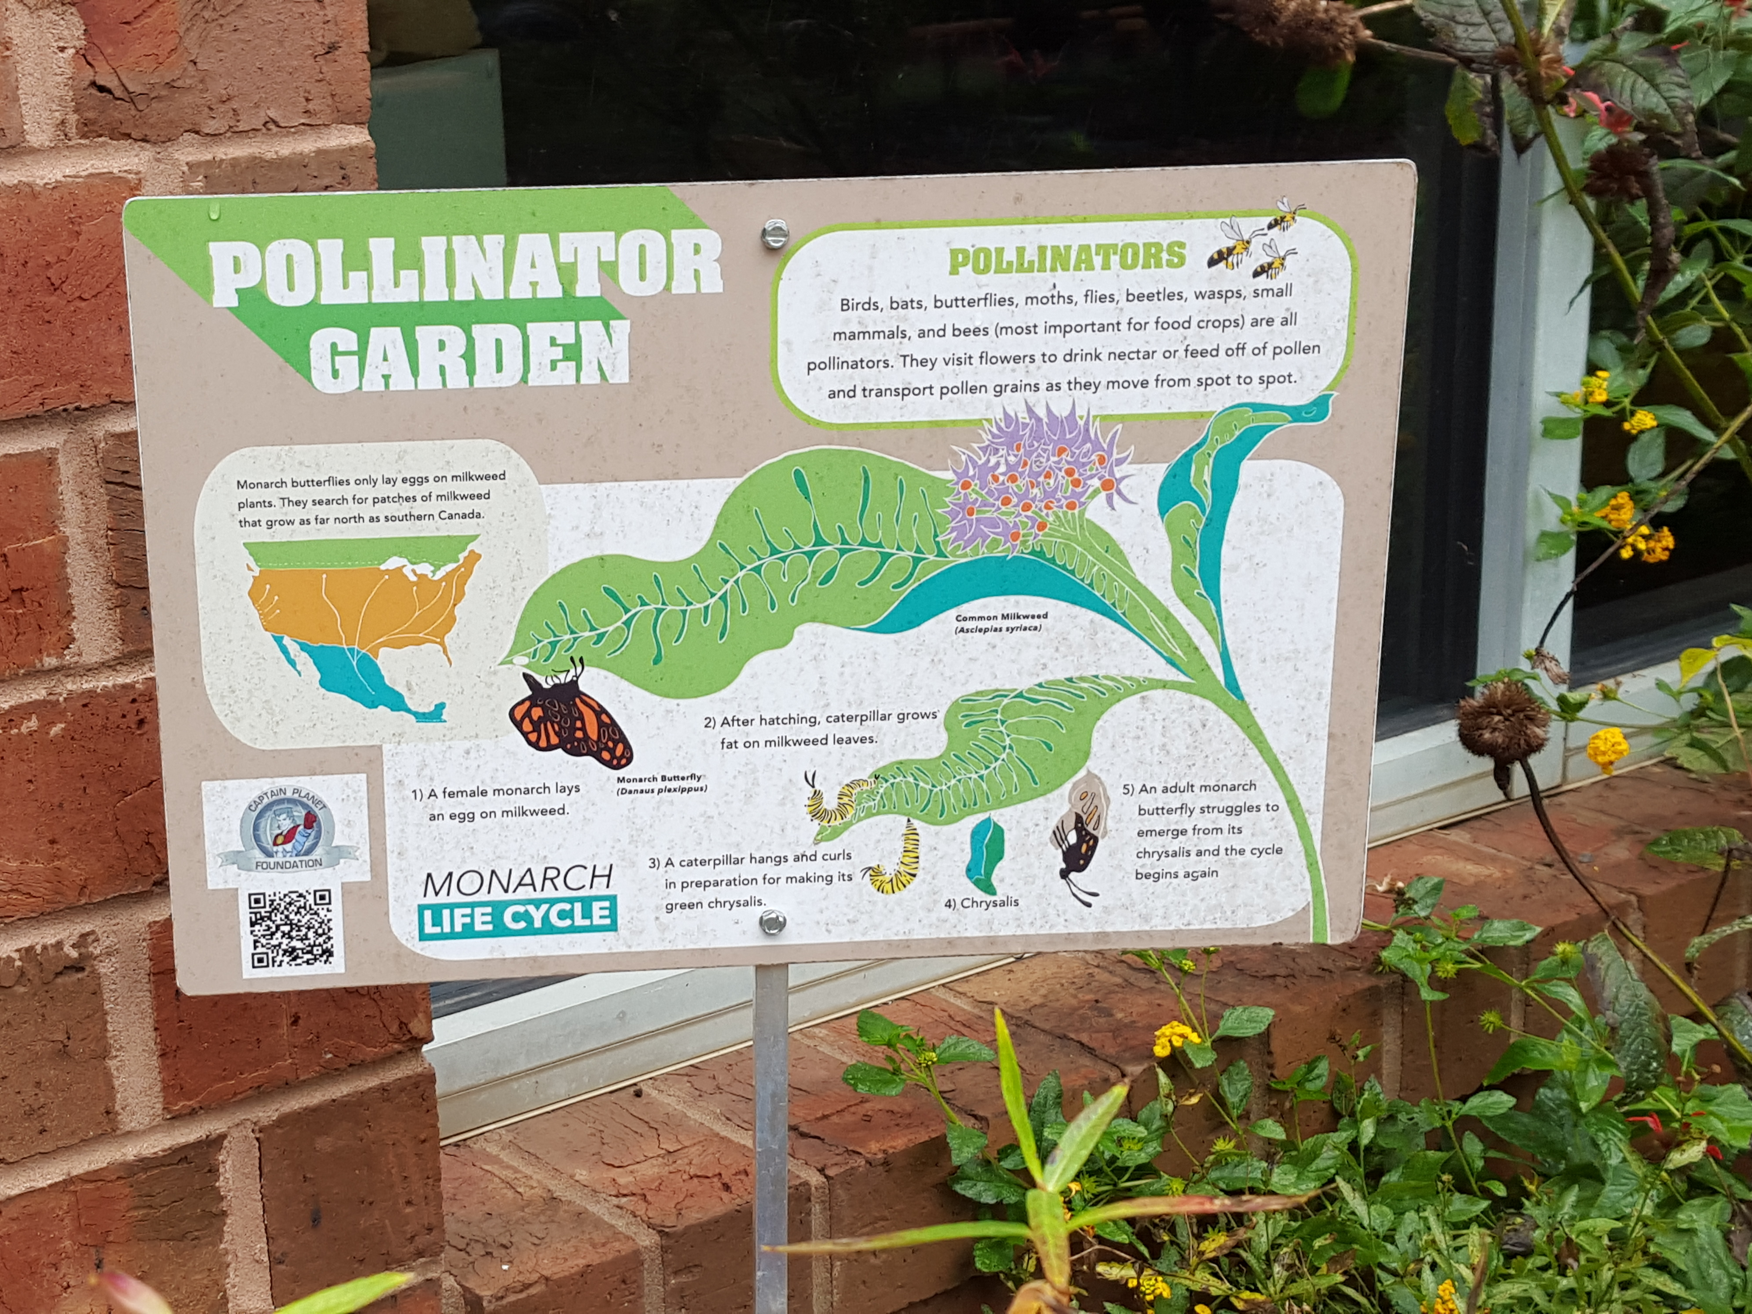
Notes:
A pollinator garden will attract pollinators and other beneficial insects to your garden. It is also used to teach entomology and ecology. It teaches students that not all bugs are bad!

Slide 16
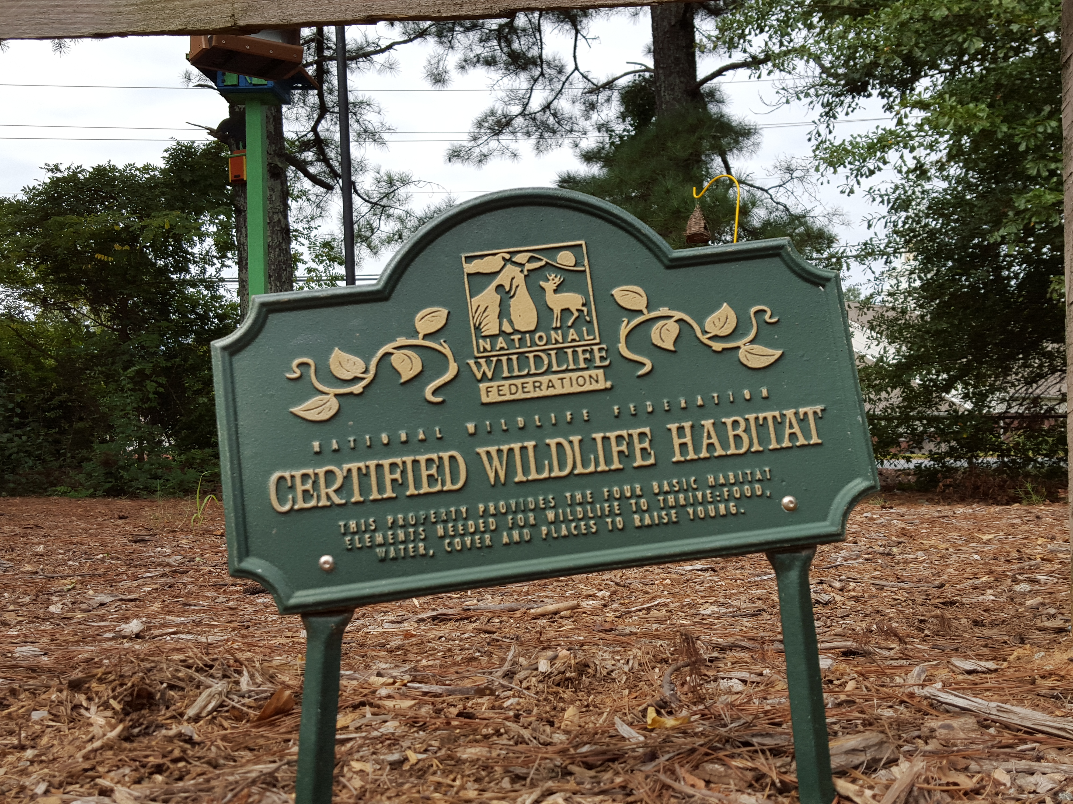
Notes:
Wildlife gardens can be ways to teach ecology. Students can participate in citizen science bird counting through Cornell University bird watching programs.

Slide 17
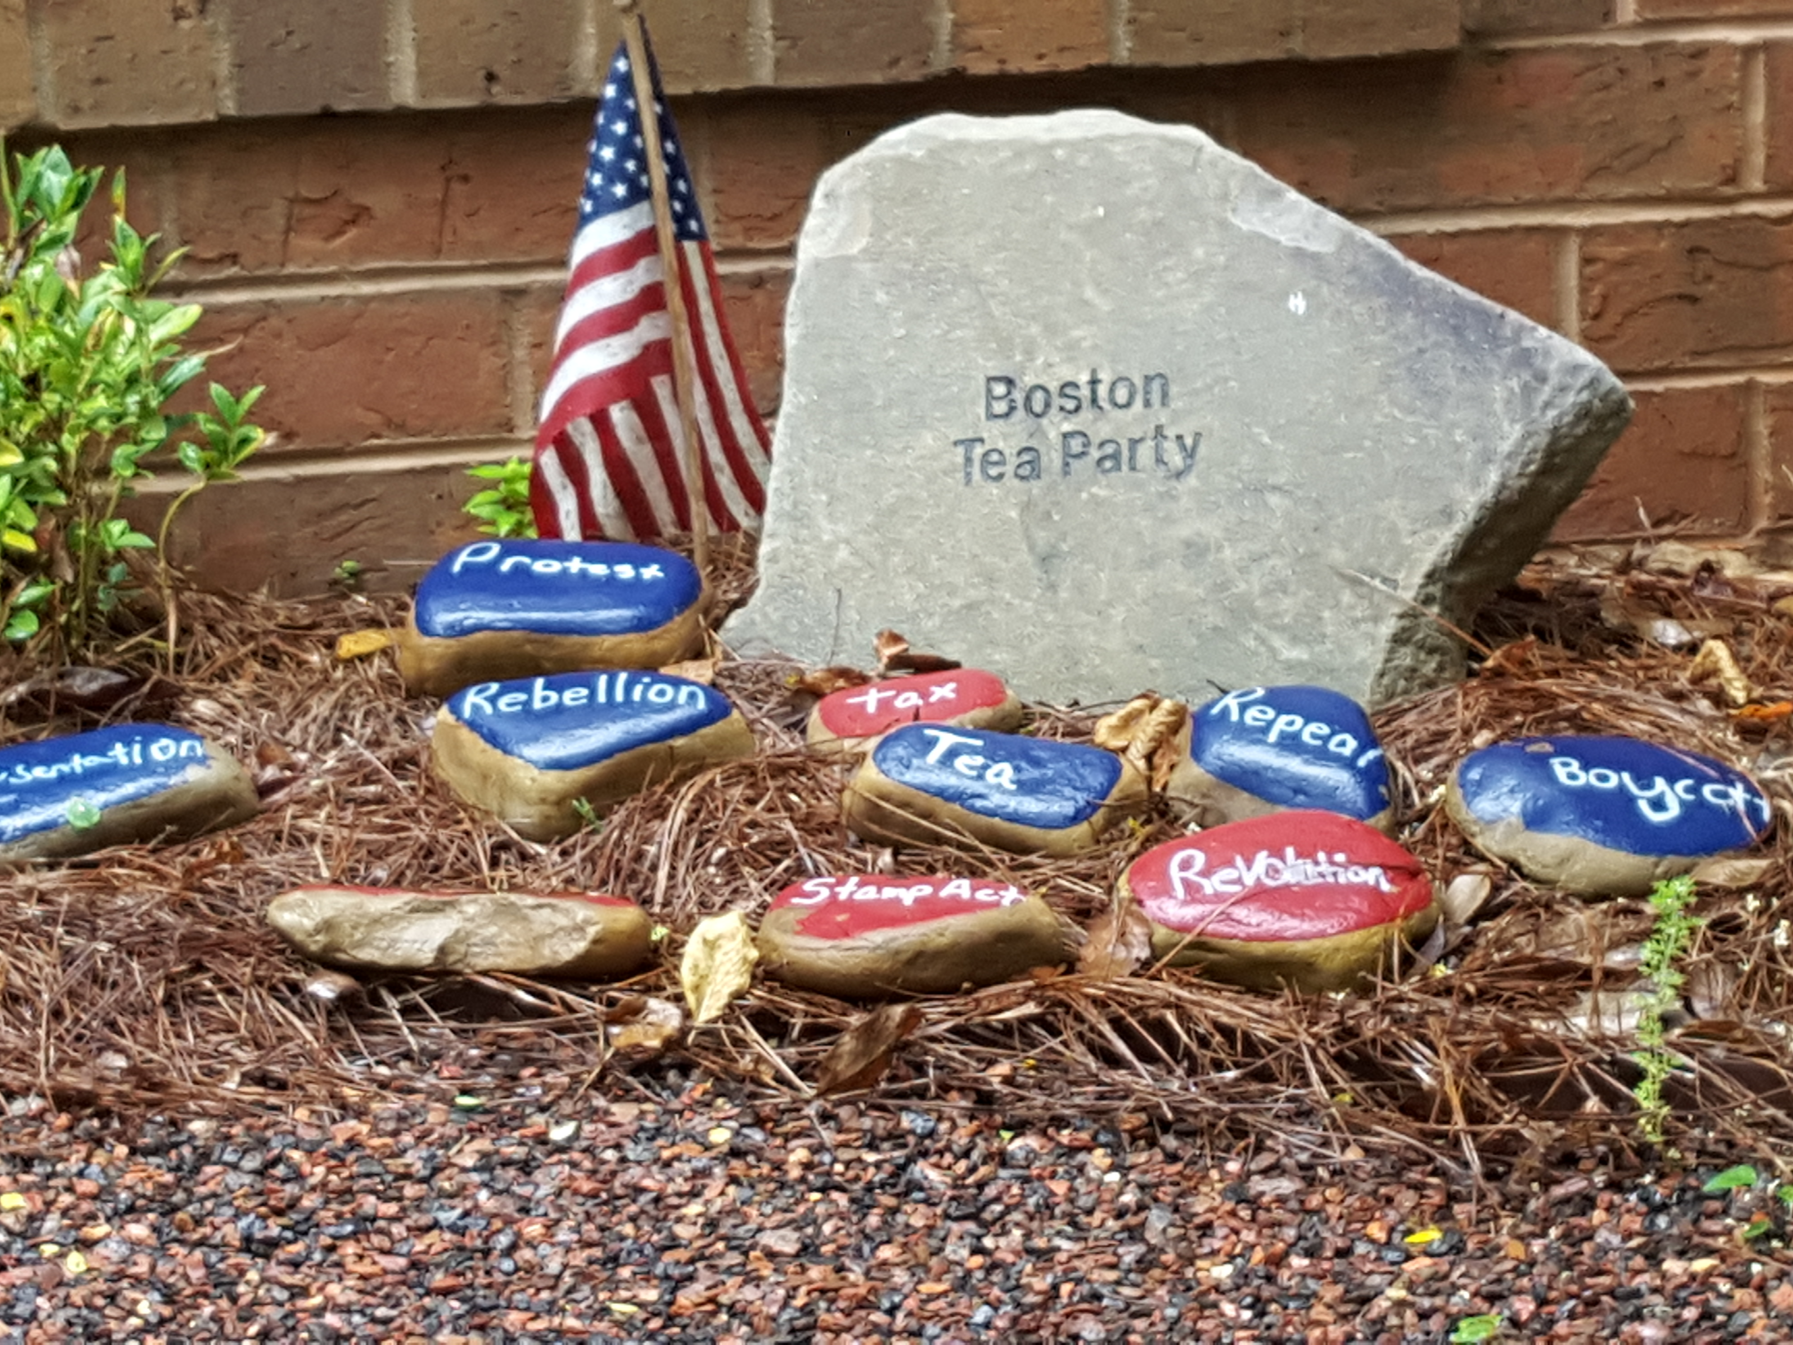
A word garden can be used to teach history. Replicas of WWII Victory Gardens are a living history lesson.
Notes:
Ford Elementary Word Garden

Slide 18
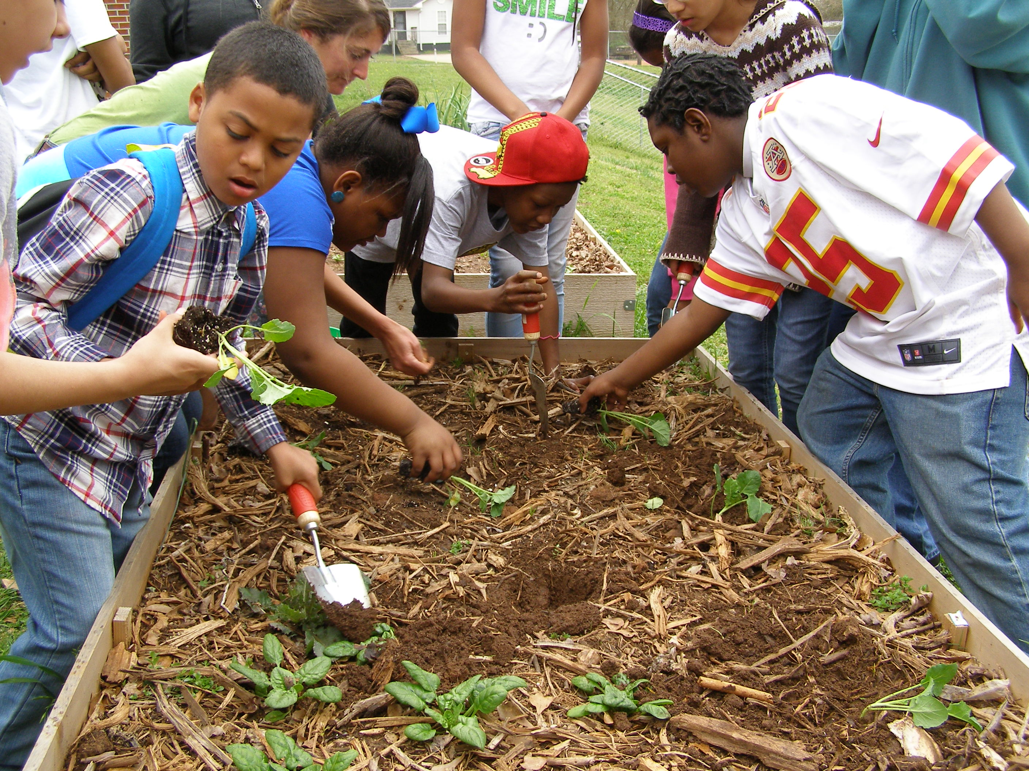
Notes:
Students at LaGrange Elementary school learned that it is okay to get dirty!

Slide 19
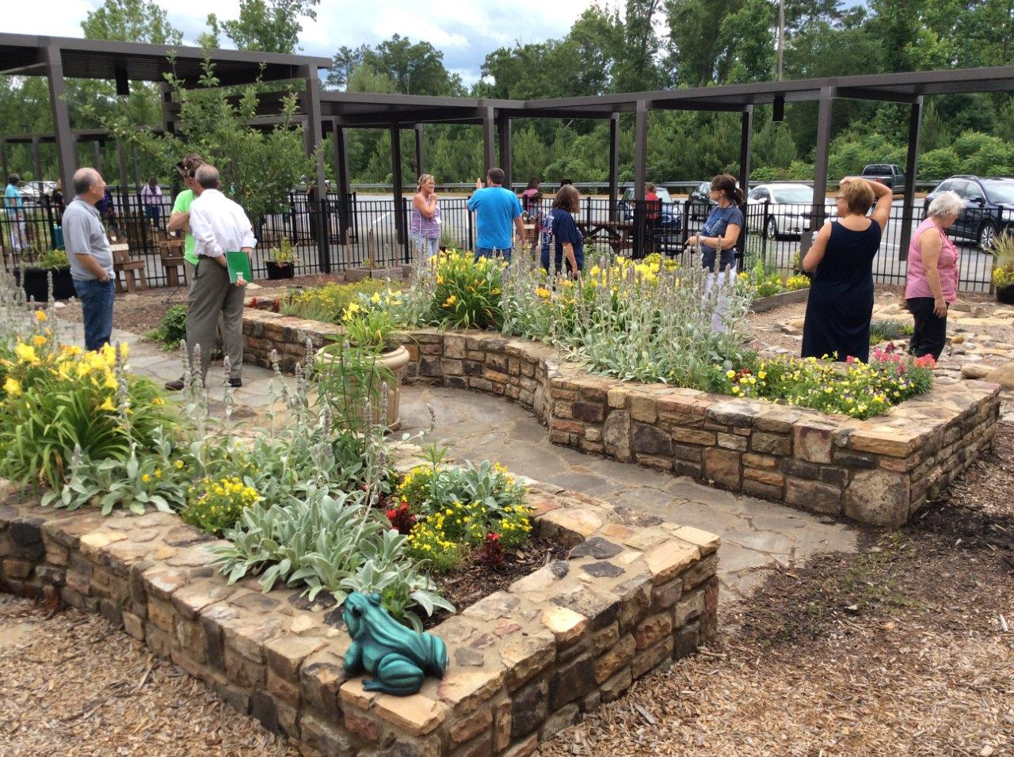
Use parent connections to help with building the hardscape of your garden. Many times parents work for companies that are happy to donate time and materials. This garden at Little River Elementary is used for many school functions.

Slide 20
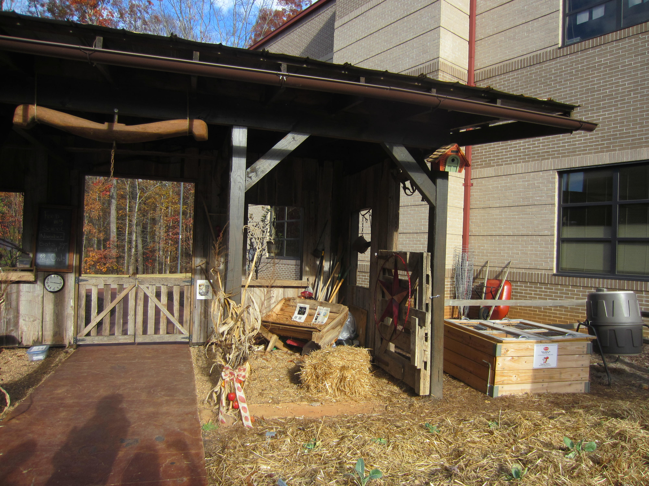
Sharon Elementary School in Cumming
Notes:
Another example of beautiful garden hardscape.

Slide 21
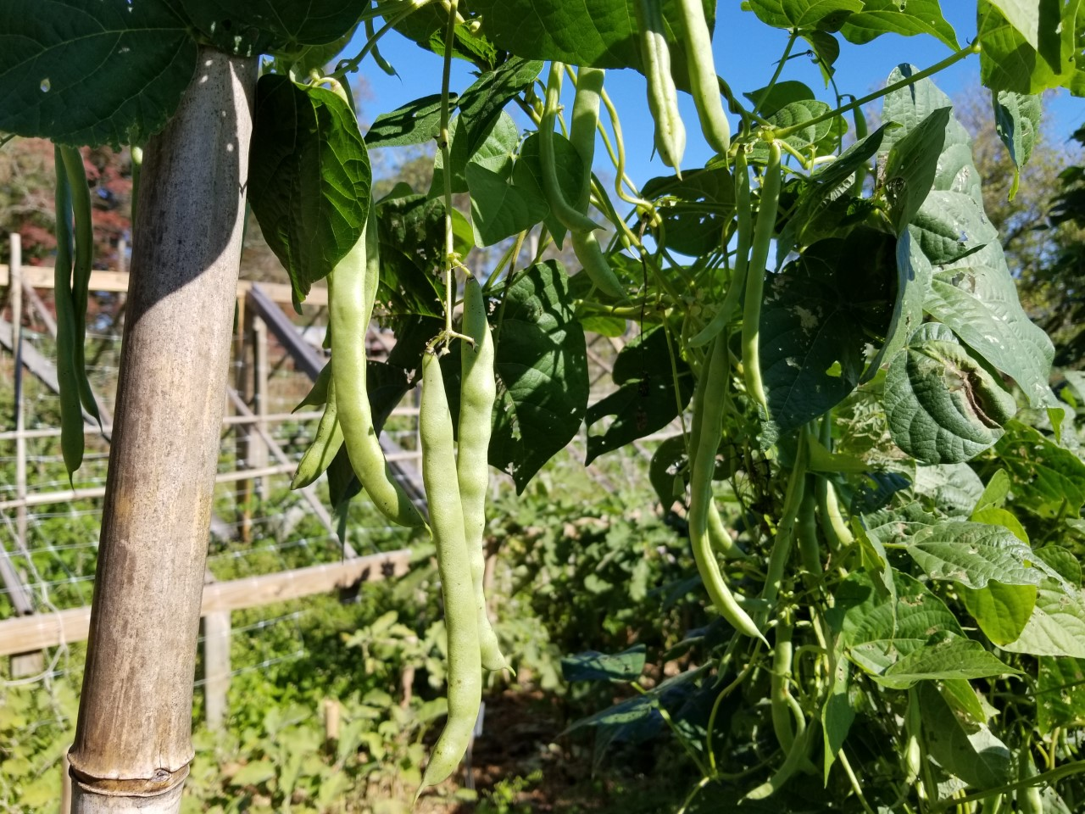
Challenge Activity: What subjects could you teach using a plot of beans?
Notes:
Math: How many beans per plant? Beans per pod? Geography: Where did the beans come from and how did they get to North America? Food Science: What type of nutrition do beans have? How do we prepare them? History: How did people harvest and preserve beans before refrigeration. Soil Science: How are beans nitrogen fixers? Agronomy: Do beans make a better crop when trellised? How hard are they to harvest on a commercial farm when trellised? Entomology: What insect pests do beans have? Pathology: What types of diseases do insects have? Literature: Have students write a haiku to the humble bean.

Slide 22
What is Possible in a School Garden
Becky Griffin
Part of the School Garden Presentation Series

