Slide 1
Steps in Starting a Sustainable School Garden Becky Griffin
One of the UGA Extension School Garden Team’s series of presentations.

Slide 2
Notes:
In order to create a usable, sustainable, long-lived school garden, it MUST have a good start which requires months of planning before the actually planting can begin. In this presentation we will discuss the steps you need to work through in order to achieve the garden you want.

Slide 3
STEP 1: ASSEMBLE A GROUP OF ENTHUSIASTIC TEACHERS AND STAFF
Notes:
Gardens started by only 1 enthusiastic teacher with no support will fail. That well-meaning teacher will quickly become overwhelmed and overworked. He/She may be transferred or be given other duties that keep her out of the garden. A committee of like-minded teachers from various grade levels and different subject areas is needed. Incorporate custodians and school support staff who may be interested in the project. If you are pursuing a food garden, include the cafeteria’s nutrition personnel in your group. If possible, visit a nearby successful school garden for inspiration..

Slide 4
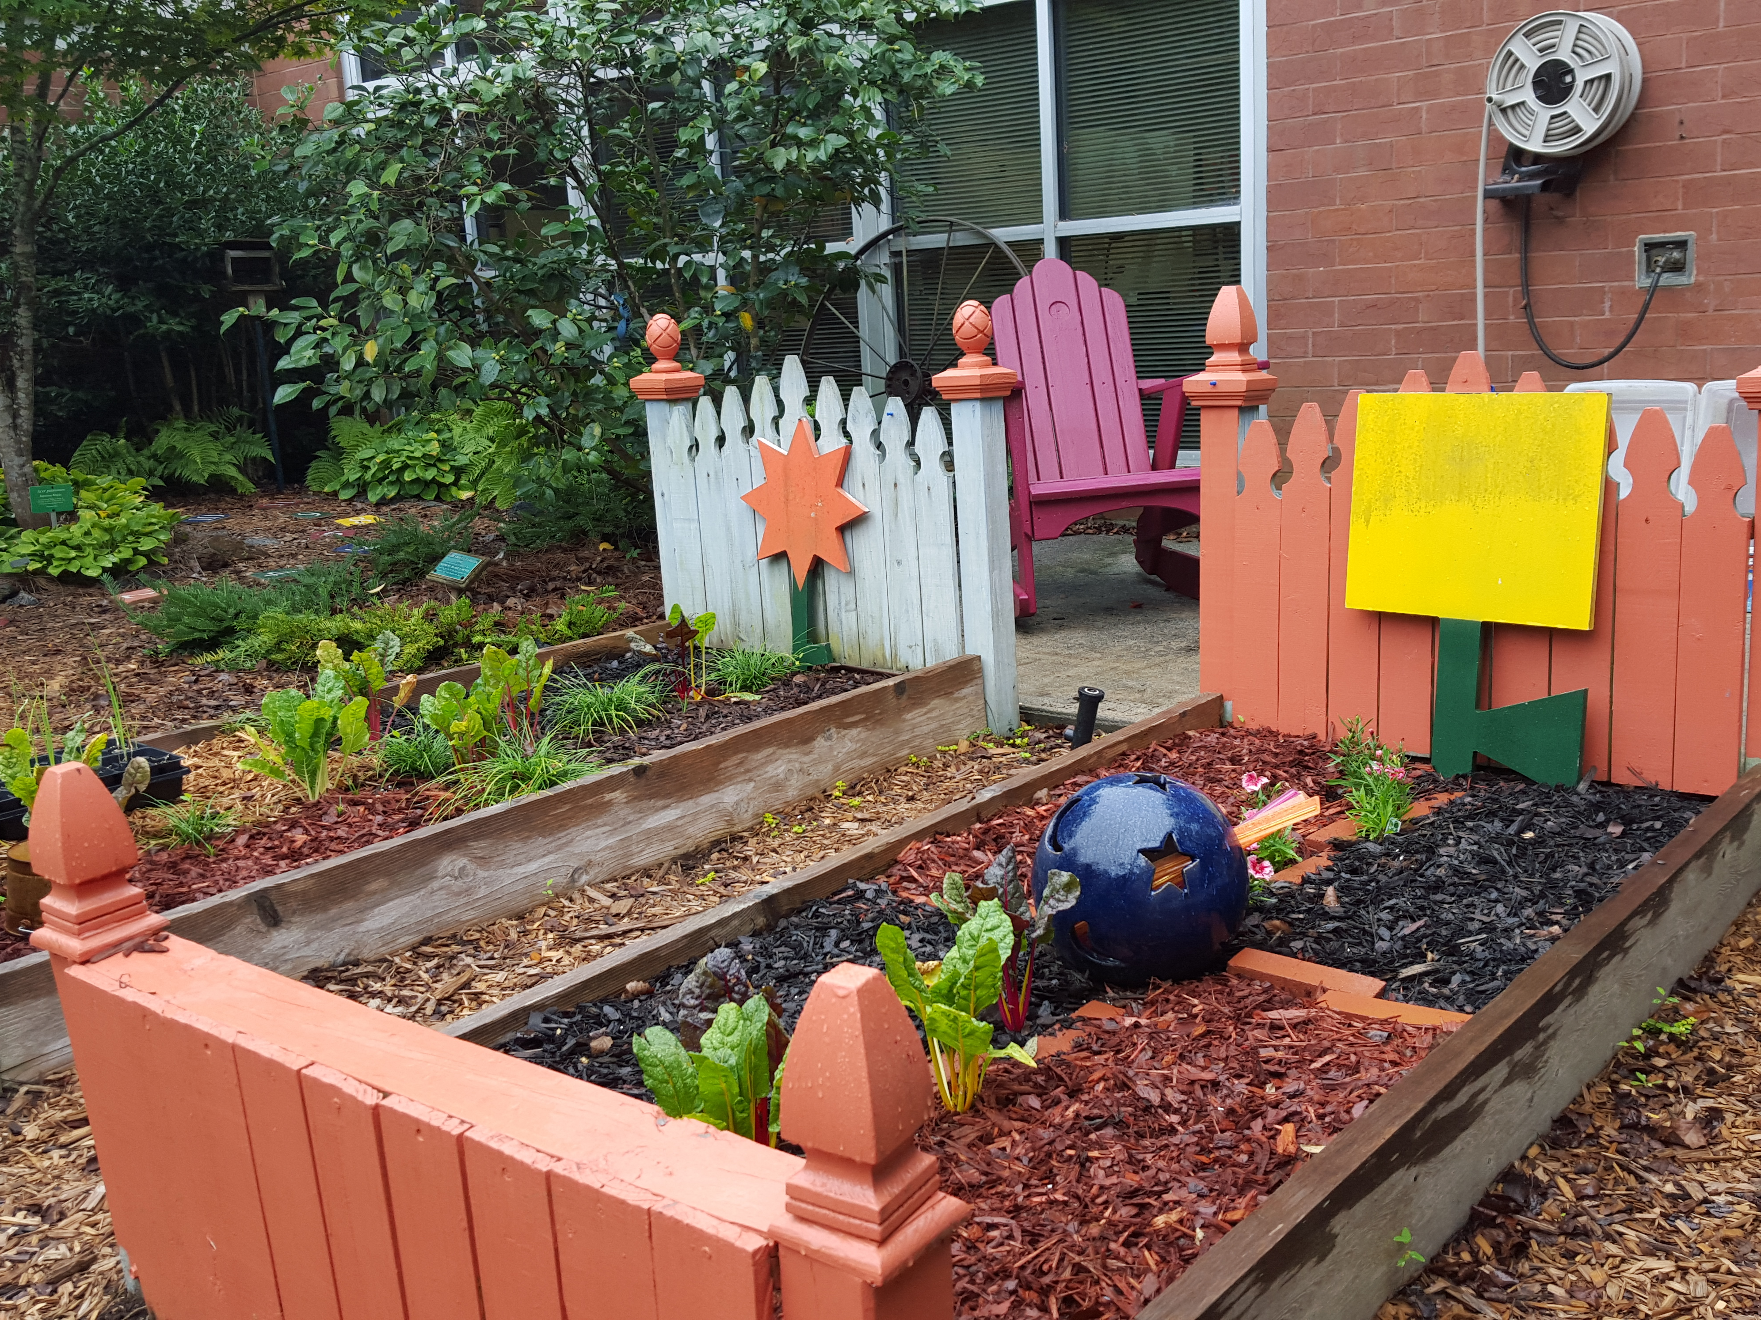
STEP 2: DRAFT A PLAN
Notes:
After your group has an idea of what you want to create, how do you turn these ideas into a garden?

Slide 5
Create a plan that includes:
Supplies – Estimate needs like garden tools, compost, and other soil amendments, raised bed materials, irrigation, fencing plants/seed, signs, etc.
Budget
Timeline
Time requirements – how much time is needed from staff and volunteers
Personnel needs – how many volunteers will be needed
Garden space requirements
Curriculum connections
Community support ideas

Slide 6
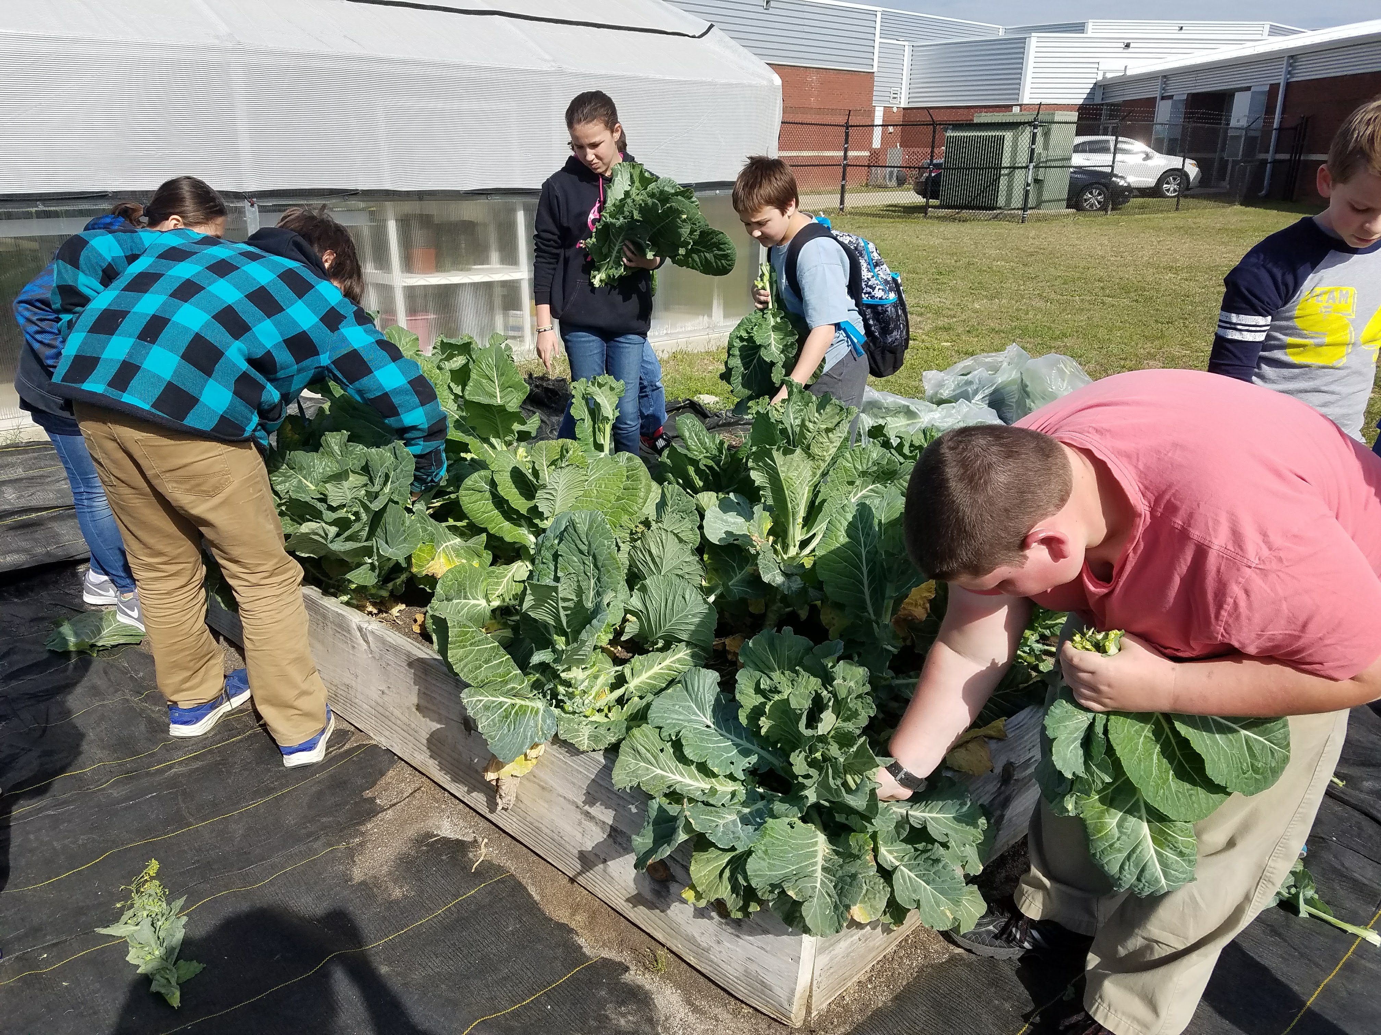
STEP THREE: GARNER ADMINISTRATIVE SUPORT
Notes:
Meet with your administrative staff. Have your plan organized and explain what you want to do with the garden in detail. Your administration will want to know how the garden will benefit the students and not be burdensome for teachers. It is important to get them excited about the project! After you answer their questions, learn whether the garden could be given time or resources.

Slide 7
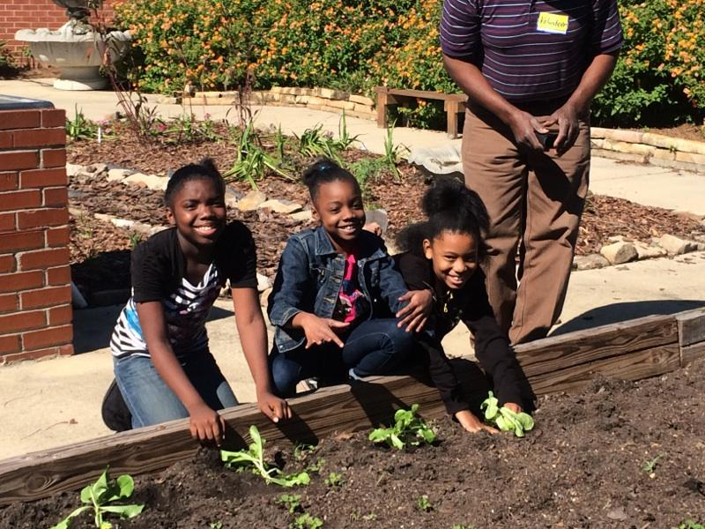
STEP FOUR: GATHER PARENTAL SUPPORT
Notes:
It would be best to create a school garden committee of the school’s Parent Teacher Association or Organization (PTA or PTO). This committee can help find volunteers, help get support from the wider community, and organize workdays in the garden. Some schools have “garden angels” or “parent partners” who are trained in basic horticulture to head up garden maintenance. You will need people to care for the garden, especially during the summer and when school is not in session. Also, school parents may have connections to free, or reduced cost, garden tools and landscape materials.

Slide 8
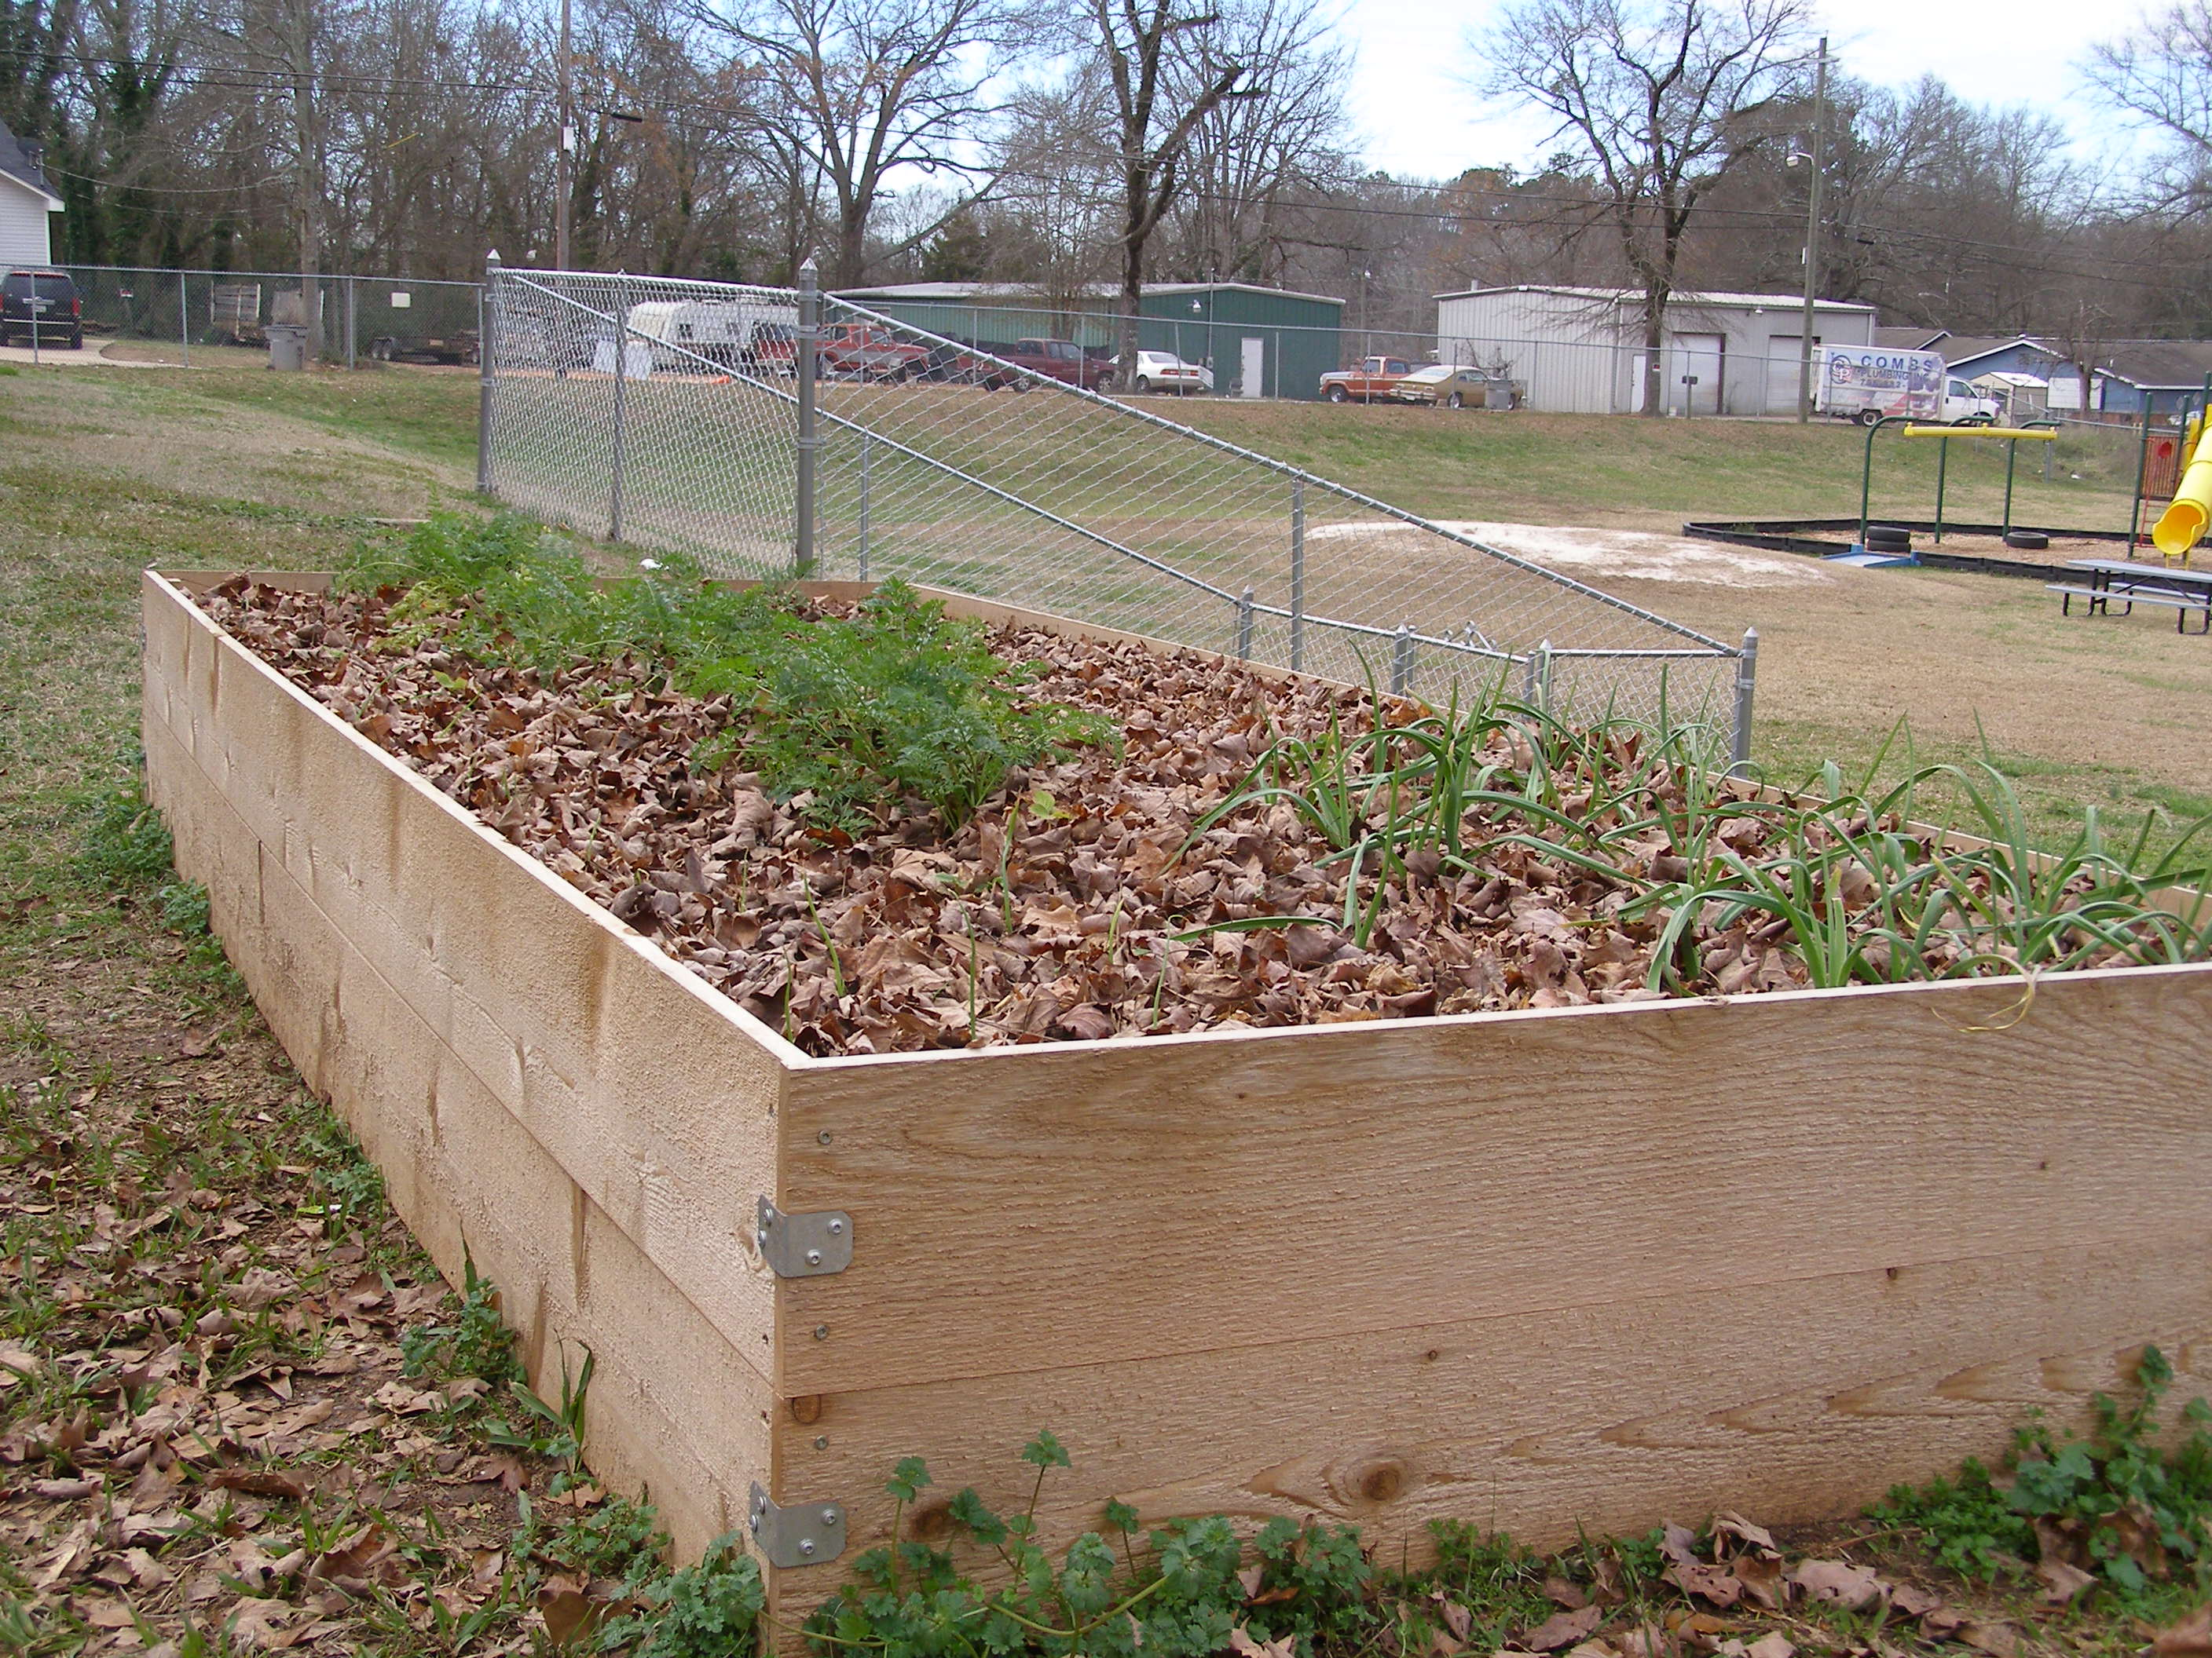
STEP FIVE: CHOOSE YOUR GARDEN SITE
Notes:
For most garden types you will need full (6+ hours) of full sun and a water source. Hauling water to a garden spot is not sustainable. Simple irrigation such as a spigot near the site will work. If full sun is not possible on your school grounds, consider a shade, or partial shade, garden. For example, leafy greens will grow with less sunlight. To determine the nutritional needs of the soil and the soil pH have your soil tested through UGA Extension. Follow the guidance provided on the test results.

Slide 9
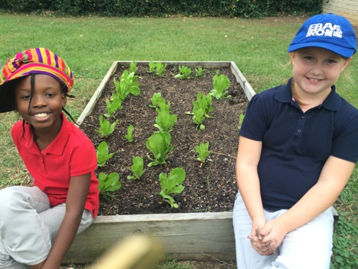
STEP SIX: NOTIFY LANDSCAPE MAINTENANCE CREWS
Notes:
Landscape maintenance crews will need to know your plans. If they are accustomed to praying herbicides or other pesticides, you will need to educate them about your garden. You do not want anyone accidentally mowing down your garden, applying herbicide too close to vegetable or spraying for insects in a pollinator space.

Slide 10
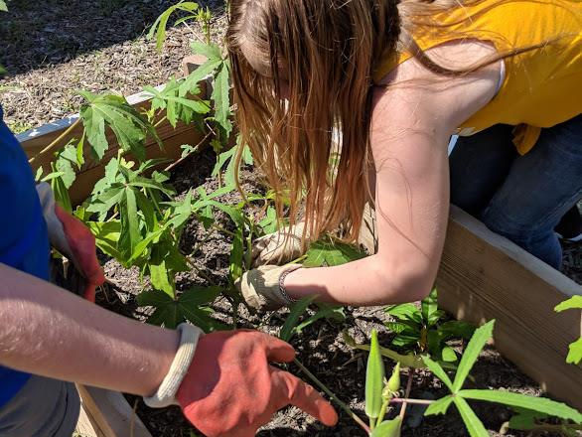
STEP SEVEN: CONNECT WITH PROFESSIONALS
Notes:
Stay connected to your local UGA Extension office for the latest information on growing your garden. Your local agent may also hold workshops of interest to school gardens. Do you have a local college in your area? Make connections with their horticulture or environmental science students.

Slide 11
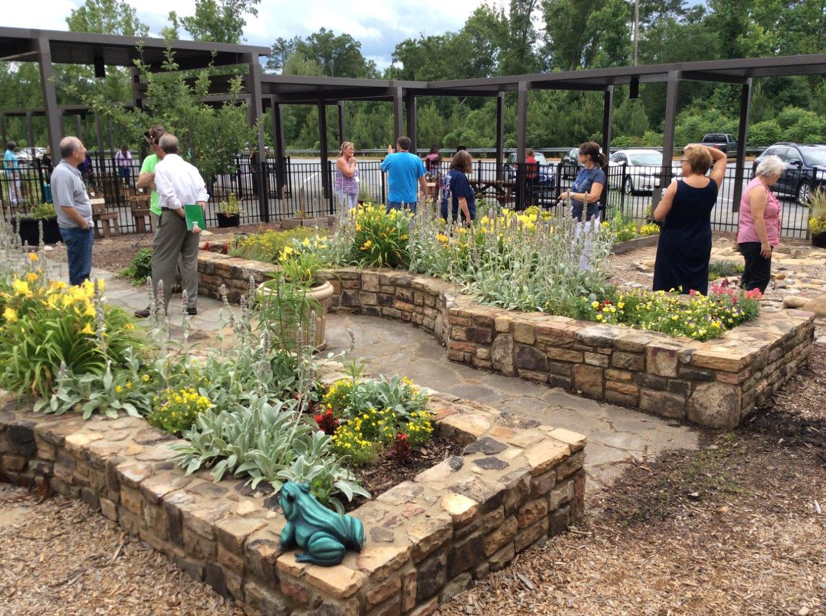
STEP EIGHT: GET OUT YOUR SHOVELS AND PLANT THAT GARDEN!

Slide 12
The Garden Planning Year
September
Create your group
October
Draft a plan
November
Garner administrative support
Dec.–Jan.
Gather parental support
February
Choose your garden site and notify landscape maintenance crews
March
Connect with the professionals
April
Plant the garden making it a celebration!
May
Enjoy the garden and get it ready for summer.
Notes:
Remember that your UGA Extension office is here to help you along the way!

