Slide 1

Tree Cleanup and Chainsaw Safety
This material was produced under grant numbers SH-26314-14-60-F-13 and 46D6-HT25 from the Occupational Safety and Health Administration, U.S. Department of Labor. It does not necessarily reflect the views or policies of the U.S. Department of Labor, nor does mention of trade names, commercial products, or organizations imply endorsement by the U.S. Government. Revisions were made to this material under grant number SHO5O77SH8 from the Occupational Safety and Health Administration, U.S. Department of Labor.
Notes:
Tree Cleanup and Chainsaw Safety
E.M Bauske, H Kolich, and J. Fuder
#1 Title Slide
Read a little of the disclaimer so they know how the training came about. There are two books that will help you operate the saw safely. The operator’s manual for you saw and the American National Standard for Arboricultural Operations, Also known as ANSI Z133. OSHA follows this ANSI standard. ANSI stands for the American National Standards Institute

Slide 2

Sister Margaret Ann
Notes:
#2 Sister Margaret Ann
Video: https://www.youtube.com/watch?v=e-ozLCZT4wg
When disasters happen, it’s natural to want to help out. Let’s watch as Sister Margaret Ann jumps right in to help clean up after a storm.
Show the video.
We can probably agree with Sister Margaret Ann that lending a hand is a good habit. But one of the first rules of emergency response is to make sure you don’t become another victim in need of help.
What risks do you noticed in the video? (No PPE for chainsaw user; in the road with no traffic control or barriers; Poison ivy, insects, abrasions . . .) What is her plan?

Slide 3
TCIA Reported 153 Tree Care-related Occupational Accidents in 2016
Falls (48)
Struck-by (38)
Electrical Contact incidents (34)
Notes:
#3 TCI Stats
The Tree Care Industry Association reported 153 Occupational Accidents in 2016. Chainsaw cuts fall under Struck-by. Only one chainsaw cut was reported to TCIA in 2016, but that one was fatal.
The youngest victim TCIA recorded was 18, the oldest was 70. The median age of the victim (all incidents) was 39. This relatively high median age suggests that complacency rather than ignorance plays a significant role in these incidents.
Supporting this claim:
The typical fall victim was unsecured.
The typical struck-by victim failed to clear the drop zone.
The typical electrocution victim violated MAD (Minimum Approach Distances) and made contact through a conductive tool/object.

Slide 4
Personal Protective Equipment – PPE
Why people resist wearing it:
PPE was uncomfortable (according to 62% of respondents)
PPE was not necessary for the task
PPE was too hot
PPE was unattractive looking
OSHA 2006
Notes:
#4 PPE Complaints
Many people don’t like PPE.
Read slide and respond to each point with these points.
If it is uncomfortable, get PPE that is comfortable. Get the appropriate size, better fit or flexibility, or a different design to work better with other PPE components.
You do need PPE. The chain moves at 68 miles per hour or 88 feet per second. At full speed, 600 teeth pass a given point per second.
Yes, it can be hot. It is always hot in the summer, period. Stay hydrated and take cooling off breaks.
You look foolish without it. You will be safe, look professional, and set a good example with it. If you don’t wear your PPE, you represent yourself and your company poorly.

Slide 5
OSHA Required PPE
Hard Hat (ANSI Z89.1)
Safety Glasses (ANSI Z87.1)
Ear plugs or Muffs
Chainsaw Chaps/Pants
Appropriate Foot Wear
Recommended: Glove and Chainsaw Protective Boots
Notes:
#5 Required PPE
This is the required PPE for chainsaw use. If you are an employee, your employer shall provide you with this. “Shall” is the word used in ANSI Z133. When ANSI Z133 says “shall,” it means “MUST.”

Slide 6
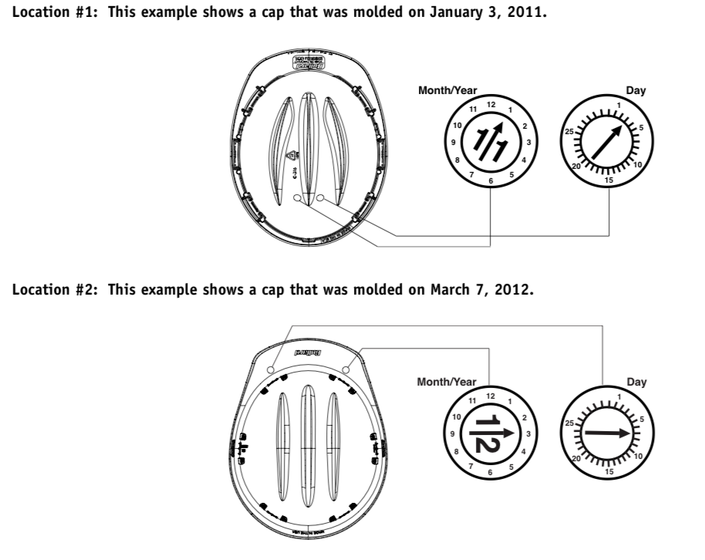
Hard Hat /Helmet
When should you wear it?
How do you know if it is safe?
Can I wear a cap, scarf or liner in cold weather under the helmet?
Can you put decals or spray paint the hard hat?
How long can you use a hard hat?
If a big branch falls on me, I’m going to die anyway, why bother with a hard hat?
ANSI Z89.1
Notes:
#6 Hard Hat Questions
When should you wear it? Any time you are at risk for head injury. I
If you are removing storm debris, you should put it on when you get out of the truck.
You know it is safe if it says Z89.1 on it. Have participants find that on their hats.
Manufacturers specification will tell you what you can wear under the hat. They sometimes recommend specific liners.
Yes, you can use decals, But avoid applying paint to your hard hat. It can damage the plastic.
Find the date on your hard hat. Check the harness and the squeeze the helmet to look for cracks before use.
How long can you use them? Replace after 3-5 years, sunlight makes the plastic brittle over time.
Hand out the hard hats. Ask them to find the Z89.1 and if they would use that hard hat.

Slide 7

This is why you need a hard hat!
Notes:
#Benefits of a Hard Hat
http://www.youtube.com/watch?time_continue=4&v=m_V8GsPdGyc
A small object gathers great force when falling. A hard hat can make the difference between a headache and death.

Slide 8
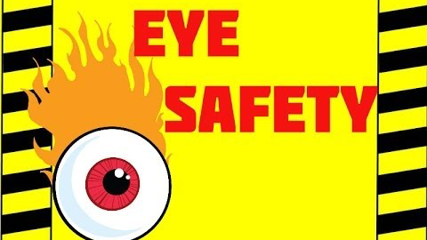
Eye Protection
Notes:
#8 Eye Protection Video
https://www.youtube.com/watch?v=pfAZwGZS-Hk
We are going to watch a little of this excellent video. It makes a good point about the implications of eye injuries. (Stop Video around time stamp 1:05).
Some people have told me that the wood chips of a tree won’t hurt you. But the truth of the mater is that you never know what might be in the tree you’re cutting.

Slide 9
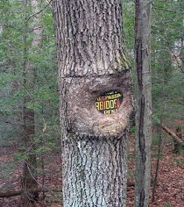
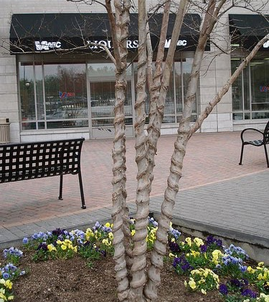
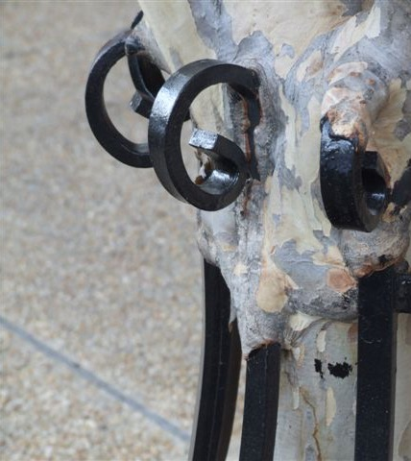
You never know what is inside a tree!
Notes:
#9 Trees Grow Around Irritations
If you have been cutting trees for a while, you have found your share of strange things in trees. People put wires, bullets, conduit, hook and eye latches, barbed wire, pipe flanges, tennis balls, fabric, plastic bags, concrete, and expanding foam, pipes, and rocks in them.
Trees do not expel foreign objects; they grow around them. They can
grow around all sorts of irritations.
This No Trespassing sign is about to disappear. The owners of this tree can’t seem to find their Christmas lights. This decorative fence will be inside this crepe myrtle tree in no time. People hide things in tree crotches and forget about them. Years later, a chainsaw or mill saw that finds these treasures may create flying shrapnel that can injure you.

Slide 10
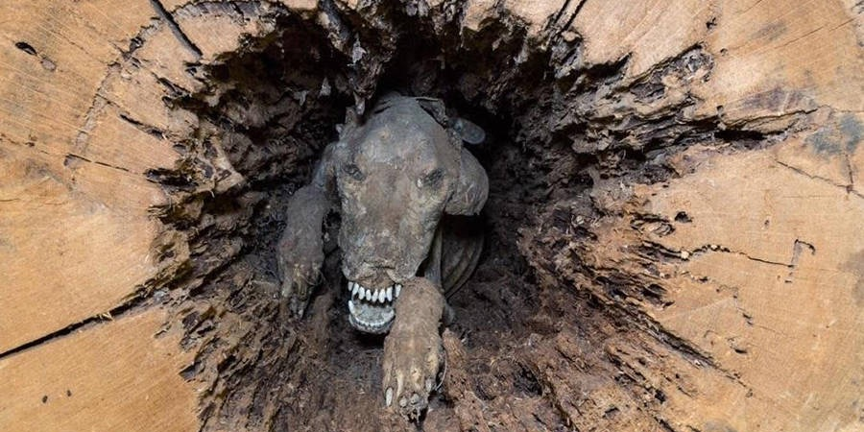
Meet Stuckie
https://allthatsinteresting.com/stuckie-mummy-dog
Notes:
#10 Stuckie
Creatures like trees too, and you’ve probably come across racoons, squirrels, and even a snake or two. However, some finds are just incredible.
Loggers cut off the top of a chestnut oak tree and they found a brown and white hunting dog!
About 60 prior to harvest, the dog ran into a hole at the bottom of a tree and shimmied 28 feet up, probably chasing something. The poor dog was named Stuckie by the people who found him
How was Stuckie so well preserved? Chestnut oaks contain tannin, which is used to tan animal pelts and prevent decay. Tannin is a natural “desiccant,” or material that absorbs moisture and dries out its surroundings.
The low-moisture environment stopped the microbial activity and immortalized poor Stuckie. You can go see “Stuckie” at the Southern Forest World Museum in Waycross, Georgia.

Slide 11
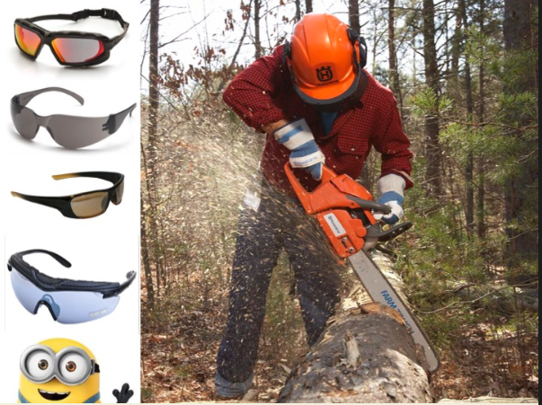
Eye Protection (ANSI Z87.1)
What happened when the tree feller didn’t wear his safety goggles?
He turned a blind eye to saw safety.
Notes:
#11 Safety Glasses
As the chainsaw blade bites into the tree, bark, wood chips, and tiny bits of the metal blade explode into the air. Your face and eyes are nice, soft targets for all this flying debris. While a faceguard with a mesh screen protects your face, it isn’t enough to protect your eyes from injury. Neither are eyeglasses or sunglasses. Flying objects can shatter the lenses of regular eyewear, increasing the chances of eye injury.
Safety glasses or goggles with side protection or wrap-around lenses deflect threats that come at the eyes from both the front and the side. There are safety glasses and goggles that fit over prescription eyewear. Alternatively, you can have safety eye wear made to your vision prescription, even if you wear bifocals.
Whether you wear prescription or off-the-shelf safety glasses, to make sure you can see clearly, select models that:
Resist fogging up
Resist scratches
Offer UV protection to minimize eye damage from UV light, and
Have an ANSI/ISEA impact rating of Z87.1.
Hand out safety glasses and ask them what the ANSI rating is. There should be at least on set of eye glasses that is not stamped with the proper ANSI rating.

Slide 12
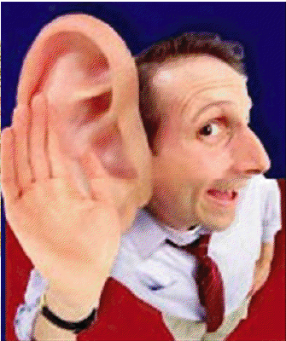
Lack of hearing protection leads to:
Hearing impairment with poor quality of life
Problems in speech recognition
Difficulties on the job
Notes:
#12 Hearing is Important
Your hearing is very important.
Read the slide.
These problems aren’t apparent when you are in your 20s, but as you move to your 50s, they can be significant. How many of you have experienced some hearing loss? What are the signs your hearing is damaged?
(Wait for the audience to respond. Possible answers: ringing in the ears, temporary deafness, get in the car the next day and the radio is too loud).
How loud does something need to be to cause noise induced hearing loss?

Slide 13
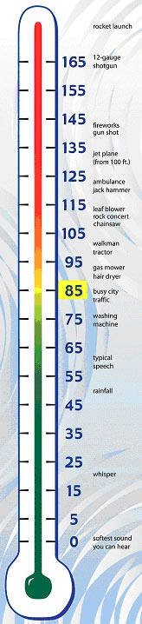
Painful:
150 dB = Rock Concerts at Peak
140 dB = Firearms, Air-Raid Siren, Jet Engine
130 dB = Jackhammer
120 dB = Jet Plane Take-off, Amplified Music at 4-6 ft., Car Stereo, Band Practice
Extremely loud:
110 dB = Machinery, Model Airplanes
100 dB = Snowmobile, Chain saw, Pneumatic Drill
90 dB = Lawnmower, Shop Tools, Truck Traffic, Subway
Very loud:
80 dB = Alarm Clock, Busy Street
70 dB = Vacuum Cleaner
60 dB = Conversation, Dishwasher
Moderate:
50 dB = Moderate Rainfall
40 dB = Quiet room
Faint:
30 dB = Whisper, Quiet Library
Notes:
#13. Noise Measurement
Loudness is only one factor contributing to noise induced hearing loss. Length of exposure and proximity to the noise are also factors. Sound is measured in decibels (dB). When you’re exposed to noise at the 85dB level or above repeatedly or for long periods of time, you’re likely to experience hearing loss.
How many decibels of noise does a chainsaw produce? (refer to the slide: 100 dB for a new one, and old one can be louder).
ANSI Regulations: The employer shall (this means MUST) provide employees protection against the effects of noise exposure when sound levels exceed an 8-hour, time-weighted average of 85 decibels.

Slide 14
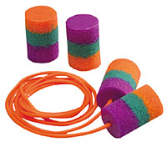
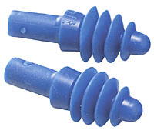
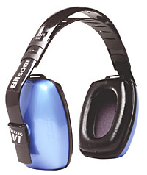
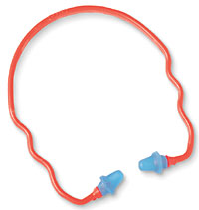

Noise Reduction Rating NRR
Notes:
#14 NRR
Look for the NRR (Noise Reduction Rating) rating on your equipment. The NRR is a single number rating which is required by law to be shown on the label of each hearing protector sold ...
It tells you the noise reduction the devise provides.
An NNR of 25 reduces noise levels by 25 dB.
An NNR of 33 reduces noise levels by 33 dB.

Slide 15
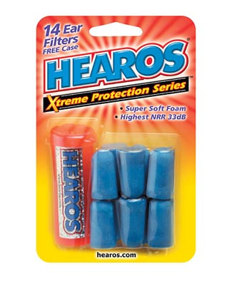

Notes:
#15. What is the NRR?
Use this slide to show them where the NRR is.
Pass out the hearing protection and ask participants to find the NRR. There should be one device that is not labeled. You should tell them not to use that one.

Slide 16
Danger!
+
=
Notes:
#16 Don’t Overprotect
It is important not to block out all the sound. There are some sounds you need to hear.
What do you need to hear? (The tree cracking. Your co-workers.)

Slide 17
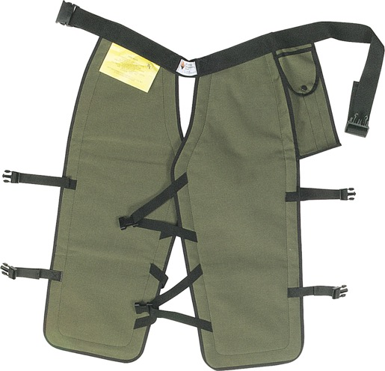
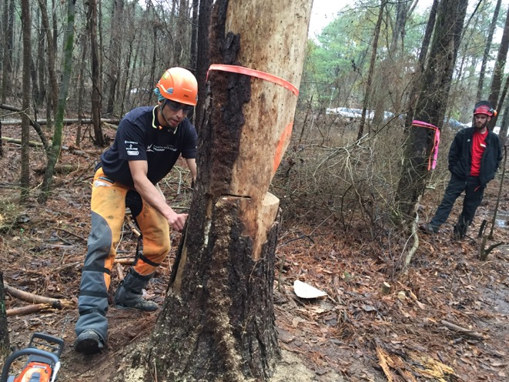
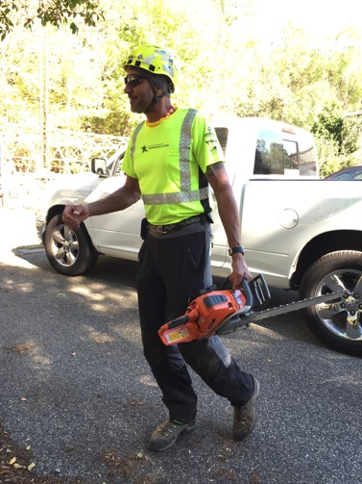
Chaps or Saw Pants
Notes:
# 17 Chaps
Moving on down, let’s look at protection for your body.
The CDC reports, “Each year, approximately 36,000 people are treated in hospital emergency departments for injuries from using chain saws.” Saw cuts are ugly cuts. The most common place for cuts is on your left hand. Do you know why? (One handing the saw and feed brush into it with the left hand). Good technique will protect you from that accident. The second most common area for a saw cut is the left leg. Why? (You get tired and the saw tends to rest there.)
There is only one article of PPE that protects you from cuts. That is your chaps.
Fasten all the buckles on chaps and keep them snug. They should cover the full length of the thigh to two inches below the top of the boot.
If you use a saw daily, it is wise to invest in safety pants. They look good, fit well, and you will be sure to have them on if you need them. They cost a bit more, but the added comfort makes them worth it.

Slide 18
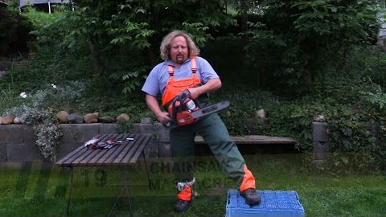
Don’t Try This At Home!
Notes:
#18. Don’t try this at home!
Pavel is going to show us why safety chaps and pants are a good investment.
https://www.youtube.com/watch?v=r5VSivQe760
Read and understand the manufacturer’s care and use instructions. Chaps and pants must be washed. They aren’t effective dirty. Some are machine washable in cold water, but they don’t like the dryer or chlorine bleach. Read the care guidelines and follow them.
If you cut your saw chaps/pants, you must replace them. One cut, you chuck!
Always keep your chaps/pants on when using your saw. They are worthless in the truck.

Slide 19
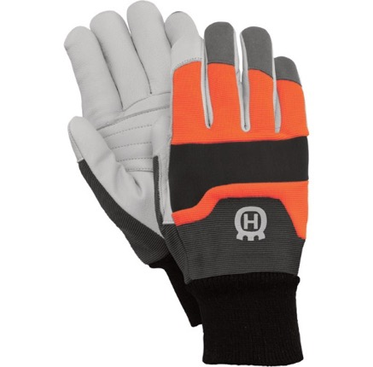
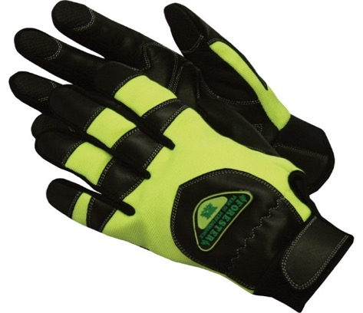
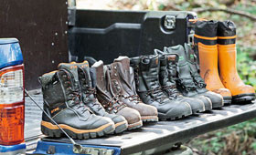
Gloves and Boots
Notes:
#19 Gloves and Boots
What are some characteristics of a good pair of gloves?
Gel padding in the palms to drastically reduce vibration.
Lined with cut-resistant DuPont Kevlar fiber to prevent minor cuts. They should be rated at Level 3 for cut resistance. (ANSI/ISEA 105-2005 Standard.
Snug fit. Get the right size to fit your hands.
Non-slip with breathable Spandex with goatskin or other materials that provide good control for your fingers and palms. Make sure the top of the glove is well made.
Wrist closure with Velcro keeps debris out and doesn’t get caught in things like
chippers, saw tips, or sticks.
Machine washable if possible.
What are characteristics of a good boot?
Correctly fitted to the size of your foot.
Lined with DuPont Kevlar for chain cut resistance .
High abrasion resistance.
Steel shank for support.
Moisture repellent upper.
Pillow cushion inserts.
Steel, titanium or plastic toed boots. Titanium and plastic toed boots reduce the overall weight of the boot.

Slide 20
If you are near traffic or hunters
Notes:
#20 Vests
A high visibility safety vest is always good near traffic or when out in the woods.
Show them the demonstration vests and note the pull apart vest could be good when working around chippers.

Slide 21
Watch Out For Bites and Stings
Chiggers
Ticks
Mosquitoes
Fire Ants
Notes:
#21. Insect Pests
These pests are always out there, but they may be in places you don’t expect to see them after flooding.

Slide 22
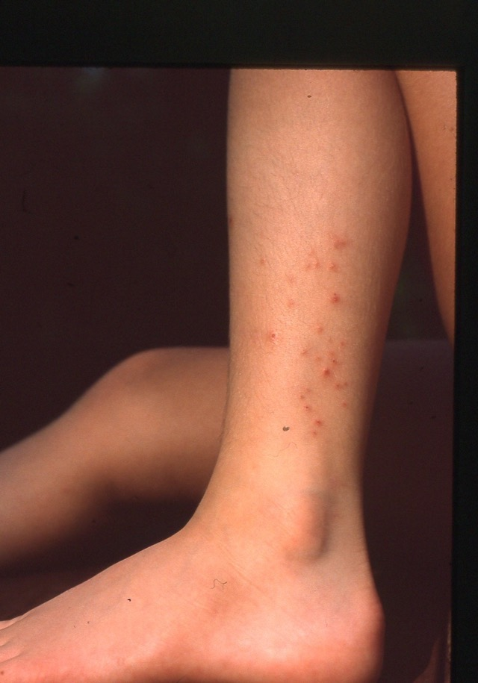
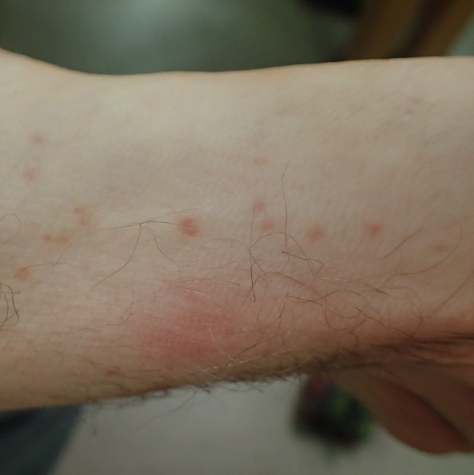
Chiggers
Notes:
#22 Chiggers
Chiggers (red bugs) are baby mites. They normally feed on snakes and lizards; they cannot survive on humans. Unfortunately, their salivary secretions cause severe reactions by the human immune system, leaving us itching for a week afterward. (Meanwhile, the chigger has died within hours of attaching to us.) Contrary to folklore, chiggers do not burrow into human skin. By the time itching starts, the larval mite has died and fallen off, so treatment from this point on is treating the symptoms. (Once the chigger has injected its salivary secretions, there’s nothing we can do but itch!)

Slide 23
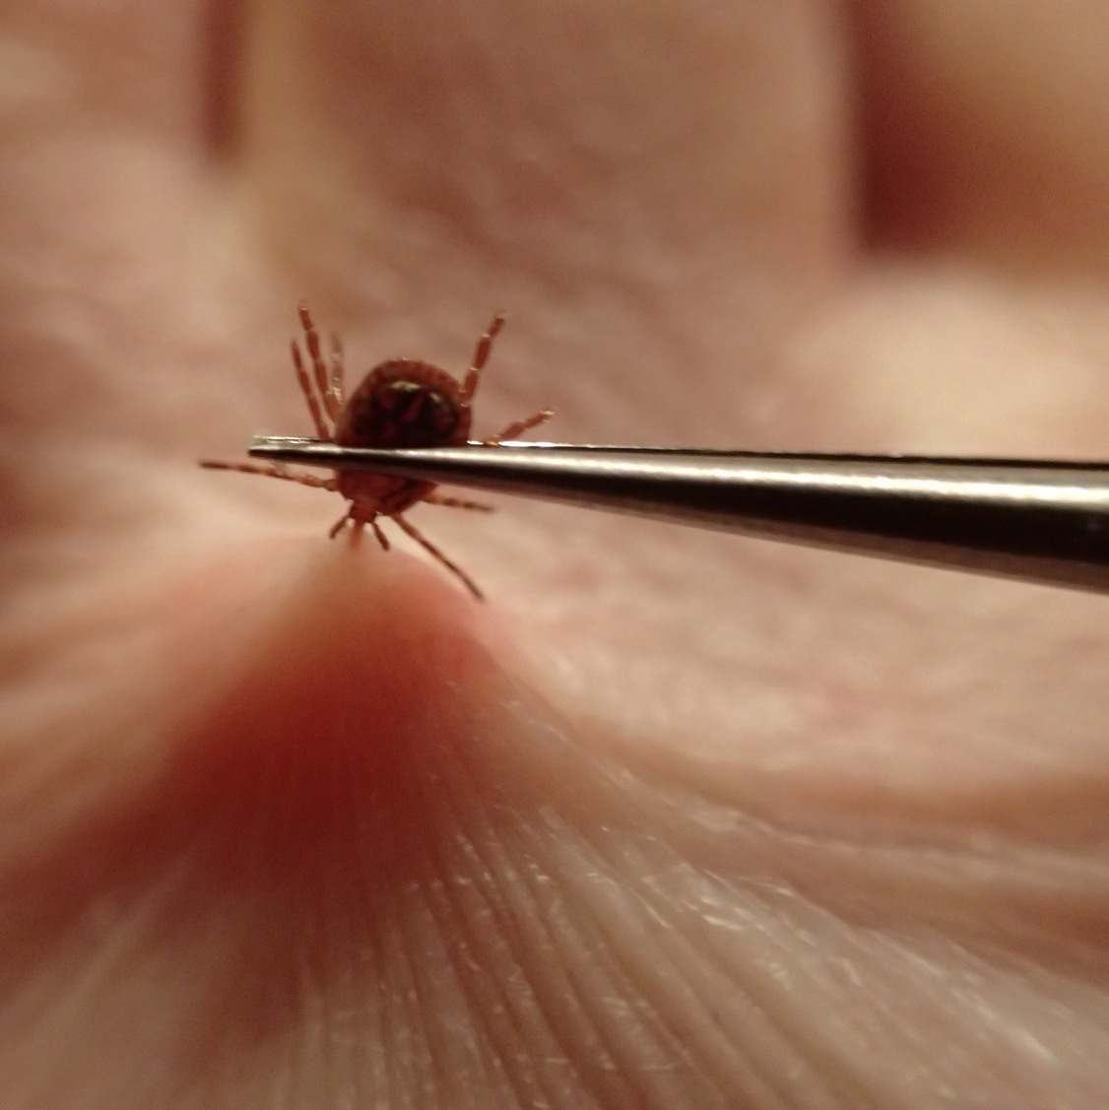
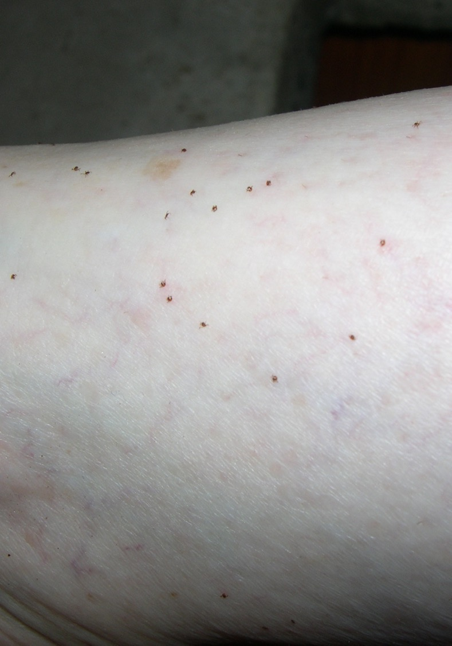
Notes:
#23 Ticks
Adult Tick (Left) and Seed ticks (right).
Remove ticks by grasping them with tweezers and pulling straight out. No need for any of those other tick removal gimmicks. Use tweezers to help insure removal.
Be aware of the symptoms of tick borne illness. Center for Disease Control and Prevention (CDC) reported an increase in the number of annual reports of tick-borne bacterial and protozoan diseases. There were less than 22,000 in 2004. In 2016 there were over 48,000. Lyme disease accounted for 82% of all tick-borne disease reported. Scarier yet, the CDC suspects that the number of cases was substantially underreported.
The CDC says the most common symptoms of tick-related illnesses are:
Fever/chills
Aches and pains
Rash
Other symptoms
Go see you’re your doctor promptly if you experience these symptoms.

Slide 24
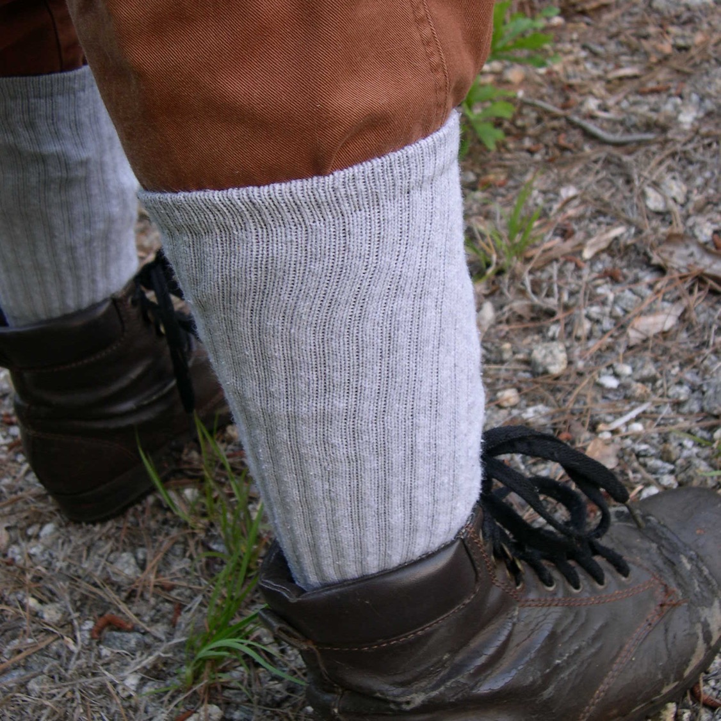
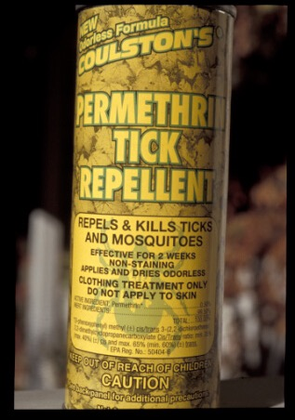
Notes:
#24 Permethrin
Products containing Permethrin (often sold under the trade name Permanone® ) can help keep chiggers and ticks off you. Spray your pants legs and socks with products containing permethrin.

Slide 25
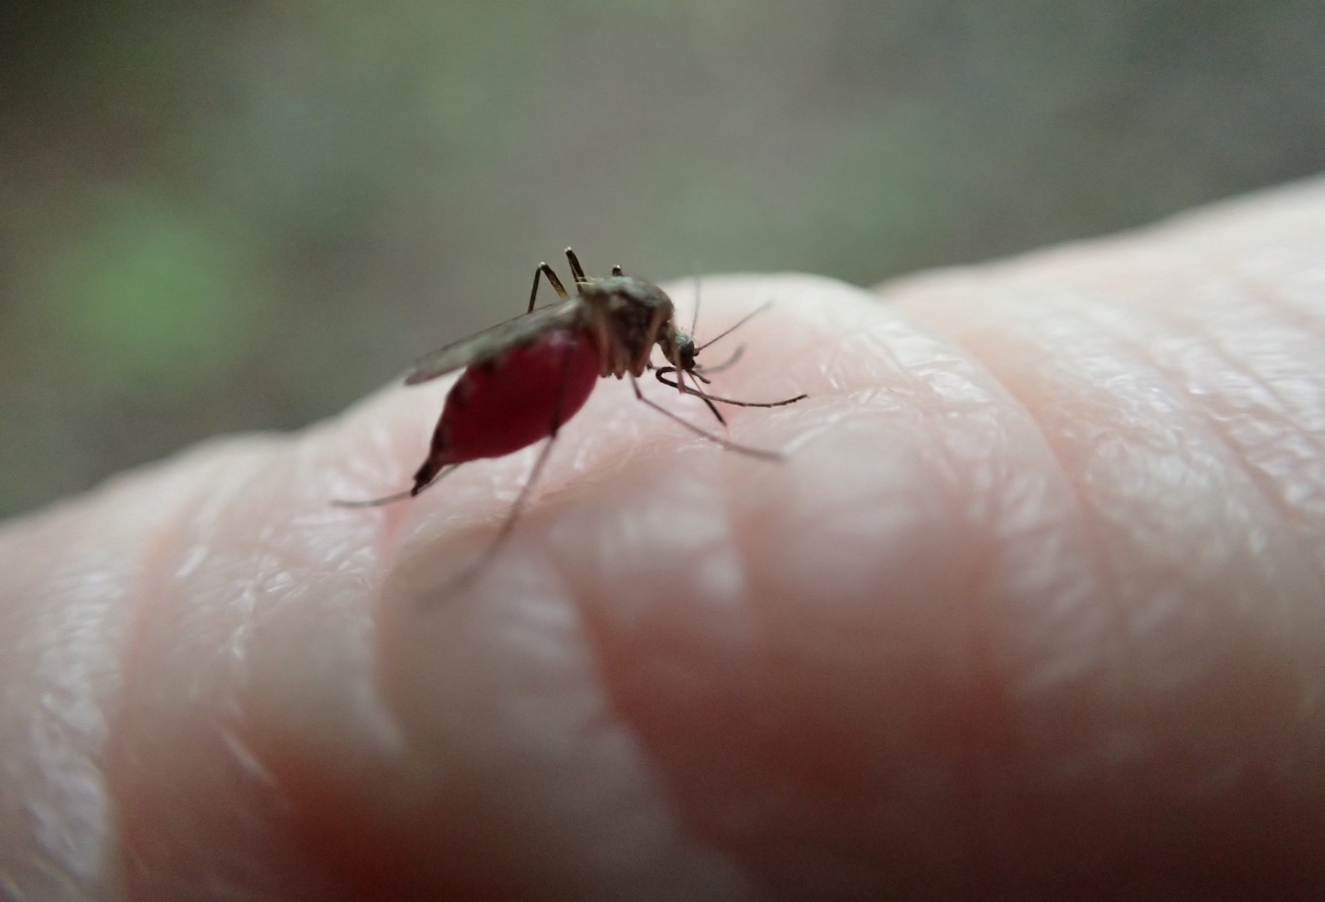
Notes:
#25 Mosquitoes
Female mosquitoes feed on blood and can transmit diseases. . There may be more mosquitoes after heavy rains and flooding because there is more standing water in which they can breed. DEET containing products are effective repellants.
Permethrin works too.
DEET can go your skin, Permethrin goes on your clothes.

Slide 26
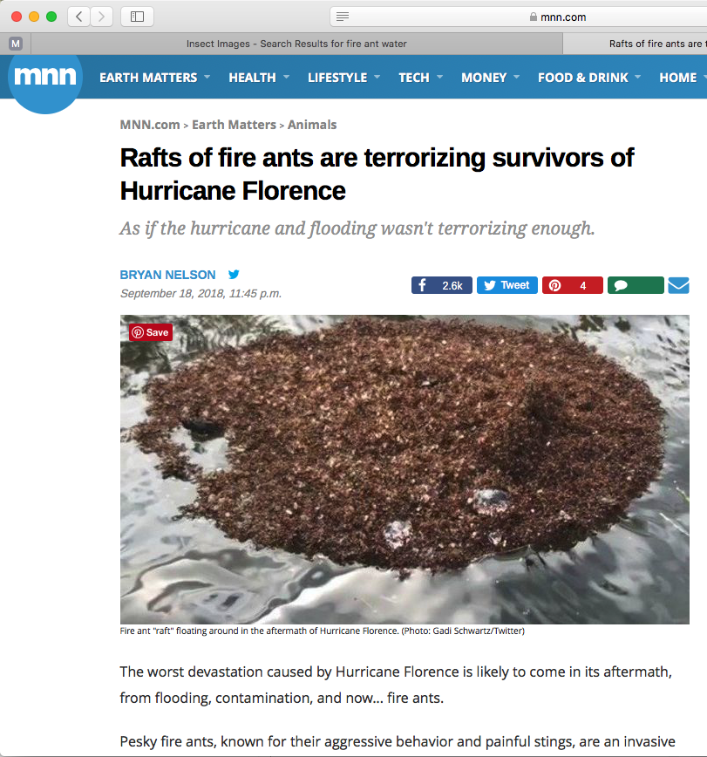
Notes:
#26 Fire Ants
Fire ants, known for their aggressive behavior and painful stings, are an invasive species in the Carolinas, and they are known for being rugged survivors. In fact, they are especially adept at surviving floods, capable of banding together to create "rafts" that float until the waters recede and they can rebuild their colony.
The raft exterior is largely composed of workers, who protect the core of the ant colony on the interior: eggs, larvae, and the queen.

Slide 27
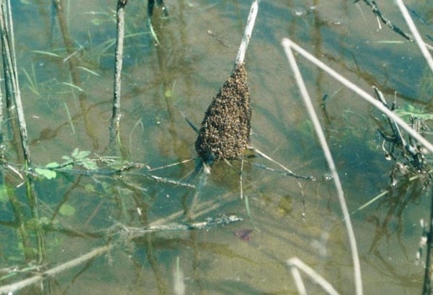
Brian Lockhart, USDA Forest Service, Bugwood.org
Notes:
As soon as the raft touches something solid, which might be a boat or a person's skin, the ants will immediately latch on.
If they latch on to you, rub them off immediately. Don’t try to submerge them, they will just cling to the skin.
Ant rafts tend to look like regular debris when they are floating in the water. It isn't until you get right up to one that you can see that the cluster is alive.
Be wary of fire ant colonies after the waters recede, as fire ants tend to build their colony back up wherever their rafts land. There could be new colonies in unsuspected areas, including playgrounds, backyards, or parks.

Slide 28
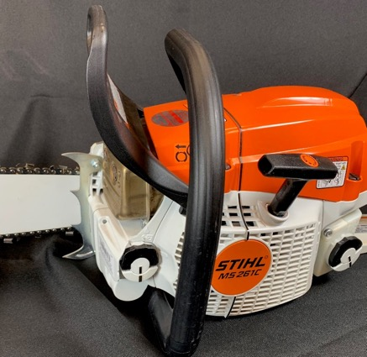
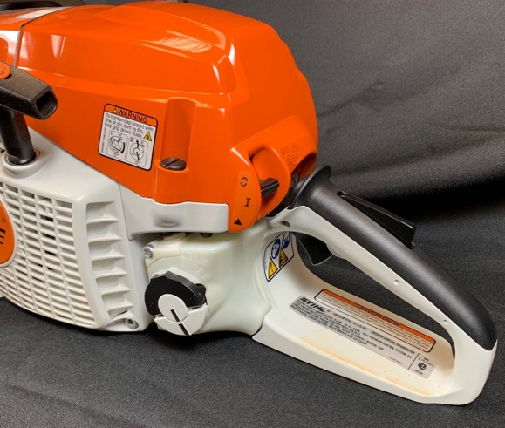

Inspect Your Equipment
Chain Brake
Five Essential Safety Features:
Chain Brake
Throttle Lock
Chain Catcher
Right-hand Guard
Stop Switch
Throttle Lock
Stop Switch
Chain Catcher
Right Hand Guard
Notes:
#28 Five Essential Safety Features
Before you use a saw, look for these five essential safety features.
KICKBACK GUARD AND CHAIN BRAKE: The chain brake stops the rotation of the chain. The chain brake is designed to be activated in two ways.
If your left wrist forces the kickback guard forwards, the chain brake will activate. Following kickback the chain brake will trigger from the inertial forces generated.
If you take two steps during cutting, push the chain brake forward with the back of your hand to engage the chain brake. If you set the saw down, engage the chain brake.
THROTTLE LOCK: The throttle lock is designed to prevent accidental throttle advance. The throttle will only work if the lock is pressed in, i.e. if you hold the saw’s rear handle with a firm grip while accelerating.
CHAIN CATCHER: The chain catcher is designed to catch the chain if the chain should break or derail. Easy to overlook because it is on the bottom of the saw. They break off but can easily be replaced at the saw shop.
RIGHT-HAND GUARD: The right-hand guard is designed to protect the user’s hand if the chain should break or derail.
EASY ACCESSIBLE STOP CONTROL: The stop control must be placed where it is easy to access on the saw so that the engine can be stopped quickly in a critical situation.
If any of these safety features are broken, don’t use the saw. Better yet, take the blade off so that nobody else uses it and turn it in to maintenance.

Slide 29
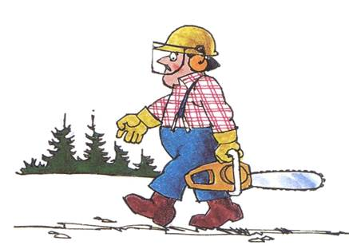
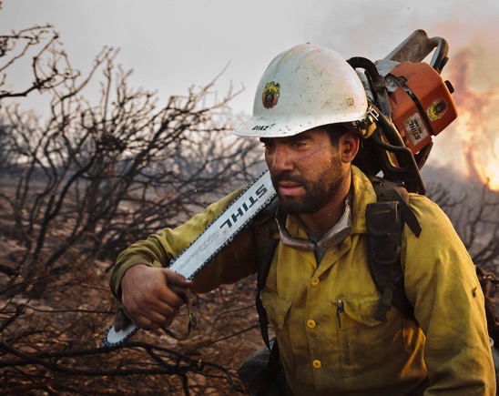
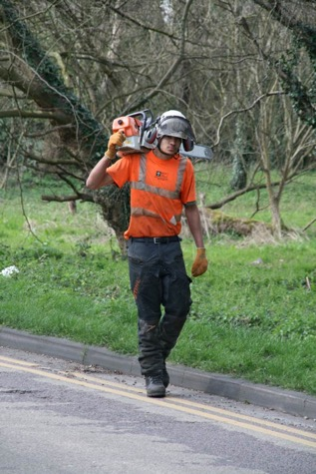
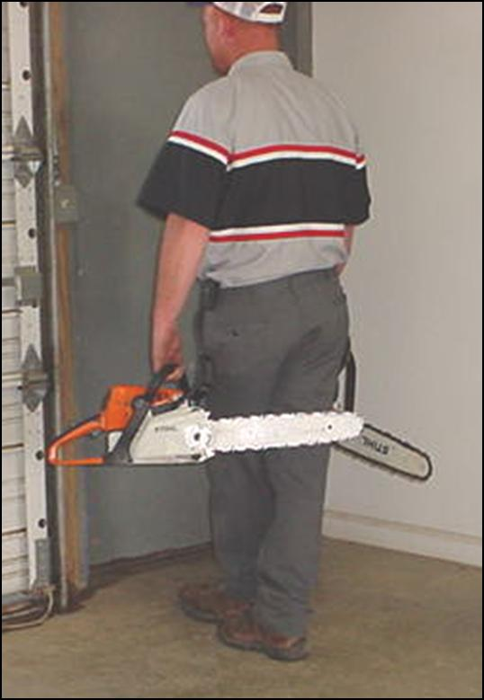

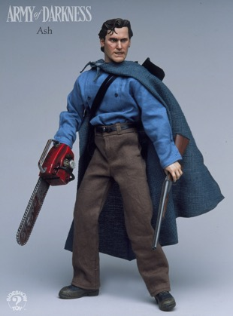
Good!!!
Bad, bad, dangerous, ouch, just imagine if these guys trip!
Notes:
#29 Safe Carry
There are lots of ways to carry a saw, but there is only one safe way. Always carry the chainsaw with the bar pointed behind you. If the saw has been running it is important to make sure the muffler side is away from the body. Always shut the chainsaw off before carrying it any sort of distance.

Slide 30
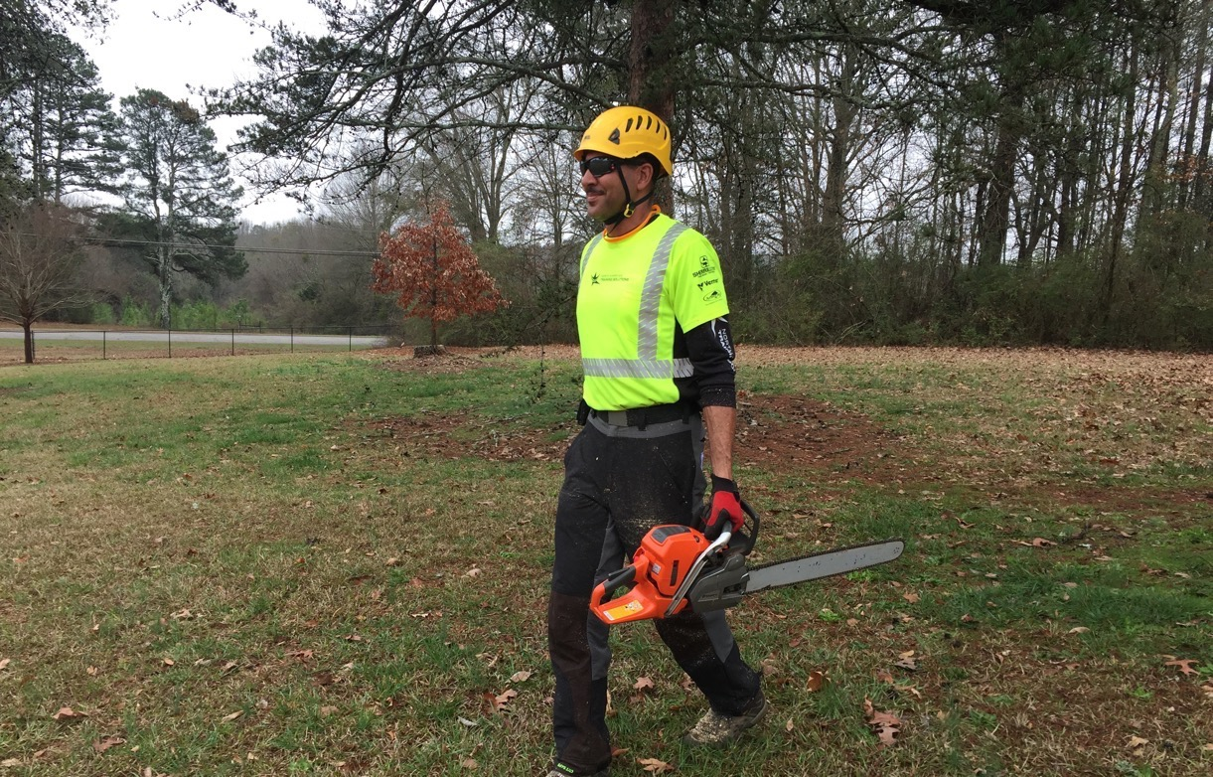
Notes:
#30 Example
This is an example of safe carrying technique: Saw powered off, bar behind.

Slide 31
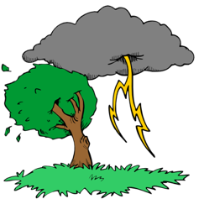
Electricity:
Before You Cut Anything
Make a thorough inspection.
Line clearance shall not be performed during adverse weather conditions, such as thunderstorms, high winds, and snow and ice storm. (ANZI Z133).
Treat all downed lines as energized.
Fences, gutters, anything conductive can be ”hot.”
Notes:
#31 Electricity
Tree work hazards increase significantly during or after a storm. Many of the tools that we rely on to help protect us from electrical hazards such as pole pruners, saws, and aerial lifts lose their capacity to insulate when wet. The trees we work in are also much more conductive when they are wet. Strong winds can push treetops into contact with conductors and make controlling cut limbs and tops extremely difficult even with rigging. Tree workers must exercise extreme caution and judgment in these situations and, when warranted, delay the work until the weather improves.
Line clearance is pruning, trimming, repairing, maintaining, removing, or clearing of trees or the cutting of brush that is near (within 10 feet of) energized power lines.
Since even a street lamp circuit or phone line can be energized with enough voltage to kill, almost all arborists in the field have at least some exposure to this hazard. In fact, workers don’t even have to touch a wire to be electrocuted – about half of all electrocution fatalities are the result of indirect contact.
Keep in mind that electricity from a downed line away from you may reach the worksite through other conductors such as chain link fences, metal curbing, or even “harmless” phone or cable lines.
Even the ground under your feet can even conduct electricity, given the right soil conditions and voltage.

Slide 32
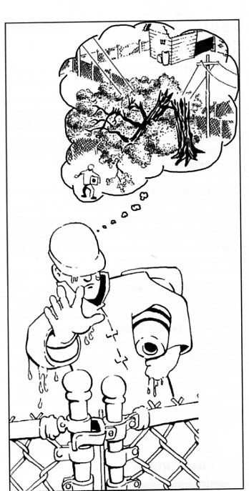
Do Not approach or touch any downed lines, (power, communication, cable, or otherwise) until the utility company has cleared it as de-energized or dead.
Notes:
#32 Electricity Warning
Read the slide. Restate the slide.

Slide 33
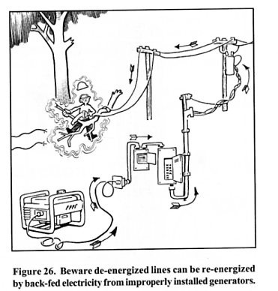
Generator Feedback
Notes:
#33 Generator Danger
In addition, homeowners using incorrectly set-up generators can cause “back feed” into their house drop, which in turn is “pumped up” in volume by transformers, reenergizing lines the tree crew may have “known” to be dead.
If you hear a generator operating or notice lights on at one residence in an otherwise blacked out area, consider all conductors to be energized.
Once again, do not begin working until the utility company has cleared all downed lines as dead.

Slide 34
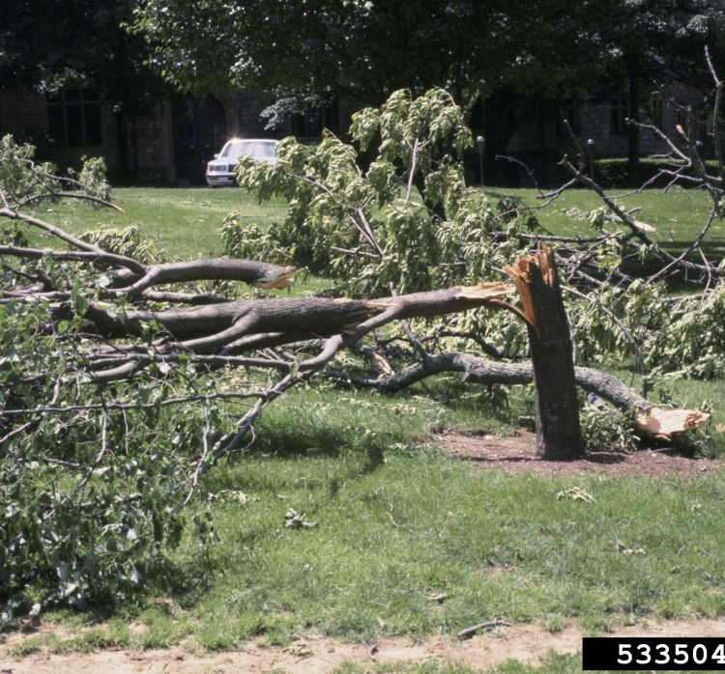
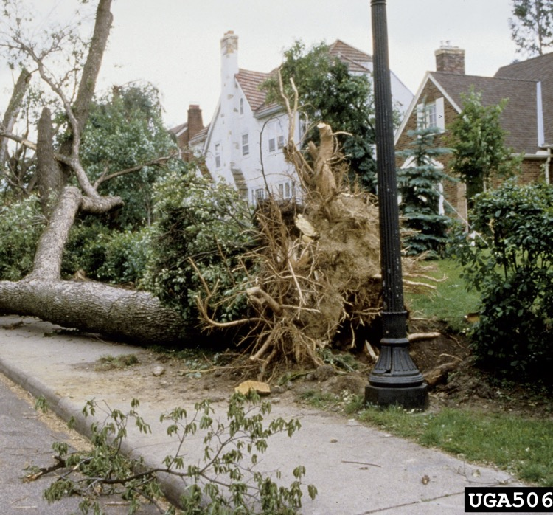
Tripping Hazards
Joseph O’Brien, USDA Forest Service, Bugwood.org
Mary Ann Hansend, VPI & State University, Bugwood.org
Notes:
#34 Remove Tripping Hazards
Clear out small debris before you begin. This will help you get a better look at things and reduce tripping hazards.

Slide 35
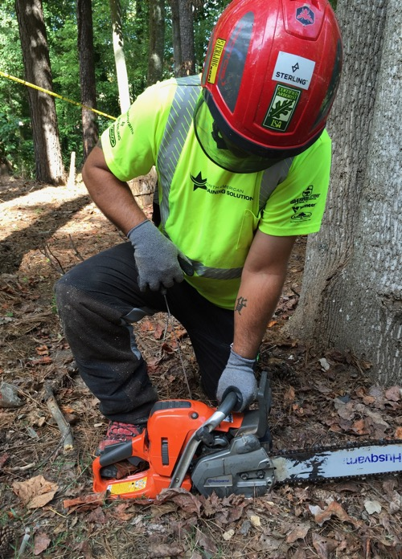
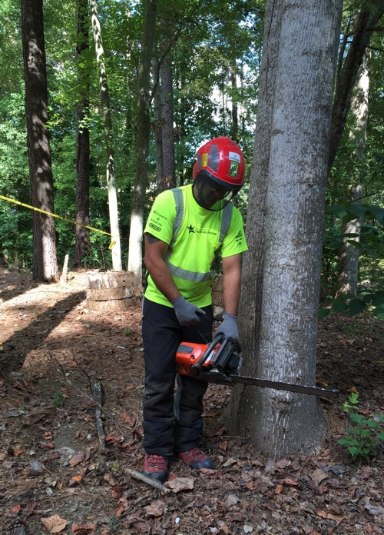
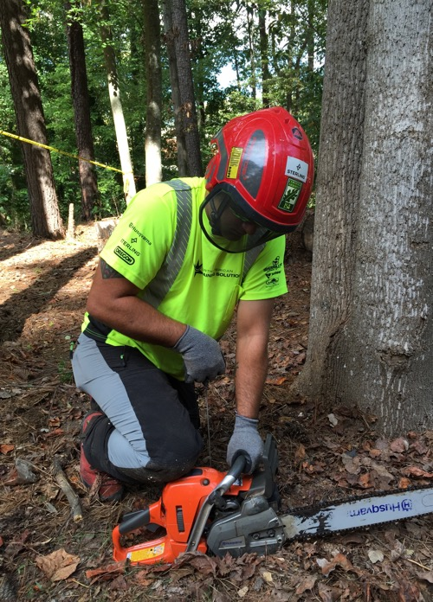
Safe Start
Notes:
#35 Safe Start
Drop-starting a chainsaw is prohibited.
Prior to starting make sure to check controls, chain tension, bolts and handles. Be sure the chain is sharp and the bar oil tank is full. Be sure you are starting the chain in an area at least 10’ away from fueling. Engage the chain brake and place the saw on flat ground or another firm surface, place your RIGHT boot toe in the handle or knee on top to stabilize before pulling the cord. The LEFT hand should be firmly around the handle with the elbow locked. When starting on the ground make sure the bar is not in contact with the ground or any objects. If ground starting is not possible due to debris or other obstructions, then a standing or pinch start can be done. Standing on firm ground with rear handle between the legs the LEFT hand around the front handle with the elbow in a locked position.

Slide 36
Don’t tell them, show them!
Set an example
Allow no exceptions
Don’t look the other way
Spend the money
Training – show proper fit and care
Give them a good reason – family
Notes:
#36 Leadership is Important
Read this slide and tell them a personal experience you have with this.

Slide 37
Final Comments:
It is unwise to cut trees or wood alone. At least let someone know where you will be cutting and an estimated time of return.
Look for and take advantage of training opportunities.
Notes:
#37 Final Comments
Read this slide.
Tell them about the trainings that will be held with North American Training Solutions. It will last a full day. Include classroom and practical demonstration. They will simulate a storm thrown tree and clean it up for you. Your agent will let you know when this is scheduled.
Finally, I have an evaluation for you to fill out. Please write comments and give feedback. This information will be collected by OSHA. The happier they are, the more trainings they will fund. That is good for everyone.
Any Questions?

Slide 38

Questions?

