Slide 1
Important Notes for Agents Using Tree Cleanup and Chainsaw Safety Materials
Dr. Ellen Bauske
678-825-7900

Slide 2
OSHA’S Objective:
The emphasis for hurricane disaster relief funding.
Dissemination of safety and health educational information and/or conducting training for workers and/or multiple employers addressing the occupational safety and health hazards associated with the clean-up efforts.

Slide 3
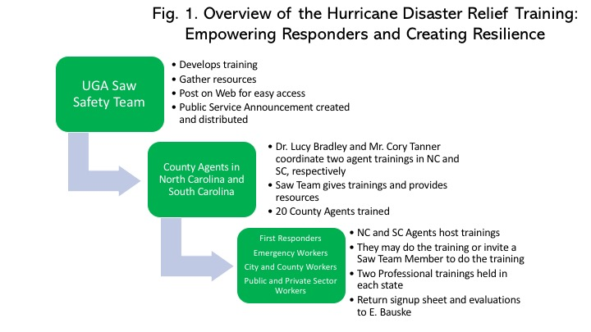

Slide 4
How this works:
All the resources you need are here: www.ugaurbanag.com/disaster
OSHA is very strict, and the PowerPoint and script must be adhered to (you can add, but not subtract material).
Put your logos on the material – but leave any OSHA disclaimers.
Use the Sign In Sheets and Evaluations provided.
Use the online CEU sheet for ISA Certified Arborists.

Slide 5
How this works (continued):
All agents receiving the training must hold a training by March 15, 2019 for a minimum of 20 people.
We can help you with online registration (contact Bauske)
Target the training to the tree care industry, city, and county government. We welcome private individuals who use chainsaws as well.
Original evaluations and sign in sheets must be returned to Ellen Bauske the day after the training is completed. She will make sure you have access to statewide results as well as your results.

Slide 6
How this works (continued):
We will pay for travel to this training and other expenses associated with the trainings you hold. Travel forms are on the web site. Contact Bauske about other expenses.
If you would prefer, you can host the training for a UGA Saw Team Member and s/he will give the training or co-train with you.
We will hold two demonstrations in your state in which professional trainers will simulate storm damage and clean it up. You can suggest attendees attend those trainings to get answer to saw use questions. Details coming.

Slide 7
OSHA Inspection- They may attend your training!
Keep that OSHA disclaimer.
Stick to the script.
Make it last 1 hour.
Let the participants handle the equipment.
They will ask for copies of your sign in sheets and evaluations.

Slide 8
How to Hold a Training:
Get a room, time, and date. You need speakers for the videos.
Send info to Bauske.
Advertise.
Borrow a Chainsaw – commercial is better (ask the city or county).
Get some ringers.
Download and use:
PowerPoint, Script, Sign In Sheets, Evaluations.
Do the training.
Send Sign In sheet and evaluations to Bauske.
Wait for very cool prize…
You will get all results of all trainings (including yours).

Slide 9
I need:
Your training schedule in advance
Agenda
Sign In Sheet
Evaluations
I have to keep the record for 7 years for OSHA!

Slide 10
Questions?

