Slide 1
How to Run the Journeyman Farmer Hands-On Program
Developing the Next Generation of Sustainable Farmers in Georgia
In partnership with:

Slide 2
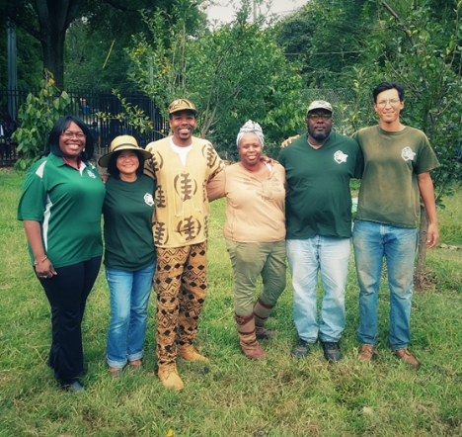
This session is meant to help YOU learn how to organize and run the Hands-On Program
I will explain what you need to know before, during, and after your program runs

Slide 3
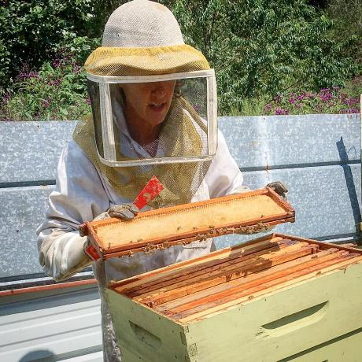
Before Your Hands-On Program Runs
Learn what Hands-On program involves
Review resources and tweak to meet your needs
Decide how to choose applicants
Look for farm sites/mentors
Keep sustainable ag program assistant in the loop

Slide 4
Required Components of Hands-On Program
Offer Steps 1 and 2
Internship
Good for those with little experience
Recommend: 120 hours
10 hours/week for 12 weeks for Small Fruit and Vegetable Training
120 hours for Small Ruminant Training
Mentorship
Meant for more experienced participants with land
Farmer available for questions/site visits
Knowledge matrix
Recommend: before and after
Can customize it based on participants
Notes:
Ideally, 120 hours is effective number of hours. Can be up to them for hours. Need to cover certain topics. Can’t be one-day thing.

Slide 5
Resources
Required: Knowledge matrix
Recommend: Hands-On Handbook
Agreement forms for farmer and participant
Responsibilities and expectations
Grievance policy
Removal from program
Knowledge matrix
Create handout and application for participants
Before you start Journeyman program
Give them specific info about your Hands-On program (locations, stipends, hours, application procedure, etc)

Slide 6
Application Criteria
Decide NOW how you will choose applicants
Need to communicate this with participants
Example criteria: knowledge evaluation scores, attendance, application, completing Steps 1 and 2
Recommend: In person interviews/phone calls

Slide 7
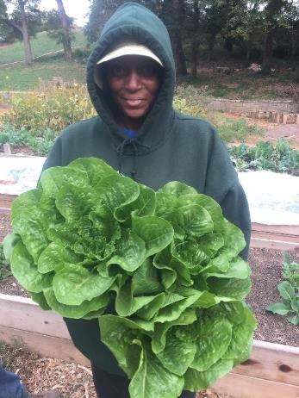
Look for Farm Sites/Mentors
Look for established farmers nearby
Visit sites
Farmers should be able to teach and answer questions
Recommend: Up to date liability insurance

Slide 8
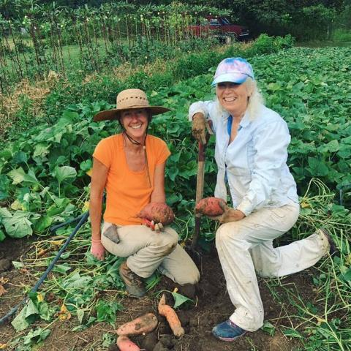
During Your Hands-On Program
Check in
Example: Time sheets signed (especially if giving stipends)
Weekly email update (hours, learned)
Administer stipends (if you are offering them)
Address any issues that come up
Knowledge matrix
Recommend before and after

Slide 9
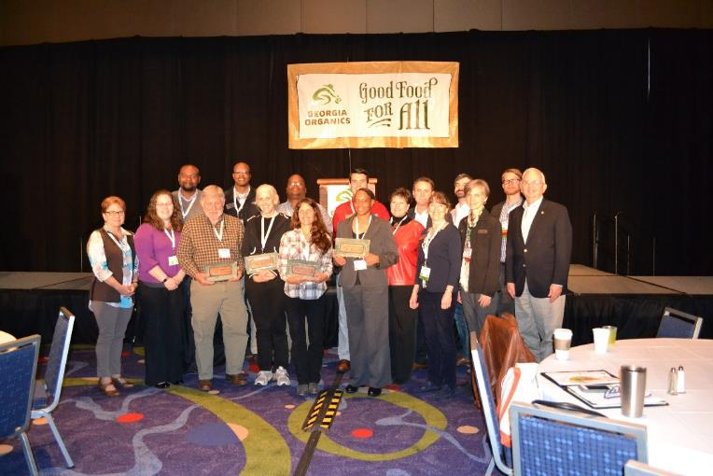
At End of Hands-On Program
Other evaluations/feedback
Graduation party/acknowledgement
Newspaper article

Slide 10
Recommendations
Select a few participants
Communicate well with farmers and participants
Check in often
Make sure you have time to commit to running this program

