Slide 1
Small Farm Business Planning

Slide 2
Session 4 Selling Your Product
Matthew Kulinski, Marketing Division
Georgia Dept of Agriculture

Slide 3
Learning Objectives
Name two avenues to sell your product. Describe the pros and cons of both.
Name a technology that can help sell your product.

Slide 4
The 4 Ps of your Marketing Mix
Marketing Mix
Product
Price
Placement
Promotion

Slide 5
Determining Your Best Product
Refer back to SWOT analysis
What is your land best suited for?
What do you know how to grow?
How do you plan on selling your product?
What is in demand in your market?

Slide 6
What is your land best suited for?
Is it Rural?
Or Urban?

Slide 7
What is your land best suited for?
Is it a large piece of land?
Does it have access to water?
What is the soil type?
All these questions will get you closer to determining the products that are available to you.
To start answering these questions contact you local extension agent: http://extension.uga.edu/

Slide 8
What do you know how to grow?
Think about the products you have the most experience growing.
How much time do you have dedicated to growing your product?
Is there a season that provides you with more time than others?

Slide 9
Is Your Product Unique?

Slide 10
Developing a Product for your Market
Farmers Markets
Need a variety of products or items that taste good and catch the eye. Easy to prepare
Peaches, apples, watermelons berries. A variety of easy to prepare vegetables. Honey.
CSA
Large variety of products that consumers could use throughout the week and season. May need to balance the normal with one unique item
Leafy greens, Variety of fruits and vegetables
On Farm Retail
Variety of standard products, maybe with good name recognition
Peaches, berries, apples, Vidalia onions, tomatoes
Restaurant
Large Retail/Institutional
Restaurants want unique items that will wow their patrons.
Unique colored vegetables, “baby "sized items and micro greens, keep it new and different
Looking for items not typically grown in this region and/or outside normal growing seasons and in large quantities
Strawberries, Asparagus, carrots, multi-colored peppers

Slide 11
Placement
Placement is in regards to distribution, location and methods of getting the product to the customer. This includes the location of your business, shop front, distributors, logistics and the potential use of the internet to sell products directly to consumers.
Placement and display tips:
Clear signs with variety and price
Pile high to give appearance of plenty
Attractive and clean containers

Slide 12
Farmers Market
Characteristics:
Markets operate roughly 4 hours once a week
Various locations to choose from throughout the week
Rules vary by market, some market charge vendor fees
May be waiting list for popular markets
More variety the better
Pros:
Easy level of entry. Low overhead.
Can sell at high price point
Sell your current product mix
Cons:
Sales can be unpredictable
May waste time sitting at slow markets
May not be able to sell all your product
Need to grow many different crops and varieties (low efficiency)

Slide 13
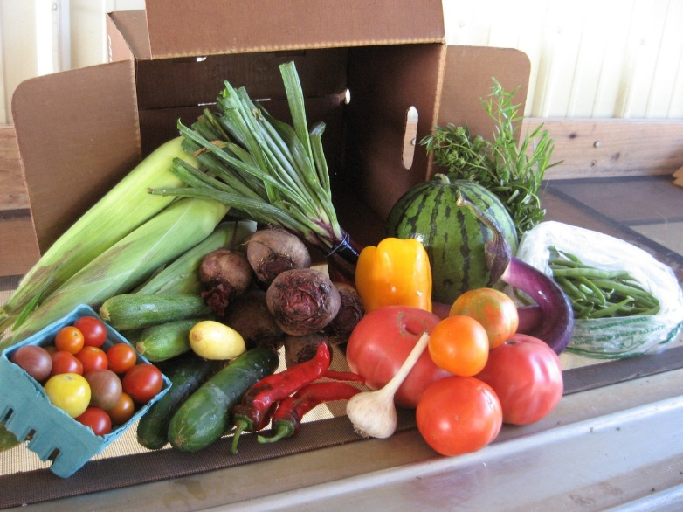
CSA (Community Supported Agriculture)
Characteristics:
Your send a portion of your farm’s produce or product to “members” of the CSA on a regular interval
Requires a lot of coordination and a variety of products.
Pros:
Funding for your farm can come upfront as you sell memberships
Predictable and high value sales
Risk is better managed through your members
Cons:
You have to heavily market your CSA to potential members
There is a lot of coordination and organization (delivery, sales, boxing)
May not be able to sell all your produce if you don’t have enough members
May be difficult for new growers to supply what they promise (bad reputation)

Slide 14
Farm Stand
Characteristics:
You set up an on farm store or pick your own at the farm.
Farm must have good visible location
You have to advertise your location
Pros:
Easy level of entry. Convenient.
Can sell at high price point
Sell your current product mix
Cons:
Sales can be unpredictable
Must do your own marketing
May run into local government regulatory issues with business licenses and zoning.

Slide 15
Restaurants
Characteristics:
You sell agricultural products directly to restaurants.
Typically, you send an email out to a number of different restaurants letting them know what you have available and they tell you what they want. You provide delivery.
Variety and uniqueness of product is key
Pros:
Easy level of entry. Low overhead.
Can sell at moderate to high price
If you build good relationships you can have consistent sales
Cons:
Sales can be competitive with other farms
Chef’s taste can be fickle and you may have to try several types of products.
May not be able to sell all your product

Slide 16
Retail
Characteristics:
You sell your products through a distributor to a retail outlet
May have to coordinate distribution
Will need a large scale production
Will have to have 3rd party food safety audits
Pros:
Little need to market or sell your product
Can spend most of your time growing your products
Consistent sales at predictable prices
Cons:
Very low margins – must sell a lot to make a profit.
Will have to spend money of 3rd party certifications

Slide 17
Schools/Institutional
Characteristics:
You sell your product through a distributor to a school or institution
Won’t need as large of production as retail
Will require 3rd party certification or audits
Pros:
Little need to market or sell your product
Can spend most of your time growing your products
Consistent sales at predictable prices
Cons:
Very low margins – must sell a lot to make a profit.
Will have to spend money of 3rd party certifications

Slide 18
Online Farmers Markets E-Commerce
Characteristics:
Join an online farmers market community
Consumers order products that they want online from a variety of producers
You are notified of purchased products, and you deliver to drop off point
Customers pick up products at predesignated time/place.
Pros:
Lower level of time commitment for sales than traditional farmers markets
Low startup costs to start selling products
Less marketing is necessary.
Cons:
Relatively new form of sale, issues may not have been ironed out.
May be difficult finding online community in your area.
Coordination can be tricky with receiving purchase information and making deliveries to drop off point.

Slide 19
Price
Price concerns the amount of money that customers must pay in order to purchase your products. There are a number of considerations in relation to price including price setting, discounting, credit and cash purchases as well as credit collection.

Slide 20
How to Find Prices
USDA Market News Reports:
http://www.ams.usda.gov/AMSv1.0/marketnews
USDA ERS Custom Average Tool
Livestock Sales Prices:
http://www.cattle.com/markets/states.aspx?state=Georgia
Visit nearby markets and view competitor websites
Determine the cost of your inputs and the time, energy, and labor costs to grow and sell the product.

Slide 21
Scale Is Important When Determining Price
Farmers Markets
CSA
Small Restaurants
Cottage Foods
$ Profit
Wholesale Distribution
Retail Stores
Schools
Volume (Yield)
$0

Slide 22
Promotion
Promotion refers to the act of communicating the benefits and value of your product to consumers. It then involves persuading general consumers to become customers of your business using methods such as advertising, direct marketing, personal selling and sales promotion.

Slide 23
What is Georgia Grown?
Georgia Grown is a marketing, community and economic development platform designed to grow local economies throughout our state.
Georgia Grown Goals: “We Help Georgia Grow”
Economic Development
Marketing, Education & Outreach
Nutrition & Wellness
Environmental
Culture & Lifestyle

Slide 24
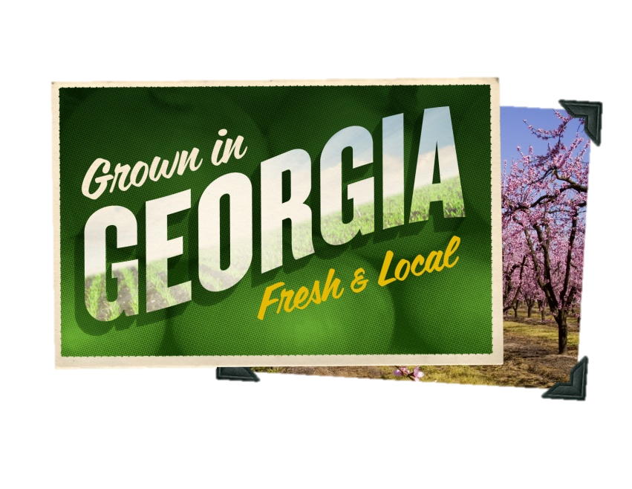
Who is Georgia Grown for?
Entities involved in Georgia agriculture or that use Georgia agri-products in its offering.
For Example:
Fruit, vegetable, and nut growers that sell to the public and other businesses
Artisanal food businesses i.e. honey, jam, cheese and wine growers/manufacturers
Restaurants, Retailers and local suppliers
Agri-tourism operations
Ag equipment and supplies dealers

Slide 25
How does Georgia Grown work?
Free Website Listing
Interested agricultural producers can sign up for a free listing on the Georgia Grown website at www.GeorgiaGrown.com
Being listed on our highly searchable statewide directory designed to connect your company with buyers and consumers
Connected to all the sales events and educational opportunities that Georgia Grown Sponsors throughout the year.
Silver Membership – $100 Annually
Allows use of the logo on your packaging and marketing materials
Access to additional benefits as the program evolves over time
Higher level memberships are available for companies with greater marketing needs or wanting more Georgia Grown involvement
Notes:
How does it work?
First, let me show you what you get for your Basic level of investment…what we call Silver Membership.
First and foremost, members have the right to use the new Georgia Grown logo on product packaging and marketing materials. When you join, you’ll receive all the artwork you’ll need to incorporate the logo into your marketing.
Second, you’ll be listed in our searchable, statewide directory…it is our ongoing intention to promote the GeorgiaGrown.com website through all of our marketing and public relations activities thereby improving the visibility of our members to wholesales, retailers, restaurateurs and consumers
Third, is education and connections. We are planning a series of events and seminars [starting with a Georgia Grown Symposium this Spring] that will offer a range of educational and professional resources to our members—as well as important connections to people within the Department of Ag and the greater business community.
And finally, as I said, it is our intention to constantly survey our members to learn what tools, knowledge and resources that want to see offered through the Georgia Grown program.

Slide 26
Certification Overload
There are many certification that will help you sell your products.
However, the number of options can be confusion and overwhelming. To determine which certifications may be beneficial to your business, start by identifying your target market.

Slide 27
Technology to Sell your Product
Technology is now necessary to selling your agricultural products
SNAP at Farmers Markets and Wholesome Wave
The ability to accept a credit card for purchase is now expected by most consumers
There are many options that exist for farmers to accept credit cards including: https://squareup.com/
World Pay has offered special rates for members of Georgia Grown.
Market Link: Free IPhone for farmers selling directly to consumers at www.marketlink.org
Facebook is a must. Social medial is required to help market and sell your products.

Slide 28
This material is based upon work that is supported by the National Institute of Food and Agriculture, U.S. Department of Agriculture, under award number 2015-70017-22861."
Beginning Farmer Rancher
Development Program
Developing the Next Generation
of Sustainable Farmers in Georgia Grant

