Slide 1








Small Farm Business Planning

Slide 2

Session 2
Financial Feasibility
Financial record-keeping
Legal Structure and compliance
Laura Katz, The University of Georgia Small Business Development Center

Slide 3
Financial Feasibility
Start Up Expenses
On Going Expenses
  Accounting/legal
  Owners’ compensation
  Salaries/wages
  Seeds, Fertilizer, etc. (COGS)
  Supplies
  Rent/Lease payments
  Telephone
  Utilities
  Insurance
  Maintenance/Repair
  Loan payments
  Miscellaneous
  Accounting/legal
  Utility deposits
  Land/building
  Farm Equipment & Machinery
  Seeds, Fertilizer, etc.
  Supplies
  Pre-opening marketing
  Organizational costs
  Closing costs
Notes:
Once you determine there is a market for your G&S we can start looking at your financial feasibility
Start up costs & recurring costs is essentially how much money you will need to open your business
Over compensate with your estimates!
At this point - enough working capital more important than profit

Slide 4
Show Me the Numbers!
Where do I get the numbers?
  Enterprise Budgets (CFSA, UGA)
  Reference materials (Ag industry standards)
    USDA, FSA, UGA
  Check with similar businesses in other locations
  Find a lawyer or accountant who represents farms similar to yours
  Suppliers/equipment dealers
  Call local competitors for information on prices/services
Notes:
CFSA - Carolina Farm Stewardship Association
Mystery shop

Slide 5
Financial Feasibility
What you need to know…
Balance Sheet
Income Statement
Cash Flow Statement
Notes:
Now you will need to project monthly for 3 years
Will show lender how well the business can do:
Profitability
Liquidity (availability of cash)
Solvency (ability to repay debts)
Get to know & understand these financial statements (samples in the book):

Slide 6
Financial Feasibility
Balance Sheet = Farm’s Financial Health
Shows what a farm owns, owes & what’s left over
Assets = Liabilities + Equity
Shows a farm’s net worth (financial progress)
Assets – Liabilities = Net Worth
Shows Accounts Receivables, Accounts Payables, Inventory
Notes:
-Snapshot of your business @ a specific point in time
-example pg. 6 Basic Accounting: Guidance for Beginning Farmers
-Assets = Liabilities + Owner’s Equity (Should show where the money to start your business originated from & how that money was used)
Assets: Tangible or intangible
-current (turned into cash within a year) or fixed (things you will use over a year)
-Liabilities: what you owe
-Owners Equity- investment you made into the business

Slide 7

Balance Sheet Assets
Current Assets – convert to cash in <1 year
Intermediate – convert to cash in 1 to 10 years
Long Term – convert to cash in > 10 years
Notes:
Intermediate is a term you will find on some farm accounting programs, and do not need to use.

Slide 8

Balance Sheet Liabilities
Current Liabilities – Pay off in <1 year
Intermediate – Pay off in 1 to 10 years
Long Term – Pay off in > 10 years

Slide 9

Balance Sheet Owner’s Equity
Any personal equity that the owner invests in the business

Slide 10
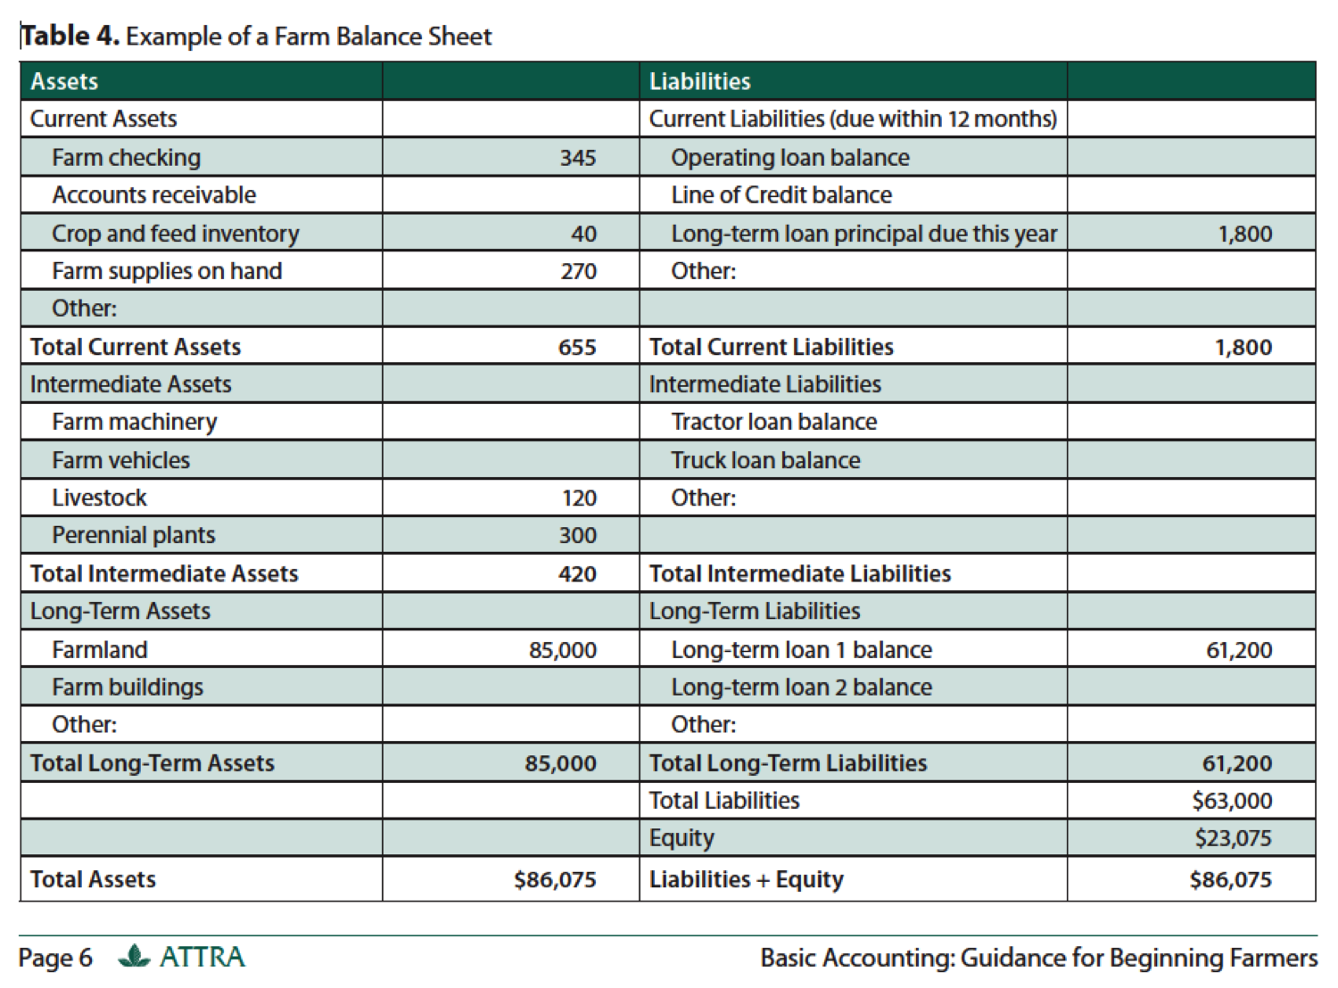
Notes:
Balance Sheet = Farm’s Financial Health
Shows what the farm owns (Assets)
Cash, A/R, Inventory, Supplies; Machinery, Equipment, land and buildings.
Shows what the farm owes (Liabilities)
Loans, line of credit, payables.
Shows what’s left over, (Equity)
what the owner invested.
Assets = Liabilities + Owners Equity.
Needs to be balanced, thus the term “Balance Sheet”

Slide 11
Financial Feasibility
Income Statement = Farm’s Profitability
Revenues – Cost of Sales = Gross Profit
Gross Profit – Expenses = Net Profit
Net Profit is taxable
If your Gross Profit is too low, then…
  You’re setting your prices too low
  You’re paying too much for your goods
  Both
Expenses can be fixed or variable.
Keep an eye on your expenses!
Notes:
AKA P&L
shows business’s profitability during a given time period (monthly, quarterly, yearly)
-operating expenses are the costs of producing revenue through the sale of G&S
-can be fixed or variable
-Inventory, AR, Equip don’t show up
-Don’t affect profitability
-That’s why it is important to project CASH FLOW!

Slide 12
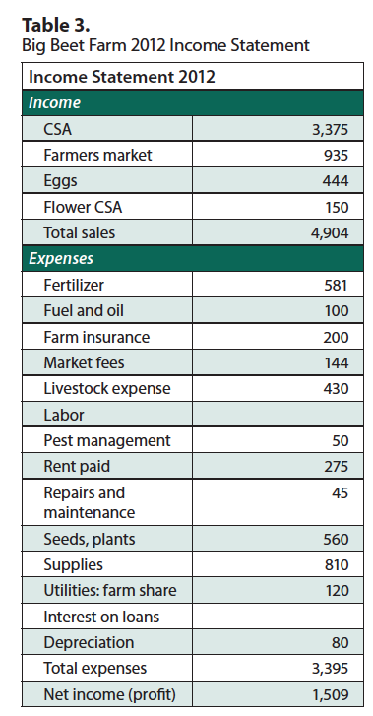
Notes:
Income (Revenue) = sales
Gross Profit = Total Sales
- good indicator of purchasing and pricing behavior
-use industry standards to make comparisons
Operating expenses = costs associated with running your farm
Net profit = gross profit - operating expenses

Slide 13
Financial Feasibility
Cash Flow Statement = Solvency
Cash Inflow vs. Cash Outflow
Shows ability to repay your debts
A farm business can be profitable and still have poor cash flow
  Accounts Receivable (not cash until you collect it)
  Principle on Mortgage (doesn’t show up on Income Statement)
  Equipment (doesn’t show up on Income Statement)
  Inventory (only Cost of Goods Sold shows up on Income Statement)
Depreciation is an expense (not cash – doesn’t show up on Cash Flow Statement)
Notes:
-Most important bc CASH IS KING
-Measures short term financial health & also shows solvency which is the ability of a business to have enough assets to cover liabilities
-Shows the cash in flows and outflows
-More business fail due to lack of CF
How can you be profitable and still have poor cash flow?
- It is important to understand how cash cycles through your business.
Cash inflow (cash from sales, accounts receivables, loan receipts, cash from investors)
Cash outflow (daily operating expenses like payroll, inventory purchases, rent utilities, etc.)
Profit not equal to cash
Important to remember
Unlike the Income Statement, Cash Flow Statement does not include a depreciation expense, because depreciation is not cash.

Slide 14
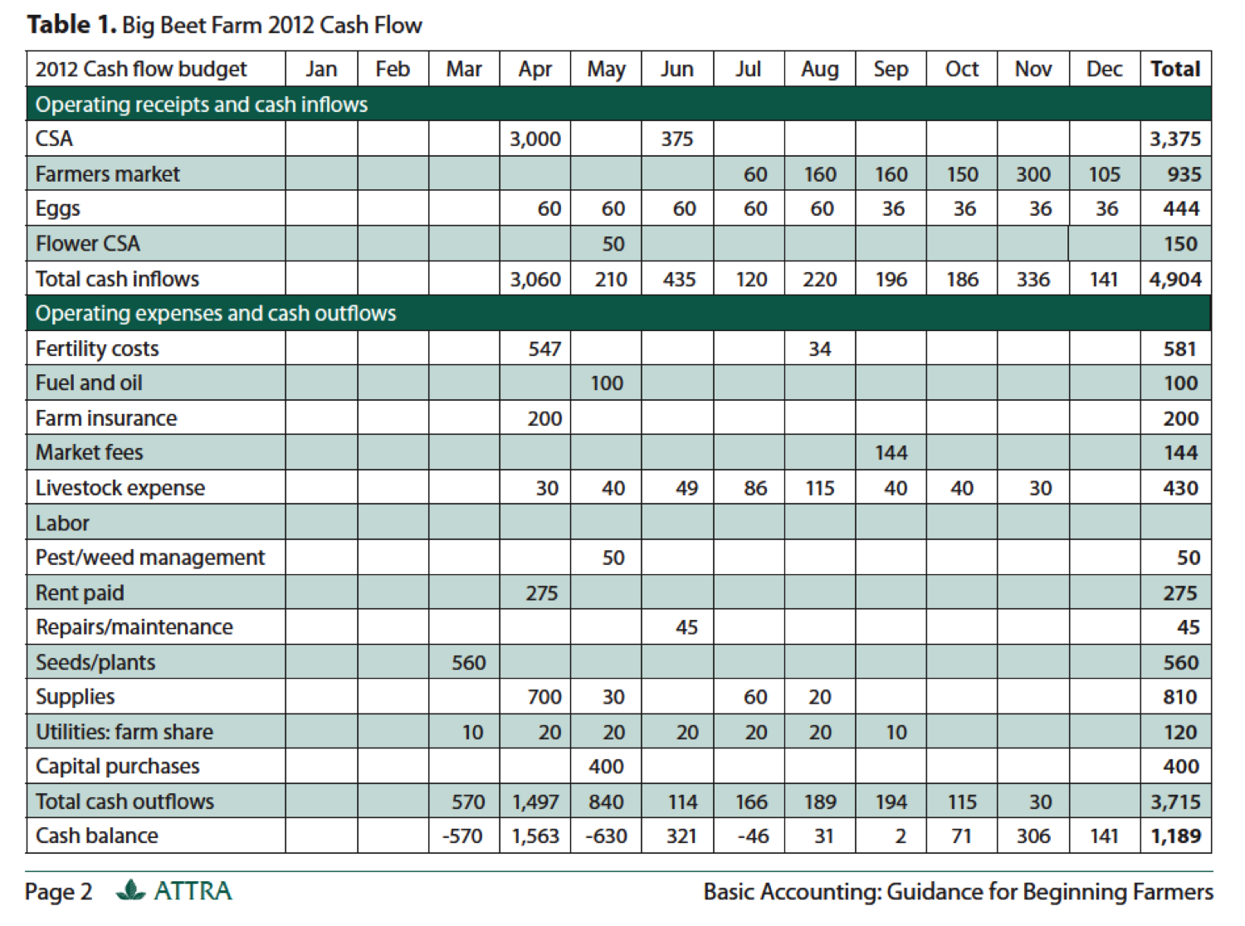
Notes:
Cash Flow = Solvency
- Monthly cash inflows and outflows
Operating receipts and cash inflows are at the top, and shows gross sales for each category
- Note: No cash inflows until April, due to seasonality of farming.
- Cash inflows are totaled for the month
Operating expenses and cash outflows are below the inflows.
- Note: In March there were expenses that needed to be paid.
- Cash outflows are totaled for the month.
Cash Balance = Total Cash Inflows – Total Cash Outflows
- Note: In March there is a negative cash balance due to no cash inflows in March.
- So owner would need to invest personal funds, or draw on a line of credit, to cover expenses in March.
- Putting together a cash flow projection helps the owner to plan for those short falls.
Annual total is calculated. Farm ended the year with $1,189 in cash.

Slide 15
Activity –
Categorizing Financial Transactions Exercise
NCAT Financial Records Template

Slide 16
Record Keeping
Why keep records?
Monitor progress of business
Use to prepare financial statements
Identify source of receipts
Keep track of expenses
Use in preparation of tax returns
Support items reported on tax return

Slide 17
What should you keep?
Gross Receipts
  Cash register tapes, bank deposit slips, receipt books, invoices, credit card slips
Purchases
  Cancelled checks, cash register receipts, credit card sales slips, invoices
Expenses
  Cancelled checks, cash register receipts, account statements, credit card sales slips
Notes:
Gross receipts are the income you receive from your farm business. Be sure that receipts note the date, vendor, and item purchased.
Purchases are items you buy and resell to customers, including the cost of raw materials (seed, fertilizer, etc.)
Expenses are costs you incur to carry on your business, other than purchases

Slide 18
How should you keep your records?
Electronically
  Quick Books, Excel spreadsheet, Farm specific accounting software
  http://www.agriculture.com/products-classifieds/product-reviews/agriculture-technology/software/buyers-guide-accounting-software_446-re7093
Manually
  One-Write System
  Packet of ledger paper
Notes:
IRS does not care if you keep your books electronically or manually, but consistent record keeping is important!
QuickBooks®
Microsoft Small Business Accounting 200X
PeachTree
Industry Specific

Slide 19
Activity –
Recordkeeping Tools
Introduction to the Veggie Compass.

Slide 20
Legal Structure
  Sole Proprietors
  Partnerships
  Corporations
    C-Corps
    S-Corps
  LLC’s
Notes:
In GA, 75% of legal entities formed are LLCs
About 23% are Corporations
The remainder are partnerships or sole proprietors
Liability? Avg. food safety court settlement $175,564
Sole proprietor – 1 owner, don’t have to register w/Sec State, Dissolve with death, Unlimited Personal Liability
Partnership – 2 or more owners, partnerhship register name with sec state, dissolve w/death, Unlimited Personal Liability
C Corp – Most complex/expensive, 1 or more owners, Must be approved by Sec State, Can raise capital w/stock, Separate legal entity, continuity, Double taxation, Limited Liability
S corp – Start as a C Corp (have to file w/in 75 days), 75 or less owners, no double taxation (only income tax), Continuity, limited liability
LLC – Hybrid of Partnerships & Corps. 1 or more owners, Register w/Sec State, Dissolves w/death, Pass through taxation, limited liability.
Seek advice from an attorney, CPA and/or insurance professionals.
Factors to consider when selecting a legal structure:
# of business owners
Type of business
Liability exposure
Taxes
Future expansion plans

Slide 21

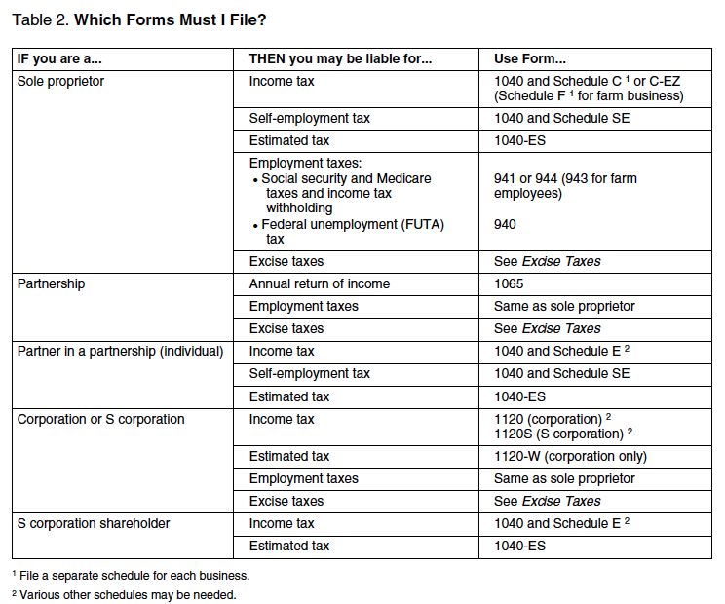
IRS Publication 583
Starting a Business & Keeping Records http://www.irs.gov/pub/irs-pdf/p583.pdf
Notes:
A reference and resource for participants to show them where to go to get the information.

Slide 22
How does an LLC File?
LLCs are not automatically included in this list, and are therefore not required to be treated as corporations.
LLCs can file Form 8832 (PDF) to elect their business entity classification.
  http://www.irs.gov/Individuals/Self-Employed/LLC-Filing-as-a-Corporation-or-Partnership
Notes:
If you do not state how you are filing will be looked at by IRS as a sole proprietor or partnership. Talk to your CPA as to the best way to file,

Slide 23
Choosing a Trade Name
All corporations & LLC’s must register with the State
  Check registered names:
    https://cgov.sos.state.ga.us/Account.aspx/LogOn?ReturnUrl=%2fhome.aspx
Check the federal register of names patented and trademarked
  www.uspto.gov
Google your business name
File trade name locally
Notes:
DBA: Trade name that is separate from your name
-Example:
Katie Murray’s Cupcakes DBA The Cupcake Kitchen
-for new businesses you don’t need a DBA; just register as what you want your business name to be…The Cupcake Kitchen
-DBA’s are good for:
-one central company that owns a lot of additional locations
-good for rebranding
-easy to change name with DBA
-don’t have to file name change with SOS
-don’t have to change tax paperwork

Slide 24
Compliance Issues
Local
State
Federal

Slide 25
Local Compliance Issues
Planning and Zoning
  Zoning Restrictions may apply to
Certificate of Occupancy
  Local Fire Marshall will inspect for fire code compliance before building can be used
Certificate of Building Inspection
  Local building inspector certifies use of accesses, restrooms, and construction types
Licenses:
  Business License/Business Tax Certificate/ Occupational Tax Permit – obtained at city hall, county courthouse or city admin building
Notes:
Check with P&Z to make sure area is zoned for business you want to open
Once final inspections are completed and all fees paid, you can get your C of O

Slide 26
State Compliance Issues
Permits, Licenses, Inspections:
  Over 30 types of businesses
    www.sos.state.ga.us/plb
    Food Sales – Ga. Dept. of Ag.
    www.agr.state.ga.us
    Check new Cottage Food Regulations
  Food Service- local environmental health dept.
Trademarks, Service Marks, Patents, Copyrights may be registered for legal protection
Sales and Use Tax:
    Apply for sales tax number with State of Georgia and get instructions for collecting, reporting and remitting tax monies
      www.dor.ga.gov
Notes:
Over 30 types of businesses are subject to special permits, licenses and inspections - See Secretary of State website
Trademark – word, name, device, symbol that appears on package or goods sold
-Nike swoosh
Service Marks – Title, slogan, phrases used by service companies
- ex: FEDEX van
Patents – granted by US gov’t to an inventor to exclude others from making, using, selling the invention throughout the US for a limited time, in exchange for public disclosure of the invention when the patent is granted.
Copyright – a form of protection provided by US laws to authors of original works.
-register at Library of Congress
-good for life of creator + 70 years
Sales Tax – need to be collected and turned into state monthly
-for any business selling products and applies to some services.
-Go to GDOR website to sign up for sales tax #.
-GA DOR Office in the mall next to SEARS

Slide 27
More State Compliance Issues
State Income Taxes
  Forms needed depends on the type of business entity
Worker’s Compensation Insurance
  Required by law for employers with 3+ employees
  Regulated by State but sold by private insurance companies
  http://sbwc.georgia.gov
State Unemployment Insurance Tax (SUTA)
  2.7% of first $8,500 of employees yearly earnings
  www.dol.state.ga.us
Notes:
Workers Comp- required if you have 3 or more employees
-if the owner works in the business he counts as one of the three but coverage is optional
-rate increases with risk
SUTA- Employers are required to pay SUTA

Slide 28
Federal Compliance Issues
Federal Income Taxes
  Federal Tax ID Number (EIN) – Form SS4
    - Can apply online; free
    www.irs.gov
    Employment Issues:
  FICA Insurance (S.S. & Medicare) – Form 941
    -calculated based on employee’s salary
    - www.irs.gov
    Federal Unemployment Tax (FUTA) – Form 940 or 940EZ
    0.8% of first $7,000 of employees yearly earnings
- Employee vs. Independent Contractor
Notes:
Business income tax is filed at both the state and federal levels. The procedure depends on your business structure.
You need a Federal Tax ID # if your business is a corp., LLC, or partnership, or a sole proprietorship with an employee
-if you are a sole proprietor ship with no employees you can use SSN
IRS has guidelines for determining who is an employee and who is an independent contractor.
-YOU CAN”T CHOOSE
- It has a lot to do with how much control you have over the person.
- See page 88-89 in the book for some guidelines.

Slide 29
Resources
ATTRA National Sustainable Agriculture Information Service, publication “Basic Accounting: Guidance for Beginning Farmers”
  www.attra.ncat.org
IRS Starting a Business and Keeping Records
Veggie Compass
  www.veggiecompass.com
  www.irs.gov/pub/irs-pdf/p583.pdf
Georgia Direct Farm Business Guide
  http://nationalaglawcenter.org/wp-content/uploads/assets/articles/GA-DFM.pdf

Slide 30



This material is based upon work that is supported by the National Institute of Food and Agriculture, U.S. Department of Agriculture, under award number 2015-70017-22861."
Beginning Farmer Rancher
Development Program
Developing the Next Generation
of Sustainable Farmers in Georgia Grant

