Slide 1







Van McCall
AgSouth Farm Credit
Education, Outreach & Special Program Manager
Session #4:
Risk Mitigation / Risk Management

Slide 2
Workshop Topics
Define Risk “Protecting Your Investment”
Five Areas of Business Risk
Potential Risks & Management Tools
  Multi Peril Crop Insurance
Putting Together the Risk Management PUZZEL
The One Page Risk Management Plan

Slide 3


The Storm Clouds of Risk
®

Slide 4

Protecting Your Investment
Risk
  The uncertainty that an adverse event will occur.
  In Farming always unsure of outcome at time planted
  “Its Your Attitude before you start that determines you Location at the finish”.
Risk Management
  Process to protect a farmer’s investment from the risks associated with the operation.
Risk – The fine line between “Thrill of Victory & Agony of Defeat”

Slide 5
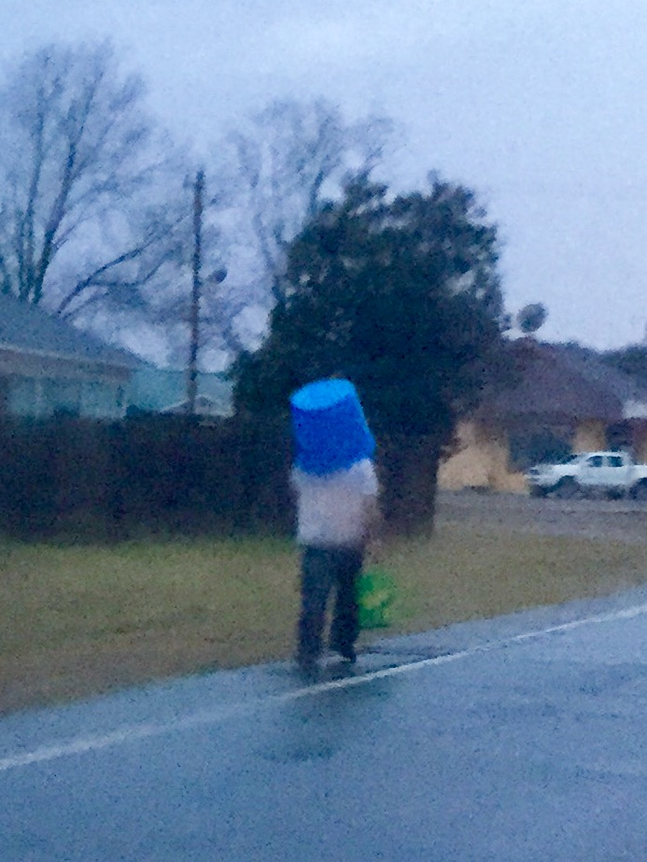
A Plan to “Get In Out Of Rain”

Slide 6
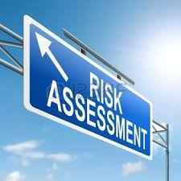
5 Areas of Business Risk
The Key People
Family / Key Man / Labor
Economic & Financial Considerations
Cash Flow / Interest
Rates / Capital
Technology
Identify Theft
CBI
Change Passwords
Anti Virus &
Spyware
People
Production
Legal
Marketing
Financial
Growing or Raising your Product
Disease / Weather /
Insects / Regulation
Liability
Injury
Workman Comp
Fire or Loss
Legal Structure
Succession , Will
Disability
Do you Sell what you Grow or Growing What you Can Sell?
Customer / Food
Safety / Market Access

Slide 7
Risks
Tools
Financial
Records – (Equity, Profit %, Liquidity, Working Capital)
Tax Management
Catastrophic
Loss
MPCI Crop Insurance · Medical Insurance
Food Safety
Training
Certification
Crop Hail Insurance
Property Insurance
Price Contracts
Interest Rate Mngt Plan
Diversify Enterprises
Wash & Pick Equipment
Risk
Liability
Business Structure (LLC; LLP; C-Corp, S-Corp,…)
Liability Insurance
Business
Continuity
Succession Planning
Key Employee(s)
Life Insurance
Disability Insurance
Bonus / Incentives / Profit Share Plan
Will and Estate Management
Return

Slide 8
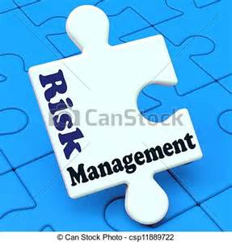
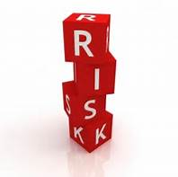
Putting The Puzzle Together
5 Steps of Risk Management
What are the Risks?
#1 Identify
#2 Prioritize
#3 Evaluate
#4 Select
#5 Review
Measure the Effectiveness of the Tool.
What will have the biggest impact on my farm?
Which tool will I select to manage the Risk?
What Risk Management Tools are available?

Slide 9
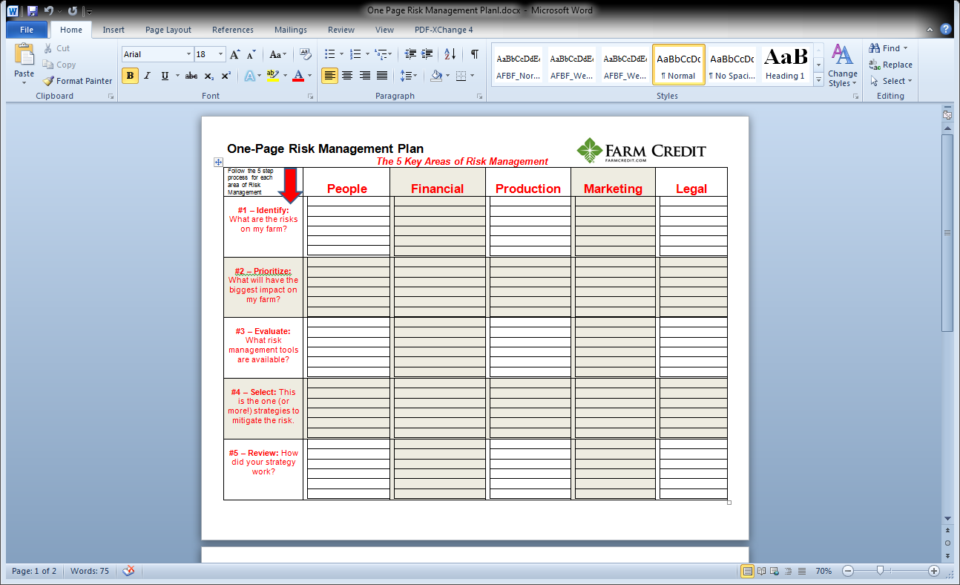

Slide 10
Labor
Key Man
Family
Cash Flow
Interest Rate
Capital Avail
Disease
Weather
Insects
1. Customer
2.Food Safety
3. Mkt Access
Labor Injury
Fire Loss
Key Man
Capital Availability
1.Weather
1. Food Safety
Labor Injury
Bonus Pay
Profit Sharing
% Ownership
Line of Credit
Build Wk Cap
Crop Insurance
Irrigation
Crop Variety
Training
Certification
Wsh/Pck Eq.
1.Insurance
2.Training
3.Mitigation
Bonus tied to Efficiency, Production & Profit
Build Savings / cycle
1.Crop Variety Selection
Certification
1.Insurance
2.Training
Gain Efficiency
Higher Profit
Happy K Man
Review Cash Flow Budget
Monitor Liquidity Positon on BS
Maintained sales across the season
Sales to Regional Chains
No Lawsuits
Risk Management Plan Project #4

Slide 11







This material is based upon work that is supported by the National Institute of Food and Agriculture, U.S. Department of Agriculture, under award number 2015-70017-22861.
Beginning Farmer Rancher
Development Program
Developing the Next Generation
of Sustainable Farmers in Georgia Grant

