Slide 1
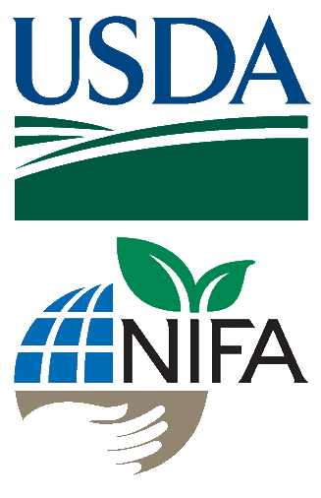
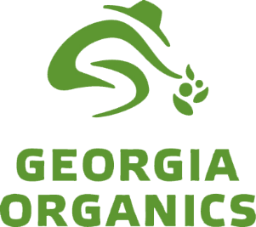
Small Farm Business Planning

Slide 2
Session 4 Licensing, Regulations, Certifications
Matthew Kulinski, Marketing Division
Georgia Dept of Agriculture

Slide 3
Learning Objectives
Recognize when you would need a Dept. of Ag permit or license
Identify a market that would require organic certification

Slide 4
Food Safety – Food Processing
The sale of fresh – unadulterated – produce is possible with out license or regulation. However, processed produce could be something as simple as sliced cucumbers and that requires a license.
There is a small exception for non profit events (bake sales)
A cottage food license is available for non-potentially hazardous food processing in a home kitchen – items must also be sold directly to the consumer
Non-potential hazardous items are baked goods, jams, jellies, and honey. Anything that has to be controlled by time or temperature (pickles, dairy, bbq sauce, salsa) are not eligible.
The food sales establishment licenses is necessary for the processing of most all major food items.
Fresh
Produce
Non-Profit Exemption
Cottage Food License
Food Sales Establishment License
Only for non-potentially hazardous food items

Slide 5
Food Safety – Fresh Produce
While there are limited regulations on fresh produce, following Good Agricultural Practices (GAP) is highly recommended.
GAPs recommend farmers be aware of potential contaminations (microbial, chemical and physical hazards) and manage operations as to minimize potential risks.
There are several programs and companies they help farms understand and follow GAP.
There are also 3rd party auditors that verify farms are following GAP.
If interested in selling large scale you will need to have 3rd party verification and certification for GAP
Fresh
Produce

Slide 6
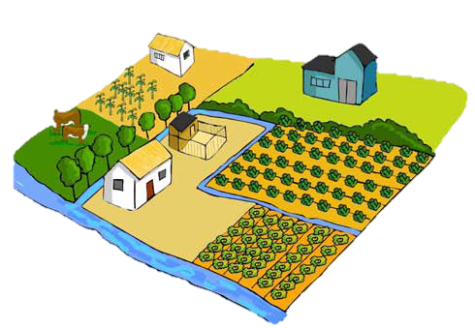
More on GAP
Water Usage
Sewage treatment, animals/wildlife/livestock
Manure and Biosolids
Raw manure applied at least 120 days before harvest
What was the previous land use?
Field Harvest and Field Packing Activates
Sanitation and hygiene
Clean containers, covered during storage and transportation
Packing Facilities
Washing process, worker health and hygiene, clean surfaces, pest control
Documentation and Traceability
Document everything

Slide 7
Food Safety Modernization Act

Slide 8
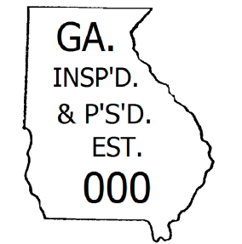
Food Safety - Meat Products
Live animal sales may only take place at licensed livestock sale facilities.
All processed or butchered meat products must be from a state or federally licensed facilities and display a inspection mark
A mobile meat sales license is required for sales of processed meat products to consumers.

Slide 9
What about Organic Certification?

Slide 10
Do I need to be Certified to use the term Organic?
In short, Yes. Most farms and businesses that grow, handle, or process organic products must be certified, including:
Farms that sell more than $5,000 in organic products per year (gross sales).
Handlers that sell more than $5,000 of organic processed food, including handlers that place bulk products into smaller packages or that repackage/relabel products.
Processors that sell more than $5,000 of organic processed products, unless all products contain less than 70 percent organic ingredients or only identify the organic ingredients in the ingredient statement.
Vendors that handle (e.g. package) and sell products online (but not in stores) or otherwise deliver organic products.
Overall, if you make a product and want to claim that it or its ingredients are organic, your final product probably also needs to be certified.

Slide 11
Using “Organic” in Processed Products
Organic products can be labeled differently depending on the percentage of organic ingredients that they contain. There are three distinct labeling categories for organic products:
100 Percent Organic - Agricultural products in the “100 percent organic” category contain only ingredients that are certified organic, including any processing aids.
Organic - Agricultural products in the “organic” category must contain no less than 95 percent of certified organic ingredients (excluding salt and water). The remaining five percent of ingredients must be organically produced, unless commercially unavailable or allowed on the National List.
“Made With” Organic - Multi-ingredient agricultural products in the “made with” category contain at least 70 percent certified organic ingredients (excluding salt and water). Any remaining agricultural products are not required to be organically produced, but must be produced without excluded methods – for example, genetic engineering.

Slide 12
Additional Resources
Online basics of food safety course - http://www.fcs.uga.edu/extension/enroll-produce-courses
Georgia Dept of Agriculture. Food Safety Division - http://agr.georgia.gov/foodsafety.aspx
UGA Extension Food Safety - http://extension.uga.edu/food/safety/
Produce Food Safety Services (part of Georgia Fruit & Vegetable Growers Assoc.) - http://www.producefoodsafetyservices.com/

Slide 13
This material is based upon work that is supported by the National Institute of Food and Agriculture, U.S. Department of Agriculture, under award number 2015-70017-22861."
Beginning Farmer Rancher
Development Program
Developing the Next Generation
of Sustainable Farmers in Georgia Grant

