Slide 1
Journeyman Farmer Small Farm Business Planning
Session #4 – Financial Resources
Obtaining Credit
Farm Credit’s of Georgia
Van McCall – Agsouth Education and Outreach Manager
Training Topics
1- Obtaining Credit
2- Farm Credit Resources

Slide 2
Obtaining Credit

Slide 3
Items/information required for a loan application
Purpose and Plan
Balance Sheet
Last 2 years’ W2s or, if self-employed, last 2 years’ tax returns
Location / Type of all real estate owned
Loan information for all Liabilities
Collateral Description

Slide 4
How can you influence your lender to make your loan?
Keep good records.
Reduce the risk to yourself and your lender whenever possible.
Have a reasonable plan ready for your lender to review.
Keep your lender informed.
When you get a loan, use it for the purpose intended.
Properly structure loan terms.

Slide 5
Character
Who is the borrower?
Reputation, Experience
Managements Ability
Farm, Financial, Production, Marketing
Past History
Farm Credit History, Credit Scores, CBI

Slide 6
Conditions
Environment in which loan is being made…
Industry / Commodity
Markets
Operation

Slide 7
Capital
Learn from Balance Sheet
Liquidity (ability to pay bills)
Equity (ownership % in assets)
Trends (growing equity)
Compare to peers in industry

Slide 8
Collateral
Should not be most important concern!
Insurance in case we guess wrong
Value is always uncertain.
Specialty operations are hard to value

Slide 9
Capacity!!!
By far, the most important factor!
Can they repay on time?
Primary Source
Secondary Source
“Do what is best for the Customer.”
May not always be what they want.

Slide 10
FSA 90% Guarantee & SBA 7(a) Loan Programs
Guarantee loan programs available to offset risk in ag loans.
Fees, rates and loan terms for ag operations.

Slide 12
Our mission
To provide sound, dependable funding for American agriculture and rural America

Slide 13
Farm Credit is…
A federally chartered and regulated lender to farmers, agribusinesses and country homeowners
A customer-owned cooperative

Slide 14
Nearly 100 years old!
President Woodrow Wilson signed the Federal Farm Loan Act in 1916
Providing financing with repayment terms that coincide with the planting and harvesting of crops.

Slide 15
Structure
There are 4 Farm Credit Banks and 76 Farm Credit associations across the U.S.
There is a Farm Credit association serving every county in the nation.

Slide 16
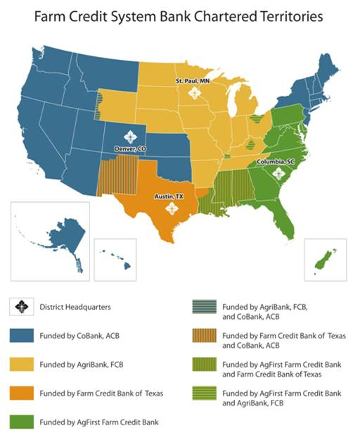

Slide 17
Structure
AgFirst Farm Credit Bank serves 15 eastern states and Puerto Rico
19 Farm Credit associations own AgFirst FCB

Slide 18
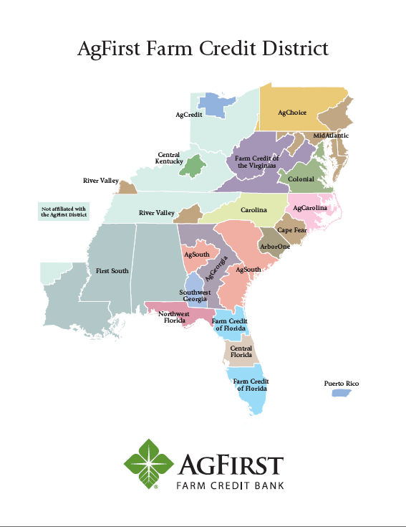

Slide 19
Structure
3 Associations make up the Farm Credit Associations of Georgia.
AgGeorgia Farm Credit
AgSouth Farm Credit
SW Georgia Farm Credit

Slide 20
Find your Area office – http:/farmcrecit.com

Slide 21
Types of Loans…
Agricultural or Rural Real Estate
Improvements to farm real estate
Purchase Livestock
Farm operating loans
Farm Equipment
Agribusiness
Homes

Slide 22
Types of Loans…
Young, Beginning and Small Farmer Loans
Micro Loan Program
Beginning Farmer Down Payment Program
Quick Credit Program
Farm Credit Express

Slide 23
Other Services Offered
Leases
Appraisals
Crop insurance
Life insurance
Rural American Bonds

Slide 24
What is Patronage?
A major difference between Farm Credit and other lenders is that Farm Credit can return a portion of profits to our borrower/members
A Patronage Refund is a way of distributing the association’s net income to our borrower/members
A Patronage Refund is basically a refund of the interest a member has paid on his/her loan
A Patronage Refund reduces the cost of borrowing

Slide 25
Patronage
In 2015, Associations in Georgia paid patronage back to their customers in the amount of:
$45,000,000

Slide 26
Thank You…
…for allowing us to tell the
Farm Credit Story

