Slide 1








Small Farm Business Planning

Slide 2

Session 3
The Business Plan
Developing Financial Projections
The Farmers’ Perspective
Laura Katz, The University of Georgia Small Business Development Center

Slide 3

The Business Plan
Notes:
- How most of us feel when we hear the words “Business Plan!”
Once you get financial projections out of the way its easy
-doesn’t have to be long
-write it yourself!
YOU ARE THE ENTREPRENEUR, MANAGER, and FARMER
-SBDC can help
-Required by lenders

Slide 4
Why a Business Plan?
It forces you to focus
It tests your commitment
It brings you down to reality
It gives you a benchmark
Required by banks and investors

Slide 5
Preparing a Business Plan
Narrative
  Executive Summary
  Business Description
  Mission Statement
  Market Analysis
  Competition
  Location
  Market Strategy
  Management
  Personnel
  Operations
Notes:
Executive summary – most important
-what lenders will see first
-highlight important stuff
Who will manage the business – lenders want to know
You?
Outside experts?

Slide 6
Preparing a Business Plan
Financials
  Sources & Uses
  Assumptions
  Balance Sheets
  Cash Flows
  Income Statements
  Breakeven Analysis
  Collateral Offering
Notes:
Financials - Most important section
-Sources & uses of funds
-Where are you getting the money?
-How are you going to use it?
-must equal!
-want at least 2 years of monthly BS, CF, and P&L projections
ASSUMPTIONS= the numbers you use to estimate
- use realistic numbers; be conservative; support numbers with research
-Don’t expect to make a profit until after 2 years→ reflect this in your projections

Slide 7
Preparing a Business Plan
Supporting Documents
  Resumes
  Personal Financial Statements
  Income Tax Returns
  Lease Agreements
  Purchase Agreements
  Construction Estimates
  Market Research
  Explanations
Notes:
-Resumes contribute to your character and experience
-Lease agreements- lenders want to know you have a place of operation
-”contingent upon receiving funds”
-REAL construction estimates

Slide 8
Preparing a Business Plan
AgPlan is a free business plan template for agriculture, fisheries and small business.
www.agplan.umn.edu

Slide 9
Activity –
Business Plans
Introduction to AgPlan
HOMEWORK – Write a brief description of the Products section of an Operations Plan for your business plan. Use the “Tips” and “Samples” in AgPlan to guide your description.

Slide 10
Financial Sources
Self
Family/Friends
Banks
Conventional loans
  US Small Business Administration
    http://www.sba.gov/content/agriculture
  USDA Farm Service Agency
    www.fsa.usda.gov
  Whole Foods Local Producer Loan Program
Notes:
Don’t you wish you had one of these?
5 C’ s of credit:
Character – credit score and payment history
Collateral – personal or business assets to be pledged
Capital – 20%-25% of personal equity to be invested “skin in the game”
Capacity – ability of business to pay back the loan
Conditions – what is happening in the external environment (economy, regulations, competition)

Slide 11


USDA Grants
& Loans
USDA Grants and Loans for Small Farmers- Alternative Farming Systems Information Center:
https://www.nal.usda.gov/afsic/grants- and-loans-farmers
Notes:
Some grants available for small farm businesses, see USDA website

Slide 12
Avoid Mistakes By . . . .
Watching cash flow
Developing time management skills!!!
Proper recordkeeping
Seeking advice from qualified experts
Training your employees
Paying attention to customers
On-going market research
Community Involvement
PLAN ! PLAN ! PLAN!

Slide 13
Developing Financial Projections
Notes:
Why
What
Who needs them?
There are simple sheets available
We have projection templates.

Slide 14
Activity –
Financial Projections
Finding information for Financial Projections
Locate CFSA Organic Broccoli Budget 2015 in your notebook. Participate in discussion.
Alabama Meat Goat Enterprise Budget excel sheet discussion
REMINDER – Bring your SWOT Analysis for Session 4!

Slide 15
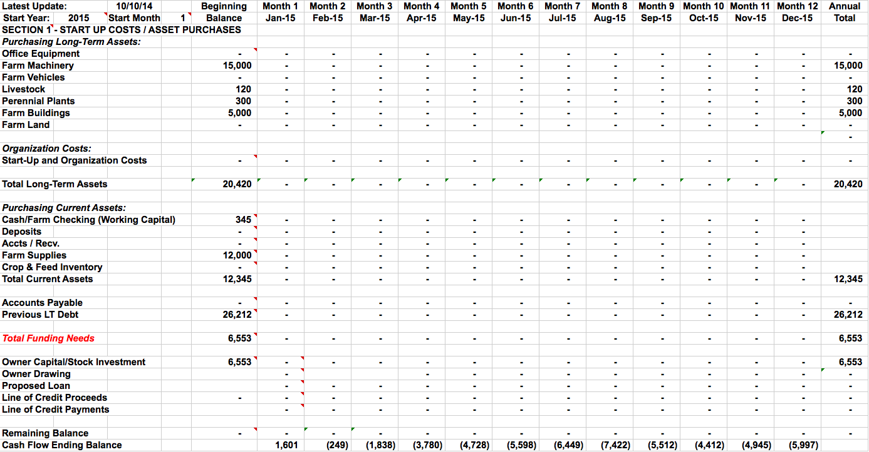
Start Up Costs
Notes:
When preparing financial projections, begin with start up costs.
Start up costs are all the assets you purchase, any liabilities you acquire, and the equity you invest to start your farm.
Start up cost are the basis of your initial balance sheet.
Long term assets are assets that will take longer than 12 months to convert to cash
Long term assets are Farm Machinery, Livestock, Perennial plants and farm buildings
Organizational costs are licenses, permits, legal fees, accounting fees any intangible assets
Organizational costs in this example are 0.
Total long-term assets=$20,420
Current assets are assets that can be converted to cash in less than 12 months.
Current assets are Cash (working capital), Farm supplies
Total current assets = $12,345
Liabilities are any loans you take to start your business
For illustration purposes we assume that you will get a loan prior to starting your business and will be shown as Previous LT Debt.
Long term debt = $26,212
Owner will need to invest 20% of personal funds into the business
Owners Capital = $6,553

Slide 16
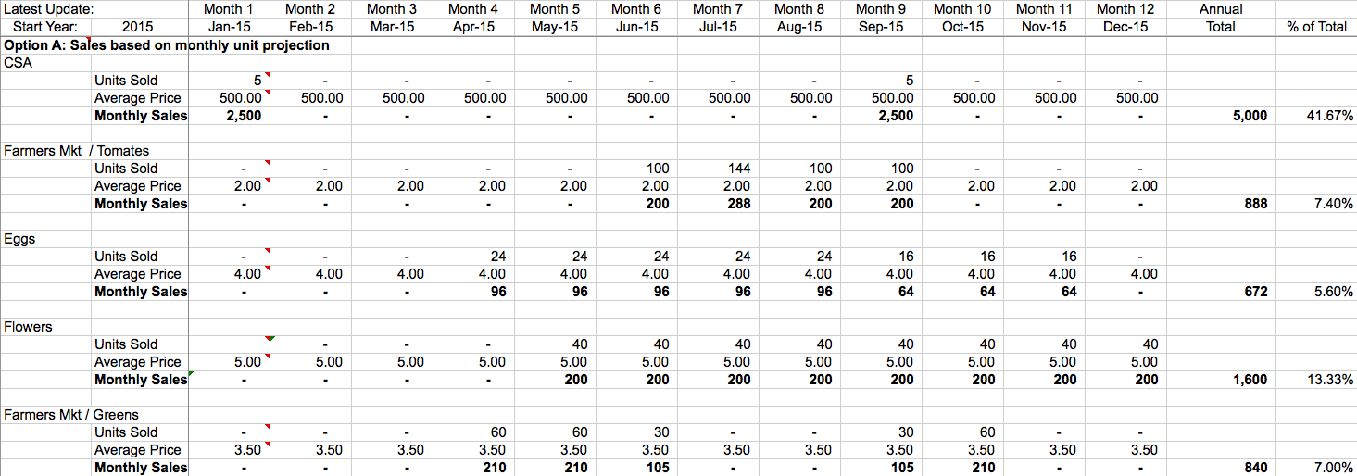
Revenues Year 1
Notes:
Revenues = sales and should be estimated monthly
Revenues are broken into unit categories of CSA, Farmer Market Tomatoes, Eggs, Flowers, Greens and Pumpkins
See next slide.
Revenues are estimated for each category by taking the # of units sold multiplied by the average sales price to get the total.
In this example, CSA’s are sold in January and September at a total of 10 units for an annual sales of $5,000
Tomato's are sold June through September and total annual sales of $888
Revenues should be estimated for each of the products that an owner will be selling.
(See next slide)

Slide 17
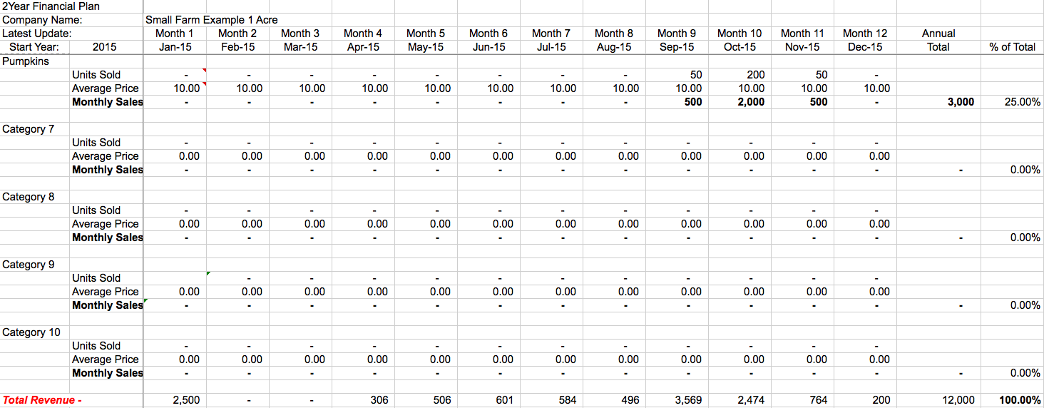
Revenues Year 1
Notes:
Pumpkins (see previous slide)
Total revenues for each category should be totaled monthly and annual.
Gross Revenues/Sales = $12,000 for year 1.

Slide 18
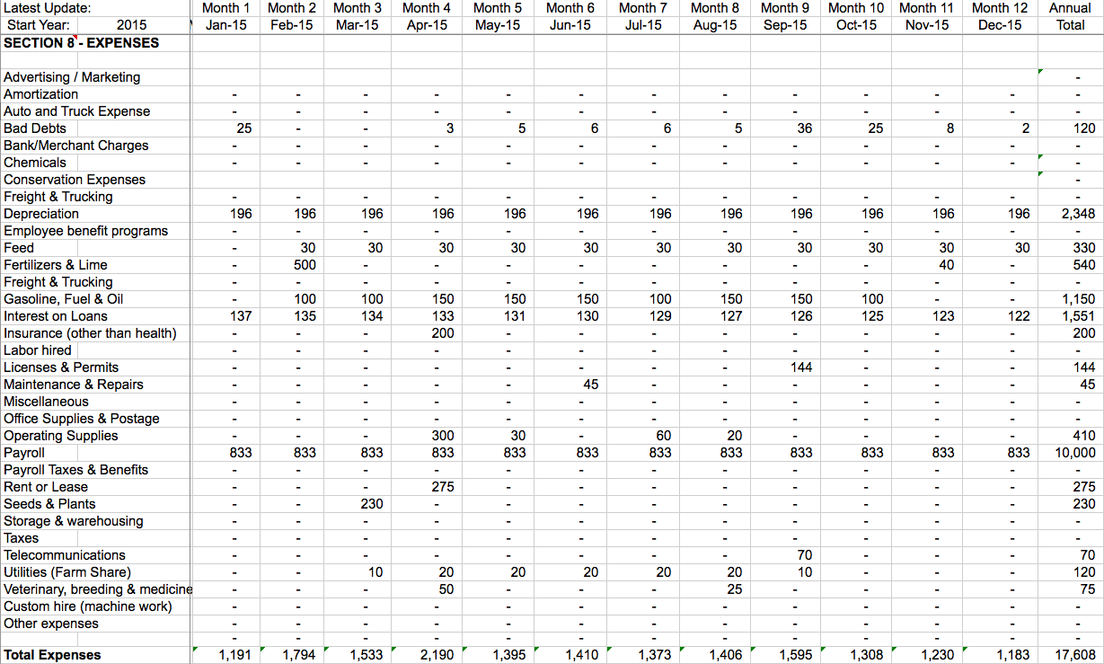
Expenses Year 1
Notes:
Calculate your estimated expenses on a monthly basis
In this example some monthly expenses are:
Bad debts (checks that bounce, A/R that are not paid) – this example considers 1% of revenues will not be collected.
Depreciation of Fixed Assets (Building, equipment, machinery) expensed monthly based on useful life. Speak to an accountant or research IRS.gov for guidelines.
Feed, Fertilizers, Machinery Gasoline, Fuel & Oil
Interest expense (just the interest can be expensed, not the principal)
Insurance, hired labor, license and permits, Maintenance and Misc (should not be a big #, better to categorize to manage)
Operating supplies are supplies that are used in the operation of the farm and not resold. Paper products, cleaning materials, etc.
Payroll in this example Owner would like to be paid $10,000/year.
Rent or lease of equipment, maybe land; Seeds and plants.
Telecommunications, Farm share of utilities, Vet bills, Custom hire and any other expenses.
This is not a comprehensive list, just an example of the types of monthly expenses a farm business might incur. You may have more or less monthly expenses.
Calculate your total monthly expenses, and your total annual expenses.
Total annual expenses = $17,608

Slide 19
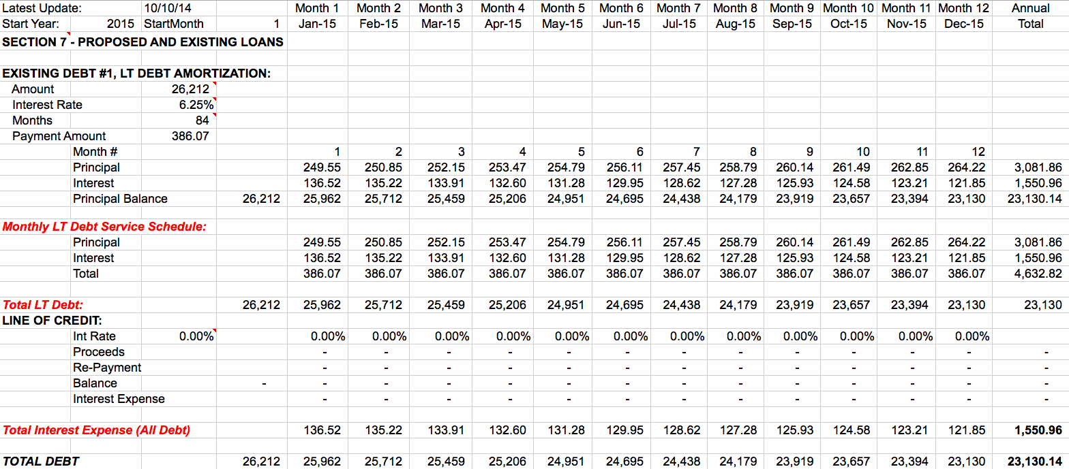
Loans
Notes:
Loan payments need to be estimated monthly and annually.
In this example the owner borrowed $26,212 at 6.25% interest for 84 months (7 years)
The total payment amount is $386.07
Interest is accounted for in the monthly expenses and will show up on the Income Statement (Profit & Loss Statement).
The Total Payment amount is accounted for in the cash flow report.
This example calculates the principal and interest amounts monthly, and shows the decreasing loan balance
The annual total principal paid out is $3,0981.86
The annual total interest paid out is $1,550.96
For a annual total loan payment amount of $4,632.82

Slide 20
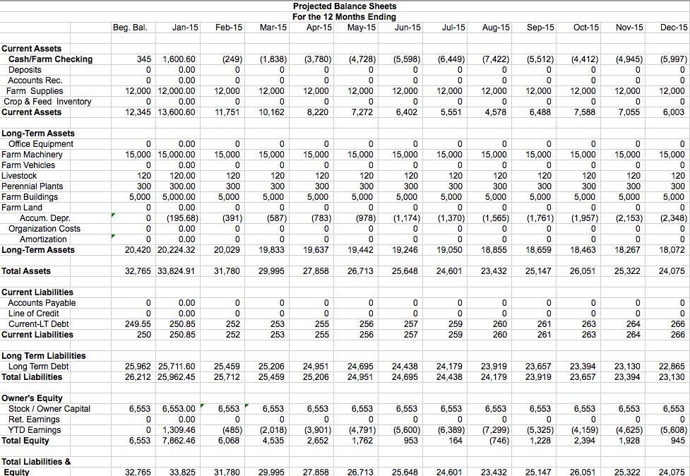
Notes:
Balance Sheet is Assets = Liabilities + Owners Equity
Balance sheet shows the health of a company at any point in time, and is used to analyze solvency and net worth.
Balance sheet will be required by lenders.
For the beginning balance, Assets, Liabilities and O.E. are taken from the Start Up costs.
Ongoing the balance sheet is calculated monthly

Slide 21
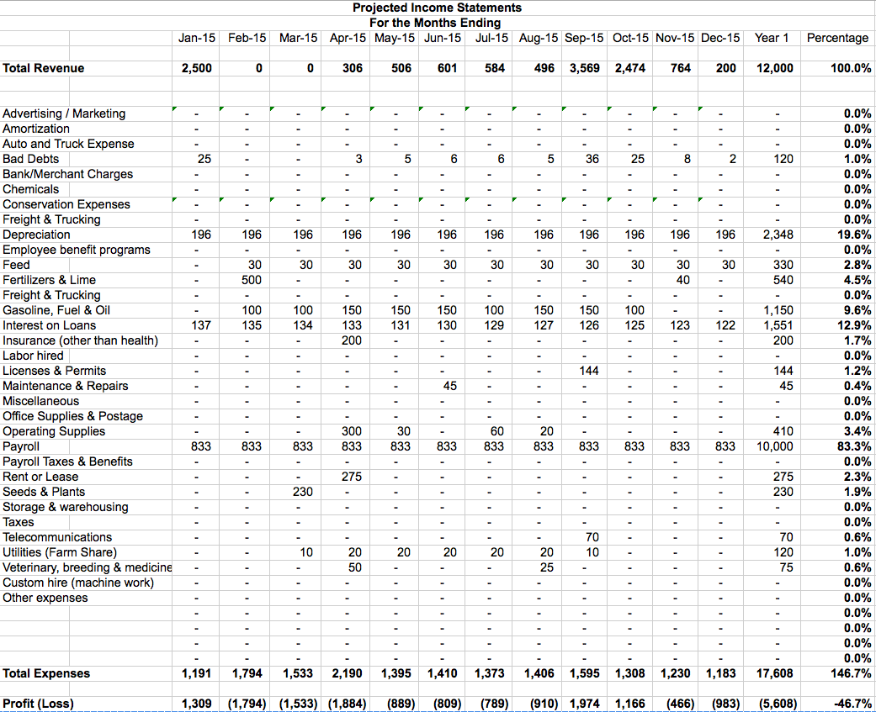
Notes:
Income Statement is also called the Profit and Loss Statement
Income statement is used to analyze the profitability of a business.
Income statement takes the total revenues (sales)
Subtracts all the expenses
To show a profit or loss for the month
For January, the farm had revenues of $2500 from the 5 CSA’s sold
The farm had expenses totaling $1,191
In January farm had a profit of $1,309
In this example, the farm business generates an total revenues of $12,0000
Total expensed of $17,608
For a loss of $5,608 or -46.7% for the 1st year.
Payroll is the farm business biggest expense
Reducing expenses would help with profitability

Slide 22
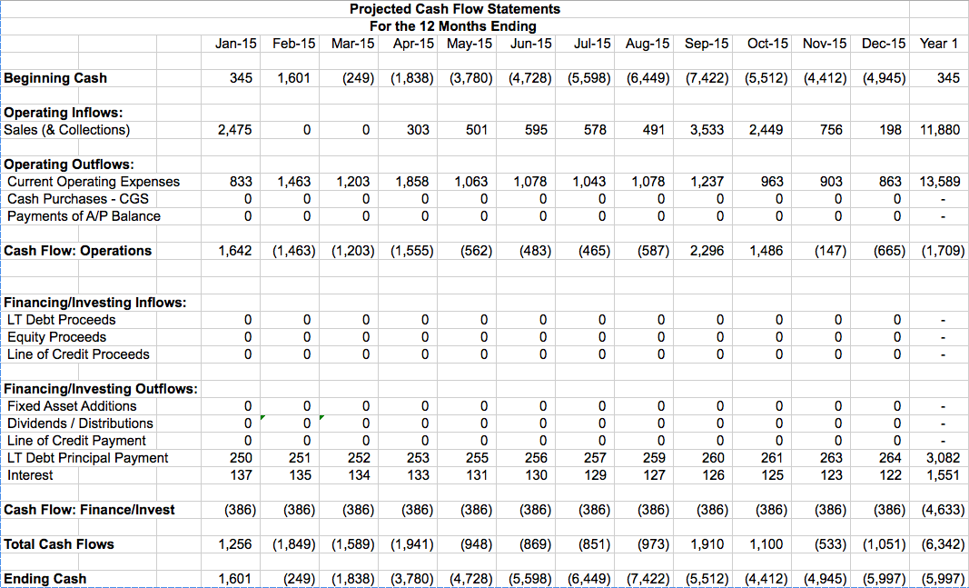
Notes:
Cash flow statement shows the amount of cash you have each month
The cash flow statement accounts for all the inflows and outflows of cash in the business due to revenues, expenses, and financing.
Each month starts with a beginning cash balance
Total operating inflows from any sales or A/R collections from the operation of the farm business
Subtract expenses, cash purchases of inventory, and any A/P that are paid.
This will give total Cash Flow from Operations.
Next is cash inflows from any financing activities, for example drawing on a line of credit
From that you subtract any Financing cash outflow, such as the principal and interest payment on the long term debt.
This gives you the total cash flow from financing, which is a negative number in this example
Now add the cash flow from operations and financing, which equals $1,256 for the month.
Add the beginning cash balance to the ending cash balance and this gives you the beginning cash balance for the next month (February) of $1,601
It is possible to show a profit and not have any cash due to A/R being included in revenues, but many not have been collected
Interest expense deducted on P&L but not the Principal payment.
It is possible to show a loss and still have cash at the end of the month due to
Depreciation and Amortization being deducted on the P&L, but no cash impact on the cash flow report.
In this example the farm business is not profitable and does not cash flow.
Based on the projections, and analysis of the financial statements, the Farm Owner can make decisions on how best to proceed with his farm business.

Slide 23
The Farmer’s Perspective
Now let’s hear from a local farmer about his approach to small farm business planning

Slide 24
Resources
AgPlan Business Plan Template
  www.agplan.umn.edu
US Small Business Association
  http://www.sba.gov/content/agriculture
USDA
  www.fsa.usda.gov
Government Statistics & Information
  www.census.gov
  www.fedstats.gov
Ag Associations
  ww.gfb.org – Georgia Farm Bureau
  http://georgiaorganics.org – Georgia Organics
  www.SustainAgGa.org – UGA Cooperative Extension; Sustainable Agriculture at UGA
  www.gfvga.org -- Georgia Fruit and Vegetables Growers Association

Slide 25
Resources
Georgia Secretary of State
  https://cgov.sos.state.ga.us
Federal Registry of Names, Patents & Trademarks
  www.uspto.gov
Georgia Dept of Agriculture
  www.agr.state.ga.us
Georgia Dept. of Revenue
  www.dor.ga.gov
Georgia Dept. of Workers Compensation Insurance
  http://sbwc.georgia.gov
Georgia Dept. of Labor
  www.dol.state.ga.us

Slide 26



THANK YOU
To Schedule an consulting Session Contact:
(706) 542-7436 / sspinks@georgiasbdc.org
www.athenssbdc.org

Slide 27




This material is based upon work that is supported by the National Institute of Food and Agriculture, U.S. Department of Agriculture, under award number 2015-70017-22861."
Beginning Farmer Rancher
Development Program
Developing the Next Generation
of Sustainable Farmers in Georgia Grant

