Slide 1
Small Fruit and Vegetable Production

Slide 2
Session 7 Marketing
Tenisio Seanima
Farmer Services Coordinator
Georgia Organics

Slide 3
Learning Objectives
List three major differences between wholesale
and direct sales markets

Slide 4
Direct Markets vs. Wholesale Markets
Pop-Up/Farmer’s Market
CSA’s
Wholesale
Terminal Market
Institutions
E-commerce (Online)
Brick & Mortar (B&M)/Roadside Market
Direct
Restaurants
Food Hub
Notes:
Mention

Slide 5
Direct vs. Wholesale cont.
Higher Revenue Margins
Highly Saturated
Wholesale
Lower Revenue Margins
Less Saturated
Non-Contractual
Lower Sales Volume (per transaction)
Direct
Contractual
Higher Sales Volume (per transaction)
High Crop Diversity
Low Crop Diversity

Slide 6
Which Market Do You Go With?

Slide 7
Market Considerations Competition
LOW | MEDIUM | HIGH
Lightly compacted (Grocer, Institutions). Greater barriers to entry. Market-entry is costly. | Moderately compacted (Restaurant). Moderate barriers to entry. Market-entry is moderately priced. | Densely compacted (Farmer’s Market). Few barriers to entry. Market-entry is low-cost.

Slide 8
Market Considerations Fulfillment Difficulty Level
EASY | MEDIUM | HARD
Consistent inventory preferred, but not required. Customers typically come to you. Transactions are 100% Cash On Delivery (COD) | Consistent inventory required. Customers either come to you or require delivery. Transactions are COD or term-based. | Consistent inventory required. Customers typically require delivery. Transactions are 100% term-based.

Slide 9
Market Considerations Certifications
Certified
Naturally Grown
Good Agricultural and Handling Practices
Certified Organic
Photo Credit: Certified Naturally Grown
Photo Credit: United States Department of Agriculture
Photo Credit: Bureau of Agriculture and Fisheries Standards

Slide 10
Market Considerations Certifications (cont.)
“Organic agriculture produces products using methods that preserve the environment and avoid most synthetic materials, such as pesticides and antibiotics. USDA organic standards describe how farmers grow crops and raise livestock and which materials they may use.”
“Organic farmers, ranchers, and food processors follow a defined set of standards to produce organic food and fiber. Congress described general organic principles in the Organic Foods Production Act, and the USDA defines specific organic standards. These standards cover the product from farm to table, including soil and water quality, pest control, livestock practices, and rules for food additives.”
Certified
Organic
Information Credit: United States Department of Agriculture

Slide 11
Market Considerations Certifications (cont.)
“[CNG] standards for produce and livestock certification are based on the standards of the National Organic Program. CNG participation requires a full commitment to robust organic practices.”
“CNG is based on the participatory guarantee system (PGS) model that relies on peer reviews in which inspections are typically carried out by other farmers. The PGS model promotes farmer-to-farmer knowledge sharing about best practices and fosters local networks that strengthen the farming community.”
“Another difference is that CNG’s certification process is transparent and open to the public. Every CNG producer has a profile on the website. On it you will find the information they submitted in their application, as well as scanned images of their inspection reports and signed declaration.”
Certified
Naturally Grown (CNG)
Information Credit: Certified Naturally Grown

Slide 12
Market Considerations Certifications (cont.)
“Good Agricultural Practices (GAP) and Good Handling Practices (GHP) are voluntary audits that focus on best agricultural practices to verify that fruits and vegetables are produced, packed, handled, and stored in the safest manner possible to minimize risks of microbial food safety hazards. GAP & GHP audits verify adherence to the recommendations made in the U.S. Food and Drug Administration’s Guide to Minimize Microbial Food Safety Hazards for Fresh Fruits and Vegetables (pdf) and industry recognized food safety practices.”
Good Agricultural and Handling Practices
Information Credit: United States Department of Agriculture

Slide 13
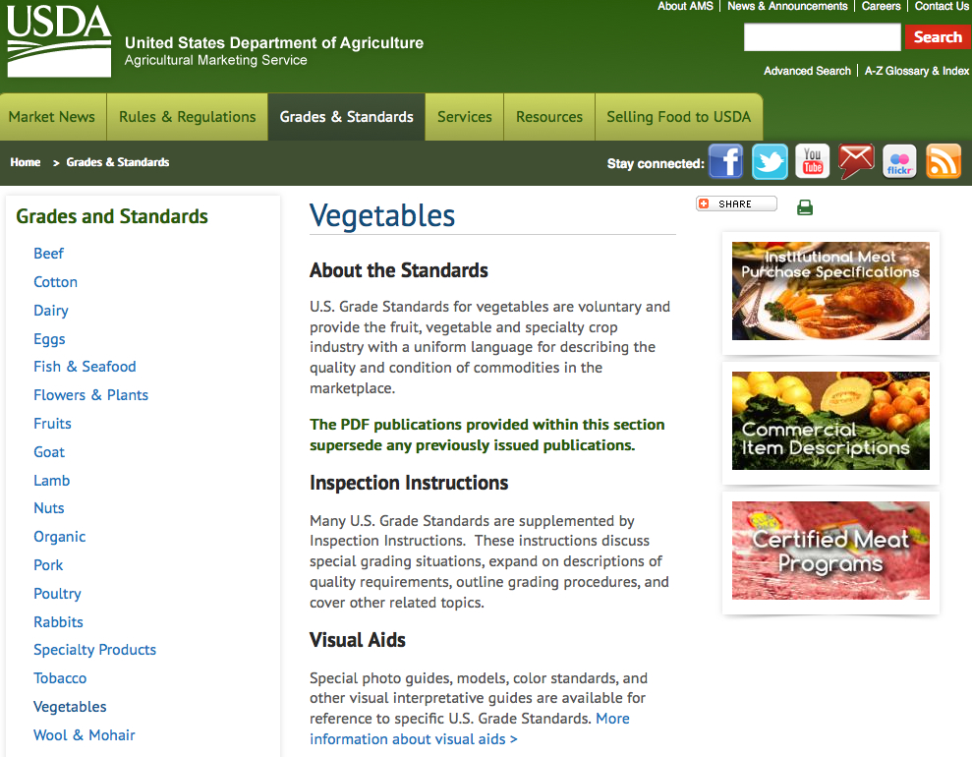
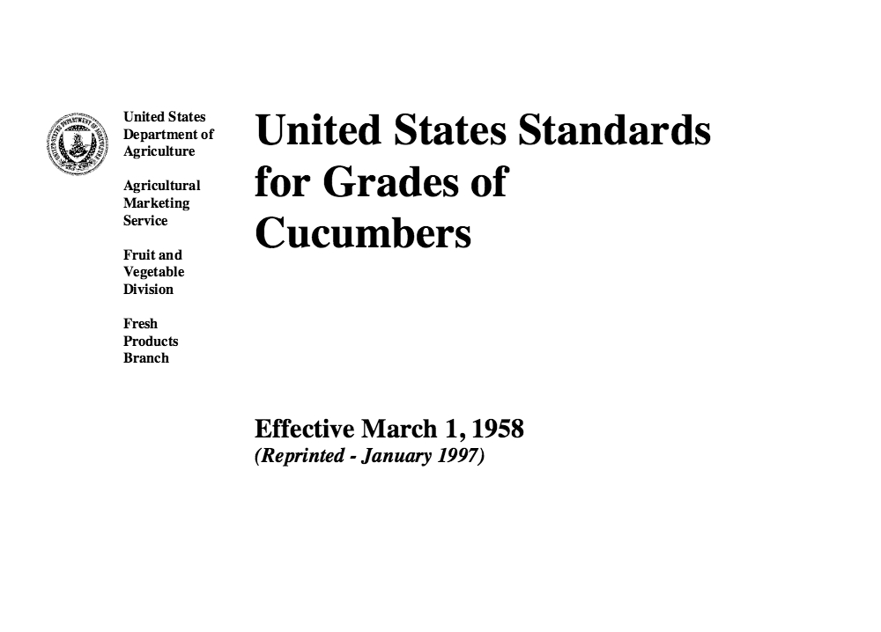
Market Considerations Product Grade Level
Photo Credit: United States Department of Agriculture
Photo Credit: United States Department of Agriculture
Notes:
Replace tomato pictures.
Also, put in another slide for another vegetable, e.g. cucumber, squash, etc. Also, insert link to USDA Grade website.

Slide 14
Example: Grades of Tomatoes
U.S. No. 1 consists of tomatoes which meet the following requirements:
a. Basic requirements:
1. Similar varietal characteristics;
2. Mature;
3. Not overripe or soft;
4. Clean;
5. Well developed;
6. Fairly well formed; and,
7. Fairly smooth.
b. Free from:
1. Decay;
2. Freezing injury; and,
3. Sunscald.
c. Not damaged by any other cause.
U.S. No. 2 consists of tomatoes which meet the following requirements:
a. Basic requirements:
1. Similar varietal characteristics;
2. Mature;
3. Not overripe or soft;
4. Clean;
5. Well developed;
6. Reasonably well formed; and,
7. Not more than slightly rough.
b. Free from:
1. Decay;
2. Freezing injury; and,
3. Sunscald.
c. Not seriously damaged by any other cause.
Information Credit: United States Department of Agriculture

Slide 15
Market Considerations Crop Diversity
DIRECT
Higher price per pound
Greater diversity per acre
More hands-on labor
Less efficient operation
WHOLESALE
Lower price per pound
Less diversity per acre
More mechanized labor
More efficient operation

Slide 16
Market Considerations Pricing (Categories)
STATIC PRICING
(Single Price Points)
Typically avoided due to the unpredictable nature of farming.
DYNAMIC PRICING
(Multiple Price Points)
Involves pricing in response to supply and demand pressures in real time.

Slide 17
Market Considerations Pricing (Research)
Industry Watch
The…Custom Average Tool (CAT) offers users a way to condense the highly detailed information provided in Fruit and Vegetable Market News reports. The tool allows users to determine average prices for any commodity available in Terminal Market, Shipping Point, and Retail reports from our entire dataset, using a variety of customizable filters. The CAT gives users the flexibility to narrow the average price selection down to a very granular range by selecting a specific location, package, unit, variety etc., or by broadening the average price range and selecting all or multiple locations, packages, varieties and other values in filter options.
USDA Custom Average Tool
Information Credit: United States Department of Agriculture

Slide 18
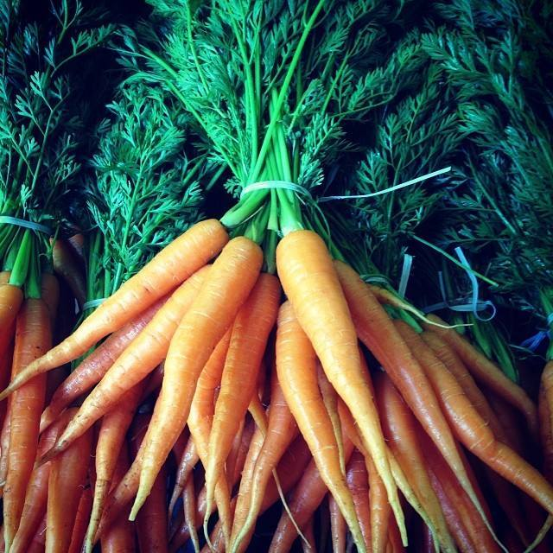
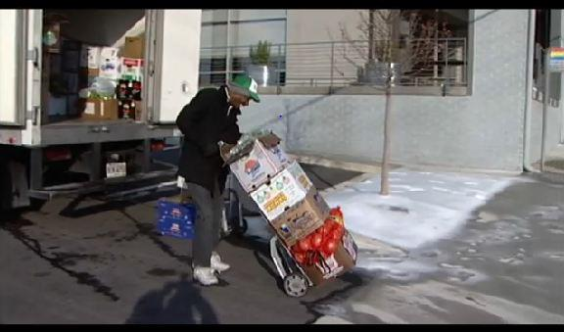
Market Considerations Packaging
RETAIL
BULK
Photo Credit: Love Is Love Farm
Photo Credit: Atlanta Local Food Initiative

Slide 19
Market Fulfillment Chart (Direct)
MARKET | COMPETITION | FULFILLMENT DIFFICULTY LEVEL | GAP & ORGANIC CERTIFICATIONS | GRADE & DIVERSITY | PRICING | PACKAGING
Pop-Up/Farmer’s Market | High | Easy | No (GAP), Conditional (ORG) | 1 & 2 / High | Dynamic | Retail
B&M/Roadside Market | Medium | Easy | No (GAP), Conditional (ORG) | 1 & 2 / High | Dynamic | Retail
CSA | High | Moderate-to-Difficult | No (GAP), Conditional (ORG) | 1 / High | Static | Retail
E-Commerce (Online) | Low | Difficult | No (GAP), Conditional (ORG) | 1 / High | Dynamic | Retail

Slide 20
Market Fulfillment Chart (Wholesale)
MARKET | COMPETITION | FULFILLMENT DIFFICULTY LEVEL | GAP & ORGANIC CERTIFICATIONS | GRADE & DIVERSITY | PRICING | PACKAGING
Terminal Market | Medium | Hard | Yes (GAP), Conditional (ORG) | 1 / Low | Dynamic | Bulk
Food Hubs | Medium | Medium | Yes (GAP), Conditional (ORG) | 1 / Low-to-High | Dynamic | Bulk
Institutions | Low | Hard | Yes (GAP), Conditional (ORG) | 1 / Low | Dynamic | Bulk
Restaurants | High | Medium | No | 1 & 2 / Low-to-High | Dynamic | Bulk

Slide 21
Idealized Case Studies
Very Small-Scale Farming
Small-Scale Farming
Mid-Scale Farming

Slide 22
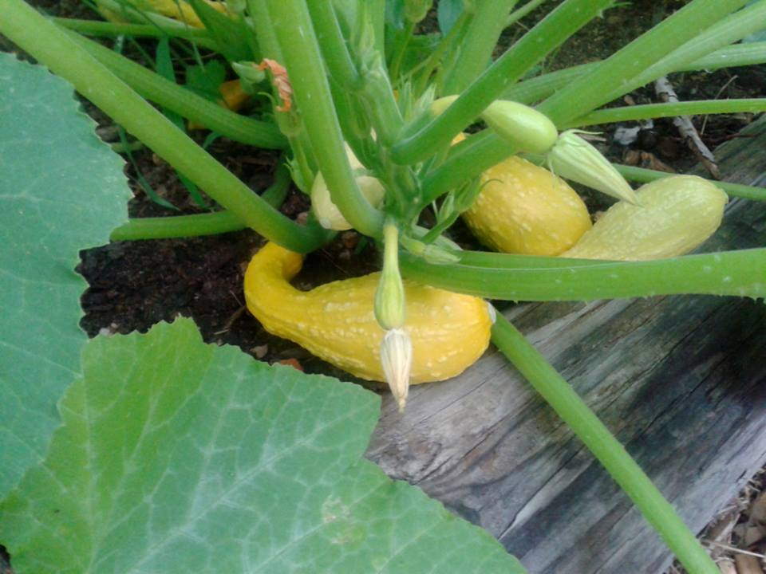
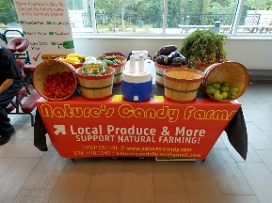
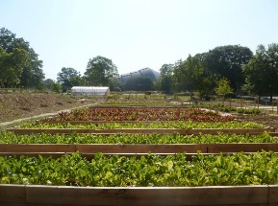
Very Small-Scale Farm Case Study Locally Yours Farms
Direct markets: 60% Pop-up markets, and Farmer’s markets.
Wholesale markets: 40% Restaurants.
Photo Credit: Tenisio Seanima
Photo Credit: Tenisio Seanima
Photo Credit: Tenisio Seanima
Photo Credit: Woolery Back
Notes:
Locally Yours Farms is a multiple-parcel site with one acre in production and one building dedicated to storage of the harvested produce. The initial growing space (Site 1) is 1/2 acre, where they grow as many as 12 crops (four per season) including: tomatoes, eggplants, peppers, kale, mustard, collards, onions, garlic, cucumbers, summer squash, bush beans, okra, and mint. Site 1 is divided into five plots, each with four 100 square foot in-ground beds (2,000 sq. ft. total). There is a small fruit-tree orchard and a single compost pile. Each plot is in a year-round rotation of warm and cool season crops. After one year, a second site was added (Site 2) that includes an additional 700 sq. ft. of growing space and two high-tunnels. Site 2 has 20 additional fruit trees. Harvest is stored in five residential-style refrigerators located at a third site.
Produce is distributed through direct markets (60%) such as pop-up markets at pre-schools and farmer’s markets. They also sell to wholesale clients (40%) such as restaurants.

Slide 23
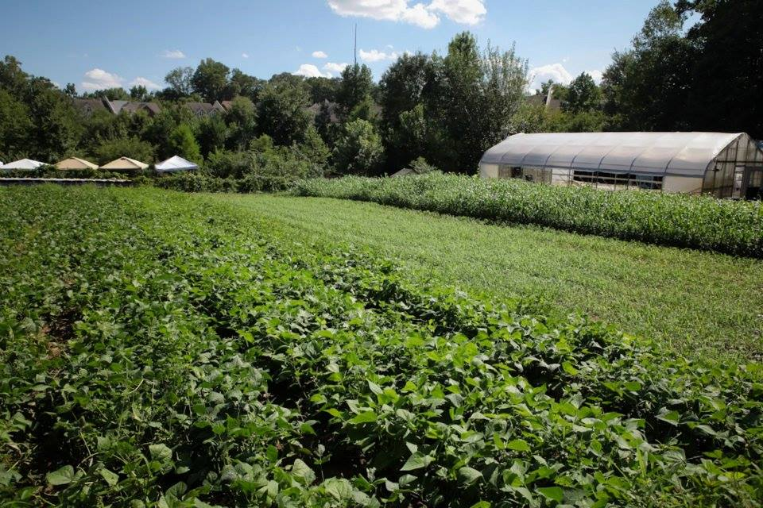
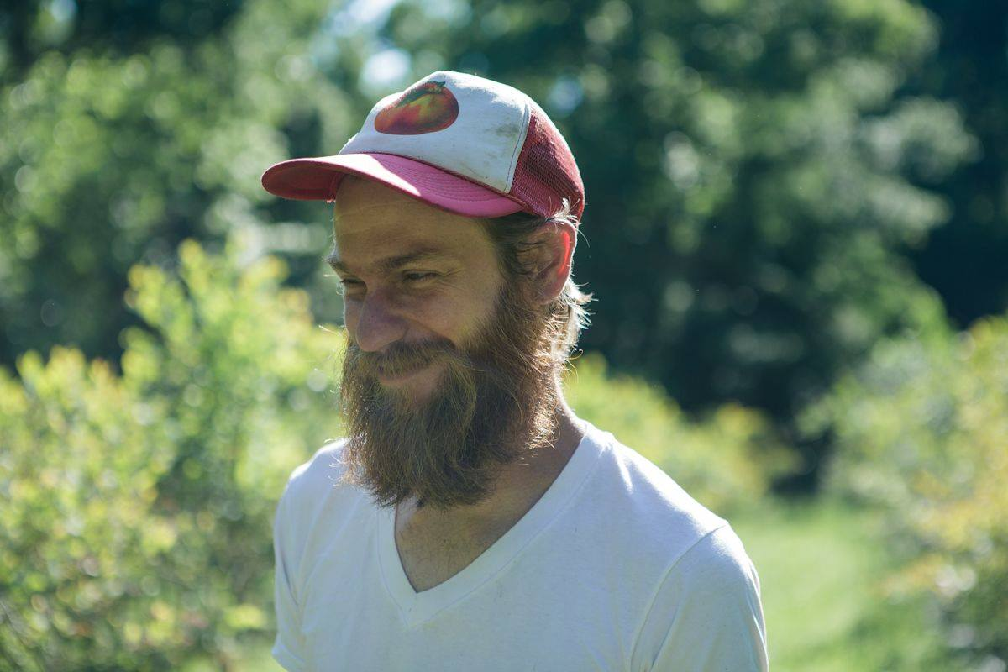
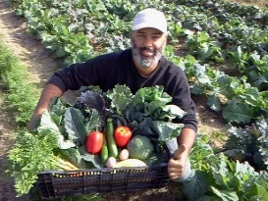
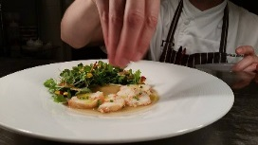
Small-Scale Farm Case Study Wanna B Farm
Direct markets: 70% CSA & Farmer’s Market
Wholesale markets: 30% Restaurants
Photo Credit: Love Is Love Farm
Photo Credit: Love Is Love Farm
Photo Credit: Local Lands
Photo Credit: Restaurant Eugene
Notes:
Wanna B Farm is a 10-acre farm that has 5 acres of open land and a small house. They grow certified organic vegetables on 0.5 acres at a given time, but have a total of 2 acres of cultivated suitable for vegetables. All crops are directly marketed to consumers; consequently, they grow a mix of vegetables and specialize in unusual, heirloom, and new cultivars. Their primary crops in the summer are squash, tomatoes, beans, peppers, and culinary herbs such as basil oregano and thyme. In the fall and spring, they grow kale, lettuce, cabbage, onions, potatoes, spinach, and carrots. Some of the herbs are dried ad sold with other seasonal crops to spread out the herb crop income.
Fifty percent of the produce is sold through a small CSA and 50% is sold at a farmers’ market and at a self-serve farm stand at the farm. The CSA uses a box per week model. Members pay up front for each 20-week season. The share price is $350/share per family-size box/week. Payments are made in advance of receiving the product. They usually sell 30 shares per season. The combined gross sales are around $42,000/year. They make extensive use of Facebook and website to keep customers abreast of crops in season.

Slide 24
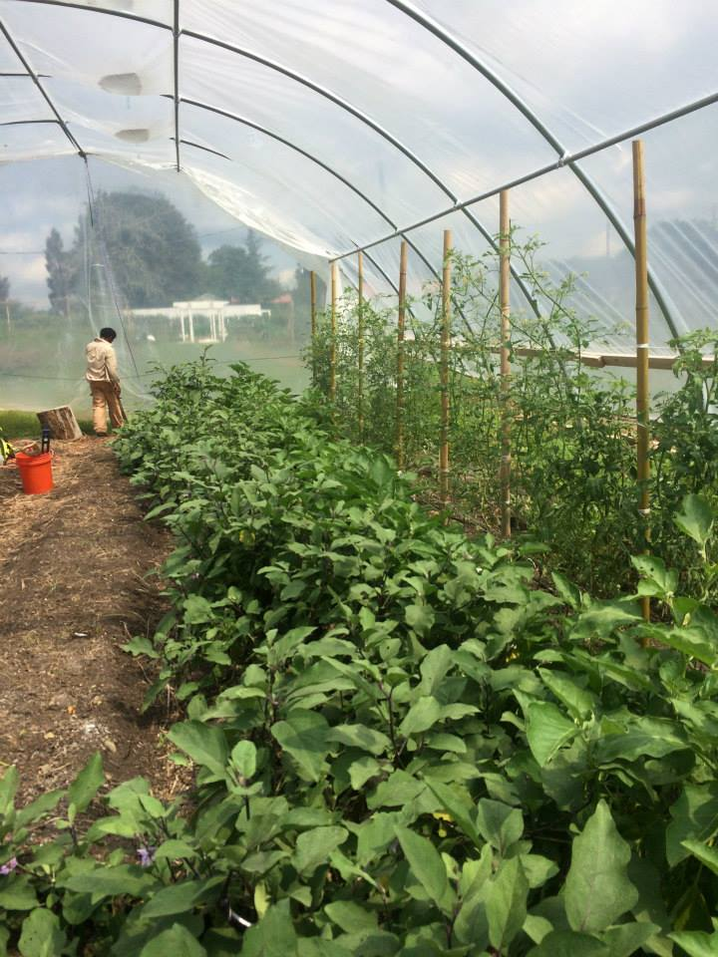
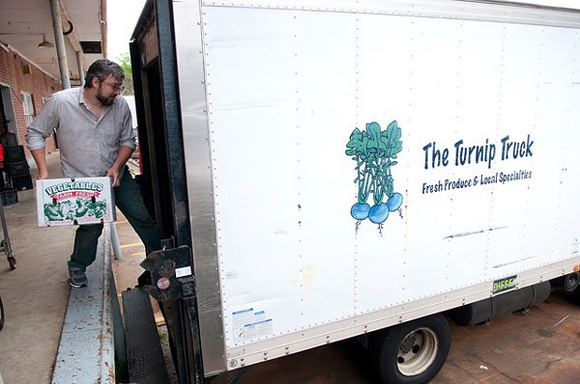
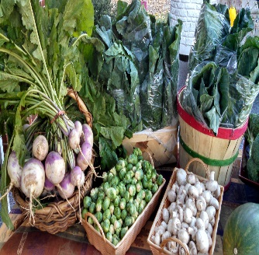
Mid-Scale Farm Case Study Gittin’ There Farms
Direct markets: 100% for first five years and 75% currently Farmer’s markets and Multi-farm CSA
Wholesale markets: 25% Terminal Markets Distributor
Photo Credit: Mayflor Farm
Photo Credit: The Turnip Truck
Photo Credit: Truly Living Well
Photo Credit: Georgia Grown
Notes:
Ideal Farms has 14 acres in vegetable production. The farm began with two acres (Bottom Field) that focused on direct marketing of crops. The Bottom Field grows up to 20 crops in a given year, though typically 6-10 in a season with several varieties of each crop. In spring/summer their crops are squash (yellow and zucchini), cucumber, snap beans, southern peas, tomato (several varieties), pepper (several varieties), eggplant, sweetcorn (successional plantings to extend harvest) and sweetpotato. Sweet corn constitutes 1/2 acre and is used as a good rotation crop between cucurbits and solanaceous crops of tomato, peppers, and eggplant. Fall and winter crops include greens (kale, turnip, mustard and collards), broccoli, potatoes (late winter/early spring), beets, carrots and green onions. The field is divided into eight 1/4 acre plots that have a complex rotation between plant families and summer and winter cover crops. In addition to grain and legume cover crops, some part of the fields is sown to buckwheat and/or sweet alyssum for pollinator and beneficial insect habitat. Strips of sunflowers are planted and harvested to give to customers at the farmers’ market. In addition these flowers can also be used by pollinators.
After five years, they expanded to another 12 acres (Front Field), which is divided into four 3-acre fields in a simplified rotation that focuses on a wholesale market. Major crops for the Front Field are fall greens, spring lettuce, snap beans and hard squash, summer sweet potatoes and sweet corn and fall-planted onions. They focus on these crops because most of these are easily direct seeded and the greens, snap beans, and corn can all be cooled using their old hydrochiller. The onions, sweet potatoes and hard squash can be cured and have easy storage requirements for wholesaling.
The farm started direct marketing at a farmers’ market. This gave them time to learn how to grow crops and what worked best on their farm. It also built their clientele and after several years they expanded their direct marketing to a multi-farm CSA. Five years later they expanded to wholesale markets of locally-focused grocery chains. The produce from the Bottom Field is direct marketed through a multi-farm CSA along with USDA #2s from the Front Field. The Front Field USDA #1s are sold wholesale through a distributor.

Slide 25
Available resources
USDA. 2015. Good Agricultural Practices (GAP) & Good Handling Practices (GHP). Agricultural Marketing Service. http://www.ams.usda.gov/services/auditing/gap-ghp
USDA. 2015. Grading services. Agricultural Marketing Service. http://www.ams.usda.gov/services/grading/request-service
USDA. 2015. Market news. Agricultural Marketing Service. https://www.marketnews.usda.gov/mnp/fv-home
USDA. 2015. Custom average pricing. Agricultural Marketing Service. http://cat.marketnews.usda.gov/cat/
GCI. 2015. Agribusiness. Georgia Centers of Innovation. http://www.georgia.org/business-resources/georgia-centers-of-innovation/center-innovation-agribusiness/

Slide 26
This material is based upon work that is supported by the National Institute of Food and Agriculture, U.S. Department of Agriculture, under award number 2015-70017-22861.
Beginning Farmer and Rancher
Development Program
Developing the Next Generation
of Sustainable Farmers in Georgia Grant

