Slide 1
Small Fruit and Vegetable Production

Slide 2
Session 6 Postharvest Learning Activity

Slide 3
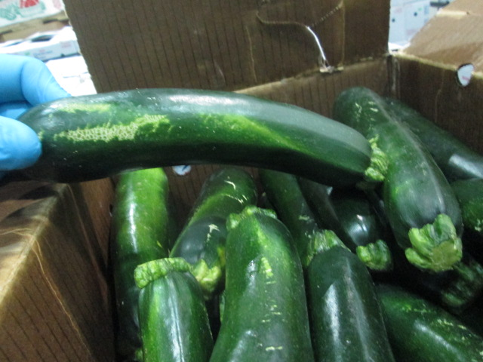
Which of the following are good post harvest handling practices?
Careful handling of produce to prevents cuts and bruising
Smooth harvest containers
Containers filled to the brim to reduce the number needed
Sharp harvest knives
Workers trained on proper harvesting
Photo: Tim Coolong
Notes:
Be gentle when harvesting – large squash growers require workers to wear gloves and use knives to cut fruit from the plant. Don’t throw produce in the field- The picture shows zucchini that was beat up prior to packing – even a small fingernail mark can be a problem- things only get worse in storage- a small injury at harvest will only get worse.

Slide 4
Which of the following are good post harvest handling practices?
Careful handling of produce to prevents cuts and bruising
Smooth harvest containers
Containers filled to the brim to reduce the number needed
Sharp harvest knives
Workers trained on proper harvesting
Photo: Tim Coolong
Notes:
Be gentle when harvesting – large squash growers require workers to wear gloves and use knives to cut fruit from the plant. Don’t throw produce in the field- The picture shows zucchini that was beat up prior to packing – even a small fingernail mark can be a problem- things only get worse in storage- a small injury at harvest will only get worse.

Slide 5
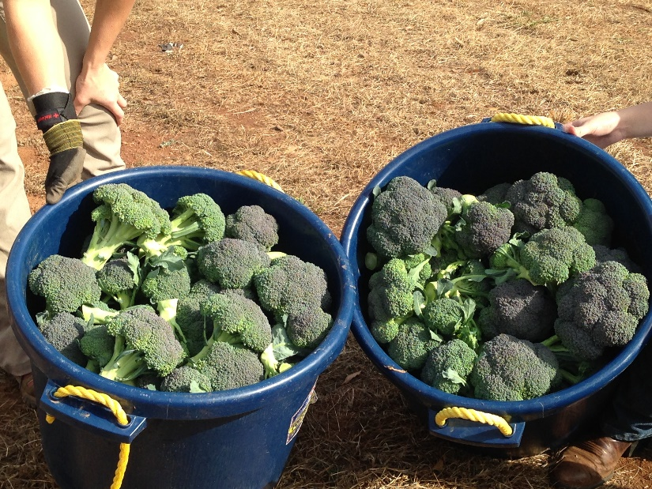
Which of the following are good post harvest handling practices?
Leave produce in containers in the sun at end of row and pick up at the end of the day
Harvest when produce is cool, but after dew has dried off.
Cool and refrigerate as soon as possible.
Photo: Julia Gaskin

Slide 6
Which of the following are good post harvest handling practices?
Leave produce in containers in the sun at end of row and pick up at the end of the day
Harvest when produce is cool, but after dew has dried off.
Cool and refrigerate as soon as possible.
Photo: Julia Gaskin

Slide 7
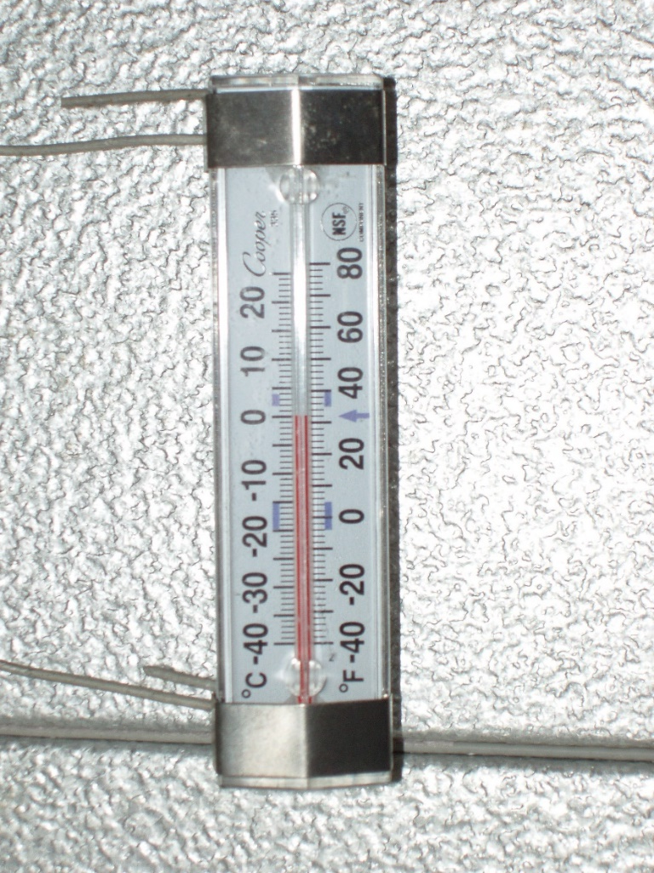
Which of the following are good post harvest handling practices?
Storing broccoli and greens at 32 to 35 ºF
Storing ripe tomatoes below 55 ºF
Storing squash at 50 to 55 ºF
Photo: Tim Coolong

Slide 8
Which of the following are good post harvest handling practices?
Storing broccoli and greens at 32 to 35 ºF
Storing ripe tomatoes below 55 ºF
Storing squash at 50 to 55 ºF
Photo: Tim Coolong

Slide 9
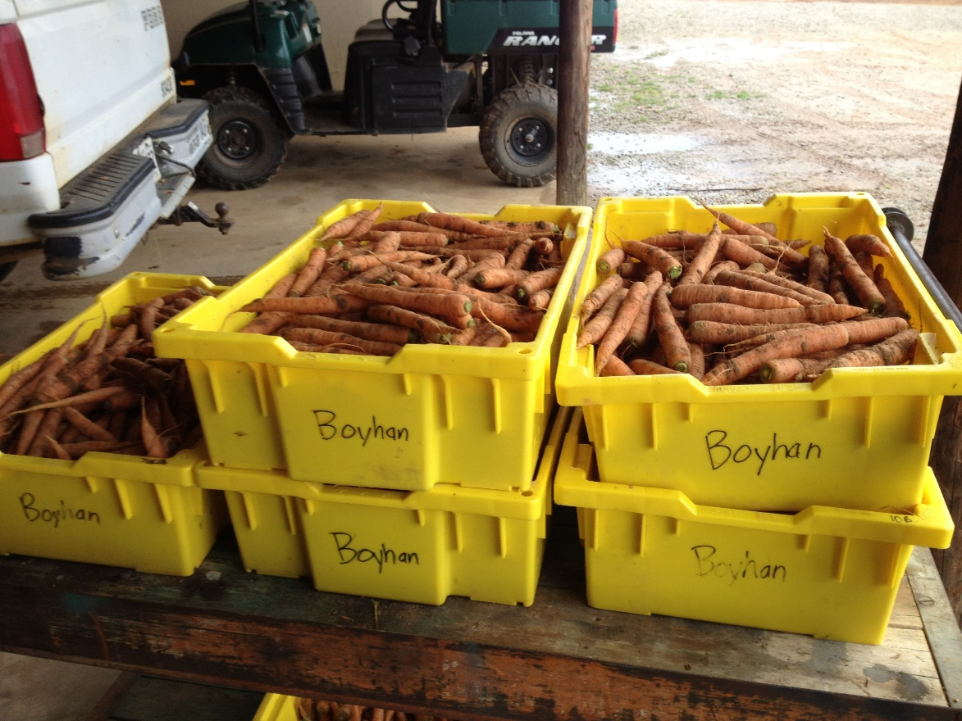
Five Factors that Affect Shelf Life
Harvest handling
Reduce field heat
Proper temperature
Ethylene sensitivity
Surface area of crop
Photo: George Boyhan

Slide 10
This material is based upon work that is supported by the National Institute of Food and Agriculture, U.S. Department of Agriculture, under award number 2015-70017-22861.
Beginning Farmer and Rancher
Development Program
Developing the Next Generation
of Sustainable Farmers in Georgia Grant
Notes:
This publication is simply the best postharvest manual for small growers – hands down.

