Slide 1
Small Fruit and Vegetable Production

Slide 2
Session 6 Postharvest Management of Vegetables
Timothy Coolong PhD
Extension Vegetable Specialist
University of Georgia, Tifton Campus

Slide 3
Learning Objectives
Identify five factors that can affect shelf life

Slide 4
Postharvest Storage
Storage losses of horticultural products are higher than other agricultural products
High water content makes them perishable
Although the U.S. has better infrastructure losses can still be high
Storage losses in developing countries
Commodity | Production (1000 tons) | Postharvest Losses (%)
Carrots | 600 | 44%
Onions | 6,500 | 15-35%
Cauliflower | 1000 | 50%
Lettuce | - | 65%
Kays and Paull, 2004. Postharvest Biology
Notes:
The first 2 slides are simply introductory information. Although not essential to the day to day operation of a farm I feel it is appropriate to point out how important postharvest losses are in the U.S. and world-wide. Because vegetables have a high water content they easily break down in storage – get the audience thinking about the length of storage life of most crops – if they decide to grow a lot more of a given crop than they can sell they must decide –1: can it be stored? 2: even if they can store it- how long will they have?

Slide 5
Postharvest Costs
Production costs are often only a portion of total costs
Particularly for horticultural crops
This needs to be considered when budgeting
Crop | Production (%) | Postharvest (%)
Snap Bean | 54 | 46
Sweet potato | 51 | 49
Sweet corn | 49 | 51
Apple | 44 | 56
Kays and Paull, 2004. Postharvest Biology
Notes:
This slide just is here to promote discussion of costs of storing vegetables – running a cooler, re-grading, packaging are all postharvest costs that need to be considered.

Slide 6
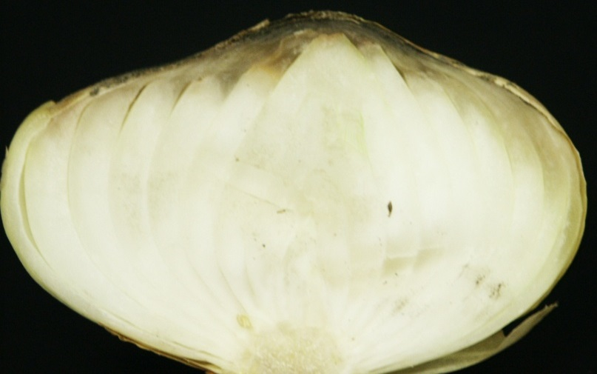
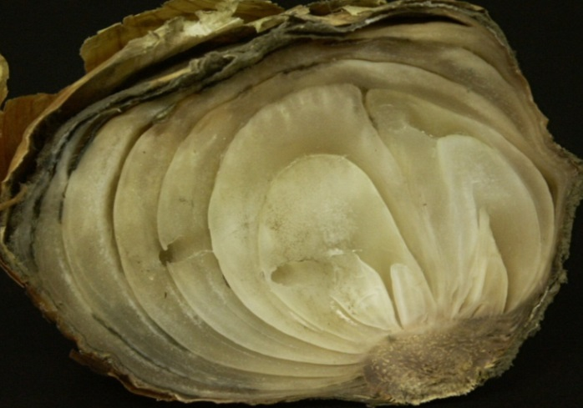
Postharvest Quality
If you start off with poor product you can only get worse in storage
Harvested fruit and vegetables are still living organisms
After harvest destructive processes are favored
4 weeks
Photos: Tim Coolong
Notes:
Impress upon the audience that once vegetables are picked they have a finite life span – the clock is ticking – you can do things to extend that time, poor practices also can shorten that time. Also – and this is sometimes difficult for new growers – but you must grade vegetables very hard if they are going into storage – if you harvest something that has even a little bit of disease – it will not get better and more than likely will ruin everything else around it. If it looks suspect do not store it! The onion picture shows how neck rot (botrytis) can spread in an onion. At harvest just a very small bit of the top of the bulb is affected…and this would be hard to catch to the casual observer, but after 4 weeks in storage it can spread to ruin and entire bulb.

Slide 7
Phytophthora in Squash
Photo: Tim Coolong
Notes:
This is only one example of a post harvest disease but I included it to show that when these zucchini were harvested and packed there was not visible disease on the fruit- just some small dark sunken areas – the grower was not careful and packed the fruit – after 5 days in transit several semi loads were discarded. Again- not a single fruit had any significant evidence of this disease at harvest – just some minor dark areas – this cost the grower nearly $90k.

Slide 8
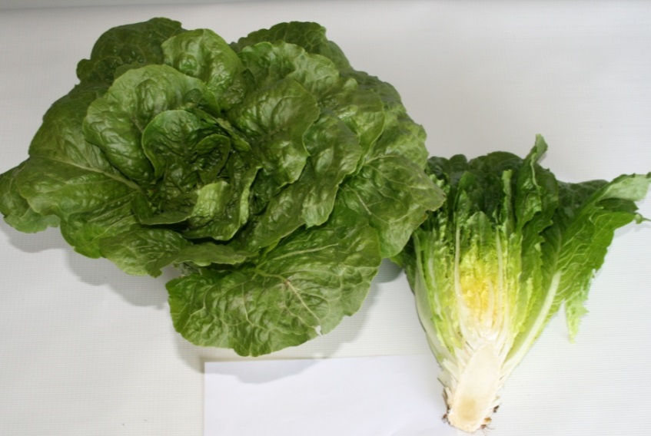
Postharvest Quality
Constructive
Photosynthesis
Root absorption of water and nutrients
Destructive
Respiration
Moisture loss
Ethylene production
Carbohydrate transformations
Pectic changes (softening)
Esters for flavor and aroma are produced
Pigment changes
6CO₂ + 6H₂O C₆H₁₂O₆ + 6O₂
Photo: Tim Coolong
Notes:
This slide is used to compare the processes that occur during growth (nutrient absorption, water uptake, and photosynthesis) that immediately cease upon harvest – in contrast, at harvest the following destructive changes start to occur – the goal is to reduce the destructive changes that occur in vegetables.

Slide 9
Respiration
Respiration is generally the conversion of stored sugars and oxygen to carbon dioxide and energy
Lose dry matter during storage
Respiration rate increases with water content, oxygen levels and temperature
Rates typically double with an 18 ºF increase in temperature
C₆H₁₂O₆ + 6O₂ 6CO₂ + 6H₂O + Energy
Notes:
Respiration is a primary destructive process that occurs during storage – vegetables respire just as humans do – they use sugars to create carbon dioxide – by consuming sugars vegetables can lose dry matter in storage. Cooling vegetables is the primary way to reduce respiration. Vegetables with high rates of respiration store only for a short period of time and are often require the most cooling (so long as the products are not injured by the temperatures) – while those that have low rates of respiration will store the longest.

Slide 10
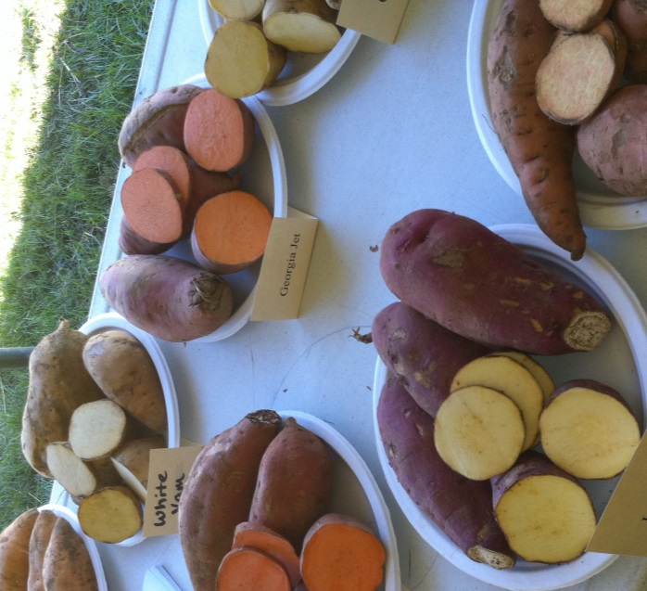
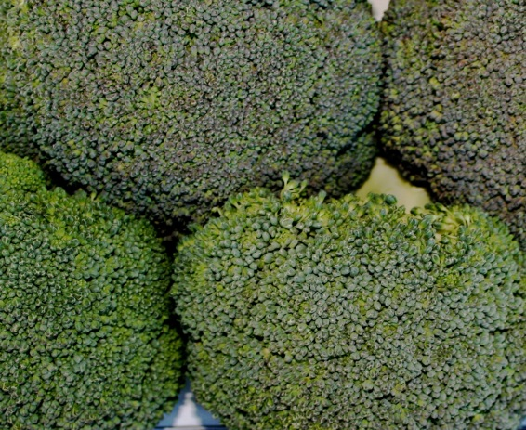
Relative Rate of Respiration
Very High | High | Moderate | Low | Very Low
Asparagus | Bean | Beet | Cabbage | Onion
Broccoli | Lettuce | Carrot | S. Potato | Potato
Corn | Limas | Cucumber | Turnip
Pea |  | Muskmelon
Spinach |  | Pepper
 |  | S. Squash
 |  | Tomato
 |  | W. Squash
Photos: Tim Coolong
Table: Dr. John Strang, UKY Horticulture
Notes:
This slide just details the rates of respiration of different crops – it should be noted that depending on when a crop is harvested can affect storability. For example – green mature tomatoes can be stored at cool temperatures for 6 weeks at times, while those that are harvested red and ripe only have a few days – By harvesting the tomatoes early and cooling them growers are picking the fruit before destructive processes (pectin changes – softening, volatiles, ethylene production, etc) take place. However- in the case of many fruit and vegetables those destructive process can also lend important flavor and texture qualities.

Slide 11
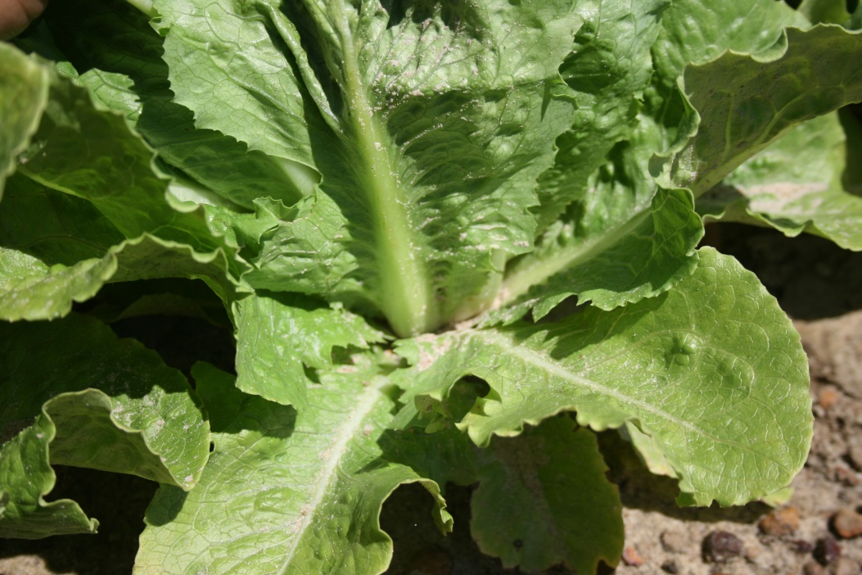
Water Losses
Horticultural products are primarily water
Much of the weight lost in storage is water
High surface area =Increase water loss
Waxes=decrease water loss
Photo: Tim Coolong
Notes:
Highlight ways to prevent water losses – sometimes waxes can be applied to fruit such as apples but for crops like lettuce that cannot be done. Therefore try to mitigate water losses by placing some vegetables in very humid environments – you can use something like a clamshell container to create a microenvironment for a small portion of your crop if you do not have the ability to manage humidity on a large scale in a storage room. Think of ways to reduce water losses.

Slide 12
Ethylene Production
Ethylene is a gas that promotes ripening and other postharvest changes
Autocatalytic process
Ethylene production increases greatly in bruised and diseased fruits and vegetables
Climacteric fruit and veggies
Climacteric fruits and veg. will ripen after harvest if picked when mature
Notes:
Ethylene is a gas produced by fruit and vegetables that can initiate widespread changes in the fruit and vegetables (ripening).

Slide 13
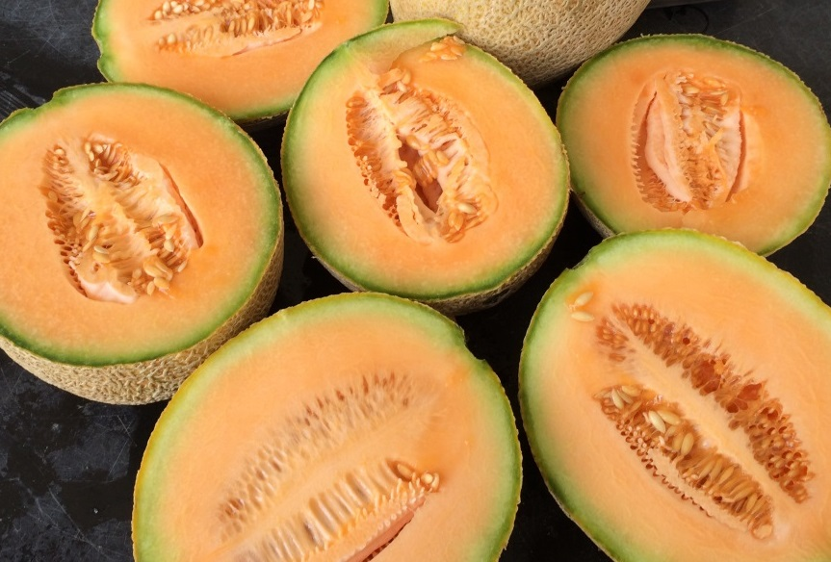
Ethylene Producing Fruit and Vegetables
Apple | Cantaloupes
Avocado | Honeydew
Banana | Hot peppers, chiles
Fig | Tomato, ripe
Mango
Papaya
Peach/Nectarine
Pears
Plums
Persimmons
Photo: Tim Coolong

Slide 14
Ethylene Sensitive Vegetables
Arugula | Chili pepper | Parsnip
Asparagus | Cucumber | Parsley
Beans, snap | Eggplant | Peas
Broccoli | Greens | Pumpkin
Brussels sprouts | Green onion | Southern peas
Cabbage | Herbs | Squash
Carrot | Kale | Tomatillo
Cauliflower | Lettuce | Watermelon
Notes:
The following vegetables can be negatively affected by placing them in close proximity to vegetable that produce large amounts of ethylene. Fruit crops in general produce more ethylene than vegetables, though some vegetables do produce large amounts of ethylene as indicated on the previous slide.

Slide 15
Relatively Ethylene Insensitive Vegetables
Artichoke | Horseradish | Rhubarb
Bean sprouts | Pepper | Rutabaga
Beet | Radish | Sweet corn
Dr. John Strang, UKY Horticulture
Photo: Tim Coolong
Notes:
All plants are sensitive to ethylene, but some less so than others- the following vegetables are relatively insensitive to ethylene and may be less of a concern when stored with ethylene producing crops

Slide 16
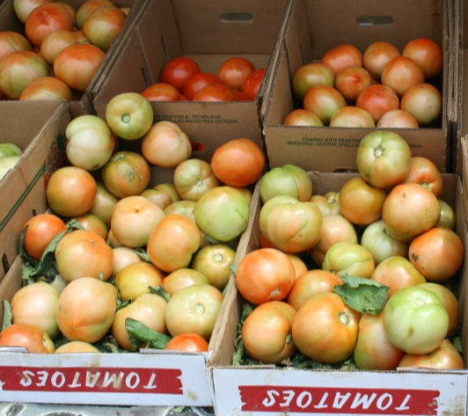
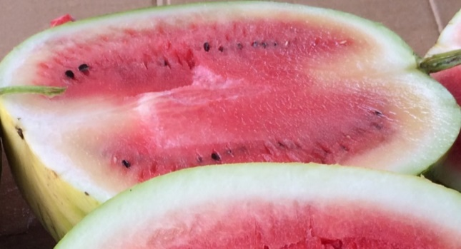
Climacteric Fruit
Climacteric
Apple
Tomato
Avocado
Banana
Honeydew
Pawpaw
Non Climacteric
Pepper
Raspberry
Blackberry
Watermelon
Potatoes, onions, etc.
Photos: Tim Coolong
Notes:
It is important to understand climacteric fruit and vegetables – these are fruit and vegetables that essentially will ripen after harvest. Although technically climacteric refers to a spike in respiration – for practical purposes it can be used to separate products that will ripen on and off the plant on which they are grown.

Slide 17
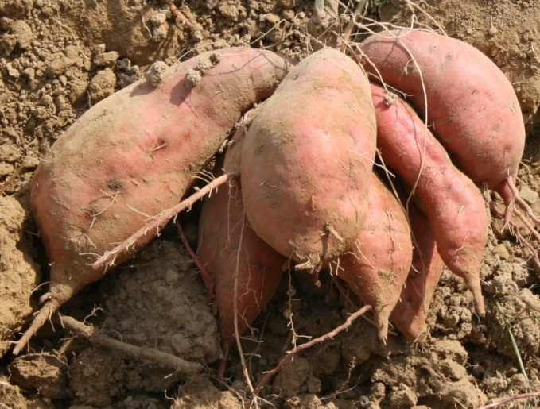
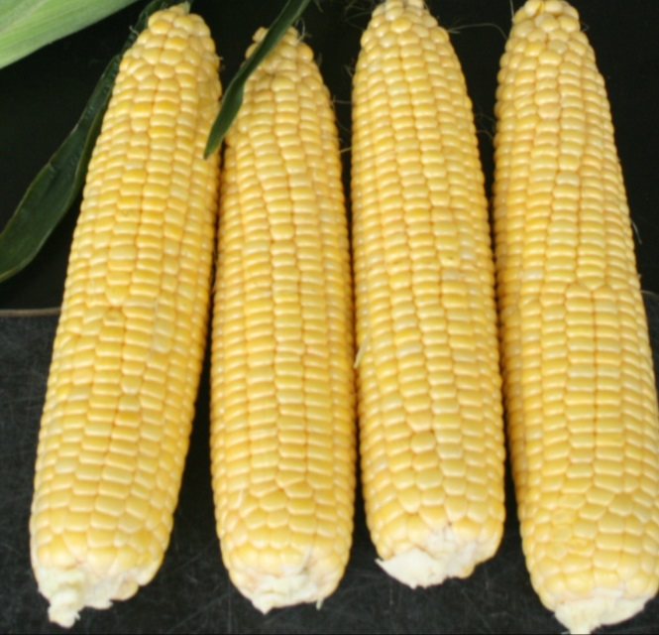
Carbohydrate changes
Some produce with starches will get sweeter as it is converted to sugar-some will get starchier as small sugars are converted into starch
Photos: Tim Coolong
Notes:
Understanding changes in carbohydrates is important – sweetpotatoes need some time after harvest for starches to break down in to simple sugars- therefore making them sweeter. Corn however can rapidly convert simple sugars into starches and must be kept very cold immediately after harvest to slow these changes.

Slide 18
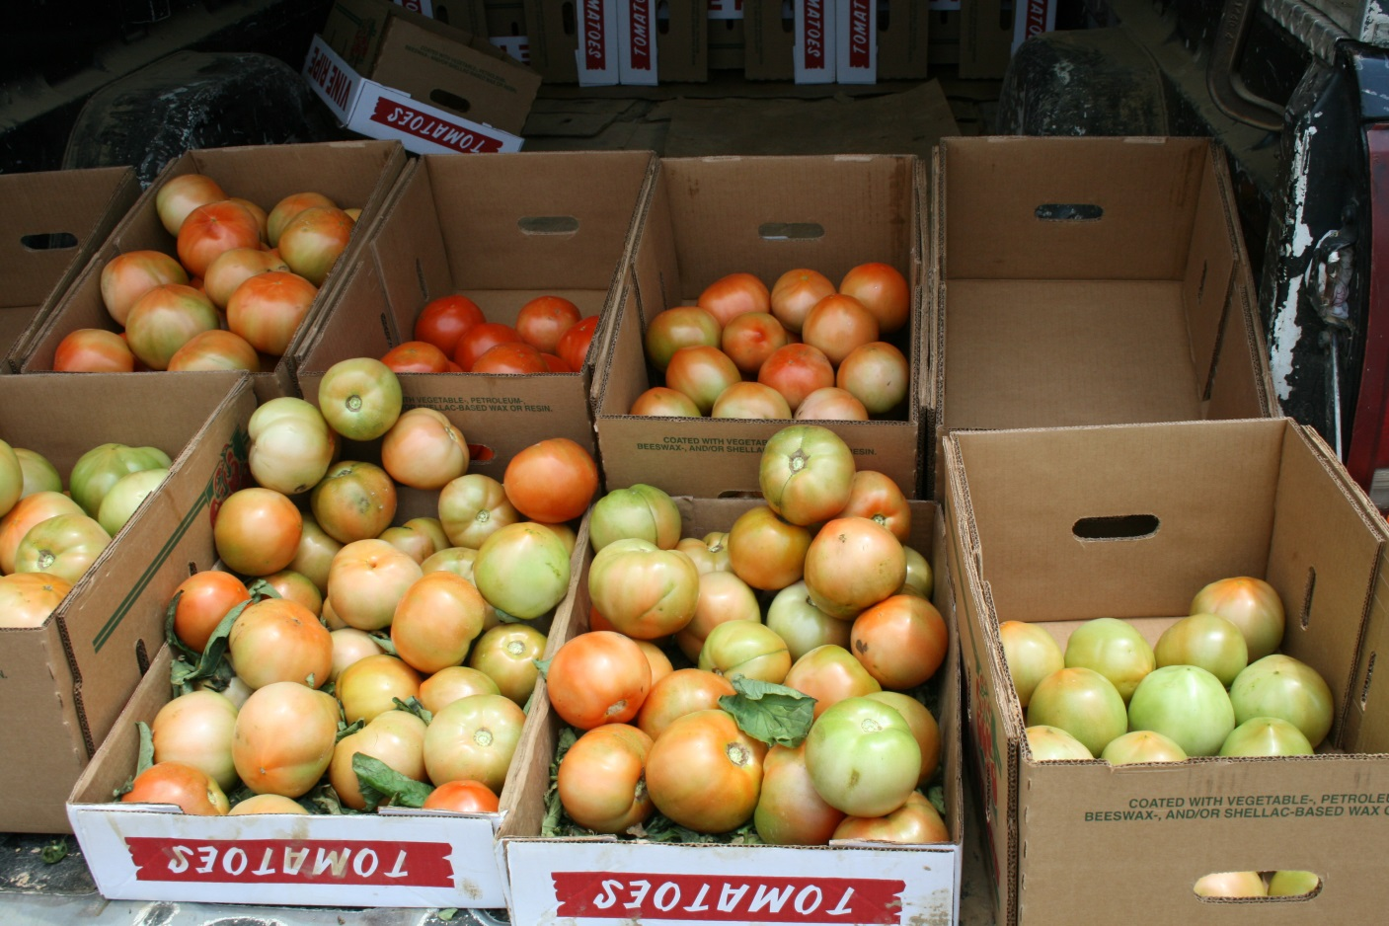
Pigment changes
Some produce will continue to color up after harvest if harvested mature
Photo: Tim Coolong
Notes:
This one is fairly obvious- but some vegetables will continue to turn color after harvest and others not- often this is related to climacteric (ripening) processes. Bell peppers will not change color from green to red off the plant, but tomatoes will.

Slide 19
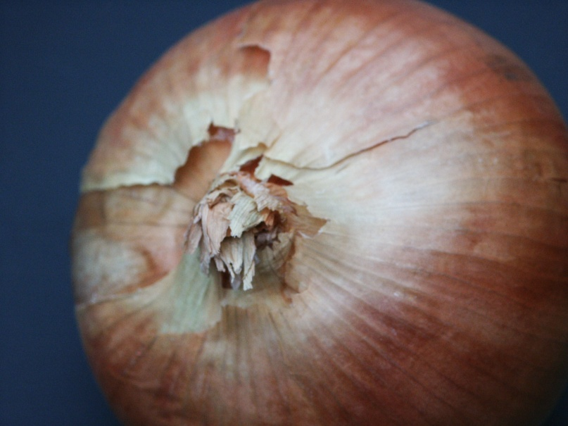
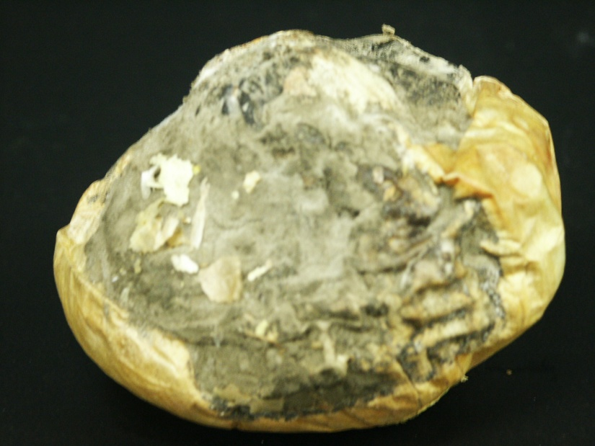
So how do we slow down the respiration rate, reduce acid, carbohydrate and pectin changes, as well as moisture loss ?
Photos: Tim Coolong
Notes:
Now that we know the processes we are dealing with – what can we do to slow them down?

Slide 20
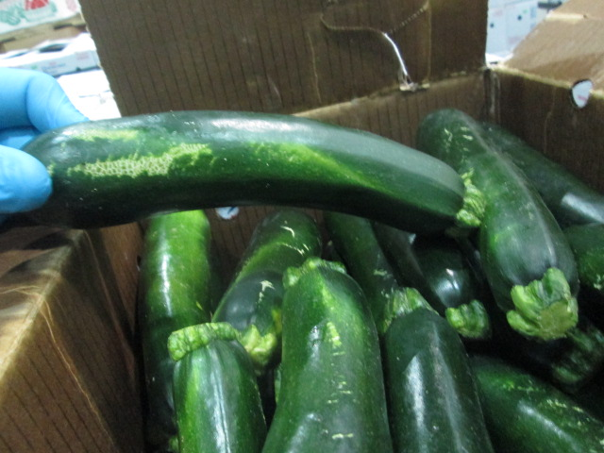
Harvest/Rough Handling
Careful handling of produce is essential
Produce injury can negate all other efforts to maintain quality
Bruising causes rates of respiration and ethylene production to increase dramatically.
Cuts and scrapes provide a point of entry for decay-causing organisms.
Photo: Tim Coolong
Notes:
Be gentle when harvesting – large squash growers require workers to wear gloves and use knives to cut fruit from the plant. Don’t throw produce in the field- The picture shows zucchini that was beat up prior to packing – even a small fingernail mark can be a problem- things only get worse in storage- a small injury at harvest will only get worse.

Slide 21
Harvest/Rough Handling
Remove protruding nails, staples and smooth rough edges on field and harvest containers- wooden boxes.
Harvest workers should not have long, sharp fingernails
Use care in dumping produce from one container to another
Photo: Tim Coolong
Notes:
This is an actual pepper grower in S. Ga- although the conveyer helps with speed- it also is set up for very gentle handling of the fruit- notice the worker on the far right who is dumping the baskets into the bin – notice how he has the basket actually lowered into to the bin to reduce how far the fruit fall- If growers that farm 500 acres of pepper can have this level of care for produce handling there are no excuses for small growers –furthermore if vegetable production is something that the audience wants to get into- they need to think long and hard about the level of care they are willing to give to a crop.

Slide 22
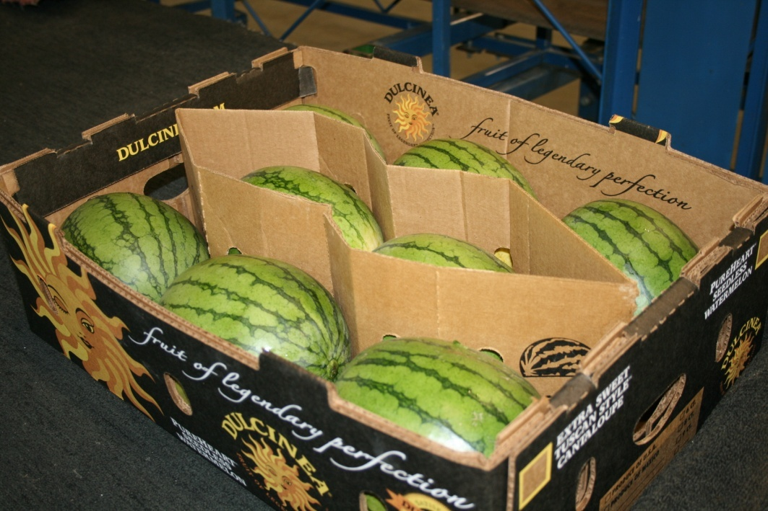
Harvest/Rough Handling
Don’t overfill containers! Severe damage results when stacked.
Consider harvest time of day. Many products are more turgid in early morning and bruise more easily.
Photo: Tim Coolong

Slide 23
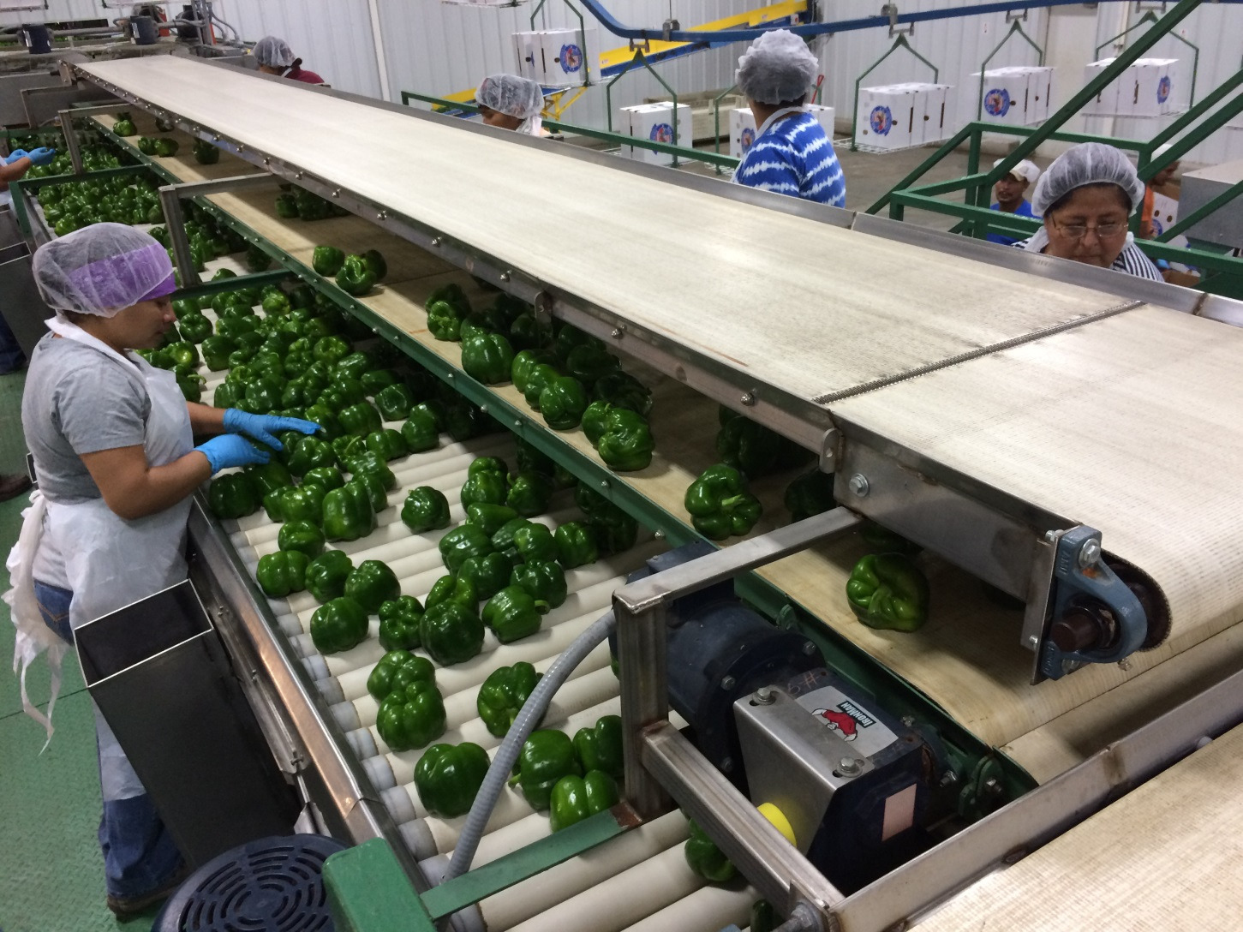
Postharvest Handling
Photo: Tim Coolong
Notes:
This slide is simply here to show the audience what the expectations should be insofar as cleanliness in the packing shed – it is not expected that a small grower would have a line like this BUT they absolutely should be as clean as this.

Slide 24
Reduce produce temperature
Harvest when produce is cool, but after dew has dried off.
Get produce out of the sun as soon as possible.
For every hour after harvest that bramble fruit are not refrigerated, one day of storage life is lost.
Cool and refrigerate as soon as possible.
Reducing the temp. also slows growth of disease and decay organisms.
Leads to produce sweating, when it is warmed up- do not warm and cool

Slide 25
Effect of a Delay in Storage
Apple softening is
2X as fast at 70º F as 50º F
2X as fast at 50º F as 40º F
2X as fast at 40º F as 32º F
The sooner an apple is placed in storage the longer it will maintain its quality.

Slide 26
Photo: Tim Coolong
Notes:
This picture shows a flume for mini-melons – be aware when using a tank to “dip” produce that if done improperly can be a vector for food-borne diseases- Water must be warmer than the produce that is being dumped in it and absolutely should be treated with a sanitizing agent – do not use dump tanks unless you are ready to manage them at a very high level –This is extremely important – you can kill people if you mess this up.

Slide 27
Handling Fresh Produce
Produce | Temp. F | Rh (%)
Apples | 32-40 | 90
Blackberries | 32 | 90-95
Broccoli & Greens | 32-35 | 90-95
Bell Peppers | 45-50 | 90-95
Squash | 50-55 | 85-90
Tomatoes, green | 50-55 | 85-90
Tomatoes, ripe | 55-60 | 85-90
Onions | 34 | 75
Courtesy Dr. John Strang, UKY Horticulture

Slide 28
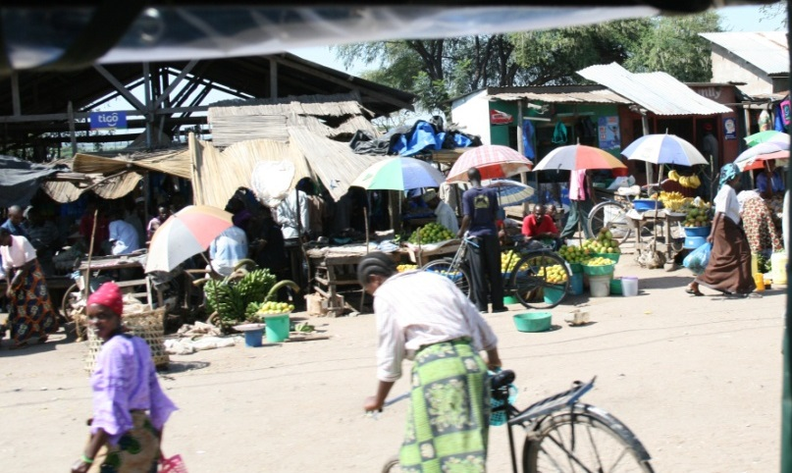
Farmers’ Market Suggestions
Keep produce, particularly that with a high respiration rate as cool as possible prior to, in transit and at the market
Room with an air conditioner
Refrigerated truck
Hold in cooled ice chests prior to displaying
Iced produce display
Keep produce out of the direct sun
Photo: Tim Coolong

Slide 29
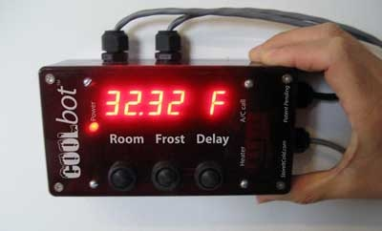
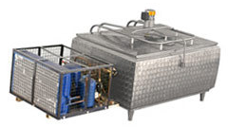
Building a cool room
Some growers install an air conditioner in a trailer & insulate
Add a Cool bot
See attached publication
Hydrocooler made from a milk cooler
Photo: Tim Coolong
Notes:
I have attached a great publication from John Wilhoit at the University of Kentucky regarding building a cool room with a cool bot. Also, if the growers have some mechanical aptitude you can build a simply hydrocooler from an old milk chiller and a pump, Essentially you chill water in the chiller and then pump the chilled water over the product to cool it – takes some work but it is very effective and a fraction of the cost of a real hydrocooler.

Slide 30
Learning Activity
Identifying good post-harvest handling practices

Slide 31
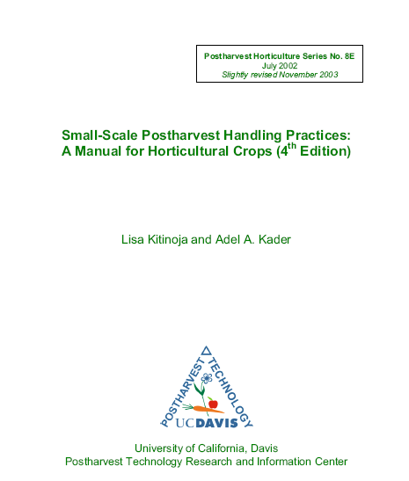
Additional Resources
Small-scale postharvest handling practices: A manual for horticultural crops 4th ed.

Slide 32
This material is based upon work that is supported by the National Institute of Food and Agriculture, U.S. Department of Agriculture, under award number 2015-70017-22861.
Beginning Farmer and Rancher
Development Program
Developing the Next Generation
of Sustainable Farmers in Georgia Grant
Notes:
This publication is simply the best postharvest manual for small growers – hands down.

