Slide 1

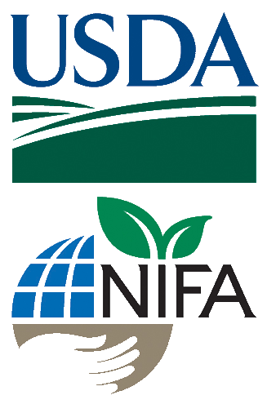
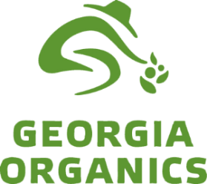

Small Fruit and Vegetable Production

Slide 2
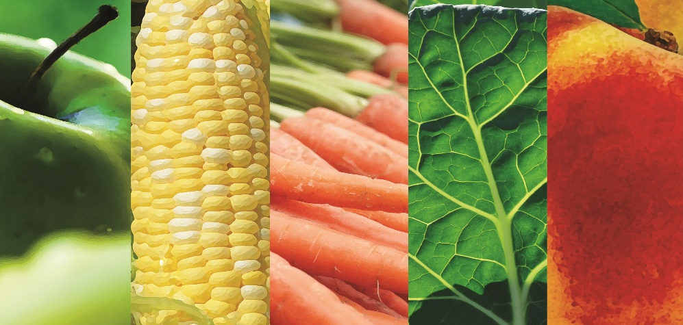

Session 6
Growing and Selling Safe Produce
Judy A. Harrison, Ph.D.
Professor and Extension Foods Specialist
University of Georgia
Notes:
Welcome to Session 6 – Food Safety – It starts with you! This session focuses on preventing foodborne illness - why foodborne illness can be a problem with produce and how to keep the produce you grow and market safe.

Slide 3
Learning Objectives
List the 6 areas of concern for food safety on the farm

Slide 4

Foodborne illness in the US Each Year
1 out every 6 Americans
128,000 hospitalizations
3,000 deaths
Centers for Disease Control and Prevention, 2011
Notes:
The Centers for Disease Control and Prevention estimate that 1 out of every 6 people in America suffer from a foodborne illness each year (or “food poisoning” as some people call it). Many cases of foodborne illness go unreported because symptoms last for a few hours or days and clear up on their own. Not everyone is so lucky. There are over 128,000 hospitalizations in the U.S. and about 3,000 people who die each year from food that they eat.

Slide 5
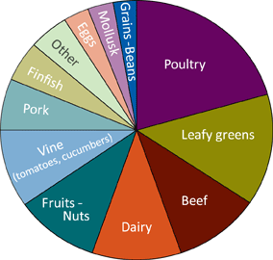
Causes of Foodborne Illness Outbreaks
Causes of illness in 1,565 single food commodity outbreaks, 2003–2008.
(46% of illnesses from produce)
2011. www.cdc.gov/foodborneburden/cdc-and-food-safety.html and Emerging Infectious Diseases. March 2013.
www.cdc.gov/eid. Vol. 19, No. 3.
Notes:
We often think of meats and poultry as being the culprits, but if you put together the illnesses attributed to leafy greens, fruits and nuts and produce that grows on vines, you can see that produce is a big cause of outbreaks. In fact, 46% of illnesses during that time period from 2003 -2008 were from produce.

Slide 6
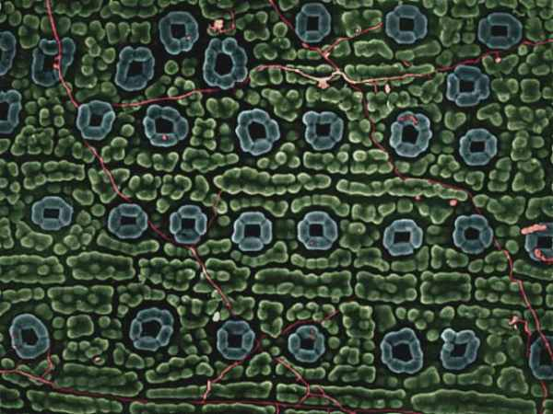
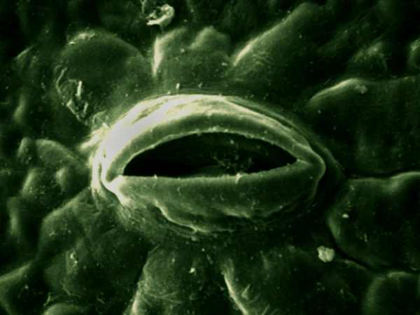
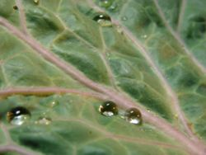
Why are there so many problems with produce?
Once produce is contaminated, it’s difficult, if not impossible to remove contamination
Courtesy of Dr. Joseph Frank, University of Georgia Dept. of Food Science and Technology
Notes:
So why are there so many problems with produce? Won’t it be safe if you just wash it? The problem is that once produce is contaminated, it is difficult, if not impossible, to remove the contamination. Here is why. Plants have openings on leaves for gas exchange. They allow the plant to take in carbon dioxide and give off oxygen and water vapor. The first two micrographs show openings on the surface of a leaf or plant. The third photo shows water collecting on the surface of a leaf like a lettuce leaf. The water could be from rain, from irrigation or just from water splashing onto the plant. If that water is contaminated, or if the surface of the plant has harmful microorganisms present, then they can enter the plant through these openings. If disease-causing microorganisms get inside the plant, it is difficult, if not impossible to remove them. So contamination may not just be on the surface. It can actually be inside.

Slide 7
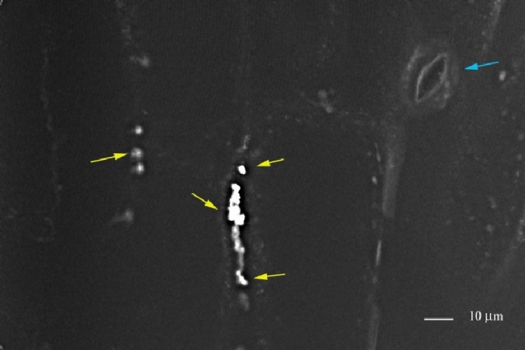
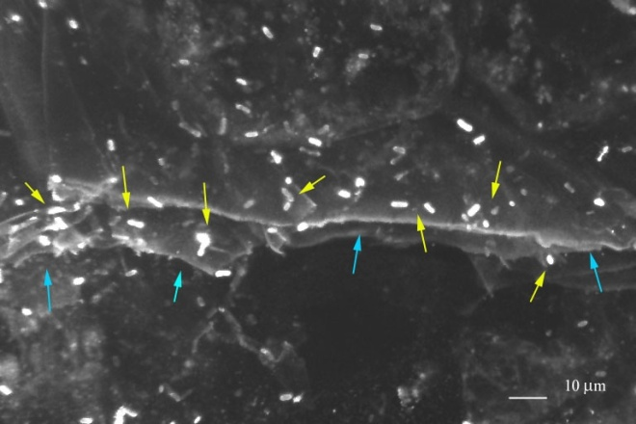
E. coli O157:H7 attached to a break in the waxy cuticle on lettuce leaf surface
E. coli O157:H7 on the cut edge of lettuce leaf
Courtesy of Dr. Joseph Frank, University of Georgia Dept. of Food Science and Technology
Notes:
The glowing rods you see in these micrographs are E. coli O157:H7 collecting along a cut or damaged area of a lettuce leaf. This is another example of how microorganisms could enter into produce and contaminate it. So keeping produce at its peak quality so that there is less damage to the produce can also be a step toward enhancing its safety.

Slide 8
What’s the big deal about foodborne illness?
Symptoms:
Diarrhea
Vomiting
Nausea
Abdominal pain
Fever
Complications:
Reactive arthritis
Guillain-Barre syndrome
Spontaneous abortion, stillbirths
HUS (kidney failure)
TTP (blood clots, can lead to stroke)
Death
Notes:
So what if someone gets a foodborne illness? Doesn’t it just go away on its own?
In many cases, yes, it may go away on its own. Symptoms can include:
Diarrhea (which is the number one symptom)
Vomiting
Nausea
Abdominal pain and
Fever, with certain types of illnesses.
In many otherwise healthy people, these symptoms may simply go away on their own. That is why foodborne illness case numbers are just estimates and probably underestimates because often, people don’t see a doctor.
However, in certain population groups, more severe complications can result. There is a type of arthritis called “reactive arthritis” that can occur after certain foodborne illnesses. Guillain-Barre syndrome is a type of muscle weakness or paralysis that can occur in some individuals after cases of certain foodborne illnesses. Spontaneous abortions, stillbirths or deaths of infants after birth can result if pregnant women become infected by Listeria that we mentioned earlier. E. coli O157:H7 is a leading cause of kidney failure in young children causing a condition known as HUS. Foodborne illnesses can and do cause deaths each year.

Slide 9
At Risk Groups
Infants and young children
Elderly
Pregnant women
Immunocompromised individuals
Notes:
The most at-risk groups for developing serious complications are young children, older adults, pregnant women and people who are already suffering from diseases like diabetes or are on chemotherapy for cancer that has weakened their immune systems.

Slide 10
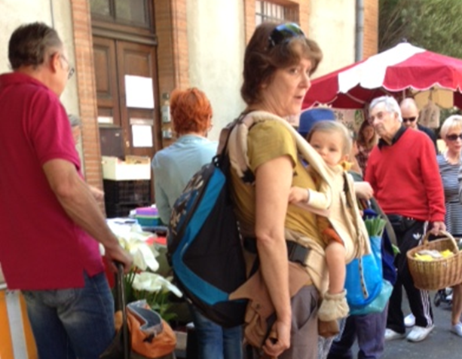
Who will be your customers?
Photo: Judy Harrison
Notes:
Take a look at this typical photo made in a farmers market. Who do you see? Many of these “at risk” people are going to be your customers for your “locally grown” produce because they think it is healthier and safer for them.

Slide 11
What if I make someone get sick?...
Liability
Table 1 Compensation in Court Cases by Severity Category, 1988-97*
Illness Severity | Court Cases with Award Information | Percent Won by Plaintiff | Average Award
Premature death | 6 | 66.7% | $274,580
Hospitalized & survived | 60 | 31.7% | $141,199
Other cases | 109 | 29.4% | $110,916
* Only 175 of 178 court decisions had award information. All awards are in 1998 dollars.
Buzby et. al, Economic Research Service, USDA, Agricultural Economic Report 799. www.ers.usda.gov/publications/aer799/aer799.pdf
Notes:
Making someone sick with food that you produce and sell can have serious consequences not only in terms of their health, but in liability issues for you. This chart from the USDA Economic Research Service shows average awards made in foodborne illness settlements in 1998 dollars. If you made someone sick and they had to be hospitalized, what would happen to your farm if you had to pay more than $100,000 or more $275,000 if that person didn’t survive?

Slide 12
And what about settlements today?
Seattle Law Firm Obtains $1.4 Million Settlement on Behalf of Salmonella Outbreak Victims
Many settlements are undisclosed…
Odwalla $12,000,000 – $15,000,000 E. coli O157:H7 settlement
Jack in the Box $15,600,000 settlement E. coli O157:H7 settlement
Notes:
That was then. This is now. One recent settlement for $1.4 million was disclosed in a case where 55 persons were infected with Salmonella from contaminated orange juice.
Many settlements are not disclosed. But some of the more high profile cases that have been made available include settlements in the millions of dollars for E. coli victims.

Slide 13
What we’ve observed among farmers, market managers and consumers
It’s locally grown…
I know that farmer…
It’s organic…
Notes:
Sometimes when I talk to farmers they say, oh yeah, but that’s from those big farms.
What we have observed among farmers, market managers and even consumers is this attitude that:
It’s locally grown…
I know that farmer…
It’s organic…

Slide 14
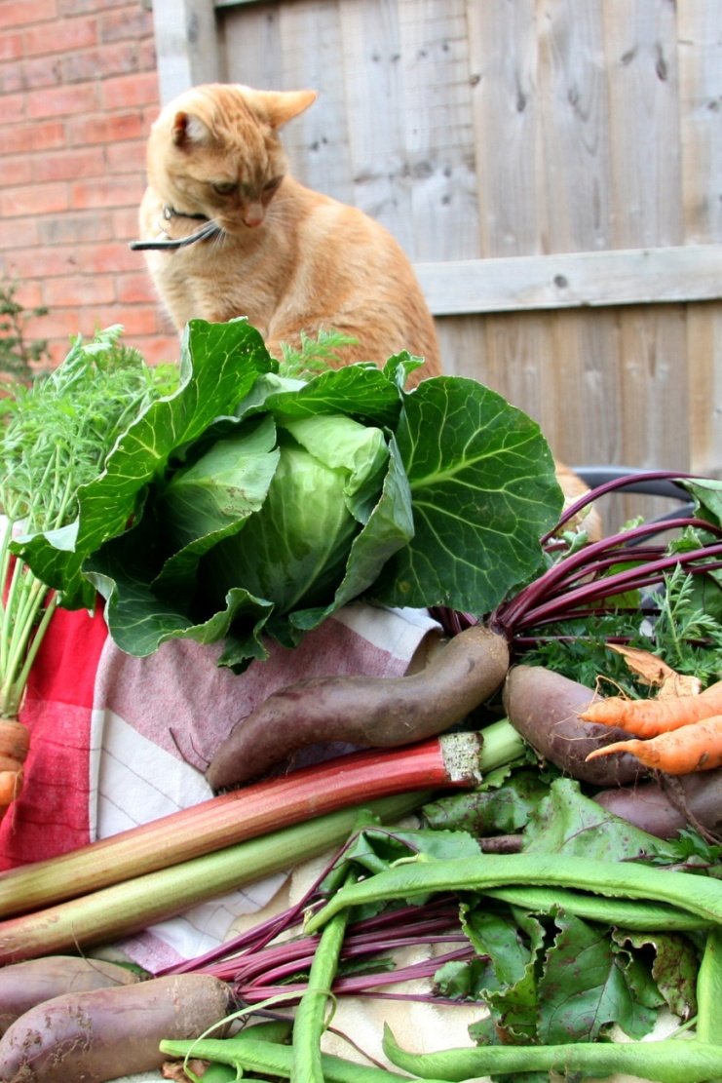
So it’s so much safer and more nutritious than what we can get at the store…
Organic Vegetables Photo 1231677 Bev Lloyd Roberts istock photo.com
Notes:
So it’s so much safer and more nutritious than what we can get at the store…

Slide 15
But the reality is…
Any produce, whether organically grown or conventionally grown, whether from your own back yard or thousands of miles away, can be contaminated if it is not handled properly all the way from the farm to the market.
Notes:
So, we have talked a lot about how produce can become contaminated. So what does this all mean?
Basically, it means that any produce, whether organically grown or conventionally grown, whether from your own back yard or thousands of miles away, can be contaminated if it is not handled properly all the way from the farm to the market.

Slide 16
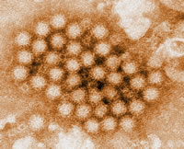
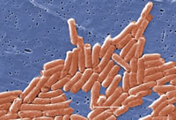
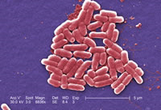
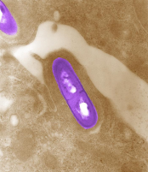
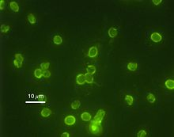
What exactly do we mean by foodborne illness?
Any disease caused by food that you eat
Illnesses caused by bacteria like Salmonella, Listeria, E. coli O157:H7, Shigella
Illnesses caused by viruses like norovirus
Illnesses caused by parasites like Cryptosporidium, Cyclospora, Toxoplasma
Illnesses caused by parasitic protozoans like Giardia
Norovirus
Salmonella
E. coli O157:H7
Listeria
Cryptosporidium
Photos: Center or Disease Control and Prevention
Notes:
So what is foodborne illness? What causes it, and how do we get it?
Foodborne illness is defined as any disease caused by food that you eat. When disease-causing microorganisms referred to as “pathogens” get into food, they can result in illness. Some of the common ones we hear about in the news are Salmonella, Listeria, E. coli O157:H7 and Shigella.
These are types of bacteria that can be found in the environment and can get into food and cause illness. They can be in soil or in water, they can be on surfaces that come in contact with food and they can contaminate produce.
But there are other causes we may not hear about as much.
For the last few years, the cause of most cases of foodborne illness has been a virus called norovirus. It is highly infectious and can be spread from person to person as well as through food. This has implications for worker health and hygiene when handling food – including produce. Good personal hygiene and thorough handwashing are important in preventing this and other foodborne illnesses.
Parasites can also cause foodborne illness. Cryptosporidium is a parasite that has caused outbreaks of illness even from some municipal water supplies. It is somewhat tolerant to chlorine so municipalities filter water to remove the cysts. It has been identified in the feces of migratory birds like Canada geese. Cyclospora is also a parasite that has caused illness from contaminated food and water. So water quality used in irrigation and in washing produce plays an important role in preventing foodborne illnesses.
Toxoplasma is another parasite. This one can have severe consequences if a pregnant woman comes in contact with this parasite and is often associated with cats. It can cause blindness or other problems if the fetus is exposed. This is one reason why it is important to keep domestic animals and also wild animals away from produce growing areas and facilities.
Whenever you enter a state park or national park, you usually see signs that warn about drinking water from lakes or streams because of Giardia which is a parasitic protozoan. And again, if the water is contaminated when it is applied to produce, then the produce can be contaminated.
So there are lots of different ways that harmful organisms can get onto produce.

Slide 17

Pieces of the food safety puzzle…
Facilities & Equipment
Land
Worker
health & hygiene
Water
Harvest & Storage
Transport
Notes:
To ensure that you are producing safe food, you need to have a big picture – a food safety plan - for how you will grow, handle and even transport produce to keep it safe. So let’s think of a food safety plan as a puzzle. You have to pay attention to all these pieces in the production and distribution of produce for it to be safe.

Slide 18
Pieces of the food safety puzzle…
Land Use
  Animal use?
  Run-off?
Manure use
  Raw manure?
  Composting properly to destroy disease-causing microorganisms?
Keeping wild and domestic animals out of growing areas?
Land
Notes:
Produce safety begins with the land you use. You need to consider how the land where you plan to grow has been used previously. Has it been used for animal production? Are growing areas located where run-off from areas likely to be contaminated could affect your crops? If you are organic, are you planning to use raw animal manures? If you plan to compost manure or litters and use that, are you composting properly and monitoring temperatures to be sure you destroy pathogens? Are you keeping animals out of growing areas?

Slide 19
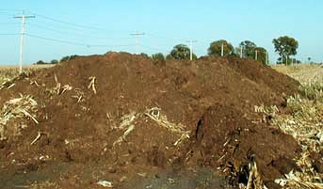
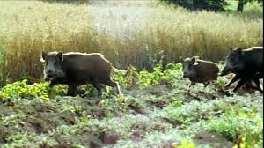
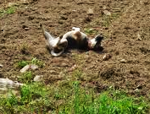
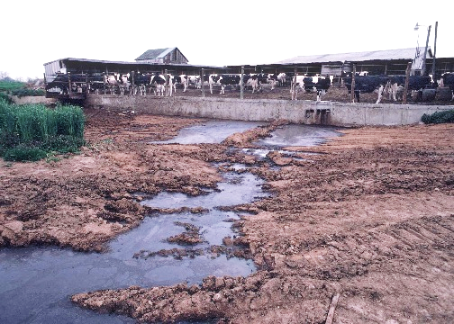
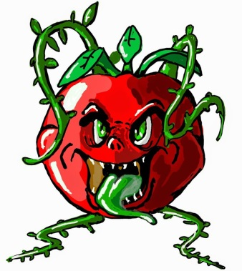


www.ipm.iastate.edu
Photo: http://footage.framepool.com/
Photo: http://organicgrowersschool.org/
Photo: NRCS
Notes:
Contaminated land can mean contaminated produce so think carefully about where to put your growing areas, where you may need fences, when you will apply raw manure to fields, etc.

Slide 20
Pieces of the food safety puzzle…
Water Use - irrigation
  Municipal, well water, surface water?
  Type of irrigation method?
  Testing plan?
Water Use – washing produce
  Use only potable water safe for drinking
Water
Notes:
Water is another important piece of the puzzle. For irrigating your crops, do you use municipal water that is treated? Do you use well water or surface water? If you are just starting out on your farm, you may want to think about advantages of choosing one irrigation system over another. For example, if you plan to use surface water to irrigate produce, drip irrigation is preferable to overhead irrigation to help minimize exposure to contamination. If you are using well water or surface water, testing the water regularly for microbes is important.
And when it comes to washing produce before eating it, taking it to market or selling it at a roadside stand, you MUST use only potable water – that is water that is safe for drinking.

Slide 21
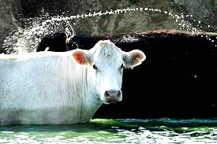
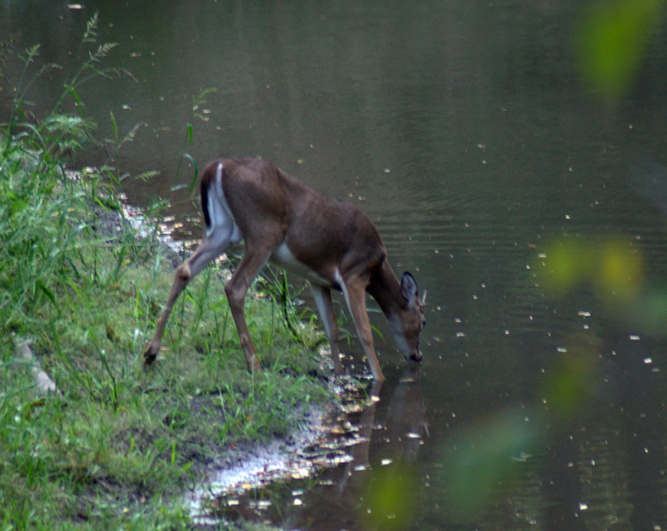
Photo: Seth Perlman
Photo: https://www.flickr.com/photos/dwilliss/7978521288
Notes:
So as you are choosing water sources, irrigation methods and methods for washing produce, remember contaminated water can mean contaminated produce!

Slide 22
Pieces of the food safety puzzle…
Health
  Avoid working with food when sick
Hygiene
  Clothing and hands can be a source of germs
  Good hygiene is a MUST when working with food – including produce
Worker
health & hygiene
Notes:
Another important piece of the puzzle is worker health and hygiene. Whether it is you, a family member or an employee that helps you, it is important to avoid working with food when sick. That includes working with produce that you intend to sell. Contaminated clothing and hands are another way that germs can spread to food so good hygiene when working with produce is a MUST!

Slide 23
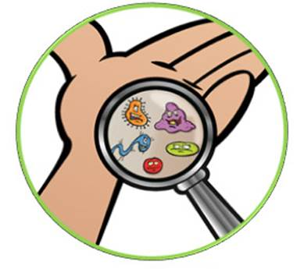
Photo: Judy Harrison
Notes:
Sick workers and dirty hands can mean --- you got it --- contaminated produce!

Slide 24
Pieces of the food safety puzzle…
Facilities
  Handwashing facilities
  Toilet facilities
  Clean, sanitized packing and storage areas
Equipment
  Clean, sanitized equipment
Facilities & Equipment
Notes:
Facilities and equipment are another important way to help prevent contamination or cross-contamination from one product to another.
This includes having handwashing facilities and toilet facilities available for people who may be helping you with your produce. Going to the bathroom at the edge of the field and not washing hands are not options!
In packing areas, storage areas and cooling facilities, think about ease of cleaning and sanitizing when you install walls, ceilings, floors, tables, sinks, etc.
In 2011, there was an outbreak caused by Listeria on cantaloupes from a Colorado farm that resulted in 33 deaths. How did the melons become contaminated? Investigators stated that melons likely were contaminated in the packing house. Their report concluded that dirty water on a floor, and old, hard-to-clean equipment probably were to blame.
So when installing surfaces and equipment, think about the ease of cleaning.
Think about using reusable bins that can be cleaned and sanitized rather than using cardboard boxes, wooden bins or straw baskets.

Slide 25
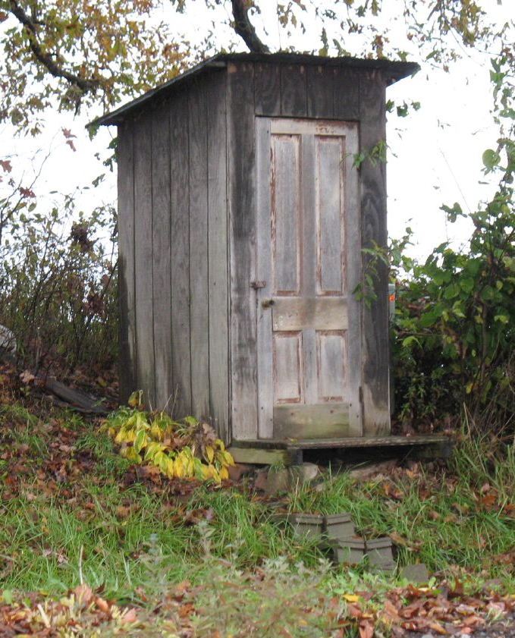
Photo: https://commons.wikimedia.org/wiki/File:Amish_Outhouse.jpg
Notes:
As you are planning your facilities, think about what facilities would look like that could cause you to end up with….contaminated produce.

Slide 26
Pieces of the food safety puzzle…
Good sanitation practices
  Clean facilities and equipment
  “Clean” clothes and hands
Handling to prevent damage
Cooling quickly to remove field heat
Harvest & Storage
Notes:
Harvesting and storage practices are also important pieces of the food safety puzzle.
Use good sanitation practices – this goes back to what we just covered about having clean facilities and using clean equipment. It is important not to be a source of contamination so wear clean clothes and practice thorough and frequent handwashing. Now I know you are working on a farm, so clean clothes – really? What do I mean by “clean” clothes? I mean don’t go work with your pigs, chickens and goats and then go straight to working with and handling your produce. Food safety is really just about common sense practices.
Handling produce in a way that you minimize damage that can result in openings that can be entry points for spoilage organisms like molds and yeasts and for disease-causing microorganisms is a way to preserve the quality of the product and also enhance the safety of the produce. Cooling is one way to preserve quality, nutritional value and slow the growth of harmful bacteria.

Slide 27
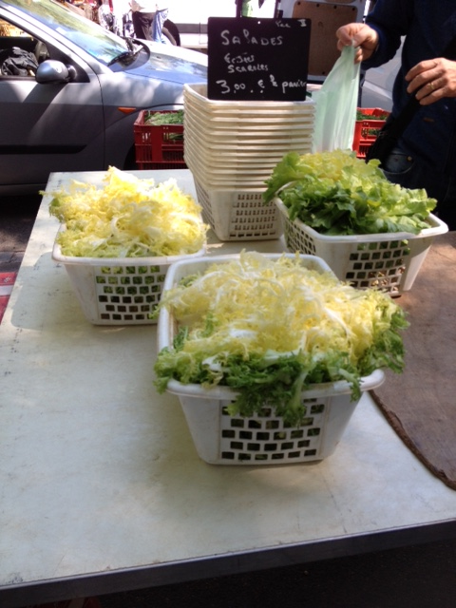
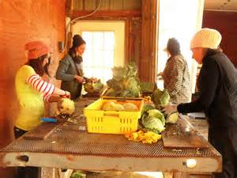
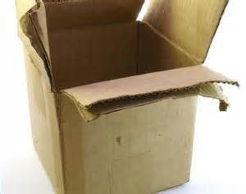
Photo: hollylucoon.com/?p=687
Photo: Vermont Valley Farm
Photo: Judy Harrison
Notes:
So as you are thinking about your harvest and storage practices, remember that dirty facilities and equipment can lead to …..contaminated produce. Not cooling produce can allow products to wilt and become susceptible to damage which can create entry points for harmful pathogens and can allow harmful bacteria to multiply rapidly.

Slide 28
Pieces of the food safety puzzle…
Cool
Covered
Clean
Transport
Notes:
So… you have grown it, harvested it and stored it – and you have done everything correctly. So now you have this beautiful, unblemished, clean and safe produce. So let’s just put it in the back of the truck where we had the calf or the manure we were hauling and take it to TOWN.
But food safety doesn’t stop with the growing, harvesting and storing. How you transport the produce to market also affects the safety of it. Keeping produce cool, keeping it covered, keeping it clean --- those are also important steps in keeping it safe.

Slide 29
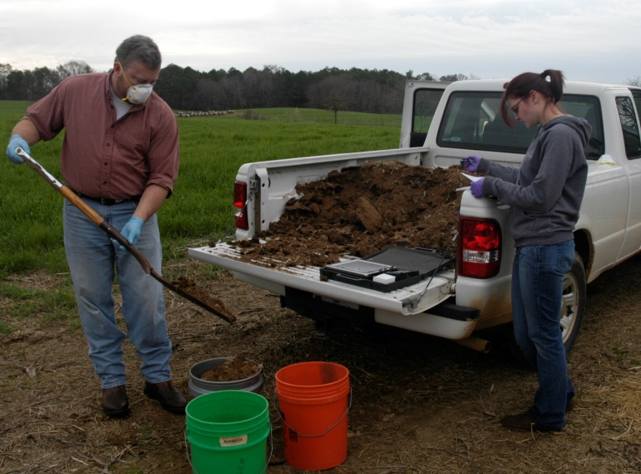
Photo: Julia Gaskin
Notes:
As you are planning your trip to market, remember not transporting produce correctly can lead to lower quality, contaminated, unsafe produce.

Slide 30
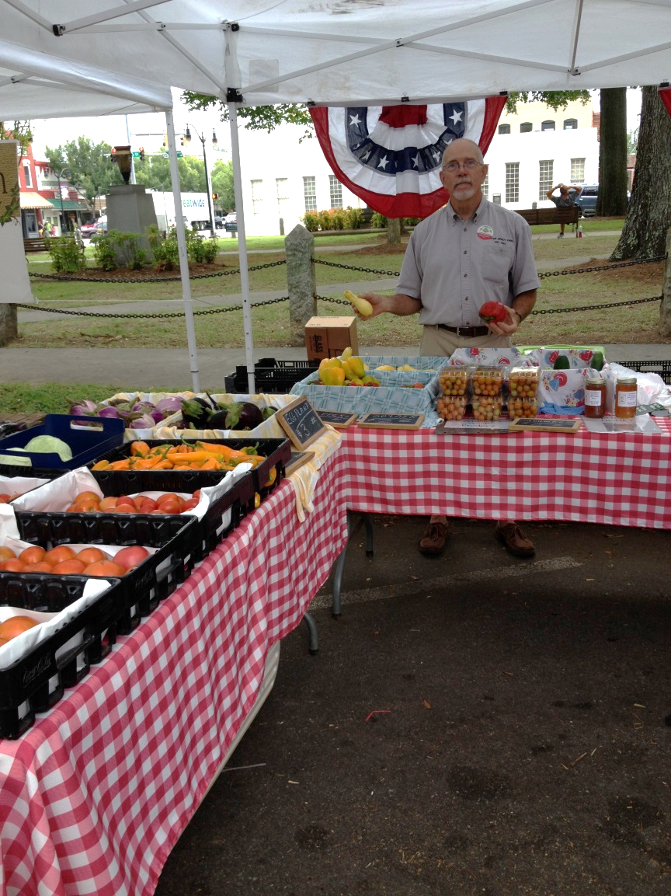
Land
Water
Facilities & Equipment
Worker
health & hygiene
Transport
Harvest & Storage
Photo: Foster-Brady Farms, Monroe Farmers Market, Monroe, GA.
Notes:
So now we have all these pieces of the food safety puzzle. Put them together, and you begin to see the big picture and how the practices that you use at each step of your process can help enhance the quality and safety of the products you grow and sell. Even in the farmers market – with products displayed off the ground, in plastic containers that can be cleaned and sanitized or lined with clean dish towels that can be washed between uses or tissue paper or freezer paper that can be discarded between uses to prevent cross-contamination – you can take steps to keep your products safe for your customers.

Slide 31
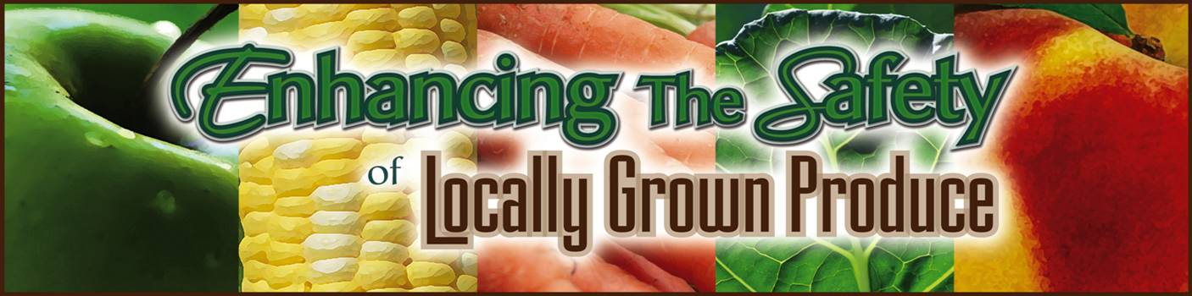
Where to Go for Additional Resources
County Extension Offices
National Extension Website
To enroll in the free, on-line course, visit:
www.fcs.uga.edu/extension/enroll-produce-courses
Notes:
Food safety is good marketing. If you plan to grow your business, then additional food safety training is a must. For more in-depth information on enhancing the safety of produce you grow and sell, contact you local County Extension Office about accessing our Enhancing the Safety of Locally Grown Produce classes. Some agents throughout the state are offering face-to-face sessions that you can attend. If you are not able to find one near you, you can take our on-line course free on the national eXtension website. Go to our website at www.fcs.uga.edu/extension/enroll-produce-courses for information on how to take the course on-line and access our factsheets for more in-depth information.

Slide 32
Free On-line Course
Practical, lost cost tips for good food safety practices
Certificate of completion that may be useful for marketing
First step for direct marketers
Wholesale markets will need GAPs
To enroll in the free, on-line course, visit:
www.fcs.uga.edu/extension/enroll-produce-courses

Slide 33
FSMA and What It Means For You
Produce Safety Rule
  Sets standards for water, specifies waiting periods for raw manure use, and specifies other food safety practices
  Size of produce sales determine whether you are covered
    $25,000 or less in average annual produce sales not covered
    As sales grow, compliance will be necessary
      Compliance dates are staggered depending on annual sales of produce
      May have as long as 4 years to comply, depending on size of sales
However, remember liability?
YOU STILL NEED TO FOLLOW BEST PRACTICES!!!
Notes:
The Food Safety Modernization Act or FSMA (acronym pronounced FIZ-MA) was passed in 2011 to help ensure that food in the U.S. is safe by shifting our focus from responding to contamination in food to preventing contamination of food from happening. As a part of this legislation, there are two rules that farmers need to be aware of because they have implications for you as you grow your business. The first rule is the Produce Safety Rule which sets standards for agricultural water, specifies waiting periods for raw manure use and addresses many of the other practices we have discussed. The extent to which this rule will apply to you depends on the size of your business. Farms with an average annual monetary value of produce sales of $25,000 or less will not be covered under the rule. However, if your business grows so that sales exceed that level, then you would need to comply with the rule. The dates for compliance are staggered, depend on the amount of your annual sales of produce in excess of $25,000 and may be as long as four years to comply. However, regardless of whether you are covered under this rule, you still need to be following best practices to keep produce safe, and you should probably have insurance for your protection.

Slide 34
FSMA and What It Means For You
Preventive Controls for Human Food Rule
  Focuses on the processing of foods
  On-farm packing and holding of produce falls under the Produce Safety Rule - not the preventive controls rule
  Farms can do only minimal processing (such as drying grapes to make raisins, treating commodities with ethylene gas to ripen)
  More extensive processing facilities may have to comply with preventive controls
Notes:
A second rule that is a part of FSMA is the Preventive Controls for Human Food Rule. This rule focuses on the processing of foods. Operations defined as "farms" under the rule are not subject to the preventive controls rule. On-farm packing or holding of produce would fall under the Produce Safety Rule. Farms are allowed to do only minimal types of processing such as drying grapes to make raisins or treating commodities with ethylene gas to ripen them. If you choose to open more extensive food processing facilities, then the preventive controls rule may come into play for those facilities.

Slide 35
Learning Activity
Read and discuss Water Use and Worker Hygiene of Gittin’ There Farms

Slide 36






This material is based upon work that is supported by the National Institute of Food and Agriculture, U.S. Department of Agriculture, under award number 2015-70017-22861.
Beginning Farmer and Rancher
Development Program
Developing the Next Generation
of Sustainable Farmers in Georgia Grant

