Slide 1
Small Fruit and Vegetable Production

Slide 2
Session 4 Vegetable Propagation, Seeds and Transplants
Dr. George Boyhan
Horticulture Dept.
University of Georgia

Slide 3
Learning Objectives
Give an example of a crop that should be direct seeded
List three reasons you might want to use a transplant

Slide 4
Crop Propagation
Goal is:
Consistent stand maximize use of space
Straight rows helps with weed control
Proper spacing for best plant growth, reducing weeds and disease
Either direct seeding or transplanting can work.

Slide 5
Direct Seeding vs Transplanting
Direct seeding advantages
Don’t need greenhouse for transplant production
Better for root crops like carrots, beets, turnips
Better for thickly seeded leaf crops – lettuce mixes, microgreens
Always used for cover crops
Direct seeding disadvantages
Usually requires more seed
Less control of germination conditions
Smaller window for production

Slide 6
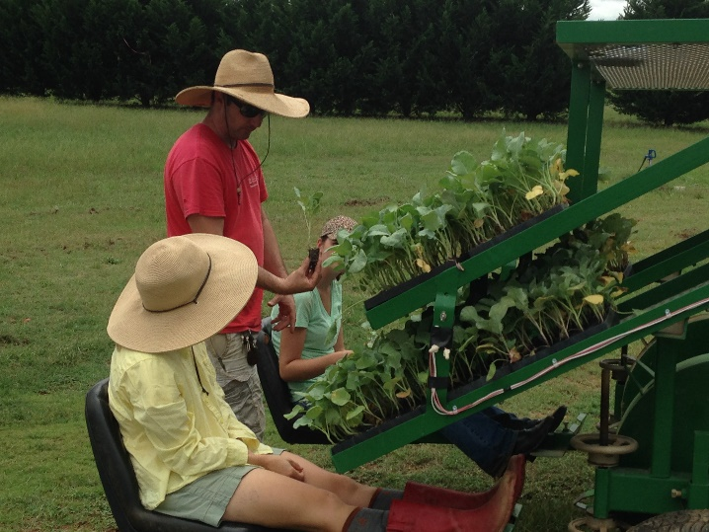
Direct Seeding vs Transplanting
Transplanting advantages
Insures a perfect or near perfect stand
Extends growing season
Production for early markets
Save on irrigation
Improve crop uniformity
Save on expensive seed
Transplanting disadvantages
Initial investment in greenhouse infrastructure
Extra labor to produce transplants
Photo: Julia Gaskin

Slide 7
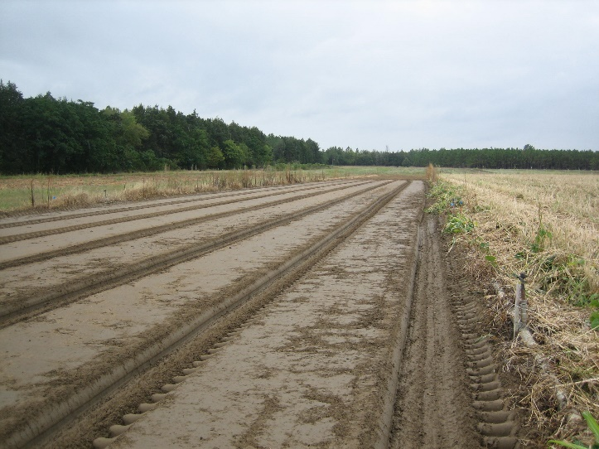
Direct Seeding -Getting Started
Good bed or ground preparation for good seed-soil contact
Know the right planting depth!
Know the right spacing!
You can find this information on many seed packets or in the seed catalog.
Photo: Julia Gaskin

Slide 8
Seeding Equipment & Methods
Hand seeding
Broadcasting
Drilling – planting one seed next to another
Cover crops
Precision sowing –best stand establishment for specific spacing
Chitting – pre-germinate seed until radical appears
Precision seeders
Plates
Belts
Vacuum

Slide 9
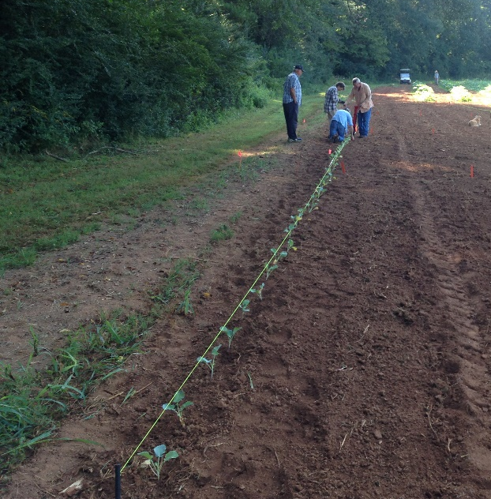
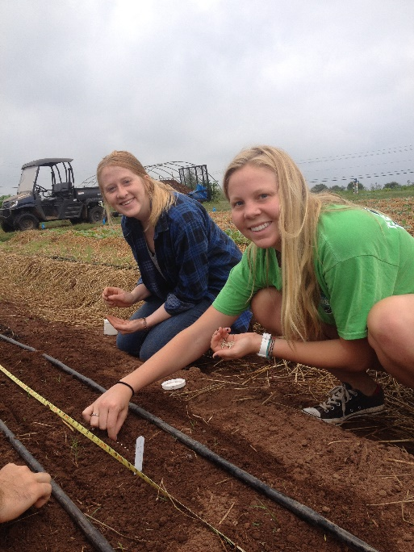
Seeding Equipment & Methods
Handseeding
Place stake with string, pull tight to mark straight row
Pull hoe along string to make furrow at right depth
Walk along furrow and drop seeds in at right spacing
Use hoe to cover furrow
Water
Photo: Jessica Cudnik
Photo: JoHannah Biang

Slide 10
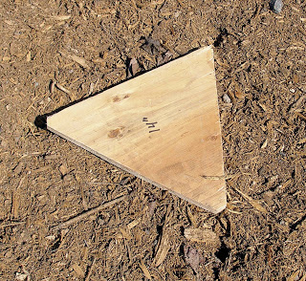
Seeding Equipment & Methods
Handseeding in biointensive beds
Offset rows to plant in triangles to maximize plants in a given space
Photo: http://www.nzdl.org - SPWP - Planting Trees - An Illustrated Technical Guide and Training Manual
Photo: Katie Chatham
Photo: http://simple-green-frugal-co-op.blogspot.com

Slide 11
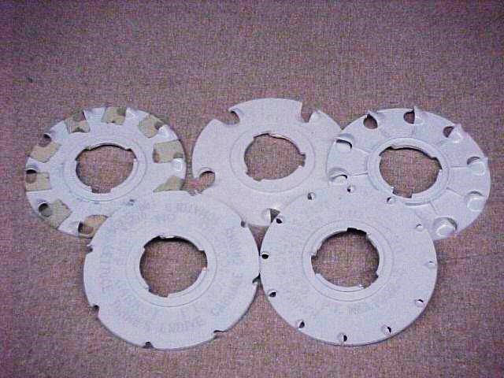
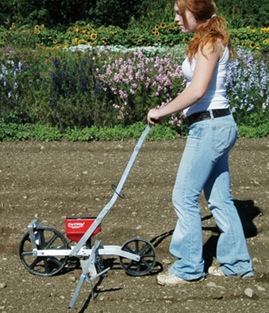
Seeding Equipment & Methods
Push seeders
Have different plates for right spacing for different crops
Row markers can be set for right row spacing
Photos: http://www.johnnyseeds.com/

Slide 12
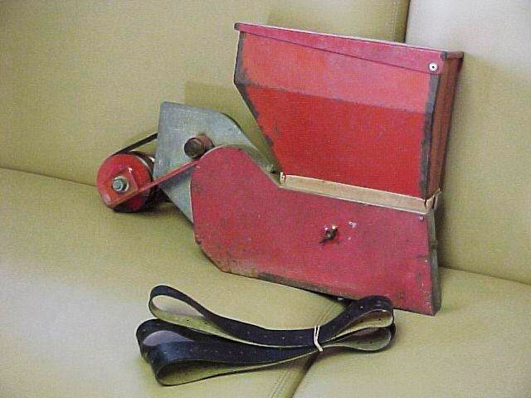
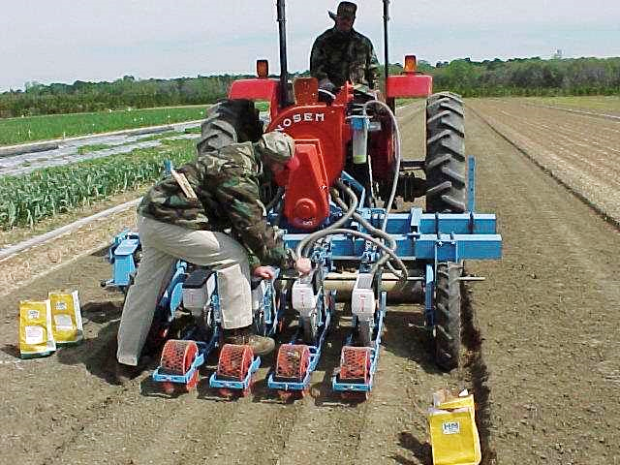
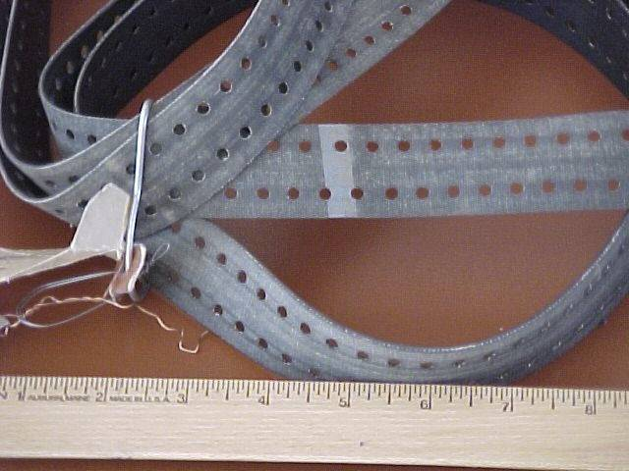
Seeding Equipment & Methods
Tractor pulled seeders
Photos: George Boyhan

Slide 13
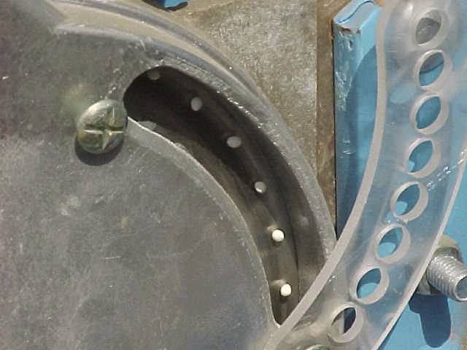
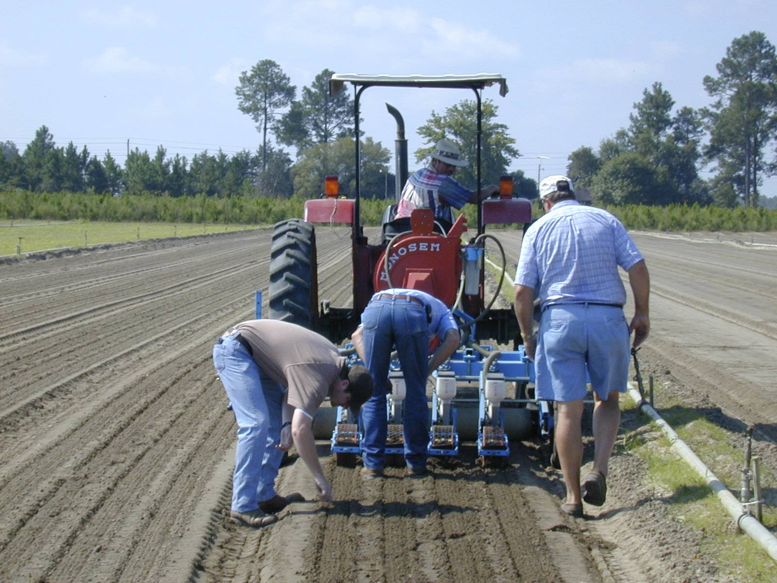
Seeding Equipment & Methods
Photos: George Boyhan

Slide 14
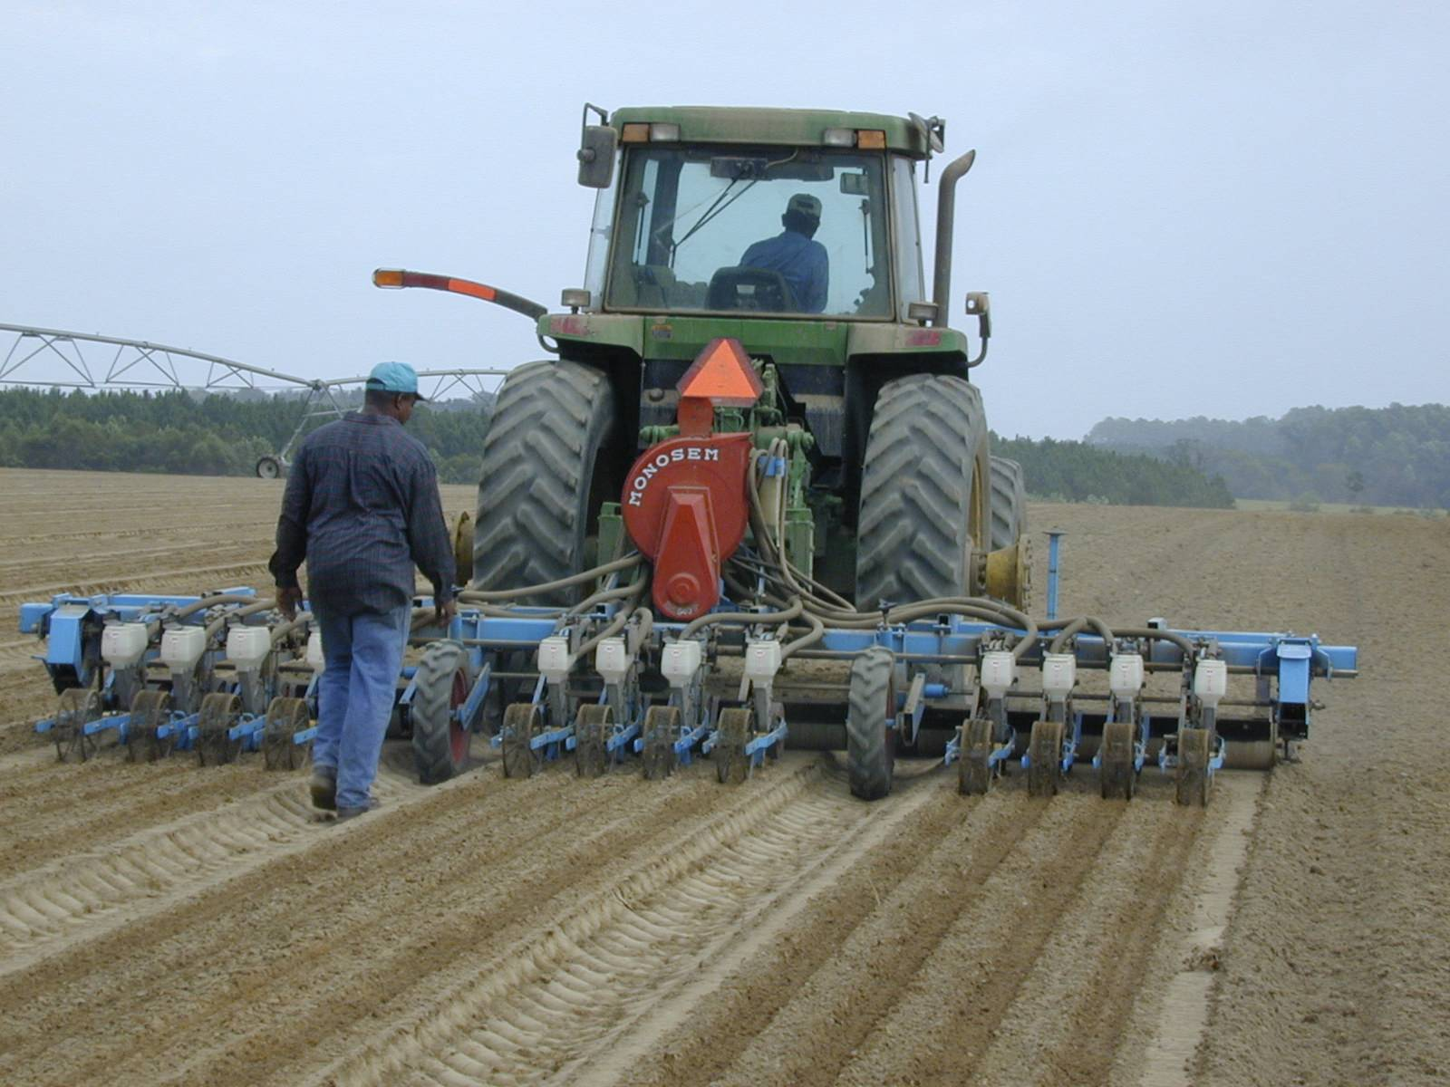
Photo:George Boyhan

Slide 15
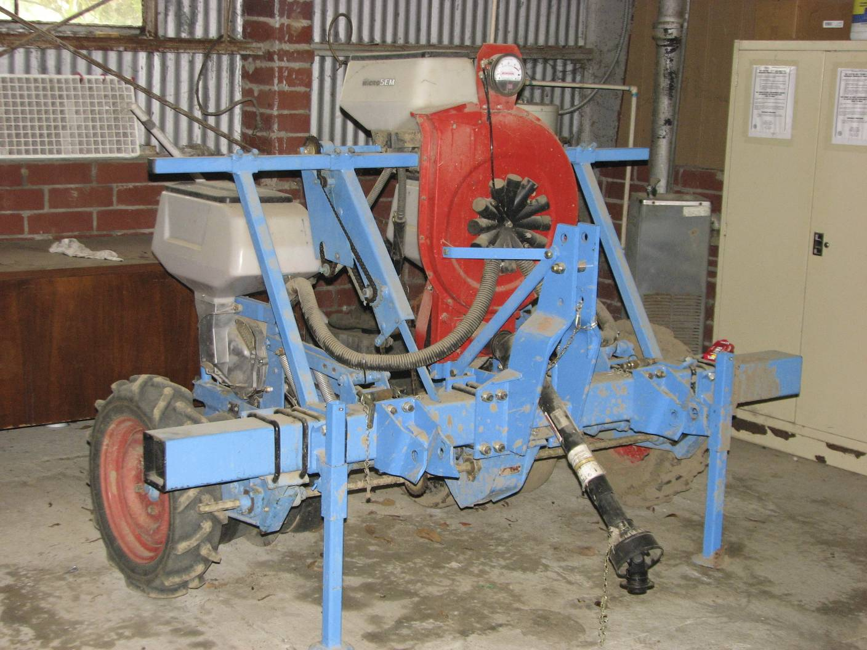
Photo: George Boyhan

Slide 16
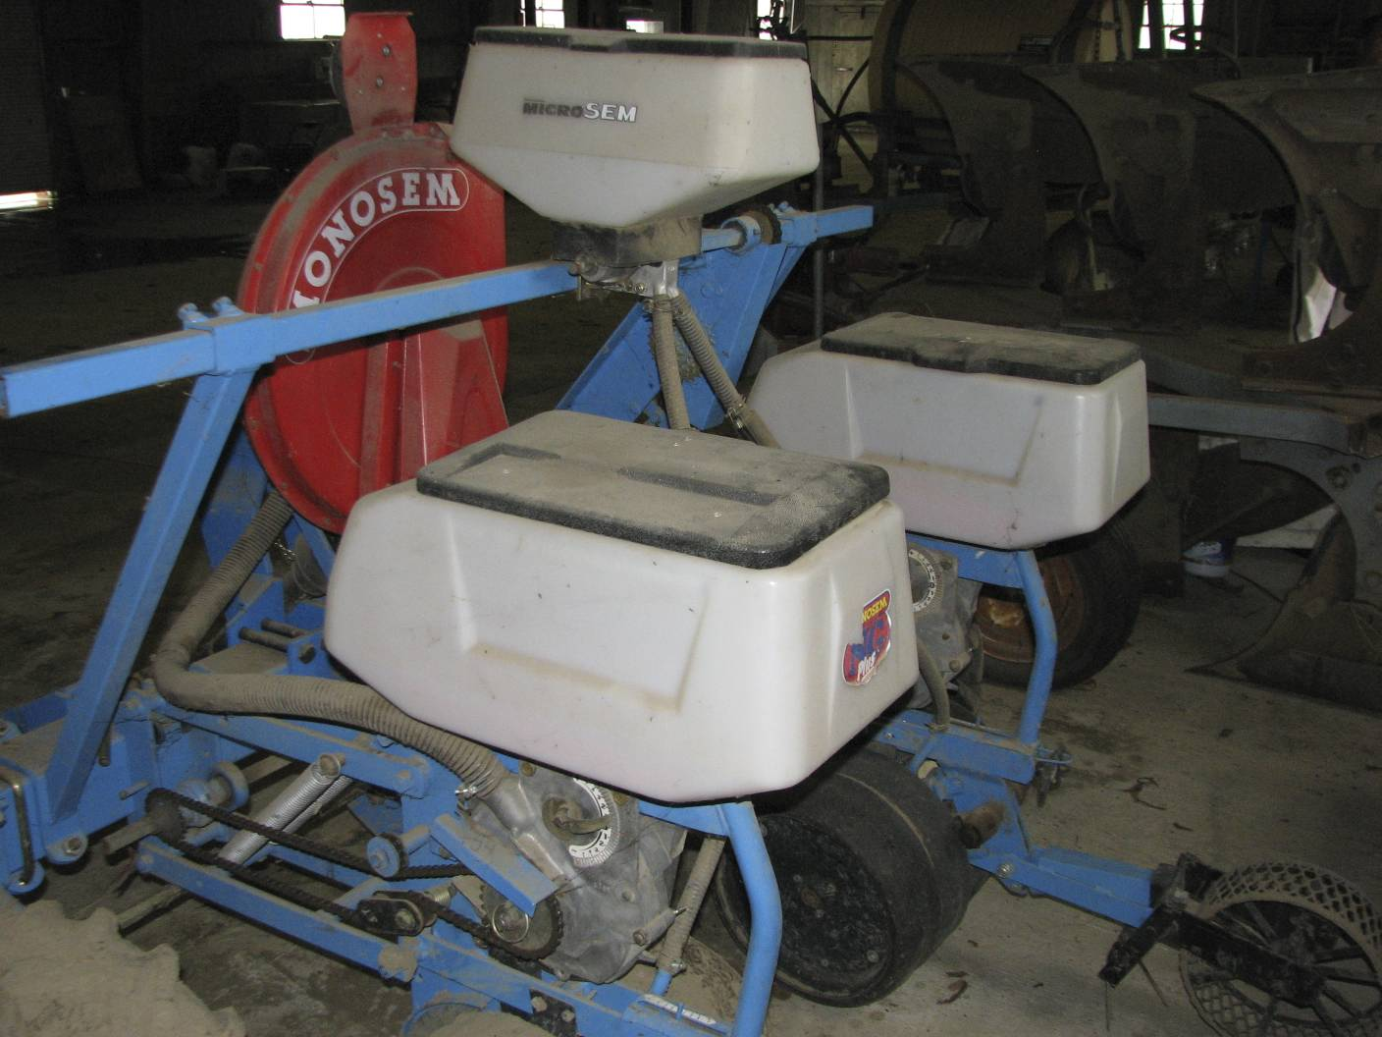
Photo: George Boyhan

Slide 17
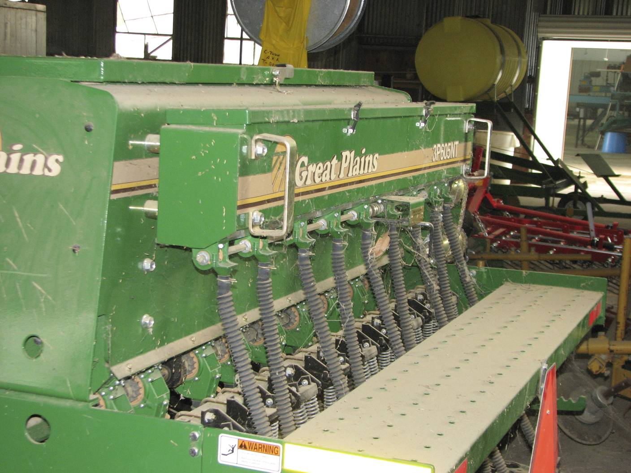
Photo: George Boyhan
Notes:
Drill

Slide 18
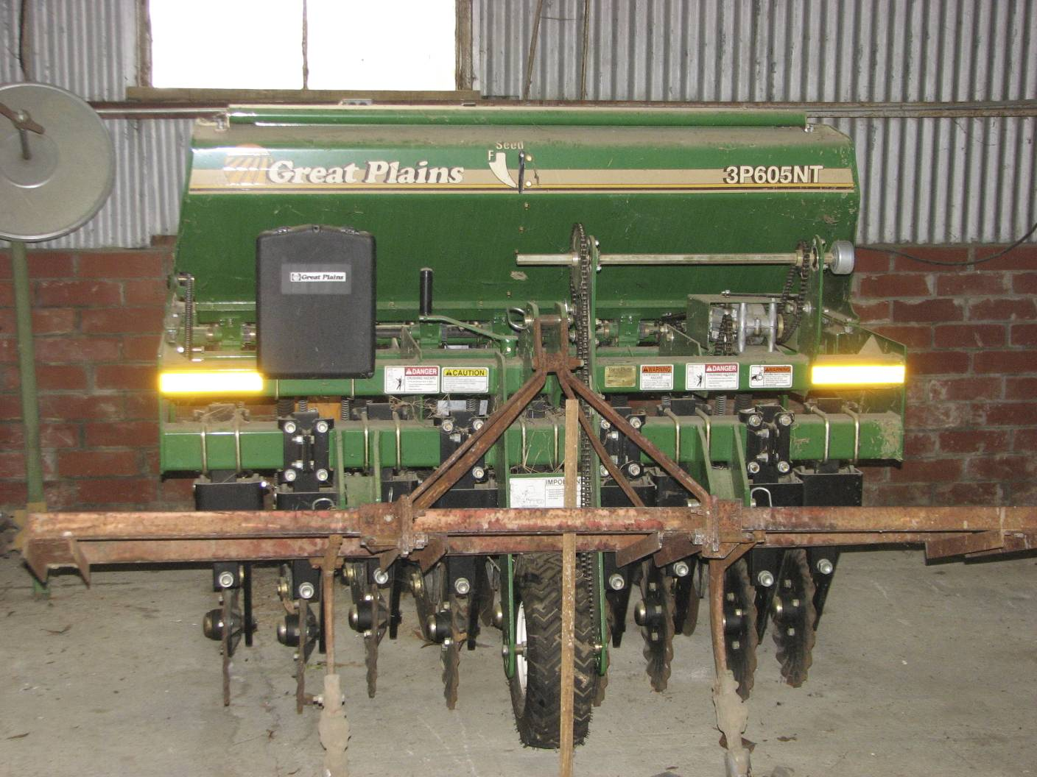
Seeding Equipment & Methods
Photo: George Boyhan

Slide 19
Transplant Production
Is it cost effective?
How much seed?
When to plant?
Containers, media, fertilizer?
Handling and transportation?
Field grown bareroot production
Sets – specialized reproductive structure
(ex. onions)

Slide 20
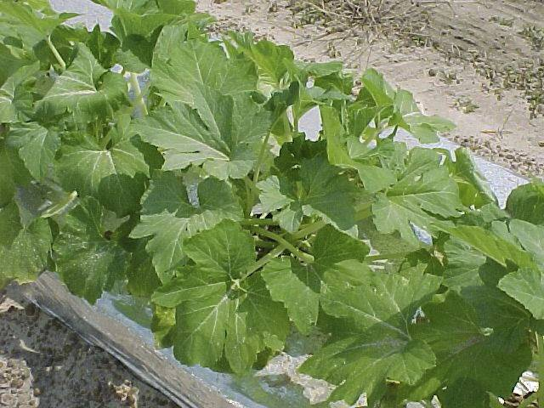
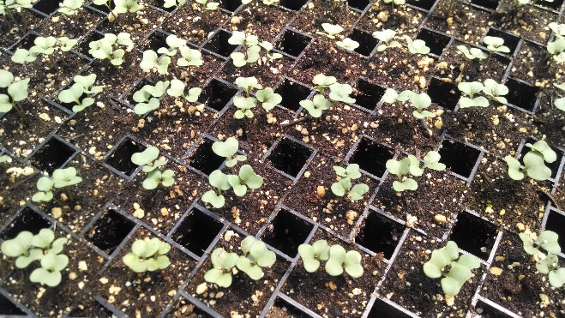
Commonly Transplanted Vegetables
Broccoli
Brussels sprouts
Cabbage
Cauliflower
Celery
Collards
Cantaloupe
Cucumber
Eggplant
Lettuce
Onion
Pepper
Sweetpotato
Tomato
Watermelon
Squash
Photo: George Boyhan
Photo: Katie Chatham

Slide 21
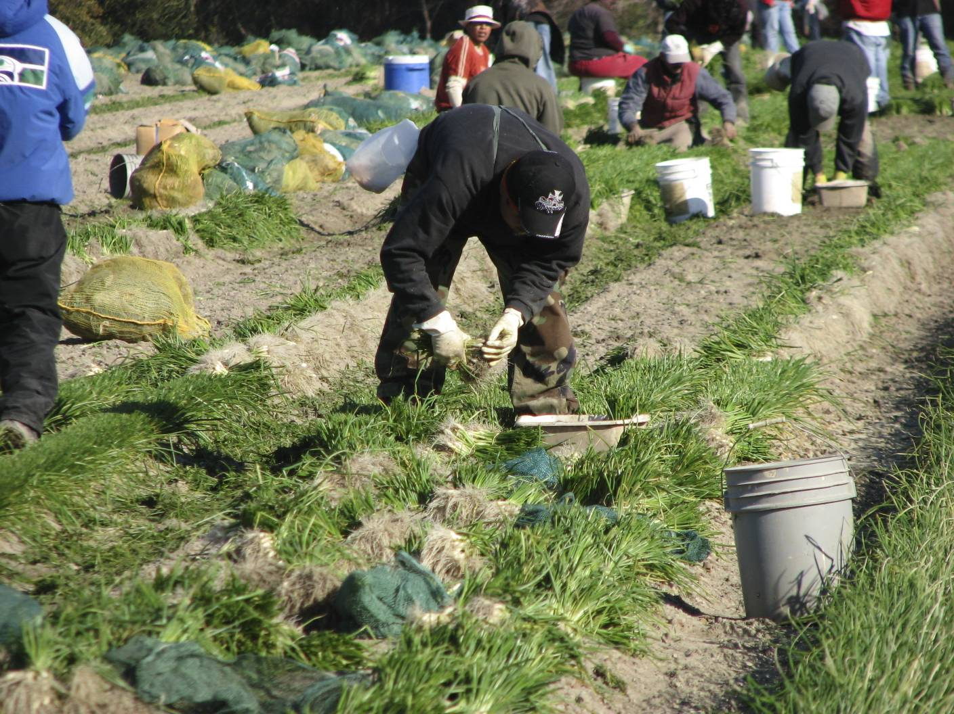
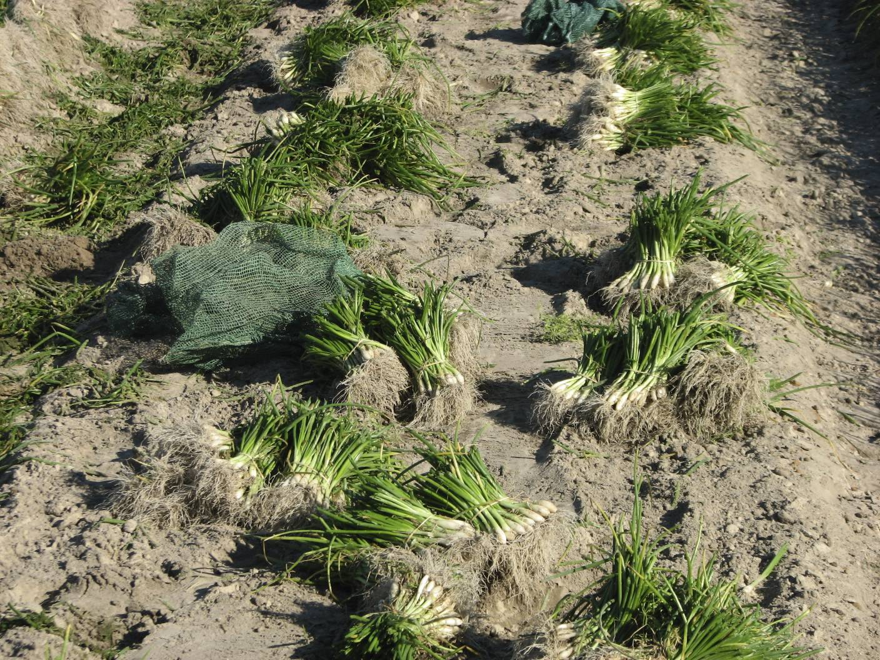
Field Production
Large industry in south Georgia years ago
Limited current production
Ex. Bonnie Plant Farms – Union Springs, AL
Onions – still a significant industry
On-farm production
Photos: George Boyhan

Slide 22
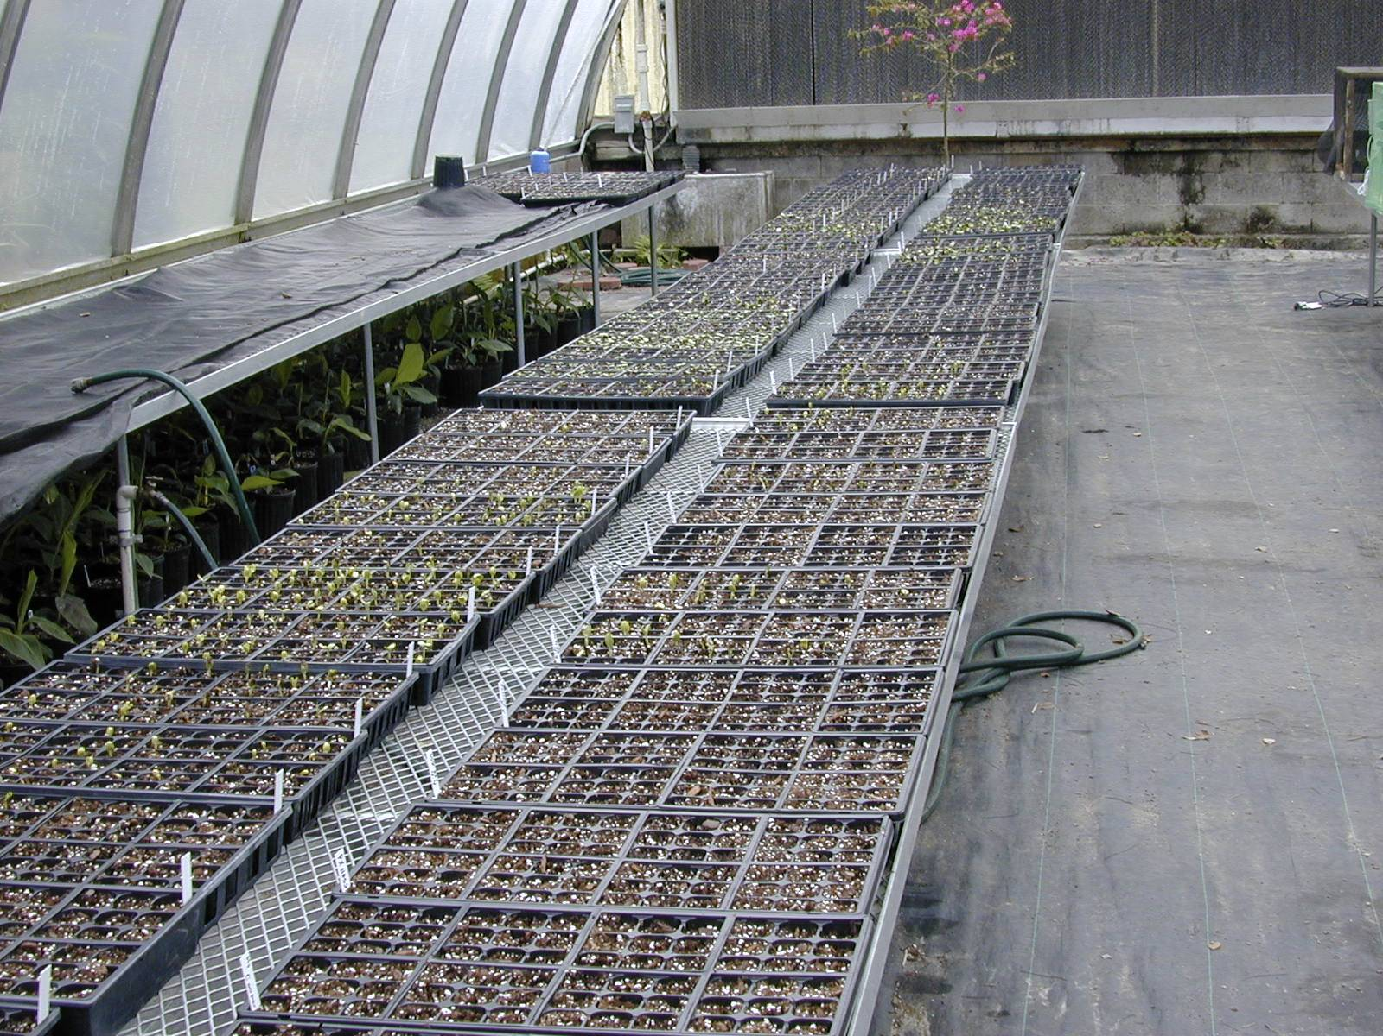
Transplant media and containers
Peat based media
Peat moss, perlite, vermiculite, pine bark
Other additives
Lime, fertilizer (enough for the crop, organic water soluble fertilizers are not available)
Containers
Speedling trays, flats & inserts, single piece polyethylene flats
Photo: Julia Gaskin
Notes:
Organic media mix: 0.4 yard sphagnum peat moss or ground pine bark, 0.3 yards vermiculite or perlite, 0.3 yards compost or topsoil (ex. Black Cow Topsoil), 4 cups complete organic fertilizer (ex. 5-6-6), 1 cup blood meal, 5 lbs ground limestone

Slide 23
Example Potting Mix
Organic media mix:
0.4 yard sphagnum peat moss or ground pine bark
0.3 yards vermiculite or perlite
0.3 yards compost or topsoil (ex. Black Cow Topsoil)
4 cups complete organic fertilizer (ex. 5-6-6)
1 cup blood meal
5 lbs ground limestone
Photo: Katie Chatham

Slide 24
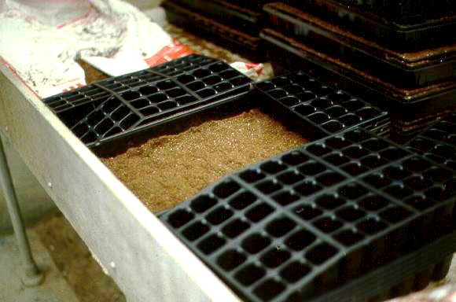
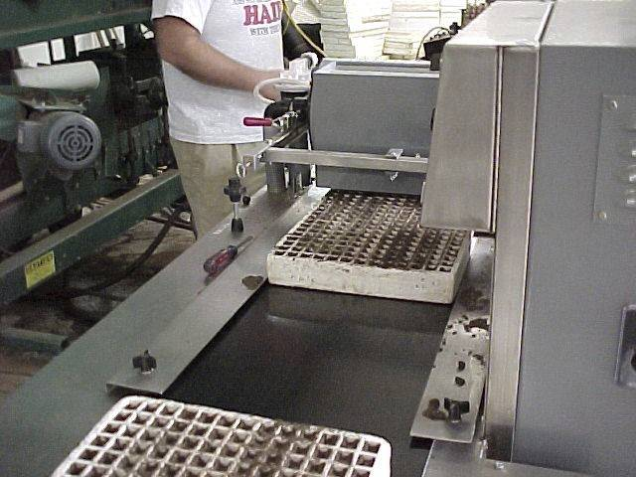
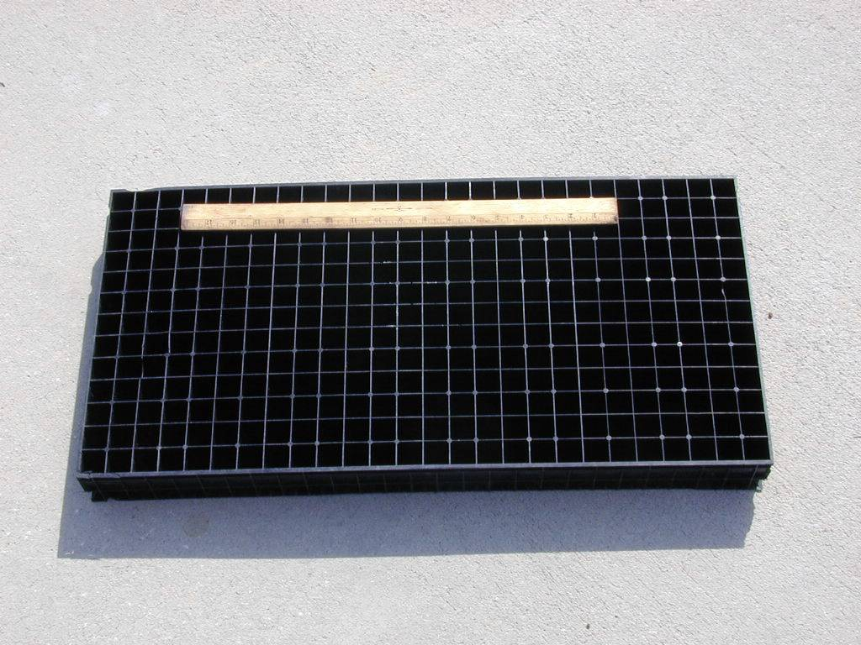
Polyethylene flats & inserts
Styrofoam Speedling Trays
Photos: George Boyhan
One piece polyethylene

Slide 25
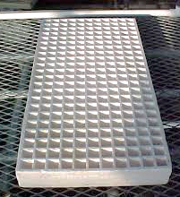
Tray cell sizes
Standard flat 11 x 22 inches
36, 50, 63, 72 cells per flat
Other sizes available
Seedling trays
Slightly larger 13.5 x 26.5 inches
Sold by the number of cells per tray
Ex. 242 cells per tray (1” square, 2” deep)
Photos: George Boyhan

Slide 26
Transplant Timing
Crop | Seed/10,000 seedlings | Germination (days) | Time Required (weeks)
Broccoli | 2 oz | 4-9 | 5-7
Cucumbers | 0.5-1.0 lbs | 3-7 | 2-3
Eggplant | 4 oz | 5 | 5-7
Muskmelon | 0.5-1.0 lbs | 3-7 | 4-5
Pepper | 7 oz | 8 | 5-7
Pumpkin | 2.5-6.5 lbs | 3-7 | 2-3
Onion | 3 oz | 4 | 8-10
Squash | 2-3 lbs | 3-7 | 2-3
Tomato | 3 oz | 5 | 5-7
Watermelon | 3.25 lbs | 3 | 3-4
Adopted from Knott’s Handbook for Vegetable Growers

Slide 27
Transplants Per Acre
Crop | Transplants/acre
Broccoli | 17,500 – 26,250
Cabbage | 12,500 – 23,200
Cucumbers | 14,500 – 19,300
Eggplant | 4,000 – 6,000
Muskmelon | 2,000 – 5,500
Pepper | 9,300 – 14,500
Pumpkin | 1,000 – 3,000
Onion | 80,000 – 100,000
Squash | 9,600 – 14,500
Tomato | 9,300 – 14,500
Watermelon | 1,600 – 3,000

Slide 28
Activity – Seed Numbers and Transplants
Locally Yours Farm wants to grow two 5 x 20 ft beds of summer squash this year for an early market. How many transplants should they start? How many seeds do they need?

Slide 29
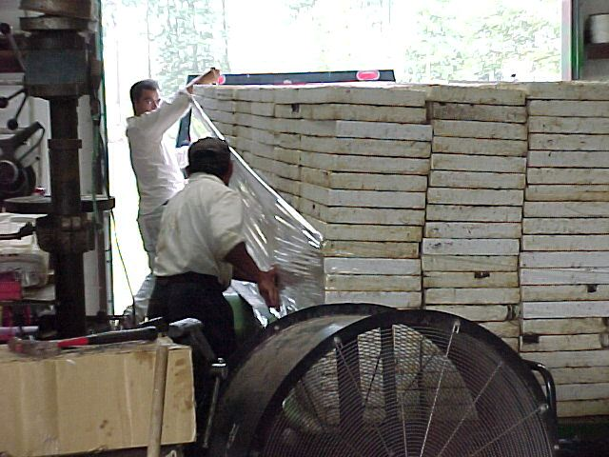
Special Handling
Triploid Watermelon
Expensive seed
Keep media on dry side
Particularly 1st 48-72 hrs
High temperature
Above 70 deg. F. nights
Coordinate with pollenizer production
Photos: George Boyhan

Slide 30
Transplant Finishing & Handling
Size (1-3 inch diameter cells)
Smaller the size the more care required (watering etc.)
Disease or insect problems
Hardening off
Delivery
Delay in Planting

Slide 31
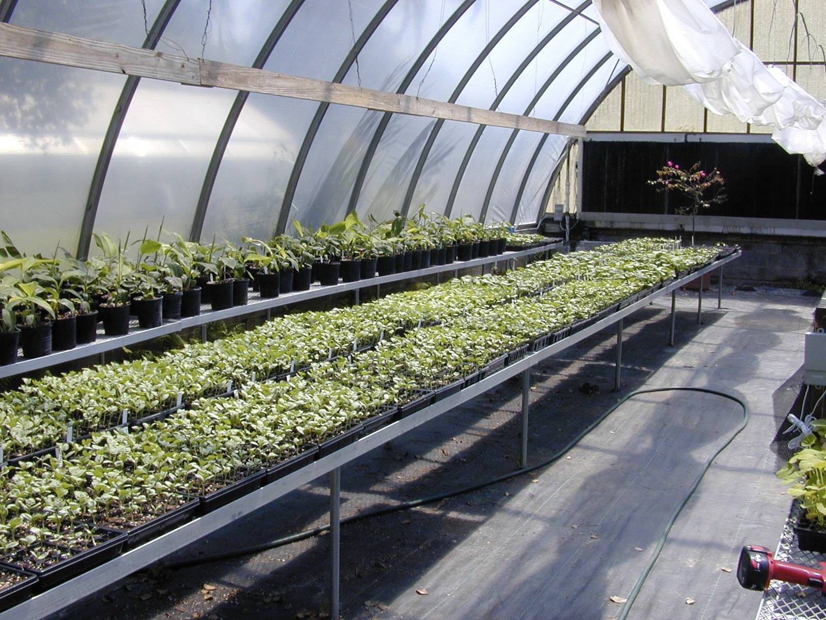
Hardening Off
Reduce water and/or temperature
Move out of the greenhouse 3-5 days prior to transplanting
Protect from excessive cold (move back to greenhouse at night if needed)
Protect from excessive light (place in the shade and/or watch the watering)
Effects
Reduces growth
Thickens cuticle
Increases dry matter
Increases water holding colloids
Decreases free water
Anthocyanins increase
Increase carbohydrates
Photo: Julia Gaskin

Slide 32
Transplanting
Similar to direct seeding – mark off row
Make hole with hoe or dibble at correct spacing or
Use hand transplanter
Put in transplant
Step on side to close hole
Water
Photo: Jessica Cudnik

Slide 33
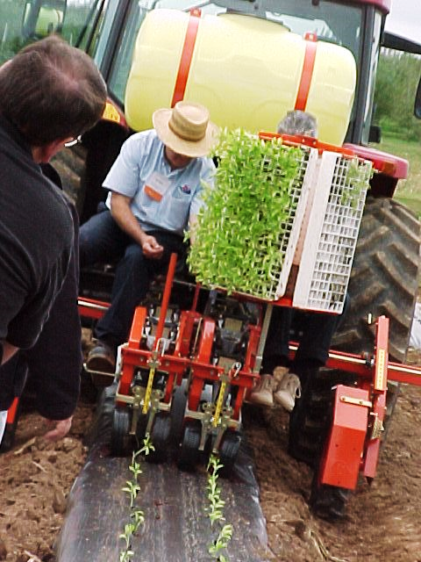
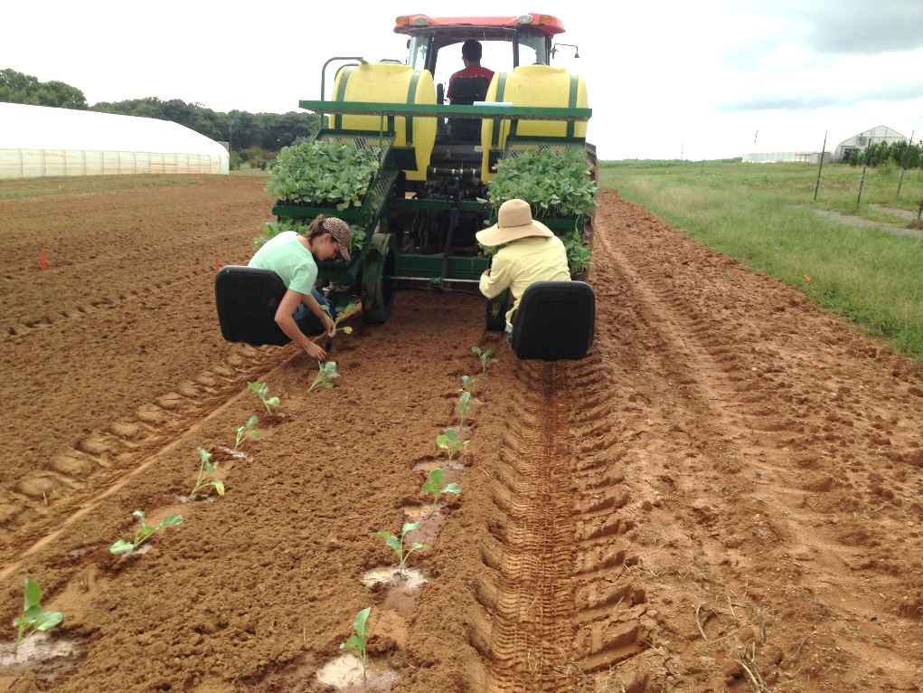
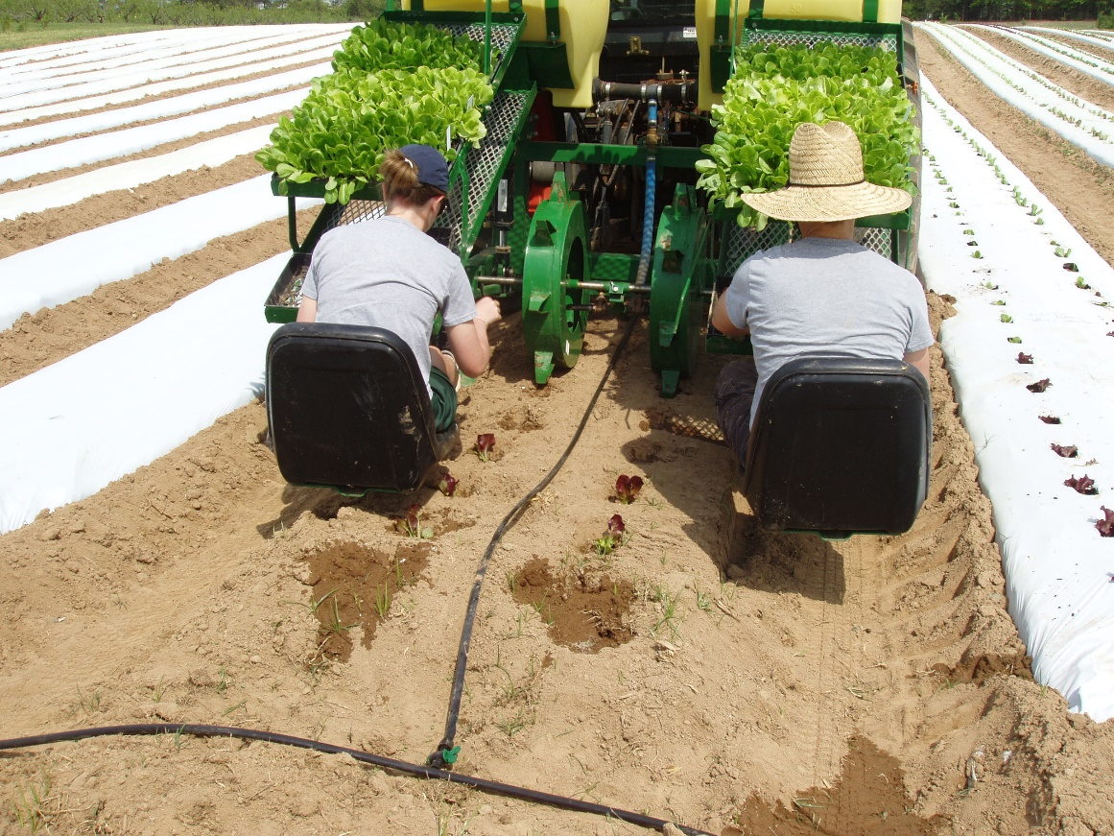
Photo: Julia Gaskin
Photo: George Boyhan
Photo: Julia Gaskin

Slide 34
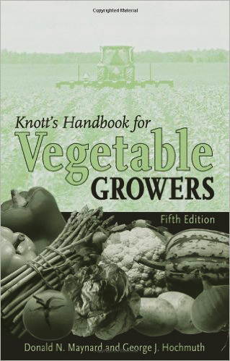
Additional Resources
Maynard, D.N. and G.J. Hochmuth. 2007. Knott’s Handbook for Vegetable Growers 5th Edition. John Wiley & Sons, Inc. Hoboken, NJ. ISBN-13: 978-0471-73828-2.

Slide 35
This material is based upon work that is supported by the National Institute of Food and Agriculture, U.S. Department of Agriculture, under award number 2015-70017-22861.
Beginning Farmer and Rancher
Development Program
Developing the Next Generation
of Sustainable Farmers in Georgia Grant

