Slide 1
Small Fruit and Vegetable Production

Slide 2
Session 4 Considerations for Small Fruit Production
Dr. George Boyhan
Horticulture Dept.
University of Georgia

Slide 3
Learning Objectives
Name three resources for small fruit production.

Slide 4
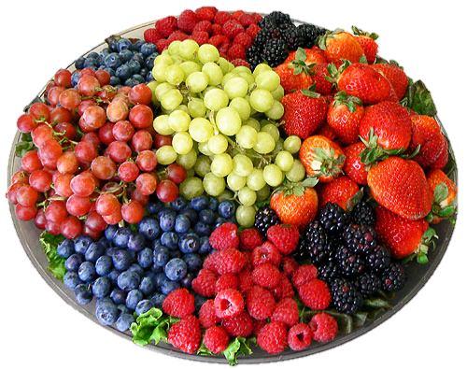
Small Fruits for Sustainable Production
Definition: Perennial crop producing small fruit.
Blueberries
Muscadines
Blackberries
Strawberries (often grown as an annual)
Photo: www.stoltzfusmarket.com/Fruit-Trays.rhtml

Slide 5
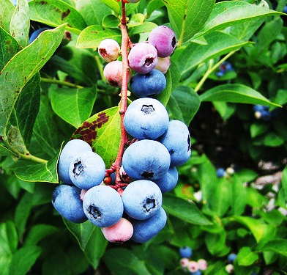
Blueberries
Rabbiteye – main season varieties
Southern Highbush – early maturing, challenging to grow, not recommended in mountain regions
Plant multiple varieties to insure proper pollination
Acid soils – pH 4.5-5.2
Plant with peat moss or pine bark to insure acidity
No lime
Cane renewal pruning after establishment (4-6 ft)
Very few problems
Photo: pendergardener.blogspot.com /2010_06_01_archive.html

Slide 6
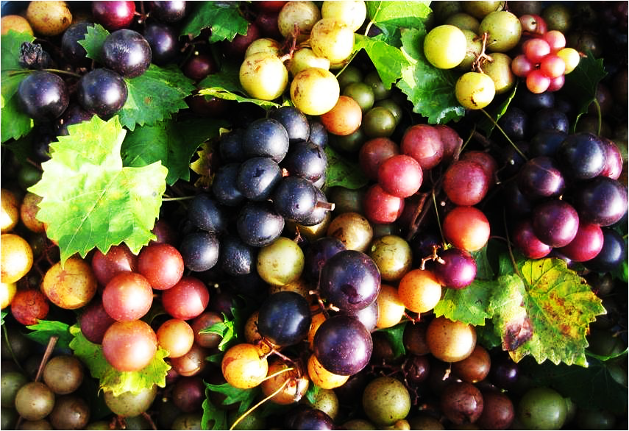
Muscadines
Adapted to the Southeast
Immune to Pierce’s Disease
Grown on trellis
Plant multiple varieties to insure pollination
Training & pruning is required
Fruit on new growth from last year’s wood
Photo: https://pender.ces.ncsu.edu/2012/08/its-time-for-muscadines

Slide 7
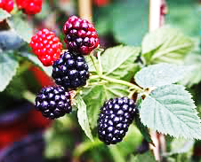
Blackberries
Brambles – includes blackberries, raspberries, etc.
Raspberries are not well adapted to the south
Erect, semi-erect, & trailing types
Fruit produced on two-year-old canes (floricanes)
Current year’s growth are called primacanes
Cane renewal pruning - floricanes are removed after fruiting
Photo: http://today.agrilife.org/2012/11/14/horticulturist-tells-how-to-have-a-berry-good-farm-in-texas/

Slide 8
Raspberries versus blackberries
Hollow center
Filled center
Photos: http://www.examiner.com/article/how -to-tell-blackberries-from-black-raspberries

Slide 9
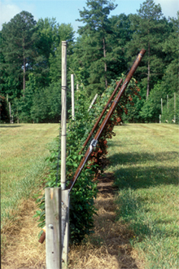
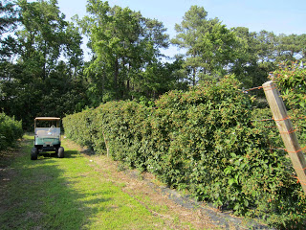
Stiles Shift Trellis
Photo: teamrubus.blogspot.com/.../blackberries-on-shift-trellis.html
Photo: www.sdedible.org/blackberry-care--cultivars.html

Slide 10
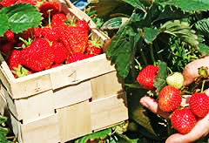
Strawberries
Annual Hill Culture versus Matted Row
AHC results in larger fruit, less disease
AHC requires more management and are usually grown on plastic
Plastic mulch requires all fertility preplant
No water soluble organic fertilizers
Fertility management can be problematic
Overwintering crop that requires frost protection
Overhead irrigation and/or row covers
Photo: www.homelife.com.au

Slide 11
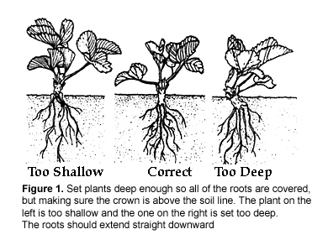
Strawberries
Important to establish fall planted transplants prior to winter weather
Obtain healthy disease free plants
Certified organic growers must obtain organically grown transplants
Photo: http://vsadulyvogorode.ru/sadovaya-zemlyanika/sadovaya-zemlyanika

Slide 12
Additional Resources
Grow Your Own Organic Small Fruits - http://www.sustainagga.org/documents/OrganicSmallFruits-brochure.pdf
Organic Blueberry Production - http://www.sustainagga.org/documents/06organicblues2.pdf
SustainAgGA.org – Go to Resources, Crops, Small Fruits

Slide 13
This material is based upon work that is supported by the National Institute of Food and Agriculture, U.S. Department of Agriculture, under award number 2015-70017-22861.
Beginning Farmer and Rancher
Development Program
Developing the Next Generation
of Sustainable Farmers in Georgia Grant

