Slide 1
Small Fruit and Vegetable Production

Slide 2
Session 4 Crop Selection
Timothy Coolong PhD
Extension Vegetable Specialist
University of Georgia, Tifton Campus

Slide 3
Learning Objectives
Basic crop and variety selection –
Matching soils, climate, landscape position, amount of sun, and markets to your cash crop using examples
Open pollinated vs. hybrids and disease resistance
Determinate vs. indeterminate

Slide 4
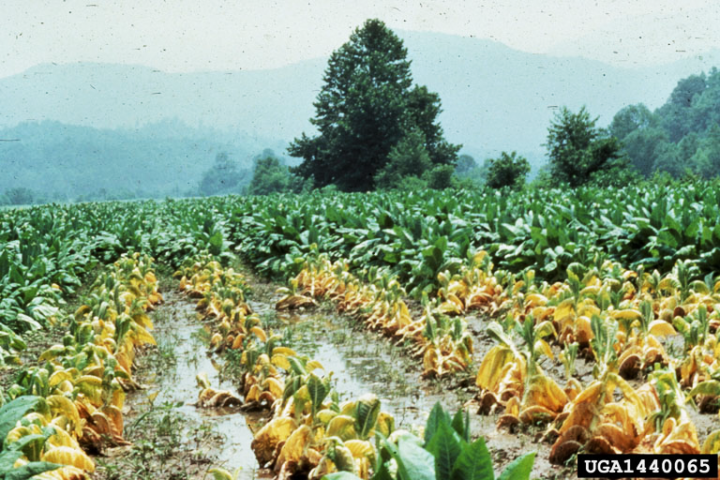
Site Selection/Plan
Most important considerations for site selection
Have good water
Horticulture Crops contain 90% water must have plenty of water
R.J. Reynolds Tobacco Company, Bugwood.org–See more at: http://www.ipmimages.org/browse/detail.cfm?imgnum=1440065#sthash.MP8pwGV3.dpuf
Soil Quality
It might take a while but you can really improve soil over time
Well drained soils are preferred over those that drain poorly
Drain tile may be an option – vegetable crops do not tolerate standing water
Notes:
When considering growing vegetables, having access to plenty of water is priority #1. Do make sure you plan for adequate water, whether it is drilling a well or having a pond –drip irrigated tomatoes can easily use 300,000 gallons of water per acre per season in S. GA. Good soil is also important, but you can build soil quality over time with organic matter. Also, when growing vegetables ensure that you have well-drained land or plan on investing in drain tiles. The picture is of a flooded tobacco field and is simply and example of problems that will occur if you have poor drainage.

Slide 5
Variety and Crop Selection
Hybrid (F1) vs. Open Pollinated (OP)
Hybrids are a controlled cross between 2 inbred parental lines
Have vigor
Do not look like parents
Have improved disease resistance (typically)
Most new varieties
Cannot save seed – they will not come true to type
Notes:
Hybrids and open pollinated varieties. Hybrids are most common in vegetable production as they combine disease resistance and vigor. Seed are more expensive (more labor to make crosses) and seed cannot be saved. Saving seed is important to discuss. Many uninformed people think that agrochemical companies genetically modify everything so that you cannot save seed- this is not true. For the most part, modern varieties are hybrids, except for some things that are planted at extremely high densities per acre (cost) and they cannot be saved. The seed, if saved, will continue to segregate out and plants will have great variability.

Slide 6
Varieties and Crop Selection
Open pollinated
Older types – heirloom vegetables are open pollinated – some new releases are also OP.
Can save seed from these and they will be true to type
Often lack disease resistance that newer varieties have
Seed are typically much cheaper
May differ significantly between companies
Hybrids are usually associated with a single company, while OP types can be sold by several sources
Notes:
Open pollinated varieties are the result of relatively random pollination events within a given variety and will come true to type. Because of this, many seed companies can market their “own” OP varieties. Therefore an heirloom OP type may be slightly different depending on where they are purchased from, while hybrids are almost always proprietary because the parental lines are kept by the companies that develop them thereby preventing any other company from creating them. Seed are much cheaper but typically do not have the advanced disease resistance that hybrids have.

Slide 7
GMO vegetables
Although GMO crops grab a lot of headlines they have a very minor impact on vegetables
Commercially there are GMO sweet corn (herbicide and insect resistance) and squash/zucchini (virus resistance)
Very little GMO sweet corn is grown by large wholesale growers
GMO Squash is limited to the fall market in Georgia (enhanced disease resistance)
Other GMO vegetables have patents issued but are not sold commercially
Notes:
Because of the public debate regarding GMO crops it is important to understand the role that GMO vegetables play – a very small one overall. GMO squash have been around for nearly 20 years and serve a small but important role in providing disease resistance to viruses in the fall. GMO sweet corn has been on the market for 15 + years. Recently a “second” generation of GMO sweet corn containing multiple insect resistance genes and herbicide resistance genes was released. The varieties are simply GMO versions of existing popular sweet corn varieties – while effective they are not widely grown due to market resistance. Otherwise there are no other commercially grown GMO vegetables. This should not be used to generate a debate in the class about GMO crops, simply to educate the growers so that if they are questioned by consumers they understand the facts of the market.

Slide 8
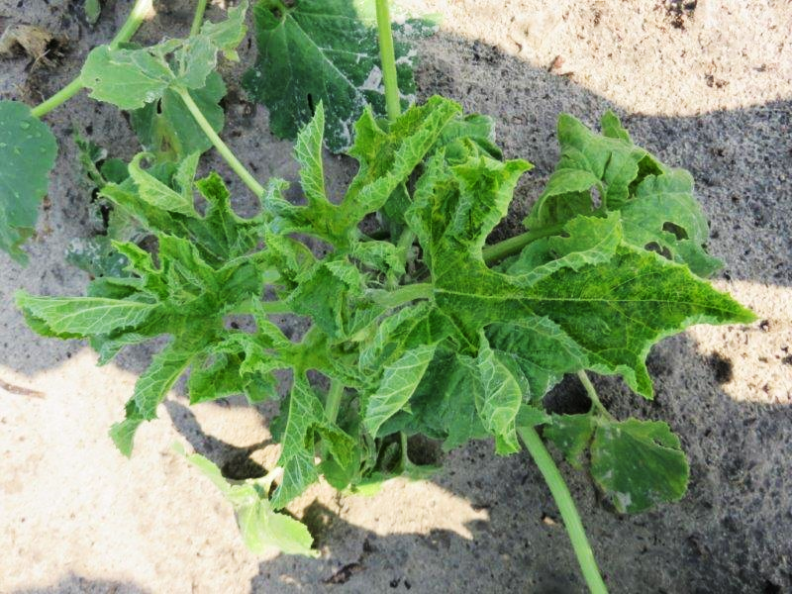
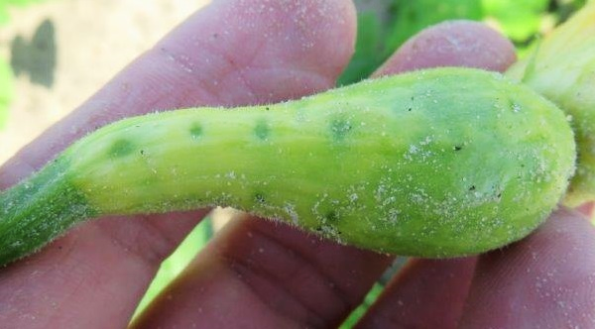
Variety Selection
Disease resistance in varieties is a critical tool to us
Often disease resistance is not present in varieties with certain quality characteristics
As the season progresses, disease resistance becomes more important (inoculum and vectors increase)
For ex. In spring non-virus resistant squash can be grown, but that becomes challenging later in the summer
Photos: Tim Coolong
Notes:
This slide and the few that follow will be discussing variety selection and how it should be used to help control diseases. It also helps to understand the disease you are interested in, how it is spread, and the potential for loss. Also stress that the impact of resistance can change over a season. A picture showing yellow squash with a mosaic disease on the slide. The variety used ‘Gentry’ had no virus resistance and in the spring performed well. However, by July, pressure became intense such that the fields (17 acres) planted were 100% loss. In this case the grower thought that controlling aphids (the virus vector) would control the disease, but even with 1 aphid per plant, virus can occur. The only solution for this situation is disease resistance.

Slide 9
Disease resistance
PM Susceptible
BLS Resistant
BLS Susceptible
PM Resistant
Photos: Tim Coolong
Notes:
The pictures on this slide show the impact of powdery mildew resistance (left) in pumpkin and bacterial leaf spot resistance (right) in pepper. In both cases plants were not sprayed and just relied on resistance to show impact. Normally a grower would still spray because resistance is rarely absolute, but these are examples of the impact of resistance.

Slide 10
Cross pollination
Most different species will not cross pollinate
Interspecific hybrids can occur
Not an issue since the fruit will not be affected, only the seed
Generally self pollinate (perfect flowers)
Beans, peas, tomatoes, peppers
Cross pollinate w/ insects (male/female flowers)
Cucurbits
Cross pollinate w/wind
Corn
Notes:
Growers need to be aware that planting a cucumber next to a melon will not be a problem insofar as cross pollination. Interspecies hybrids are rare and even if they did occur would only manifest themselves in the seed which would need to be planted for the following crop. There is one big exception – sweet corn – Why is this? Because you are consuming the seeds and their characteristics will be affected by cross pollination. Also a brief and very general overview of vegetables that will self pollinate or cross pollinate typically.

Slide 11
Sweet corn types
There are at least 9 types of sweet corn available now
Most come from 3 genes and combinations
Su (standard sweet corn)-5-15%
Se (sugary enhanced) – 8-20%
Sh2 (shrunken 2/super sweet) 25-40%
Notes:
This slide just discusses the 3 main types of sweet corn. Su – standard sweet corn is the old Silver Queen type of corn and has between 5-15% soluble sugars. Sugary enhanced sweet corn or SE has more sugars than SU corn and a creamy texture. Sh2 or supersweet corn has very high sugar and slow conversion to starch – these are the types grown commercially for wholesale markets.

Slide 12
Sugary enhanced
Has either one or two copies of the recessive se-1 gene
Either 25% or 100% kernals contain the se characteristics
Works in conjunction with the recessive su-1 gene (regular sweet corn)
Produces extra sugars, but does not slow starch conversion
Tend to be creamy, do not ship well – sold for direct markets
Notes:
Se corn can be grown with regular SU sweet corn with no problems. These varieties are commonly sold for roadside markets. These varieties have better emergence in the spring in cool soils compared to Sh2 (supersweet types). For most beginning farmers these are a good choice.

Slide 13
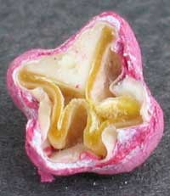
Supersweet (Sh-2)
Supersweets contain a recessive gene of sh-2
This increases sugar and prevents the conversion of sugars to starch
They lack the production of phytoglycogen (starch)
Why they are not creamy
Also do not germinate well because no starch available
Ship very well and are sold on the wholesale market
Photo: Tim Coolong
Sh-2 kernel,
Harris Moran Seed Company
Notes:
Supersweets are grown commercially because they ship well and are very sweet. The biggest downside to these varieties is that they do not emerge well in very cold soils. A picture of an Sh2 seed is shown – the lack of starch means the seed is very small and somewhat deformed – because of this lack of starch, there are few reserves for germination and they do not emerge well in cold soils.

Slide 14
In summary
Se, Su, Synergistics can grow together
Sh-2, and augmented supersweets can be grown together
Keep the two groups isolated
Isolation 250 feet will get minor contamination
Isolation of 700 feet will be complete
10-14 days of maturity/planting time

Slide 15
Other varietal characteristics to be aware of…
Tomatoes
Indeterminate vs. determinate
Indeterminate will continue to grow, eventually getting very tall
Many heirloom types
Harvest spread out over a long period
Determinate will terminate in a flower bud (fruit cluster) after a set time period
Hybrid types, shorter more compact, concentrated yields
Photo: Tim Coolong
Determinate tomatoes in a field
Notes:
Because tomatoes are a crop that many people grow they should be aware of the differences in determinate or indeterminate types. Nearly all commercial growers grow determinate types – they facilitate a short, concentrated harvest. The plants are easier to stake and spray and manage but only produce for a relatively short period of time.

Slide 16
Systems-based farming
Photo: Tim Coolong
Notes:
I want to stress that when selecting crops farming should be viewed as a system – not choosing something in isolation. For example if you only choose a tomato because you like the flavor, but it has no disease resistance then you need to be sure that flavor is so important to your market that you could potentially risk losing a crop to something such as TSWV – if you are okay with this then it is fine, but at least you need to understand the risks involved. Success is impacted by all the factors that go into making crop decisions. Take a few minutes to discuss this slide – the picture is beautiful, who wouldn’t want their field to look like that? – However you will notice Collards, mixed greens, kale etc all planted next to each other….if you are going to spray with chemicals are they labeled for all the crops in that picture? In this scenario the growers were organic and did not need to spray…but it is worth discussing what you see in this picutre.

Slide 17
Crop Selection
#1 – Grow what you can sell and have it sold before you plant it
#2 – Can it fit into your production system
Weed and pest control, post-harvest treatment, labor, etc.
Photo: Tim Coolong
Notes:
When choosing what crops to grow you must think about what will sell, how much money you will make, competition, resources required, etc. – Once you determine that you can sell something (wholesale, retail, etc.) then you must determine can you grow it in your location and how does it fit within your system. Do not try to immediately grow a crop that requires a high degree of specialization and doesn’t fit into your production system unless it can make you a lot of money. Also, while diversification can help spread risk, it makes management more difficult. The picture shows a 2-row system for growing lettuces – as an example if you are set up to cultivate only and not use herbicides then you should determine how a new crop can be cultivated and fit into your system. Likewise, if you rely on herbicides, make sure that you are willing to spend the money on an herbicide for your new crop if options are limited.

Slide 18
Crop Selection
Labor is a significant factor in crop selection.
Tomatoes are widely regarded as the most labor intensive
Slide courtesy of Dr. Brent Rowell, University of Kentucky.
Notes:
Crop Selection – Labor is the most limiting and costly factor for vegetables. The above chart is old but still holds true. Most of the common vegetable crops will require 150-200 hours of labor per acre from planting to harvest and packing. If you choose to plant 5 acres with only yourself as labor you will not be successful as there is now way you will be able to manage the entire crop unless it is something such as beans that is mechanically harvested.

Slide 19
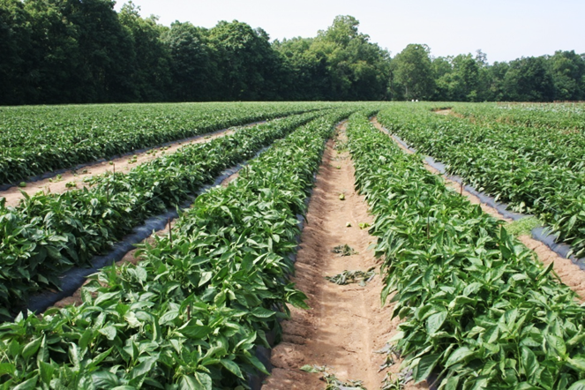
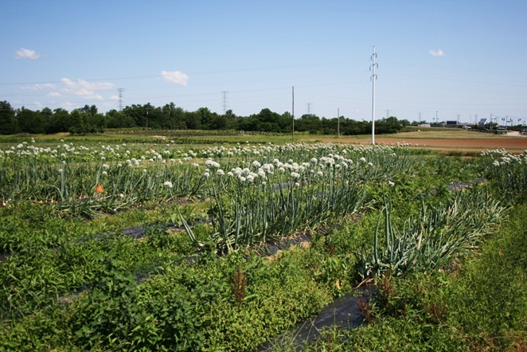
Crop Selection
How does the crop grown fit into your system
Example weed management for a crop-
Decisions made regarding selecting a crop
Photos: Tim Coolong
Notes:
The next few slides will go step by step into thinking about how a crop fits into you system using weed management- however the same type of process will be followed for disease and insect management, even postharvest handling. What is important is to start thinking about the entire system when organizing your farm.

Slide 20
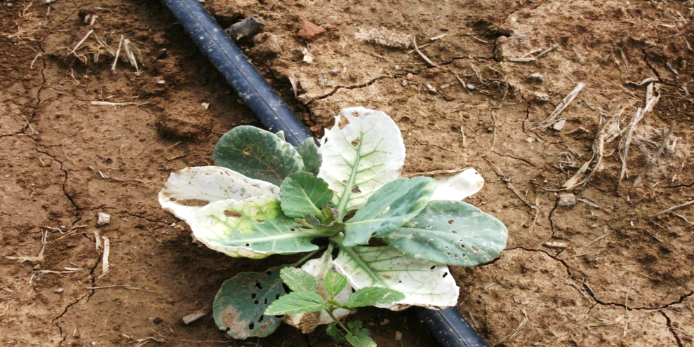
Will you use herbicides?
What herbicides are available? http://www.gaweed.com/
Do they have rotation restrictions?
Can they be used on a variety of crops
Photo: Tim Coolong
Notes:
Again this is one set of decisions, but it is good to start thinking this way……for weed control in a given crop will you use herbicides? If so, are there good options? Are they expensive? Are rotation restrictions such that it is not practical? I included a picture of cabbage with command injury- if the growers want to grow wheat after a fall cabbage crop and have used command then rotations restrictions could a problem- just an example of the process that needs to be followed.

Slide 21
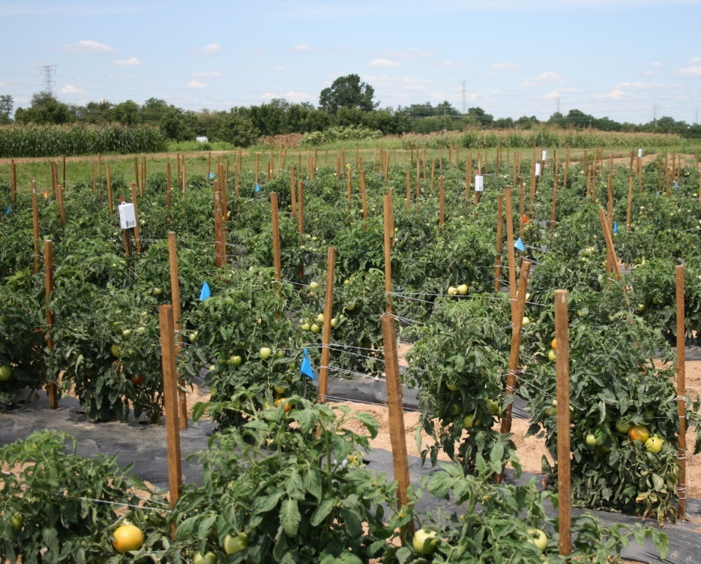
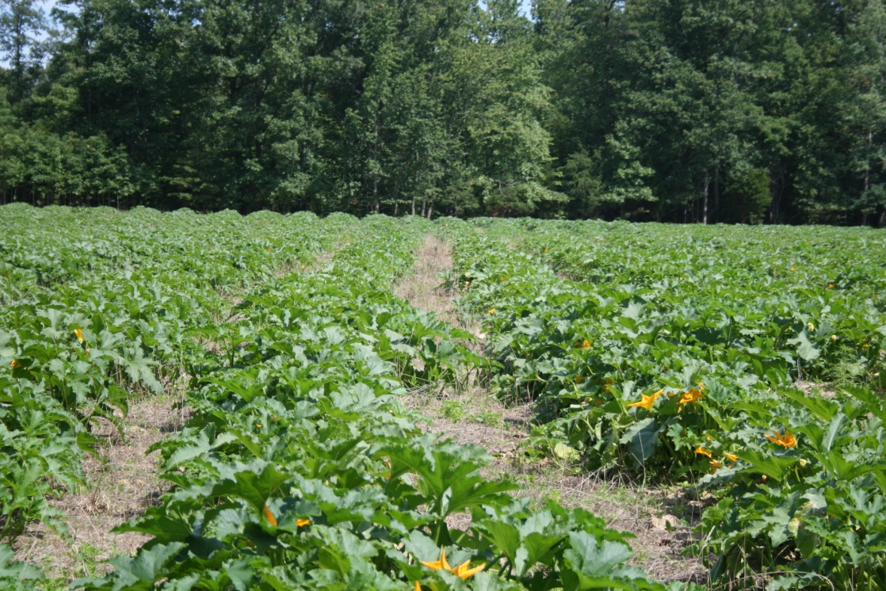
What will you grow
Staked or vining-how will you cultivate
Photos: Tim Coolong
Notes:
Crop selection – if you plan on cultivating, make sure you are set up for it or use herbicides.

Slide 22
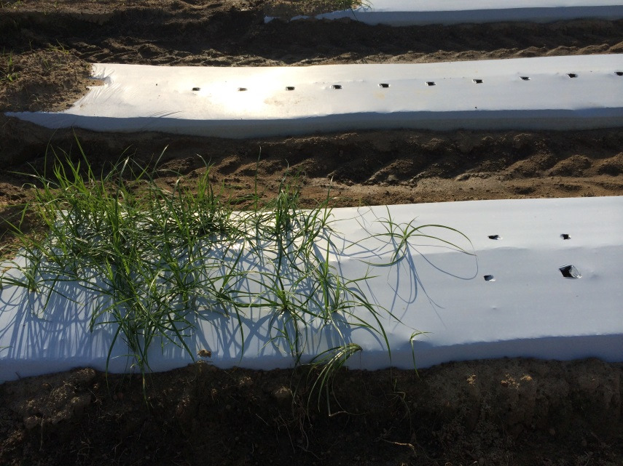
Plastic or Bare Ground?
Photos: Tim Coolong
Notes:
Will you use plastic mulch or bare ground? Plastic may give better weed control, but not if nutsedge (bottom pic) is present. Also some crops such as onion do better on bareground compared to plastic due to the heat it provides and subsequent negative impact on bacterial diseases.

Slide 23
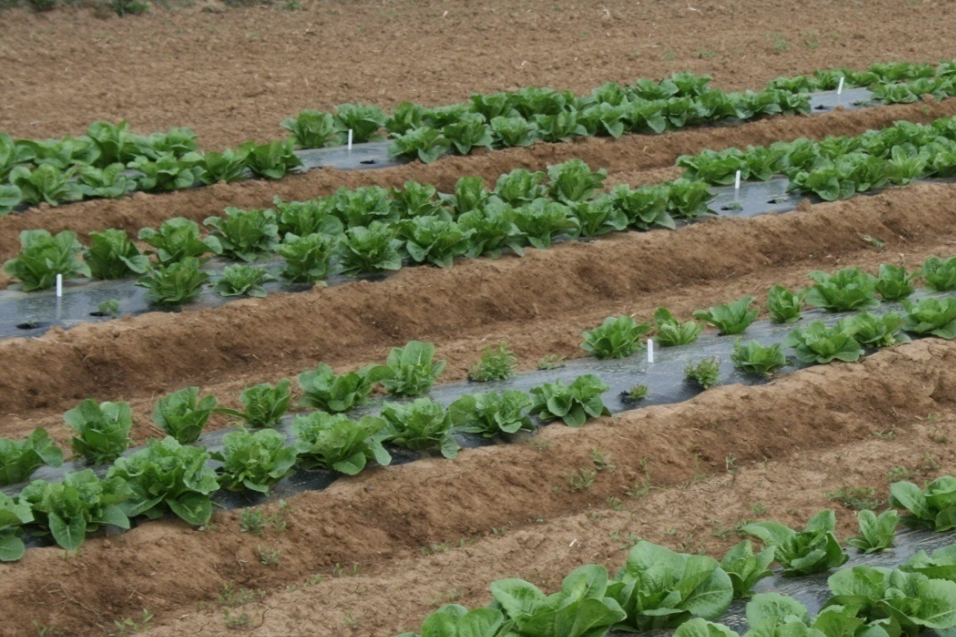
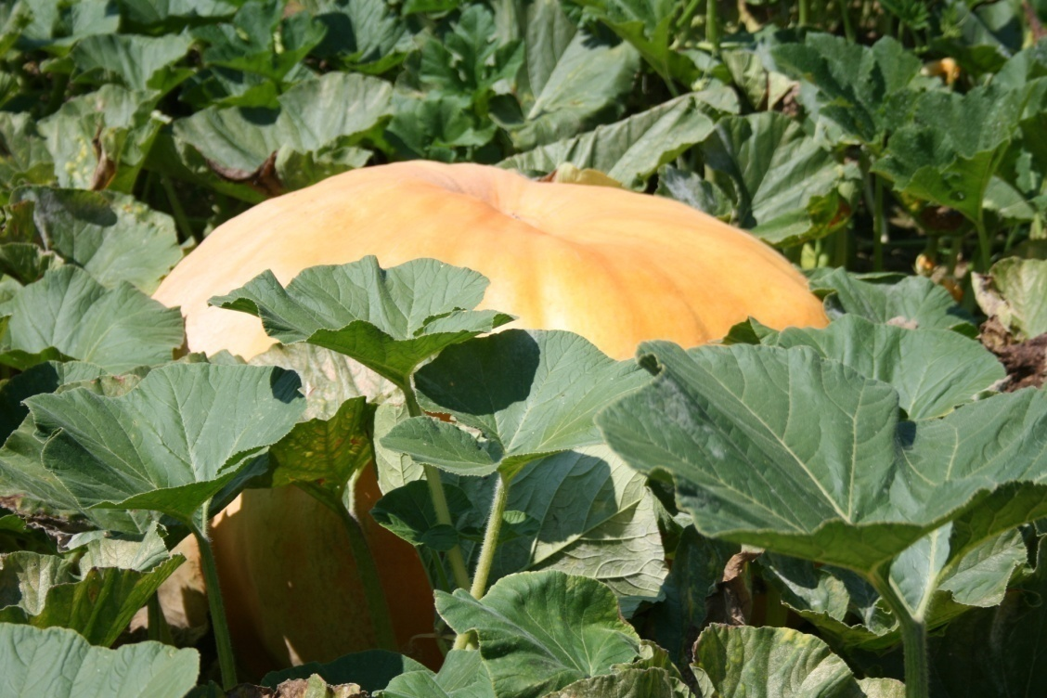
Crop Selection
Short season vs. long season
Photos: Tim Coolong
Notes:
Lettuce can be grown in 50 days from transplant, while a large pumpkin can take 150 from seed. If you can cycle 2 or 3 short season crops on the same ground as 1 long season crop can you make more money in a year off your land using several short crops or 1-2 long crops? How will herbicide residue from a short season crop impact the next crop if there is only 6-8 weeks between application and the next crop?

Slide 24
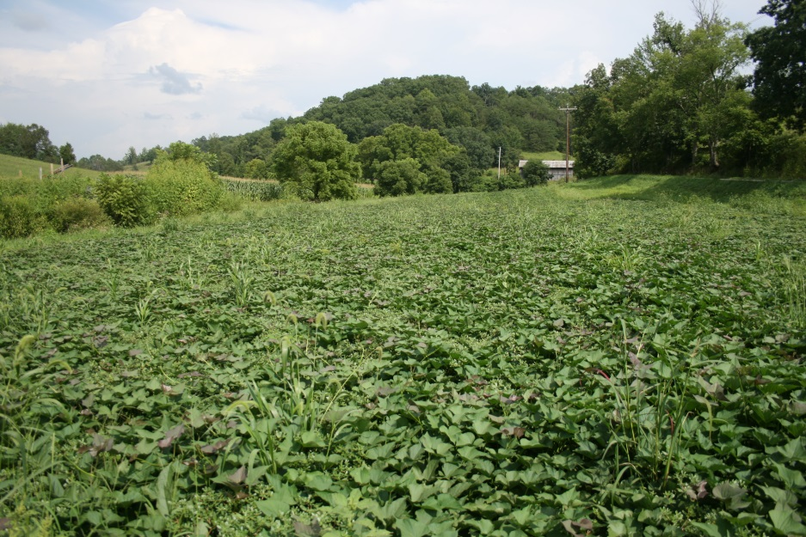
Crop Selection
Quick coverage vs. poor competitors
Photos: Tim Coolong
Notes:
If you are to rely on cultivation and/or herbicides will your crop choke out weed seeds quickly such as sweet potatoes or will they be poor competitors as onions are?

Slide 25
Crop Selection Storing Vegetables
Not all vegetables should be refrigerated
Cool and dry
Room temperature or slightly cooler (~ 60F)
~ 60% relative humidity
Cool and “moist”
~ 55-60 F, refrigeration for a few days generally ok
Protect from drying (silted plastic bag, slightly open container)
Cold and moist
Refrigerated (32-40 F)
~ 95% relative humidity
Notes:
Discuss storing the harvested product and any specialized equipment you may need when choosing your crop.

Slide 26
Storing Vegetables
Cool and dry
Potatoes
Pumpkins/winter squash
Watermelons
Cool and “moist”
Cucumbers
Summer squash
Eggplant
Peppers
Tomatoes
Cold and moist
Beans
Beets
Broccoli/cauliflower
Cabbage
Cantaloupe
Carrots
Corn
Leafy greens (lettuce, spinach, kale)
Radishes

Slide 27
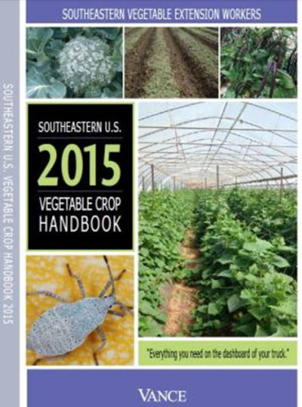
Additional Resources
SE Regional Vegetable Production Guide
http://www.thepacker.com/grower/2015-southeastern-us-vegetable-crop-handbook
GA Pest Management Handbook
http://www.ent.uga.edu/pest-management/

Slide 28
Supported by
Beginning Farmer and Rancher
Development Program
Developing the Next Generation
of Sustainable Farmers in Georgia Grant

