Slide 1
Small Fruit and Vegetable Production

Slide 2
Session 2 Cover Crops
Julia Gaskin
Sustainable Agriculture Coordinator
Crop & Soil Science Dept
University of Georgia

Slide 3
Learning Objectives
List three reasons you might want to use cover crops
Name three major plant families that are used for cover crops

Slide 4
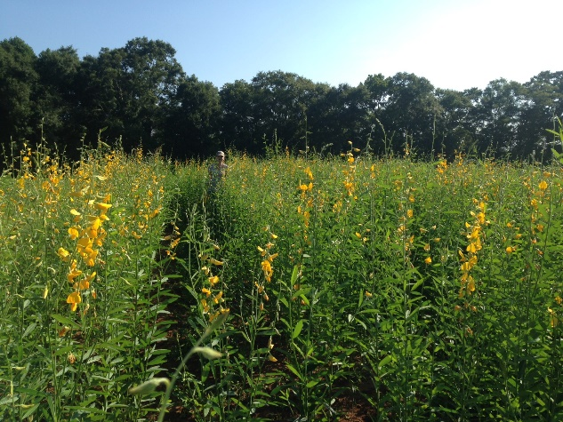
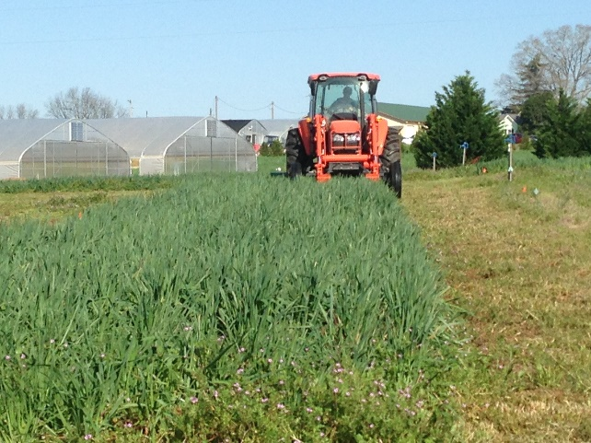
Why use cover crops?
Grown primarily for soil or ecosystem improvement rather than cash
Important fertility management tool for farmers
Negative consequences if managed incorrectly or the wrong species is used.
Sunn hemp summer cover crop
Photos: Julia Gaskin
Black oats winter cover crop

Slide 5
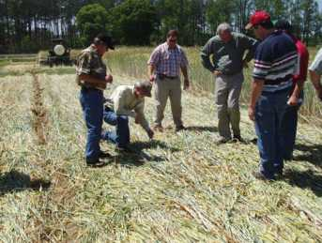
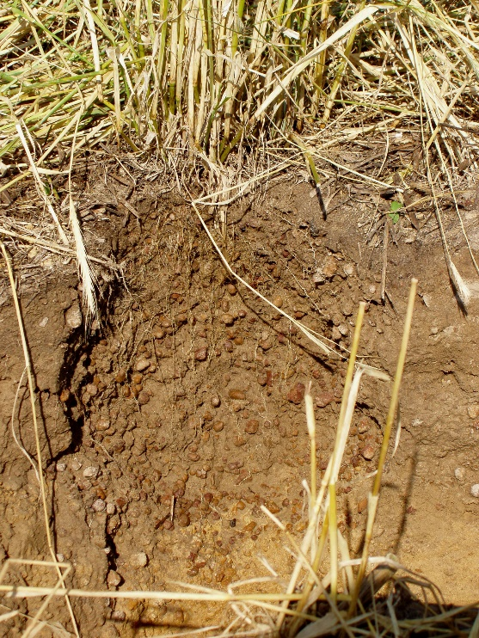
Cover Crop Benefits
Reduce soil erosion
Improve soil quality by adding carbon
Reduce nutrient loss
Increase water holding capacity
Improve water quality
Reduce weed pressure
Provide habitat for beneficial insects
Provide nitrogen (legume cover crops)
Thick rye mulch acting as weed control
Rye roots and nutrient scavenging
Photos: Julia Gaskin
Notes:
Cover crops provide several benefits. These include:
- controlling erosion by keeping the soil covered,
- improving soil quality by increasing soil organic matter,
- retaining nutrients in biomass and through deep roots that prevent leaching.
The combination of decreased erosion, improved infiltration and reduced leaching of nutrients can improve water quality.
Well-managed cover crops can also help reduce weed populations in many situations.
Finally if legumes are used, cover crops can be a source of nitrogen.

Slide 6
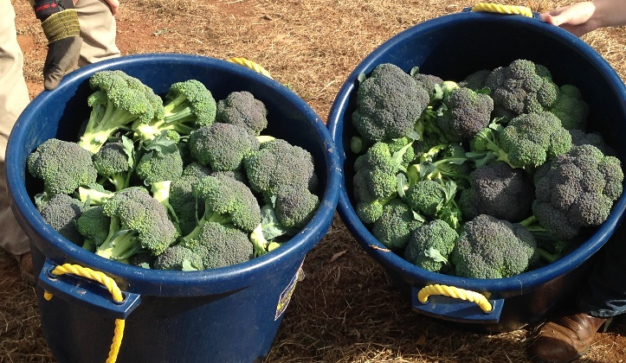
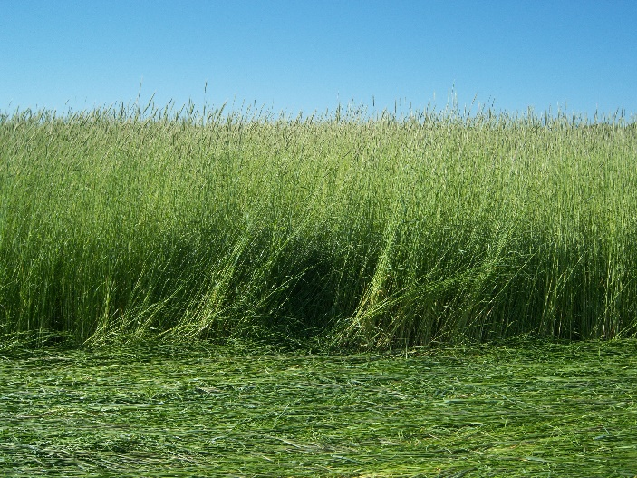
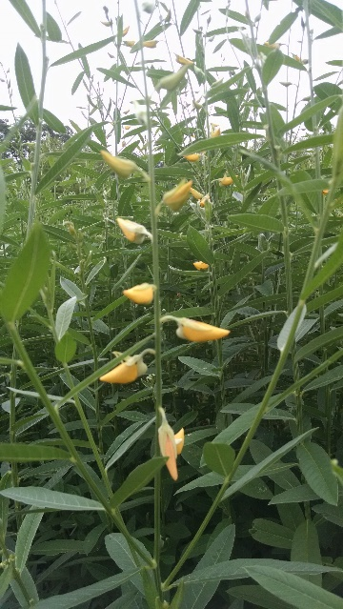
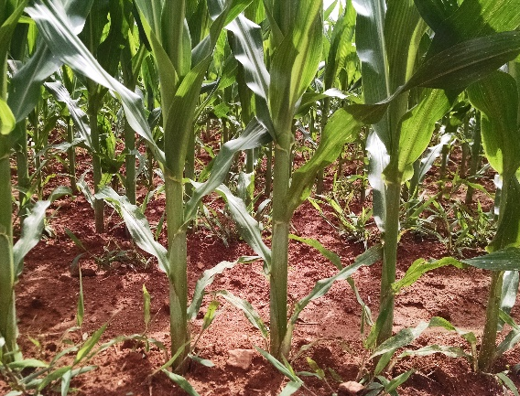
Challenge !
Finding the right cover crop that fits your rotation and accomplishes your specific purposes.
Photos: Julia Gaskin

Slide 7
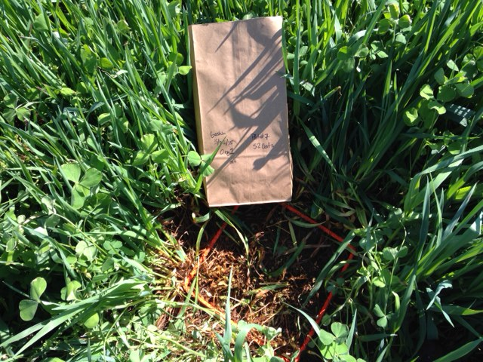
Cover Crop Categories
Major season for growth
Winter – planted in fall and killed in the spring
Summer – planted in the spring and killed in fall
Plant family
Grains
Winter - cereal rye, wheat, oats, black oats,
Summer - sorghum, sudangrass, millets
Legumes
Winter – clovers, winterpeas, vetches, lupines
Summer – cowpeas, sunn hemp, velvetbean, pigeon peas
Brassicas
Winter – radishes, mustards, rapeseed
Others
Buckwheat, sunflowers
Photo: Julia Gaskin

Slide 8
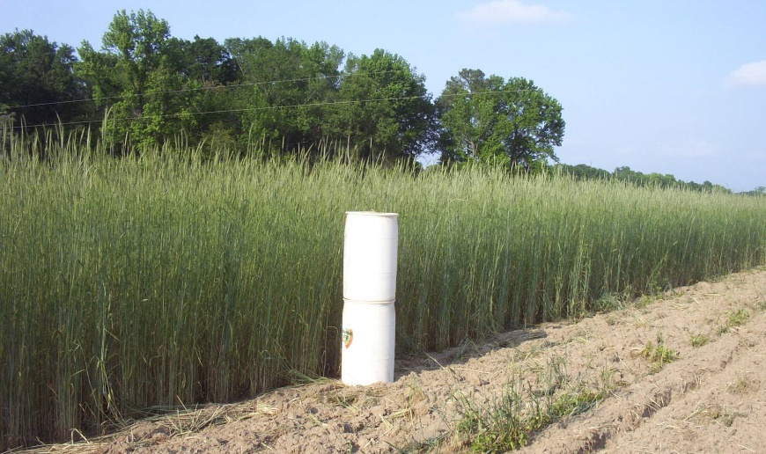
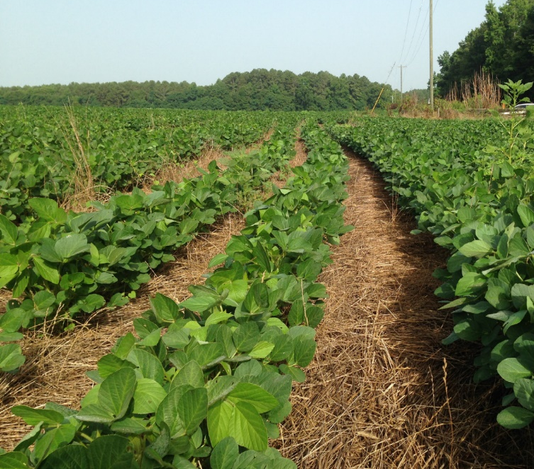
Grains
Characteristics
High biomass (as much as 8,000 lbs/ac)
High carbon:nitrogen ratio when mature
Primary functions
Improved soil quality
Weed suppression
Nutrient scavenging
Potential problems
Nitrogen immobilization
High biomass hard to manage
Photo: Jimmy Dean
Photo: Julia Gaskin

Slide 9
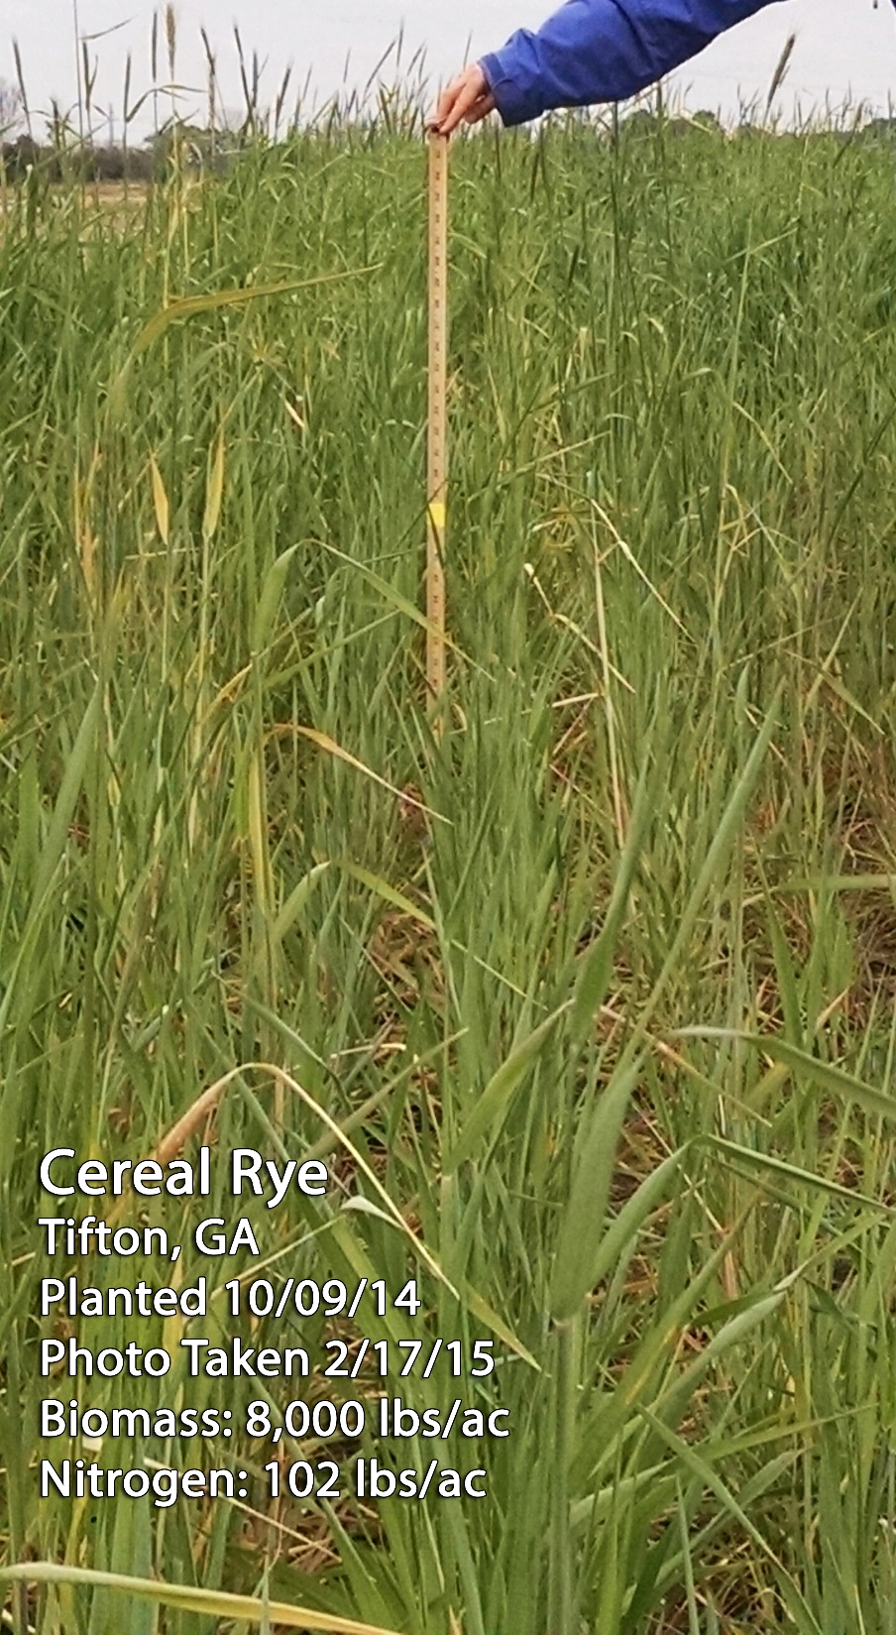
Cereal Rye
Photos: Julia Gaskin
Winter annual grass
Grows rapidly
Tolerant of low fertility and pH
Weed suppressing
Most winter hardy of annual grasses
Slow to break down
Deep rooted (recycling nutrients)
Seed 60 -120 lb/A, in late Sept. - late Nov.

Slide 10
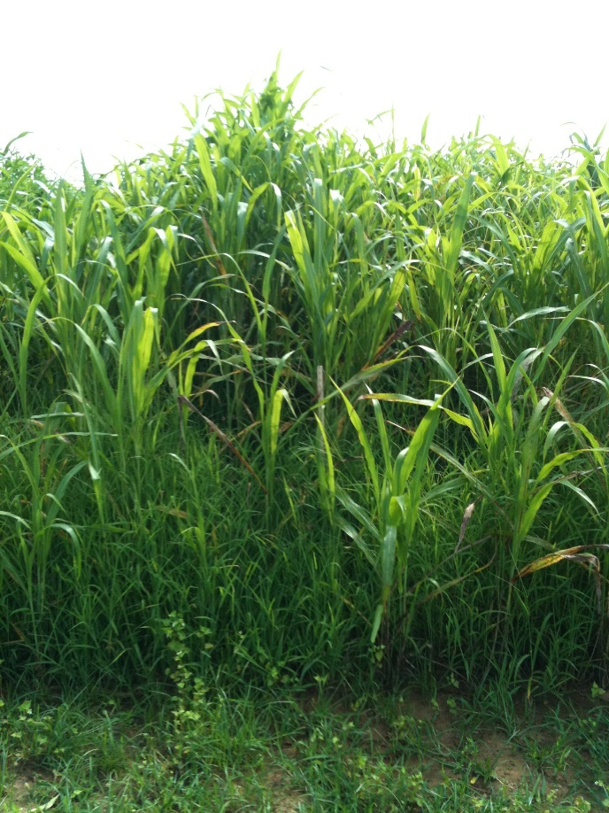
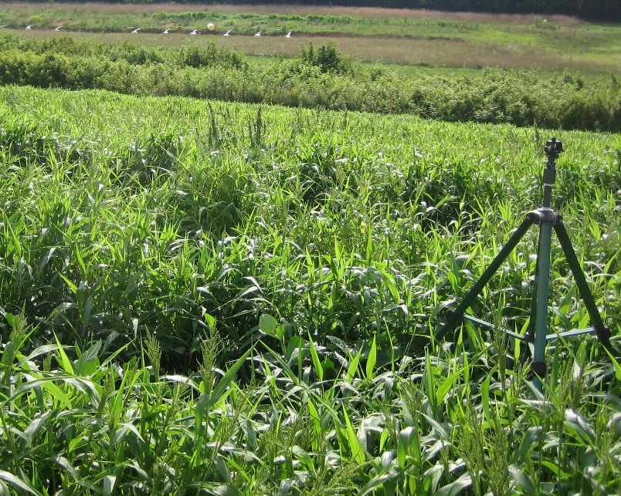
Sorghum, Sudangrass, Millet
Sorghum, sudangrass
High biomass (>8,000 lbs/ac)
Allelopathic
Johnson grass problem
Seed May-July 35- 50 lbs/ac
Millets
Moderate biomass
Better suited for operations without heavy equipment
Attracts birds
Seed May- July 10 – 35 lbs/ac
Sudangrass sorhgum
Photo: Julia Gaskin
Browntop millet
Photo: Julia Gaskin

Slide 11
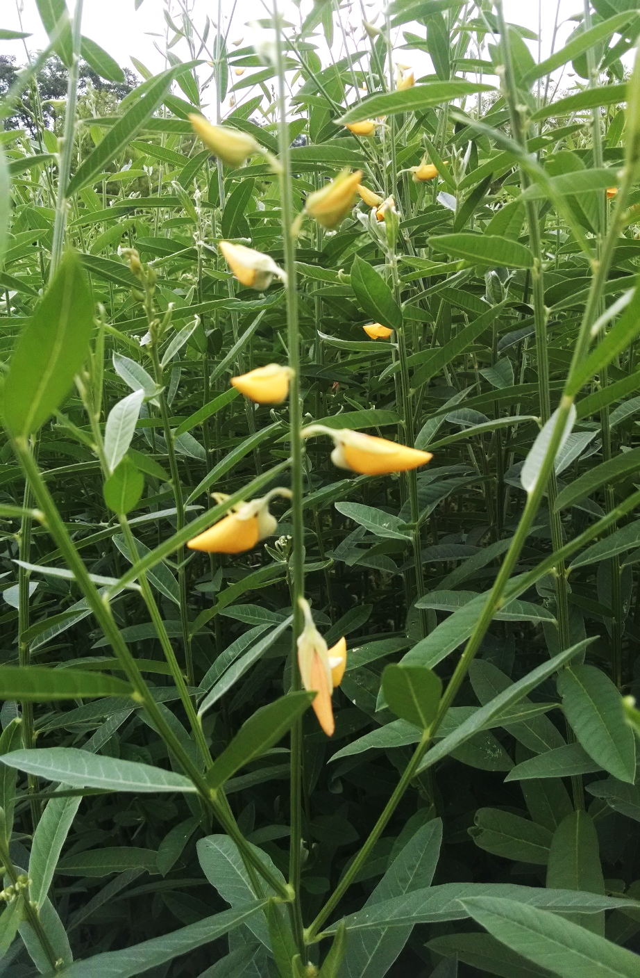
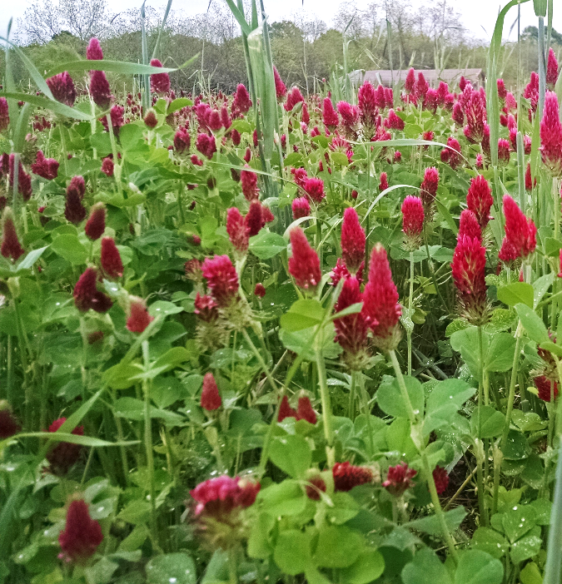
Legumes
Characteristics
Moderate biomass (4,000 lbs/ac)
Fixes nitrogen from atmosphere
Low carbon:nitrogen ratio when mature
Primary functions
Provides nitrogen
Provides habitat for beneficials (particularly pollinators)
Potential problems
Not good weed suppressants
Photos: Julia Gaskin

Slide 12
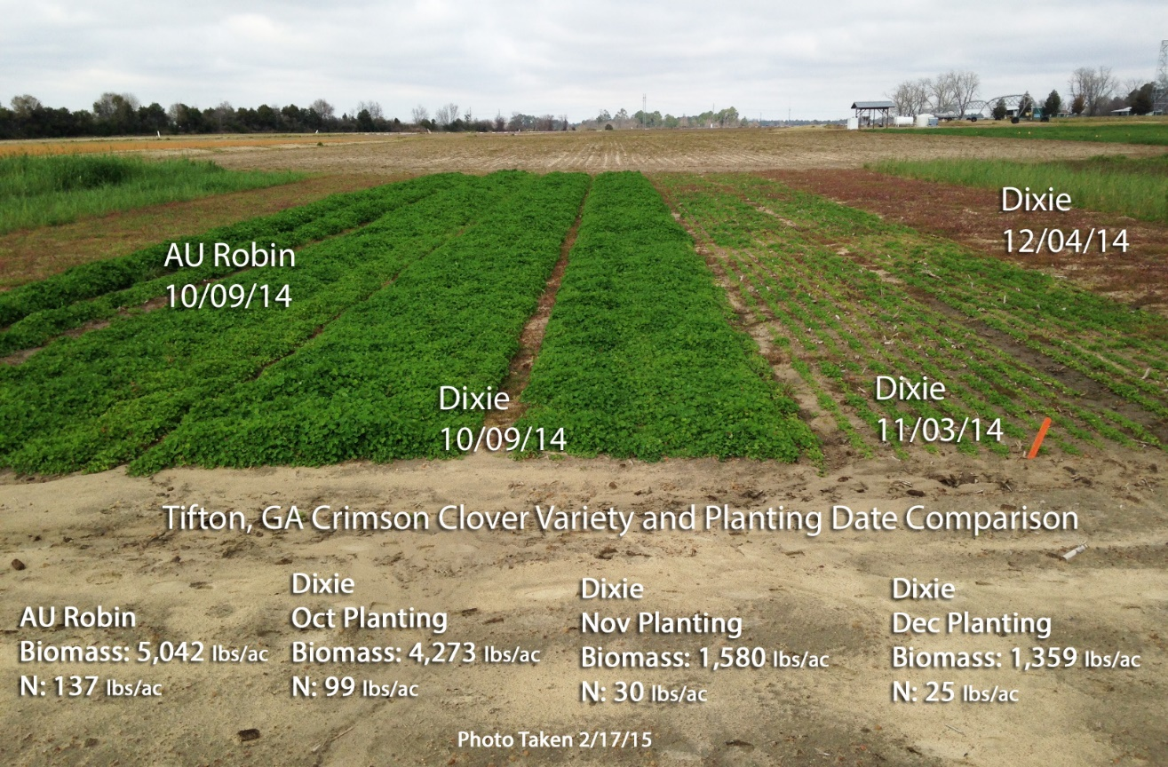
Crimson Clover
Winter annual 12-20 inches
500-5,000 lb/ac
Up to 140 lbs nitrogen/ac
Seed Sept – Oct at 12-20 lbs/ac
Photo: Julia Gaskin

Slide 13
Cowpeas
Seed available
Good biomass can help suppress summer weeds (5,000 lbs/ac)
Up to 100 lbs nitrogen/ac
Seed at May – June at 50-60 lbs/ac
Photo: Julia Gaskin

Slide 14
Legumes
Nitrogen fixation from bacteria – Rhizobia spp.
Need fresh inoculant for best results
TREAT IT RIGHT!
Keep refrigerated before use
Don’t leave in hot car or sun
Follow inoculant instructions
Slightly moisten seed and mix inoculant just before planting

Slide 15
Rhizobium-Legume Symbioses
Host plant Bacterial symbiont
Alfalfa Rhizobium meliloti
Clover Rhizobium trifolii
Soybean Bradyrhizobium japonicum
Beans Rhizobium phaseoli
Pea Rhizobium leguminosarum
Sesbania Azorhizobium caulinodans
Source: Dr. Julie Grossman, North Carolina State University http://articles.extension.org/pages/64401/legume-inoculation-for-organic-farming-systems
Both plant and bacterial factors determine specificity

Slide 16
Nitrogen in Cover Crop Residues
Grain Species | lb N / Acre | Legume Species | lb N / Acre
Barley | 35-70 | Alfalfa | 100-250
Oats | 30-70 | Crimson clover | 50-160
Rye | 35-70 | Austrian Pea | 40-175
Wheat | 25-70 | White clover | 75-140
 |  | Vetch | 45-200
 |  | Cowpeas | 40-60
 |  | Soybean | 35-45
Reeves, 1994

Slide 17
Nutrient Release
Soil temperature and moisture
C to N ratio - N mineralization or immobilization by soil microbes
< 25 net mineralization (release)
> 25 net immobilization (tie up)
The “woodiness” of the cover crop (Lignin, tannins and polyphenols are resistant to microbial breakdown and slow the rate of decomposition).

Slide 18
Estimating N from Cover Crops
Need aboveground biomass and nitrogen concentration
Rule of thumb – 30 to 60% of total N will be available for next cash crop
Three resources:
SARE – Managing Cover Crops Profitably
Oregon State Cover Crop Calculator
UGA Cover Crop N Calculator

Slide 19
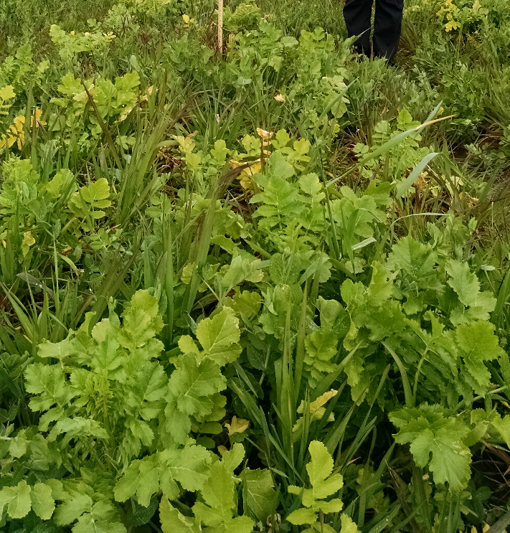
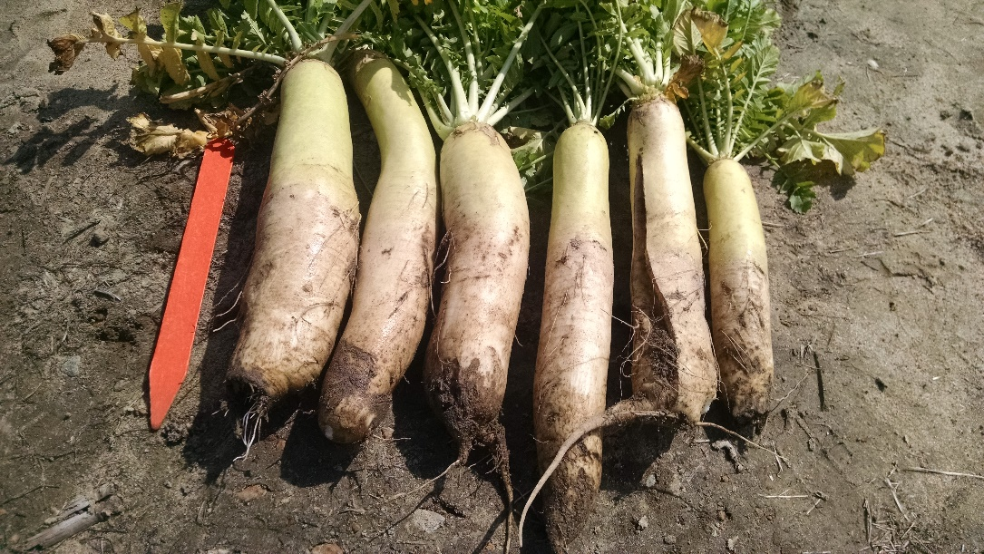
Brassicas
Characteristics
Moderate biomass (lbs/ac)
20:1 carbon:nitrogen ratio when mature
Primary functions
Loosening compaction layers
Nematode suppression
Early flowering for pollinators
Potential problems
Diseases
Photos:
Julia Gaskin
Tillage radish

Slide 20
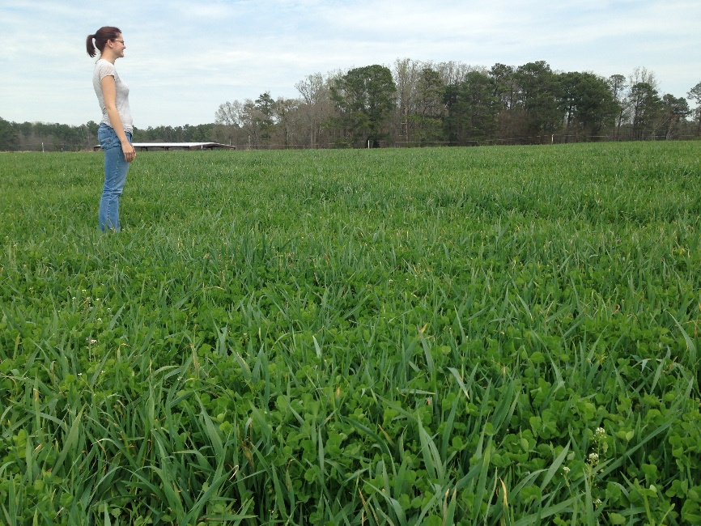
Cover Crop Mixtures
Mix species to add diversity and functions
Most common is grain/legume
Slows nitrogen release to spread it over growing season
Can improve weed suppression
Black oats/crimson clover winter cover crop before corn
Photo: Julia Gaskin

Slide 21
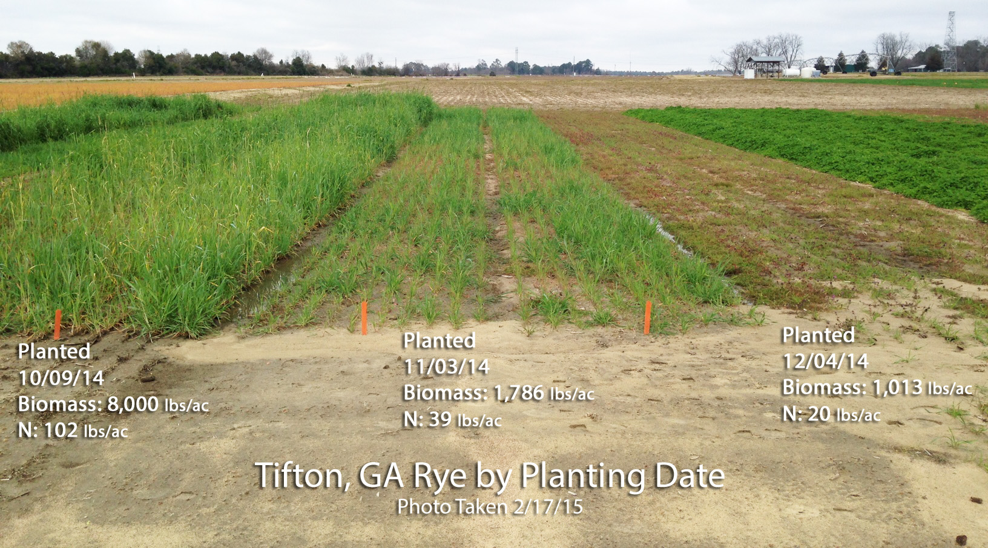
Maximize Biomass to Maximize Benefits!
Treat like cash crop
Good seed bed
Good seed soil contact
Timely planting
Kill as late as possible
Photo: Julia Gaskin

Slide 22
Planting Cover Crops
Broadcasting
Use higher seeding rates
Hand broadcast
Estimate area you need to plant
Calculate lbs of seed needed at correct seeding rate
Walk through area using a sowing motion until all seed is put out
Spin seeder
Follow manufacturers instructions
Rake or harrow in seed to get seed/soil contact
Water in
Photo: Julia Gaskin
Notes:
For cover crops to be effective in conservation of water and soil, a good, dense stand of plants that will produce adequate biomass must be properly established. Planting date, planting method, seeding rate, and good pest control are all important factors in establishing the proper stand. A well established stand of cover can produce in excess of 6-8 tons of biomass.

Slide 23
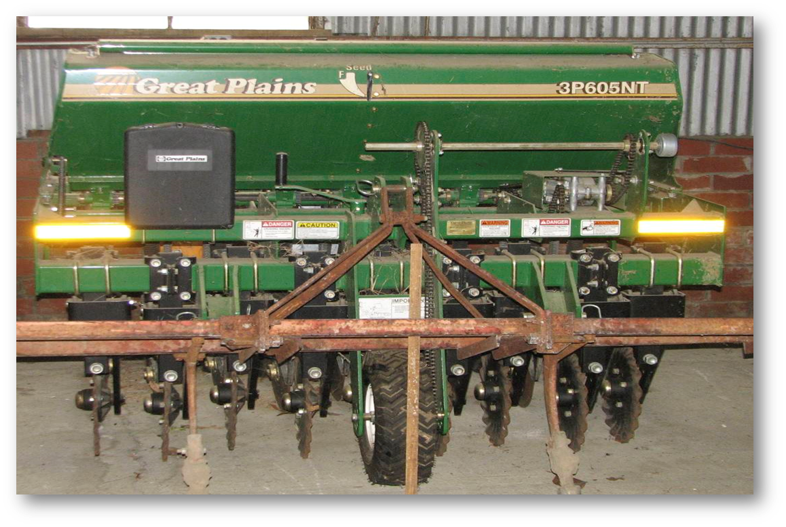
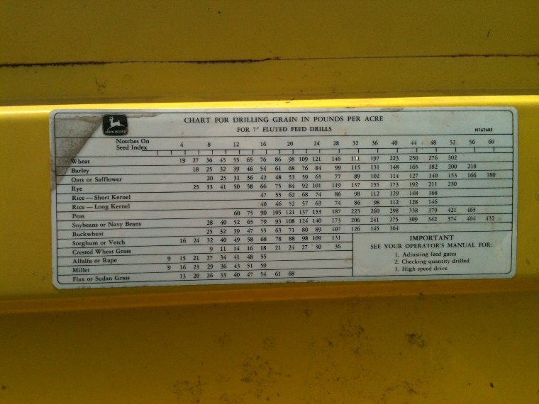
Planting Cover Crops
Drills
Typically get more uniform stands
Sometimes can be rented or can contract with neighbor
Use manufacturer settings for rate estimate
Use recommended seeding rates
Photos: George Boyhan

Slide 24
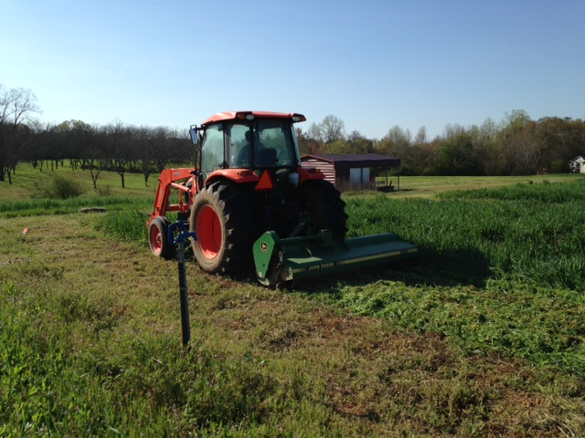
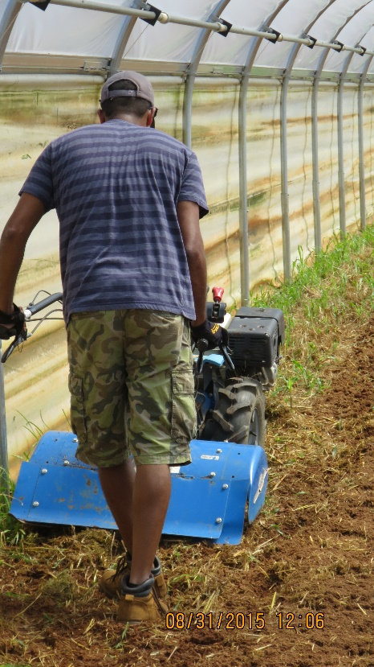
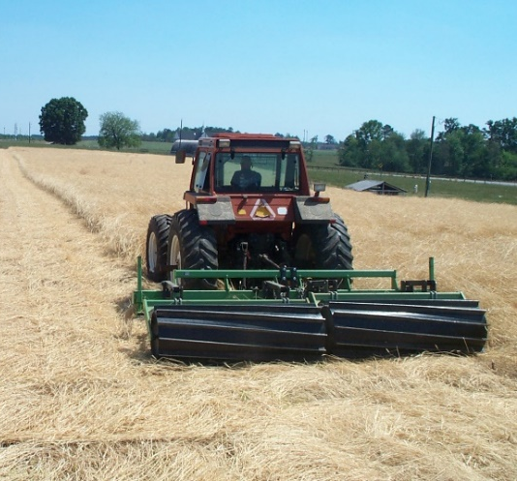
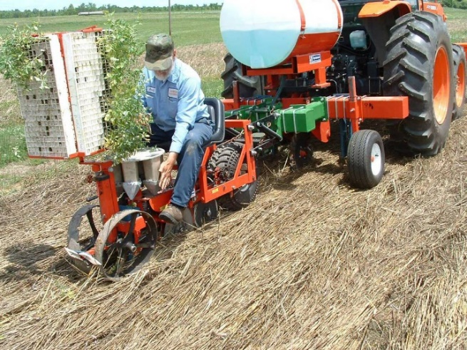
Killing Cover Crops
When to kill?
2 to 4 weeks before planting
How to kill?
Mowing
Tillage
Rolling and crimping
Herbicides
Photo: Julia Gaskin
Photo: Suzanne O’Connell
Photo: USDA ARS

Slide 25
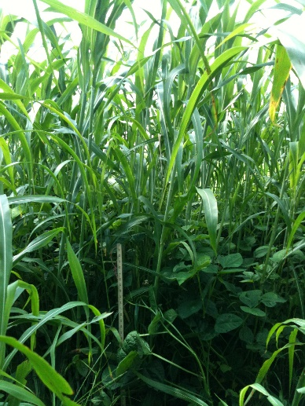
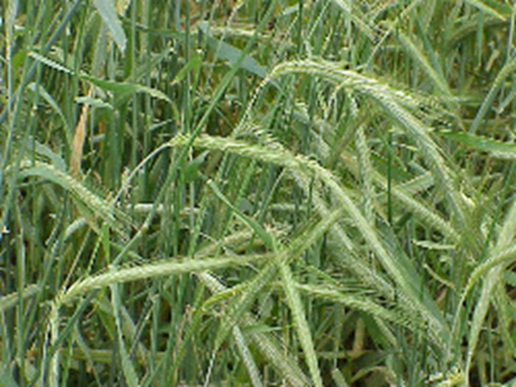
Choosing a cover crop
What is my primary goal or goals?
How will I manage it?
What is my crop rotation? What is the planting window for the cover crop?
Select the best species or mix to satisfy 1 -3.
Photos: Julia Gaskin

Slide 26
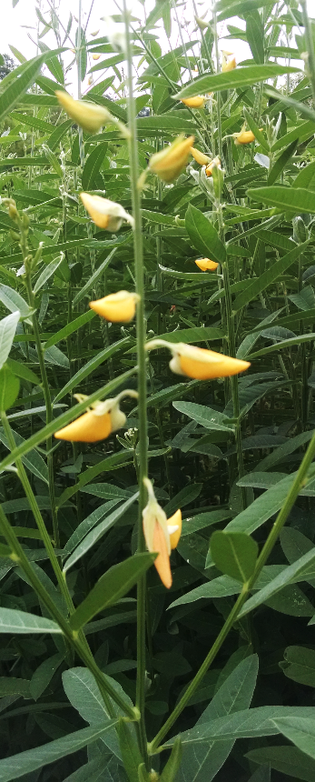
Step 1.What is my primary goal?
Address the most important factors limiting productivity and sustainability of your system.
Possible goals include:
Improve nutrient availability and provide nitrogen
Improve soil physical properties
Reduce erosion, leaching and protect water quality
Suppress weeds, pests and diseases
Provide beneficial habitat
Provide surface mulch
Photos: Julia Gaskin

Slide 27
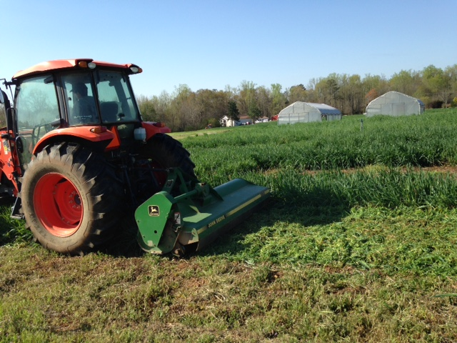
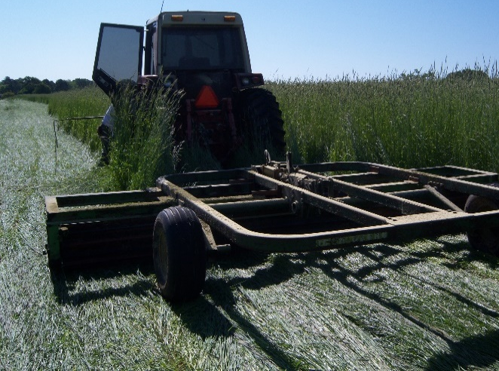
Step 2. How will I manage it?
Planting – drill or broadcast and rake/harrow in
Killing:
Mowing – Can my mower handle the biomass?
Incorporation – Can my tiller or tractor handle turning the cover in OR\
Roller crimping – How can I roll it down and leave on surface?
Photos: Julia Gaskin

Slide 28
Step 3: What is the crop rotation?
Identify “window” where cover crop fits
Minimize conflicts in timing of field operations for cash crops.
Select species for climatic and soil conditions during the window.
e.g.- frost patterns, soil and air temperatures for germination and growth, soil pH.
Photos: Julia Gaskin

Slide 29
Step 4: Select species/mix to meet goals from steps 1 - 3.
Match the candidates identified in step 1 with characteristics identified in step 2 and 3.
Remember to consider characteristics you don’t want as well as those you are looking for.
No “perfect” cover crop. Trade-offs will need to be made.
A final considerations – economic assessment
cost and availability of seed
labor

Slide 30
What to avoid…...
Seed production - particularly by cover crops with hard seed - vetch seed remain viable for years and can become a weed.
Avoid using the same cover crop every year, particularly a single species.
Risk build up of populations of competitive weeds, as well as pests and disease organisms.

Slide 31
Additional Resources
Managing Cover Crops Profitably, SARE Learning Center. http://www.sare.org/Learning-Center
Cover crops at UGA - http://www.SustainAgGA.org
UGA Cover Crop Nitrogen Availability Calculator – Contact your county agent for sample collection and submission. http://aesl.ces.uga.edu/mineralization/
OSU Organic Fertilizer and Cover Crop Calculator - http://smallfarms.oregonstate.edu/calculator
Sustainable Practices for Vegetable Production in the South www.cals.ncsu.edu/sustainable/peet/ index.html
National Sustainable Agriculture Information Service (ATTRA) www.attra.org
Inoculant information http://cmgm.stanford.edu/~mbarnett/rhiz.htm
Notes:
These are some reference that are available online and in the literature to assist the farmer in selecting, using and terminating cover crops.
Extension.
Another very good source is a farmer that has been using cover crops and has some experience with management and use of cover crop for maximum benefits.
Tillage alliance

Slide 32
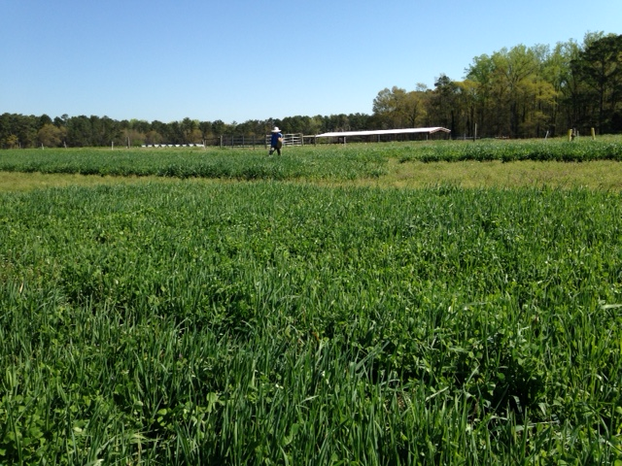
Learning Activity
Cover Crop Jeopardy
Photo: Julia Gaskin

Slide 33
This material is based upon work that is supported by the National Institute of Food and Agriculture, U.S. Department of Agriculture, under award number 2015-70017-22861.
Beginning Farmer and Rancher
Development Program
Developing the Next Generation
of Sustainable Farmers in Georgia Grant

