Slide 1
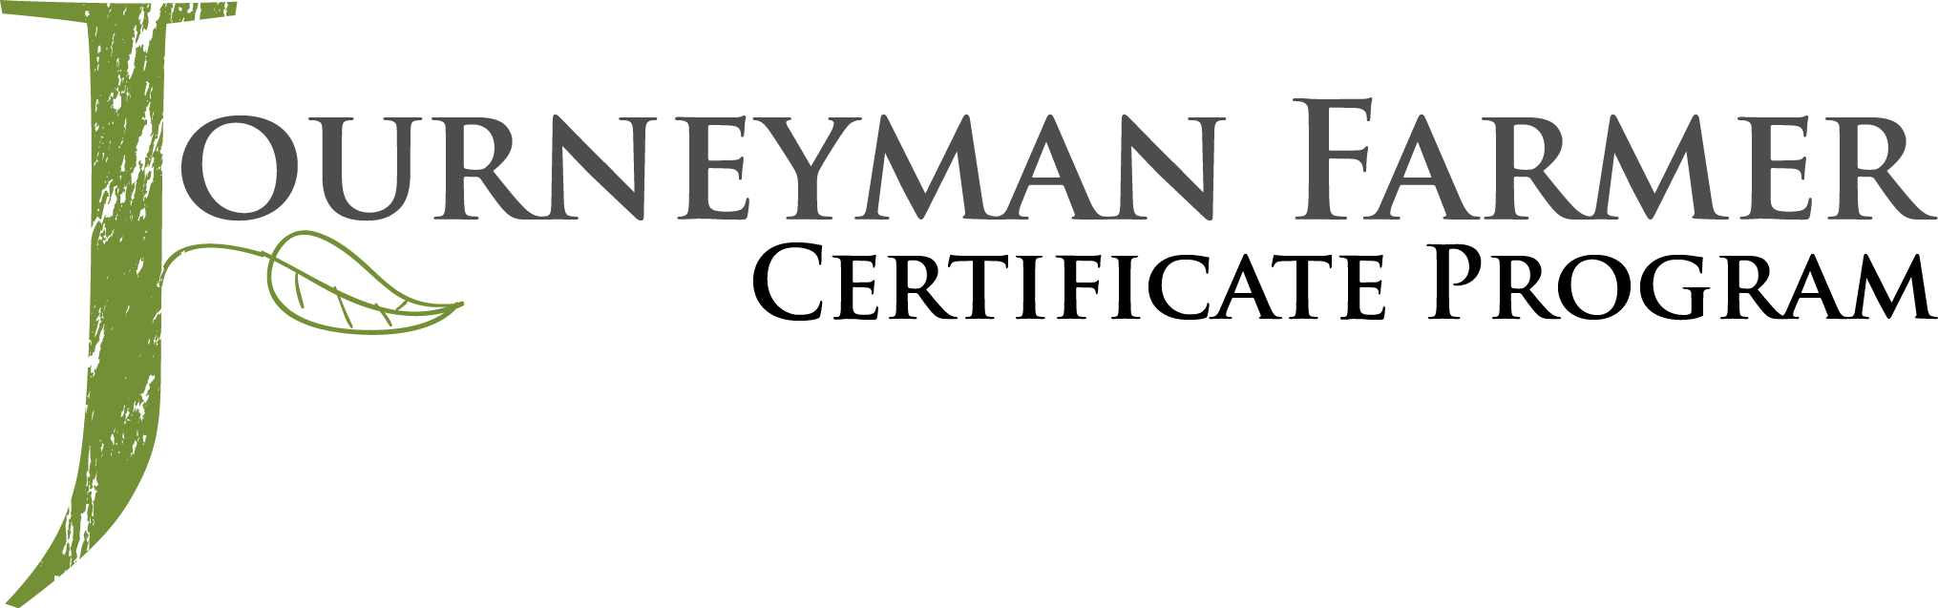



Small Fruit and Vegetable Production

Slide 2
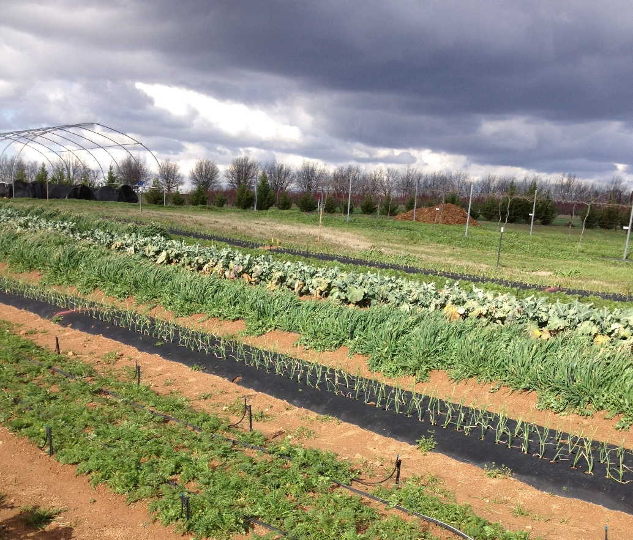

Session 1
The Foundation –
A Systems Approach
Julia Gaskin
Sustainable Agriculture Coordinator
Crop & Soil Science Dept
University of Georgia
Photo: Julia Gaskin

Slide 3
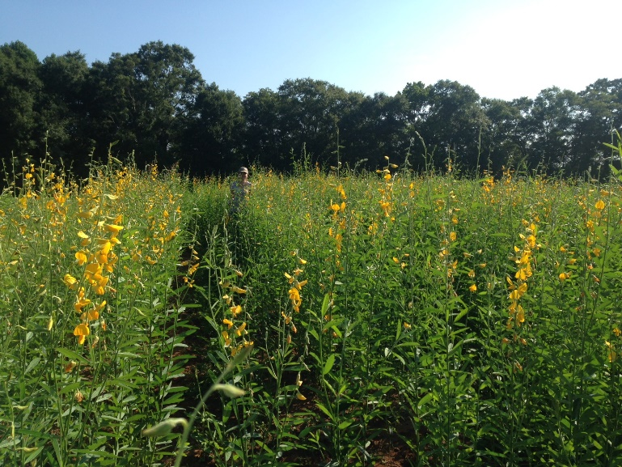
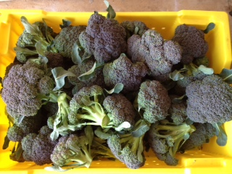
How Do We Farm More Sustainably?
Think about a systems approach
  i.e. everything is related to everything else
Work with natural cycles to reduce inputs
  Build soil health
  Biodiversity
  Ecologically based pest management
Photos: Julia Gaskin

Slide 4

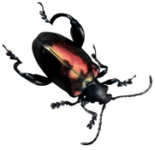

Sustainable Approach
Many Little Hammers
Trap crops
Proper fertility
Reaction Farming
Predator habitat
Resistant varieties
Planting timing
Pesticides
Pesticide
Crop rotation
High soil quality
Good sanitation

Slide 5
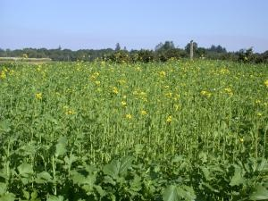
Many Little Hammers
Example – plant parasitic nematodes
  Organic amendments
    - improves soil tilth, water holding capacity, etc. so reduces plant stress
  Use cover crops in mustard family
    - Glucosinolates reduce nematode population
  Release predatory nematodes
    - Biocontrol
  Rotate into crops that aren’t hosts
Mustard cover crop
Photo from Extension.org

Slide 6
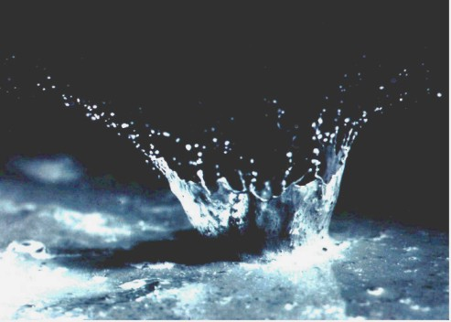
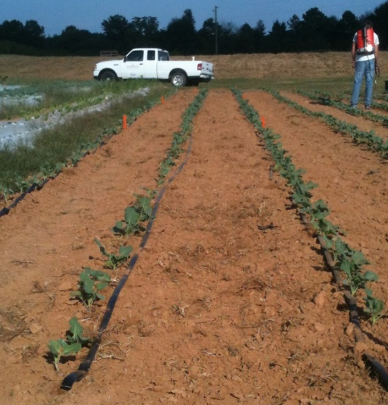
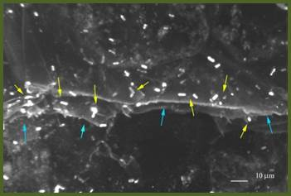
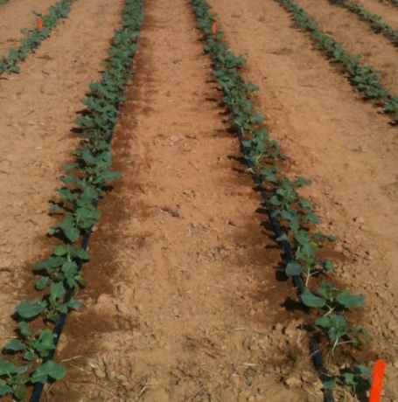
Irrigation, Weeds, Plant Disease, and Food Safety
Photo: NRCS
Raindrop hitting the soil at 15 mph
E. coli O157:H7 on the cut edge of a lettuce leaf
Courtesy of Dr. Joseph Frank, University of Georgia Dept. of Food Science and Technology
Reduces plant disease
Photo: Julia Gaskin
Limited water in middles reduces weed growth
Reduce potential pathogens
Photo: Julia Gaskin
Drip irrigation prevents soil splash

Slide 7
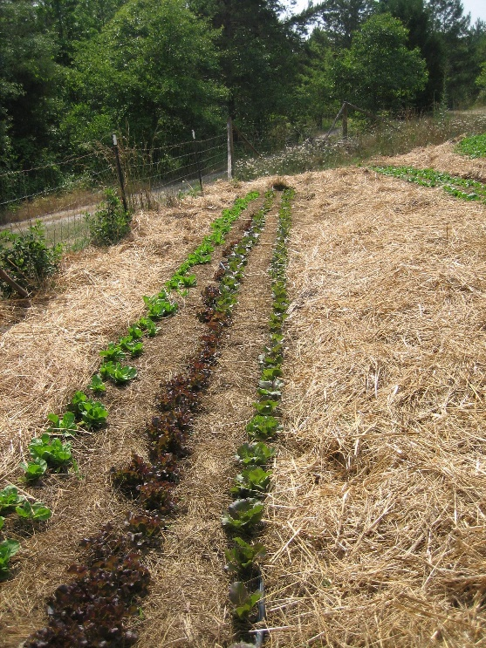
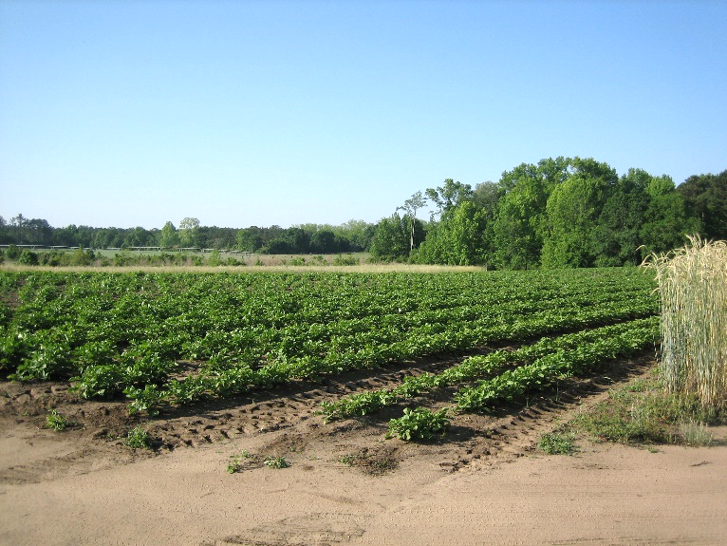
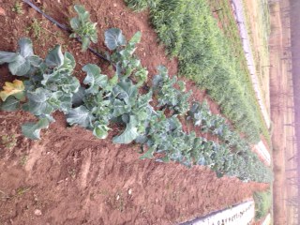
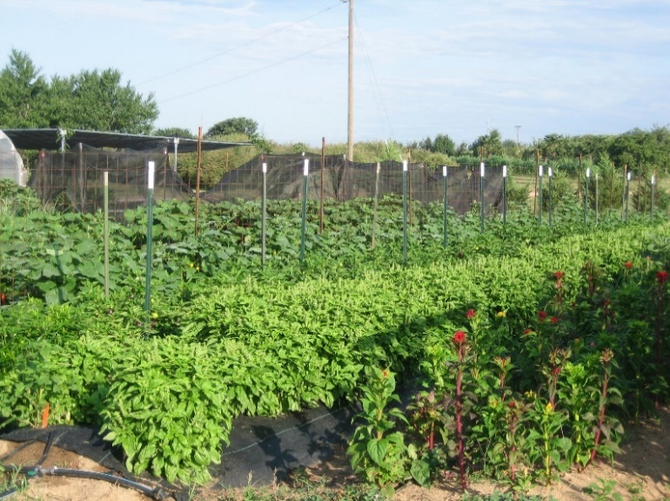
What Is Your System?
Time
Soils
Landscape
Equipment
Crops
Photos:
Julia Gaskin
Fertility
Primary Pests

Slide 8
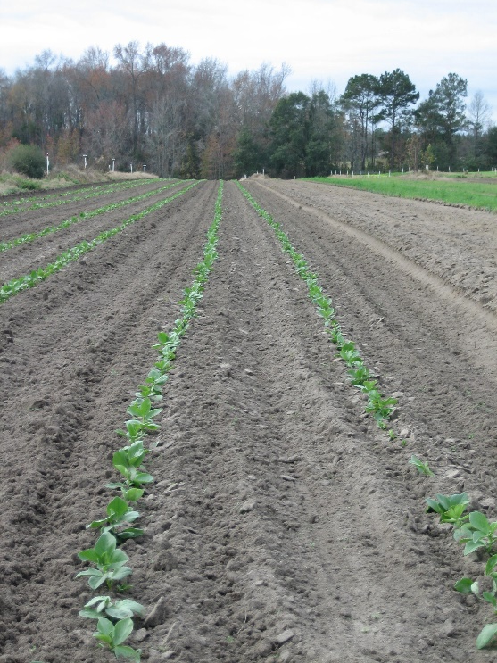
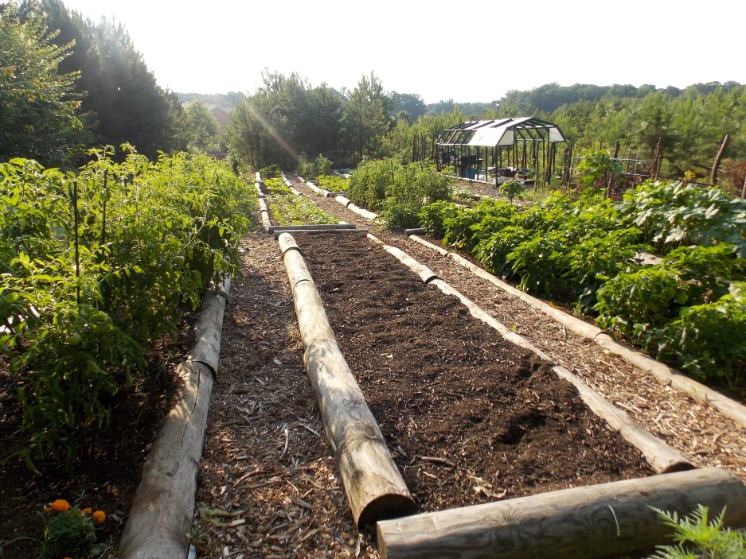
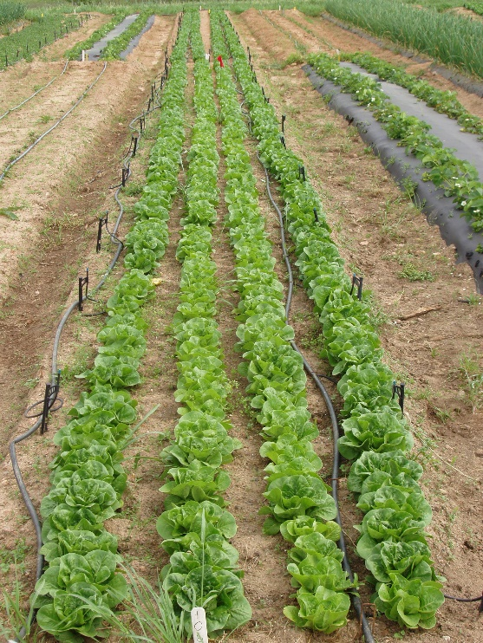
Case Studies
Very small (< 1 acre) - Locally Yours Farm
Small (2 acres) – Wanna B Farms
Mid-scale (14 acres) – Gittin’ There Farms
Photo: Tenisio Seanima
Photo: Julia Gaskin
Photo: Julia Gaskin

Slide 9



This material is based upon work that is supported by the National Institute of Food and Agriculture, U.S. Department of Agriculture, under award number 2015-70017-22861.
Beginning Farmer and Rancher
Development Program
Developing the Next Generation
of Sustainable Farmers in Georgia Grant

