Slide 1
Small Fruit and Vegetable Production

Slide 2
Session 1 Soil Health & Fertility
Julia Gaskin
Sustainable Agriculture Coordinator
Crop & Soil Science Dept
University of Georgia

Slide 3
Learning Objectives
List the components of soil (mineral, soil organic matter, air, and water).
Interpret a sample soil test report.
List three examples of how organic matter affects the physical, chemical, and biological properties of a soil.

Slide 4
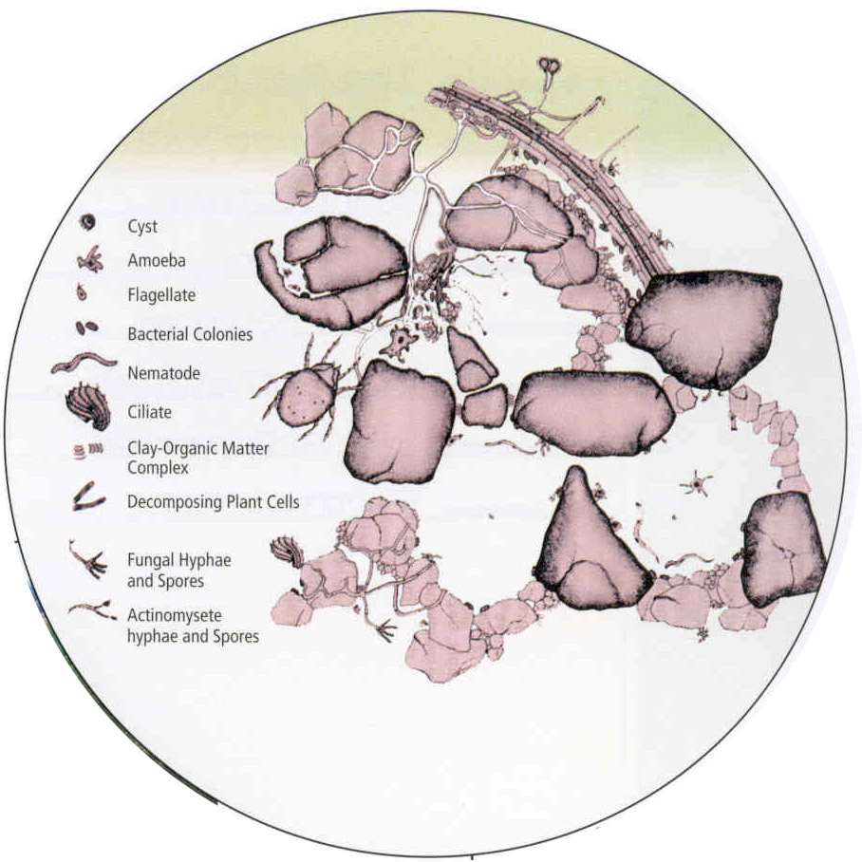
What is Soil?
Air
25%
Solids
50%
Water
25%
Photo: Julia Gaskin
Composed of:
sand, silt, clay,
organic matter (don’t forget the critters),
water, and
air
Soil Biology Primer, NRCS
Illustration from Soil Biology Primer, USDA NRCS
Notes:
First some soil basics.
When we look at soil, we generally see a solid. But in fact, soil is made of solids such as sand, silt, and clays, air, water and organic matter. That organic matter consists of dead and decayed materials that were once living and things that are still living such as roots, bacteria, and fungi. If we look at this picture of soil on a microscopic scale. We see the solids, and a lot of empty space or pores. In a healthy soil, some of those pores will be filled with air (from which the plant roots get oxygen) and some will be filled with water.

Slide 5
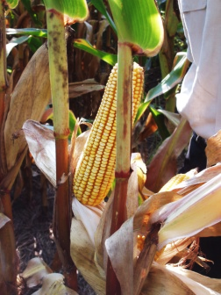
Goal is Healthy Soil
Good tilth
Nutrients for healthy plants and good yields
Good water storage and drainage
Low disease and pest pressure
Able to bounce back from disturbance
Photo: Julia Gaskin

Slide 6
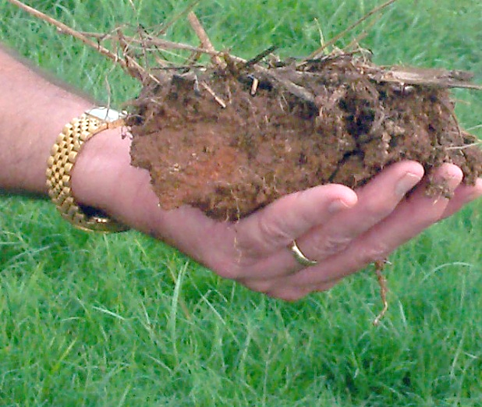
Key Factors for Healthy Soils
Soil organic matter
pH
Management effects on soil tilth
Photo: Julia Gaskin

Slide 7
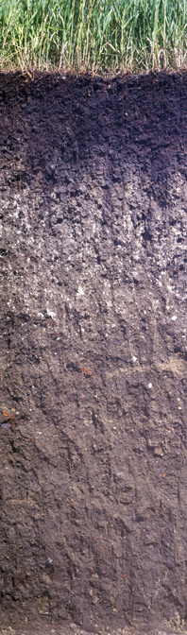
Fertility and Georgia Soils
Hot, humid climate
History of poor soil management
High soil erosion
Low soil organic matter
Photos: NRCS
Georgia soil vs Midwest prairie soil
Notes:
Mollic epipedon >= 0.6% organic C or about 1% SOM

Slide 8
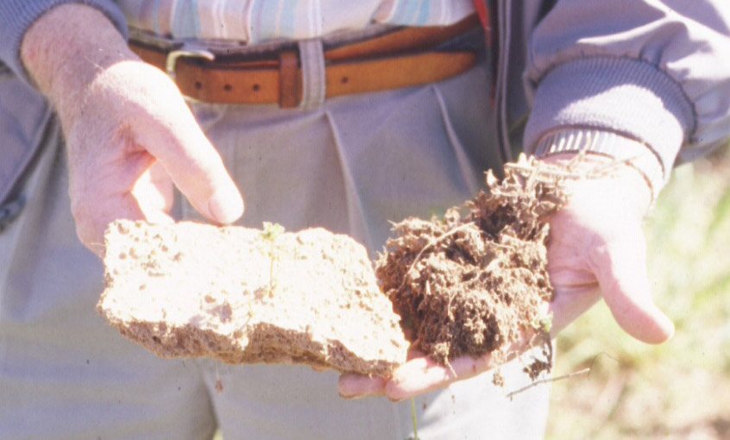
Soil Organic Matter
Texture* you’ve got!
Soil organic matter you can improve.
Photo: Julia Gaskin
0.5% soil organic matter
2.5% soil organic matter
*Texture is determined by percent sand, silt, and clay in a soil e.g. loam, loamy sand, sandy clay loam. See resource materials.
The difference soil organic matter can make!

Slide 9
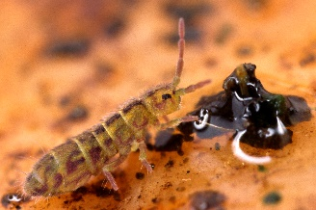
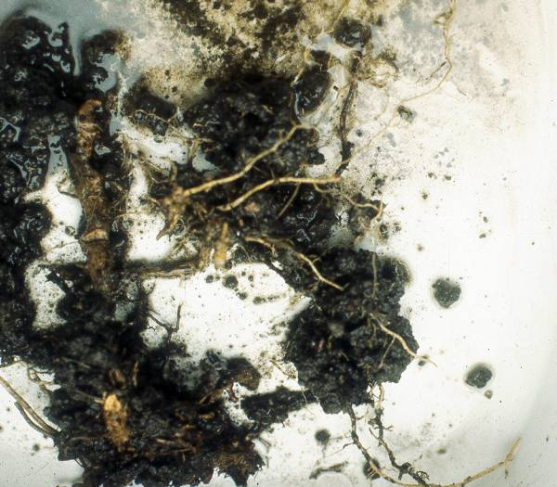
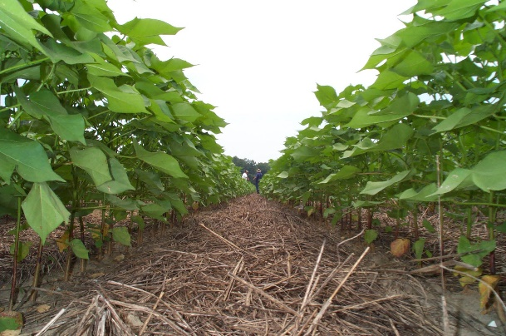
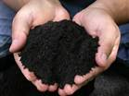
Soil Organic Matter
“The living, the dead, and the very dead.”
Dr. Fred Magdoff
The living
The dead
The very dead
Photo:
Steve Hopkin
Photo: Harry Schomberg
Photo: Jimmy Dean
Photo: http://www.daviddarling.info/encyclopedia/H/AE_humus.html
Primarily composed of carbon

Slide 10
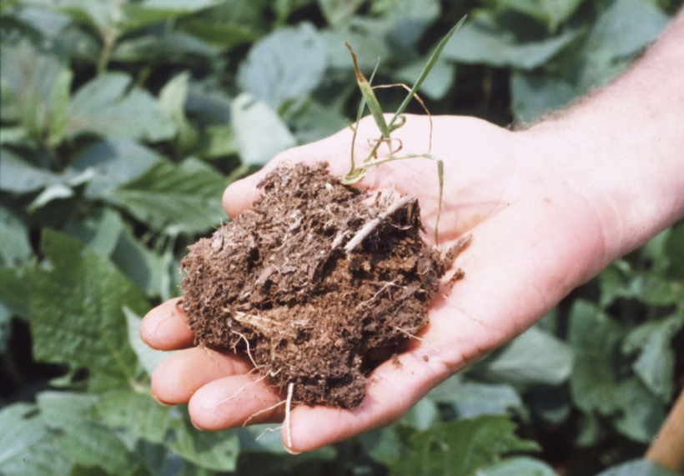
Soil Organic Matter – Effects Soil Properties
Chemical
Source of nutrients
Helps hold nutrients in the soil
Physical
Helps create and maintain soil structure
Biological
Base of food chain
Photo: Julia Gaskin

Slide 11
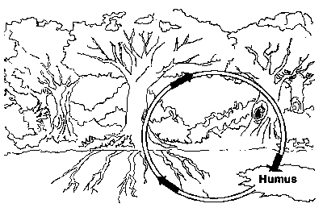
Soil Organic Matter – Your Nutrient Bank
Chemical
Each 1% soil organic matter releases about 10 lbs nitrogen
Also source of:
Potassium
Some phosphorus
Sulfur
Micronutrients – copper, iron, zinc
Drawing from fao.org

Slide 12
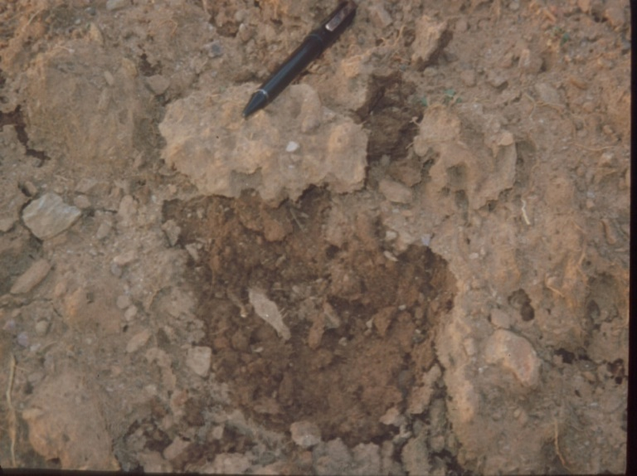
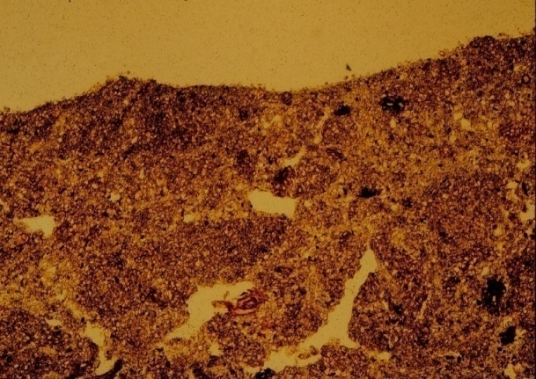
Soil Organic Matter & Soil Structure
Physical
Raindrop hits the soil at 15 miles per hour.
Good soil structure keeps pores open for water and air
Clay and organic matter are important
Photo: NRCS
Plugged pores decrease water and oxygen exchange
Soil pores
Photo: NRCS
Dislodged soil particles form crusts
Photo: Bill Miller

Slide 13
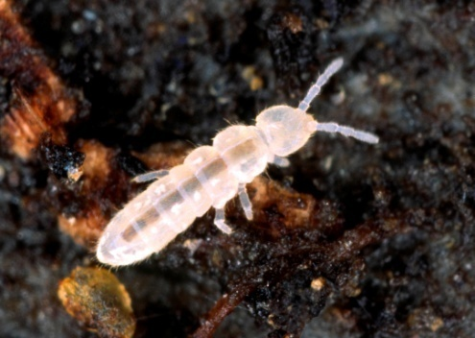
Soil Organic Matter & Life
Biological
Plant root!
Energy source for microbial life.
Base of the food chain.
Release nutrients- mineralization
Microbius hartellei
NH₄⁺
NH₄⁺
Photo: Steve Hopkin
NH₄⁺ - Ammonium-nitrogen
Photo: http://www.ucl.ac.uk/
NH4+
NH₄⁺

Slide 14
How Do We Maintain and Build Soil Organic Matter?
Balance – Add more than you lose
Reducing tillage
Cover crops
Organic amendments (manures, composts, etc)
Carbon inputs
Carbon outputs

Slide 15
Soil Organic Matter – Case Studies
Very small farm – Locally Yours Farm
Biointensive – always something growing
Roots, compost and manures add organic matter
Minimal tillage helps maintain soil organic matter
Small farm – Wanna B Farms
Rotation with cash crops and cover crops
Cover crops, compost and manures add organic matter
Mid-scale farm – Gittin’ There Farms
Rotation with cash crops and cover crops
Cover crops and manures add organic matter

Slide 16
Learning Activity – Soil Organic Matter
Soil organic matter in:
forest,
well managed pastures,
conventional tilled, and
conservation till or organic soil.
Discuss color differences and the amount of soil pores and roots in each

Slide 17
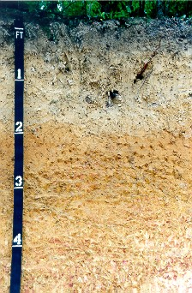
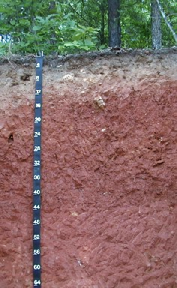
Fertility and Georgia Soils
Highly weathered, low CEC (cation exchange capacity)
Very acidic (pH<6), a lot of aluminum and iron, not a lot of calcium, potassium, etc.
Photos: NRCS
Fuquay soil series
Coastal Plain
Cecil soil series Piedmont
Notes:
A – sand
E – sand
Bt - scl

Slide 18
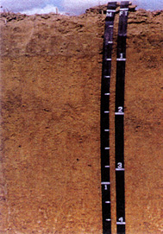
Soil pH
Optimal pH for most crops
Soils in GA naturally acidic
Subsoils as low 4.5 or 5.0
Roots don’t like pH below 5.5
4.0 5.0 6.0 7.0 8.0 9.0 10.0
Very Acid Neutral Very Basic
Vinegar Chlorox
pH - 4.8
Photo: USDA
Tifton soil series
Coastal Plain
Notes:
-COOH ---- -COO- + H+
Rule of thumb. For every 1% SOM, get about 1 meq of charge for every pH unit above 4.5

Slide 19
Plant Nutrients
Macronutrients
Nitrogen (N)
Phosphous (P)
Potassium (K)
Calcium (Ca)
Magnesium (Mg)
Sulfur (S)
Carbon (C)
Hydrogen (H)
Oxygen (O)
Micronutrients
Boron (B)
Chlorine (Cl)
Copper (Cu)
Iron (Fe)
Manganese (Mn)
Molybdenum (Mo)
Nickel (Ni)
Zinc (Zn)
Soil
Soil
Atmosphere/ water

Slide 20
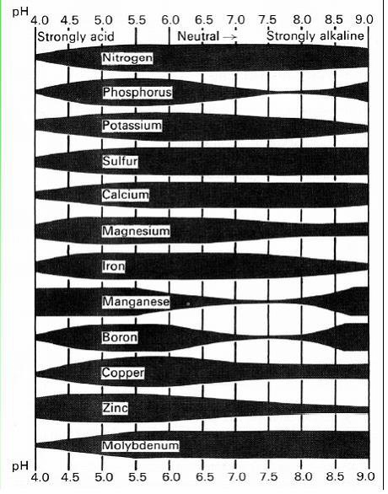
pH and Nutrient Availability
Target is usually 6.0 to 6.8 (near neutral)
At these pHs phosphorus and micronutrients most available
Low pH (<5.5) – aluminum toxicity
At high pH also decreased nutrient availability
Width of black bar represents nutrient availability
Notes:
Copper needed for strong cell walls
Manganese needed in chloroplasts for electron transfer (involved in photosynthesis
Molybdenum - needed for nitrogenase (legumes in N2 fixation) why they prefer higher pH

Slide 21
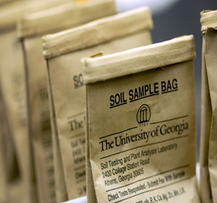
Soil Testing
Many labs, many different types of tests
Pick a lab and stay with it
Try to sample at the same time each year
Take a representative sample
Use test to look at long term trends

Slide 22
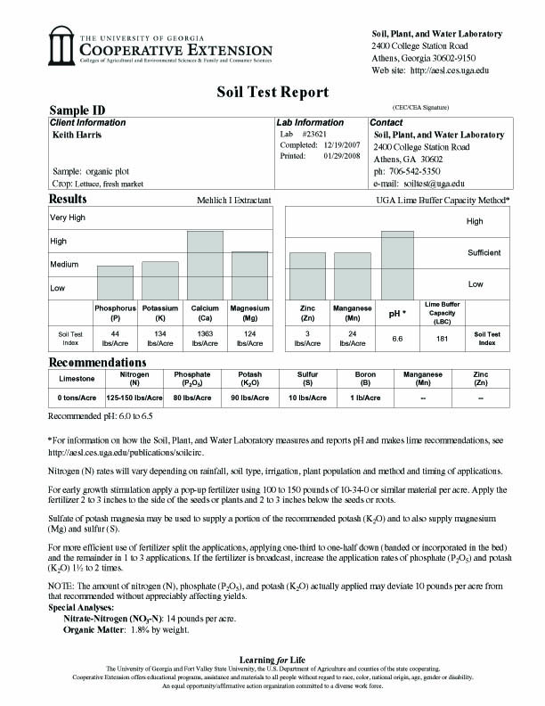
Soil Tests from UGA
Major plant nutrients:
Nitrogen
Phosphorus
Potassium
Routine test gives information on plant available nutrients
Have to request additional test for soil organic matter
Nitrogen NOT tested
Fertilizer recommendations based on conventional field trials

Slide 23
For fertilizer recommendations ask for particular crop or home garden
Bars represent level of plant available nutrients
Lime and fertilizer recommendations based on amount of plant available nutrients and specific crop.
Discussion of recommendations
Results for special analysis

Slide 24
pH, Ca and Mg good
no limestone needed
Zinc and Mn good
No addition needed
Need P and K
Phosphorus - 44 lbs/ac
Potassium - 134 lbs/ac
N specific for crop
Give recommendations for split applications
Soil organic matter is OK

Slide 25
Considerations for Organic Production
Building and Maintenance Phases
New or transitioning growers need to build SOM, phosphorus and potash levels
Can take 3 to 5 years
Julia Gaskin

Slide 26
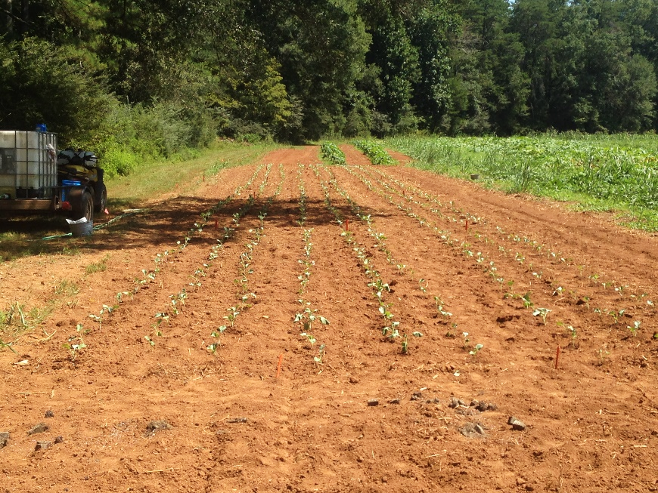
Soils in Building Phase
Soil organic matter:
<1.5% in Coastal Plain,
<2.5% in Piedmont, Ridge & Valley, Mountains
Low soil pH
Soil test indices in low or medium range for:
Phosphorus (P₂O₅),
Potassium (K₂O),
Calcium,
Magnesium,
Zinc,
Manganese
Photo: Julia Gaskin

Slide 27
Building and Maintenance Phase
Building phase
Soil test fertilizer recommendations are a good guide
Maintenance phase
Some organic growers reduce fertilizer to account for inherent fertility of the soil

Slide 28
Learning Activity – Interpreting Soil Tests
Very small farm – Locally Yours Farm
Does not soil test - What are the risks?
Small Farm – Wanna B Farms
pH – What does this graph say about pH on this farm?
Mid-scale farm – Gittin’ There Farms
Routine soil test
Does this farm need lime?
What about P or K?
If the soil organic matter is 2%, is this good for a sandy soil?

Slide 29
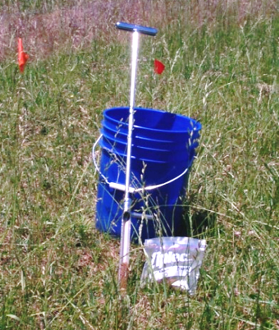
Taking Soil Samples
Need clean plastic container and soil probe or trowel
Collect sample form each field or group of field that are similar
Each sample is composite of six or more subsamples
Collect from 0-6 inches
Mix subsamples up thoroughly and put in soil bag
Submit sample through county extension office
Routine sample - $8
*Refer to Soil Testing for Home Lawns, Gardens, and Wildlife Food Plots In resources
http://pubs.caes.uga.edu/caespubs/pubcd/C896.htmx
Photo: Julia Gaskin

Slide 30
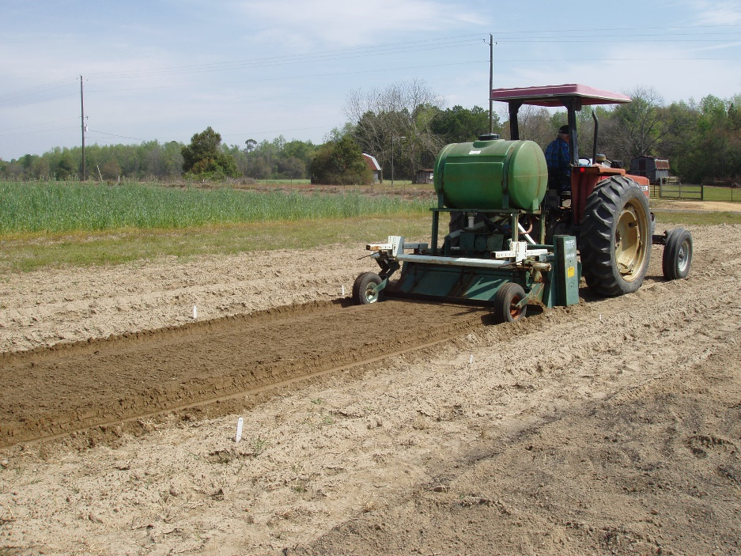
Tillage and A Healthy Soil
Increases oxygen
Breaks soil aggregates
Disrupts soil pores
Changes water relations
Relocates nutrients
Photo: Julia Gaskin
Increases decomposition
Increases erosion
Changes community of soil critters

Slide 31
Soil Structure and Tilth
Worst thing you can do!
Till the soil when its too wet.
How to tell
Take small portion of soil, squeeze it. If you can get water from it
It’s TOO wet!
Make loose ball, bounce in hand or drop on ground, if ball doesn’t break apart,
Its TOO wet!
Photo: NRCS

Slide 32
Soil Structure and Tilth
The second Worst thing you can do!
Till the soil when its too dry.
Tilling soil when too dry shatters soil structure
How to tell
If the soil is hard and a small piece shatters when you crush it
It’s TOO dry!

Slide 33
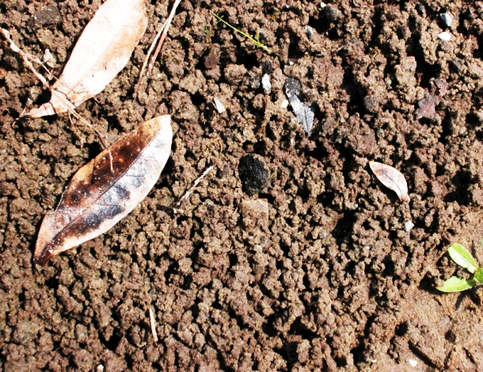
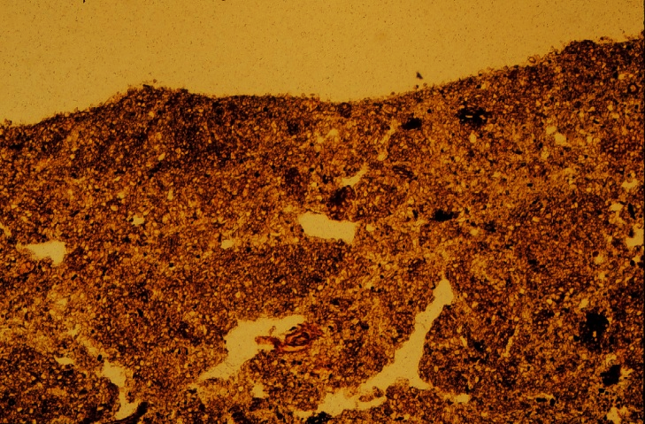
Soil Structure and Tilth
Excessive tillage destroys structure
Till only when needed for seed bed preparation or weed control
Use least aggressive tillage possible
Use cover crops, mulches and transplant
Photo: David Lindo , NCSU
Photo: Bill Miller

Slide 34
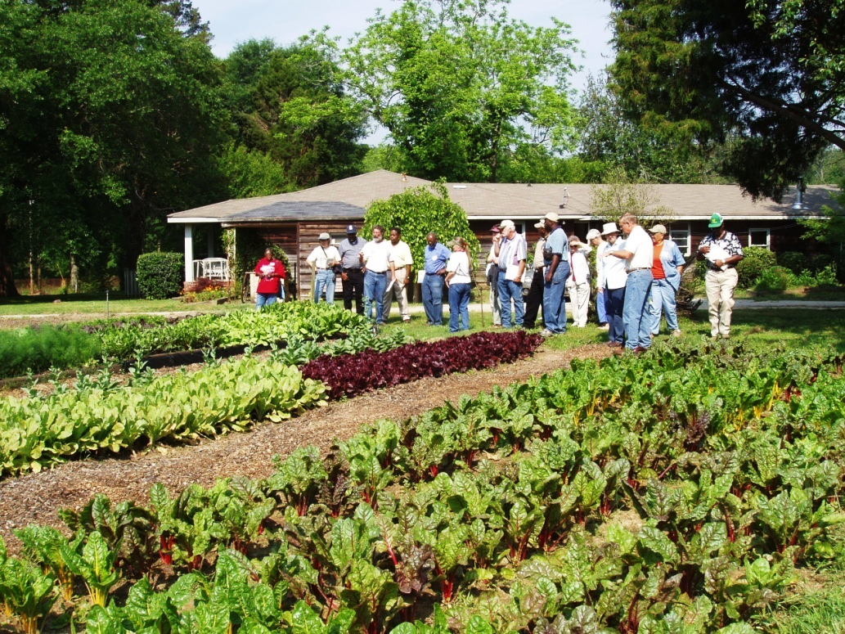
Fertility
The ability of the soil to supply nutrients needed for plant growth.
Recognize there are: physical, biological, and chemical components
These are interrelated.
Photo: Julia Gaskin
Notes:
Well, I’ve introduced you to some basics of soils. Let’s move on to fertility.
Note: physical, biological and chemical components of this are interrelated. It you work a fine-textured (clayey) soil too early in the spring and damage soil structure so there is poorer drainage and less pore space for air (physical component). What happens, less air, less O2 you affect the microbial community and microbes that don’t have to have O2 out compete those that do – example denitrifiers lose n in soil to gas (biological).

Slide 35
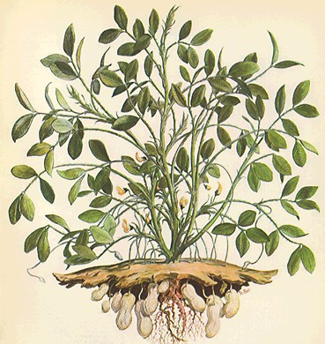
Two Models for Fertilization
Gas Losses
Gas Losses
Soluble fertilizers
Soluble fertilizers
Plant/animal residues/rock phosphate
Plant/animal residues
Soil organic matter + microbes
Soluble N, P
Soil organic matter + microbes
Soluble N, P
Mineral reservoirs
Leaching Losses
Mineral reservoirs
Feed the plant.
Feed the soil.
Leaching Losses
Adapted from Drinkwater and Snapp 2007

Slide 36
Fertilization Strategies
Depends on:
Crops to be grown
Fertilizer costs
Building or maintenance phase
Soil texture – sandy, sandy loam, sandy clay loam, etc.
Get your soil tested!

Slide 37
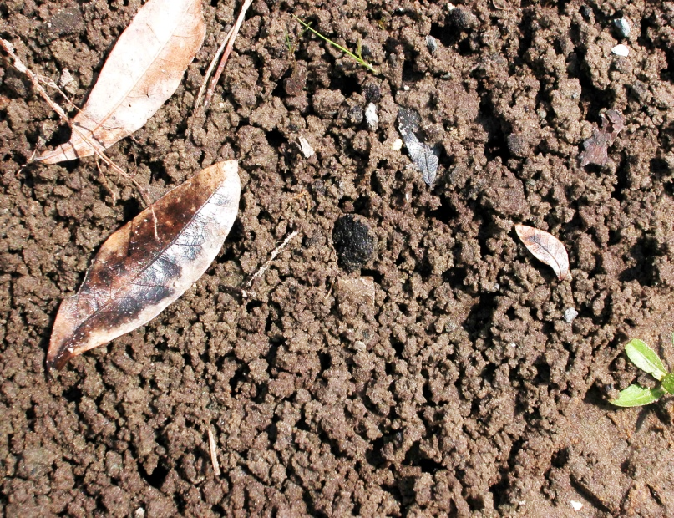
How Do We Manage?
Build up soil reservoirs – soil organic matter and available nutrients
Get your soil pH right!
Take care of your structure
Dr. Lindo NCSU

Slide 38
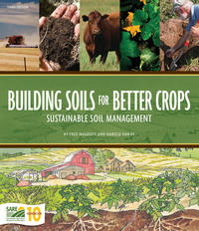
Additional Resources
Building Soil for Better Crops – http://www.sare.org/Learning-Center/Books.
Free pdf online or buy book.
Growing Vegetables Organically – UGA Extension Publication http://extension.uga.edu/publications/detail.cfm?number=B1011
Good overview of things to consider from a small scale perspective.
Soil Biology Primer – USDA NRCS http://www.nrcs.usda.gov/wps/portal/nrcs/photogallery/soils/health/biology/gallery/?cid=1788&position=Promo
Soil Management: National Organic Program Regulations – ATTRA https://attra.ncat.org/organic.html#soils
Soil Testing for Home Lawns, Gardens and Wildlife Food Plots – UGA Extension Publication - http://extension.uga.edu/publications/detail.cfm?number=C896. How to take a representative soil sample.

Slide 39
This material is based upon work that is supported by the National Institute of Food and Agriculture, U.S. Department of Agriculture, under award number 2015-70017-22861.
Beginning Farmer and Rancher
Development Program
Developing the Next Generation
of Sustainable Farmers in Georgia Grant

