Slide 1
Small Fruit and Vegetable Production

Slide 2
Session 2 Soil Fertilizers and Amendments
David Berle, Associate Professor
Horticulture Department
University of Georgia

Slide 3
Learning Objectives
Calculate amount N, P₂O₅, K₂O in a bag of 10-10-10
Provide examples of organic fertilizers
Recognize characteristics of a well-stabilized compost

Slide 4
Fertilizer
The most common nutrients needed for fruits and vegetables
Nitrogen (N)
Phosphorus (P)
Potassium (K)
Fertilizer comes in bags
Fertilizer bags list the amount of N, P and K
Notes:
Georgia law requires fertilizer producers to display the guaranteed analysis or grade on a label on the fertilizer container. A fertilizer grade or analysis that appears on the bag gives the percentages of nitrogen (N), phosphate (P₂O₅) and potash (K₂O) in the material. These are the most common plant nutrients needed in the greatest amount. Generally, fertilizer comes in a bag, though it can be purchased as a liquid (anhydrous ammonia) and sometimes in bulk. Most small farmers purchase fertilizer in bags. Fertilizers can be blended, which means they contain 2-3 of these primary nutrients and possibly other nutrients as well, or they can be single-ingredient fertilizers, providing just one nutrient.

Slide 5
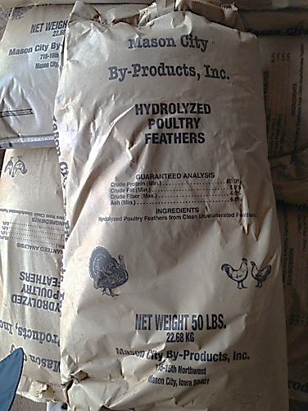
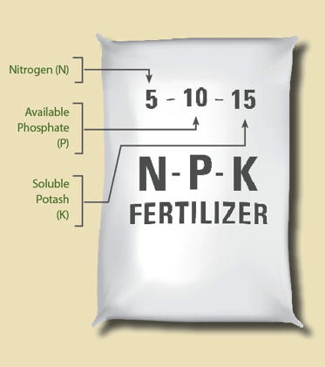
What’s in the bag?
The amount of each nutrient is listed on the bag as a PERCENT of the total contents
Example: 5-10-10 has 5% N, 10% P₂O₅ and 10% K₂O
Example: Feather meal has 13% N so its listed as 13-0-0
Photos: http://goodlifegarden.ucdavis.edu/
Notes:
A bag of 10-10-10 fertilizer contains 10 percent nitrogen, 10 percent phosphate and 10 percent potash.
Fertilizer grades are made by mixing two or more nutrient sources together to form a blend, that is why they are called "mixed fertilizers.” Manufacturers produce different grades for the many types of plants.

Slide 6
What’s in the bag?
To calculate the pounds of nitrogen (N) in a 50-lb bag of 10-10-10 fertilizer:
Multiply 50 by 0.10.
50 lbs x 0.10 = 5 lbs of N
Use the same method for calculating the amounts of phosphate (P₂O₅) and potash (K₂O)
Notes:
To calculate the pounds of nitrogen in a 50-lb bag of 10-10-10 fertilizer, multiply 50 by 0.10. Do the same for calculating the amounts of phosphate and potash. A 50-lb bag of 10-10-10 contains a total of 15 lbs of nutrients: 5 lbs nitrogen, 5 lbs phosphate and 5 lbs potash. The remaining weight is filler, usually sand or granular limestone.
Another example:
50-lb. bag of 5-3-4 organic fertilizer
To calculate the pounds of nitrogen: Multiply 50 by .05, which equals 2.5.
To calculate the pounds of phosphate: Multiply 50 x .03, which equals 1.5.
To calculate the pounds of potash: Multiply 50 by .04, which equals 2.
A 50 pound bag of 8-0-24 fertilizer contains a total of 6 lbs of nutrients: 2.5 lbs nitrogen, 1.5 lbs phosphate, and 2 lbs potash. This would leave us with 44 lbs of filler or more complex forms of these nutriients. Regardless, you can’t assume anything else will be available to the plant than the percent printed on the bag

Slide 7
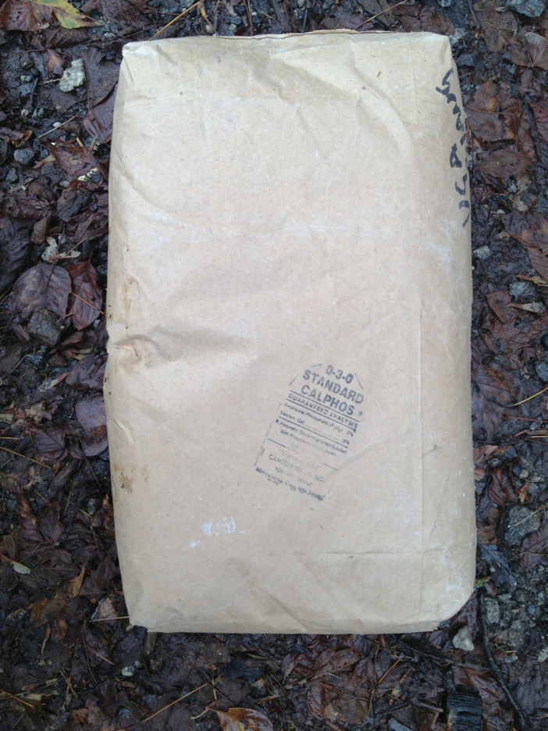
What’s in the bag?
What else is in the bag? Filler, typically limestone, sand or clay as a carrier.
For organic fertilizers, the “extra” material is usually other elements or complex materials bound to the fertilizer component
Photo: David Berle

Slide 8
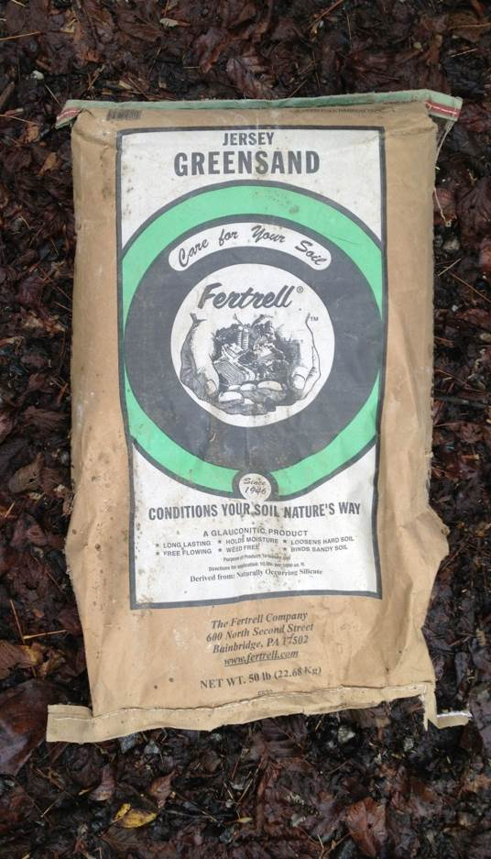
Conventional and organic fertilizers
Common fertilizers used in fruit and vegetable production on a small farm include: 10-10-10, 34-0-0, 0-46-0, 16-4-8
Organic fertilizers usually come with single nutrient
Nitrogen: Feather meal (13-0-0), Blood meal (12-0-0), Alfalfa meal (3-0-0)
Phosphate: Colloidal phosphate (0-20-0), Bone meal (2-14-0)
Potassium: Green sand (0-0-7), Granite dust (0-0-5)
Organic low total available nutrients, release slowly
Photo: David Berle
Notes:
There are many different fertilizer products available, both conventional and organic materials. Some are specially blended for a specific crop or region, based on research and experience as to what nutrients are most often limiting in a soil and which are most needed by different crops. Most conventional fertilizers are blended with 2-3 different nutrients, while most organic fertilizers are single-ingredient materials. In general, organic fertilizers are lower in concentration, or percent analysis, than conventional fertilizers and are released more slowly into the soil. It can be challenging to match the needs of the plant, the availability in the soul and the expense of certain nutrients, particularly when it comes to phosphorus and potassium.

Slide 9
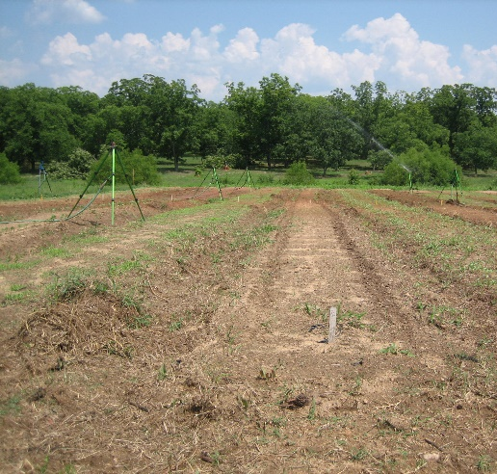
Amount of organic fertilizer to use
Total amount of each nutrient based on soil sample
First, determine amount of N, P₂O₅ and K₂O needed
Second, for areas over ¼ acre, select single nutrient materials
Photo: Robert Tate
Notes:
To calculate how much of a nutrient is needed, first look at the soil analysis. Recommendations are given based on the level of nutrients in the soil and the crop to be grown. If you change crops from when you took a sample, the amount may vary. Look at the recommendations to determine how much of each of the big three nutrients are recommended, starting with Nitrogen.
Take into account any nutrients that might have been increased due to previous practices. For example, a legume cover crop will increase the nitrogen level in the soil for the next crop. If compost is applied, it will likely have some N, P and K and that’s why is good to get a sample of your compost from time to time as well. One goal is to find the least expensive, most environmentally safe fertilizer material to use.

Slide 10
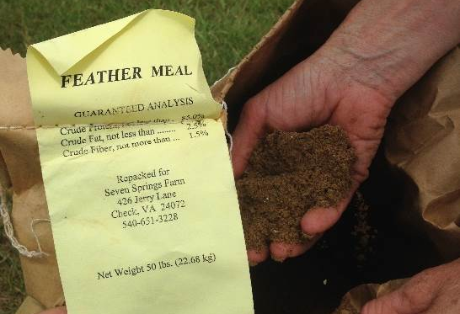
Amount of Organic Fertilizer to Use
Nitrogen
Consider any carry over N from previous cover crop
Consider N in any amendment added like compost
Select least expensive material (shipping is expensive)
Photo: Katie Chatham
Notes:
Recommendations from a soil lab for Nitrogen will be in either pounds per acre or pounds per 1,000 square feet. Remember two things: 1) the lab assumes there is no nitrogen remaining the soil and typically does not sample for N unless you pay for it separately; and 2) the amount of N recommended will vary with crop. For this example, we will use a common recommendation of 200 pounds of actual N per acre.
Blood meal is a fairly easy to find organic fertilizer and one of the cheaper sources or organic Nitrogen. Most sources have 12% (or .12) N and the rest is material that is associated with the dried blood. For an acre calculation we would divide 200 by .12 and get 1,667 pounds of blood meal required to provide 200 pounds of actual N. There are 43, 560 square feet in an acre, so to convert the recommendation to a 1,000 square feet, we divide by 43.5 and get 38 pounds per 1,000 sqaure feet.

Slide 11
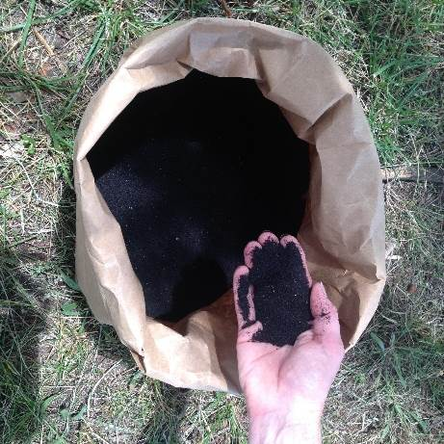
Amount of Organic Fertilizer to Use
Nitrogen
Divide amount recommended by percent in bag (see example below)
Amount recommended is 200 lbs N per acre
Blood meal (12-0-0) or 12% N
200 lbs / 0.12 = 1,667 lbs. Blood meal per acre, or
38 lbs per 1,000 sq. ft.
(1,667/43.5 because 43,560 sq. ft. per acre)
Bloodmeal (12-0-0) Photo: Julia Gaskin

Slide 12
Amount of organic fertilizer to use
Phosphate
Consider that P stays in a clay soil a long time
Consider P in any amendment added like compost
Select least expensive material (shipping is expensive)
Divide amount recommended by percent in bag (see example below)
Amount recommended is 20 lbs P per acre
Cal Phosphate (0-20-0)
20 lbs / .20 = 100 lbs. CalPhosl per acre, or
2.25 lbs CalPhos per 1,000 sq. ft. (100/43.5 because 43,560 sq. ft. per acre)
Notes:
The logic and math is similar for P as well. Because phosphorus can remain in certain soils 9especially clay) for a long time, we often think of building up P levels in soils that are low in P at the start, but easing off applications after a few years. The best way to know what is happening, of course, is to soil test. Most soils in Georgia that have been farmed in the past will have at least some P in the soil. Newly cleared land, urban soils and old farm land will often have lower levels of P.
In our example, a recommendation has been made to apply 20 pounds of actual P per acre. Using an organic fertilizer to provide the P, we choose the most common material, which is Cal Phosphate, which has as much as 20% (or ;20) available P, however it will take some time for entire amount to be available. To determine the amount of Cal Phos needed for an acre, divide 20 by .20 and get 100 pounds per acre, or when divided by 43.5, about 2.25 pounds per 1,000 square feet.

Slide 13
Amount of organic fertilizer to use
Potassium
Consider K in any amendment added like compost
Select least expensive material (shipping is expensive)
Divide amount recommended by percent in bag
Amount recommended is 150 lbs K₂O per acre
Greensand (0-7-0) or 7% K₂O
150 lbs / 0.07 = 2,142 lbs. Greensand per acre, or
49.25 lbs per 1,000 sq. ft.
(2,142/43.5 because 43,560 sq. ft. per acre)
Notes:
The process is pretty much the same for Potassium as it was for Nitrogen and Phosphorus, only the amount recommend is often different form N and P, depending on the soil sample analysis and the analysis of the fertilizer varies.

Slide 14
Amount of organic fertilizer to use
In GA, recommendations for Sulfur and Boron are NOT based on basic soil analysis, but on a standard
Sulfur
If applying, use Elemental Sulfur (90% S) 10 lbs/ac, so
10 lbs / 0.90 = 11 lbs/ acre or 0.25 lb per 1,000 sq. ft.
Boron
Only needed for certain crops- Broccoli for example
Very small amount, 2 lbs per acre
If applying, use Sodium Calcium Borate (10% B) 2 lbs/ac, so
2 lbs /0.1 = 10 lbs/ acre or 0.25 lb per 1,000 sq. ft.
Notes:
For samples sent to the Georgia Soil Test lab, there will often be a general recommendation for both Sulfur and Boron. Unless you pay extra, they do not actually sample for either of these, they just give a standard recommendation, based on research and experience. If either of these are recommended for your crop, its because experience has shown that additions of these two nutrients will help a crop. When first getting started in farming, you can following these general recommendatins, but at some point, you will want to pay the extra cost to have the actual level in your soil analyzed.

Slide 15
Amount of conventional fertilizer to use
Conventional fertilizers are cheaper than organic
Blends are more common than single ingredient fertilizers
Exception is Nitrogen fertilizer Ammonium Nitrate (34-0-0)
Consider
Soil sample results
Carry over from cover crops
Nutrient content of any soil amendments
Notes:
The calculations are basically the same for conventional fertilizers, only as mentioned previously, most conventional fertilizers are sold as a blend. The manufacturing cost is cheap enough that a small farmer can purchase a bag of 10-10-10 cheaper than many other fertilizers. This is not always best and can lead ot excess application of any one of the three (N,P,K) depending on how much of each is needed.

Slide 16
Amount of conventional fertilizer to use
If only Nitrogen required, select single ingredient fertilizer
If N + P + K needed, use 10-10-10 (or 20-20-20)
If N + P needed (no K), use either 10-10-10 or 34-0-0 + 0-46-0
If N + K needed (no P), use 10-10-10 or 34-0-0 + 0-0-50
Using a fertilizer with all three nutrients when only one or two are needed is NOT recommended
Notes:
If only Nitrogen is required, its cheaper to use a single source fertilizer like ammonium nitrate, which has 3 times as much actual N in a bag as 10-10-10. The calculation, however, is just like the organic fertilizers….take the actual amount needed, and divide by the analysis or concentration. If either Phosphorus or Potassium are needed, in addition to the Nitrogen, then 10-10-10 is probably the best way to go for a small farmer, though you can purchase bags of fertilizer with just Phosphorus )0-46-0) and Potassium(0-0-50) alone

Slide 17
Applying fertilizer
Broadcast fertilizer over top area, before planting
Mix into soil to insure contact of roots to fertilizer
Nitrogen moves in soil easily
Phosphorus does not move in soil
Potassium moves fairly easily in soil
Photo: Katie Chatham
Notes:
Whichever fertilizer is selected, the best way to apply it is to broadcast the recommended amount over the area where the crop will be growing and till, or mix it in BEFORE planting. This will insure there is not too high a concentration next to the seed or young plant and will make sure the nutrients are spread out in the soil. Phoshorus, in particular does not move very far in the soil, so if you put in one spot, the roots will grow out to it before it can be used by the plant. This might not happen if you drop it too far from the plant.

Slide 18
Soil amendments
Soil amendments can help fruit and vegetable crops
Compost
Pine bark helpful amendment for blueberry production.
Helps hold moisture in sandy soils
Makes good environment for roots
Must be aged
Avoid amending soil with peat moss (potting soil) or wood chips
Un-composted animal manures should be looked at as a fertilizer and used only with proper waiting times
Notes:
There are other amendments that can be added to the soil to help improve the soil and help plants grow better. The most common amendment is compost. Other amendments that some farmers, particularly urban farmers, use are pine bark, potting soil (which is mostly peat moss) and wood chips. Each of these other amendments can cause problems with drainage and robbing the soil of nitrogen. The exception is aged pine bar, which is very beneficial to blueberry plants.

Slide 19
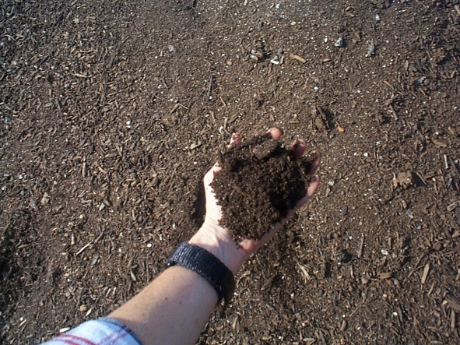
Compost
If possible, include composting program in farm plan
Compost benefits:
increases organic matter (and all the benefits that go with OM)
improves water holding
increases nutrient exchange capacity
provides small amount of nutrients
Photos: Julia Gaskin
Notes:
Compost provides many benefits to the soil, including,
increasing soil organic matter (OM)
Improving water holding capacity
Increasing nutrient exchange capacity
Providing a small amount of nutrients
There are many other benefits to numerous to list here
Here are a few hard number:
1) Only a 5% increase in organic material quadruples soils water holding capacity.
2) Compost usually provides about 1 percent (.010) of N, P and K (each)

Slide 20
How to make compost
Use mix of greens and browns
Grind or chop materials place in pile, the smaller the better
Turn when pile when pile gets hot and starts to cool
Keep pile moist, but not too wet
Materials to keep out of pile
Large plant parts
Very diseased plant, especially tomatoes, squash and cucumbers
Noxious weeds like Bermuda grass and nutsedge
Notes:
Compost can be made on site, using plant materials and animal waste from a small farm. Its best to have a mix of about 2/3 browns (Browns- dry plant parts (leaves & pine needles) to 1/3 greens (Green- fresh (grass clippings, vegetable scraps, weeds). Grinding or chopping things before they go in the pile will speed things up a lot.
Turning the pile frequently helps add oxygen to the inner part of the pile and makes sure all parts o the pile go through a “heat.” Compost is turned just after the temperature goes way up (about 120 degrees) and starts to cool.
Compost is considered finished when it can be stored in large piles indefinitely without becoming anaerobic or generating appreciable heat. It can be safely spread because of its low Carbon to Nitrogen ratio. The material, however, is still slowly active and will "ripen" somewhat in the large stacks. At this time it should be grayish-black or brownish-black in color, depending on what color of materials were used. However, color alone is not a good criterion of finished compost because the appearance of rich soil humus develops in a good compost long before the temperature decline signals the decrease in microbial activity.
Characteristic changes in odor during the period of composting help define stable compost. The material should be odorless, or have a slightly earthy odor or the musty odor of molds and fungi, similar to the forest floor. Also, look for critters.
One easy test that can be performed to determine if compost is ready to use is to put compost in a couple of pots and plant some radish seeds in the compost. If 3/4 or more of the seed sprout and grow into radishes, then your compost is ready to use in any application. Radishes are used because they germinate (sprout) and mature quickly.

Slide 21
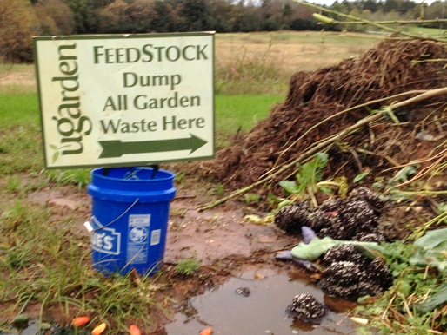
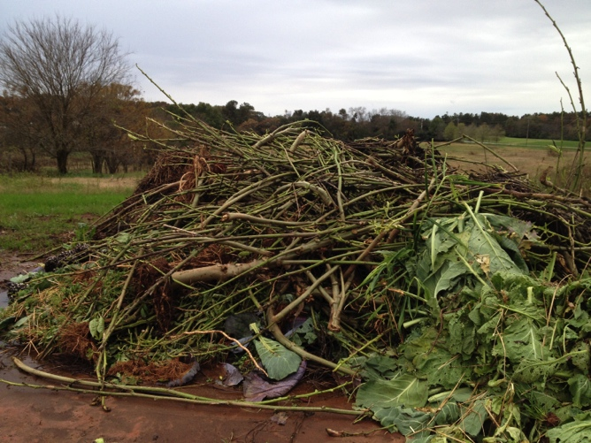
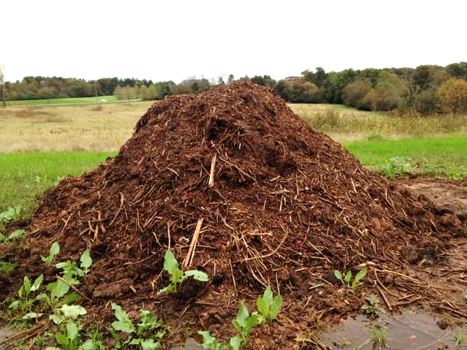
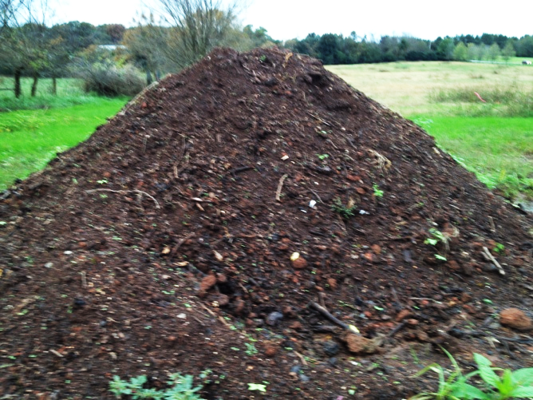
Stages of Small Farm Composting
Photos: David Berle
Notes:
Every farm will establish a composting system that work for the scale of operation and the availability of equipment. The system pictured starts will all farm waste, except certain difficult weeds like Bermudagrass. The, all material is ground up using a tractor-mounted flail mower, then turned as needed using a front loader bucket on a 29 hp tractor.

Slide 22
How to use compost
Apply aged compost prior to planting and tilled in
Apply just like fertilizer
Aged compost does not smell bad
Aged compost is not hot to the touch
Use as top dressing, but better benefit if mixed into soil
Greatest benefit to new ground or poor soils
Continue adding with each new cash crop until OM level approaches 5%
Notes:
The best way to use compost is to spread it over the garden area, about 2-4 inches thick and till it in prior to planting. Compost can also be spread next to growing crops as a top dressing, but it is more effective if tilled in. Compost provides the biggest benefit to compacted soils and soils low in organic matter. The number varies with soil type and conditions, but a good organic matter percent to shoot for in Georgia is 5%. This can be determined by an additional soil test.

Slide 23
Suggested “Do It Yourself” Minimum Testing for Good Compost
Moisture – feel test
Smell – no ammonia, good “earthy smell”
pH - strips
Inerts – sieve and weigh
Germination – tomato or cress seeds
Notes:
Moisture – compost should not be very wet to feel. Sopping wet compost usually has decomposed without proper oxygen and can have compounds that can inhibit plant growth
Smell – a properly cured compost will have a good earthy smell. When wetted up, it should not smell of ammonia. If it does it needs to be further stabilized by curing and is not ready for use.
pH – a good compost should have a neutral pH. You can test this with pH strip to get a rough idea. If the compost is acidic (below 6.0) then it is likely to have a lot of fatty acids in it that will inhibit plant growth.
Inerts – look for the presence of plastics or glass
Germinatin – We are having trouble with composts having trace herbicides that are persistent. Take a small amount of the compost, moisten it, put some tomato or cress seeds on the surface and see if they germinate properly.
NH4-N <100 v mature 100-500 mature >500 immature

Slide 24
Learning Activity
Fertilizer Calculations Worksheet

Slide 25
This material is based upon work that is supported by the National Institute of Food and Agriculture, U.S. Department of Agriculture, under award number 2015-70017-22861.
Beginning Farmer and Rancher
Development Program
Developing the Next Generation
of Sustainable Farmers in Georgia Grant

