Slide 1
Small Ruminant Production

Slide 2
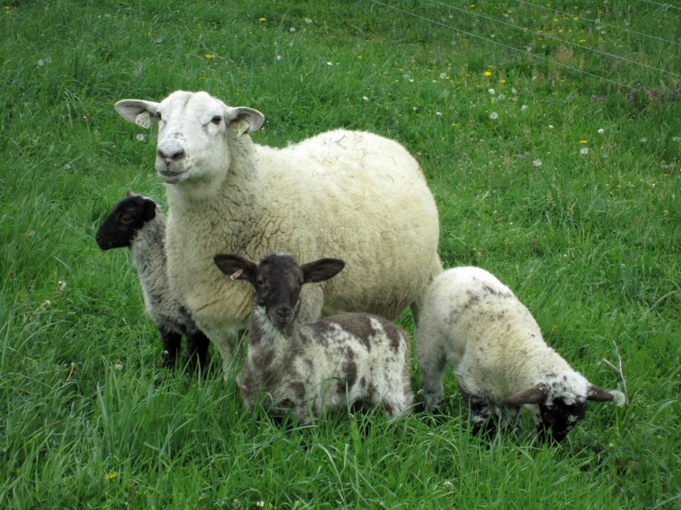
Session 4 Integrated Parasite Management II
Susan Schoenian (Shāy nē ŭn)
Sheep & Goat Specialist
University of Maryland Extension

Slide 3
Integrated parasite management (IPM) Using chemical and non-chemical means to control parasites
Non-chemical
Chemical
Host immunity
Laming/kidding and weaning management
Nutritional management
Pasture and grazing management
Genetic selection
Proper use of anthelmintics, including Targeted Selected Treatment (TST)
FAMACHA©
Five Point Check©
Testing for anthelmintic resistance/fecal egg counts

Slide 4
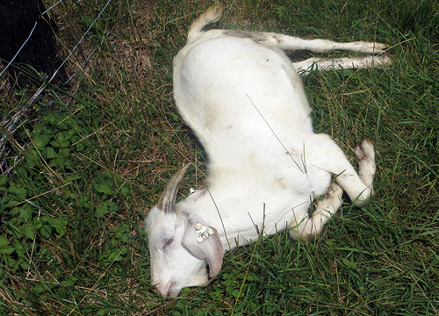
Host immunity Animals vary in their susceptibility to parasites
Most susceptible
Less (but still) susceptible
Lambs and kids
Weanlings
Early weaned
Spring born
Late-born
Artificially reared
Periparturient females
High producing
Yearlings
Geriatric animals
Mature males
Dry females
Pets

Slide 5
Birthing and weaning management
Can manage lambing/kidding to lessen parasite problems
Optimal time to lamb/kid will vary (climate, other factors)
Some producers who lamb/kid in fall/winter report less parasite problems
Housing indoors during late gestation/early lactation to minimize effect of periparturient egg rise
Weaning age affects susceptibility
Pros and cons to different weaning ages

Slide 6
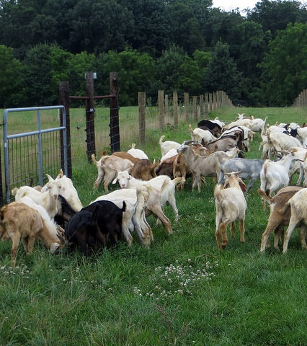
Nutritional management
Sheep/goats in better body condition and higher plane of nutrition are more resilient
Extra protein (by-pass, above NRC) in late pregnancy reduced fecal egg counts in periparturient ewes
Many pastures are usually deficient in energy
Bucks in 2014 test were supplemented with soy hulls during second half of test.

Slide 7
Pasture and grazing management
Safe (clean) pastures
Low risk pastures
Evasive grazing
Strip grazing
Short-duration grazing
Rotational grazing
Management-intensive grazing
Multi-species grazing
Composting manure before spreading on fields.
Browsing
Alternative forages
Tanniferous forages
Annuals
Legumes, forbs, herbs
Minimum grazing height
Delayed grazing
Night penning
Zero grazing (dry lot feeding)

Slide 8
Western Maryland Research & Education Center Pen vs. pasture studies Avg. fecal egg counts, epg
2013
2014
No pen goats required deworming; pasture goats received 28 (2013) and 5 treatments (2014)

Slide 9
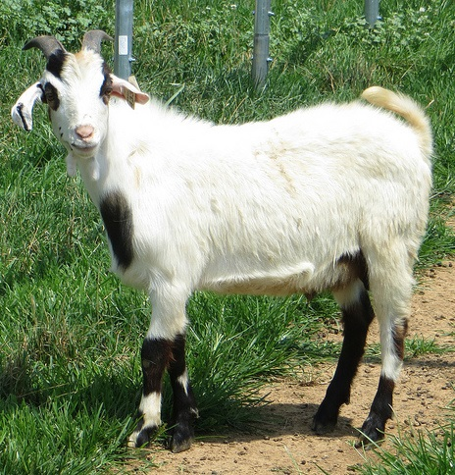
Genetic selection
There are documented differences in breeds with regards to parasite resistance.
There is as much genetic variation within a breed as between breeds.
Fecal egg counts are not evenly dispersed in a herd. Approximately 20-30% of the herd is responsible for 70-80% of the pasture contamination.
One of the more resistant bucks in the 2014 test.
Note: Some recent research from West Virginia indicates Texel sheep may have some resistance.

Slide 10
FECs are not evenly dispersed

Slide 11
Genetic selection: two traits
RESISTANCE
RESILIENCE
Ability of the host to reduce number of parasites that establish, reproduce, or survive in its body.
Quantified by fecal egg counts (# worm eggs per gram of feces), which are an indirect measure of the worm burden in the animal.
Ability of host to tolerate parasitic infection, i.e. maintain health, thrive, grow, and reproduce.
Quantified by observation or measurement of clinical signs: packed cell volume (PCV), weight gain/loss, body condition, dag score.
FAMACHA© scores are an estimate of PCV.

Slide 12
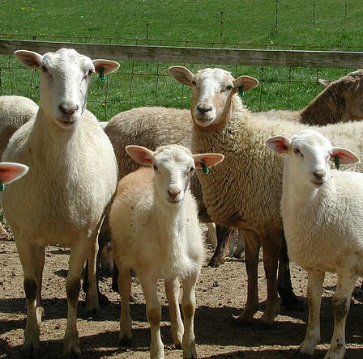
Genetic selection
Significant (but variable) correlations between FEC and PCV and FEC and FAMACHA© scores.
Parasite resistance moderately heritable trait in sheep, variable estimates for FEC heritability in goats - no estimates for the US goat population.
Lincoln University (in Missouri) has embarked on a long term selection study on parasite resistance in meat goats (research herd is ¾ Kiko x ¼ Boer).

Slide 13
Targeted Selective Treatment (TST)
What is it?
What does it do?
Only treating animals that require treatment or only treating animals that would benefit from treatment.
Slows drug resistance, b/c
Reduces # of treatments
Increases refugia
Identifies resistant and susceptible animals for selection purposes.

Slide 14
Decision-making tools for TST
TST requires practical decision-making tools that farmers/ producers can use.
The first tool developed was the FAMACHA© system.
The Five Point Check© is an extension of the FAMACHA© system.

Slide 15
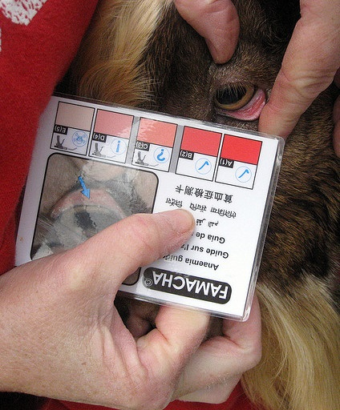
FAMACHA© System
FAMACHA© system - developed for small-scale sheep farmers in South Africa in response to growing anthelmintic resistance
System validated for goats
System validated in US for sheep and goats
System to assess anemia (primary symptom of barber pole worm infection) in sheep/goats and to determine need for deworming individuals
Named for its originator: Dr. Francois “Faffa” Malan : Faffa Malan Chart

Slide 16
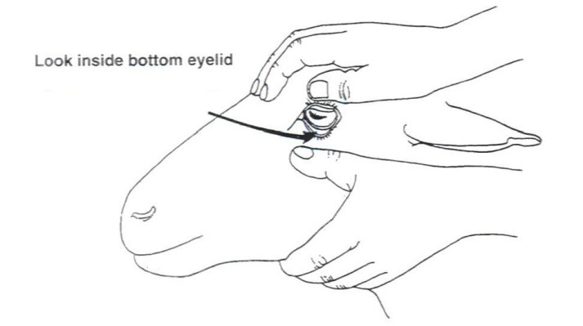
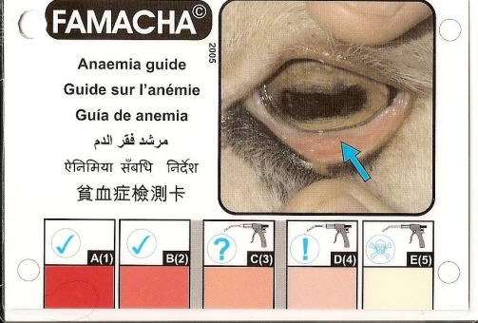
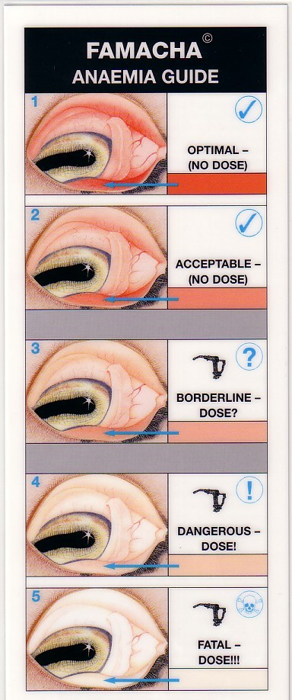
FAMACHA© System
Clinical Category | Eye Lid Color | Packed Cell Volume/PCV | Treatment recommendation
1 | Red | > 28 | No
2 | Red-Pink | 23-27 | No
3 | Pink | 18-22 | ?
4 | Pink-White | 13-17 | Yes
5 | White | < 12 | Yes

Slide 17
Decision-making: FAMACHA© score 3
Deworm | Don’t deworm
Goats | Sheep
Kids and lambs | Mature animals
Periparturient females | Non periparturient females
Lactating females | Dry females
High parasite challenge | Low parasite challenge
Infrequent monitoring (> 3 weeks) | Frequent monitoring (1-3 weeks)
> 5-10% FAMACHA© 4s and 5s | < 5% FAMACHA© 4s and 5s
Downward trend in 1s and reciprocal increase in 2s and 3s | No downward trend in scores
Flock/herd not in good body condition and overall health | Flock/herd in good body condition and overall health
To increase sensitivity of system (probability of identifying anemic animals) | To increase specificity of system (probability of identifying non-anemic animals)

Slide 18
Tips for using FAMACHA©
Check at appropriate intervals; varies by season, animals, and risk of infection/reinfection.
No half scores, use the paler score.
Be consistent.
Learn your animals.
Don’t ignore other symptoms and factors.
Test for anthelmintic resistance.
Replace card, as necessary.
**If you complete this Journey Farmer training, you will get a FAMACHA card; you can also get training at: http://web.uri.edu/sheepngoat/parasite-control/

Slide 19
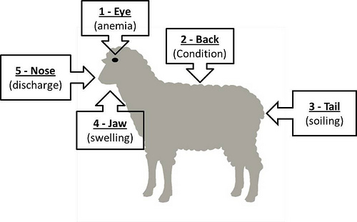
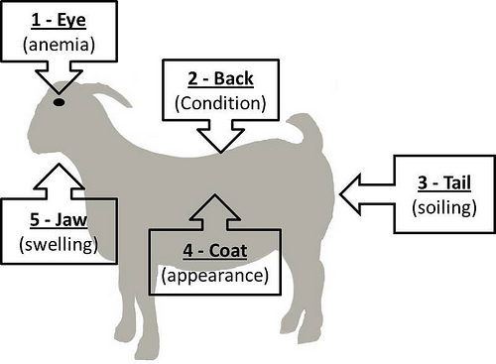
Five Point Check© 5.✓©
Addresses FAMACHA© limitation - only effective for blood feeding parasites
Extension of TST - determine need for deworming for all small ruminant internal parasites
Especially useful for FAMACHA© score 3 deworming decisions
5 check points: eye, back, tail, jaw, nose
Developed for sheep.
For goats, can replace nose checkpoint with coat condition.

Slide 20
Check Point | Observation | Possibilities
EYE | Anemia 1-5 (FAMACHA© card) | Barber pole worm (Haemonchus) Liver fluke Hook worms Other worms and causes
2. BACK | Body condition score 1-5 (BCS card) | Brown stomach worm (Teladorsagia) Bankrupt worm (Trichostrongylus) Nodular worm Other worms and causes
3. TAIL | Fecal soiling (1-5) Dag score card | Brown stomach worm (Teladorsagia) Bankrupt worm (Trichostrongylus) Coccidia (Eimeria) Nodular worm (Oesophagostomum) Other worms and causes
4. JAW | Soft swelling “Bottle jaw” 1-5 | Barber pole worm (Haemonchus) Coccidia (Eimeria) Liver fluke Hook worms Other worms and causes
5. NOSE | Discharge 1-5 | Nasal botfly Lungworms Pneumonia Other causes
5. COAT | Coat condition 1-3 | Barber pole worm (Haemonchus) Brown stomach worm (Teladorsagia) Bankrupt worm (Trichostrongylus) Coccidia (Eimeria) External parasites Other causes

Slide 21
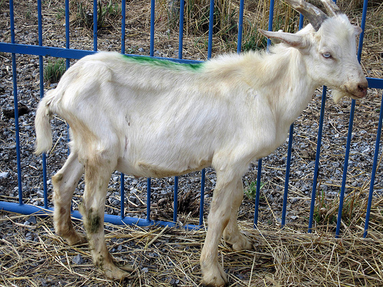
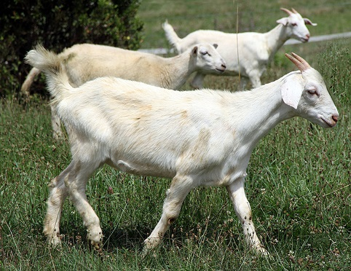
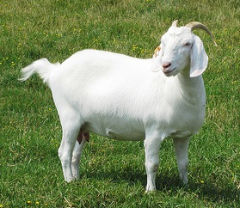
#2 - Back - Body condition score (BCS)
Many parasites can cause a loss of body condition.
Poor or declining body condition can also be a sign of age, poor nutrition, or other diseases.
Animals also vary in their ability to carry and hold body condition.

Slide 22
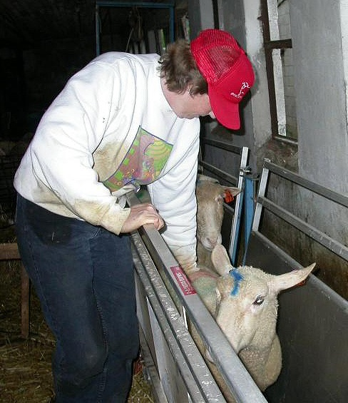
Body condition scoring (BCS)
Is used to determine how fat or thin an animal is.
Cannot be determined by simply looking at an animal.
Is accomplished by feeling for the amount of fat and muscle over the back, ribs, and loin.
Is one of the most useful management practices.
Should be done on a regular basis.

Slide 23
Body Condition Score |  | Spineous process | Rib cage | Loin eye
1 | Very thin | Easy to see and feel, sharp | Easy to feel and can feel under | No fat covering
2 | Thin | Easy to feel, but smooth | Smooth, slightly rounded, need to use slight pressure to feel | Smooth, even fat cover
3 | Good condition | Smooth and rounded | Smooth, even feel | Smooth, even fat cover
4 | Fat | Can feel with firm pressure, no points can be felt | Individual ribs cannot be felt, but can still feel indent between ribs | Thick fat
5 | Obese | Smooth, no individual vertebra can be felt | Individual ribs cannot be felt. No separation of ribs felt. | Thick fat covering, may be lumpy and “jiggly”
Source: www.smallstock.info

Slide 25
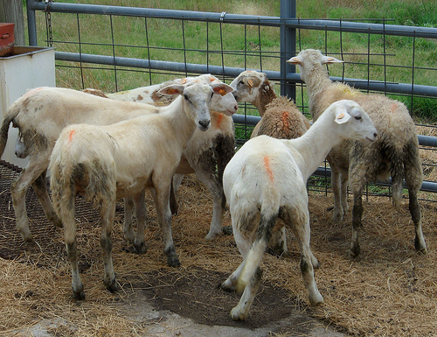
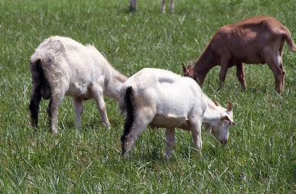
#3 - Tail - dag score
The hindquarters of the animal are assessed to determine dag score or degree of fecal soiling.
Many parasites can cause scours (diarrhea).
Stress and diet are other causes of diarrhea.

Slide 26
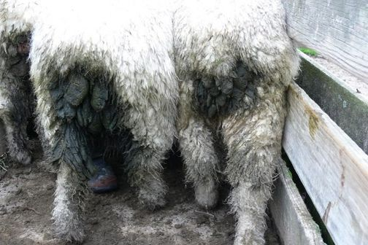
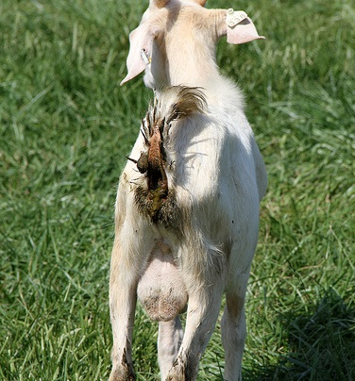
What are dags?
Dried feces left dangling on the wool on a sheep’s rear end.

Slide 27
Dag Score | Description | Action
0 | No fecal soiling at all. No indication for treatment/action. | None
1 | Very slight soiling on edge of tail/on each side | None
2 | Slight soiling on edge of tail/on each side | Usually none
3 | Moderate soiling, dag formation | Consider treatment/action
4 | Severe soiling, severe dag formation | Treatment recommended
5 | Very severe, watering diarrhea extending to hocks. | Treatment essential
Source: University of Pretoria, South Africa

Slide 28
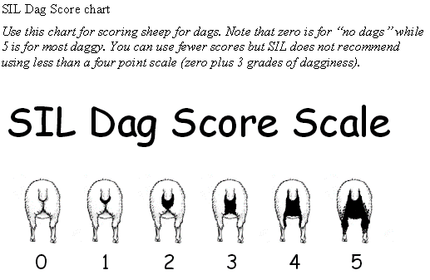
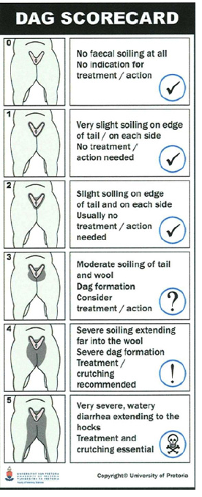

Slide 29
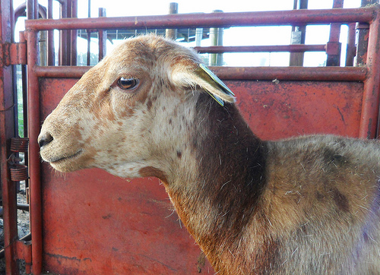
#4 - Bottle jaw (submandibular subcutaneous edema)
An accumulation of fluid (swelling) under the lower jaw.
Usually a result of anemia (blood loss).
Occurs primarily due to the infestation of barber pole worms (Haemonchus contortus) or other blood-feeding parasites.
Can also be caused by coccidiosis and other parasites.
Can die without showing bottle jaw.

Slide 30
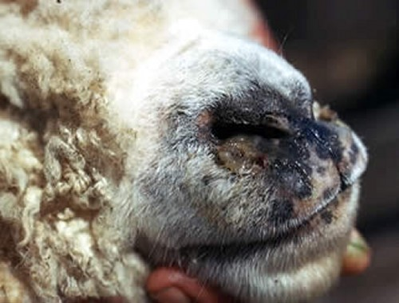
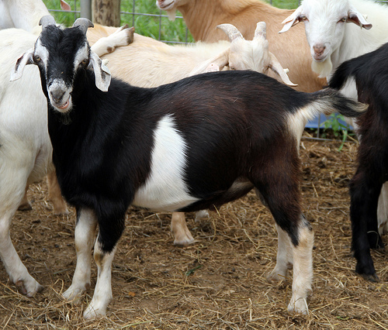
#5 – Nose (or coat)
Sheep Nose
Goats Coat condition
The condition of a goat’s hair coat can be indicative of its overall health and thriftiness.
Diet (nutrition) also has a large effect on coat condition.
Nasal discharge (for nasal bots)

Slide 31
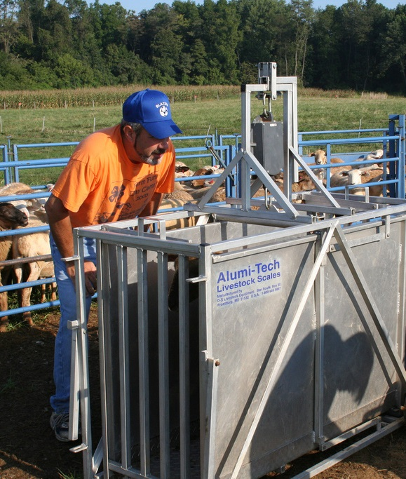
Other factors to consider …especially when deciding whether to deworm FAMACHA 3’s
Fecal consistency
Fecal egg count
Weight gain
Scores of other animals
Risk of reinfection
Frequency of FAMACHA© scoring and Five Point Check©

Slide 32
What do to when deworming is not enough or only marginally effective.
Dose with another class of anthelmintic.
Give supportive therapy
Vitamin B complex
Iron or Red cell
Nutri-drench
Probiotics
Electrolytes
Proteinaceous feeds
Remove parasitized animal from pasture (source of reinfection).
For pets: Your vet could do a blood transfusion

Slide 33
Fecal Egg counts (FECs)
A quantitative measurement that is expressed as eggs per gram of feces (EPG, epg) vs. “positive” or “negative” or +,++, +++ from a simple fecal flotation (which is not very useful!)
Uses a measured amount of feces and flotation solution.
An approximation of the worm load an animal is carrying.
A “snapshot” in time.
McMaster slide

Slide 34
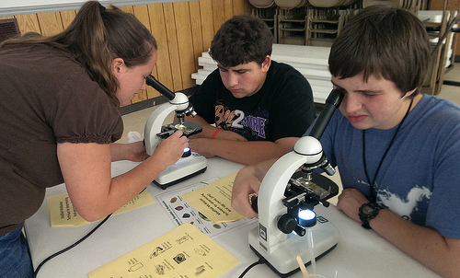
FEC data from the Western Maryland Pasture- Based Meat Goat Performance Test
Test ID | FEC d-28 | FAMACHA©
303 | 1650 | 3
304 | 1000 | 3
305 | 275 | 3
310 | 2040 | 2
334 | 125 | 3
335 | 3000 | 4
337 | 1300 | 3
338 | 3167 | 3
355 | 4650 | 2
356 | 6725 | 2
357 | 6000 | 3
358 | 4900 | 4
339 | 120 | 4
340 | 4240 | 3
351 | 14680 | 3
352 | 2125 | 5
353 | 33 | 4
359 | 867 | 3
360 | 200 | 2
361 | 1240 | 3
362 | 2225 | 2
363 | 525 | 2
367 | 200 | 2
Year | Genetic correlation (-1 to 1) between FECs and FAMACHA© scores
2007 | 0.29 | Intermediate
2008 | 0.42 | Intermediate
2009 | 0.18 | Weak
2010 | 0.23 | Weak
2011 | 0.14 | Weak
Avg. 5 years | 0.25 | Weak to intermediate

Slide 35
Limitations of fecal egg counts
Not a highly accurate test, especially at low numbers.
Parasites vary in their egg producing capacity.
Immature worms (L4s) suck blood, but do not lay eggs.
Inhibited larvae do not lay eggs.
There is a day-to-day variability in counts, even in stable worm populations.
Eggs are not always evenly distributed in manure.
Loose stools (diarrhea) may underestimate egg counts.
Some eggs look the same and cannot be differentiated at the egg stage (e.g. Haemonchus vs. Trichostrongylus)
Not all parasites (or strains) are pathogenic.
There are different procedures for doing fecal egg counts.
The possibility of human error.

Slide 36
Three main uses of fecal egg counts
Determine anthelmintic (drug) resistance.
Monitor pasture contamination.
Select animals for their genetic ability to resist worms.
Not a reliable way to diagnose parasitic disease in an individual animal.
What do fecal worm egg counts tell us? http://ohioline.osu.edu/vme-fact/pdf/0027.pdf

Slide 37
Use fecal egg counts to select goats (especially bucks) that are more resistant to internal parasites.
COWPs

Slide 38
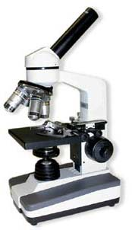
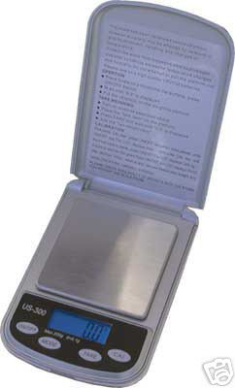
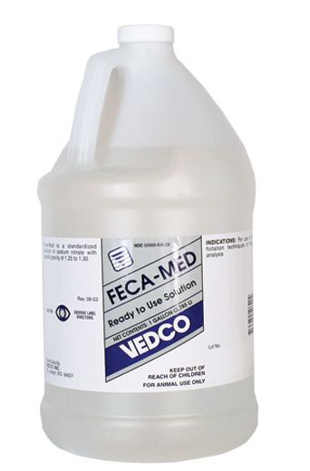
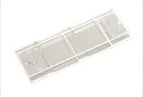
Doing your own fecal egg counts
What you need
Compound microscope (10x wide field eyepiece, 10x objective, mechanical stage)
McMaster slide
Flotation solution
Gram scale (optional)
Cups or vials
Craft stick or tongue depressors
Cheese cloth or tea strainer
Pipettes or syringes
To learn how see: http://web.uri.edu/sheepngoat/video/

Slide 39
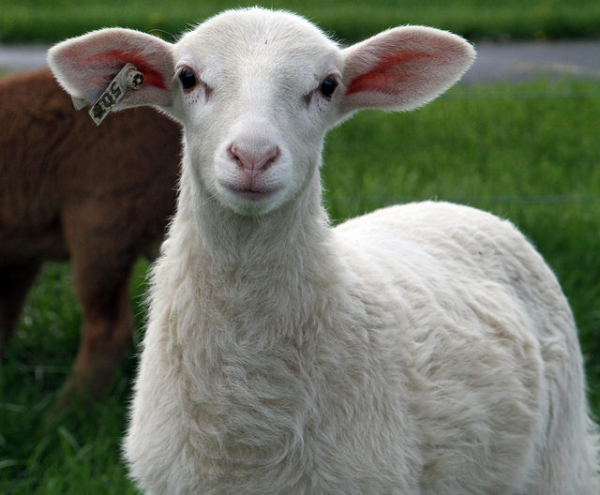
Thank you for your attention.

Slide 40
Additional Resources
www.wormx.info
www.sheepandgoat.com/#!webinars/cu81
http://web.uri.edu/sheepngoat/parasite-control/

Slide 41
This material is based upon work that is supported by the National Institute of Food and Agriculture, U.S. Department of Agriculture, under award number 2015-70017-22861.
Beginning Farmer and Rancher
Development Program
Developing the Next Generation
of Sustainable Farmers in Georgia Grant

