Slide 1
Small Ruminant Production

Slide 2
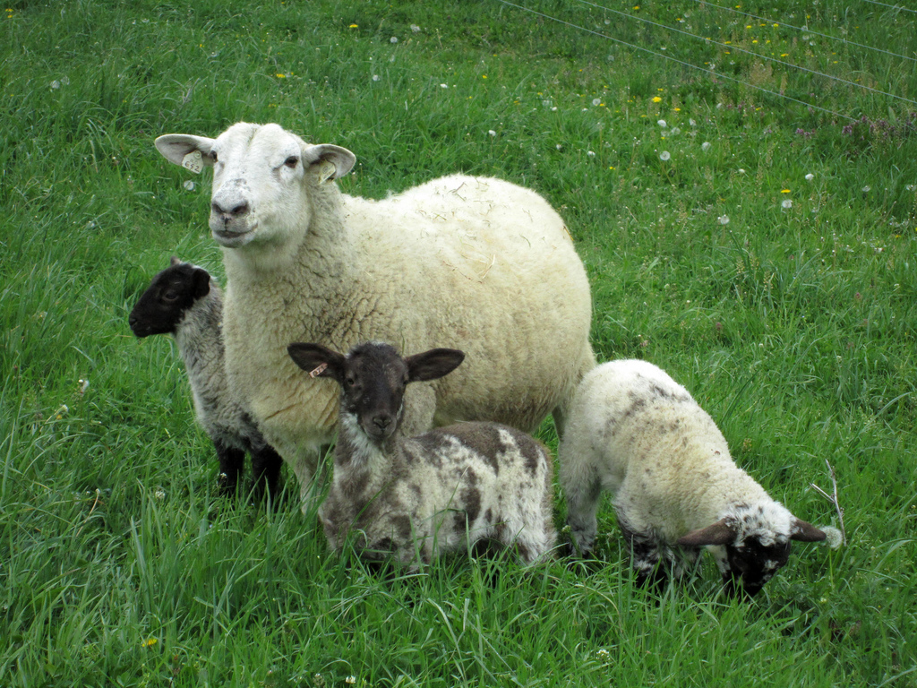
Session 4 Integrated Parasite Management I
Susan Schoenian (Shāy nē ŭn)
Sheep & Goat Specialist
University of Maryland Extension
No products, business, companies or manufacturers are being endorsed.

Slide 3
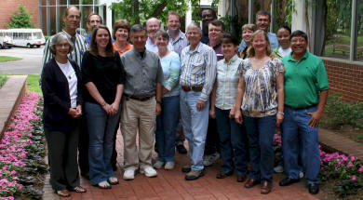
American Consortium for Small Ruminant Parasite Control (ACSPRC) www.acsrpc.org www.wormx.info

Slide 4
Anthelmintic (dewormer) resistance
Anthelmintic = Dewormer
Resistance is inevitable; no treatment will kill 100 percent of worms.
Worms have developed resistance to all dewormers and all dewormer classes.
Resistance varies by geographic region and individual farm and is the result of past deworming practices.

Slide 5
Levamisole sold under the trade names of Prohibit® and LevaMedTM

Slide 6
Anthelmintic (dewormer) resistance
Resistant worms pass their resistant genes onto their offspring; resistance is permanent!
You cannot prevent resistance, but you can affect the rate by which it develops.
On most farms, resistance is probably at a level where there is still time to slow it down and enable the continued use of some anthelmintics.

Slide 7
Understanding anthelmintic resistance
95-100% effective. Small number of resistant worms may be present.
80-95% effective. Treatment is effective, but resistance is increasing.





Less than 80%. Production losses become apparent as effectiveness of dewormer moves closer to zero.
Anthelmintic failure. Animals die.
Adapted from Wormer Resistance “The need for change” Meat Promotion Wales

Slide 8
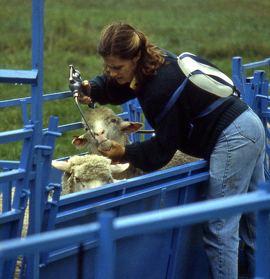
You can slow drug resistance by increasing refugia.
Decrease frequency of anthelmintic treatments.
Do not treat everyone; leave some animals untreated.
Do not move treated animals to a clean pasture.
Do not deworm when there is a low level of pasture contamination or infection in animals.
Re-introduce susceptible worms (?) to your farm.
Refugia are worms that have not been exposed to drug(s): “in refuge”.

Slide 9
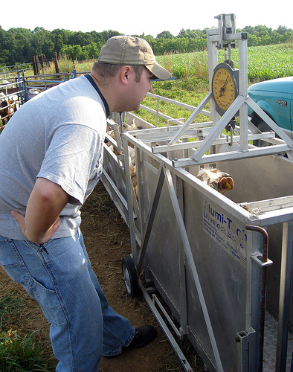
Don’t make it easier for worms to develop resistance to the drugs.
Caused by exposing them to sub-therapeutic levels of drug(s); so DO NOT:
Underdose
Inject dewormers
Pour dewormer on back
Administer drugs improperly
Do not squirt injectable into mouth
Do not drench with pour-on
Deposit drug into mouth instead of esophagus
Use persistent activity dewormer
Rotate dewormers

Slide 10
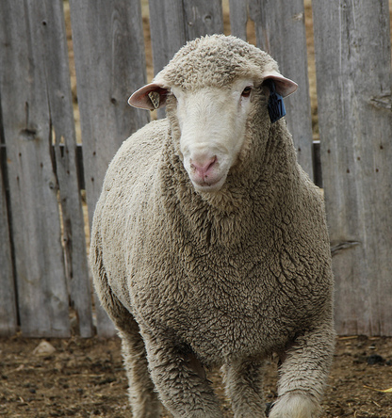
Do not bring resistant worms to your farm
Quarantine drenching: to prevent the introduction of resistant worms to your farm, deworm all newly acquired animals with anthelmintics from 2-3 anthelmintic classes.
Moxidectin + levamisole
Albendazole + moxidectin + levamisole
In Western Maryland Pasture-Based Meat Goat Performance Test, deworming with albendazole, moxidectin, and levamisole at same time (but one at a time) usually reduces fecal egg counts by more than 95 percent (in 6-12 days).
For sale Ram - $1,000 Resistant worms - free

Slide 11
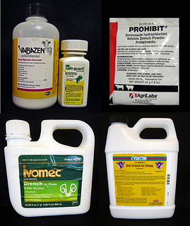
Anthelmintics 101 There are only 3 families of drugs.
Avermectins
Ivermectin Ivomec® Primectin® Privermectin®
Eprinomectin Eprinex® LongRange ®
Doramectin Dectomax®
Milbimycins
Moxidectin Cydectin® Quest®
Imidazothiaoles
Levamisole Prohibit® Leva-MedTM
Tetrahydropyrimidines
Morantel Rumatel® Positive Goat Pellet Goat dewormer
Pyrantel Strongid®
Fenbendazole Safeguard® Panacur®
Albendazole Valbazen®
Oxybendazole Synanthic®
BENZIMIDAZOLES
MACROCYCLIC LACTONES
NICOTINIC AGONISTS
1
2
3

Slide 12
FDA-approved anthelmintics for sheep
 | (1) Benzimidazoles | (2) Macrocyclic lactones |  | (3) Nicotinics
 |  | Avermectins | Milbemycins
Adult worms | ✓ | ✓ | ✓ | ✓
Immature worms (L4) | ✓ | ✓ | ✓ | ✓
Hypobiotic larvae | ✓ | ✓ | ✓ | ✓ ?
Lung worms | ✓ | ✓ | ✓ | ✓ +
Tape worms | ✓
Adult liver flukes | ✓
Coccidia
External parasites |  | ✓ | ✓ (Nose Bots)
Persistent activity |  |  | ✓
Safety | Restricted use during early pregnancy | ++++ | ++++ | ++
Resistance | ++++ | +++ | ++ | +
FDA-approved | Valbazen® | Ivomec® | Cydectin® | Levamisole®
Labeled dosage | 3 ml/100 lbs. | 3 ml/26 lbs. | 1 ml/11 lbs. | 2 ml/50 lbs.
Meat withdrawal | 7 days | 11 days | 7 days | 3 days

Slide 13
FDA-approved anthelmintics for goats
 | (1) Benzimidazoles |  | (3) Nicotinics
 | SafeGuard® | Valbazen® | Rumatel®
Adult worms | ✓ | ✓ | ✓
Immature worms (L4) | ✓ | ✓
Hypobiotic larvae | ✓ | ✓
Lung worms | ✓ | ✓
Tape worms | Not labeled
Adult liver flukes |  | ✓
Coccidia
External parasites
Safety | ++++ | Restricted use during early pregnancy | +++
Resistance | ++++ | na | ?
Labeled dosage per 100 lbs. | 2.3 ml | 4 ml | 0.44 g
Meat withdrawal | 6 days | 7 days | 30 days
Milk withdrawal | NA | NA | 0 days

Slide 14
Extra-label anthelmintics for goats (Rx)
 | (1) Benzimidazoles |  | (2) Macrocyclic lactones |  | (3) Nicotinics
 | SafeGuard® | Valbazen® | Ivomec® | Cydectin® | Prohibit®
Adult worms | ✓ | ✓ | ✓ | ✓ | ✓
Immature worms (L4) | ✓ | ✓ | ✓ | ✓ | ✓
Hypobiotic larvae | ✓ | ✓ | ✓ | ✓ | ✓ ?
Lung worms | ✓ | ✓ | ✓ | ✓ | ✓ +
Tape worms | ✓ | ✓
Adult liver flukes |  | ✓
Coccidia
External parasites |  |  | ✓ | ✓
Persistent activity |  |  |  | ?
Safety | ++++ | Restricted use during early pregnancy | ++++ | ++++ | ++
Resistance | ++++ | ++++ | +++ | ++ | +
Dosage per 25 lbs. | 1.1 ml | 2 ml | 6 ml | 4.5 ml | 2.7 ml
Meat withdrawal | 16 days | 9 days | 14 days | 17 days | 4 days
Milk withdrawal | 4 days | 7 days | 9 days | 8 days | 3 days

Slide 15
Zolvix® (monepantel): a new anthelmintic
New drug class: amino-acetonitrile derivative.
Unique mode of action.
First new anthelmintic in 25 years.
Kills worms that are resistant to other drugs.
Resistance already reported in Australia (in goats).
Not yet available in US.
Will be available by prescription (Rx) only. ELDU for goats.
Will be expensive (?).

Slide 16
“Alternative” (non-chemical) dewormers
Many natural compounds are said to have “anthelmintic-like” properties; the list is overwhelming!
Studies are lacking, inconsistent, and/or not repeatable.
Some natural anthelmintics are potentially toxic to the animal, e.g. copper sulfate, nicotine sulfate.
Considerable research is being done on alternative or natural “dewormers.”
COWP bolus

Slide 17
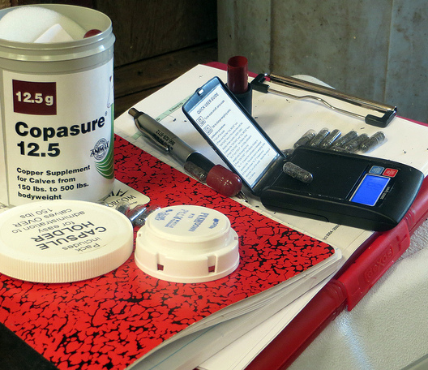
2014 Western Maryland Pasture-Based Meat Goat Performance Test Anthelmintic effect of copper oxide wire particles (COWPs)
Mid-way through the test, at day 42, which was the end of the “parasite challenge phase” of test, test bucks (n=77) were given a gel cap containing ~0.5 g of copper oxide wire particles (COWPs).
On day 42, nine (9/77) bucks required deworming (based on FAMACHA© and 5 Point ✓©) and were also dewormed with a commercial dewormer (levamisole or moxidectin).
Fifteen (15) bucks from our pen vs. pasture study (pasture group) served as controls: they did not receive any treatment.

Slide 18
Treatment |  | # goats | July 17 Avg. FEC | July 31 Avg. FEC | Avg. FECR
Dewormer | Effective | 8 | 8735 | 103 | 98.6
 | Ineffective | 1 | 500 | 275 | 45.0
COWP | Effective | 53 | 2768 | 388 | 81.7
 | Ineffective | 8 | 723 | 2000 | < 0
No treatment (Control) | Pasture | 15 | 2164 | 2371 | < 0
 | Pen | 12 | 1216 | 758 | 37.7

Slide 19
COWP
Avg. fecal egg count, epg

Slide 20
My perspective and recommendation on alternative “dewormers”
Alternative dewormers are not likely to replace commercial anthelmintics.
Alternative dewormers may complement commercial dewormers by:
Disrupting the free-living stage of the parasite (e.g. inhibit egg hatching or larvae development)
Improving natural immunity of animal
Improving overall management of the herd
Reducing the number of animals that require treatment with a commercial dewormer.
It’s okay to use alternative dewormers so long as animals are monitored regularly for signs of parasitism and need for deworming with effective drug.

Slide 21
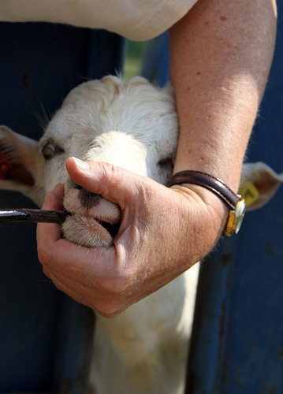
Determining anthelmintic resistance
It is recommended that you test for anthelmintic resistance every 2-3 years.
FAMACHA© and the Five Point Check© don’t work if you don’t have an effective treatment(s) for clinically-parasitized animals.
Clinically-parasitized animals will almost always die without an effective anthelmintic treatment (deworming).
There are two ways to test for anthelmintic resistance.
Fecal egg count reduction test (FECRT)
DrenchRite® Assay

Slide 22
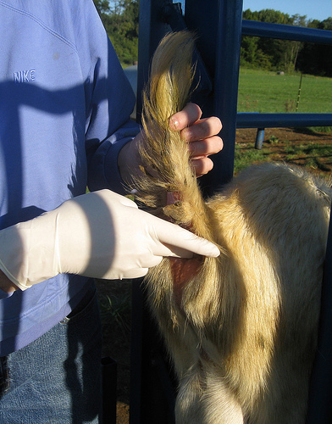
1) Fecal egg count reduction test (FECRT)
Determines how effective dewormer is
Best time to do is when Haemonchus (barber pole worm) is most active
Collect fecal samples (FECs > 250 epg) from animals at and after treatment (ideally, n > 15) for each dewormer you want to test
If possible, include a group of controls (same number) that you will not treat
Favor animals with higher FAMACHA© and dag scores and lower BCSs
Doing a fecal egg count reduction test on one or a few animals may suggest resistance or effectiveness, but it does not prove it.

Slide 23
Fecal egg count reduction test (FECRT)
Compare pre- and post-treatment fecal egg counts
8-10 days for benzimidazoles (SafeGuard®, Valbazen®)
14-17 days for macrocylic lactones (Ivomec®, Cydectin®)
5-7 days for levamisole (Prohibit®)
10-14 days for all dewormers
http://www.uaex.edu/Other_Areas/publications/PDF/FSA-9608.pdf

Slide 24
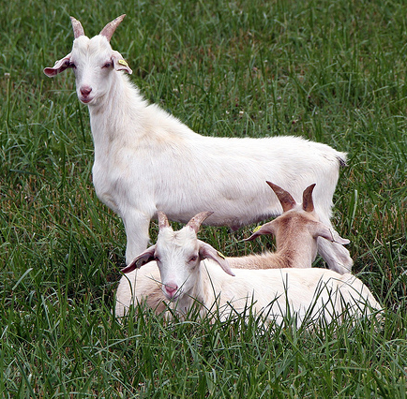
Fecal egg count reduction test 2012 Western Maryland Pasture-Based Meat Goat Performance Test [Pre-test Tx: albendazole + moxidectin + levamisole]
AVERAGE | 2532 | 29 | 97.7%
MEDIAN | 1266 | 0 | 100.0%
STDEV | 3373 | 76 | 5.77%
TEST ID | 2-Jun | 14-Jun | 14-Jun
 | FEC-0 | FEC-1 | FECRT
AVERAGE | 2532 | 29 | 97.7%
MEDIAN | 1266 | 0 | 100.0%
STDEV | 3373 | 76 | 5.77%
49 animals; Most had 100% reduction; one had only 68.8% and another 88.9%. Others (10) that were not 100% were above 90%.
FEC ranged from 0 to 15150 epg

Slide 25
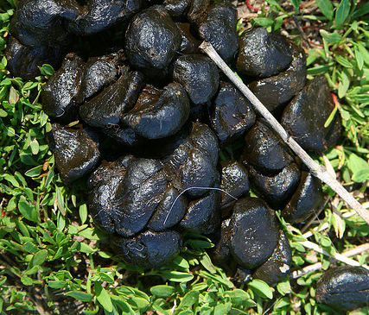
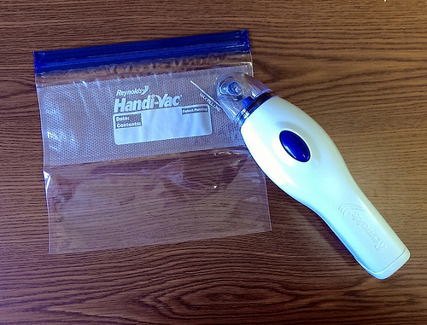
2) DrenchRite® or larval development assay
Determines resistance for all drug classes at the same time using a pooled fecal sample.
Determines which parasites your animals have.
Collect a fresh pooled fecal sample from at least 10 animals with FECs >350-500 epg.
Follow instructions for collecting, handling, and shipping sample to Dr. Ray Kaplan’s lab at the University of Georgia.

Slide 26
DrenchRite Report Form
 | BZ | LEV | IVM | MOX DD
Critical Well/ Delineating Dose | 10.5 | 3 | 6.5 | 10
Resistance Status | R | S | R | S
Pooled fecal egg count: 2050 epg
COMMENTS: Coproculture results-96% Haemonchus, 3% Trichostrongylus/Teladorsagia mix, 1% Oesophagostumum*
*There were several strongyloides present on both FEC and on the coproculture

Slide 27
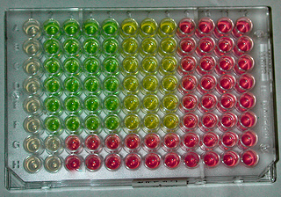
A comparison of tests
FECRT
DrenchRite® Assay
Takes 7-14 days to get results, longer if someone else does FECs.
Cost for 75 samples (15 samples x 4 drugs + control group) 75 x Labor = ? 75 x $5 = $375 75 x $10 = $750
Need more animals
Results: % efficacy
Results can vary by animal, so need to do enough animals for results to be valid.
Labor-intensive lab test
Only one lab in US does DrenchRite® Test (UGA)
Takes 3-4 weeks to get results
Results: S, SR, R
Cost $450 per sample
UGA is working on a pooled sample FECRT which would be much cheaper and would reduce animal to animal variation.

Slide 28
Small ruminants are affected by many internal parasites, but only a few are usually important.
Multi-cellular (helminths)
Nematodes Roundworms
Cestodes Tapeworms
Trematodes Flukes
Single-cell (protozoa) like coccidia

Slide 29
Roundworms - nematodes – strongyle-type
Primary
Secondary
Cooperia (small intestinal)
Nematodirus (thread/thin necked intestinal)
Oesaphagostomum (nodule worm)
Bunostomum (Hookworm)
Trichuris ovis (Whipworm)
Strongyloides
Lungworms
Parelaphostrongylus tenuis Meningeal, deer, brain worm
Haemonchus contortus Barber pole worm
Teladorsagia circumcinta (Ostertagia) brown stomach
Trichostrongylus spp. black scour/stomach/ hair

Slide 30
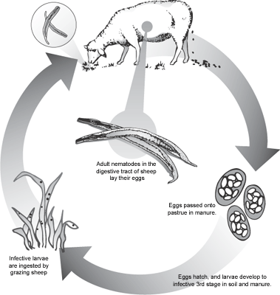
Haemonchus – Trichostrongylus – Teladorsagia
Short, direct life cycles (avg. 3-4 weeks) that are weather-dependent.
Can overwinter on pasture.
Ability to go into hypobiotic (arrested) state (in host) when environmental conditions are not conducive to their development (hot, dry or cold, dry).
Vary in their egg laying ability.
Eggs look same under microscope.
L4, adult
L3
L1/L2

Slide 31
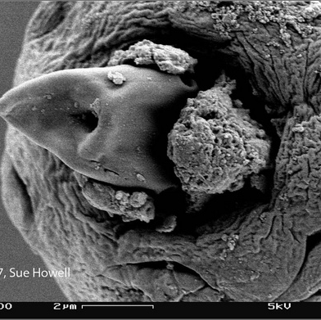
Haemonchus contortus - Barber pole worm
Primary parasite in warm, moist climates and/or during summer grazing season (in more northern climates).
One of the most pathogenic parasites
Prolific egg layer
Blood sucker/feeder
Causes anemia and bottle jaw.
Other symptoms: weight loss, loss of body condition, poor stamina, anorexia -- but not usually diarrhea.
Death can also be sudden (acute haemonchosis).
Image from University of Georgia

Slide 32
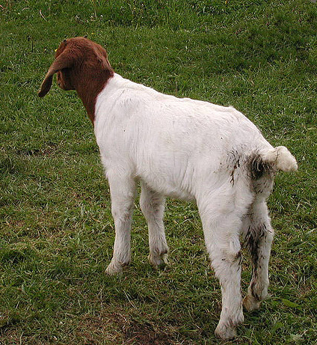
Other strongyle-type Teladorsagia and Trichostrongylus
Usually of secondary importance.
Usually part of mixed infections with barber pole worm.
Cause production loss, weight loss, dagginess (scours/diarrhea) - only occasional death.
May be more problematic in cooler, wet climates, e.g. Pacific Northwest, UK, and Canada.

Slide 33
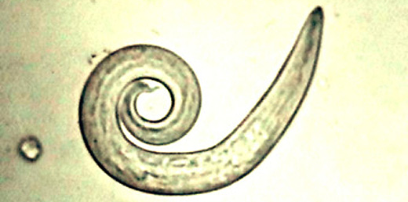
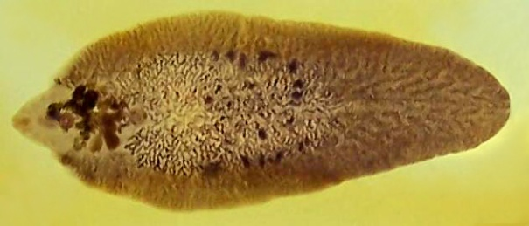
Lungworms
Liver flukes
Fasciola hepatica
Direct or indirect life cycle
Larvae visible in feces (microscope)
High loads – respiratory symptoms: coughing, fluid on lungs, pneumonia
Difficult to diagnose in live animal; usually diagnosed at necropsy.
Drugs which control GI parasites will also control lungworms.
Regional problem: mostly Pacific Northwest and Gulf States.
Require open water and aquatic snails as intermediate host.
Similar symptoms as barber pole worm (anemia, bottle jaw).
Treat adult liver flukes with albendazole (Valbazen®) or Ivomec® Plus (clorsulon).

Slide 34
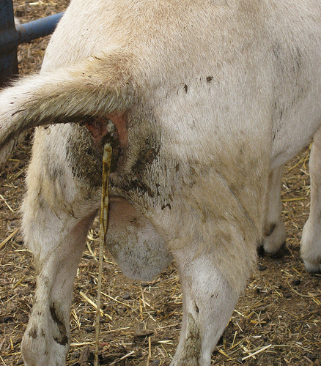
Tapeworms (Moniezia expansa)
Only worm visible in feces
Indirect life cycle; pasture mite intermediate host.
Usually non-pathogenic (so no benefit to treatment) but high loads rarely cause blockages or occasionally affect gut motility.
Treat with SafeGuard® (2x dose, Rx), Valbazen® [Rx], or praziquantel* [Rx] (Quest Plus®, Equimax®, or Zimecterin Gold®).
Sheep and goats are intermediate host for one species of tapeworm that also infects dogs.

Slide 35
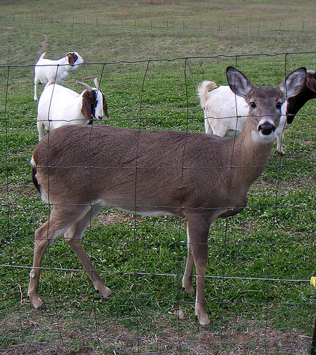
Meningeal worm (Parelaphostrongylus tenuis)
Parasite of white tail deer; sheep, goats, and camelids are abnormal (and dead end) hosts.
Has indirect life cycle: snail or slug required is intermediate host.
Causes neurological symptoms that vary in severity; no definitive diagnosis in live animal.
Treatment protocols involve high doses of anthelmintics and anti-inflammatory drugs.
Fenbendazole (SafeGuard®) and ivermectin (Ivomec®) are drugs of choice for meningeal worm [Rx].
Cornell University is working on vaccine and treatment protocols.

Slide 36
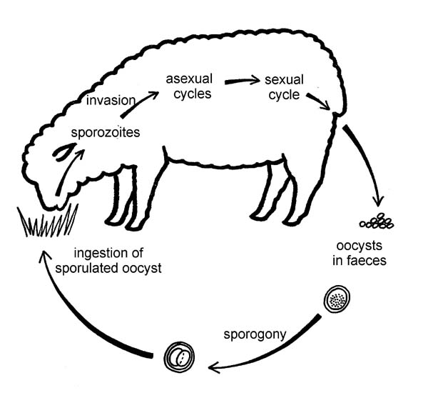
Coccidia (Eimeria spp.)
Single-cell protozoa
Species-specific
Not all species pathogenic
More complicated life cycle than roundworms.
Damages lining of small intestines, affecting nutrient absorption; damage can be permanent.
Causes diarrhea (not always), ill thrift, and death.

Slide 37
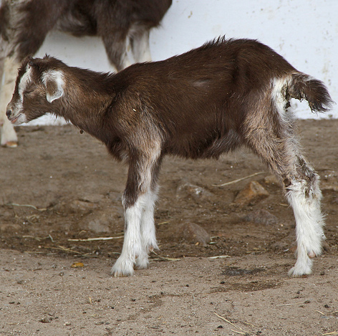
Coccidia (Eimeria spp.)
Prevent mostly with good management and sanitation.
Prevent with coccidiostats in water, mineral, feed, and/or milk replacer.
Lasalocid (Bovatec®) [sheep], toxic to horses
Monensin (Rumensin®) [goats], toxic to horses
Decoquinate (Deccox®) [sheep, goats]
Amprolium (Corid) [Rx]
Treat with Corid [Rx] or sulfa antibiotics [Rx]*
Sericea lespedeza pellets may provide “natural” control of coccidiosis.
http://www.wormx.info/Resources/Topics/SL-SS.html

Slide 38
End - Integrated Parasite Management First Presentation, Part 1 Continued in Part 2

