Slide 1
Small Ruminant Production

Slide 2
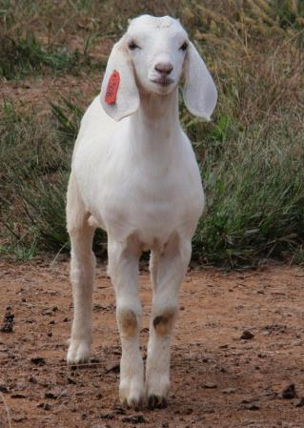
Session 1 Activity Breed and Breeding Stock Selection
Dr. Niki Whitley
Animal Science Extension Specialist
Fort Valley State University
Photos: Susan Shoenian, Baalands farm and Dr. Niki Whitley

Slide 3
Given the following information, give the answer in the form of a question.
1. This four-letter word is used to describe animals that are removed from the breeding herd because they do not meet production or performance guidelines (including milk/fiber production). Also used as a verb for the act of removing animals from the breeding herd….

Slide 4
Given the following information, give the answer in the form of a question.
2. This type of market will be needed for any species, breed or production system that you decide upon.

Slide 5
Given the following information, give the answer in the form of a question.
3. Simply put, you may increase this by decreasing your inputs or increasing your outputs.

Slide 6
Given the following information, give the answer in the form of a question.
4. In this production system, when selecting animals, performance and fitness traits are of primary importance with body conformation and fiber/wool less important.

Slide 7
Given the following information, give the answer in the form of a question.
5. Breeds of this overall type include Suffolk, Hampshire, Texel and Dorper sheep as well as Boer, Savanna and Kiko goats?

Slide 8
Given the following information, give the answer in the form of a question.
6. Body conformation is important in these two production systems.

Slide 9
Given the following information, give the answer in the form of a question.
7. Hair sheep breeds and Spanish and Kiko goats are generally considered to part of this overall breed type because they do well in number of offspring born/raised and have good fitness traits

Slide 10
Given the following information, give the answer in the form of a question.
8. This type of breeding takes advantage of using different breeds to help meet farm goals and satisfy a market; it is choosing traits from the different breeds you will use such as growth and carcass from a terminal sire breed and mothering traits from a maternal breed for improved offspring.

Slide 11
Given the following information, give the answer in the form of a question.
9. This 2-word process is vital for selection of animals to keep for breeding AND for marketing your animals for breeding; examples include number born and raised, birth weight, weaning/post-weaning weights, number of times dewormed, fecal egg counts and others.

Slide 12
Given the following information, give the answer in the form of a question.
10. When we conduct this for animals we are selecting on other farms or our own, we want to evaluate health status, if masculine or feminine, udders, teats and testicles, teeth, legs and overall conformation.

Slide 13
Optional Selection Activity

Slide 14
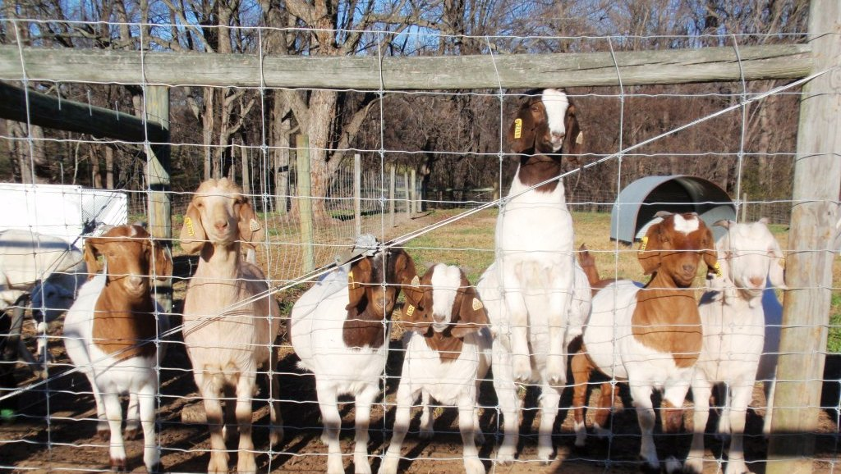
Selection
Which young Spanish buck would you buy?
Which yearling doe would you buy?

Slide 15
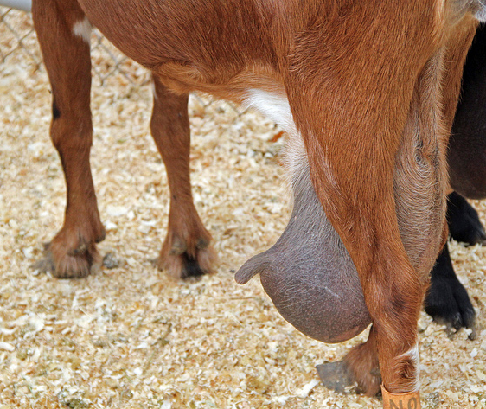
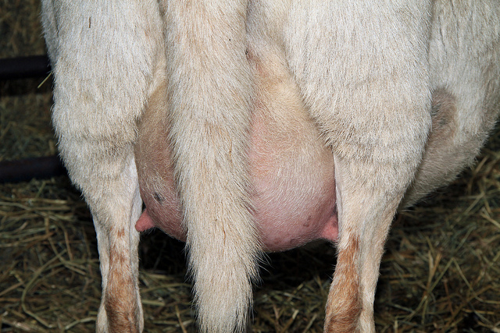
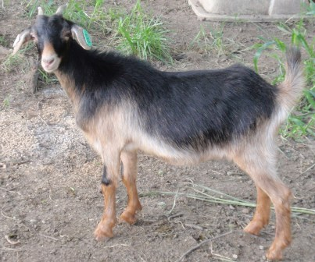
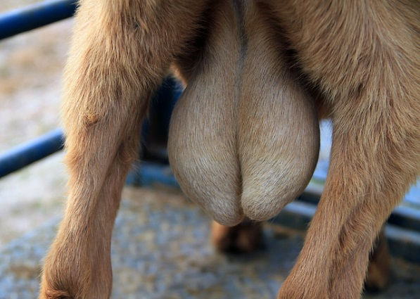
Selection
After records and health status are all deemed satisfactory…...keep/buy or cull/do not buy for breeding stock?
A
B
C
Lactating females – doe and ewe (both nursing twin offspring)
Young ewe lamb
D
E
Yearling doe
Young male

Slide 16
Selection
After records and health status are all deemed satisfactory…...keep/buy or cull/do not buy for breeding stock?
A-Bad
B-Good
C -
Overall nice lamb; may not have perfect leg conformation, but with good records, a good choice
D-Not good
E - Bad
Yearling doe
Young male – Split scrotum

Slide 17
This material is based upon work that is supported by the National Institute of Food and Agriculture, U.S. Department of Agriculture, under award number 2015-70017-22861.
Beginning Farmer and Rancher
Development Program
Developing the Next Generation
of Sustainable Farmers in Georgia Grant

