Slide 1




Small Ruminant Production

Slide 2
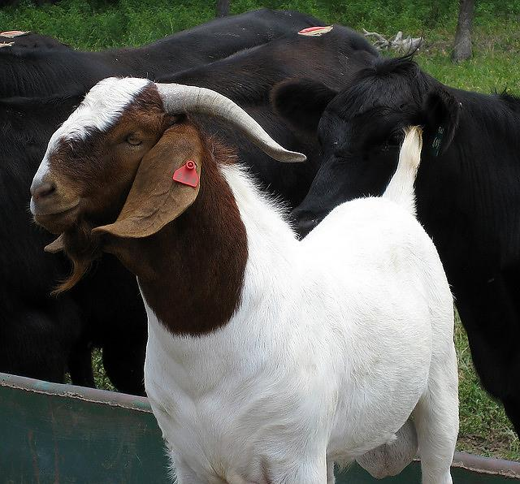

Session 5
Meats
Alex Stelzleni, PhD
University of Georgia
Meat Science Technology Center

Slide 3
Learning Objectives
Understand the difference between live weight, hanging weight (hot carcass weight) and retail yield
Describe how animal age, sex, and management practices affect meat quality

Slide 4
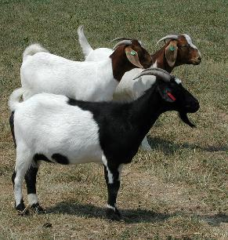
Why is Small Ruminant Production Important?
Growing US minority populations that consume lamb/goat on a regular basis
  US = 34% minority population
  44% of population for individuals under 18 yrs
  47% of population for individuals under 5 yrs
As long as traditional dietary habits continue, consumption should increase
  May be restricted to certain times of the year
Photo: Susan Schoenian, Baalands Farm
Runge, AU; US Census

Slide 5
The Meat of the Matter
Producers have the opportunity to market live animals for meat or to market meat directly to consumers!

Slide 6
Important Considerations
Hot Carcass Weight (HCW) and Dressing Percentage (DP)
  HCW gives starting weight for sale value
  DP = (HCW/LW) x 100
    How much carcass (meat) was in the live animal
    Considerations – gut fill, age, amount of hair/wool
Retail vs. Total Yield
  If selling cuts important to know along with production cost to figure break even (BE) and % profit
  RY = (Retail cut wt/carcass wt) x 100
  TY = (Retail cut wt/Live wt) x 100
Typical Carcass Characteristics/Considerations

Slide 7
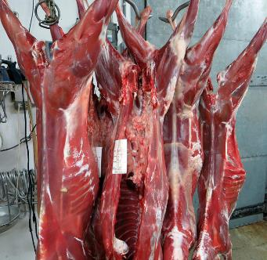
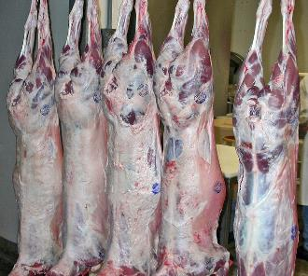
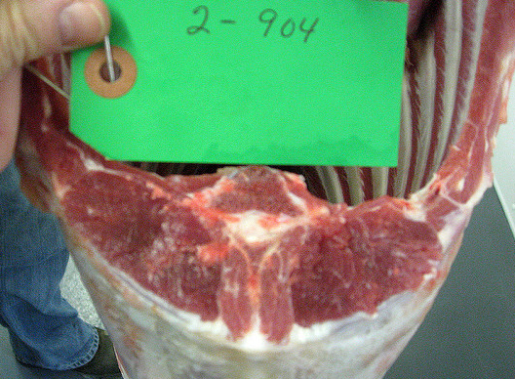
Carcass Characteristics
Dressing %
  Lamb and goats, 45-55%
Fat Cover
  Minimal - lambs have more
  0.1-0.3”
Carcass wt
  <50#, depends on time
  Can lose 5-8% wt overnight
Loin/rib eye area
  Goat 1-3 inches²
  Lamb 2-4.5 inches²
Lamb left, Goat right
Photos: Susan Schoenian

Slide 8
So once we harvest them, what?
Dr. McMillin at LSU developed a grading standard for goats which is used by some sale barns
Loveday, UT

Slide 9
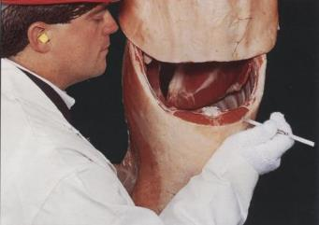
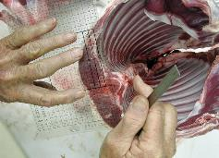
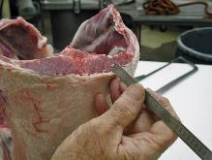
Lambs
Yield Grade
  0.4+(10*12th rib fat) %BCTRC
Yield Grade | Expected Yield
Yield Grade 1 | 47.4 % or more
Yield Grade 2 | 47.2 – 45.6%
Yield Grade 3 | 45.4 – 43.8%
Yield Grade 4 | 43.6 – 42.0%
Yield Grade 5 | 41.8 % and less
Bottom two photos: Susan Schoenian

Slide 10
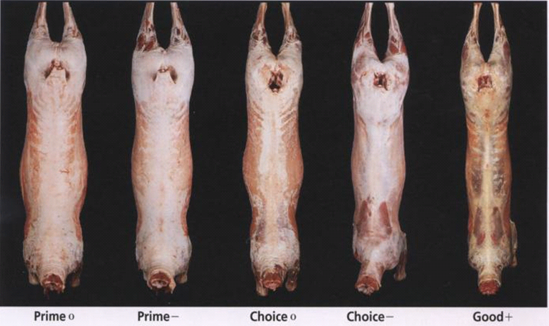
Lamb Quality Grade
To segregate lamb carcasses into palatability groups based on the expected eating quality of the cooked retail cuts from the lamb carcass
What to look for
  Carcass conformation
  Maturity (lamb worth more $
  than mutton)
  Fat deposition (Flank)
  Fat and lean firmness

Slide 11
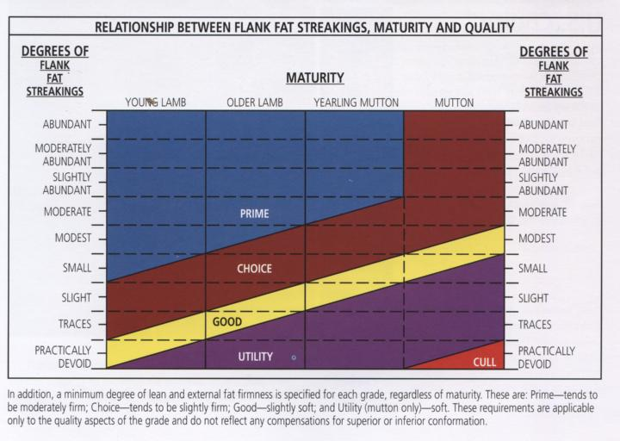
Putting it all Together

Slide 12
Goat Suggested Grades
Used by some sale barns (with graded sales), can find them at:
www.ams.usda.gov/market-news/goat-reports

Slide 13
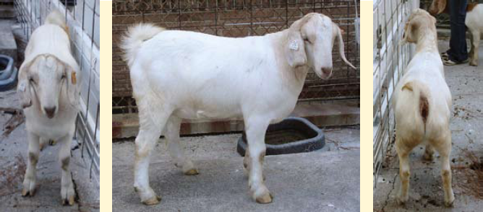
Selection 1 Market Kids
Live goats have a superior meat type conformation; Thickly muscled throughout the body as indicated by
  Bulging outside legs
  Full (rounded) back strip
  Moderately thick outside shoulder
Loveday, UT

Slide 14
Selection 2 Market Kids
Live goats have a average meat type conformation; Moderately muscled throughout the body as indicated by a
  Slightly thick outside legs
  Slightly full (rounded) back strip
  Slightly thick to slightly thin outside shoulder
Loveday, UT

Slide 15
Selection 3 Market Kids
Live goats have an inferior meat type conformation; Thinly muscled throughout the body as indicated by
  Legs, back and shoulders are narrow
  Body has angular, sunken appearance
Loveday, UT

Slide 16
Comparison of Live Goat
Selection Grades
1
2
3
Loveday, UT

Slide 17
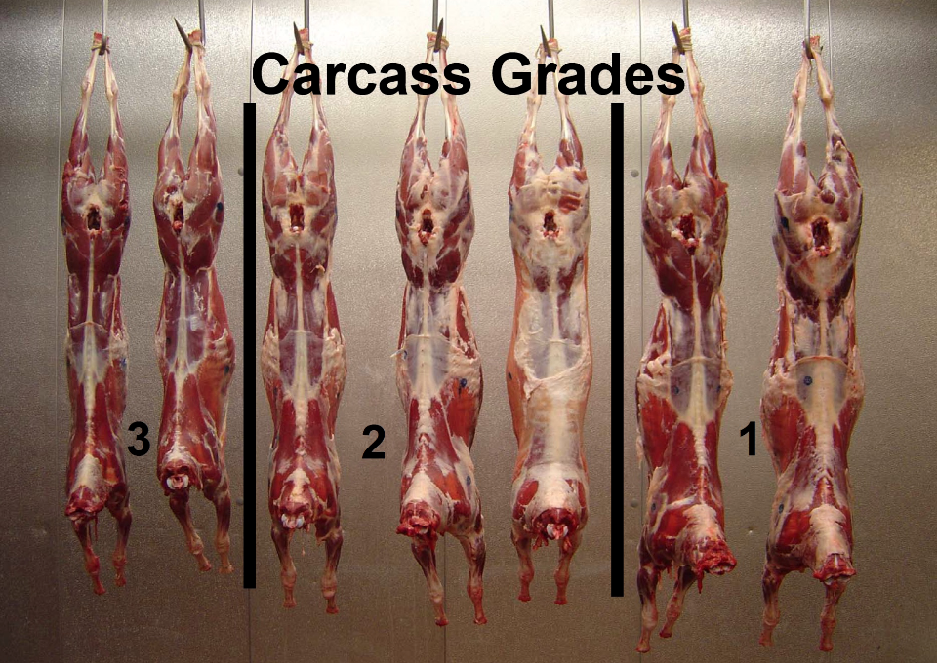
Carcass Grades
3
2
1
Rentfrow, UK

Slide 18
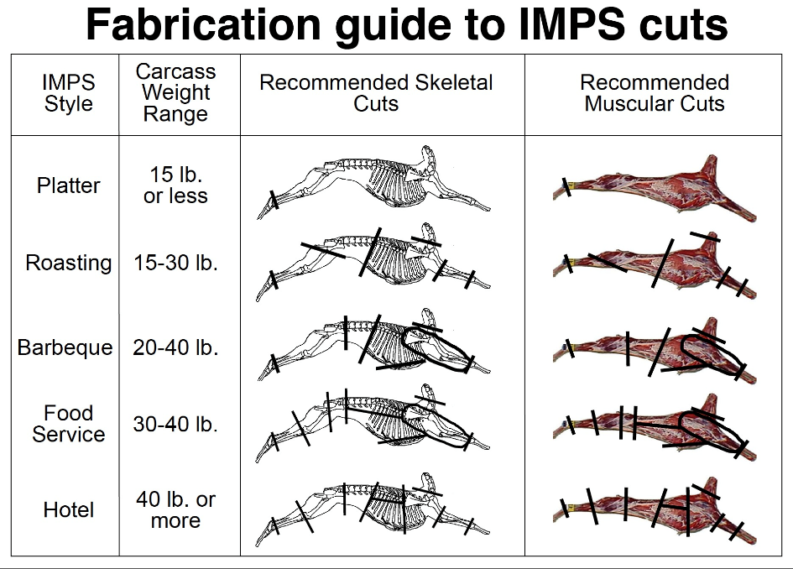

Slide 19
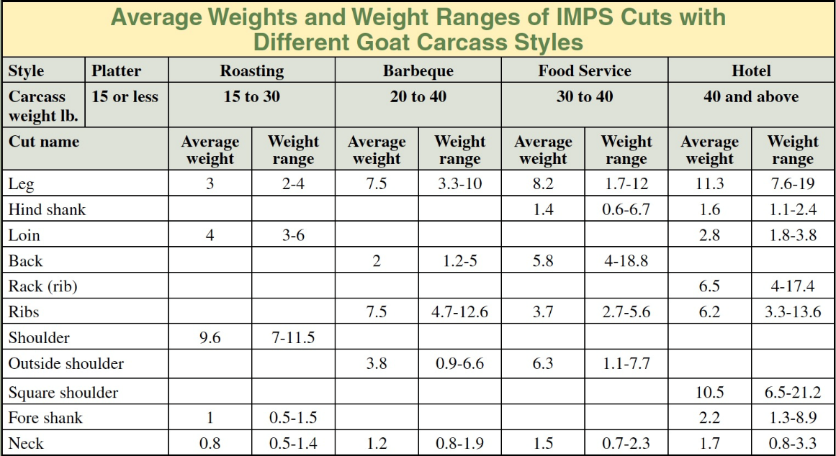
McMillin, LSU

Slide 20
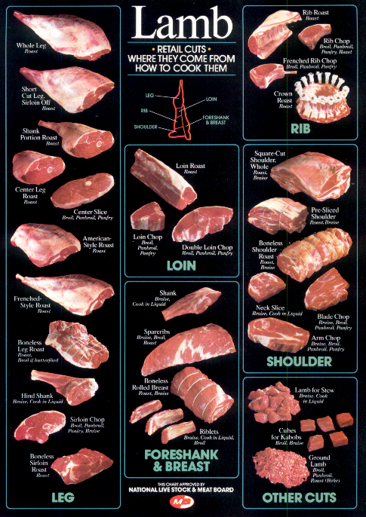
Talk to your processor; not all will process sheep/goats and if they do, they may not be able to create all the cuts you see here.

Slide 21
% Wholesale Cuts for Lamb and Goat
Primal | Lamb | Goat
Leg | 32 | 32
Loin | 12 | 8
Rack | 14 | 8
Shoulder | 24 | 35
Shank | 4 | 7
Breast | 8 | 9
X Fat | 3 | 1
Adapted from Aaron Renfroe, TX AgriLife

Slide 22
General impacts on meat quality
Age
  Increases yield (muscle) to a point, then fat increases (as long as + nutrition)
  Meat tenderness decreases with age
Sex
  Intact males are leaner (have less fat) and can have tougher meat but may have more muscling/meat than castrated males or females
  Goat males have a very strong musky smell than can impact meat taste; some consumers are turned off by this (especially Americans)
Management
  Animals raised primarily on grass usually have less fat than those fed grain-based feeds (at the same age)
  Stress can decrease meat tenderness, impact flavor, color, and WHC

Slide 23
Additional Resources
Goats
www2.ca.uky.edu/agc/pubs/asc/asc179/asc179.pdf
www.sheepandgoat.com/#!meat-goat-carcass-evaluation/ce9c
Sheep
www.sheep101.info/201/lambmarketing.html
www.sustainagga.org/documents/didthelockerstealmymeat.pdf
Both
sheepgoatmarketing.info/education/dressingpercentages.php

Slide 24



This material is based upon work that is supported by the National Institute of Food and Agriculture, U.S. Department of Agriculture, under award number 2015-70017-22861.
Beginning Farmer and Rancher
Development Program
Developing the Next Generation
of Sustainable Farmers in Georgia Grant

