Slide 1
Small Ruminant Production

Slide 2
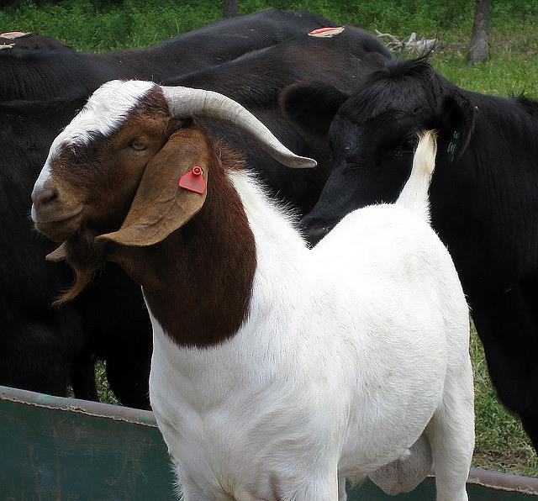
Session 5 Marketing
Alex Stelzleni, PhD
University of Georgia
Meat Science Technology Center
Most photos/some slides: Susan Schoenian, University of Maryland and Baalands Farm

Slide 3
Learning Objectives
Identify different markets for live animals.
Understand the requirements for marketing meat products in Georgia.

Slide 4
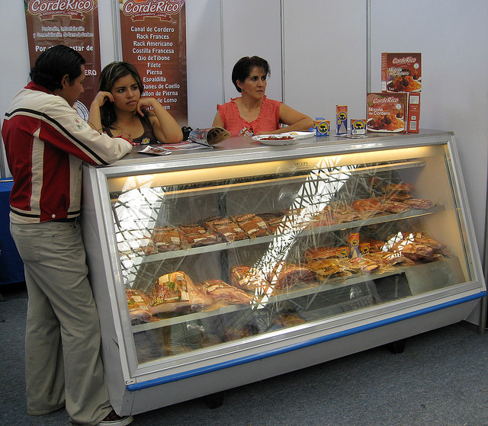
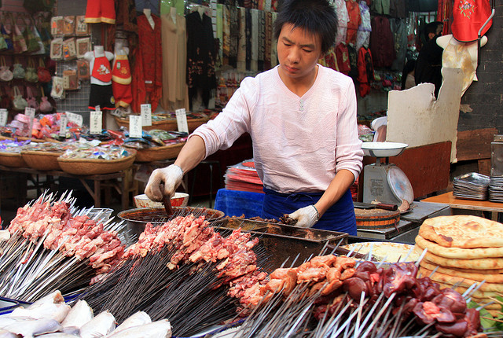
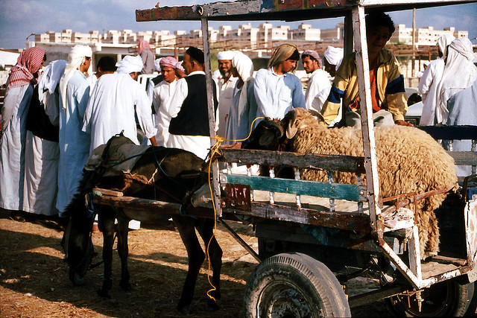
Lamb(mutton) / Goat Meat Consumption
Purchasers are usually ethnic
~60% Muslim, Latino/Hispanic, Asian, Caribbean, Italian, Greek, Eastern European
Different ethnic groups have preference for different types of meat
Age, Sex, Cut, Preparation
May desire Halal or Kosher slaughter
Runge, AU
Photos: Susan Schoenian, Baalands Farm

Slide 5
Major Goat Consumption Holidays
Jones and Raper, OSU
Many ethnicities traditionally consumed goat, but have switched to lamb due to availability, price, assimilation, and other factors

Slide 6
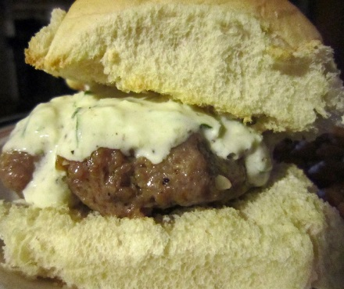
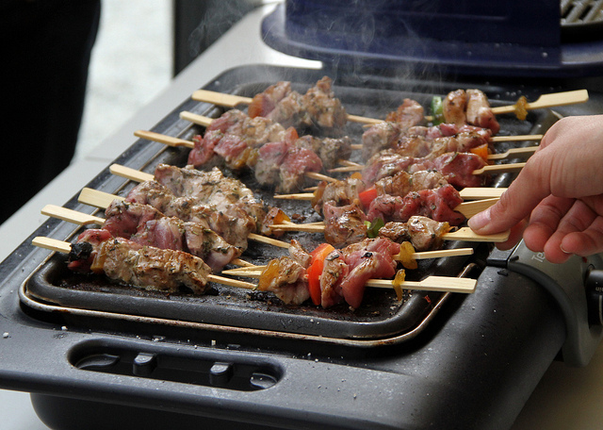
Consumption
Consumers of goat (chevon/cabrito) or lamb also purchase it for many other celebrations:
Christmas
Thanksgiving
Birthdays
Weddings
Family reunions
Others
Superbowl/Game day parties
Coming of age parties
More

Slide 7
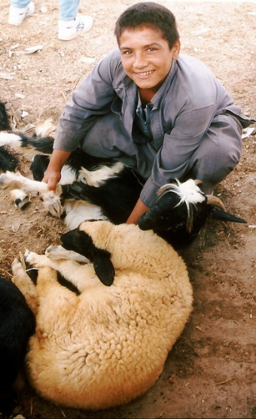
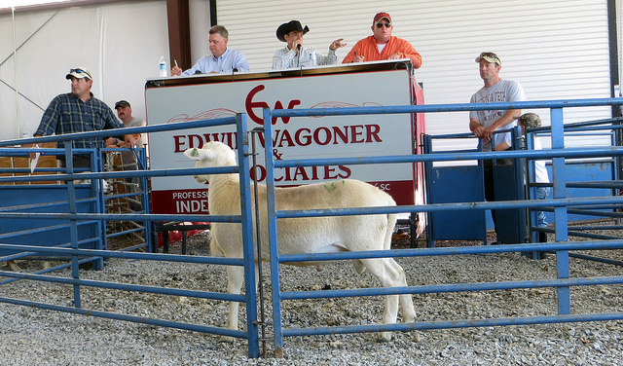
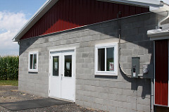
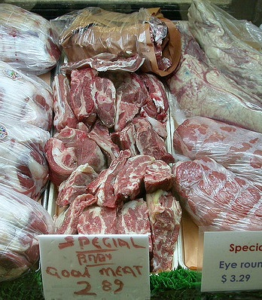
Marketing opportunities
Can take advantage of these times of high consumer demand through marketing:
Sales at livestock auction/sale barns
Sales to a harvest/processing facility or other middlemen
Farm gate (on-farm) sales of live animals directly to consumers
Sales of meat or value added products

Slide 8
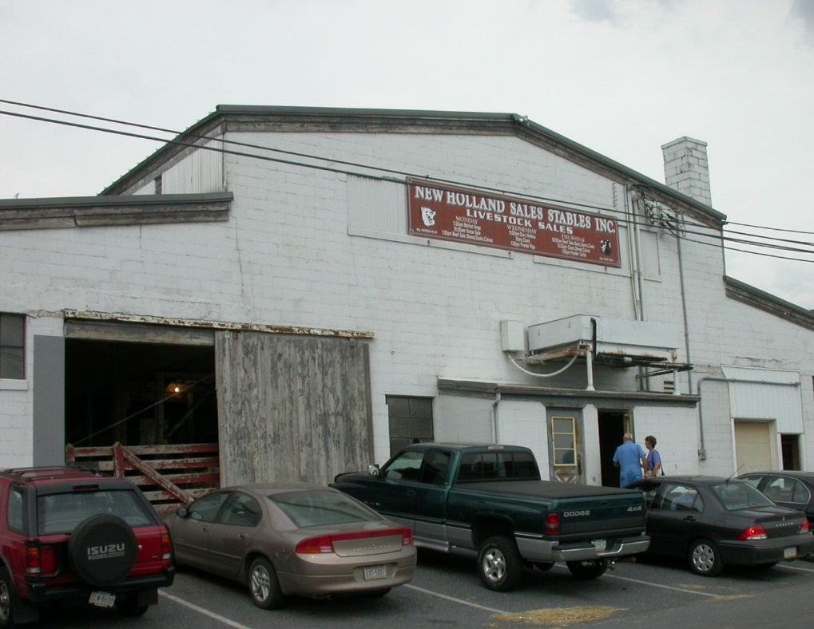
Marketing animals through a sale barn (also called auction or stockyard)
Not all auctions are equal - consider ones who are experienced with goats/sheep; graded sales usually better.
Local
Terminal
Weekly
Special
Graded
Sponsored

Slide 9
Sale barn Pros/Cons
PROS
CONS
Place of price discovery
Price competition (usually)
Prompt, guaranteed payment (P&S Act)
Unbiased grading (usually)
Animals are weighed and weights are certified.
Easy
Convenient
Low labor
You are a price taker
Prices not known ahead of time
Price volatility
Selling fees can be substantial (commission, insurance, yardage, feed), especially for lighter lambs.
Stressful to livestock
Transportation costs
Shrink

Slide 10
Tips for sale barn (ethnic) marketing
Sell livestock prior to major ethnic holidays, at least one week ahead of time.
Do not castrate males, unless necessary.
Do not dock lamb tails, unless necessary.
Do not sell dirty animals with soiled hocks and hindquarters.
Consider shearing animals that are neither too fat nor too thin.
When selling suckling lambs/kids, sell them directly off their dams.
Mark your animals according to how you want them sold.
Do not bring your animals to the sale barn at the last minute.
Make sure your animals have feed and water.
Call the market manager ahead of time. Get to know manager(s).
Sit through auctions. Get to know buyers.
Consider selling when reported prices are low.
Consider breeding out-of-season.
Pay attention to body condition. Don’t sell culls that are too fat or too thin.
Sell to the auction that offers you the most profit – not necessarily the
highest price.

Slide 11
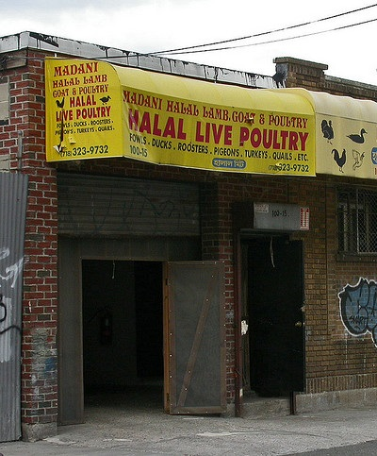
Abattoir/processor or other middlemen
Abattoir/processor
Order buyer/brokers
Ethnic Stores
Cooperatives
Other producers
Breeding stock, records needed, pedigrees?
There are buyers in Georgia willing to come to you farm to pick up groups of sheep and goats (usually lots of 40+ animals). The abattoirs/processors buying animals are generally near big cities.

Slide 12
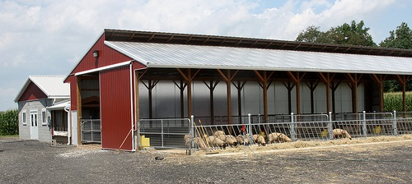
Abattoir/middlemen Pros/Cons
PROS
CONS
Opportunity to negotiate
Price
Shrink
Delivery
Contract
Price known ahead of time
Low cost method
No selling fees
No processing costs
Low labor
Payment risk [sell to bonded/licensed dealers; require cash payment]
May not always be the highest price offered; middleman needs to make a profit
May not always be buying

Slide 13
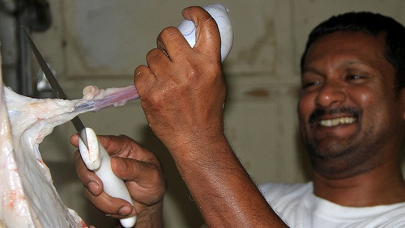
Farm Gate (direct marketing live animals)
Different options
Cash-and-carry
Custom slaughter Mobile slaughter
On-farm slaughter (where legal)

Slide 14
Farm Gate Pros/Cons
CONS
PROS
Payment risk
Someone has to be on the farm to sell, risk of no-shows
Language and cultural barriers
Buyer may lack suitable transportation
You may not know where and how animal is slaughtered
On-farm slaughter
Not legal in most states, need a place to harvest and for offal disposal
Comfort (not for everyone)
Set your own price
No selling fees
Commission
Yardage
Insurance
Feed
No processing or transportation costs
Less stress to animal (?)
Low labor

Slide 15
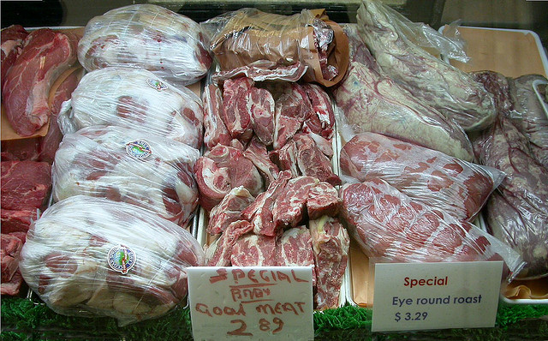
Sales of Meat/Products
Direct to consumer
Farmers markets
Fees, insurance
Waiting list?
Farm store/off farm
Retail stores
Grocery stores
Require liability insurance; may require certifications (i.e. Whole Foods)
Want consistent quality and high quantity year round
Butchers
Restaurants
Want consistent quality and quantity year round

Slide 16
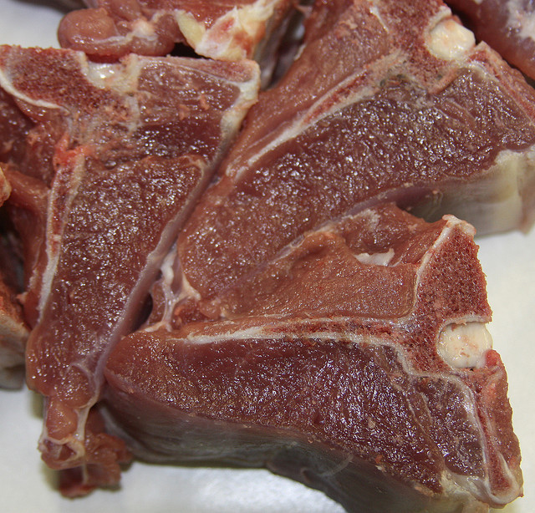
Sales of Meat/Products
PROS
CONS
Set your own prices; opportunity for higher net price/animal
No live animal/sale barn type fees
Can tell your farm story/interact directly with consumers
Finding abattoir/processor who will process small ruminants in the manner/cuts desired
Cost of processing
Transportation costs for animals and products
High labor
Requires a marketing personality to interact directly with consumers
Costs may be associated with sales:
Farmer’s market fees
Storage locker fees
Labeling costs
Audit fees for some certifications/labels
Sales tax collection (?)
Fees to take credit cards (?)

Slide 17
General Marketing Tips
Keep or sell the best (top 10-20%) for breeding stock and sell the rest for consumption
Sell animals/products for a profit – know your cost of production
If cost of production (and marketing) is $125/female/year and your females provide only 1 marketable offspring per year, your break-even price, the minimum price you need to get, is $125 for that kid or lamb.
Divide that price by two if they provide you with 2 marketable offspring per year ($75 per kid or lamb).
Sell for highest “net” price; consider all marketing costs (i.e. fees, transportation) when choosing best option(s)

Slide 18
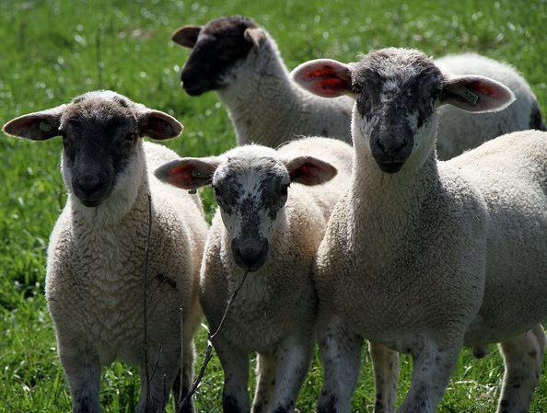
General Marketing Tips
Have a plan for marketing your animals (more than one market?) and schedule breeding for marketing opportunities
Follow Scrapie Program requirements (free tags/tagger; keep purchase/sales records): www.eradicatescrapie.org
For sheep, follow rules for the Lamb Checkoff (mandatory fees assessed to seller and first handler): http://lambresourcecenter.com/lamb-checkoff/who-we-are
If marketing meat/products, follow state/federal rules and regulations

Slide 19
Rules and Regulations for Selling Red Meat in GA

Slide 20
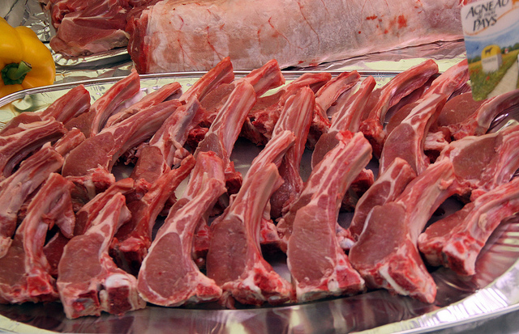
Can I Sell Meat from My Animals?
It Depends
Farmers Exemption, Custom Processing, Inspected, Retail Exempt – Mobile vs Fixed
Part of Federal MIA
Enforced by USDA and GDA (local municipality)
Laws as we understand them and told to us as a Processing Plant and discussions with inspectors
Before doing anything questionable be sure to ask GDA!!!

Slide 21
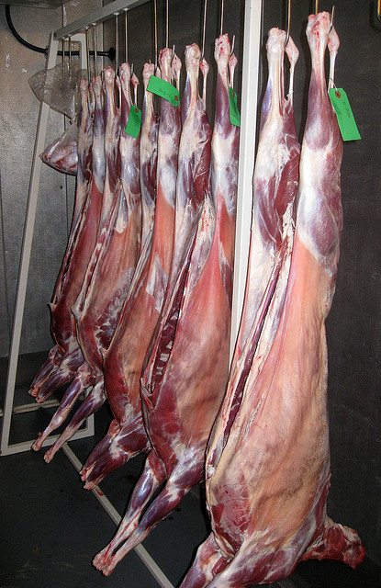
Types of Plants
Custom Processor – “Cut and Wrap”
Kill, cut, wrap for individual use
MUST be marked NOT FOR SALE on each package
Meat CAN NOT be sold, donated, traded, bartered
Animal owner (end user) pays for kill, processing, storage
Oversight from GDA and USDA for records and sanitation
Keeps legal records (names, addresses, pounds)

Slide 22
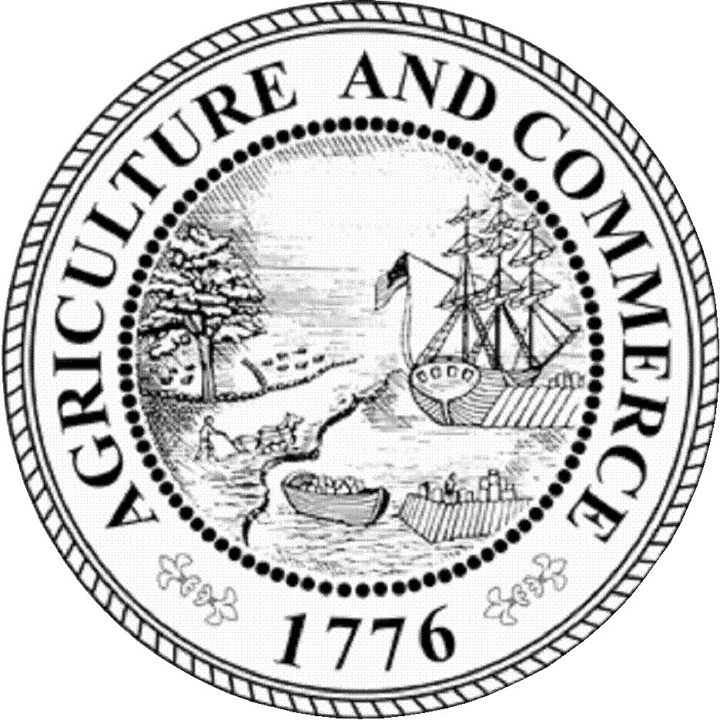
Types of Plants
State Inspected – GDA, Meat can be sold within state lines
Federally Inspected (TA) – By USDA or GDA on behalf of USDA, Meat can be sold in US
But, need other permits, licenses, approvals to sell
Under continuous inspection
Owner pays for services and takes meat back for sale (see permits etc. above)
Meat must be inspected for direct sale!!!!
Plant has high risk potential
agr.georgia.gov
Georgia Department of Agriculture has a list with contact information for all inspected (Custom, State and Federal) facilities in Georgia available upon request. Also, there is a searchable Federally inspected facility directory at: www.fsis.usda.gov/wps/portal/fsis/topics/inspection/mpi-directory

Slide 23
Farmer’s Exemption
Part of Custom Exemption (Curtis Amendment)
For the farmer, family, non-paying guests ONLY
Farmer may kill and haul to Custom plant for processing
Can do alone if know how (not recommended)
Must declare animal was ambulatory (Scrapie, TSE, BSE)
May take live animal to Custom plant and have killed, processed
Must be for personal use only
Plant must keep records, who, how much, how often, animal age

Slide 24
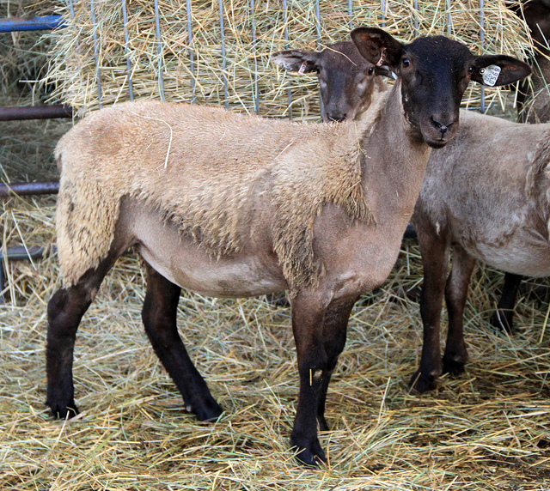
Custom Exempt
Producer sells LIVE animal to someone else
May deliver to slaughter for new owner (no charge)
New owner contacts plant
Fills cut sheet, pays for kill, processing, picks up
Old owner can deliver product as a favor, no charging
Can’t kill then sell sides, quarters … Must sell live animal. Separate transaction for animal vs kill and processing

Slide 25
Custom Exempt
Others
Producer can sell portions of LIVE ANIMAL, issues with cuts and plant abilities, 2 vs 10 owners
Plant keeps records of old owner, new owner(s)
If 1 person brings and takes 1 animal/week that is way above personal consumption levels
Animal age (cattle, BSE), must be ambulatory
Producer cannot sell animal, then kill and cut for another person…operating as processor
Ga State Law 26.2.209 prohibits letting others (new owner) from killing and cutting on your land!!!

Slide 26
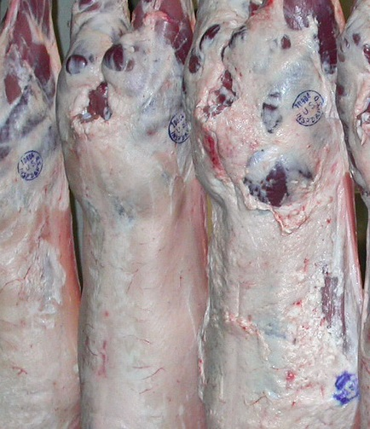
Inspected
As producer you can retain ownership
Gives privilege of selling meat and cuts…If you meet other requirements
Facilities, Licenses, Permits, Labels
Must work with processor on cutting and packaging
Must work with processor and USDA/GDA on Label
Does not mean you can:
Put in trunk of car and sell in mall parking lot or sell out of barn, basement, garage

Slide 27
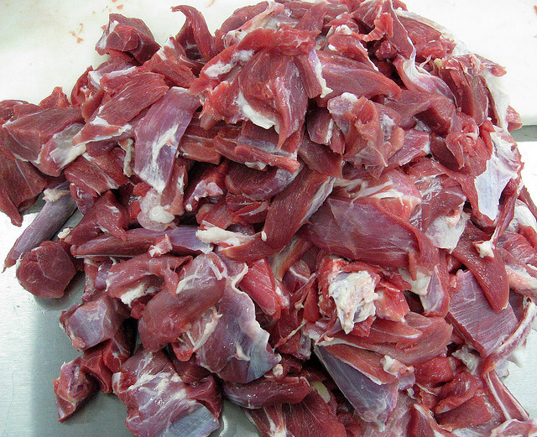
How to have it cut?
Farmers Exemption
However you want, or however the Custom plant you use does it
Custom Exempt
As a producer it is out of your hands, you already sold the animal
Inspected
Will vary from plant to plant, must do homework
Specialty and new cuts may be desired for ethnic markets, but odds of getting are slight

Slide 28
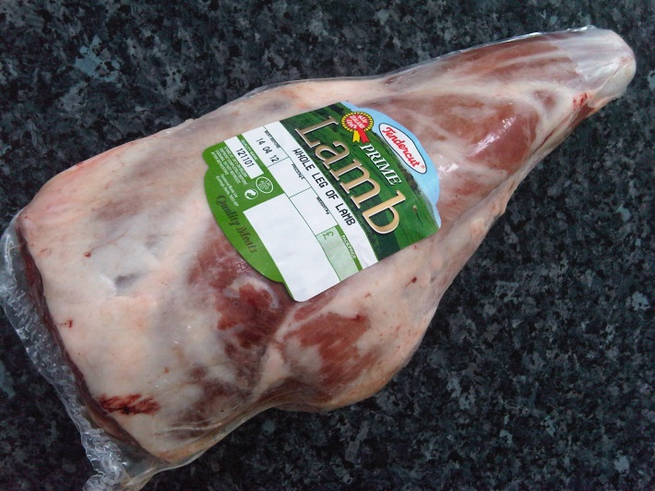
Labeling
Custom
No Claims, Generic plant label, Not For Sale
Inspected
Must work with Plant, may not be willing to put special label on product
Must be approved by USDA/GDA
Must follow Federal Labeling Guidelines
All claims must be verified process controlled
Label still has plant address and inspection number (why some are iffy about doing this)
Label belongs to plant not you
www.tendercutmeats.co.uk
For labeling guidelines - www.fsis.usda.gov

Slide 29
How to sell cuts?
Mobile License (Delivery to end user)
Farmers markets, parking lots, delivery to Hotel/Restaurant GDA annual basis, $100 GA 40-7-5
Fixed Location
Georgia Food Safety Divisions Licensing GA 40-7-1-19
Further Processing – cutting, bacon, sausage
If fixed location, inspected product, end user only
$ Volume and % of total sales (cure/cook MUST be inspected if for use other than household consumer no matter what)
75% end user, 25% or less wholesale &/or less than $76,900
If mobile – must be made at inspected facility

Slide 30
Straight from USDA via our GDA Inspector
FSIS' policy regarding whether the preparation of meat products for sale to other than household consumers by a retail store is exempt from inspection is based on what operation is employed in preparing the product, and where that operation falls under 9 CFR 303.1 (d) (2) (iii) (f). If the retail store engages in the operations of cutting up, slicing, and trimming of carcasses, halves, quarters, or wholesale cuts into retail cuts such as steaks, chops, and roasts, and freezing such cuts; grinding and freezing products made from meat; breaking bulk shipments of products; or wrapping or rewrapping such products in the preparation of retail products for sale to other household consumers, it would be exempt from inspection. 9 CFR 303.1 (d) (2) (iii) (f). The retail store would also have to make no more than 25% of its sales to other than household consumers, and its sales to other than household consumers could not exceed the dollar limits on such sales that FSIS establishes. 9 CFR 303.1 (d) (2) (iii) (b).
If a retail store cures, cooks, renders, refines livestock fat, or engages in other operations to prepare products for other than household consumers, then those operations are subject to inspection, regardless of the percent of its sales that are to other than household consumers or of the dollar amount of those sales. 9 CFR 303.1 (d) (2) (iii) (f).

Slide 31
Final Considerations
These are the laws as we understand them
There are a ton of ‘grey areas’
Be sure to follow due diligence before starting
Contact GDA – Inspection and Food Safety - with any questions BEFORE doing anything
Keep and handle as though your young child was eating it, consumer comes first; it only takes one outbreak to shut the system down
Follow the laws at all times, the consequences are real
Strongly consider liability insurance!

Slide 32
Additional Resources
GA Dept of Agriculture (GDA)
www.agr.georgia.gov
USDA – Food Safety Inspection Service
www.fsis.usda.gov
Inspection Law GDA
www.agr.georgia.gov/meat-inspection.aspx
Food Safety (Licenses and laws for sales) GDA
www.agr.georgia.gov/foodsafety.aspx
Marketing webinars:
www.sheepandgoat.com/#!webinars/cu81

Slide 33
This material is based upon work that is supported by the National Institute of Food and Agriculture, U.S. Department of Agriculture, under award number 2015-70017-22861.
Beginning Farmer and Rancher
Development Program
Developing the Next Generation
of Sustainable Farmers in Georgia Grant

