Slide 1
Small Ruminant Production

Slide 2
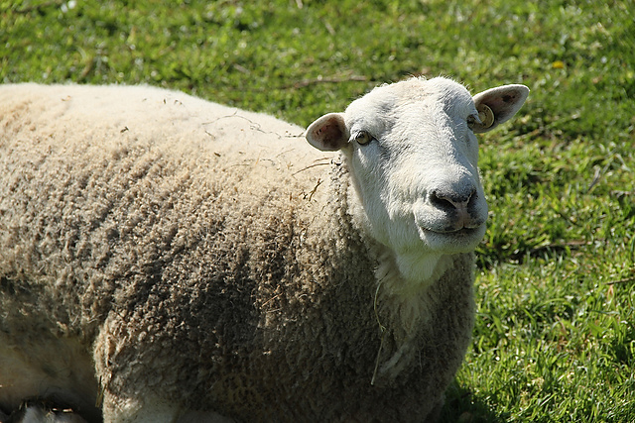
Session 5 Body Condition Scoring
Dr. Niki Whitley
Animal Science Extension Specialist
Fort Valley State University

Slide 3
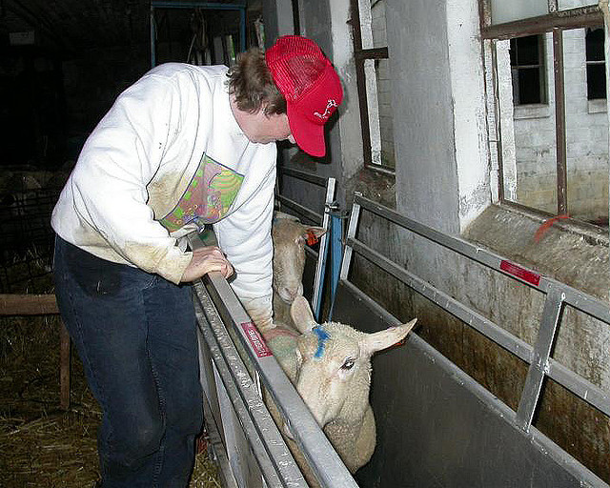
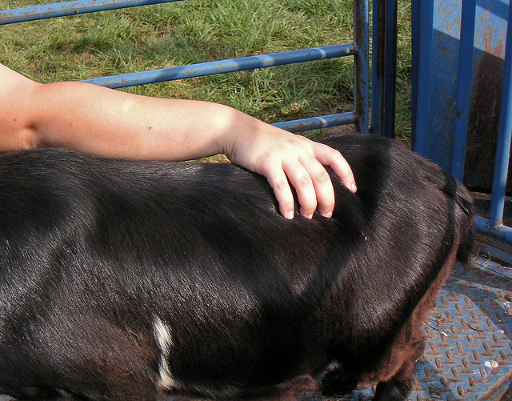
Learning Objectives
Be able to body condition score goats and sheep
Photos courtesy of Susan Schoenian, Baalands Farm

Slide 4
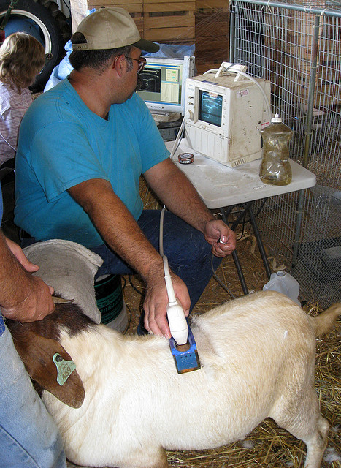
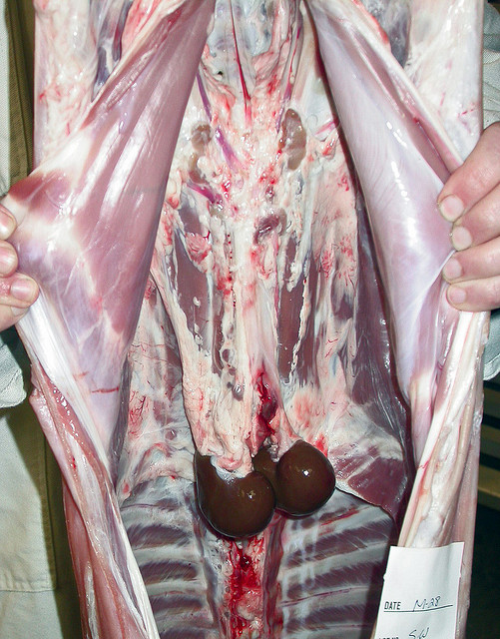
How fat?
Ultrasound
Carcass tests
Body Condition Scoring
Photos: Susan Schoenian, Baalands Farm

Slide 5
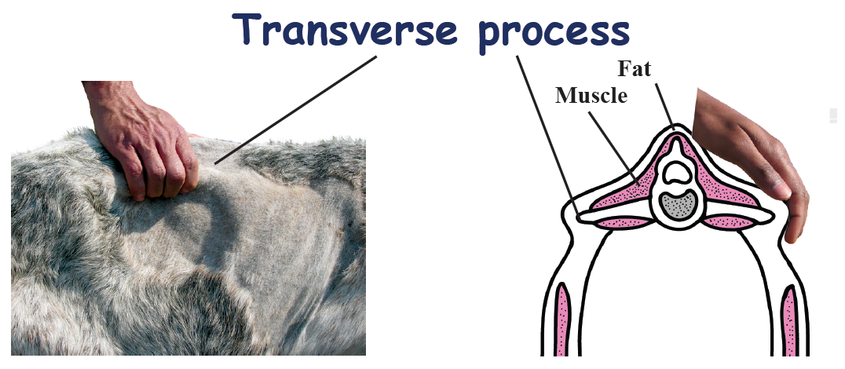
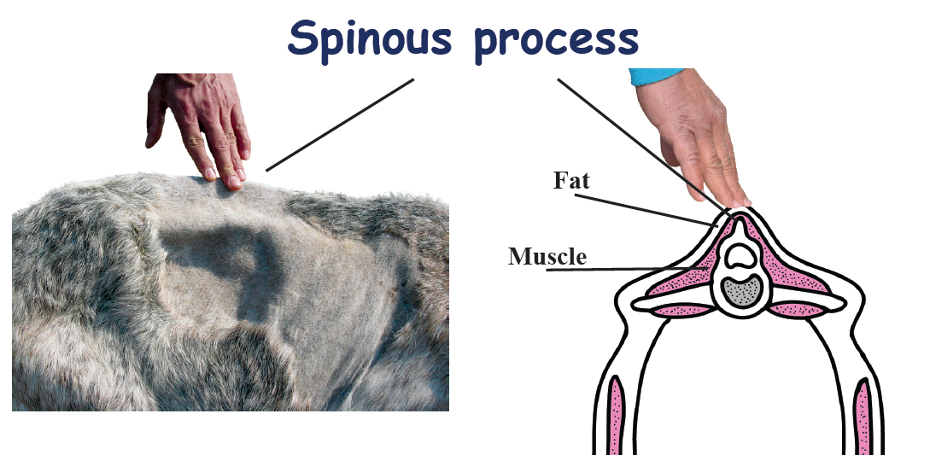
Body Condition Scoring (BCS)
Must get your hands on them
At least backbone and ribs
Goats – sternal fat
Ribs
www2.luresext.edu/goats/library/field/bcs07.pdf

Slide 6
Body Condition Scoring Overview
Score | Spinous process | Rib Cage | Loin
BCS 1 Emaciated (Very thin) | Easy to see and feel, sharp | Easy to feel each rib | Little muscle, no fat covering
BCS 2 Thin | Easy to feel, but smooth | Smooth, slightly rounded, can feel ribs with slight pressure | Has muscle, thin fat cover
BCS 3 Good Condition | Smooth and rounded | Smooth, even feel | Muscle is full, moderate fat cover
BCS 4 Fat | Can feel with firm pressure, no points felt | Individual ribs not felt, can feel indention between ribs | Muscle full, thick fat cover
BCS 5 Obese | Smooth, no points, may slightly dip in | Individual ribs not be felt. No separation of ribs felt | Muscle full, very thick fat covering
Adapted from a presentation by Scott Sell, Clemson University

Slide 7
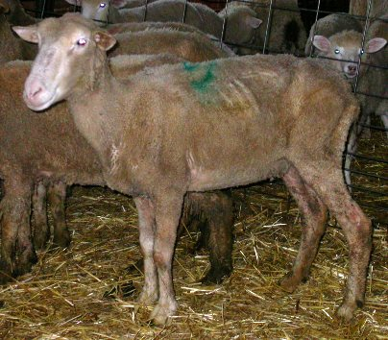
BCS 1 – Emaciated (very thin)
Very thin, weak animal; individual backbone points and ribs easy to see and feel; fingers fall into spaces between the ribs easily
Can easily grasp the top and sides of the spine; saw-tooth appearance of backbone; very little muscle and no fat felt along backbone, dip between top and side of backbone (over the loin)
Photo: Susan Schoenian, Baalands Farm

Slide 8
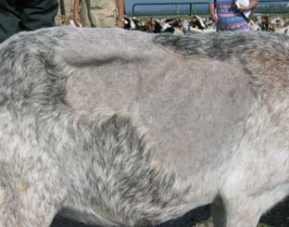
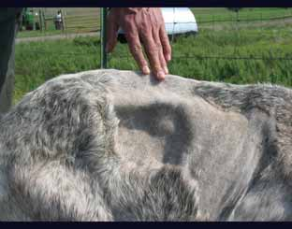
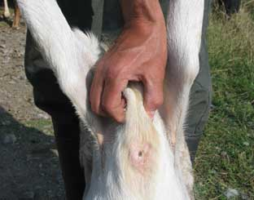
BCS 1
Sternal fat can be easily grasped between thumb and fingers and moved from side to side.
www2.luresext.edu/goats/research/BCS_factsheet.pdf

Slide 9
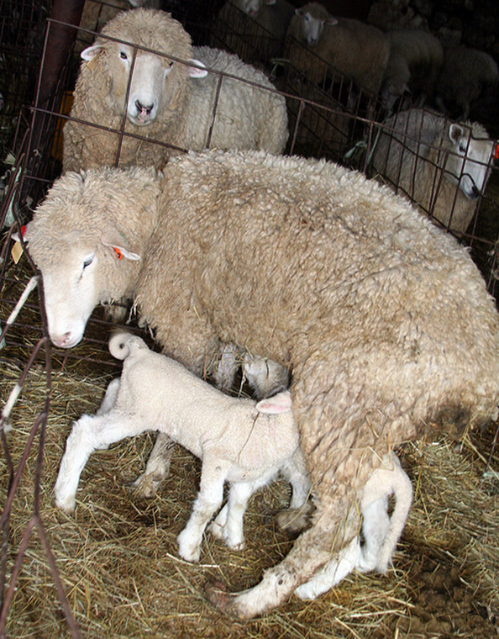
BCS 2 Description
Backbone is visible; some ribs can be seen/all can be felt and fingers can still go between ribs
Can grasp backbone between the thumb and forefinger and still grasp side of backbone but points on the side are harder to see; can feel some muscle, but still a depression over the loin (between top/side of backbone)
Photo: Susan Schoenian, Baalands Farm

Slide 10
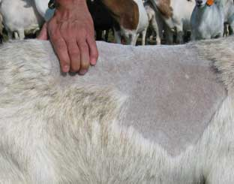
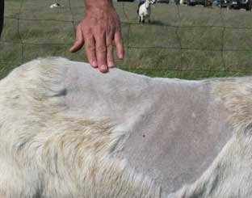
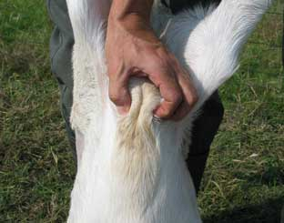
BCS 2
Sternal fat is wider and thicker but can still be grasped and lifted by the thumb and forefinger. The fat layer can still be moved slightly from side to side.
www2.luresext.edu/goats/research/BCS_factsheet.pdf

Slide 11
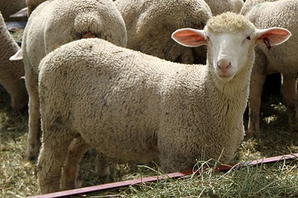
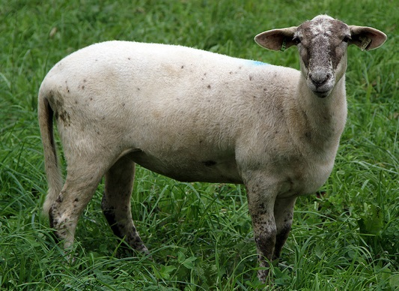
BCS 3
Backbone not sticking up but can feel a slight dip between points; can barely see ribs and have even layer of fat over then; space between the ribs felt with pressure
Side of backbone not easily grasped; smooth over the loin from the top to side of backbone; can barely see the outline of the side of the backbone
Photos: Susan Schoenian, Baalands Farm

Slide 12
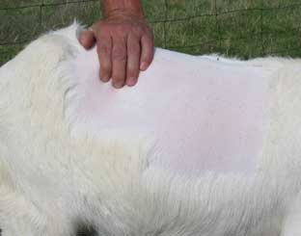
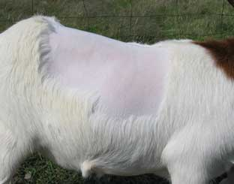
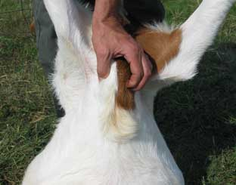
BCS 3
Sternal fat is wide and thick. It can still be grasped but has very little movement.
www2.luresext.edu/goats/research/BCS_factsheet.pdf

Slide 13
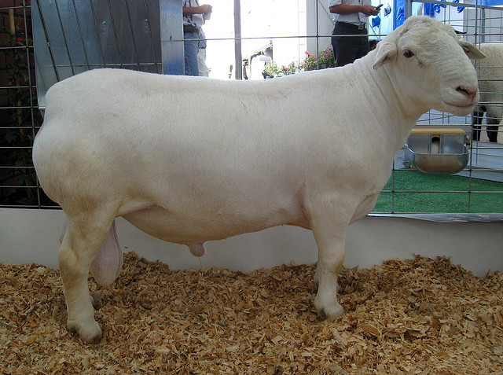
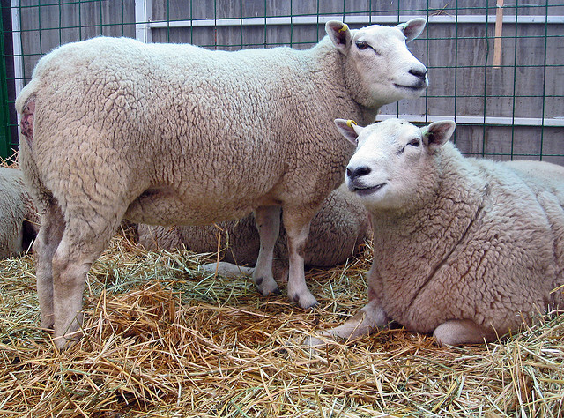
BCS 4
Backbone and ribs cannot be seen; cannot grasp the top of the backbone due to muscle and fat; loin is rounded; smooth sided
Cannot see outline of the side of the backbone; points of the side are smooth and rounded – not individual points felt; muscle and fat thick over loin
Photos: Susan Schoenian, Baalands Farm

Slide 14
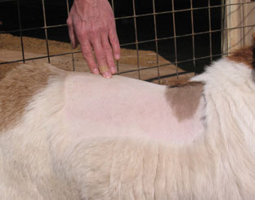
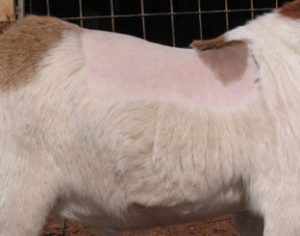
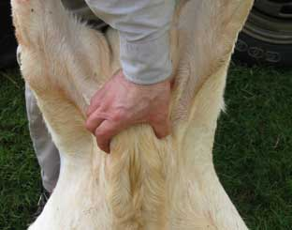
BCS 4
Sternal fat is difficult to grasp because of its width and depth. It cannot be moved from side to side.
www2.luresext.edu/goats/research/BCS_factsheet.pdf

Slide 15
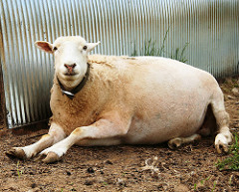
BCS 5
Backbone is buried in fat so cannot feel; ribs not visible or felt and covered with excessive fat
Thick muscle and fat over the loin, making a bulge so that there is a dip over the backbone; side of backbone cannot be found and is impossible to grasp
Photo: Susan Shoenian, Baalands Farm

Slide 16
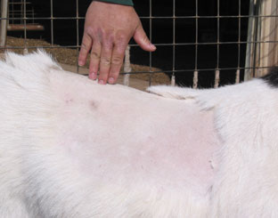
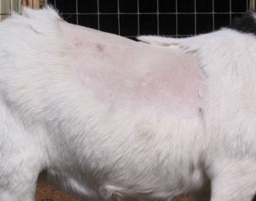
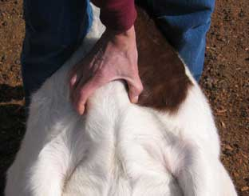
BCS 5
The sternal fat now extends and covers the sternum and cannot be grasped.
www2.luresext.edu/goats/research/BCS_factsheet.pdf

Slide 17
Goat Body Condition Scoring Review
Score
BCS 1 Emaciated (Very thin)
BCS 2 Thin
BCS 3 Good Condition
BCS 4 Fat
BCS 5 Obese
Stage of Production | Target Body Condition Score
Maintenance | No less than 2
Breeding | At least 3
Early Gestation | At least 3
Late Gestation | More than 3
Lambing/Kidding | 3.5
Weaning | No less than 2
Note: Goats fatten faster inside than outside where they are being scored, so some people feel that an extra half a score could be added; if dairy, some feel half to one score could be added (half for dairy sheep, one for dairy goats). Example: BCS 3 for a sheep may be a 3.5 for a goat or dairy sheep or a 4 for a dairy goat.

Slide 18
References and Additional Resources
Langston University:
www2.luresext.edu/goats/research/BCS_factsheet.pdf
www2.luresext.edu/goats/research/bcshowto.html
University of Arkansas Pine Bluff:
www.uaex.edu/publications/pdf/FSA-9610.pdf
eXtension.org:
www.extension.org/pages/19530/goat-body-condition-score#.VexiOBFVikp
BCS video (sheep): www.agric.wa.gov.au/management-reproduction/condition-scoring-sheep
Sheep 101:
www.sheep101.info/201/feedingewes.html

Slide 19
This material is based upon work that is supported by the National Institute of Food and Agriculture, U.S. Department of Agriculture, under award number 2015-70017-22861.
Beginning Farmer and Rancher
Development Program
Developing the Next Generation
of Sustainable Farmers in Georgia Grant

