Slide 1
Small Ruminant Production

Slide 2
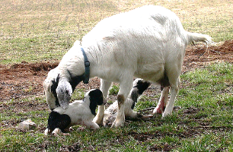
Session 3 Sheep and Goat Lambing and Kidding Management
Kevin Pelzer, DVM
Professor, Production Management Medicine/Epidemiology
Virginia-Maryland College of Veterinary Medicine

Slide 3
Learning Objective
Understand best management practices for lambing or kidding

Slide 4
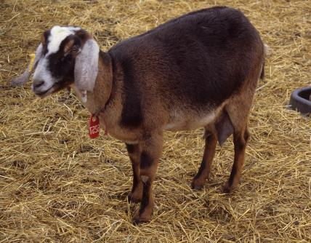
Prepartum Activities
Four weeks prior to lambing and kidding
Vaccinate for Clostridium CD and T
Vaccinate for E. coli?
Deworm (if needed)
Supplement ½ to 1 lb of grain per head per day above what already getting

Slide 5
Be Prepared
Delivery kit
Tool box
Obstetrical sleeves
Soap
Lubricant – KY jelly, OB lube
Iodine
Feeding tube – urinary catheter (or ‘tubing’ kit)
Paper or cloth towels
Have clean environment ready
Have a “delivery kit”
Umbilicus supplies
Colostrum supplies
14 or 16 fr urinary catheter
Can buy a kit for ‘tubing’ lambs and kids, syringe and tube

Slide 7
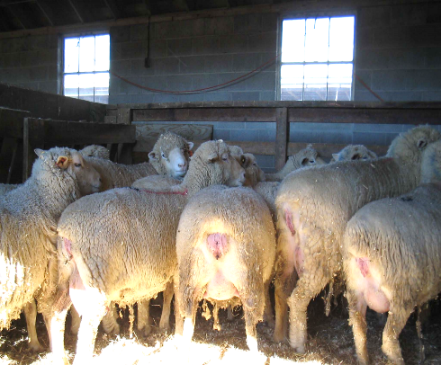
Impending Parturition
Bagging up
Softening of tail head
Enlargement of the vulva
Mucus discharge

Slide 8
Stages of Parturition
First Stage
dilation of the cervix
takes 2 to 12 hours
don not observe much
separate themselves
paw at the ground
up and down, appear uncomfortable
have a far-off stare
Second Stage
Expulsion of the fetus
2 hours once ewe starts straining
30 - 45 minutes for twin

Slide 9
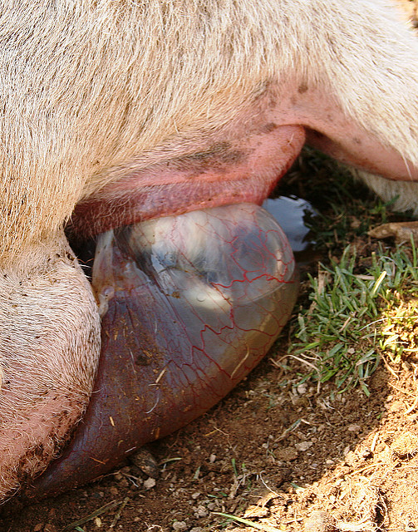
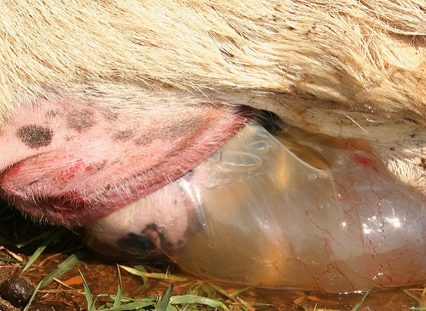
Photos on left: Susan Schoenian

Slide 10
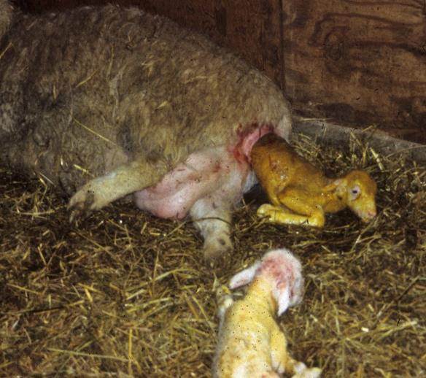
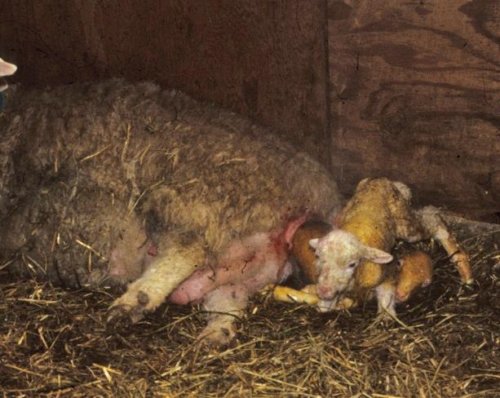

Slide 11
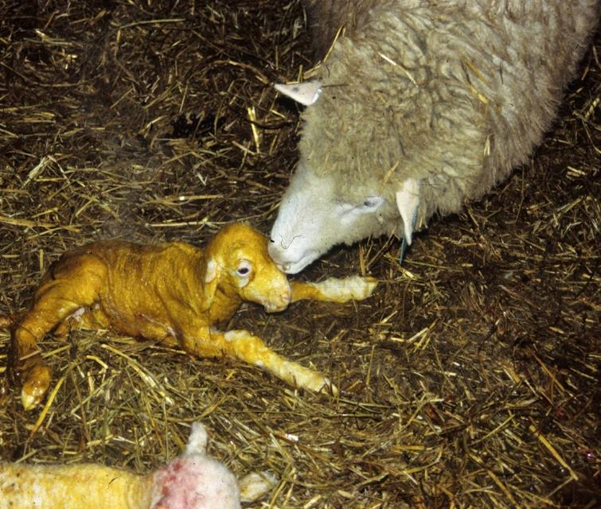

Slide 12
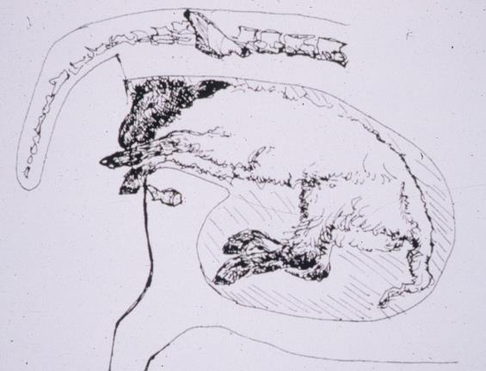
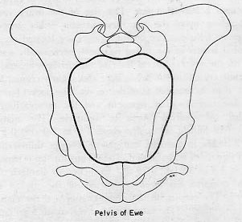

Slide 13
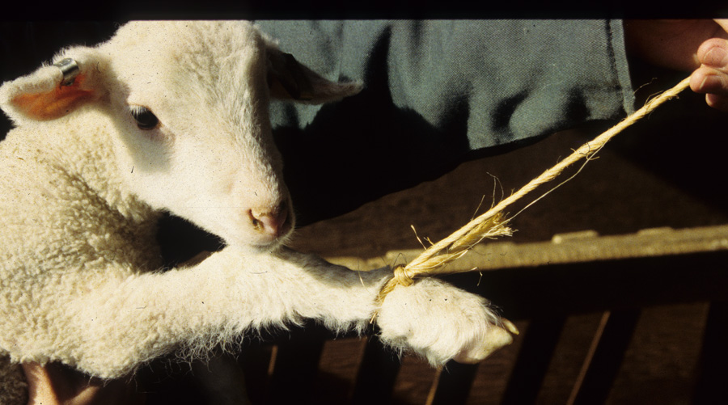

Slide 14
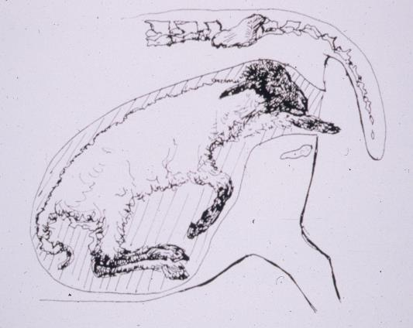
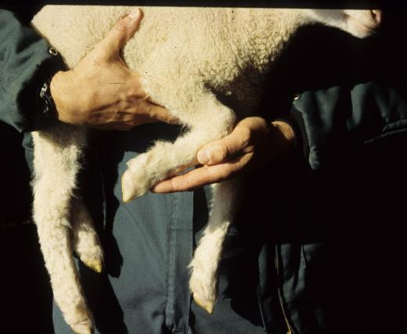

Slide 15
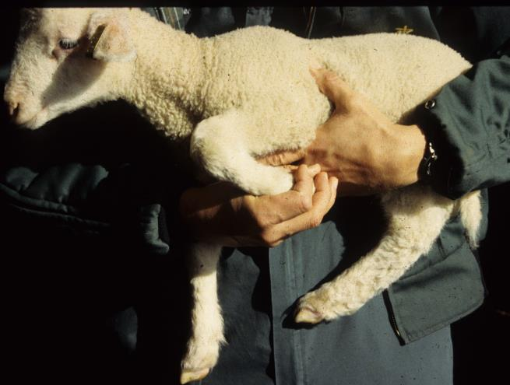
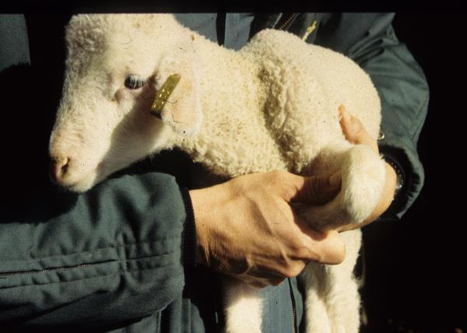

Slide 16
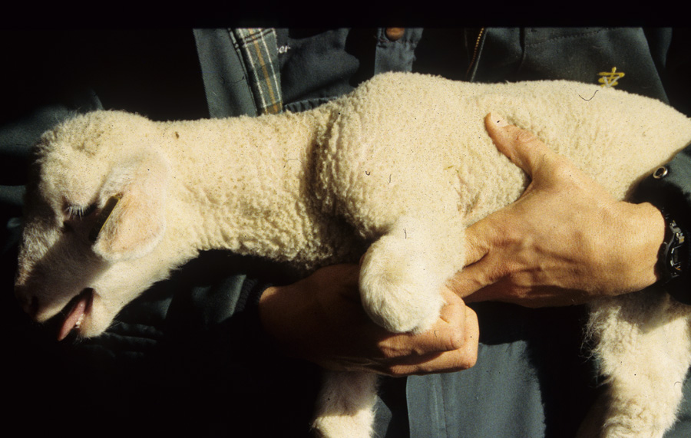

Slide 17
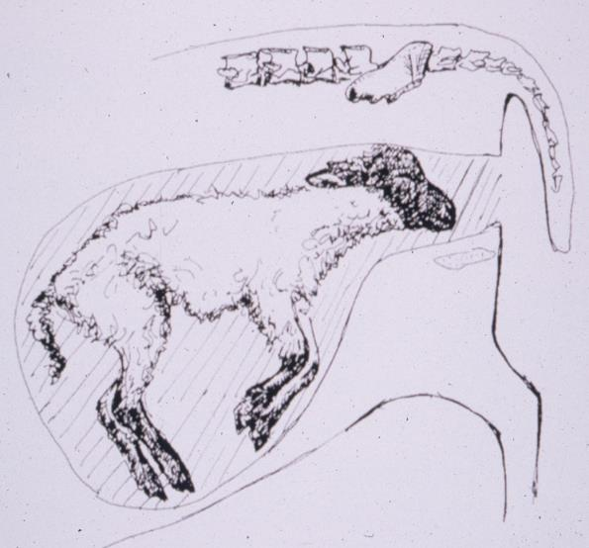
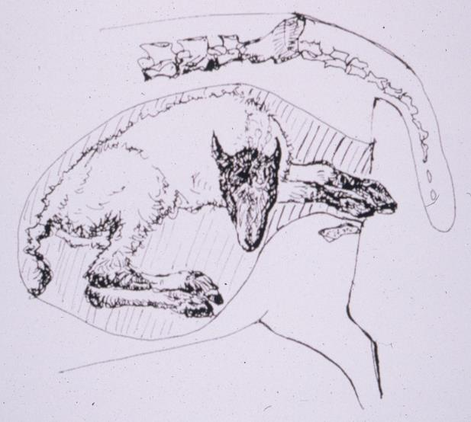

Slide 18
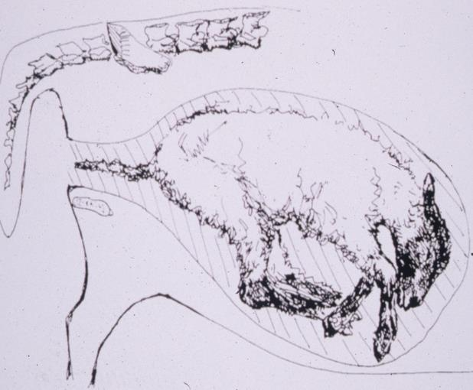
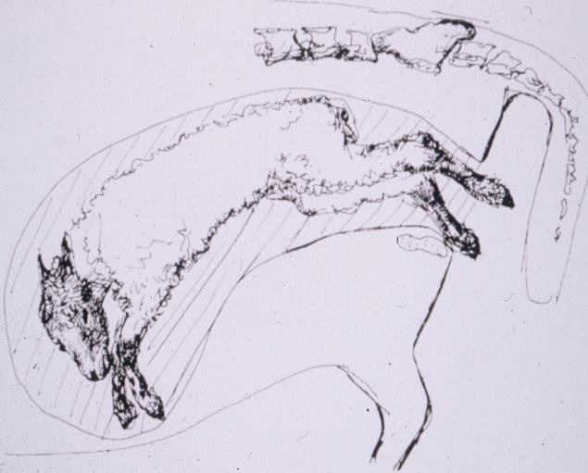

Slide 19
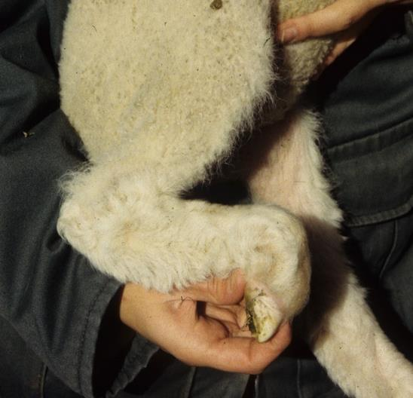
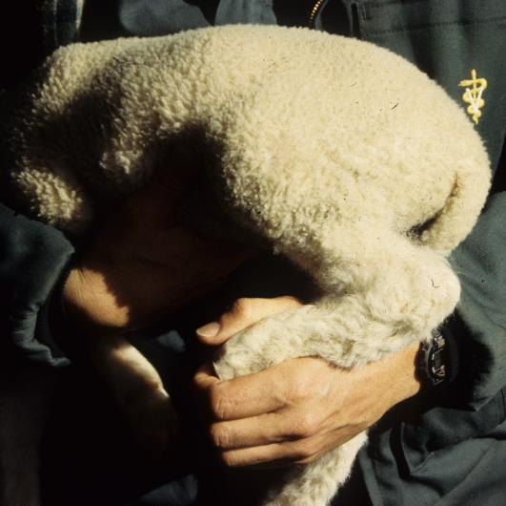

Slide 20
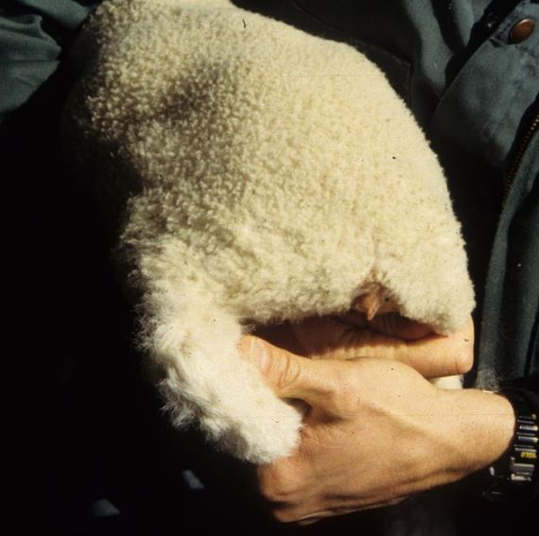
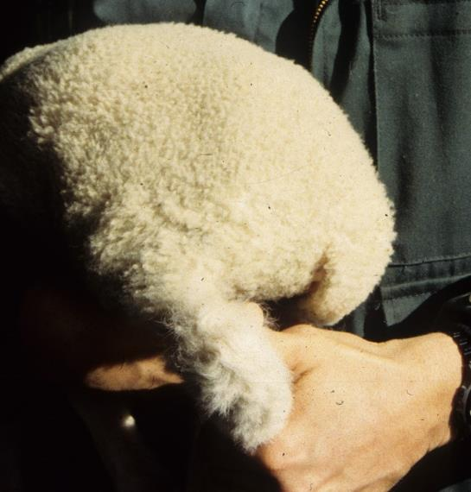

Slide 21
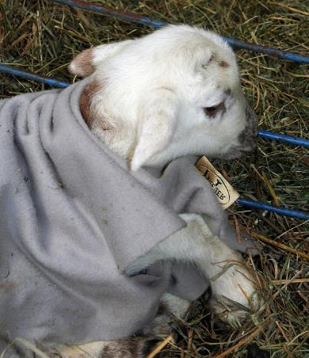
At Birth
Remove excess mucus from mouth and nose
Rub vigorously with towel and dry off
Do not hang upside down
Dip navel
Evaluate vigor, look for defects
Photo: Susan Schoenian

Slide 22
Third Stage
Expulsion of the fetal membranes
usually expelled in 30 min. to 2 hours
retained if still attached 12 hours after lambing or kidding
When to worry?
If ewe/doe goes off feed
If ewe/doe develops a fever (temp > 103.3)
Treatment
Penicillin 3cc/100lbs twice a day for 4 days, withdrawal is 28 days
Gentle pull

Slide 23
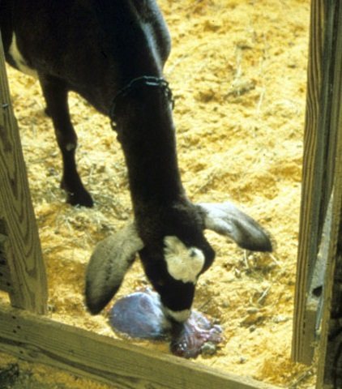
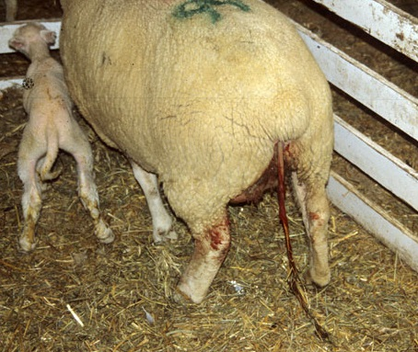

Slide 24
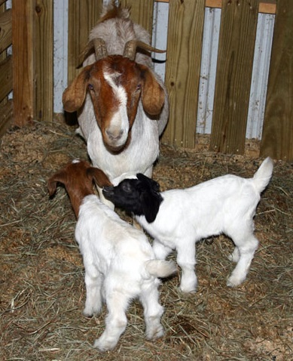
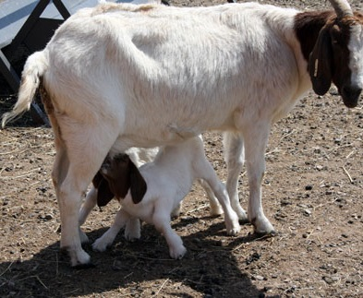

Slide 25
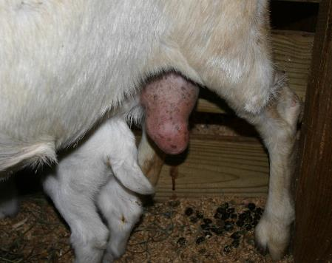
Colostrum Management
Nurse
Should nurse within an hour
Clean and milk teats to ensure colostrum is present
Watch to ensure lambs/kids can nurse the teats
Note: consider culling if teats are too big for kids to nurse on their own

Slide 26
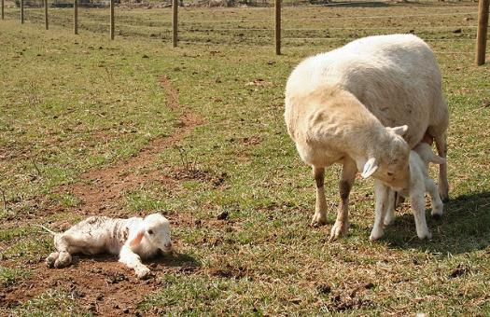
Kid/Lamb Care
Milk out teat
Make sure baby nurses within 2 hours
Colostrum
20ml/lb or 3/4 oz/lb first 2 hours
100 -125 ml/lb or 3.5 oz/lb 24 hours

Slide 27
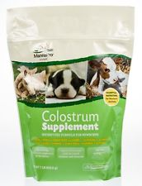
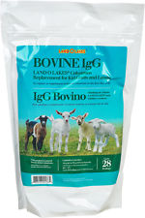
Colostrum Management
$7-12
Colostrum banking
Should be collected from dams within 12 hours of lambing/kidding
Specific gravity 1.029 or greater
Cool down and freeze
Thaw by placing in warm water
Colostrum alternatives (make sure has IgG/antibodies)
Bovine
Colostrum substitutes
$36 - 42
Colostrum Supplement
Colostrum Replacer

Slide 28
Supplements
Nutri-Drench bottle says: “Delivers high energy, vitamins, minerals, amino acids, electrolytes and antioxidants in minutes.”
No products, companies or manufacturers are being endorsed.

Slide 29
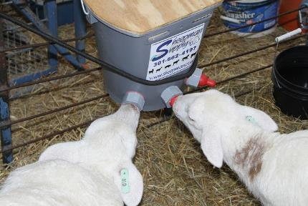
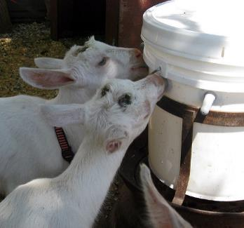
Feeding Milk
Milk replacer (for your species, can follow directions on bag)
Feed 1 liter/day by 1 week and 1.5 - 2 by 3 weeks of age
20% body weight into 3 feedings/day for 1st 2 weeks
Can use self feeder (keep full if do) or bucket feeders
Feed warm or cold
Photos: Susan Schoenian

Slide 30
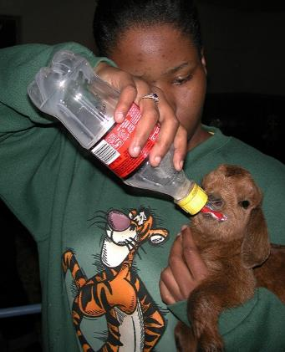
20% Body Weight into 3 Feedings for 1st 2 weeks
8 lb kid * 0.20 = 1.6 lbs
1.6 lbs * 16 oz = 25.6 oz
25.6 oz / 3 feedings = 8.5 oz
25.6 oz / 4 feedings = 6.4 oz
10 lb lamb * 0.20 = 2 lbs
2 lbs * 16 = 32 oz
32 oz / 3 feedings = 10.8 oz
32 oz / 4 feedings = 8 oz

Slide 31
Additional Resources
www.slideshare.net/schoenian/getting-ready-for-lambing-and-kidding
www.infovets.com/books/smrm/C/C460.htm
http://articles.extension.org/pages/27126/kidding-management
www.sheepandgoat.com (articles)
www.sheep101.info/201/lambingprocess.html

Slide 32
This material is based upon work that is supported by the National Institute of Food and Agriculture, U.S. Department of Agriculture, under award number 2015-70017-22861.
Beginning Farmer and Rancher
Development Program
Developing the Next Generation
of Sustainable Farmers in Georgia Grant

