Slide 1
Small Ruminant Production

Slide 2
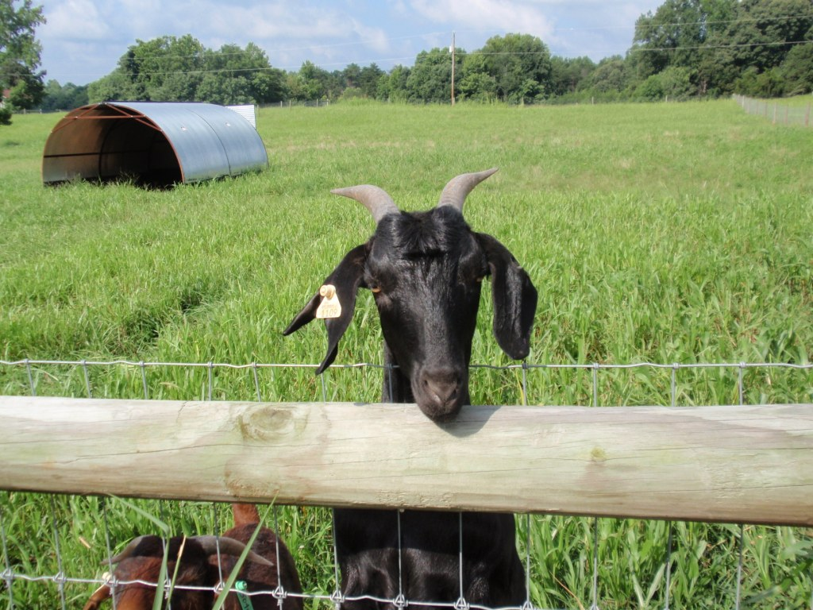
Session 3 Health and Diseases
Charlotte Clifford-Rathert, DVM
State Extension Specialist - Small Ruminants
Lincoln University

Slide 3
Learning Objective
List some of the most common diseases of goats and sheep and understand how to prevent or treat them

Slide 4
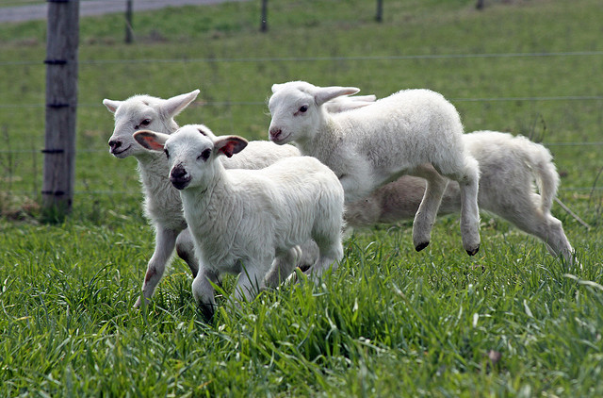
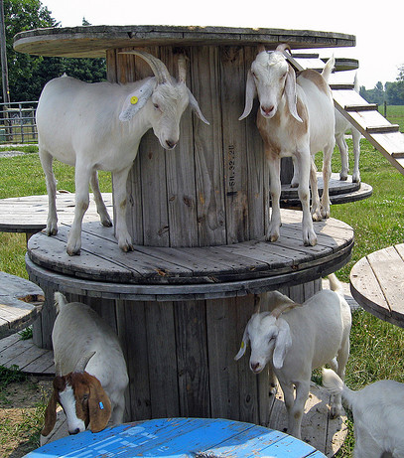
Know What ‘healthy’ Looks Like
Runs to feed
Bouncy, springy step
Bright eyes
Carries head upright
Flashy tail
Healthy coat
Playful
Round solid pellets (stool)
Photos: Susan Schoenian

Slide 5
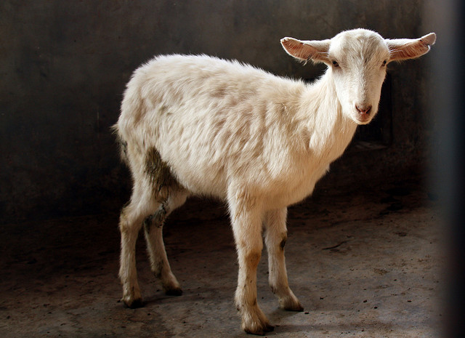
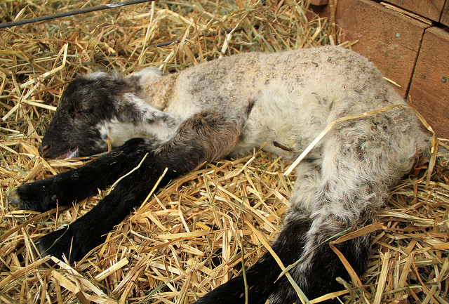
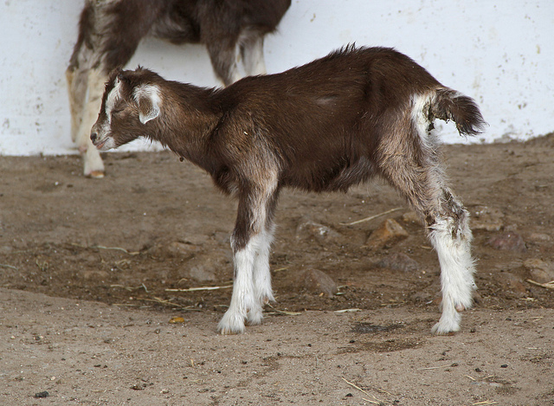
Signs of Problems
Depressed, not getting up and moving around
Standing hunched with head and tail down
Coughing, wheezing, and/or breathing hard
Not interested in others and playing
Off feed/not eating
Grinding teeth
Dull eyes
Diarrhea
Runny nose
Lameness
Poor body condition
Photos: Susan Schoenian

Slide 6
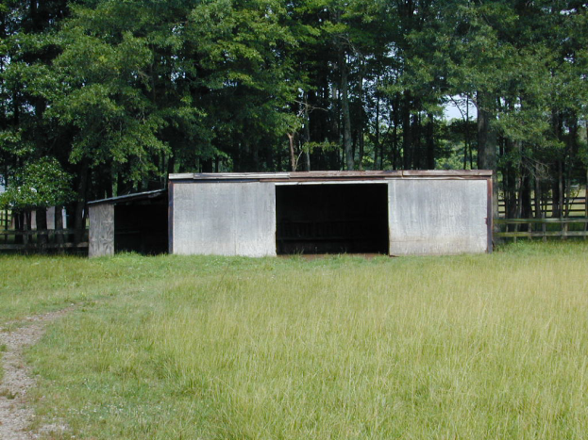
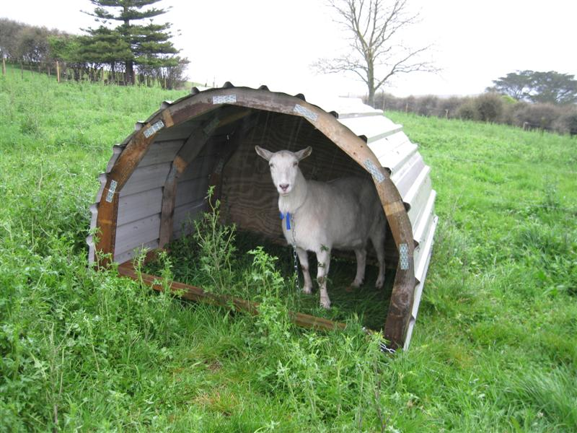
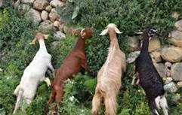
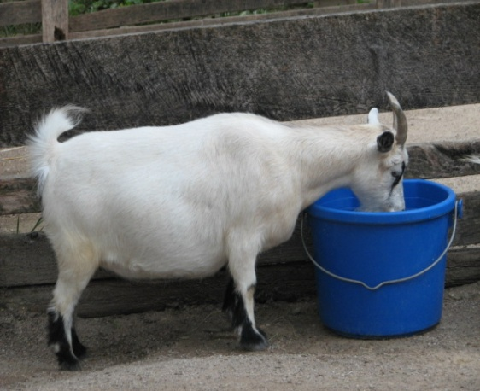
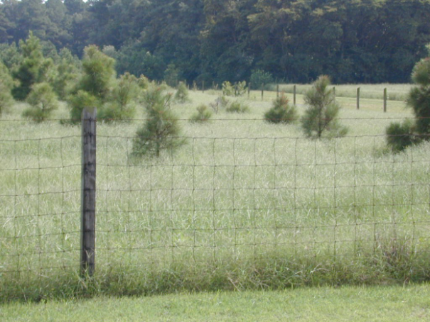
Good Management = Good Health
Adequate Facilities
Quarantine / Isolate
Prevent introduction of disease and parasites to animals on farm
KEEP RECORDS!
Adequate forage & water (1-4 gallons head/day; warm in winter, cool summer)
Good NUTRITION supports the immune system; learn to body condition score

Slide 7
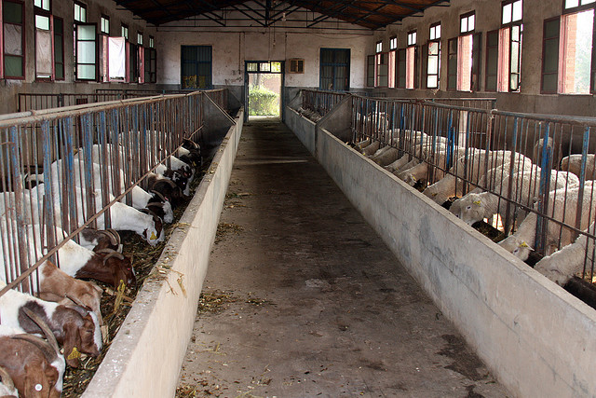
Basic Vaccination Program
Vary from farm to farm, vaccinate production animals annually
Lambs and kids: 5-6 weeks of age, booster at 8-9 weeks
CD&T vaccine, prevent “over-eating disease”/ bloody scours; especially important when:
Feeding high concentrate diets
Dehorning and castrating, to prevent tetanus
7 or 8-way (contains 7-8 Clostridium serovars - (Blackleg, Malignant edema, Red Water); if not an existing problem, may be added expense
Photo: Susan Schoenian

Slide 8
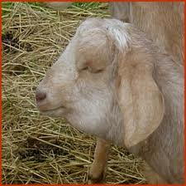
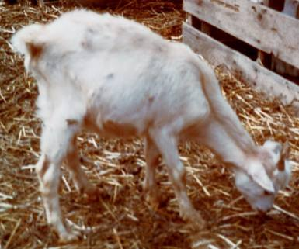
Watch for Signs of Parasites*
Pale gums and eyelids
Poor weight gain
Weight loss
Bottle Jaw
Diarrhea
Decreased milk production
Poor hair coat
Parasites are worse when it is hot and humid
*More information will be provided in another session on parasite control.

Slide 9
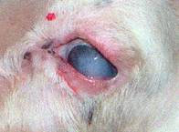
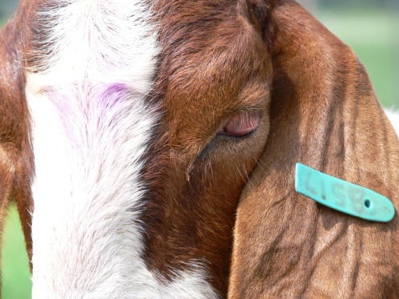
Pinkeye (a.k.a. infectious keratoconjunctivitis)
Highly contagious
Many different infective agents: Chlamydia, certain viruses, and mycoplasma (different from cattle)
Usually completes its course in three weeks
Eye medications containing antibiotics may be helpful
No effective vaccines available
Photos: C. Clifford-Rathert

Slide 10
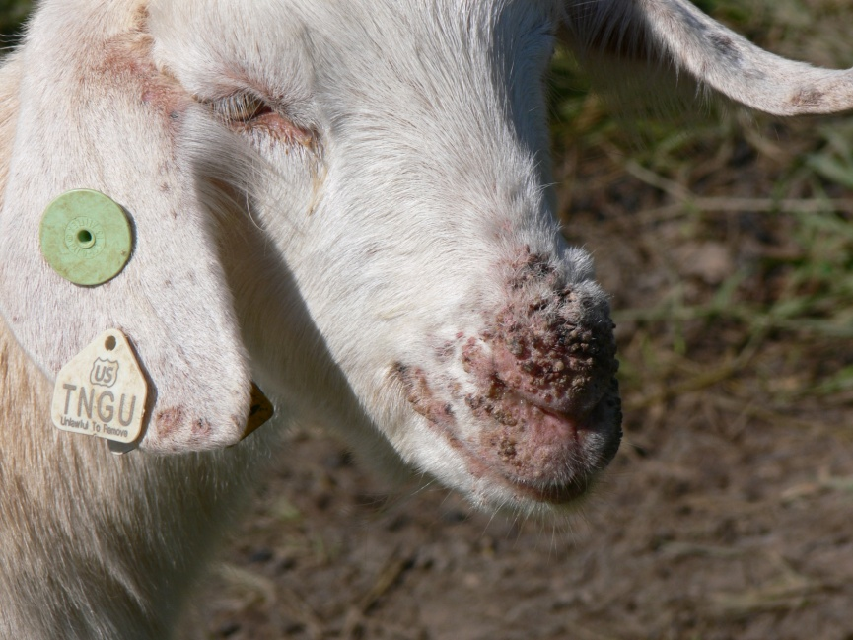
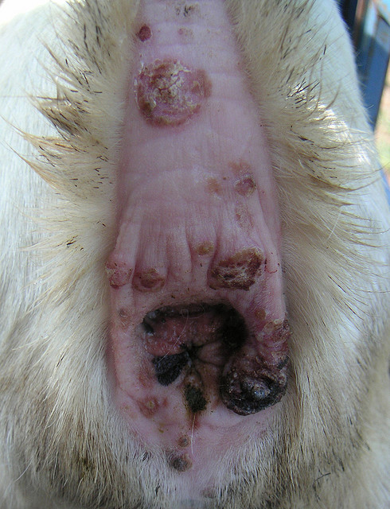
Soremouth (a.k.a.Orf or Contagious Ecthyma)
A contagious/zoonotic disease - other animals/humans can get; reportable in GA
Isolate animals to prevent contamination
Clean all feed and water buckets thoroughly (CHLOROX)
If you remove the scabs, wear gloves, scrape off scab until raw and treat with 7% iodine to control
A vaccine is available for prevention if a problem on the farm
Photo above: C. Clifford-Rathert
Photo below: N. Whitley
Photo: Susan Schoenian

Slide 11
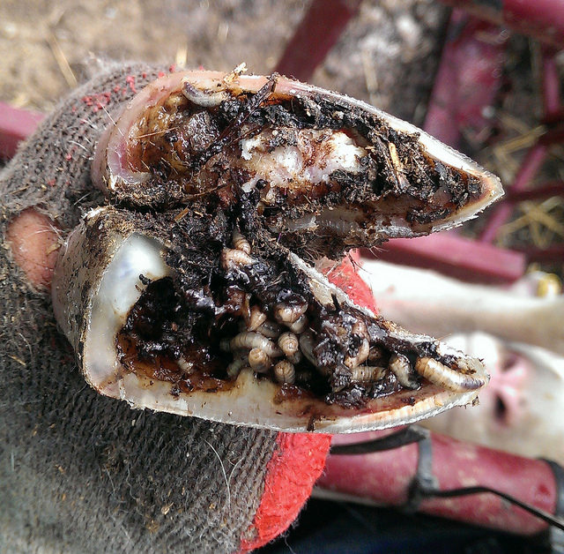
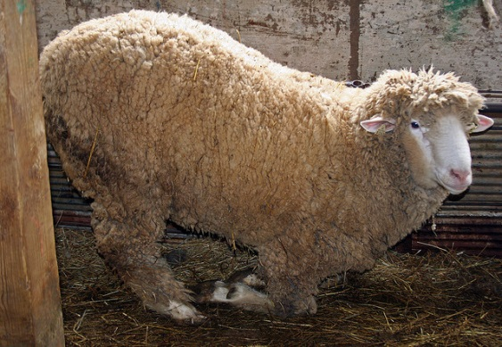
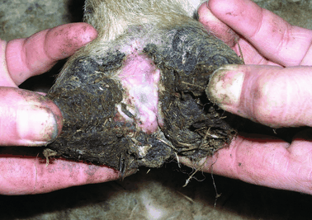
Footrot and Foot Scald
From standing in muddy/wet areas
Bacteria: Fusobacteria necrophorum (common in soil) and Dichelobactor nodosa (found on skin; survives 2 wks if not in hoof)
Starts with lameness
May affect one foot or more, and may be periodic, the foot be swollen and red with a bad odor and painful to the touch
Successful treatment requires early diagnosis
Photos above: Susan Schoenian
Foot scald photo: www.county-vets.co.uk/

Slide 12
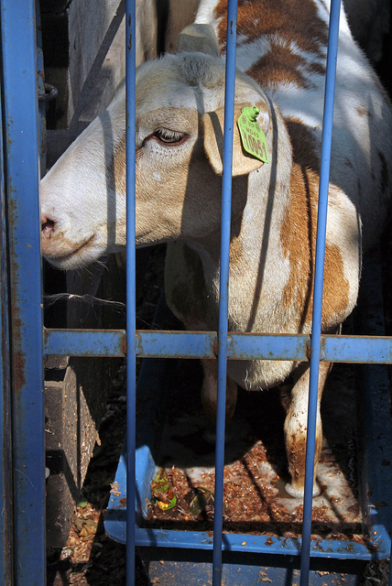
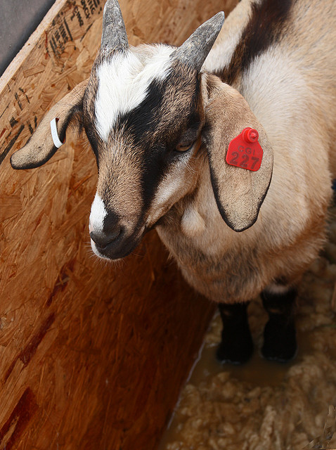
Treatment
Isolate infected animals
Penicillin
Tetracycline
Intradigital (LA-200)
Crumbles on top of feed
10% copper sulfate foot bath
10% zinc sulfate foot bath
Hydrated Lime / drylot
Therapeutic foot trimming
Photos: Susan Schoenian

Slide 13
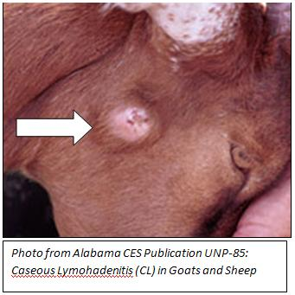
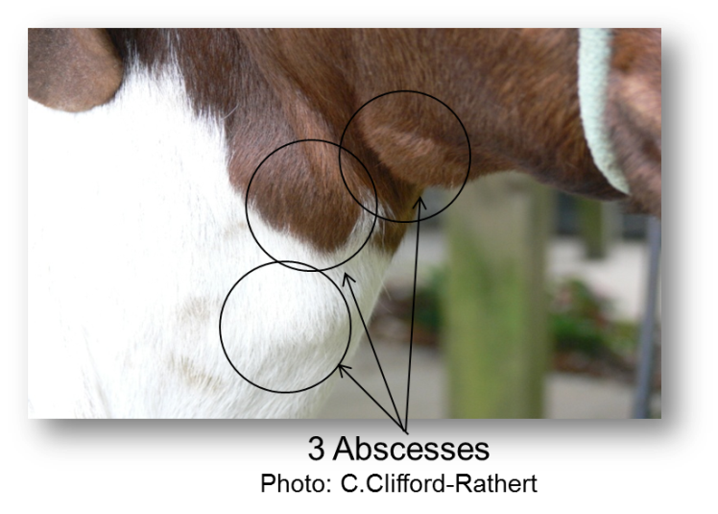
Caseous lymphadenitis (a.k.a. CL, CLA) (boils, abscesses, cheesy gland disorder)
Corynebacterium pseudotuberculosis
Pale green then cream colored “cheesy” pus
Bacteria get in through a wound or breathing/eating it
External or internal abscesses
Treatment - isolate infected animals and:
Lance, drain and flush + antibiotics (Vet)
Infuse with saline flush + antibiotics (Vet)
NOT FORMALIN
Prevent/control: do not buy, disinfect areas where abscesses have drained and all equipment, prevent spread at shearing time, vaccine (not goats), blood test, CULL
Reportable in GA
Photos: Alabama CES Publication UNP-85

Slide 14
External Abscesses
More common in goats
Internal Abscesses
More common in sheep
One or more abscesses
Sheep – shoulder (near the neck), thigh (near the flank)
Goats – under the jaw or on the neck
Easily spreads to other animals if it bursts
Decreases pelt value
Transmissible to humans
Involves the lymph nodes and other organs (kidney and liver)
Causes weight loss, poor health, reduced wool and milk production
“Thin ewe/doe syndrome”
Third most important cause of carcass condemnation
Goat Medicine by Dr. Mary Smith and David Sherman

Slide 15
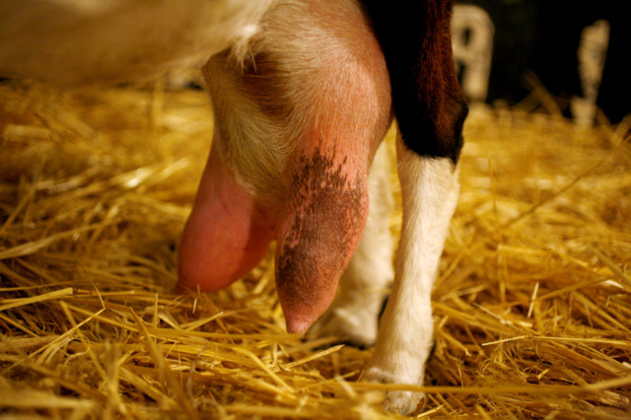
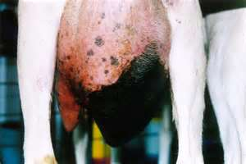
Mastitis
Inflammation/swelling of the mammary gland or udder
Udder painful, hot, and hard; will not allow lambs/kids to nurse
Can lose milking ability in the udder (or part of the udder completely)
Control with good management practices (clean, dry areas for lactating animals; start drying up does/ewes before weaning)
Isolate infected animals
Peppermint oil helps with swelling
Antibiotics/pain meds

Slide 16
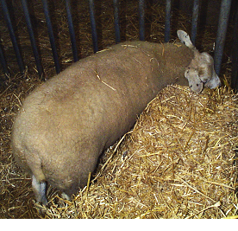
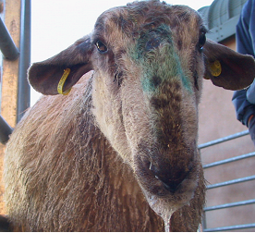
Listeriosis
Caused most commonly by Listeria monocytogenes
Three main forms:
Neurological (encephalitis/brain) – off feed, depressed, excessive salivation, leaning to one side, circling, stumbling, standing against wall, death within 24-48 hr (treated early 30% recover); usually <2% flock/herd infected
Abortive – usually last trimester and with no signs
Septicemic/visceral – chronic diarrhea; not common but increasing in small ruminants (has been found in US)
Treatment (with vet) – very high doses penicillin or other effective antibiotic
Bad silage can host it; dogs, cats, wild rabbits and other small mammals can transmit it
Photos: www.nadis.org.uk

Slide 17
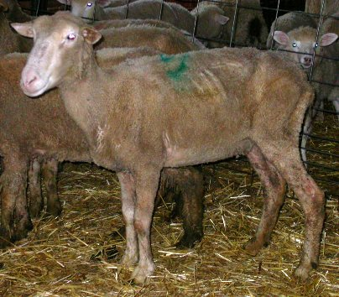
Ovine Progressive Pneumonia (OPP)
Chronic progressive pneumonia of sheep; long incubation (2-4 years)
Clinical signs in older animals but can affect lambs
Mastitis (“hard bag”), pneumonia, arthritis, encephalitis, and rarely hind limb paralysis
Chronic wasting despite good appetite
Death within 1 year of symptoms
Can test for it
Reportable disease
Photo: Susan Schoenian

Slide 18
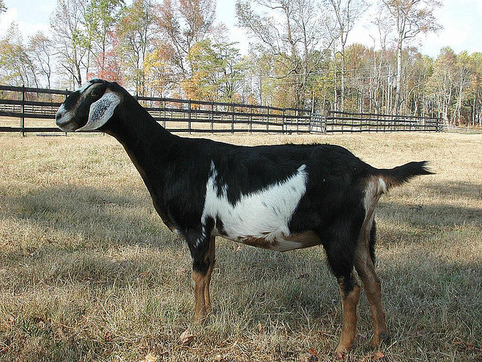
Caprine Arthritis Encephalitis Virus (CAE)
Common dairy goat problem
Lifelong infection
Several forms:
Neurological (young kids 2-6 mo)
Decreased/no milk (young does)
Arthritis (2 yrs & older) – front legs
Respiratory disease (adults any age)
Weight loss
Passed on through milk/colostrum not heat treated; can test animals for it; avoid getting it, if have it, work with vet to get rid of it
Dairy goat - photo by: Susan Schoenian

Slide 19
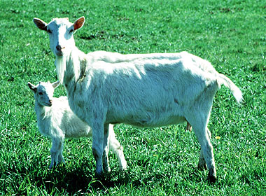
Johnes Disease (Paratuberculosis)
Mycobacterium avium paratuberculosis
Chronic wasting disease
Goats do not get diarrhea like cattle
Transmission is fecal-oral
Clinical signs: progressive weight loss without diarrhea, appetite remains intact initially but decreases later on, leading to severe emaciation
Goats 2-3 years of age
No known treatment
More prevalent in dairy goats

Slide 20
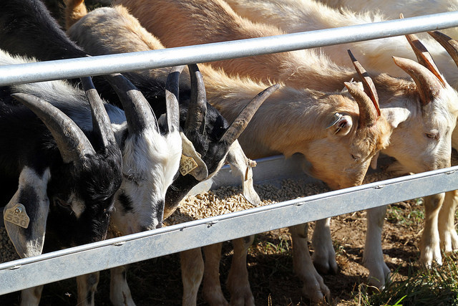
Overeating (a.k.a Enterotoxemia, Acidosis, Grain Overload)
Caused sudden change in diet – i.e. grain eaten by animals not used to it or a lot eaten by very hungry animals
Can occur 6-12 hours after ingestion
“Feed-bunk Disease”
Signs: off-feed, dull, irritable, swollen belly, severe diarrhea, dehydration, sunken eyes, staggering, collapse, coma and death.
Photo: Susan Schoenian

Slide 21
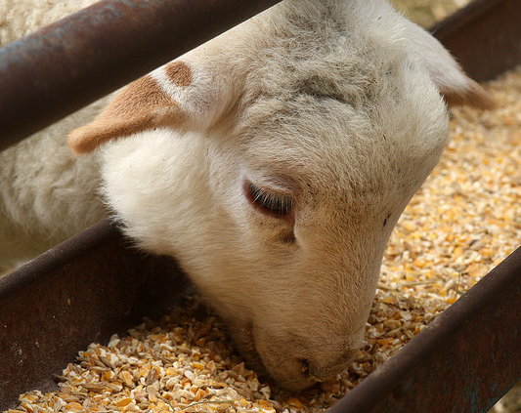
Treatment
Best to PREVENT!
Remove cause (feed properly)
Do not feed grain free choice to animals
not used to it or starving animals
Vaccinate properly with CD &T (combination enterotoxemia and tetanus toxoid)
If putting in feedlot, changing diets or stressing them, give a booster 3-4 weeks beforehand
Feedlot: one injection as brought in (at weaning), booster 3-4 weeks later
Photo: Susan Schoenian

Slide 22
Pregnancy Disease (Ketosis)
A nutritionally based disease
Common in overweight does/ewes carrying twins or triplets; also seen in poor condition animals
Brought on by stress including storms, transport, fasting, excessive heat, and poor nutrition
Causes low blood sugar leading to ketosis and death
Signs: stumbling, no energy, no appetite, wandering, leaning on things, twitching ears, eyes, tail; teeth grinding, urine ketones, blindness, loss of reflexes, paralysis, lying on chest, coma, death

Slide 23
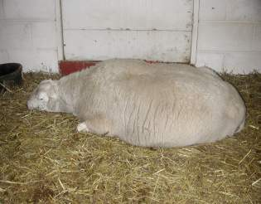
Treatment
Need a vet!
Not always successful
Treat with glucose-producing substances
such as propylene glycol, maple syrup
Give intravenous (i.v.) fluids with dextrose (Vet)
Remove of kids/lambs by c-section or by inducing labor
Give steroids per veterinary recommendation
Best to prevent: proper weight/body condition during pregnancy; feed adequate energy in late pregnancy; reduce stress
Photo: Susan Schoenian

Slide 24
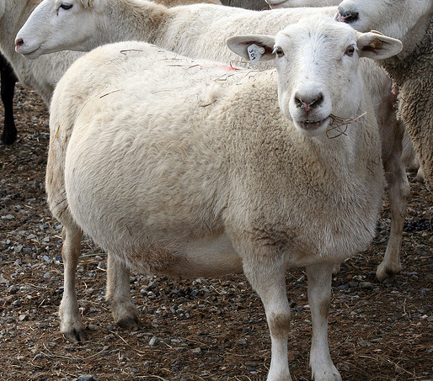
Chlamydia (Chlamydophola abortus) Ovine Enzootic Abortion - OEA
Most common cause in North America
Zoonotic potential- placenta, uterine fluids,
feces and lungs
Usually late term abortions; recovered females are immune
Diagnosis: placenta cotyledons are gray-brown and leathery
Isolate affected ewes/does
Can prevent future/additional abortions with antibiotics (usually tetracyclines; consult vet)
Photo: Susan Schoenian
Notes:
Prevention: feed tetracycline crumbles under the direction of a veterinarian

Slide 25
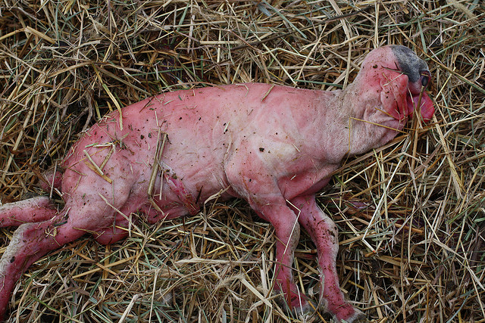
Campylobacter- Vibrio
Campylobacter fetus and jejuni*
Not sexually transmitted in sheep
Ingestion of organisms
Can have carrier state 20-70%
Abort late gestation, last 6-8 weeks
Lambs born weak or dead
Ewes are sick and can die, but will recover and be immune next year but become carriers
Diagnosis – need placenta and fetus (for stomach fluid and liver); Fetus is edematous (“Water belly babies”)
Photo: Susan Schoenian, Baalands Farm

Slide 26
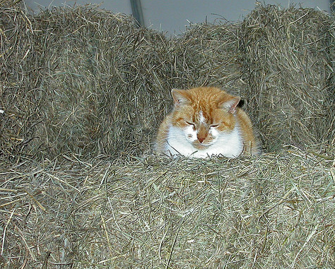
Toxoplasmosis
Cats shed oocysts in feces
Oocysts survive a long time in the environment
Zoonotic potential
Placenta is infected 14 days after ingestion
Infection: <50 d gestation = fetal death/ reabsorption
60-100 d gestation = fetal death
120 d gestation= no affect on fetus
Abortion late pregnancy = 15-20%
Diagnosis - need placenta and fetus
Feeding monensin in mineral suppresses infection (Vet Rx)
Prevent: control cat population, store feed in container
Photo: Susan Schoenian

Slide 27
Scrapie
A fatal degenerative disease (TSE) that affects the central nervous system of goats and sheep. Incubation period is 2-5 years
Clinical signs develop slowly: behavioral changes, tremors, scratching and rubbing against objects, incoordination (high stepping, hopping like a rabbit, swaying in the back end)
An infected animal may appear normal if left undisturbed at rest. However, when stimulated by a sudden noise, excessive movement, or the stress of handling, the animal may tremble or fall down in a convulsive state
Reportable Disease in all states
Tag and keep records of all goat and sheep sales and purchase. Save and maintain records for five years.
All goats or sheep leaving farm premises should be tagged
Prevention: testing and genetic selection, maintain closed herds/flocks

Slide 28
State ID Requirements: Georgia
In addition to Federal requirements, Georgia requires official individual identification of all high-risk goats (those in contact with sheep) as well as official ear tags on all sheep going to a livestock market; new proposed protocol will likely include ALL goats
Complete information is available by contacting:
Dr. Robert Cobb Jr, SV
Ph: 404-656-3671
Email: Robert.cobb@agr.Georgia.gov
Dr. Stan Crane
Designated Scrapie Epidemiologist
Ph: 404-656-3667
Email: stan.crane@agr.Georgia.gov
If in doubt, tag them!!!
Scrapie tags are FREE and available by contacting the USDA
1-866-USDA-TAG (1-866-873-2824)

Slide 29
Basic Rules to Remember
Don’t buy sick animals.
Select for healthy genetic lines.
Don’t believe everything you hear from someone trying to sell you an animal.
BEWARE of sale barn buys.
Keep in mind…there is as much bad info as there is good info…be selective learners.
KEEP GOOD RECORDS!
Practice good biosecurity on the Farm!!!!

Slide 30
Additional Resources and References
Goat Medicine, Dr. Mary Smith & Dr. David Sherman
Sheep and Goat Medicine, Dr. David Pugh
Dr. Margaret Masterson, Ohio State University, College of Veterinary Medicine
www.extension.org/goat
www.extension.org/sheep
www.sheepandgoat.com

Slide 31
This material is based upon work that is supported by the National Institute of Food and Agriculture, U.S. Department of Agriculture, under award number 2015-70017-22861.
Beginning Farmer and Rancher
Development Program
Developing the Next Generation
of Sustainable Farmers in Georgia Grant

