Slide 1
Small Ruminant Production

Slide 2
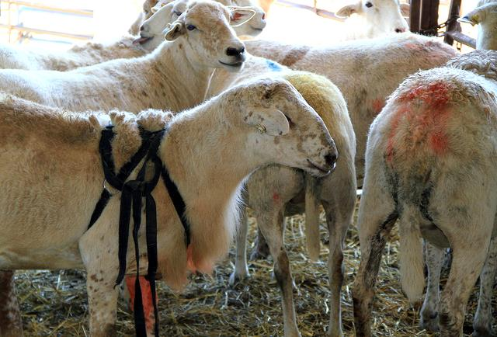
Session 3 Sheep and Goat Breeding
Dr. Niki Whitley
Extension Animal Science Specialist
Fort Valley State University
Slides/pictures from Dr. Kevin Pelzer, Virginia-Maryland CVM and Susan Schoenian, University of Maryland Extension)

Slide 3
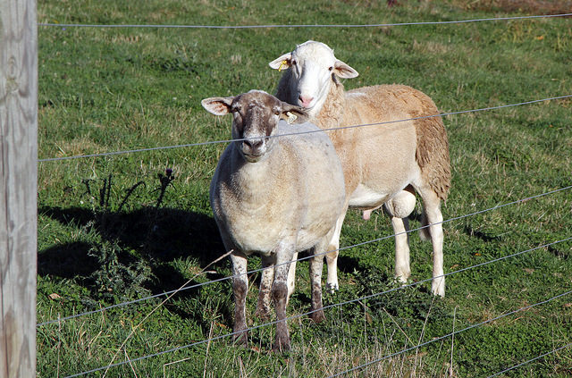
Learning Objective
Understand best management practices for breeding

Slide 4
Reproductive Characteristics
Characteristics | Sheep | Goats
Age at puberty | 5-7 months | 5-7 months
Length of estrus (heat) cycle | 17 days | 21 days
Duration of estrus | 36 hours | 30-40 hours
Gestation length (around 5 months) | 144-151 days | 147-155 days

Slide 5
Basic breeding information
Seasonal breeders (mostly Fall/Winter)
Some can breed before or after that time but usually fewer get pregnant and they have fewer babies (mostly singles)
Can use hormones to breed out of season (i.e. CIDRs - approved for sheep only)
Females: Breed first time at 75% of mature body weight and 8-10 months of age
Males: Usually a minimum of 8-10 months of age (only a few non-aggressive females); preferably at least 1 year; can breed as early as 4 months of age

Slide 6
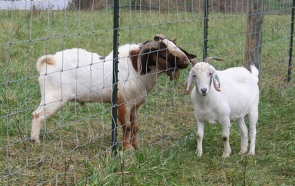
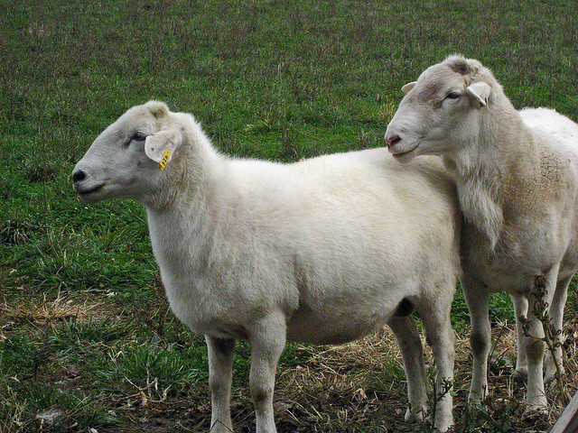
Estrus (Heat) Behavior
Ewe
Seeks ram
Swollen vulva
Doe
Seeks male
Wags tail
Vocalizes
Swollen vulva
Clear-cloudy-milky white mucus
Photos: Susan Schoenian

Slide 7
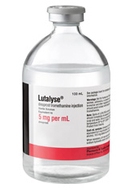
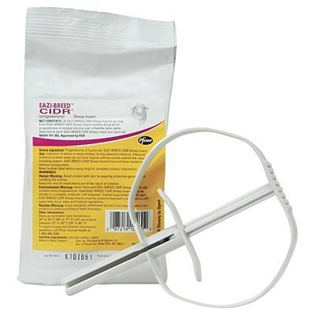
Breeding Management
Goat females seem to come into heat at the same time when exposed to buck
If during the breeding season, can use hormones to get the does (or ewes) into heat at the same time for birthing at same time (so can schedule labor) and for marketing
Prostaglandins, i.m., two shots, 9-11days apart or single shot (60-70%); do not use if previously exposed to males – may abort them; use with veterinarian input
CIDRs (use as directed; approved/sold for sheep)
www.zoetisus.com
No products, companies or manufacturers are being endorsed

Slide 8
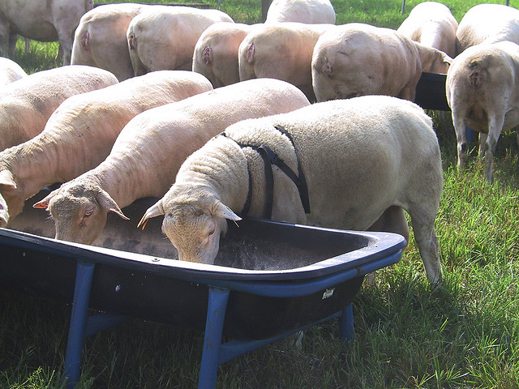
Breeding Management
Fewer females per male if synchronized to be in heat at the same time
1 mature, proven male per 30-40 females not synchronized
1 mature, proven male per 15-20 females synchronized
Depends on age, breed and time of year (younger males – 1 per 15-20)
Large groups: 3-5 males/100 females
Photo: Susan Schoenian

Slide 9
Breeding Management
Two-four weeks prior to breeding
Feed extra to ewe/does to increase twinning
At least 2 weeks prior to introducing breeding males
Feed ½ lb of grain per head per day above normal
Place on lush/new pasture
Trim feet and deworm if needed
Vaccinate for Chlamydia and Campylobacter if needed
Breeding Soundness exam for males if possible
Check udders
Move into breeding groups?
Male lease?

Slide 10
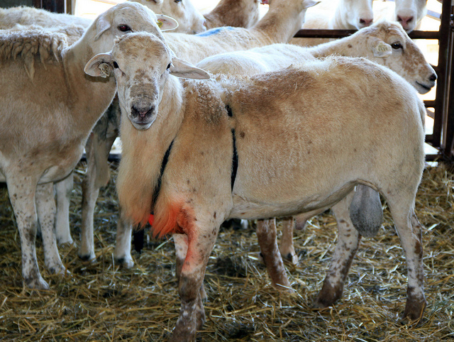
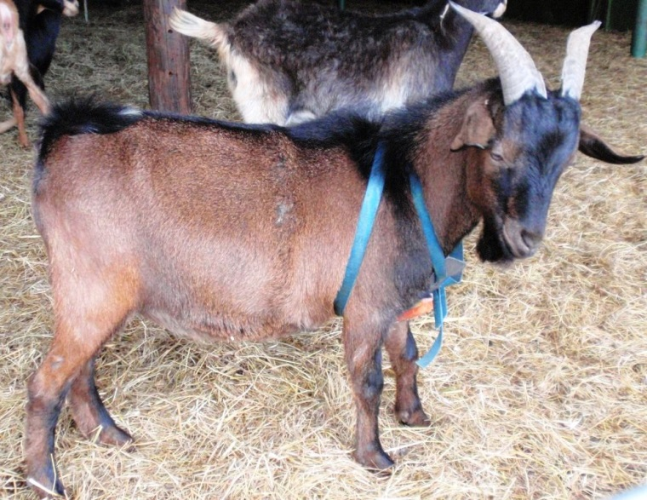
Breeding Season
Sheep minimum 28 days, Goats minimum 32 days; controlled season usually around two heat cycles plus a couple of days
Watch for weight loss in males
Marking harness can help determine females bred (mounted)/which male bred which female
Can breed one female at time (hand-mating)
Photo: Susan Schoenian
Photo: Niki Whitley

Slide 11
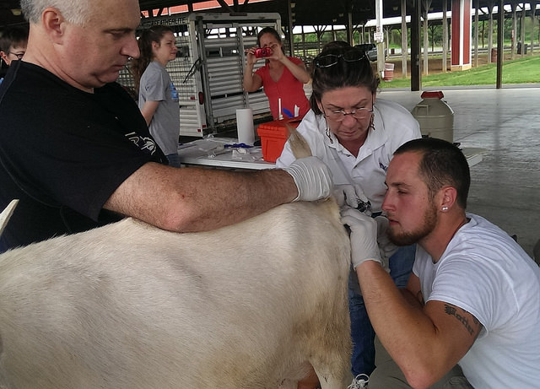
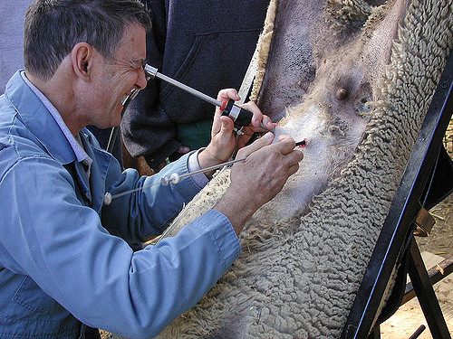
Breeding Season
Artificial insemination (AI)
Easy with goats (can learn yourself); common with dairy goats
Can use expensive/rare breed male (frozen semen)
Sheep usually surgical AI (laparoscopic), not as good pregnancy rates
VSU doing research into fresh semen and vaginal AI in sheep with pretty good results; teaching producers in their area
Photos: Susan Schoenian

Slide 12
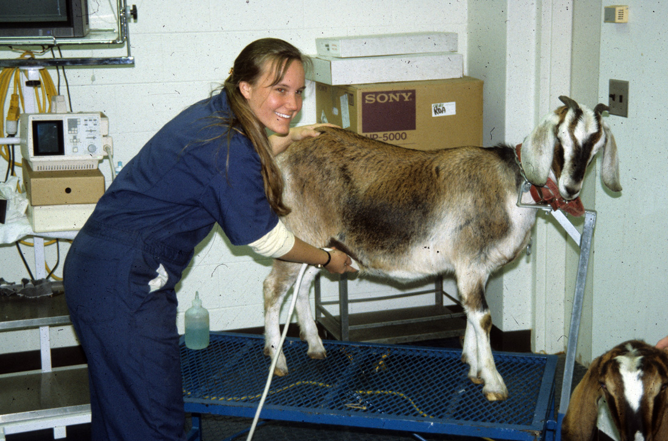
Pregnancy Diagnosis
Did they come back in heat?
Trans-rectal/Transabdominal; ultrasound; if experienced can tell at 24 days after male removal (easier the farther along they are)
Blood test (Biopryn: www.biotracking.com); no earlier than 30 days after male removal

Slide 13
Additional Resources
Goats:
http://articles.extension.org/pages/19720/goat-reproduction-puberty-and-sexual-maturity
http://www2.luresext.edu/goats/training/reproduction.html
http://aces.nmsu.edu/pubs/_d/D704.pdf
Sheep:
http://aces.nmsu.edu/sheep/sheep_reproduction/breeding_habits.html
http://ag.ansc.purdue.edu/sheep/articles/repromgt.html
www.sheep101.info/201/ewerepro.html

Slide 14
This material is based upon work that is supported by the National Institute of Food and Agriculture, U.S. Department of Agriculture, under award number 2015-70017-22861.
Beginning Farmer and Rancher
Development Program
Developing the Next Generation
of Sustainable Farmers in Georgia Grant

