Slide 1
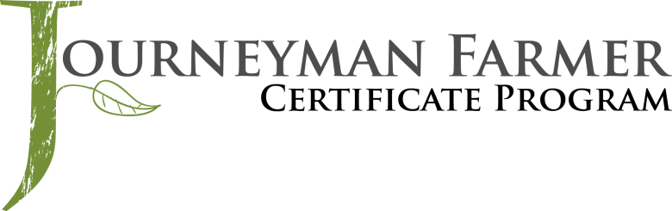



Small Ruminant Production

Slide 2
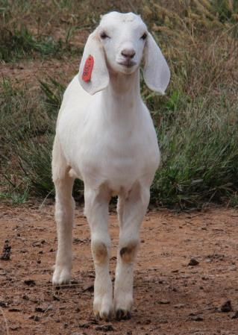


Session 2
Predator Control
Dr. Jay Daniel
Associate Professor of Animal Science
Berry College

Slide 3
Learning Objectives
Risks that determine the need for predator control
Types of predator control
Resources needed for each

Slide 4
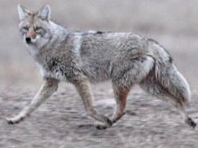
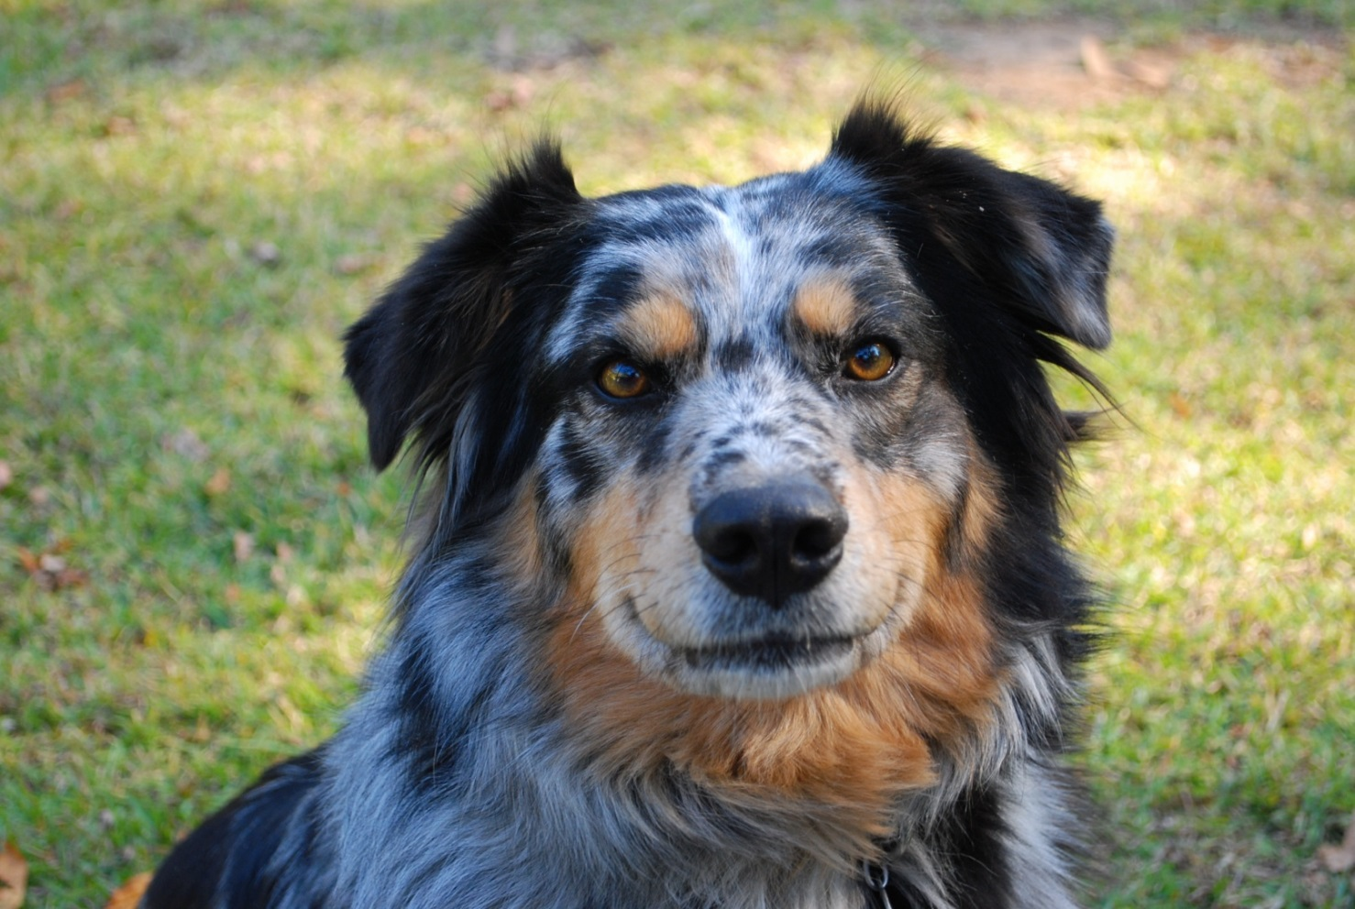
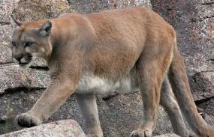
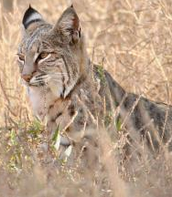
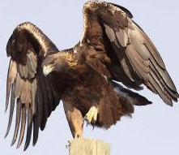
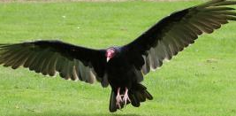
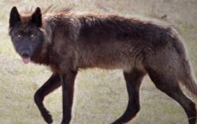
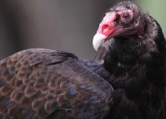
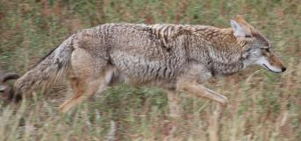
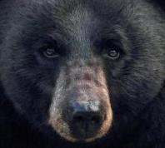
Predators
Photo: Jay Daniel
Photos left: Flickr – Pat Gaines,
creative commons license
Photos right: Flickr –Tony Hisgett,
commercial license

Slide 5
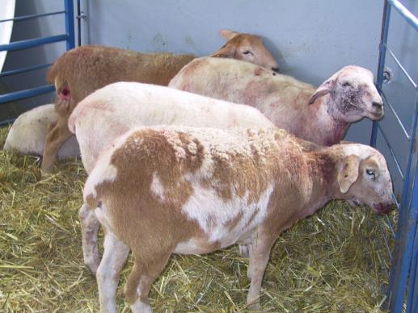
Predators
Coyote
Dogs (wild and neighbor’s)
Fox
Bobcat
Wolf
Bear
Cougar
Eagle
Photo by: Niki Whitley
Notes:
Picture of yearling Katahdin ewe lambs that survived an attack by a couple of Chesapeake Bay Retrievers that had gotten out of their fenced yard overnight. They killed one of the ewe lambs, injured many others, then moved to a pasture of adult bred does, killing two of them and injuring others.

Slide 6
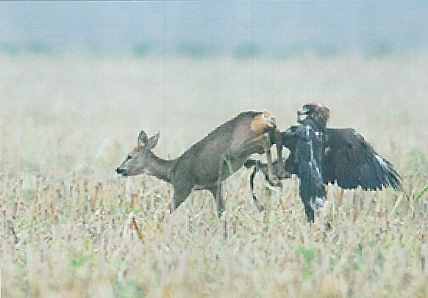
Golden Eagle capturing a deer
http://www.youtube.com/watch?v=Yz7FFlFy8eM

Slide 7
Predators
Vultures
  In addition to eating the dead, they have been known to kill live animals (especially newborn/those lambing or kidding).
Crows
  A flock of crows killed 17 sheep in Loerrach, Germany (February 7, 2003).
Mustangs
  Running herds have been reported to trample entire flocks.
Photo: George Gallagher

Slide 8
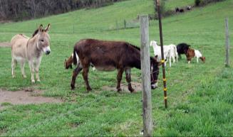
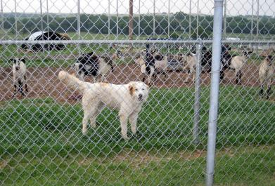
Control Means
Adjust management
Fencing
Repellants and Frightening Devices
Trapping/Poisoning/Hunting
Guard Animals
  Dogs
  Donkeys
  Alpacas/Llamas
Photos: Susan Schoenian, Baalands Farm

Slide 9
Adjust Management
Avoid attacks
  Keep animals healthy (sick and weak animals make easier prey).
  Pen animals at night.
  Adjust kidding/lambing season (highest coyote losses from late spring to September).
  Remove and properly dispose of dead animals.
  Select safer pastures.

Slide 10
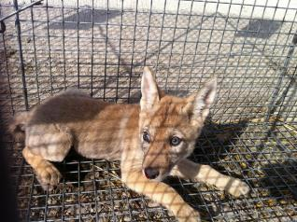
Adjust Management
Avoid attacks
  If high losses are expect, it may be worthwhile to initiate trapping or other control means before turning animals out.
  Sometimes removing coyote pups will stop attacks.
  Weaning can sometimes stop attacks.
Photo: Chris Sasenbach (https://www.flickr.com/photos/kurisu/5742418582/) via freeforcommercialuse.com

Slide 11
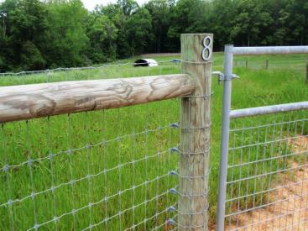
Fencing
Must prevent crawling under/jumping over
Electric fence must be no further than the distance from the tip of the nose to the top of the poll apart.
Net-wire openings less than 6” high and 4”wide
Effective deterrent; not 100% preventive
Photo: Niki Whitley
Notes:
This fencing is high-tensile woven wire 'goat' fencing, 4" x 4" squares with gates that have 2" x 4" wire fill.

Slide 12
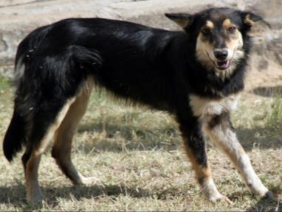
10”
Predator Exclusion Electric Fence
10”
8”
8”
48”
6”
42”
6”
6”
6”
6”
6”
6”
6”
6”
Photo: Susan Schoenian, Baalands Farm

Slide 13
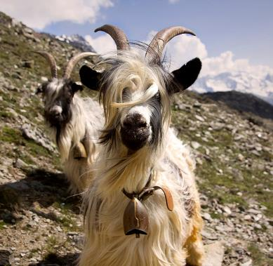
Repellants and Frightening Devices
Lighted corrals or pens
Vehicles parked near where losses occur
Change repellants periodically
Other devices include propane cannons, horns, sirens, bells, radios with amplifiers, flashing strobe lights
Photo: Jeff P (www.flickr.com/photos/jeffpang/3686267667/) via freeforcommercialuse.com

Slide 14
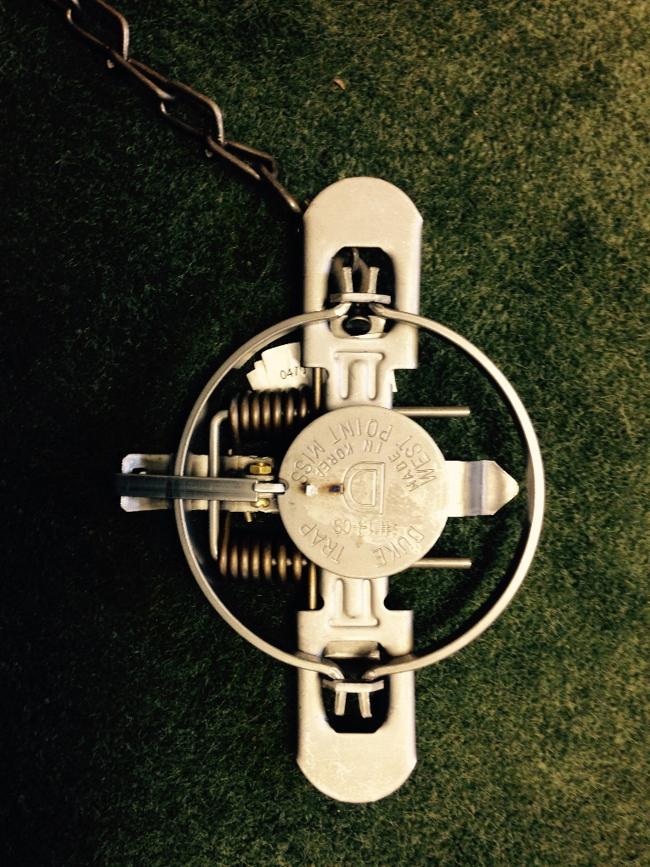
Traps
Learn/follow regulations
Limited effectiveness
Georgia trapping regulations:
  http://www.georgiawildlife.com/node/342
Photo: Jay Daniel

Slide 15
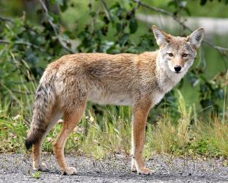
Poisoning
Non-selective
M-44 device (“Coyote Getter)
  Sodium cyanide the poison.
  Limited to trained personnel
Compound 1080 livestock protection collar
  Not widely used
  Used carbofuran as the poison; leaking a problem
  One on all animals?
Photo: Jitze Couperus (www.flickr.com/photos/jitze1942/1751241022/) via freeforcommercialuse.com

Slide 16
Hunting
Learn the regulations and follow them.
  http://www.georgiawildlife.com/hunting/regulations
Calling should be used sparingly.
A coyote population can be maintained with annual kill rates up to 70%.
An annual kill rate of 75% would take 50 years to eradicate coyotes.

Slide 17
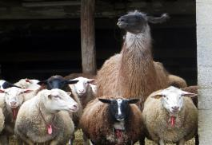
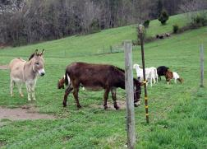
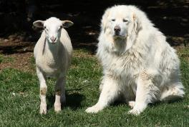
Guard Animals
45% sheep operations use guard animals (alpacas, dogs, donkeys or llamas)
82% herded/open range flocks use guard animals
Dogs most common (30% of sheep operations)
Photos: Susan Schoenian, Baalands Farm

Slide 18
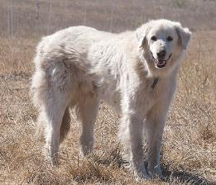
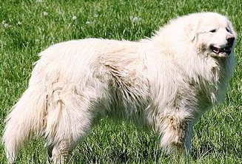
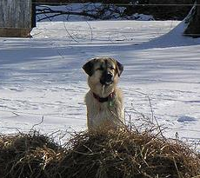
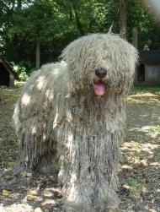
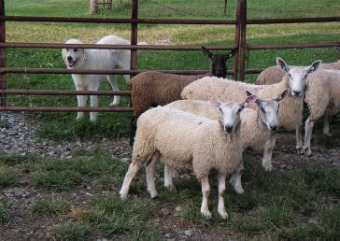
Guard Dogs
Great Pyrenees
Akbash
Komondor
Photo Jerry Kirkhart
(www.flickr.com/photos/jkirkhart35/ 2888698653/in/photolist-5pgktc-5pkARy) via creativecommons.org
Anatolian
Maremma
Photo: Schmeegan
www.flickr.com/photos/45699481) via creativecommons.org
Photos left and middle: Susan Schoenian

Slide 19
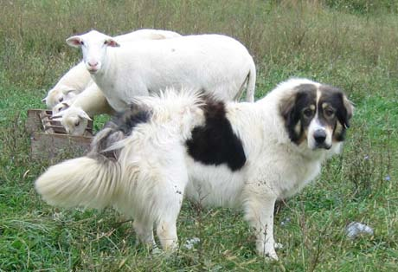
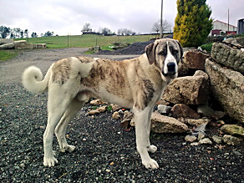
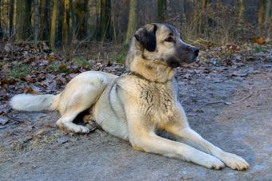
Guard Dogs
Karakachan or Bulgarian Shepherd
Cão de Gado Transmontano
Photo: www.sheepmagazine.com/31-2/karakachan_livestock_guardian_dogs/
Cão de Gado Transmontano
Photo: caodegadotransmontano.net/machos.html
Kangal
Photo: caodegadotransmontano.net/machos.html
Photo: Christ vT
(www.flickr.com/photos /chrisvt/7665280990/in/photolist-cFmyZ5) via creativecommons.org

Slide 20
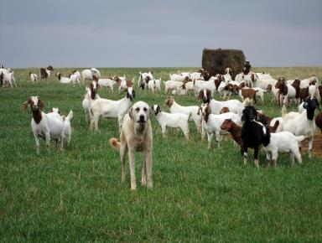
Guard Animals - Dogs
Match breed with environment
Availability
Adequate number for job
Adequate fencing
Proper care (do not let the dog run out of food)
Photo: Susan Schoenian, Baalands Farm

Slide 21
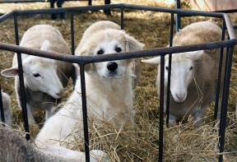
Guard Animals – Dog Training
Guarding is instinctive.
At 7-8 weeks of age, place in a small pen with sheep or goats, preferably lambs or kids.
At about 16 weeks of age, can release them into larger pasture.
Correct any undesirable behavior (ear chewing, roaming).
You should be able to catch and handle the dog, but a good guard dog is not a pet.
Photo: Susan Schoenian, Baalands Farm

Slide 22
Guard Animals – Dog Behavior
Scent marking boundaries
Warning barks occasionally – should not bark constantly
Circle animals into a small group
Run at threat, may run into or roll
Fight/attack threat

Slide 23
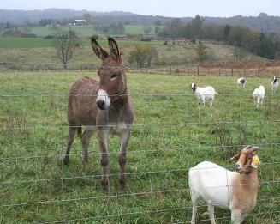
Guard Animals - Donkeys
Inherent dislike for dogs, coyotes, foxes
Success highly variable
Test response to a dog before use
Respond to dogs/canid predators with braying, bared teeth, running attack, kicking and biting.
Photo: Susan Schoenian, Baalands farm

Slide 24
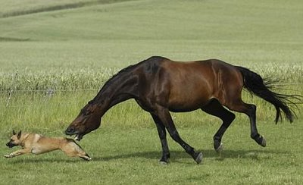
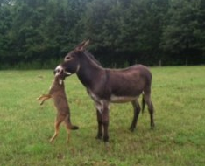
Photo: https://www.youtube.com/watch?v=YnCA-aDYbPA
Photo: Georgia Outdoor News: http://www.gon.com/article.php?id=3915

Slide 25
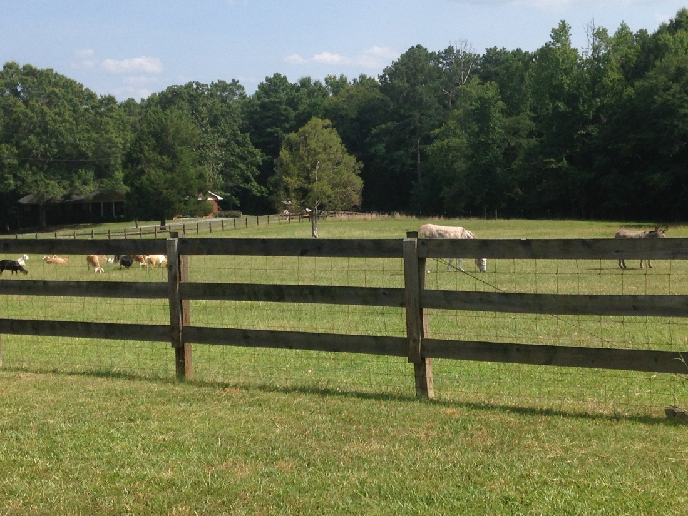
Guard Animals - Donkeys
Use only a jenny or gelded jack.
Use only one donkey for each group of sheep or goats (300 head or less).
Allow 4-6 weeks for the donkey to bond with sheep or goats.
Remove the donkey during lambing or kidding.
Use donkeys in small, open pastures.
Avoid feeds with monensin or lasalocid, which are poisonous to donkeys.
Photo: Jay Daniel

Slide 26
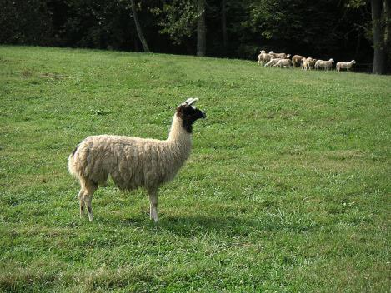
Guard Animals – Llamas (Alpacas?)
Inherent dislike for dogs, coyotes, foxes
Use similar to donkeys
Wool production, but not to mix with sheep wool
Do not distinguish between predators and herding dogs
Photo: Susan Schoenian, Baalands Farm

Slide 27
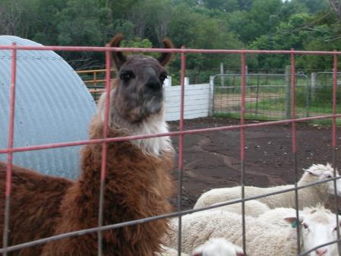
Guard Animals – Llamas (Alpacas?)
Use a gelded male.
Llamas are browsers and grazers and can be easily managed with sheep or goats; winter supplementation can be one square bale/week.
Train by exposing to sheep or goats in a small pen for 5-7 days, moving to a larger paddock for 5-7 days, and finally to pasture.
Photo: Jay Daniel

Slide 28
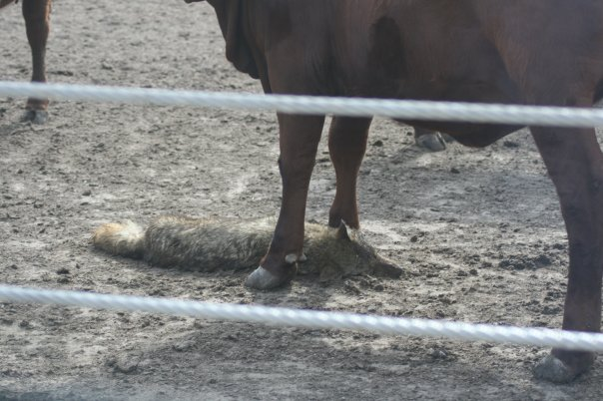
Heifer kills a coyote
Photo: Trey Gafnea, University of Georgia Cooperative Extension

Slide 29
Additional Resources
Meat goat production handbook (Langston University): www2.luresext.edu/goats/extension/handbookorderform.pdf
eXtension.org -
www.extension.org/pages/27119/goat-predator-control
Sheep 101 http://www.sheep101.info/201/predatorcontrol.html

Slide 30
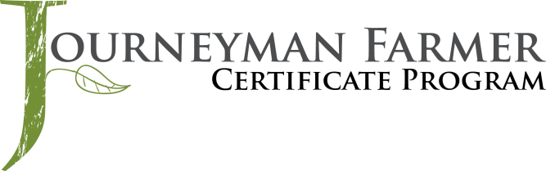


This material is based upon work that is supported by the National Institute of Food and Agriculture, U.S. Department of Agriculture, under award number 2015-70017-22861.
Beginning Farmer and Rancher
Development Program
Developing the Next Generation
of Sustainable Farmers in Georgia Grant

