Slide 1




Small Ruminant Production

Slide 2
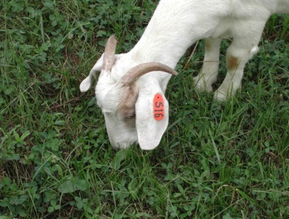
Session 2
Pasture Management
Dr. Dennis Hancock
Extension Forage Specialist
Crop & Soil Sciences Dept
University of Georgia

Slide 3
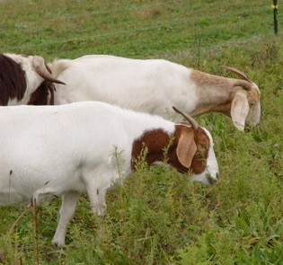
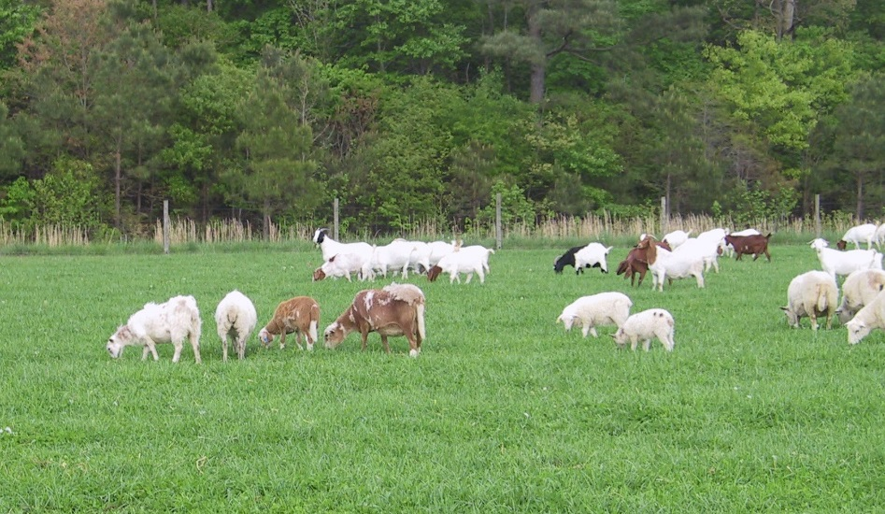
Learning Objectives
Identify forage types and basic nutrient content (i.e. grasses, legumes, forbs and browse)
Recognize the link between forage height/maturity and nutrient content/quality as well as parasite management.

Slide 4
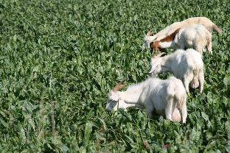
Over the next few minutes…
Photo: Susan Schoenian, Baalands Farm
Pasture management to meet nutritional needs of various small ruminant production classes
The necessity for improved pastures
  Desirable forage species
  Enabling the instinct to browse for goats (maybe hair sheep)
Ensuring forage availability
  Goal: year-round feed supply
  Emphasizing the use of legumes
Reducing internal parasite load
  Novel forages
  Rational grazing

Slide 5
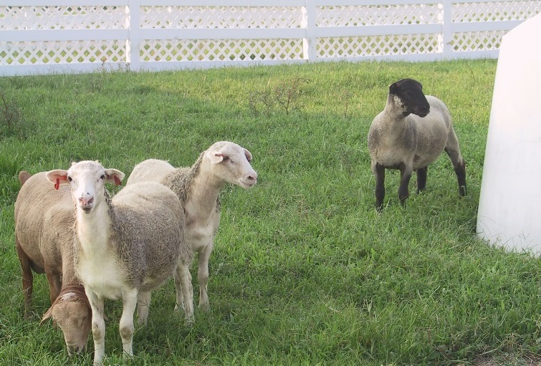
Pasture basics
Soil type/texture (percentage sand, silt and clay; i.e. sandy clay loam, loam)
Soil Health/Fertility
  Enough nutrients for healthy plants/good yields
  Optimal pH (target 6.0 to 6.8, near neutral); need appropriate pH to get the most out of fertilizer
  Good water storage and drainage
  Low disease and pest pressure
Notes:
What grows best on your farm will depend on your soil type and health. Soil maps (Soil & Water/NRCS) or soil sampling (?) can tell you want kind/texture of soil you have; soil testing can tell you more about your soil health.

Slide 6
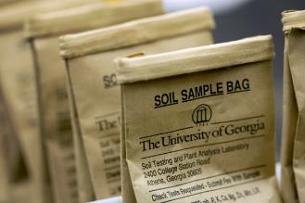
Soil Testing
Many labs, many different types of tests
Take a representative sample
  Soil test handbook available at:
  http://extension.uga.edu/agriculture/soil/
Use test to look at long term trends
Contact your local county extension office for assistance/more information:
http://extension.uga.edu/about/county/index.cfm

Slide 7
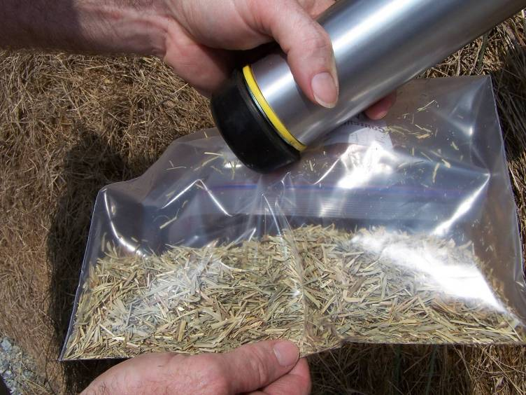
Photo credit: Bobby Smith, Morgan CEC
The least used and least understood element of a good forage management plan.

Slide 8
The Paradox of Forage Yield and Quality
Available Forage
(dry lbs/acre)
Relative Forage Quality
Days of Growth

Slide 9
Meat Goat Needs*
 | Protein (CP) | Energy (TDN)
Bucks (110-220 lb) 2% BW | 7% | 54%
Dry doe (88 - 154 lb) 2% BW | 7% | 53%
Late gestation (twins) 2.5% BW | 13% | 66%
Early lactation (twins) 3% BW | 13% | 53%
**Growing kid (30 lb; 0.44 lb/day)
Boer (4.0% BW) | 25% | 90%
Local (3.6% BW) | 21% | 89%
Yearlings (66 lb Boer, avg growth, 2.5%BW) | 15% | 66%
*% BW is all feed/forage eaten on dry matter basis as % of their body weight (NRC, 2007)
**Kids gaining less than 0.44 lb/day would require less; from Dr. Niki Whitley, Fort Valley State University

Slide 10
SHEEP Needs
 | Protein (CP) | Energy (TDN)
*Rams (220 lb, maintenance) | 7% | 53%
*Dry ewe (132 lb) | 7% | 53%
Late gestation (twins) 2.75% BW | 10% | 66%
Early lactation (twins) 3% BW | 15% | 67%
Weanling (4 mon, 66 lb, max ADG )
Early maturing - 5% BW | 12% | 79%
Late maturing - 3% BW | 19% | 66%
*Yearling ewes (88 lb) | 8% | 66%
*Based on dry matter intake of around 2% of body weight, or BW, unless otherwise noted (NRC, 2007); from Dr. Niki Whitley, Fort Valley State University

Slide 11
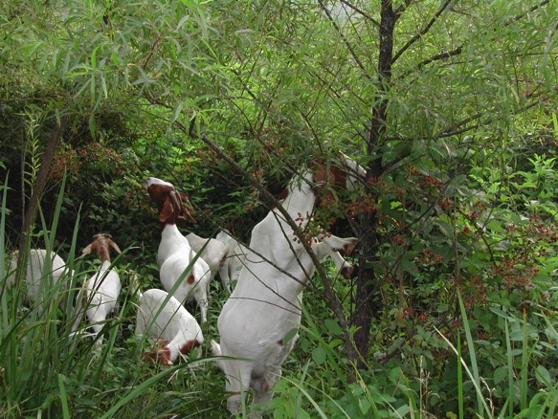
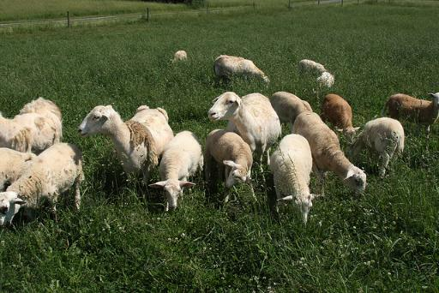
Grazing Habits
Goats prefer to graze above the shoulder. Sheep usually prefer to graze, though they will also eat forbs.

Slide 12
Approximate Diet Selection of Grazing Animals when Given Choice
 | Type of Diet
Animal Species | Grasses | Legumes | Browse
Cattle | 65-75 | 20-30 | 5-10
Horses | 70-80 | 15-25 | 0-5
Sheep | 45-55 | 30-40 | 10-20
Goats | 20-30 | 10-30 | 30-50
White-tailed deer | 30-60 | 40-50 | 10-30

Slide 13
Graphical Description of Diet Choice
Forage Type
GOATS
High
SHEEP
Grass
Selectivity
Legume
HORSE
Browse
Low
Steep
CATTLE
Slope Preference
Flat

Slide 14
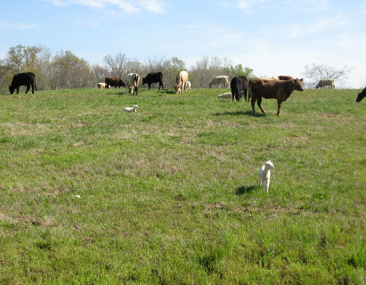
Stocking Rates on 2-2 ½ Acres
Pasture Type | Cows | Sheep | Goats | Cows + Goats
Excellent Pasture | 1 | 5-6 | 6-8 | 1 + 1-2
Brushy Pasture | 0.75 | 6-7 | 9-11 | 0.75 + 2-4
Silvopasture | 0.5-0.75 | 4-6 | 6-8 | 0.5 + 2-4
*Brush Eradication |  |  | 9-15 | 0.5 + 6-8
*Sheep can also be used for brush clearing though it often takes longer than for goats.

Slide 15
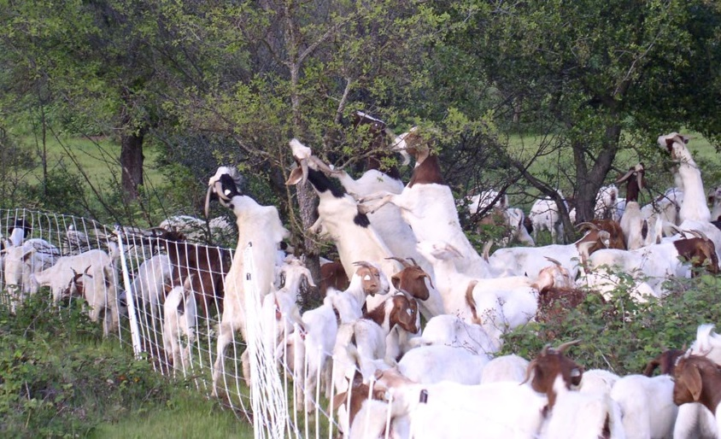
Goat Browsing
Photo Credit: Angela Boudro, Oregon St. Univ.

Slide 16
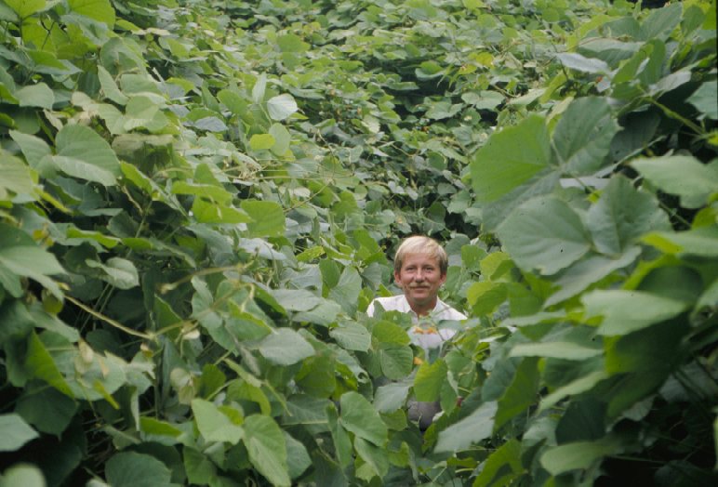
Kudzu
55-60% TDN; 12-18% CP
Photo credit: D. Ditsch and B. Sears, UKCES

Slide 17
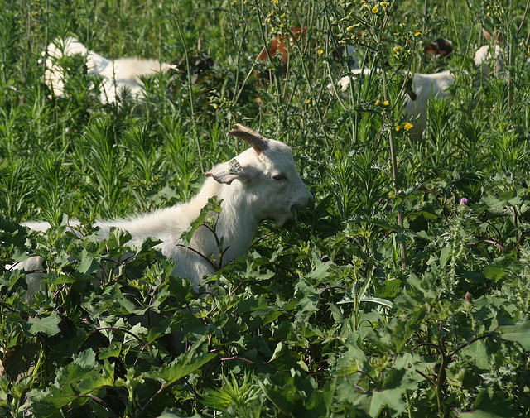
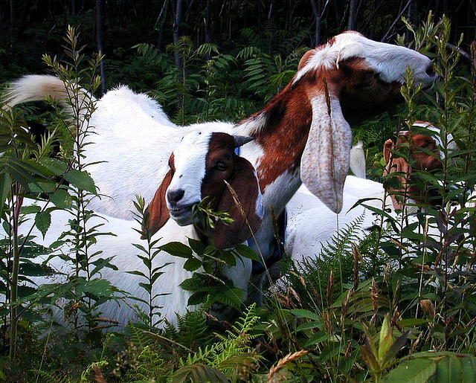
Also known to like…
Many browse/weed species:
Chinese privet
Pigweeds
Thistles
Stinging nettle
Blackberry/dewberry
Plantain
Curly dock
Multiflora rose
Sweet gum
Photos: Susan Schoenian, Baalands Farm

Slide 18
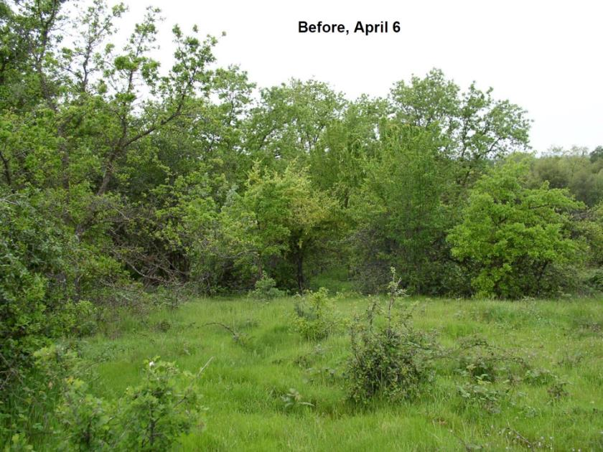
Photo Credit: Angela Boudro, Oregon St. Univ.

Slide 19
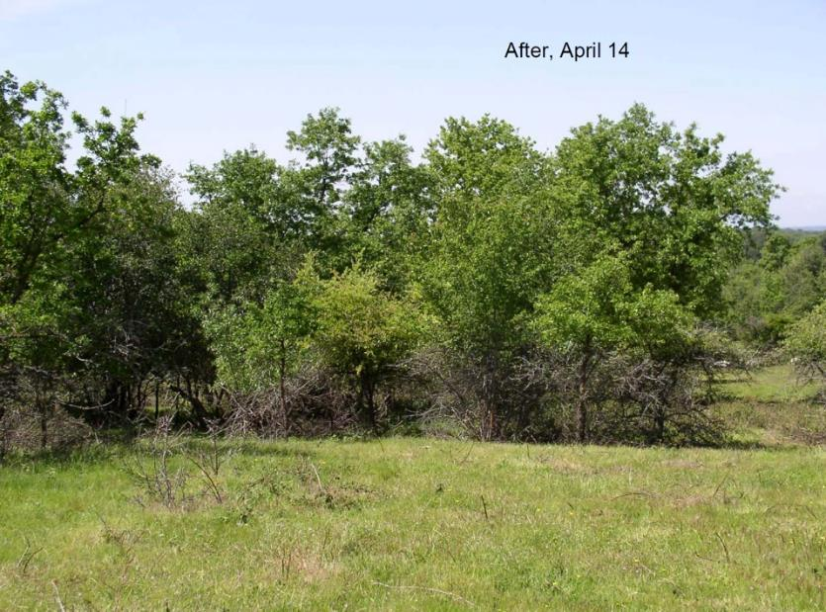
Photo Credit: Angela Boudro, Oregon St. Univ.

Slide 20
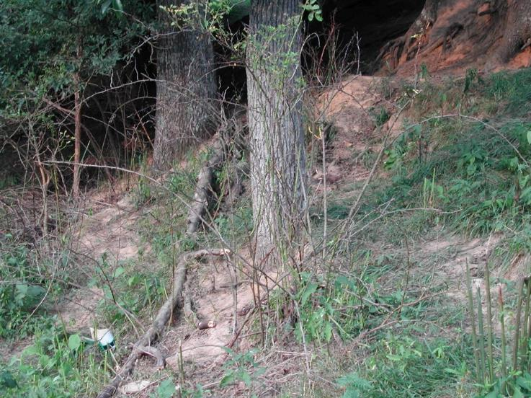
Sustainable Forage System?
Photo credit: D. Ditsch and B. Sears, UKCES

Slide 21
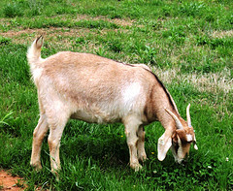
What else do we know about goat grazing behavior?
Diverse diet
  But, browse alone may not be sustainable
Consume undesirable plants
Co-grazing ability
  Cattle
  Horses
  Sheep
Preferential consumption of seedling stems
Resistant to some plant toxins/anti-quality factors

Slide 22
How do we get enough energy in the animal?
The animal eats more forage.
  What is the physical limit?
  Can a doe or ewe eat enough straw to meet her energy needs?
What forage the animal eats must be high in energy.
  High digestibility -> High energy
Bottomline: Every bite has to count!
  Pre-hensile lips make selective grazing/browsing easy!

Slide 23
Forage Distribution
Ideal
Relative Forage Provided

Slide 24
Forage Distribution
Winter Annual (small grain/annual ryegrass)
Cool-season perennial grasses
Warm-season perennial grasses
Relative Forage Provided

Slide 25
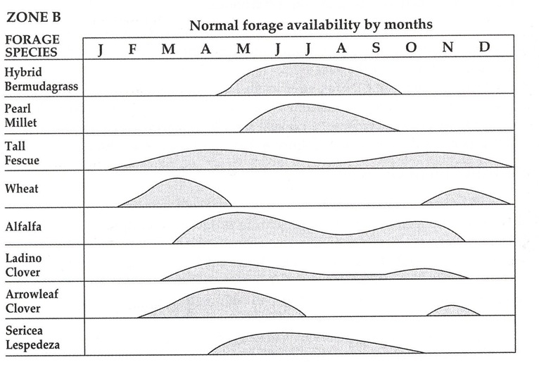
Forage Productivity Differs Throughout the Year
Piedmont
Source: Southern Forages, 5th Edition (2015)

Slide 26
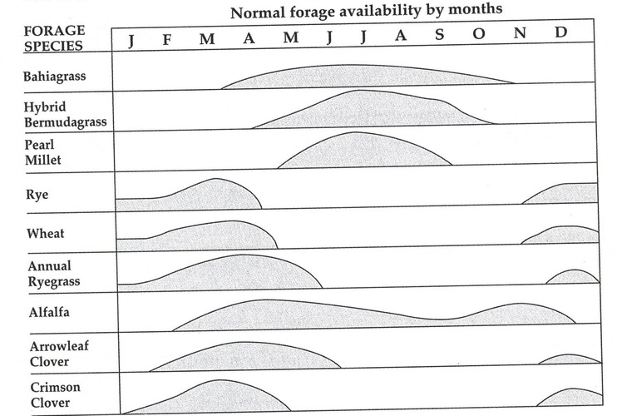
Forage Productivity Differs Throughout the Year
Coastal Plain
Source: Southern Forages, 5th Edition (2015)

Slide 27
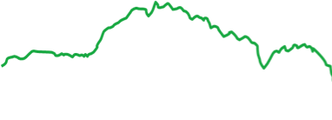
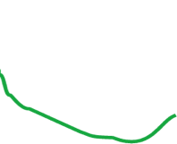
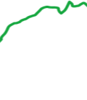
Forage Distribution
Ideal
Relative Forage Provided
Sustainable Stocking Rate
Actual

Slide 28
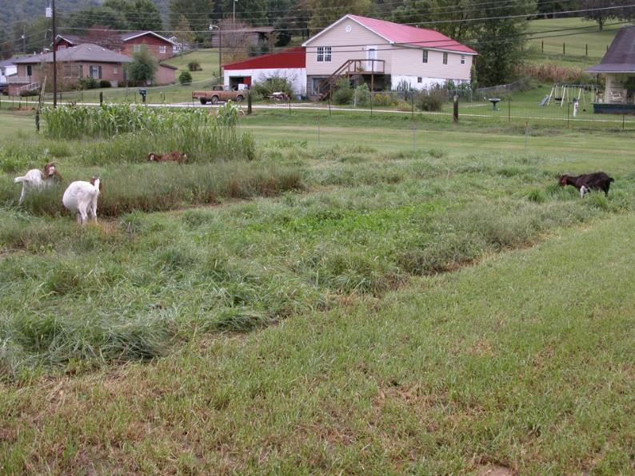
Goat Grazing Preference Trial
UK Robinson Station
2006
Photo credit: D. Ditsch and B. Sears, UKCES

Slide 29
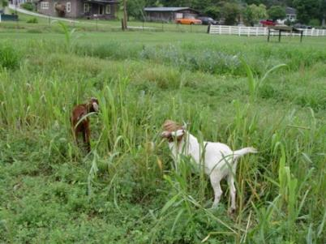
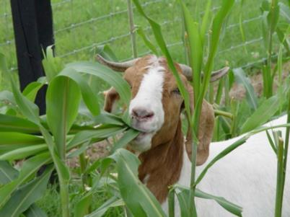
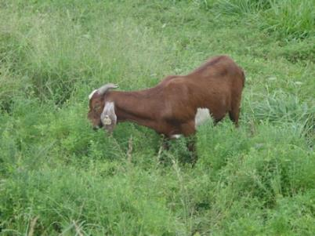
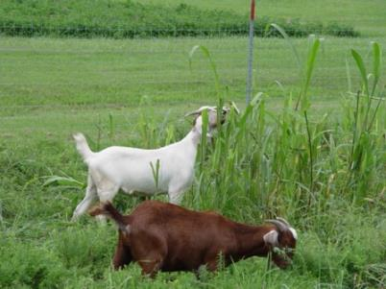
Goat Grazing Preference Trial
UK Robinson Station
2006
(Most to least)
Sorghum Sudan
White clover
Turnip
Red clover
Chicory
Sericea Lespedeza
Tall Oatgrass
Alfalfa
Warm Season Grasses
(EGG, Switch, BB, Indian)
Reed Canarygrass
Orchardgrass
Annual Lespedeza
Novel Endophyte TF
Endophyte Free TF
Infected TF
Bluegrass
Bermudagrass
Photo credit: D. Ditsch and B. Sears, UKCES

Slide 30
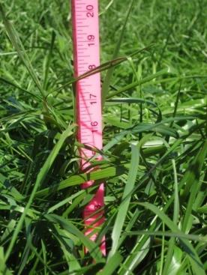
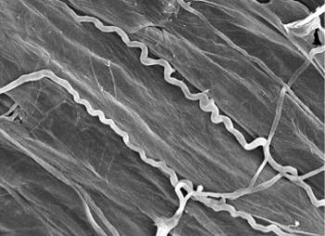
Cool Season Perennial Grasses - Tall Fescue
Most widely used forage grass in the U.S.
  High yields and persistent.
Endophytic fungus produces toxic alkaloids
  Fescue toxicosis
  Alkaloids aid drought tolerance and persistence
Novel Endophyte TF gives persistence benefit w/o toxicosis problems.

Slide 31
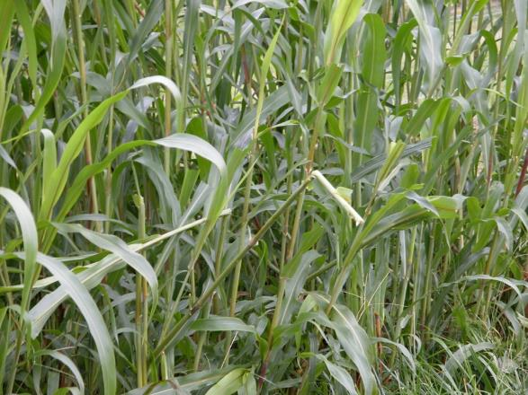
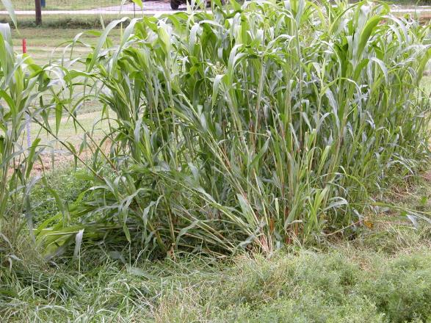

Warm Season Perennial Grasses

Slide 32
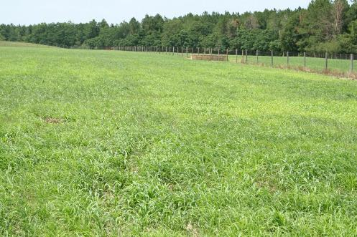
Summer Annuals
Pearl Millet, Sorghum x Sudan, Sudangrass, Brown Top Millet, Proso Millet, ect.
All have nitrate toxicity potential
Sorghums have prussic acid potential
    Sorghums should NOT be fed to horses
Late plantings result in low yields

Slide 33
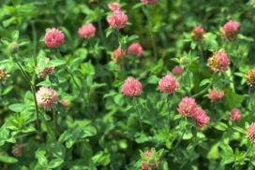
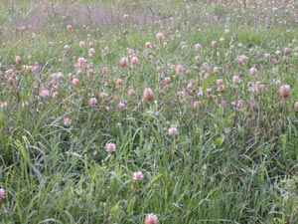
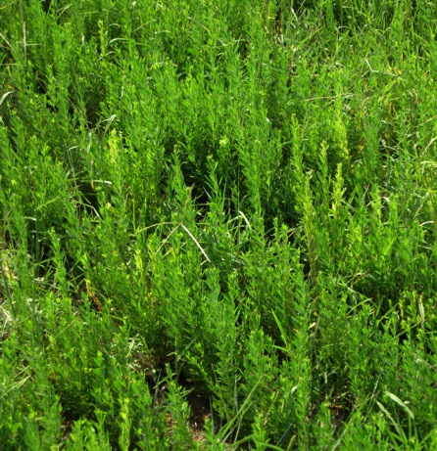
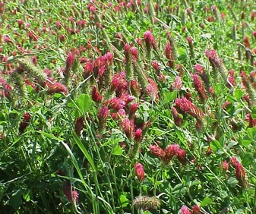
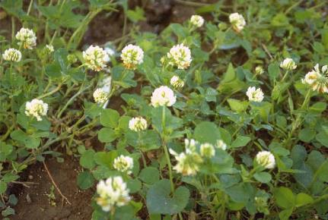
Legumes

Slide 34
Quality Differences in the Major Forage Species
High
Production
Mod.
Production
Maint.

Slide 35
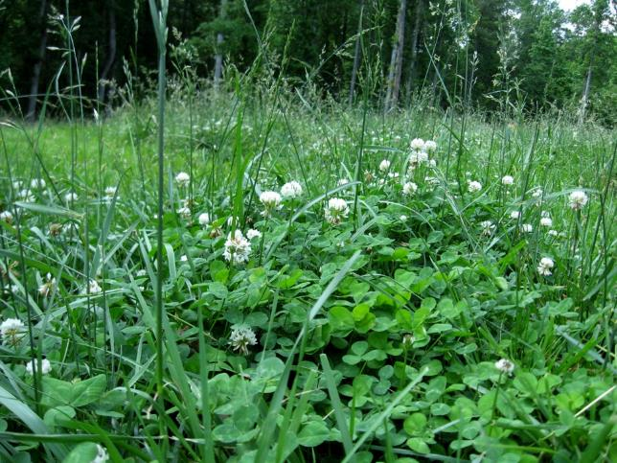
Legumes Help to Offset the Negative Effects of Endophyte-Infected Tall Fescue

Slide 36
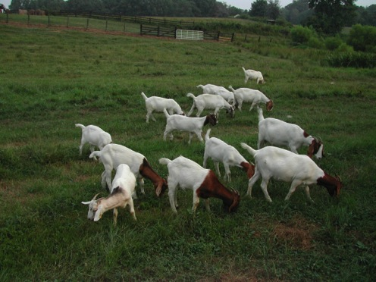

We force goats (and sheep) to graze close to the ground.
Grazing close to the ground increases the opportunity for parasitic larva consumption.
Better to graze over 4-6” in height to avoid parasites, however, over-mature (tall) forage can be less nutritious, so it is a balancing act.

Slide 37
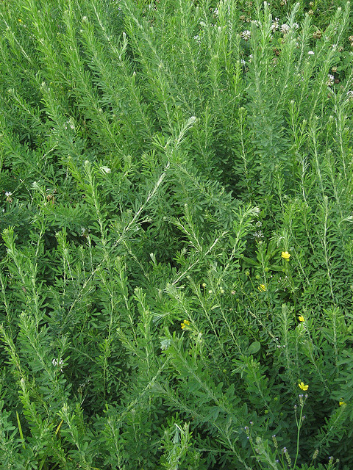
Serecia lespedeza
Has been shown to reduce parasite fecal egg counts in goats and sheep
Thought to work in part through specific types of condensed tannins
  Tannin- found in many plants
  Most research with AU grazer serecia lespdeza

Slide 38
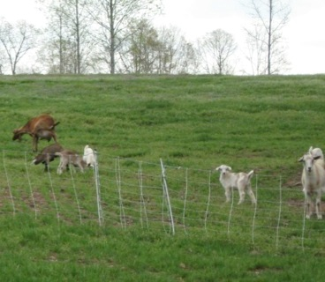
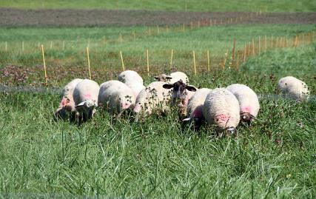
Rational (aka Rotational) Grazing
Allows one to:
Rotate out of heavy parasite pressure
Optimize selection of highest quality forage
Prevent overgrazing
Graze multiple forage species
Integrate woodlands and grass - legume pastures
Integrate warm and cool season forage species

Slide 39
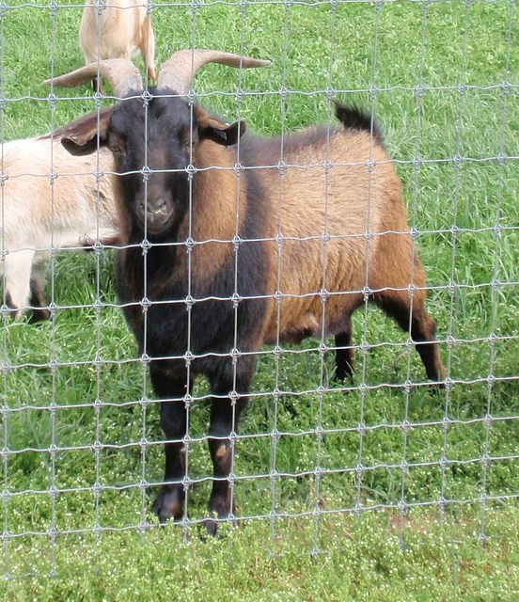
Perimeter Fencing
Goats need better fencing than sheep (stronger, taller)
Electric will work with the correct number of hot wires (always hot)
Smaller openings (4x4, 2x4) best with woven wire due to horns (or offset hot wires - always hot)
Various fencing for cross-fencing to split pastures (i.e. for rotational grazing)

Slide 40
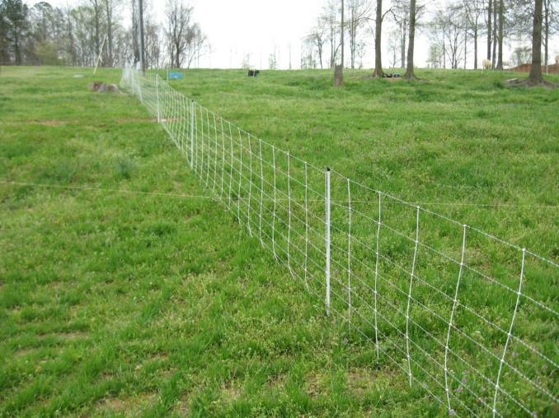
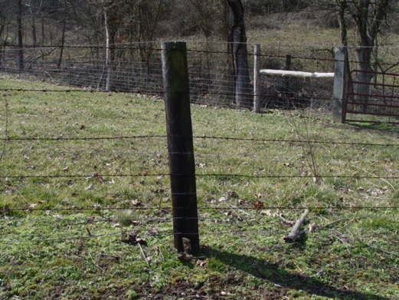
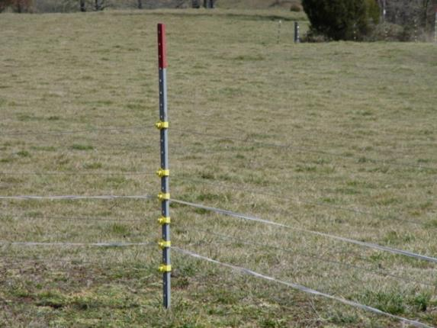
Fencing
3 hot wires: 10, 20, and 36 inches

Slide 41
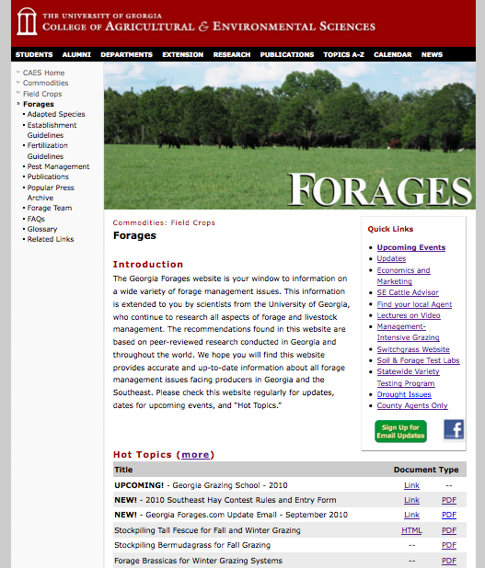
www.georgiaforages.com
GeorgiaForages.com Email Updates

Slide 42
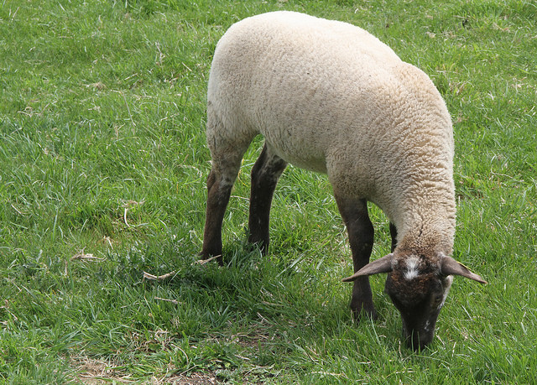

Questions?
www.georgiaforages.com

Slide 43

Additional Resources
Forages and pastures
www.georgiaforages.com
www.sheep101.info/201/pasturemgt.html
www.sheepandgoat.com/#!webinars/cu81
Fencing
www.sheep101.info/201/fencing.html
www.premier1supplies.com/instructions.php
www.staytuff.com/PDF/Stay-Tuff Installation Guide final Oct 13.pdf
No products, business, companies or manufacturers are being endorsed.

Slide 44



This material is based upon work that is supported by the National Institute of Food and Agriculture, U.S. Department of Agriculture, under award number 2015-70017-22861.
Beginning Farmer and Rancher
Development Program
Developing the Next Generation
of Sustainable Farmers in Georgia Grant

