Slide 1
Small Ruminant Production

Slide 2
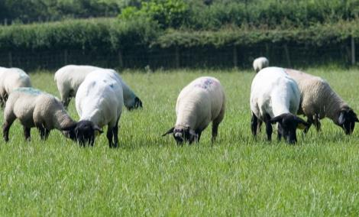
Session 2 Activity Small Ruminant Nutrition
Photos: Susan Schoenian, Baalands Farm and Dr. Niki Whitley

Slide 3
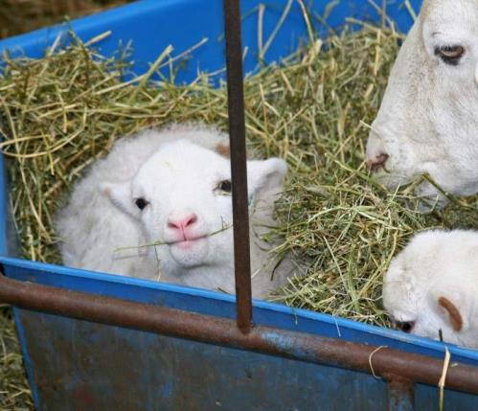
Learning Activity
For the next slides, indicate which of the pictured animals need more nutrients (have higher nutrient requirements in general).

Slide 4
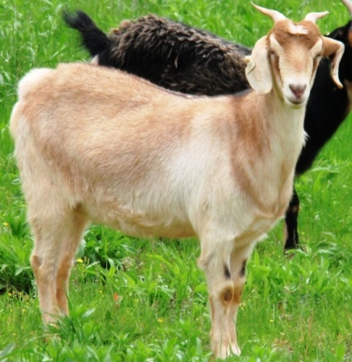
Learning Activity
Which needs more nutrients?
Not pregnant (open) yearling doe or a lactating yearling doe

Slide 5
Learning Activity
Which needs more nutrients?
2. A lactating yearling doe
Still growing and milking
Yearlings need more than mature females if same production stage
Same answer for sheep

Slide 6
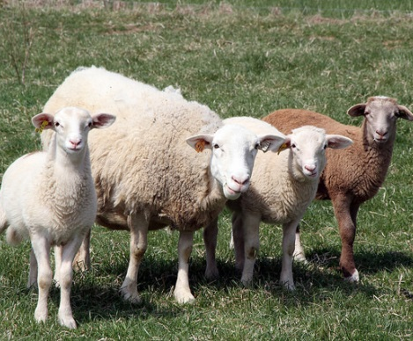
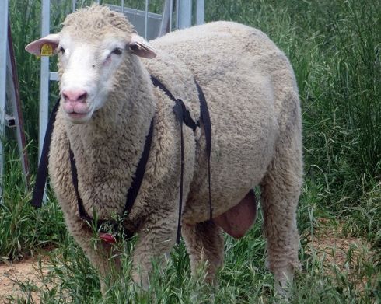
Learning Activity
Which needs more nutrients?
A ewe with triplets or a large adult ram during breeding season

Slide 7
Learning Activity
Which needs more nutrients?
A ewe with triplets
Lactating/nursing females have higher nutrient requirements than healthy males
Same answer for goats

Slide 8
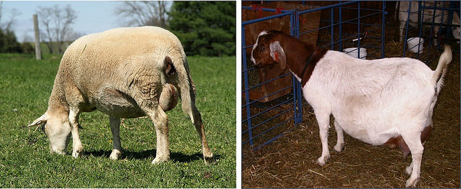
Learning Activity
Which needs more nutrients?
A late gestation ewe or late gestation doe?

Slide 9
Learning Activity
Which needs more nutrients?
A late gestation doe
All else the same, goats have higher requirements than sheep
If ewe carrying triplets but doe a single, answer would likely change
If ewe in poor condition (needed to gain weight) but doe was fat, answer may change

Slide 10
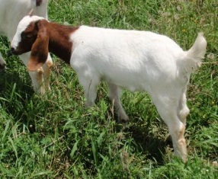
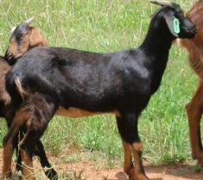
Learning Activity
Which needs more nutrients?
A Boer kid or a Spanish kid?

Slide 11
Learning Activity
Which needs more nutrients?
A Boer kid
Boers greater genetic potential for muscling and growth
All else the same, will have higher requirements than Spanish

Slide 12
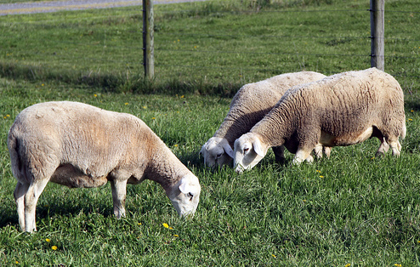
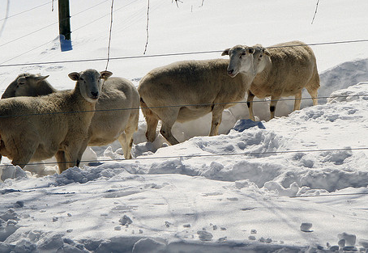
Learning Activity
Which needs more nutrients?
Ewes in the spring or ewes in the winter?

Slide 13
Learning Activity
Which needs more nutrients?
Ewes in the spring or ewes in
the winter?
Goats and sheep housed outdoors need more energy in winter to keep warm
Hay digestion helps create body heat
Good quality hay along with other needed energy supplementation important

Slide 14
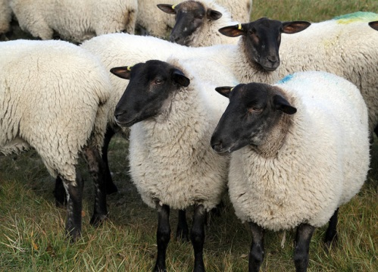
Learning Activity
Which needs more nutrients?
Early pregnant ewes or open (not pregnant) ewes?

Slide 15
Learning Activity
Which needs more nutrients?
Early pregnant ewes and open (not pregnant) ewes are similar
Trick question
Requirements for early pregnant and open does and ewes are not really that different
If in good condition, extra feed/nutrients not needed in early pregnancy
Good time to feed extra if need to gain weight

Slide 16
Learning Activity
How can you provide protein and energy for growth to a young kid or lamb:
Using a forage-only feeding system?

Slide 17
Learning Activity
How can you provide protein and energy for growth to a young kid or lamb:
2. Using a forage-only feeding system?
Excellent forage planning and management may be able to meet the needs of lambs and older kids for optimal (not maximal) growth
Good quality grass/legume mix pasture and browse/forbs
Rotational grazing
Fertilization/Irrigation (?)
Plant height management for nutrients and parasite control
Younger just weaned kids and some breed lambs may need extra supplementation, especially if pastures have high parasite loads

Slide 18
Learning Activity
How can you provide protein and energy for growth to a young kid or lamb:
Using a forage plus feed supplement feeding system?

Slide 19
Learning Activity
How can you provide protein and energy for growth to a young kid or lamb:
2. Using a forage plus feed supplement feeding system?
Allows for flexibility when forage resources are limited (not enough land/pastures available, drought, etc.)
Feed supplement with pasture or hay, depending on farm resources can provide extra protein and energy
Ex: When pasture/hay low or low quality, a grain-soybean meal fed at one half to one percent of total animal body weight can help; more may be needed for kids than for lambs and for winter than for summer
Supplementation can vary based on requirements and animal body condition.

Slide 20
Learning Activity
How can you provide enough energy for weight gain to a very thin doe or ewe just giving birth to triplets:
Using a forage-only feeding system?

Slide 21
Learning Activity
How can you provide enough energy for weight gain to a very thin doe or ewe just giving birth to triplets:
2. Using a forage-only feeding system?
Highly unlikely that forage-only feeding system would be adequate
Could remove some of the offspring (bottle feed)

Slide 22
Learning Activity
How can you provide enough energy for weight gain to a very thin doe or ewe just giving birth to triplets:
Using a forage plus feed supplement feeding system?

Slide 23
Learning Activity
How can you provide enough energy for weight gain to a very thin doe or ewe just giving birth to triplets:
Using a forage plus feed supplement feeding system?
Feed supplement with high energy and appropriate protein for the species (goat or sheep) along with excellent quality forage (pasture) and/or hay
Cannot eat enough forage to meet needs for milk production and to gain weight (productive females lose weight during lactation)
High fat supplement or adding corn oil to the feed adds energy (calories) without increasing diet ‘bulk’ so can eat more calories

Slide 24
This material is based upon work that is supported by the National Institute of Food and Agriculture, U.S. Department of Agriculture, under award number 2015-70017-22861.
Beginning Farmer and Rancher
Development Program
Developing the Next Generation
of Sustainable Farmers in Georgia Grant

