Slide 1




Small Ruminant Production

Slide 2
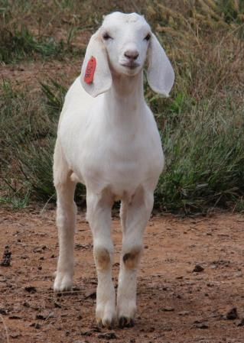

Session 1
Breed and Breeding Stock Selection
Dr. Niki Whitley Susan Schoenian
Animal Science Extension Specialist Sheep & Goat Specialist
Fort Valley State University University of Maryland Extension

Slide 3
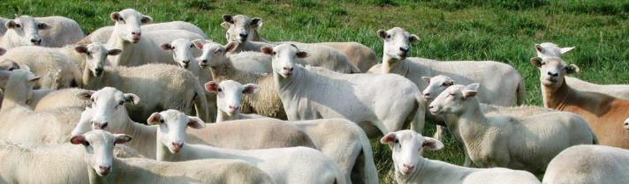
Learning Objective
Understand how to select animals using records and visual appraisal

Slide 4
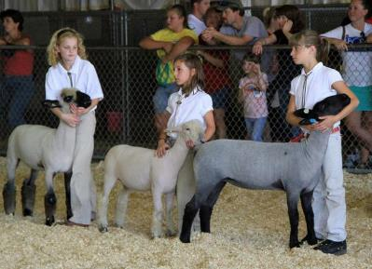
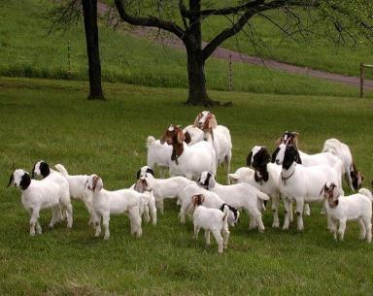
Selection
Species/breed depends on:
  Production system/market
    Meat animals
    Breeding stock/meat
    Show/meat
    Fiber/meat
    Dairy/meat
  Resources
Photos: Susan Schoenian, Baalands Farm

Slide 5
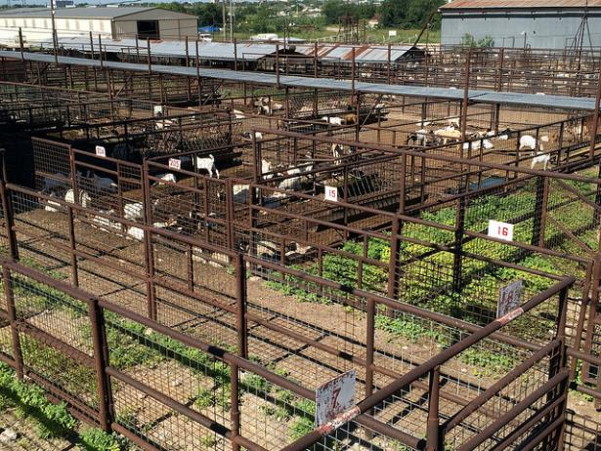
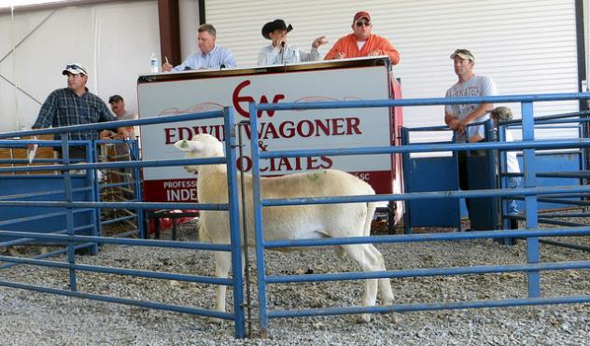
Production System/Market
Meat animals
  Local sale barn
  Livestock buyers
  Direct to consumer/farm
  Meat-processing; permits
Breeding stock
  Direct sales
  Special breeding stock sales
Photos: Susan Schoenian, Baalands Farm

Slide 6
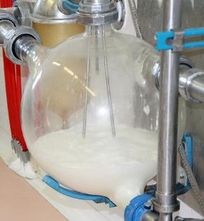
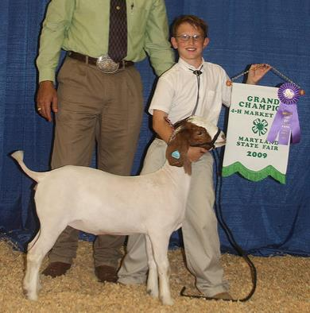
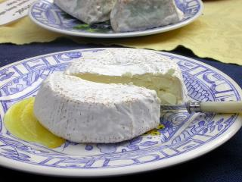
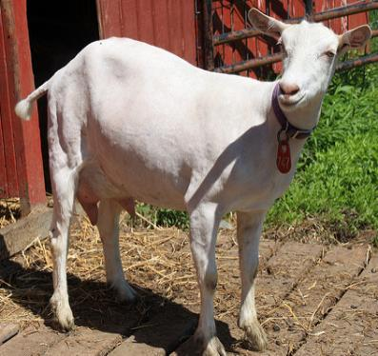
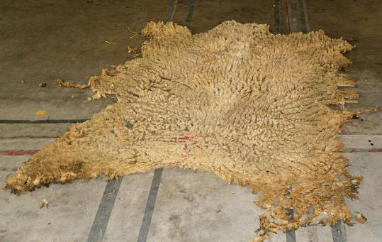
Production System/Market
Show animals
  Direct sales
  Show sales
  Market for culls
Fiber/dairy
  Direct sales
  Products - processing
  Regulations for dairy
  Market for culls
Saanen dairy goat
Photos: Susan Schoenian, Baalands Farm

Slide 7
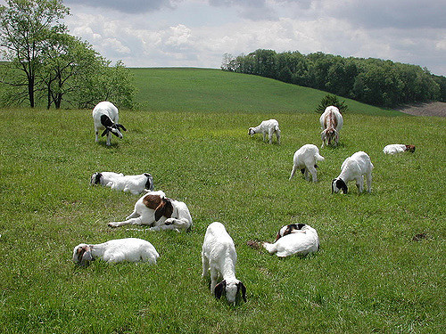
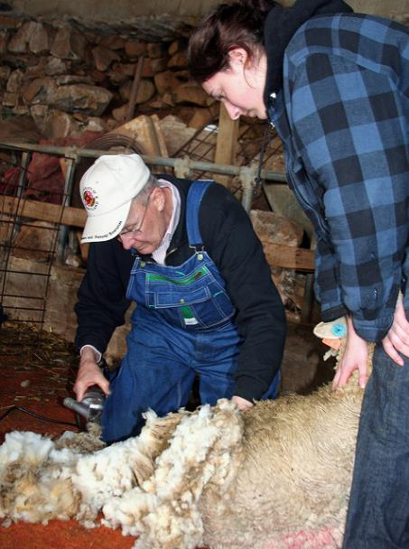
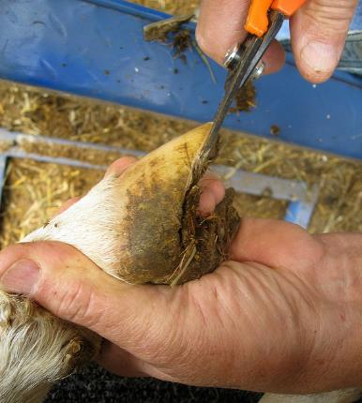
Resources
Farm size
  Stocking rates
Structures
  Barns/shelters
  Storage/Other
Labor
Funds
  For animals
    Hard to find?
  Feeding
  Vet/Health Care
  Marketing
Photos: Susan Schoenian, Baalands Farm

Slide 8

Potential profitability
Look at market to determine possible output (sales) from animals
Resources you have or have to purchase for inputs/costs
Profit = outputs – inputs
Enterprise budgets can help
  Internet search “goat and sheep budgets”
  Local County Extension Office

Slide 9
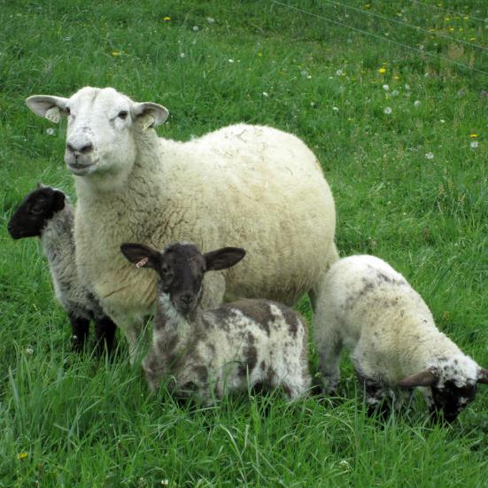
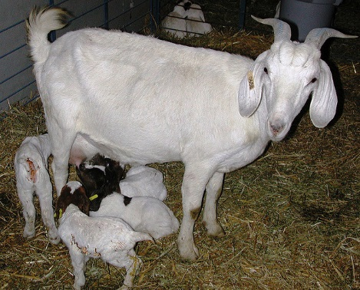
Commercial Meat Production
Important
Performance (output)
  Pounds of quality offspring to sell
  Meet market needs
Fitness (input)
  Disease-resistant
  Longevity
  Easy-care
Photo: Susan Schoenian, Baalands Farm
Less important
Body conformation
Fiber/Wool
Sire selection is very important, three generations = 88% genetics

Slide 10
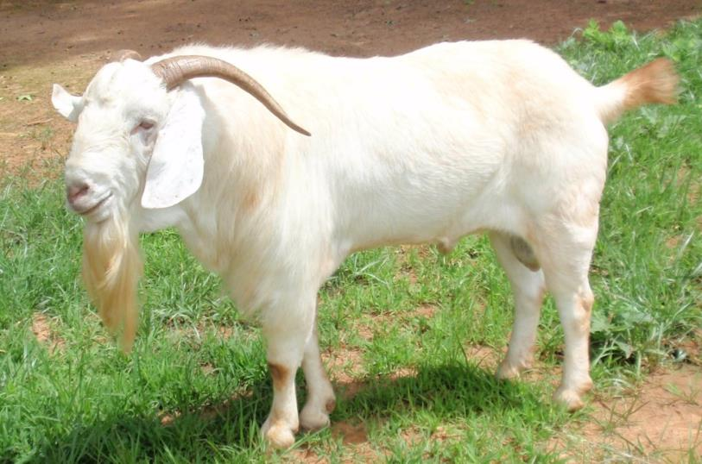
Breeding Stock
Important
What the market is looking for- pedigree/bloodlines, breed character, fitness, growth
Reproductive efficiency
  Pounds quality offspring to sell
Body conformation
  Structural correctness - related to performance/longevity
Current fad?

Slide 11
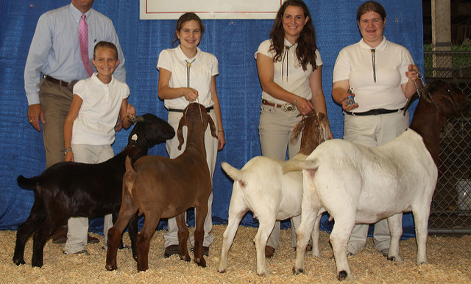
Show animals
Important
Looks/conformation (what market is looking for)
Winning records
Current fad?
Reproductive efficiency?
  Number quality offspring to sell

Slide 12
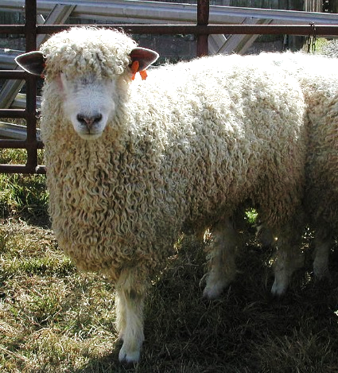
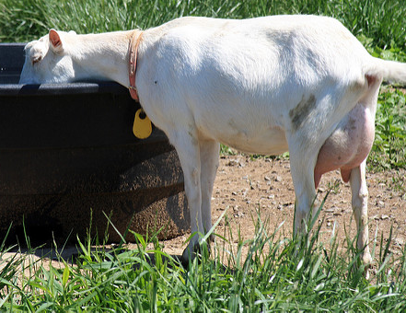
Fiber/Dairy Animals
Important
Quality/quantity of product
Winning/best records
  Fiber shows
  DHIA results
Reproductive efficiency?
  Number quality offspring to sell
Conformation (udder)

Slide 13
US Sheep Breeds by Primary Purpose
Meat | Wool | Multi-purpose | Other
Hair (or shedding) | Fine | Wool | Babydoll Southdown Black Welsh Mountain Blueface Leicester Calif. Variegated Mutant Clun Forest Florida Cracker Florida or Gulf Coast Native Hog Island Icelandic Jacob Karakul Navajo-Churro Scottish Blackface Shetland Soay
American Blackbelly Barbado California Red Dorper Katahdin Romanov Royal White St. Croix Wiltshire Horn | Booroola Merino Cormos Debouillet Merino Panama Rambouillet | Columbia Corriedale Finnsheep Polypay S. African Meat Merino Targhee
Wooled | Long | Dairy
Border Cheviot Dorset Hampshire Ile de France North Country Cheviot Oxford Shropshire Southdown Suffolk Texel Tunis | Border Leicester Coopworth Cotswold Leicester Longwool Lincoln Perendale Romney Wensleydale | Awassi East Friesian Lacaune

Slide 14
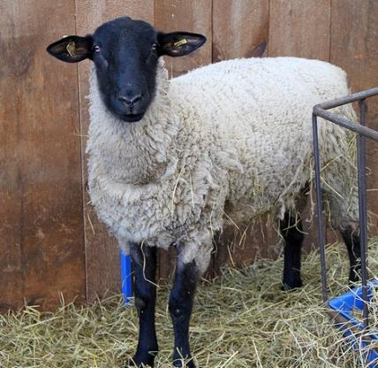
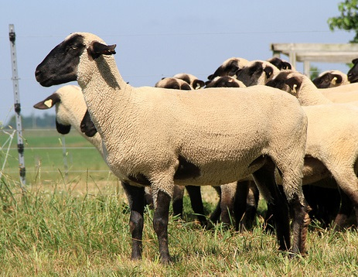
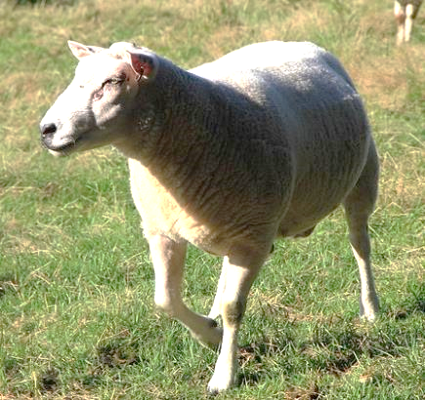
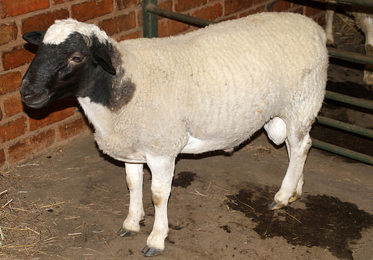
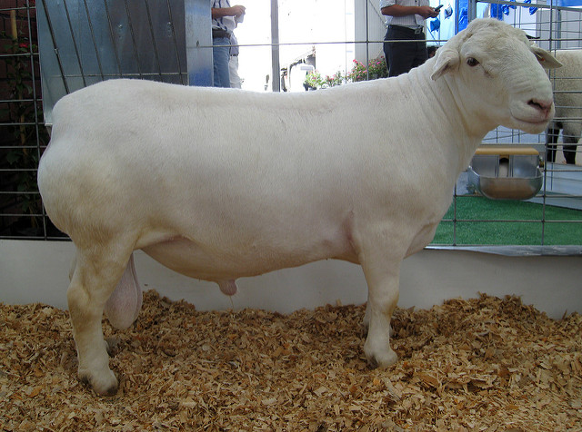
Sheep Terminal (sire breeds)
Suffolk, Hampshire – Frame/growth (feedlot)
Texel– Muscling/carcass (pasture)
Dorper/White Dorper – Muscling, hair (pasture)
Photos: Susan Schoenian

Slide 15
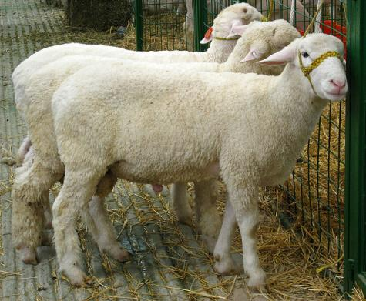
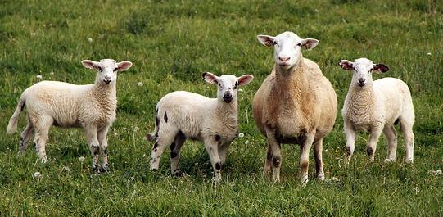
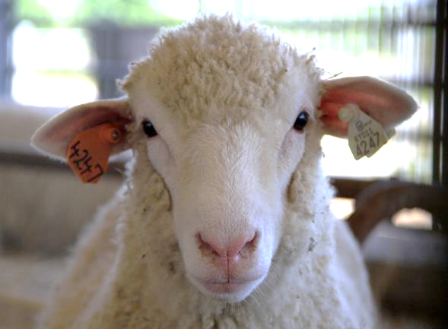
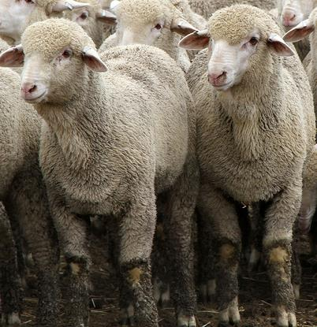
Sheep Maternal (ewe breeds)
Katahdin – Fitness, reproduction
Dorset – Both: reproduction, good growth
Polypay – prolificacy, mothering
Rambouillet – Maternal wool
Photos: Susan Schoenian, Baalands Farm

Slide 16
US Goats Breed by Primary Purpose
Meat | Dairy | Fiber | Other
Boer Kiko Myotonic (Tennessee Fainting) Pygmy Savanna Spanish* | Alpine La Mancha Nigerian Dwarf Nubian Oberhasli Saanen Toggenburg | Angora Cashgora Cashmere* Pygora | Arapawa Golden Guernsey Kinder Other mini-goats Sable (Saanen) San Clemente Scrub/Brush/Wood*

Slide 17
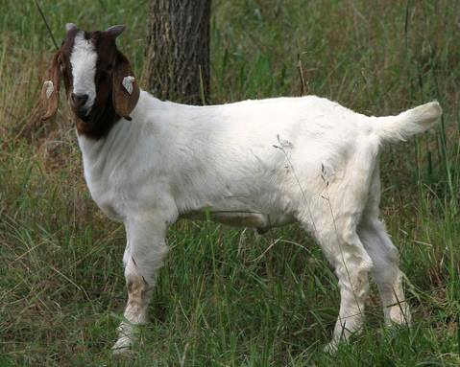
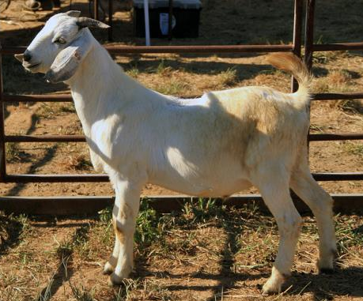
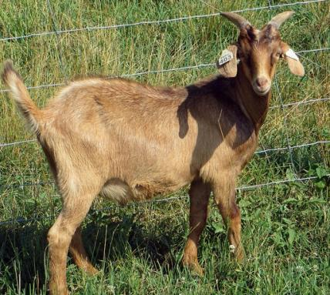
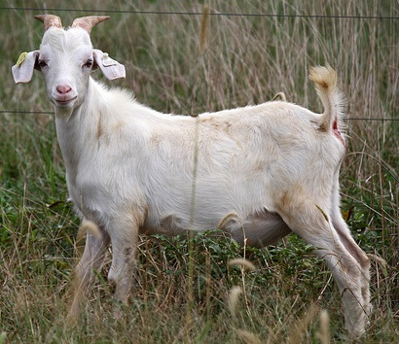
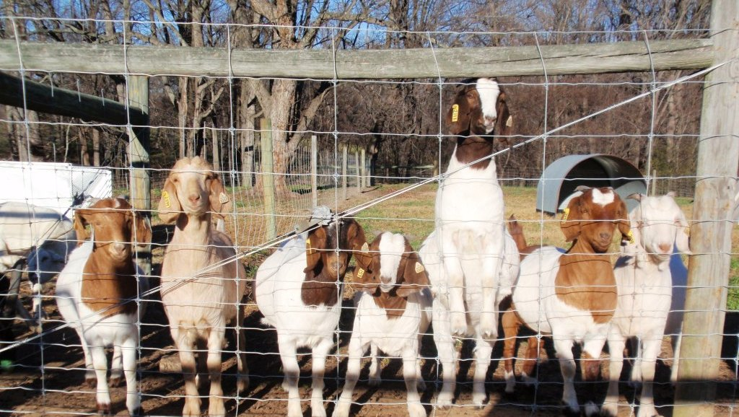
Goat Terminal (sire breeds)
Boer, Savanna – muscling, growth
Kiko – growth, fitness (both?)
Photos above: Susan Schoenian, Baalands Farm

Slide 18
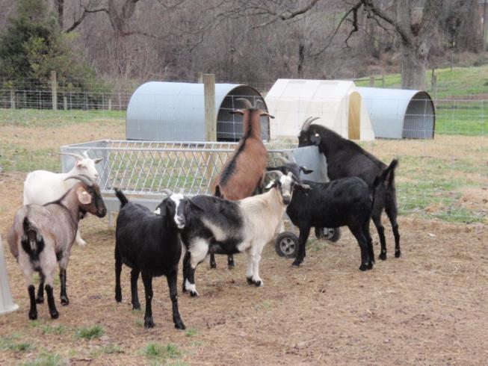
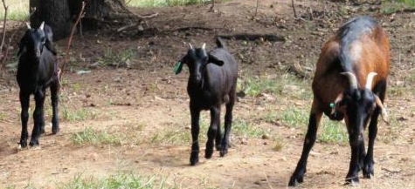
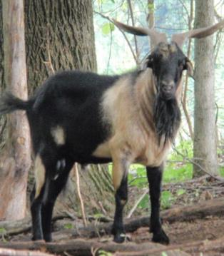
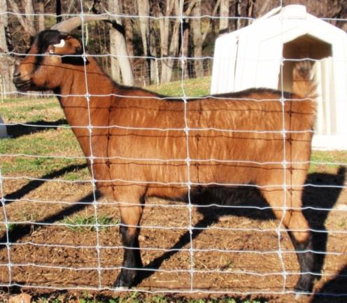
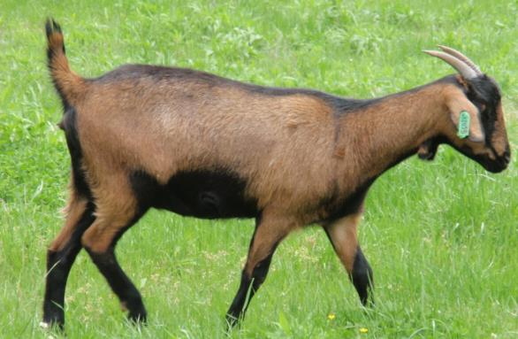
Goat Maternal (Doe breeds)
Kiko – both?; fitness, mothering, growth
Spanish – Fitness, mothering

Slide 19
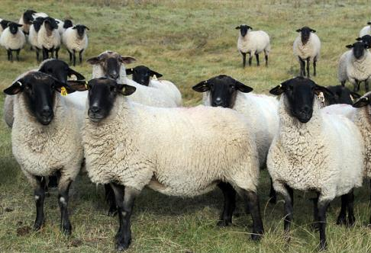
Selection and Marketing
Performance (objective)
Visual appraisal (subjective)
Birth records
Growth records
Deworming/fecal egg counts
Ultrasound
Actual carcass measurements
Fleece weights/Micron testing
Milk yields
EPDs/EBVs
Genetic testing
Body conformation
Udder conformation
Live evaluation/handling
Visual evaluation of wool
Show winnings
Photo: Susan Schoenian

Slide 20
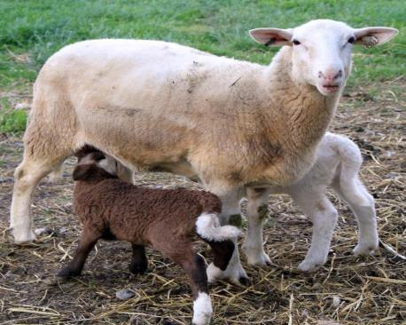
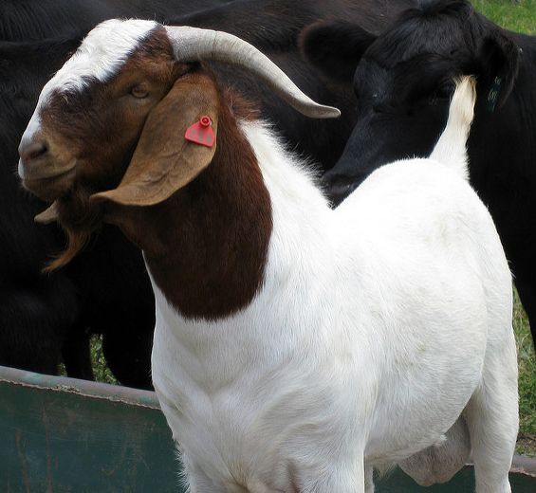
Selection and Marketing
Performance and looks are impacted by environment and genetics
Environmental factors: Nutrition, health, weather/season, management, housing, age
Purchase from people with similar management/farm environment

Slide 21

Selection and Marketing
Performance selection – genetics
    On farm records comparisons – reproduction, adjusted weights, fecals or dewormings, flock/herd EBVs/EPDs
    Performance tests (compares animal data); across-flock EBVs/EPDs
    Genetic testing – scrapie, myostatin, fecundity genes
nsip.org – EPDs/EBVs for sheep and goats

Slide 22
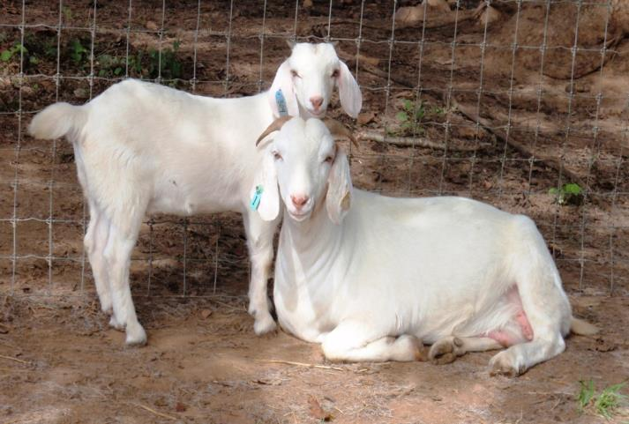
Selection Tips
Decide traits you want
Balanced selection - can select for multiple traits
Set minimum standards
Example:
  Twin or better
  Dewormed once as lamb/kid
  Weaning wt ratio above 100% (pre-weaning for females, also post-weaning for males)

Slide 23
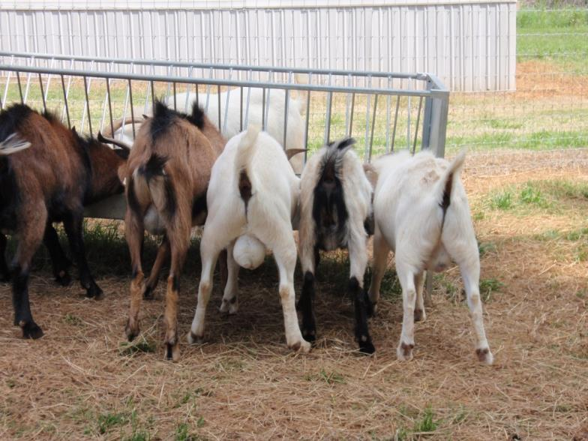
Within herd/flock selection
Look at:
  Data/records – within the breed or breed type
  Check pedigree to avoid inbreeding
  Problems/issues – health, behavioral
  LAST: Visual appraisal – reduces temptation to keep probable bad genetics in a pretty animal

Slide 24
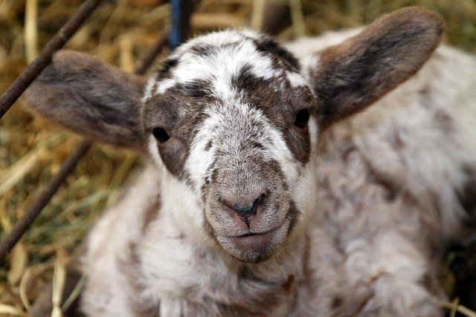
Purchase from another farm
Consider/ask about:
  Farm Health Status - problems/issues, vaccinations, routine treatments
  Management - feeding, housing, lambing assistance, records/information kept
  Records specifically for all animals for sale
  LAST: If no problems related to health and management, visually appraise animals chosen based on records
Photo: Susan Schoenian, Baalands Farm

Slide 25
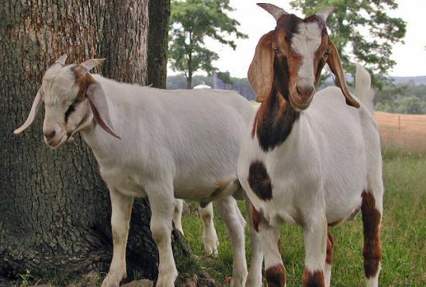
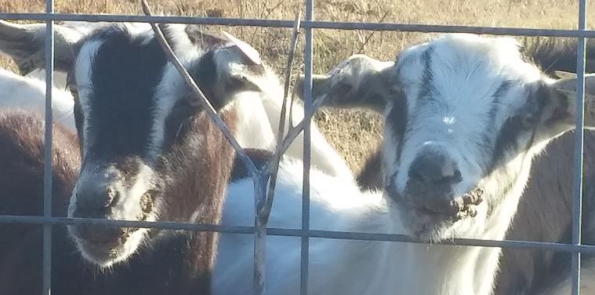
Visual appraisal
Health/Soundness
  Bright, alert, front of flock/herd?
  Good body condition
Problems (do not buy)
  Limp
  Abscesses or pink eye
  Sore mouth lesions
  Respiratory symptoms- snotty nose, labored breathing
  Extremely poor condition
Photo above: Susan Schoenian
More info: http://www.sheep101.info/201/acquiringstock.html

Slide 26
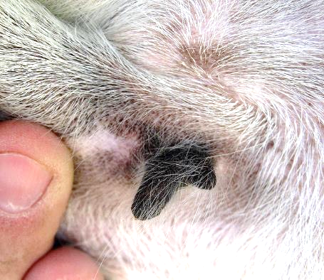
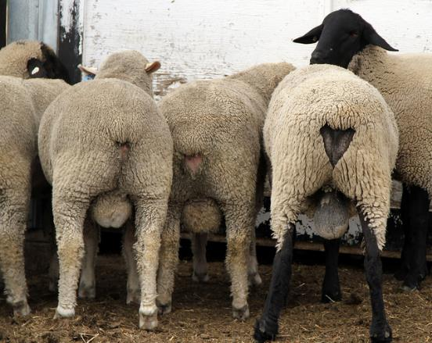
General Visual Appraisal
Fish teat, not good
  Males look masculine, females look feminine
  Udder connection good, no lumps/bumps, no teat defects/extra teats (males too), seem functional
  Testicles firm, no lumps/bumps, normal size
Photos: Susan Schoenian, Baalands Farm

Slide 27
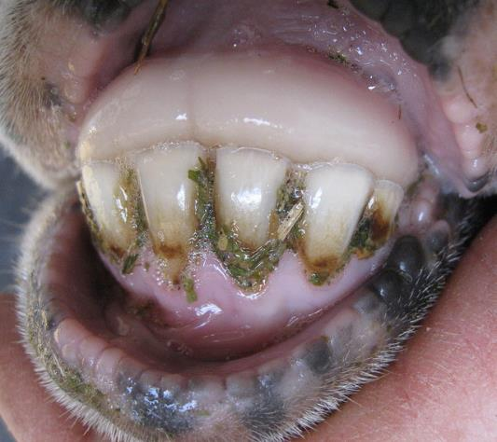


General Visual Appraisal
  Mouth:
    Top palate and bottom teeth should meet
    No undershot bottom jaw (monkey mouth) or overshot top (parrot mouth)
  Good conformation
Undershot jaw/underbite – not good
Photos: Susan Schoenian, Baalands Farm

Slide 28
Sheep too!
Picture and following text from ATTRA (attra.ncat.org)- Animals with good conformation are strong in structure, deep bodied, wide chested and able to walk squarely on feet and legs.
More: www.danekeclublambs.com/SheepFeetandLegStructureTest.html

Slide 29





A nice ewe lamb
Photo above: Susan Schoenian
Sickle
Hock
Sires in ANY production system should have good conformation!!!
Pastern-area between ankle and hoof
www.lazyjvranch.com/sitebuilder/images

Slide 30


Summary tips
Select a breed (or breeds to crossbreed) based on your farm goals, market and resources
For stock selection, get performance records first, then do visual appraisal and choose healthy, sound animals
Buy from reputable breeder (with management similar to your own)
Be aware - sale barns/grouped animals from different places – isolate new animals for 30 days

Slide 31
References and Additional Resources
Small Ruminant Webinars:
www.sheepandgoat.com/#!webinars/cu81
Goats:
www.famu.edu/cesta/main/assets/File/coop_extension/small ruminant/goat pubs/Selecting_Goats.pdf
www.aces.edu/pubs/docs/U/UNP-0110/UNP-0110.pdf
extension.psu.edu/courses/meat-goat/basic-production/selecting-meat-goats
www.youtube.com/watch?v=A4LFKjInVmE
Sheep:
www.aces.edu/pubs/docs/A/ANR-0821/index2.tmpl
www.sheep101.info/201/acquiringstock.html
www.onlinesheepshow.com/placed.htm (show sheep)

Slide 32
References and Additional Resources
General:
attra.ncat.org/attra-pub/download.php?id=218
attra.ncat.org/attra-pub/livestock/
http://www.sheepusa.org/ResearchEducation_OtherResearch_UsBaselineLambCostOfProductionModel
Budgets:
economics.ag.utk.edu/budgets/2010/PB1793-MeatGoat.pdf
www.sheep101.info/201/budget.html
agecoext.tamu.edu/resources/crop-livestock-budgets/by-commodity/sheep-and-goats/2015-sheep-and-goats/
agebb.missouri.edu/mgt/budget/

Slide 33



This material is based upon work that is supported by the National Institute of Food and Agriculture, U.S. Department of Agriculture, under award number 2015-70017-22861.
Beginning Farmer and Rancher
Development Program
Developing the Next Generation
of Sustainable Farmers in Georgia Grant

