Slide 1
Small Ruminant Production

Slide 2
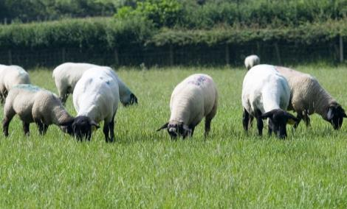
Session 1 Small Ruminant Nutrition
Dr. Lawton Stewart
Extension Animal Scientist
University of Georgia
Susan Schoenian
Sheep and Goat Specialist
Western Maryland REC

Slide 3
Learning Objectives
Identify basic nutrient (protein, energy and fiber) sources for goats and sheep
Understand different animal requirements based on production stage /level

Slide 4
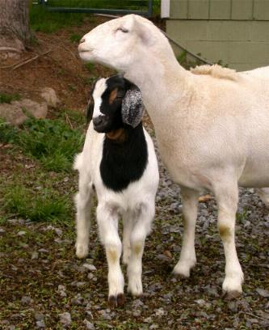
Basic Nutrition
Six Key Nutrients
Protein
Carbohydrates
Fats
Minerals
Vitamins
Water

Slide 5
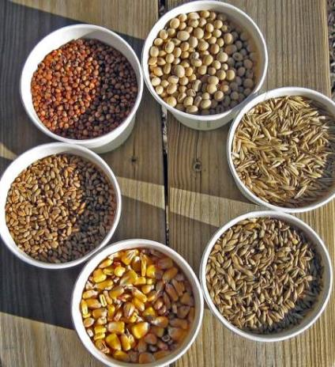
Six Essential Nutrients
Many (most) feedstuffs contain more than one of the essential six nutrients.
Feedstuffs vary considerably in their content of the six essential nutrients.
No single feedstuff can supply all six essential nutrients that an animal needs to survive and thrive.

Slide 6
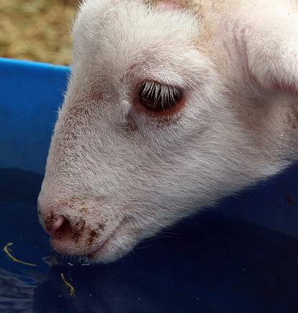
Water
The most critical “nutrient”.
Has many important functions in the body.
Needs vary by species, stage and level of production, and climate.
Quantity + Quality

Slide 7
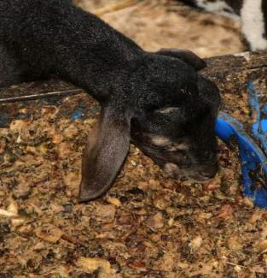
Water Content of Feeds
Pineapple
All feedstuffs contain water. This must be considered when balancing rations.
Rations are balanced on a dry matter (DM) basis.

Slide 8
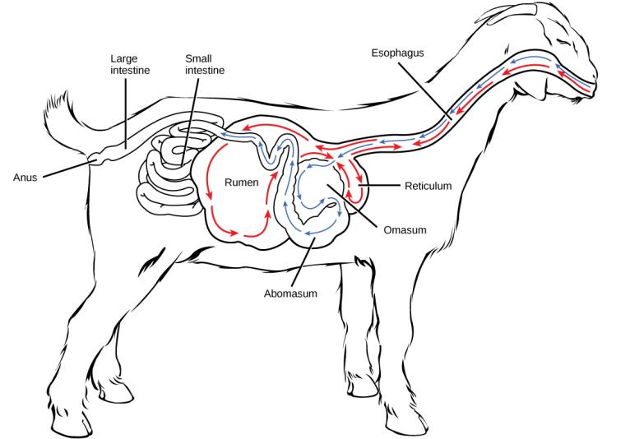
The Small Ruminant Digestive System

Slide 9
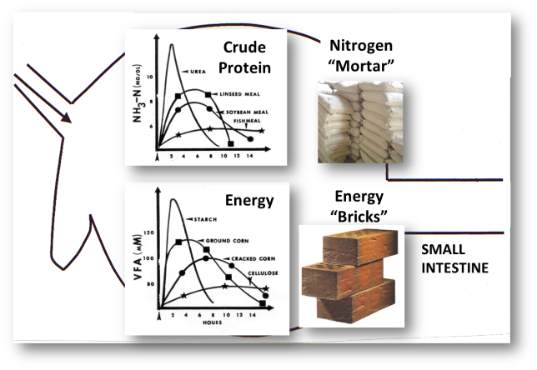
Crude Protein
Protein is often the most expensive feedstuff, but as the building block for animals, is an important one
Ruminant animals can convert nitrogen to protein due to the microbes in their rumen
Energy is needed to create and to digest protein

Slide 10
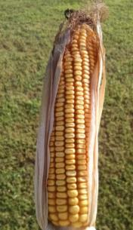
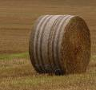
Energy - Carbohydrates
Energy is needed in the greatest quantity; it is the building block for other nutrients.
Requirements change based on age, sex, stage of production, and work.
Sources of energy are starch, fat/oils, protein and cellulose (in forages).
Fat/oils (i.e. corn oil) provide the most energy.
Dietary excess is stored as fat.
Expressed as total digestible nutrients (TDN), net energy (NE) or metabolizable energy (ME)

Slide 11
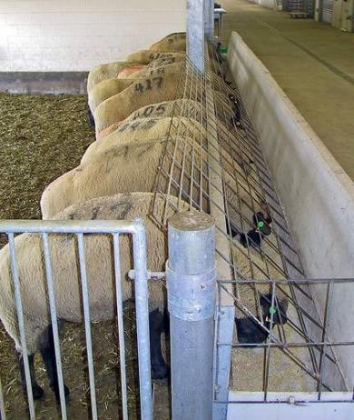
Energy content of feeds
Feedstuff | % TDN
Urea | 0%
Oat straw | 48%
Orchardgrass hay | 59%
Grass silage | 61%
Fescue pasture | 64%
Dry beet pulp | 75%
Barley | 84%
Corn | 88%
Bread by-product | 91%
Distiller’s grains | 92%
Fat | 195%

Slide 12
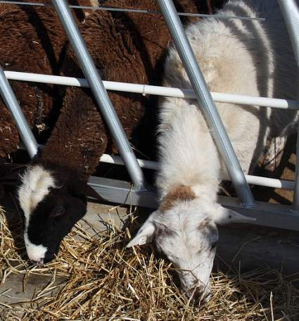
What about fiber?
Not a nutrient
Essential dietary component for ruminants
Does not have to be long stem roughage for young lambs/kids
Adults seem to do better with some long stem roughage

Slide 13
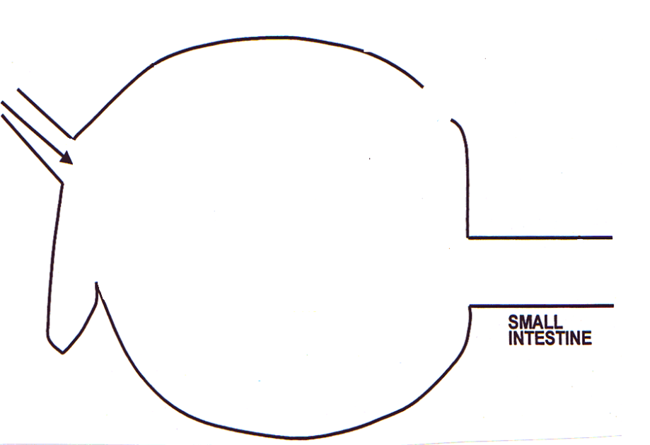
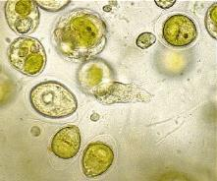
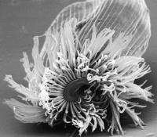
RUMEN
Sources of Energy
Fiber | Starch

Slide 14
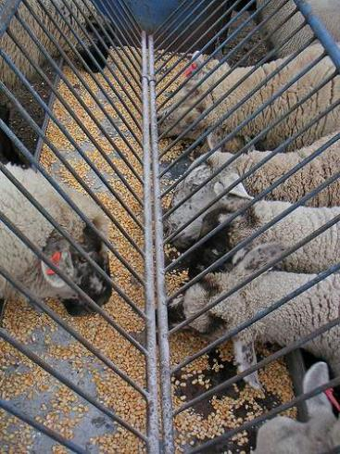
Energy – Fats/lipids
Cheapest energy source.
2.25x as much energy as carbohydrates.
Used to raise energy level of feed, improve flavor, texture, and palatability (how tasty it is).
Source of heat, insulation and body protection.

Slide 15
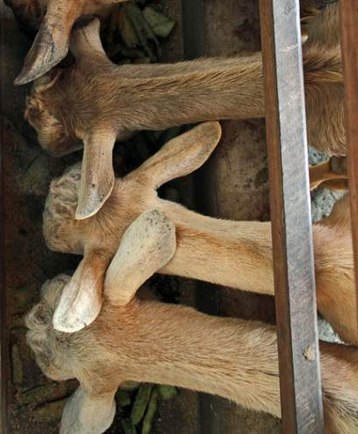
Fat content of feeds
Feedstuff | % EE
Urea | 0%
Dry beet pulp | 0.7%
Barley | 2.1%
Alfalfa hay, mid-bloom | 2.3%
Orchardgrass hay | 3.3%
Corn | 4.3%
Fescue pasture | 5.5%
Corn distiller’s grains | 10.5%
Whole cottonseed | 17.8%
Whole soybeans | 18.8%
Fat | 99%
Fat can be used to help increase body condition score/provide energy to high producing animals, but usually want to feed it at no more than 7% of the total diet (counting everything they eat on a dry matter basis)

Slide 16
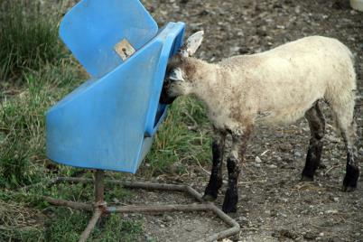
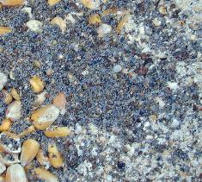
Minerals
Macro Needed in gram amounts Ca, P, Na, Cl, Mg, K, S
Micro Needed in milligram amounts Co, Cu, F, I, Mn, Mo, Se, Zn
Multiple functions in body

Slide 17
Ca and P content of feeds
Dry matter basis | Ca | P | Ca: P
Corn | 0.02% | 0.30% | 0.07
Barley | 0.06% | 0.38% | 0.16
Soybean meal | 0.28% | 0.71% | 0.39
Orchardgrass hay | 0.32% | 0.30% | 1.07
Fescue pasture | 0.48% | 0.37% | 1.30
Soybean hulls | 0.55% | 0.17% | 3.24
Alfalfa hay, mid-bloom | 1.4% | 0.24% | 5.83
Dried kelp | 2.72% | 0.31% | 8.77
Dicalcium phosphate | 22% | 18.65% | 1.18
Bone meal | 27% | 12.74% | 2.12
Ground limestone | 34% | 0.02% | 1700

Slide 18
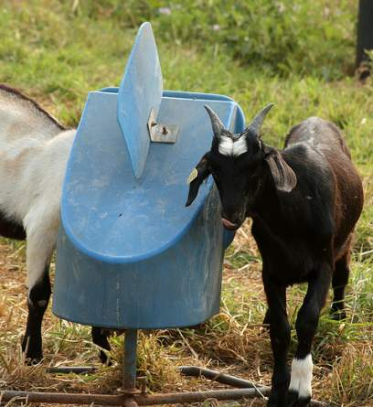
Minerals
Georgia soils are low in Se and Cu
Goats have a much higher Cu (copper) requirement than sheep
Sheep are more likely to experience copper toxicity.
Use a mineral designed for your species and state/region/area.
Loose minerals are better to use than a mineral block.

Slide 19
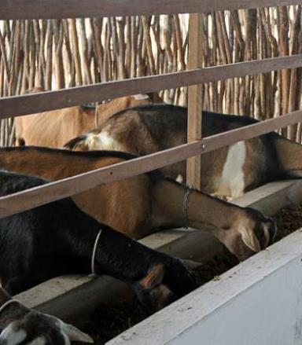
Vitamins
Water soluble B & C
Fat soluble A, D, E , & K
Multiple functions in body.
Requirements increase with age.
No dietary requirement for vitamin K or B complex.

Slide 20
Vitamin sources
Vitamin | Feedstuff
β-caroteen (vitamin A) | Green, pasture forage; dehydrated hay; cured hay, vitamin supplements
D | Ultraviolet irradiation, sun-cured hays, vitamin supplements
E | High quality legume hay, dehydrated alfalfa, wheat germ, vitamin supplements
K | Green, leafy feedstuffs (K1). K2 synthesized in rumen
B | Not required in diets of ruminants

Slide 21
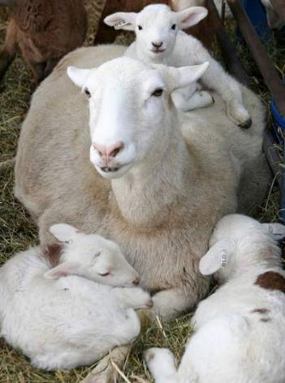
Nutrient requirements depend on …
Species
Size (weight)
Sex
Age
Genetics
Stage and level of production
Climate, environment, and activity
Body condition

Slide 22
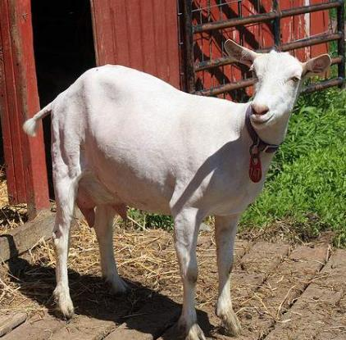
Nutrient needs – general
Sheep have lower maintenance requirements than goats.
Dairy goats have higher maintenance requirements than meat and fiber goats.
Females with a higher genetic potential for milk production (meat or dairy animals) have higher nutritional requirements.

Slide 23
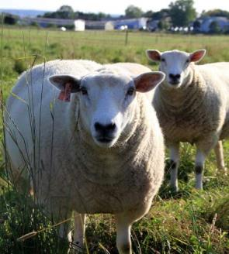
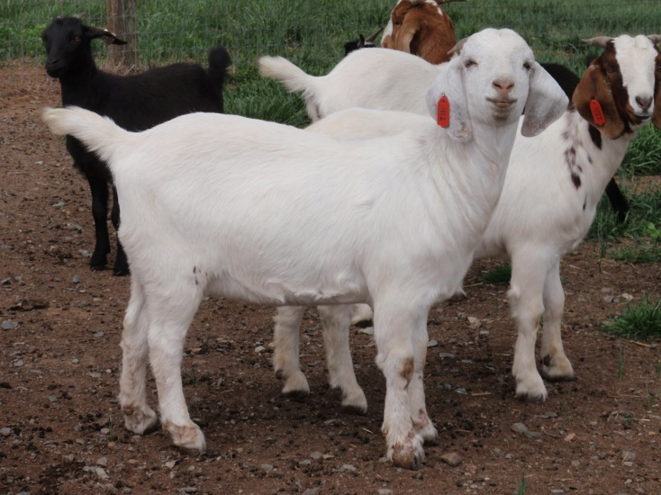
Nutrient needs – adult size/age:
Bigger (mature weight/frame size) animals need to eat more and consume larger quantities of nutrients.
However, smaller animals need to consume a more nutrient-dense diet.
Mature females are usually bigger and need to eat more to get the greater pounds of nutrients needed.
However, young females need a more nutrient-dense diet.

Slide 24
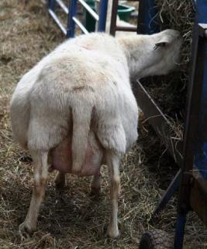
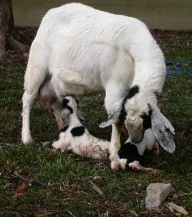
Nutrient requirements – stage of production, females:
Energy requirements during late gestation are more than 50% higher than for maintenance.
Females require a more nutrient-dense diet during late gestation and lactation.
Protein requirements increase in late gestation or when the female begins to lactate.

Slide 25
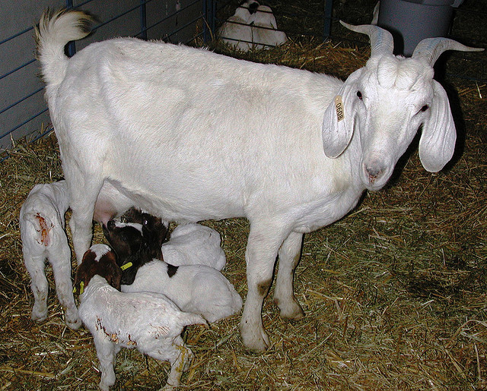
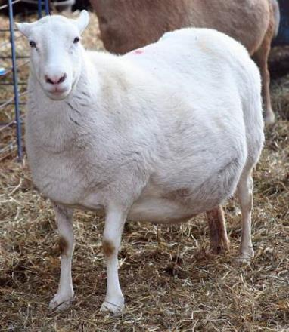
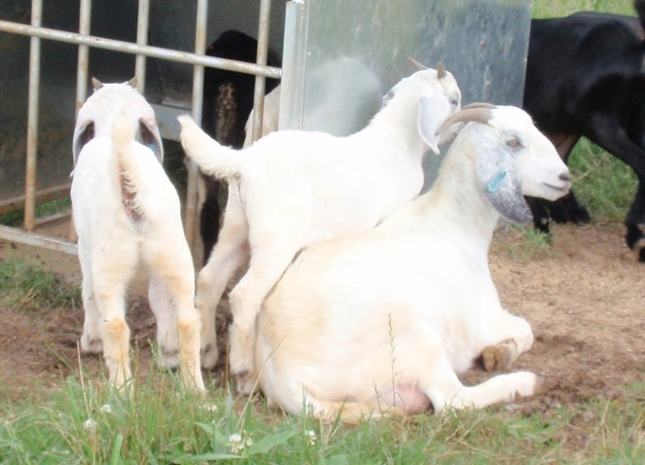
Nutrient needs – number of offspring
Females carrying or nursing twins and triplets need to eat more of a more nutrient-dense diet.
Those carrying triplets needs 43% more energy than those carrying a single fetus.

Slide 26
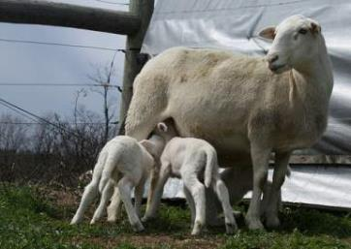
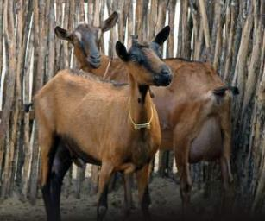
Nutrient needs - milking:
The more milk a female produces the more nutrients she needs to consume.
Energy
Protein
Minerals
In some cases, animals can simply be fed more, but in the case of higher-producing animals, a more nutrient dense diet must be fed.
Nutrient requirements are significantly higher for dairy does and ewes.

Slide 27
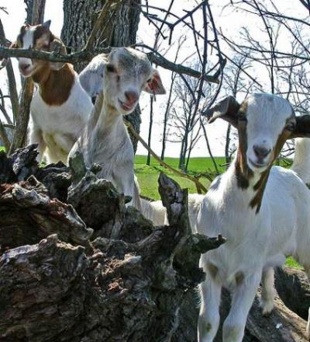
What about growing lambs and kids?
Their nutritional requirements are affected by many of the same factors.
Age
Species
Size
Genetic type and potential
Level of performance
Environment, activity

Slide 28
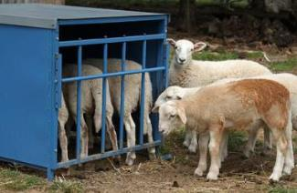
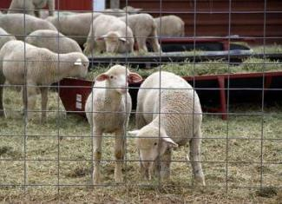
Nutrient needs - lambs:
Assuming the same size and rate-of-gain:
Young lambs convert feed more efficiently, but need a higher percentage of protein in their diet.
Older lambs need to eat more and require a more digestible diet to achieve the same rate-of-gain.
Later maturing (larger breed) lambs need to eat more, but have lower protein requirements.

Slide 29
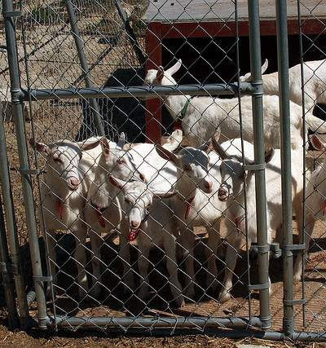
Nutrient needs – kids, size:
Assuming the same rate of gain:
Smaller kids (weight) need to consume a more nutrient-dense diet, both energy and protein.
Bigger kids need to consume more quantity of nutrients, but the diet does not need to be as high quality (% TDN, CP).

Slide 30
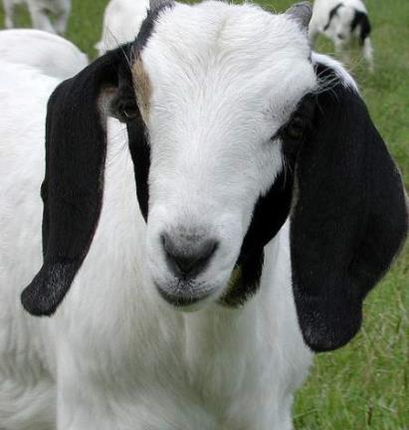
Nutrient needs – kids, type/sex:
Assuming the same rate of gain:
Dairy goat kids have the highest energy needs.
Boer buck kids need to eat the most, and have the highest requirements for protein.
Indigenous (local/native) breed goat kids have lower requirements for protein than improved breeds (like Boer).
Buck kids need to eat more than does.
Buck and doe kids require the same amount of protein, but since does eat less, they require a higher percentage of protein in their diet.

Slide 31
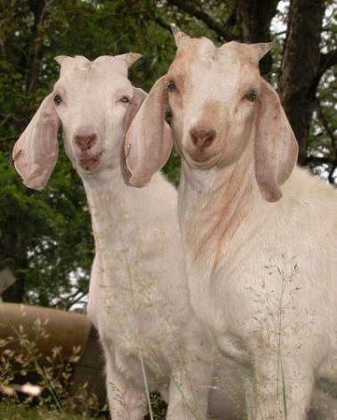
Nutrient needs – kids and lambs:
Assuming the same genetic potential for growth:
The more you feed a kid or lamb the more it will gain.
Better performance requires both more feed and better quality feed.
Higher% TDN
Higher% CP
The bigger question is: is better performance economical?
ADG | % TDN | % CP
0 lbs/day | 49.7% | 7.8%
0.22 lbs/day | 67.1% | 13.8%
0.33/lbs/day | 87.9% | 19.9%
0.44 lbs/day | 89.2% | 21.7%
0.55 lbs/day | 88.6% | 23.1%

Slide 32
Summary
Different feedstuffs offer different levels of nutrients; for example, grains, quality forages/hay, and fat sources provide more energy; soybean products and legumes provide more protein.
Minerals are important and should be fed based on species and location and in loose form.
Animals with higher nutrient requirements may need supplementation: young, growing animals and females in late gestation and lactation (especially with twins or more)

Slide 33
Additional Resources
Goats:
http://extension.psu.edu/courses/meat-goat/nutrition
http://www2.luresext.edu/goats/training/nutrition.html
Sheep
https://pubs.ext.vt.edu/410/410-853/410-853.html
http://www.sheep101.info/201/

Slide 34
This material is based upon work that is supported by the National Institute of Food and Agriculture, U.S. Department of Agriculture, under award number 2015-70017-22861.
Beginning Farmer and Rancher
Development Program
Developing the Next Generation
of Sustainable Farmers in Georgia Grant

