Slide 1








Small Farm Business Planning

Slide 2

Session 1
Lessons from Small Farm Success
Considerations before starting
Market Feasibility
Laura Katz, The University of Georgia Small Business Development Center
Donn Cooper, Georgia Organics

Slide 3



Small Farm Business Planning: Sustainability Includes Profitability
A Guide for Farm Entrepreneurs

Slide 4
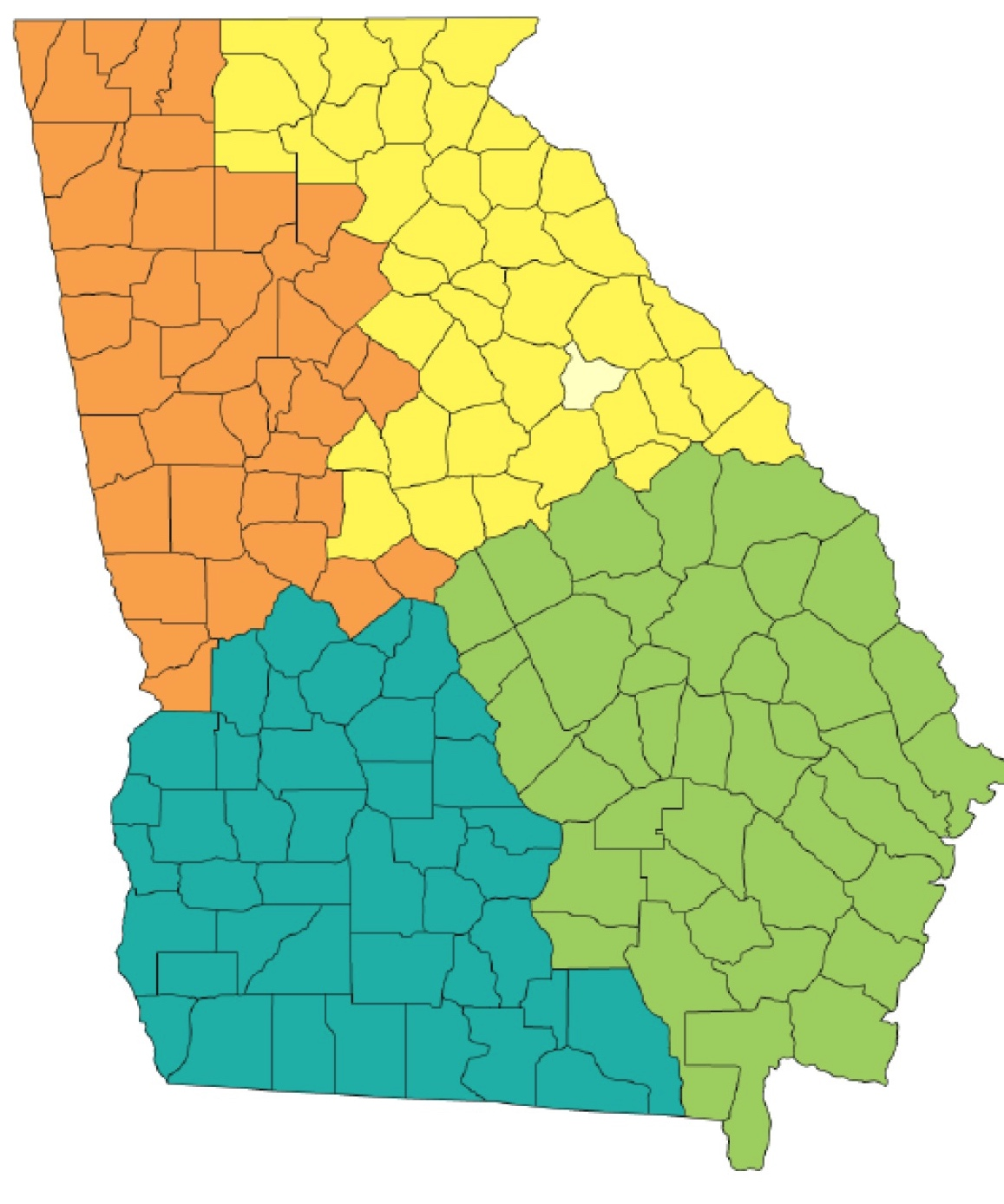

UGA Extension
LEGEND
Northwest District
Griffin
Northeast District Office
Northeast District
Athens
Southwest District
Tifton
Northwest District Office
Southeast District
Statesboro
Southeast District Office
Visit Extension.UGA.edu to find your county office.
Southwest District Office

Slide 5
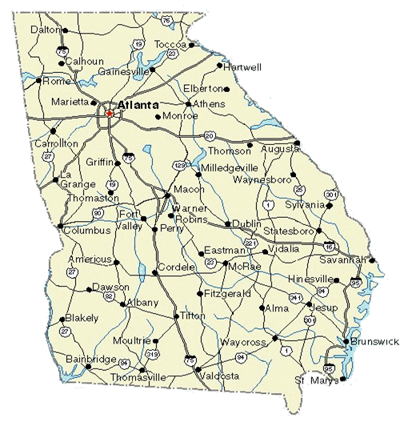
GEORGIA SBDC NETWORK
University of Georgia SBDC
Georgia State University SBDC
University of West Georgia SBDC
Kennesaw State University SBDC
Clayton State University SBDC
Georgia Southern University SBDC
Valdosta State University SBDC
Notes:
Chicopee Complex
Funded in part by UGA and by the SBA
17 offices in GA
Provide consulting/classes
How to start a business
How to write a business plan
How to apply for business loans
How to market their products & services
Specialized services for
minority-owned businesses
Women-owned businesses
international businesses

Slide 6
Georgia Organics
Member-based nonprofit working to connect organic food from Georgia farms to Georgia families
www.georgiaorganics.org
Mentoring program
Annual Conference
Farm to School
Notes:
Get class to introduce themselves: State name, county and if currently farming
This class is just an overview
What to consider
What is next step

Slide 7
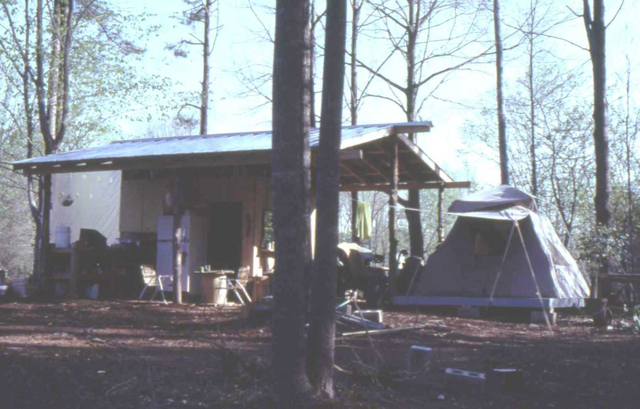
Lessons from a Small Farm Success Story
“We arrived in North Carolina […] with a dream to live in the country and farm. Just over a year later we had developed a plan, incorporated a business and purchased a piece of land, the adventure was on!
“We were young, tough, not afraid of work and naïve. In 1982 we planted our first crops, the plan was pick-your-own berries. Four acres of blackberries and raspberries with more to come. We had no money so we moved into a tent so we could be here to work and save what little money we had.”
-Alex Hitt, Peregrine Farm
www.peregrinefarm.net/ourstory/
Notes:
Lesson 1 - they developed a plan and though it has evolved over the years, they have constantly paid attention to the business side as wells as the growing side.
Lesson 2 – They prioritized spending

Slide 8
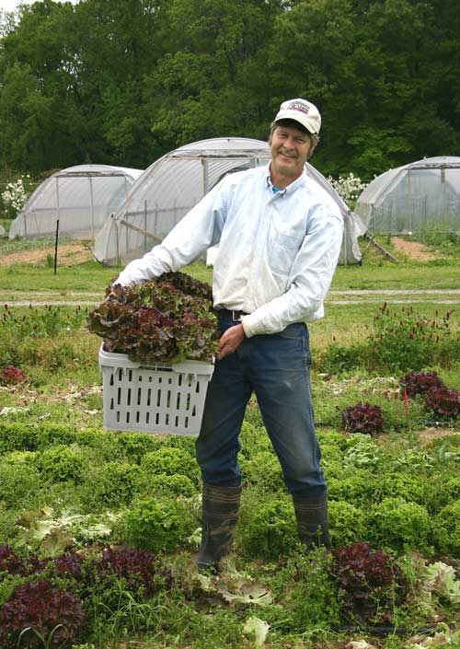
Lessons from a Small Farm Success Story
Lessons from a Small Farm Success Story
“Our original goals,’ Alex says, ‘were to make a living on this piece of ground while taking the best care of it that we could.’”
…
“When they first bought the farm almost two decades ago, Alex and Betsy capitalized it an unusual way, selling shares to family and friends and working as employees of the corporation. …
“Their only labor other than themselves consists of a few part-time seasonal workers. They prefer to hire labor rather than use interns—though workers come to learn—because it forces them to take a more realistic look at labor costs.”
“Betsy has been farming full time since 1983; Alex, since 1990.”
Source: The New American Farmer, 2nd ed.
Source: Debbie Roos, www.growingsmallfarms.ces.ncsu.edu
Notes:
Peregrine Farm is not certified organic but uses organic production practices. This met their goal of taking care of the land. After several iterations and looking at what worked economically and in terms of their quality of life, the farm now sells direct at the Carboro Farmers Market and to some restaurants. They have specialized in crops that they know are profitable with a few things like heirloom tomatoes that at least break even but are in demand by customers. The point – they know what it costs to grow 110ft or row, and they track their labor costs. They have been able to farm full time successfully, have medical insurance and save for retirement. Their approach is akin to holistic management, where you have multiple management goals that include environmental, quality of life and profitability.
Donn

Slide 9
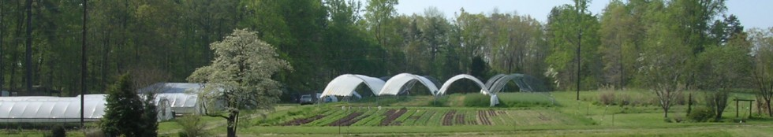

Peregrine Farm Today
“‘We wanted to reduce the dependence on outside labor and raise the crops we like best,’ Alex says. ‘We’re actually getting smaller.’”
…
“Alex and Betsy keep financial and market records in a budget program, where they can easily compare income from specific crops. They are now meeting their economic goals, expecting each acre to give them $20,000, and each high tunnel to bring $1000 per crop, with about $30,000 in total expenses. Half the income comes from vegetables, half from flowers.”…
“Over the years they have gradually bought out their 17 original investors and now own the farm free and clear.”
Source: The New American Farmer, 2nd ed.
Notes:
Donn’s

Slide 10
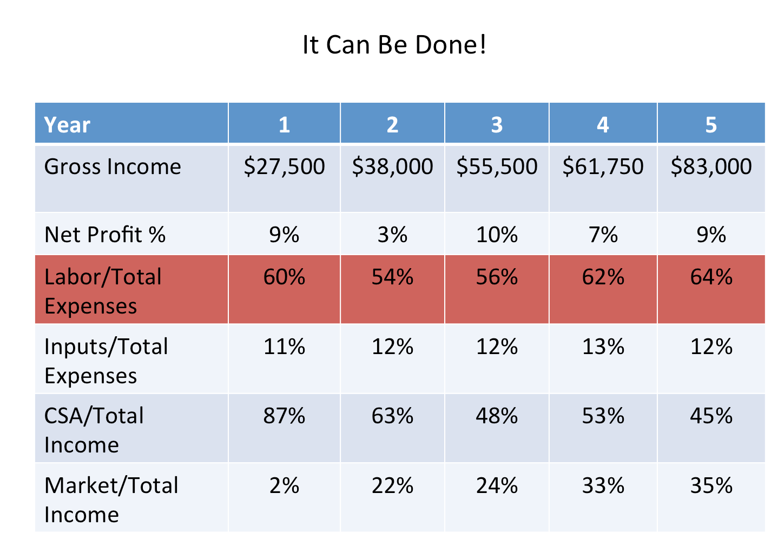

Slide 11
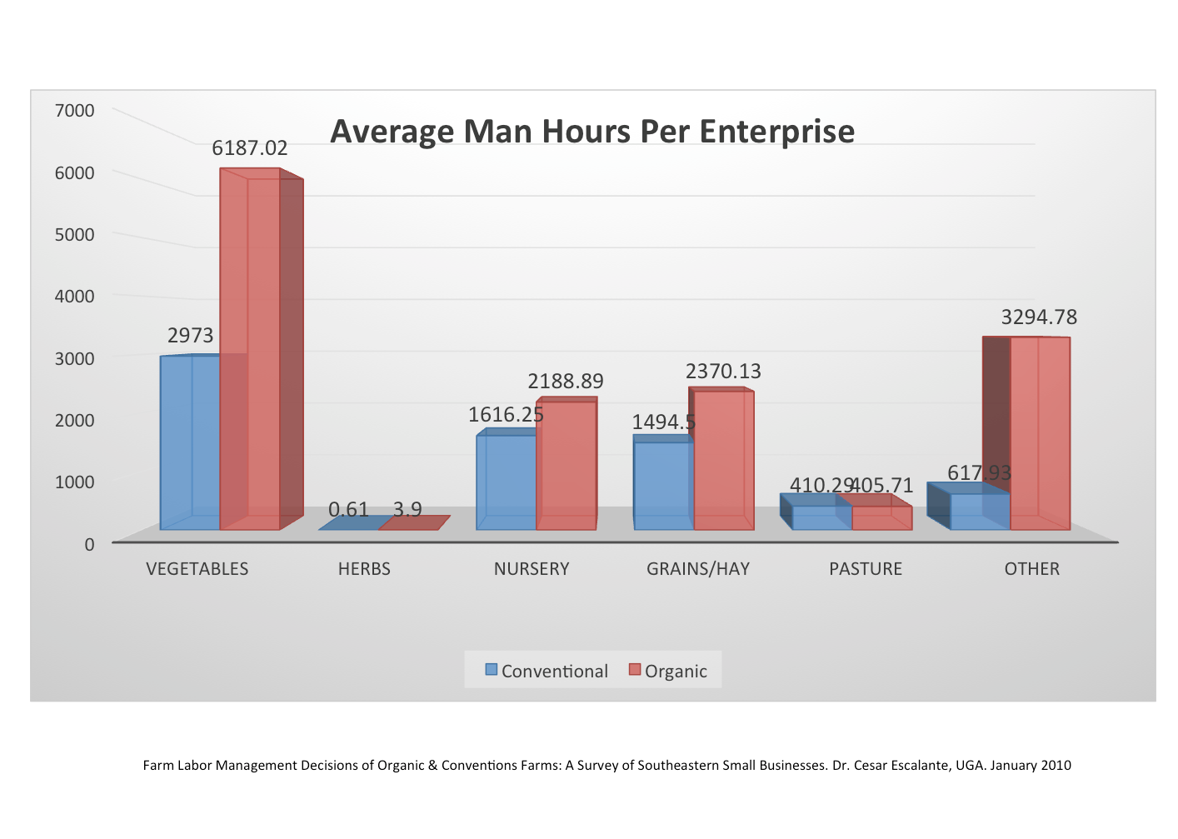
Farm Labor Management Decisions of Organic & Conventions Farms: A Survey of Southeastern Small Businesses. Dr. Cesar Escalante, UGA. January 2010
Notes:
Donn’s

Slide 12
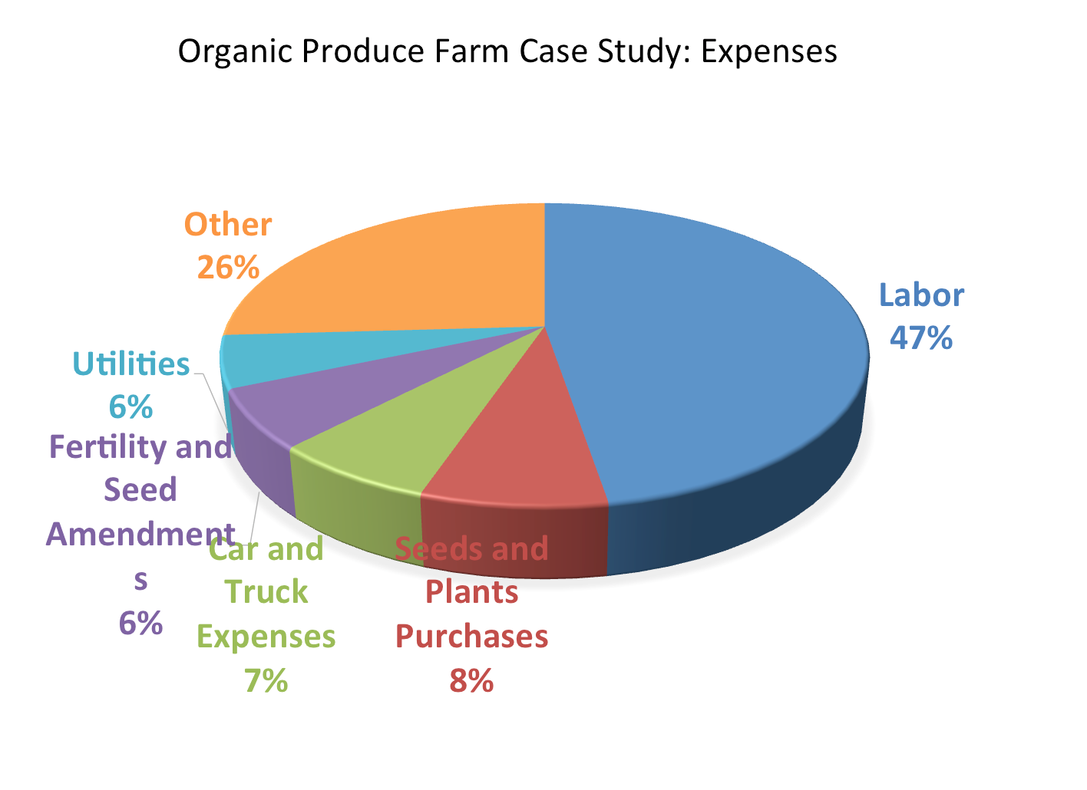
Notes:
Another example from additional farm.
Donn’s

Slide 13
Lessons from a Small Farm Success Story
Look at this as a business.
Keep records!
Setting a profit goal and adapting production to reach that.
Set priorities for purchase.
Be prepared for long hours and the long haul.
Notes:
Donns

Slide 14

Considerations Before Starting
What is your Primary reason for farming?
Self assessment – Do you have what it takes?
Define what your farming business will be.
Are you a Hobby or a Business?
Notes:
-Self Assessment
-leadership skills, willingness to sacrifice, organization, common sense, manage
-3 things in 1: entrepreneur, manager, technician
-can’t handle it? Hire someone, outsource
-Is it worth the time & effort?
An important part of starting your farm business is defining what it will be. Do you want to have a micro-scale vegetable farm? Do you plan to grow acres of hay for other farmers? Maybe you want to have a diversified farm - a small-scale operation that grows a variety of animals and crops. You might even be wondering how to start an ecotourism farm, where people will come to stay to see the workings of your farm and perhaps even participate in farm chores.
-Time to establish short/long term goals
-If you don’t set goals how will you know you are successful.
-will business goals accomplish personal goals?
-successful entrepreneurs write goals down and review them
-goals should be realistic and measurable
-short vs long
-Do I have everyone’s support?

Slide 15
Considerations Before Starting
Goal setting
  Short term
  Long term
Is your idea feasible?
  Marketing
  Financial
IRS Hobby Rules
  “3 of 5” Years Test
  Keep Good Records!
Notes:
Personal and Business Goals Short term 1, 3 and 5 year goals; Long term Goals What is my exit strategy?
Is there a market? Will you make money?
The IRS has “hobby rules” which basically says that if you consistently use your business as a tax shelter, deducting your losses from your other income year after year, you'll probably attract the attention of the IRS. Make sure that the IRS will consider you a real business in case you're ever audited, before you start claiming deductions for the costs of your farming business. Why is this distinction important? Because the bottom line is this: hobby expenses are only deductible to the extent of hobby income, i.e., no hobby losses are deductible for tax purposes!
The deciding factor in determining whether a business is legitimate is whether the activity is engaged in "for profit." In other words, you must prove to the IRS that you're trying -- not necessarily succeeding -- to make a profit with your venture. 3 straight years of losses may be inviting an audit! Keep Good Records

Slide 16
Activity –
Whole Farm SWOT Analysis
Locate the USDA SWOT Analysis – A tool for making better business decisions
Take a few minutes to read about SWOT analysis on next page
As a group, fill out the SWOT Analysis Sheet
HOMEWORK – Fill out the SWOT Analysis Sheet for your farm.

Slide 17
Market Feasibility
Field of Dreams
If you grow it, they will come . . .
Notes:
Once you have decided entrepreneurship is for you..you can now determine your market feasibility
“Field of Dreams” mentality…
If you build it they may not come.

Slide 18
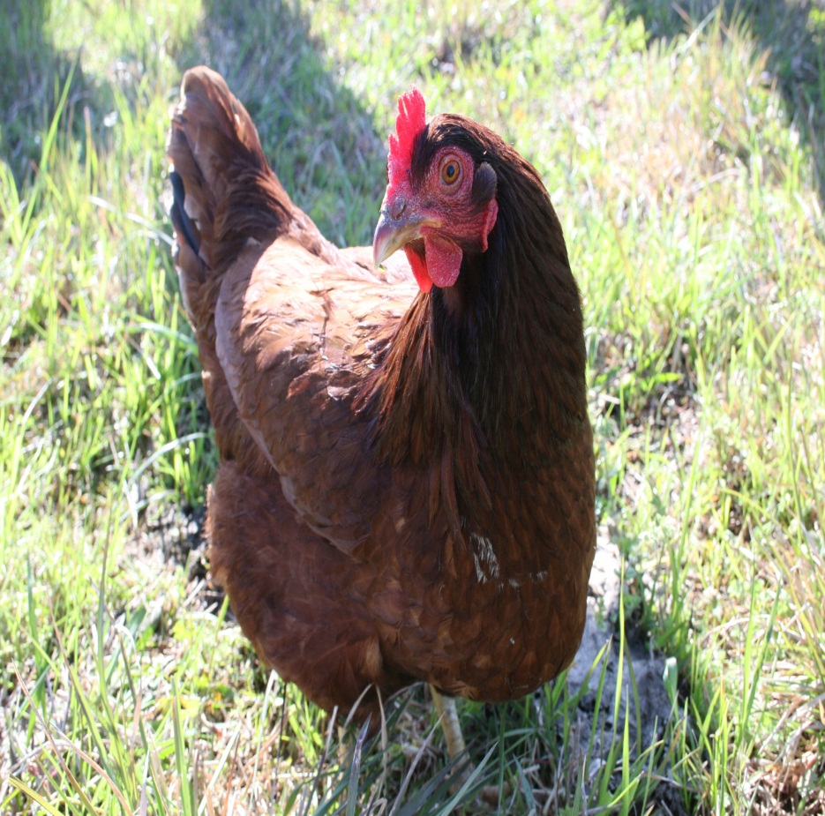
Market Feasibility
What is your Target Market?
How large is the Market?
Who are your Competitors?
How does your Product Compare?
How much do you expect to Sell?
Notes:
-Who is your target market?
-find it and serve it well
-remember you cant be everything to everybody
-Indirect/ direct competitors
-get examples from audience
*Competitive Analysis*
-How does product compare?
*USP sheet*
-How much do you expect to sell?
-Use strong market research and solid methodology for sales predictions
-can use industry standards, surveys, gov’t info, market research

Slide 19
Market Feasibility
Secondary Market Research
Industry Associations
      Growing for Market (magazine, www.growingformarket.com)
Government Information
      www.census.gov
      www.fedstats.gov
      Georgia Center for Innovation in Agribusiness
      UGA Sustainable Ag Webpage
Internet
Public Libraries
      GALILEO – full-text articles, UGA Library/Public Library
Nonprofit Category:
  ATTRA www.attra.ncat.org , Georgia Organics, Appalachian Harvest, Carolina Farm Stewardship
Notes:
Secondary- SBDC can pull demographic and industry reports
ATTRA National Sustainable Agriculture Information Service. Tons of free resources, publications and information.
Primary - Samples of surveys are in the back of your book.

Slide 20
Market Feasibility
Primary Market Research
Observations
Surveys
Associations (CFSA)
Industry Buyers
  Local Vendors Coalition, Whole Foods, Earth Fare, The Fresh Market, Fresh Point, Destiny Organics, Internatural Marketing, Turnip Truck
Chefs
School Nutrition Directors
Notes:
CFSA – Carolina Farm Stewardship Assoc.

Slide 21
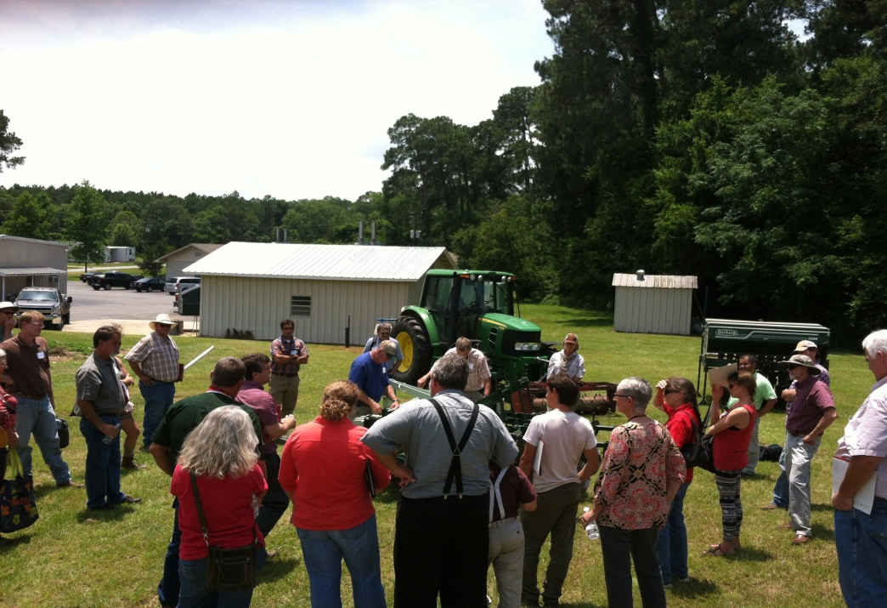
Get involved with your farm community!
Visit local farmer’s markets
Join Ag Industry Associations
  ww.gfb.org – Georgia Farm Bureau
  Georgia Fruit and Vegetable Growers Association
  Georgia Organics
Develop relationships
with local Cooperative
Extension Office

Slide 22
Activity –
Obtaining Produce Prices
USDA Custom Average Tool (CAT)
  Terminal Market – “A terminal market is a central site, often in a metropolitan area, that serves as an assembly and trading place for commodities. Terminal markets for agricultural commodities are usually at or near major transportation hubs.” Wikipedia. This calculator gives you wholesale prices at a terminal market such as the Atlanta Farmers Market.
  Shipping Point Averages – This is the wholesale price paid by the “first handlers” of the produce. It includes broker fees but not freight charges.
  Retail Averages – This is the price retailers are getting for produce and can be a guide for direct market prices.
Locate the CAT webpage in your notebook
Work through the online example
HOMEWORK – Find prices for three additional crops

Slide 23



This material is based upon work that is supported by the National Institute of Food and Agriculture, U.S. Department of Agriculture, under award number 2015-70017-22861."
Beginning Farmer Rancher
Development Program
Developing the Next Generation
of Sustainable Farmers in Georgia Grant

