Slide 1
Small Fruit and Vegetable Production

Slide 2
Session 5 Case Study Discussion
David Berle and Tim Coolong, Horticulture Dept UGA
Julia Gaskin, Crop & Soil Science Dept UGA
Tenisio Seanima, Georgia Organics

Slide 3
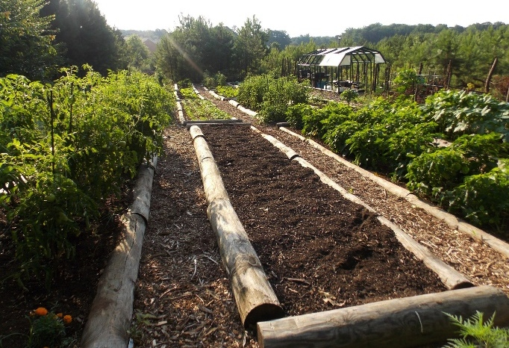
Case Study 1: Very Small Farm (< 1 acre) Locally Yours Farms
Land:
Three sites: Two growing areas and a separate post harvest handling area
Production area
Site 1 – 1/2 acre of raised bed vegetables, small fruit-tree orchard and compost pile
Site 2- 700 sq. ft. growing area, 2 high tunnels, and 20 fruit trees
Markets
Direct through e-commerce website, pop-up farmers market at pre-schools and nearby grocery, and farmers’ market.
Commercial sales to restaurants
Market niche is locally grown, fresh vegetables
Photo: Tenisio Seanima

Slide 4
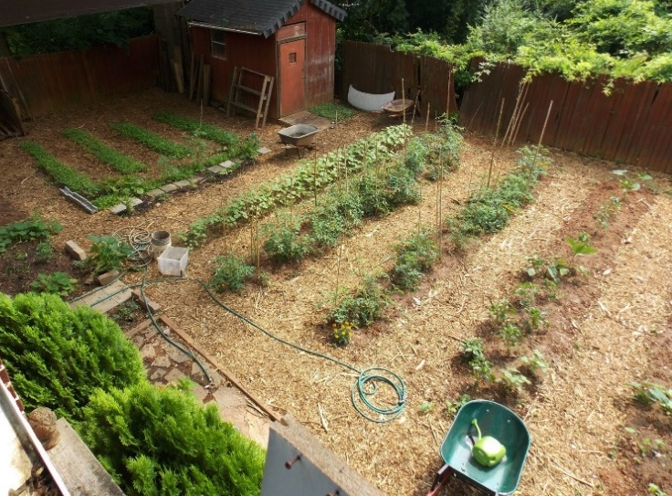
Case Study 1: Very Small Farm (< 1 acre) Locally Yours Farms
Crops
Summer - squash, cucumbers, tomatoes, peppers, beans, okra
Fall and spring - kale, mustards, collards, onions, and garlic
Example crop rotation:
Year 1
Spring Crop - Spring garlic & onions, mature garlic & onion
Summer Crop – Tomatoes or peppers,
Fall Crop - Kale, collards, mustard
Year 2
Spring Crop – Carrots
Summer Crop – Cucumbers or summer squash
Fall Crop - Lettuce
Year 3
Spring Crop – Beets or Swiss chard
Summer Crop – Bush beans
Fall Crop – Arugula, mesclun mix micro greens
Photo: Tenisio Seanima

Slide 5
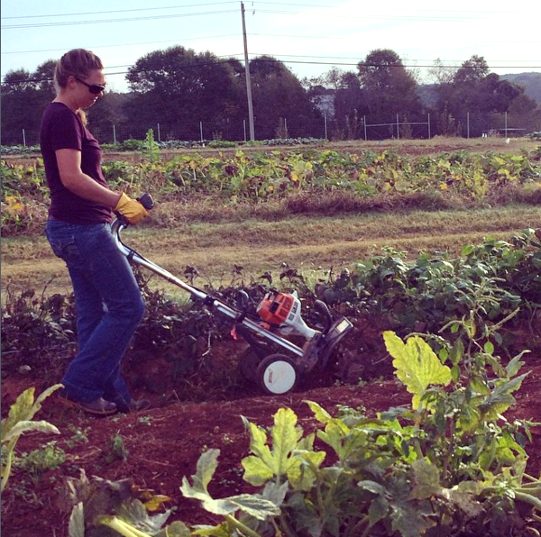
Case Study 1: Very Small Farm (< 1 acre) Locally Yours Farms
Ground Preparation
Front-tine rototiller
Beds double dug periodically to minimize use of rototiller
Cultivation
Weeds – Intensive planting, sheet mulching, and hand weeding
No further cultivation after seedbed preparation
Photo: Johannah Biang

Slide 6
Double digging – often done for initial bed preparation
Technique where top 6” to 12” of soil are removed
Lower 6” to 12” is loosened with pitchfork and organic matter added
Top soil in next block is shoveled into first block
Repeat
Subsequent tillage can also be done with broadfork, pitch fork and rake to level and prep seedbed
NOTE: Don’t bring up hard red clay to surface when using this technique

Slide 7
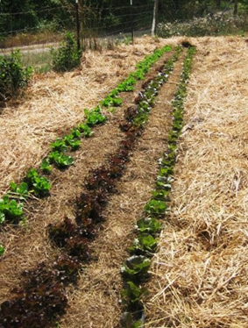
Case Study 1: Very Small Farm (< 1 acre) Locally Yours Farms
Planting
Most vegetables transplanted; direct-seeded crops planted by hand
Irrigation
Hand watering with hoses or watering cans
Equipment
Front tine rototiller
Hand tools
Hose & nozzle, watering can
Hand-held sprayer
Photo: Julia Gaskin

Slide 8
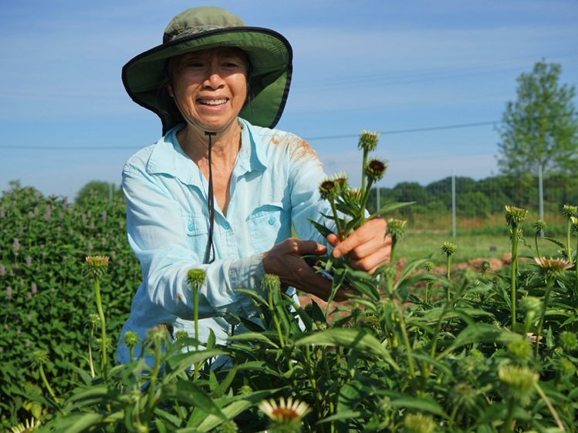
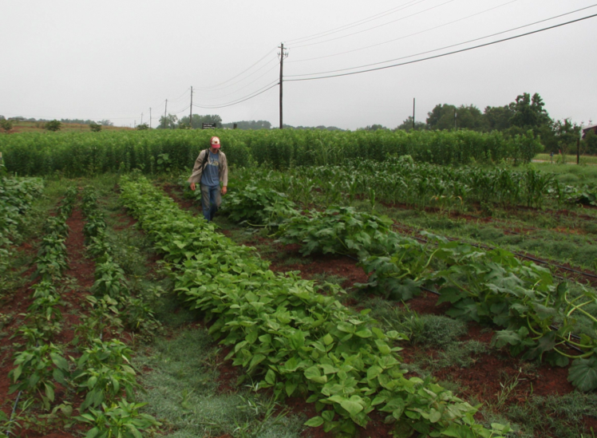
Case Study 2 – Small Farm (2 acres) Wanna B Farms
Land
Rented 10 acres land with house, 5 acres open land
Production area
2 acres,
Vegetables- 0.5 acres at one time
Herbs- 0.25 acres
Markets
Direct through CSA, farmers’ market and self-serve roadside stand
Market niche is unusual, heirloom and new vegetables with fresh herbs
Photos: David Berle

Slide 9
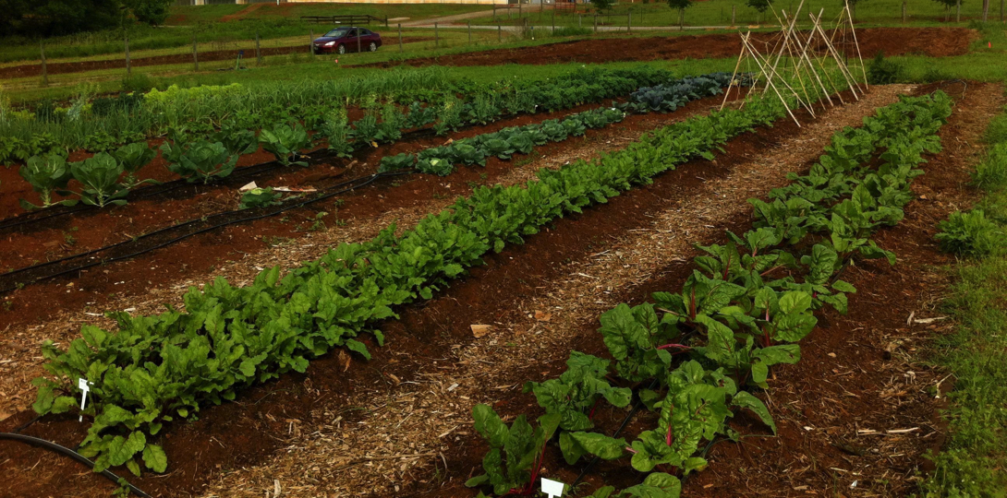
Case Study 2: Small Farm (2 acres), Wanna B Farms
Crops
Summer - squash, tomatoes, beans, peppers, and culinary herbs such as basil oregano and thyme
Fall and spring - kale, lettuce, cabbage, onions, potatoes, spinach, carrots, dried herbs
Crop rotation
Year 1: Buckwheat> Winter Squash> Oats/Austrian Winter Peas
Year 2: Tomatoes> Oat/Winter Pea> Sunn Hemp> Kale/Broccoli> Rye
Year 3: Field Peas> Oats/Winter Pea> Lettuce> Buckwheat> Okra
Photos: David Berle

Slide 10
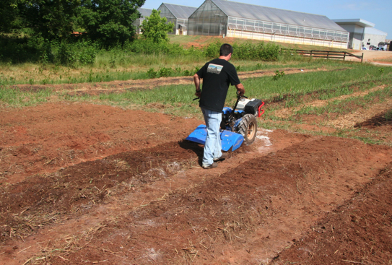
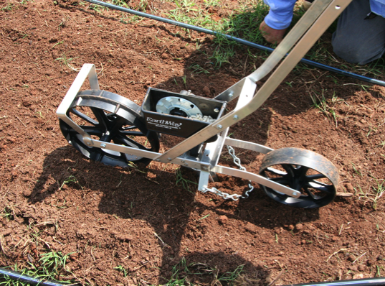
Case Study 2: Small Farm (2 acres), Wanna B Farms
Ground Preparation
Neighbor with tractor and plows paid for ground preparation
Beds bed shaped and finished with tiller attachment
Cultivation
Hand hoes and wheel hoes
Planting
Push seeder
Hand held broadcast seeder for cover crops
Hand transplanting
Sprayers
Solo backpack sprayer and 30-gallon battery powered sprayer
Photos: David Berle

Slide 11
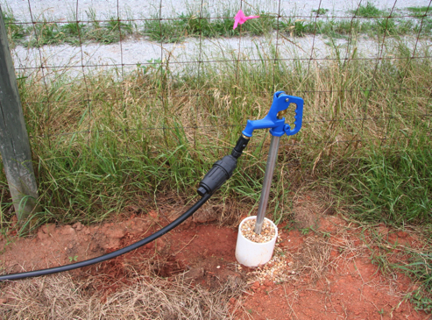
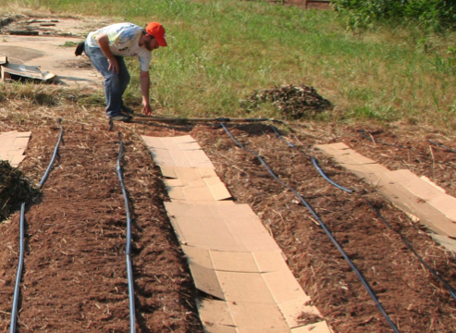
Case Study 2: Small Farm (2 acres), Wanna B Farms
Irrigation
Well (10 gallons per minute) with T-style filter
1” PVC pipe connected to drip tubes w/ in-line emitters
Equipment
Walk behind tractor (tiller, rotary plow, brush mower)
Push seeder and broadcast seeder
Wheel hoes, hoes, shovels and rakes
Backpack sprayer and 30-gallon battery powered sprayer
Photos: David Berle

Slide 12
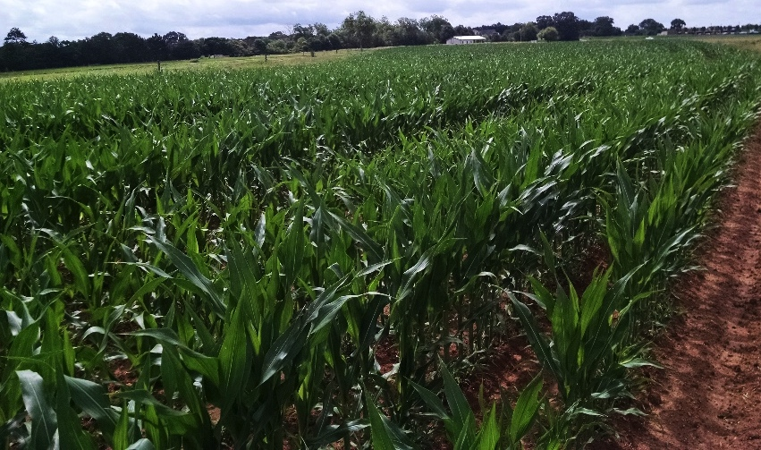
Case Study 3: Mid-scale Farm (14 acres) Gittin’ There Farms
Land
14 acres in production, began with 2 acres
Production area
2 acres mixed vegetables for direct markets
12 acres mixed vegetables for wholesale market
Markets
Began at farmers’ market, after 2 years expanded to multi-farm CSA, after 5 years expanded to wholesale
Market niche is local produce
Photo: Katie Chatham

Slide 13
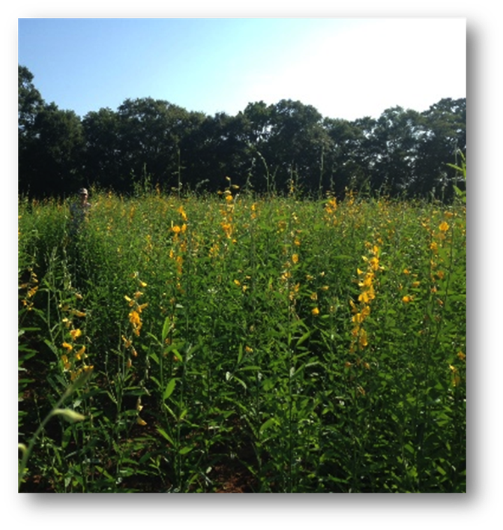
Case Study 3: Mid-scale Farm (14 acres) – Gittin’ There Farms
Crops
Spring/Summer - squash (yellow and zucchini), cucumber, snap beans, southern peas, tomato (several varieties), pepper (several varieties), eggplant, sweetcorn (successional plantings to extend harvest) and sweetpotato
Fall/winter - greens (kale, turnip, mustard and collards), broccoli, potatoes (late winter/early spring), beets, carrots and onions
Example wholesale crop rotation:
Year 1:
Early summer legume cover crop
Fall greens (kale, collards, etc)
Spring hard squash
Year 2:
Sweet potatoes
Winter grain/legume mix cover crop
Year 3:
Sweet corn – Late summer buckwheat cover crop
Winter grain cover crop
Spring snap beans or lettuce
Year 4:
Summer legumes
Onions
Photo: Julia Gaskin

Slide 14
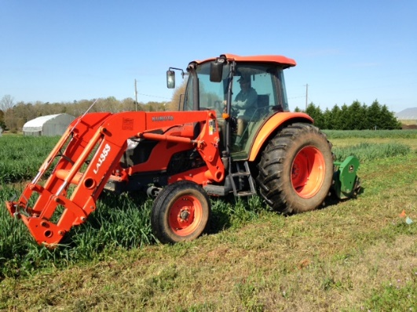
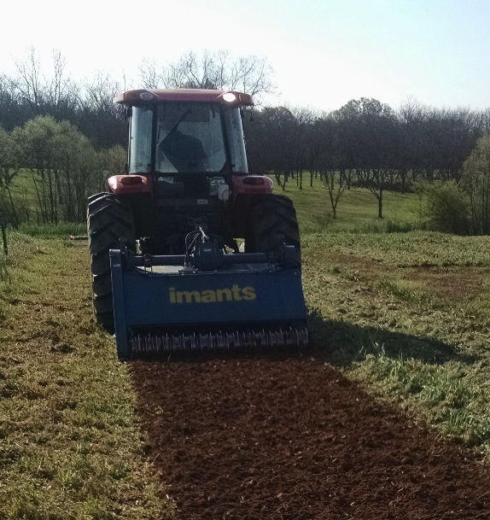
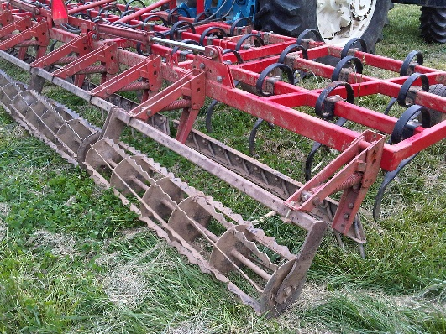
Case Study 3: Mid-scale Farm (14 acres) – Gittin’ There Farms
Ground Preparation
Cover crops mowed with flail mower pulled by 75 HP 4wd tractor
First pass with rotary spader to turn in cover crops
After week, shallow cultivation with field cultivator to destroy weeds and prep seedbed
After another week, final shallow cultivation
Small plastic layer used to lay plastic on onions beds to prevent weeds
Cultivation
Sweep cultivator for between rows
Hand hoes for in row (between the plants)
Photos: Julia Gaskin

Slide 15
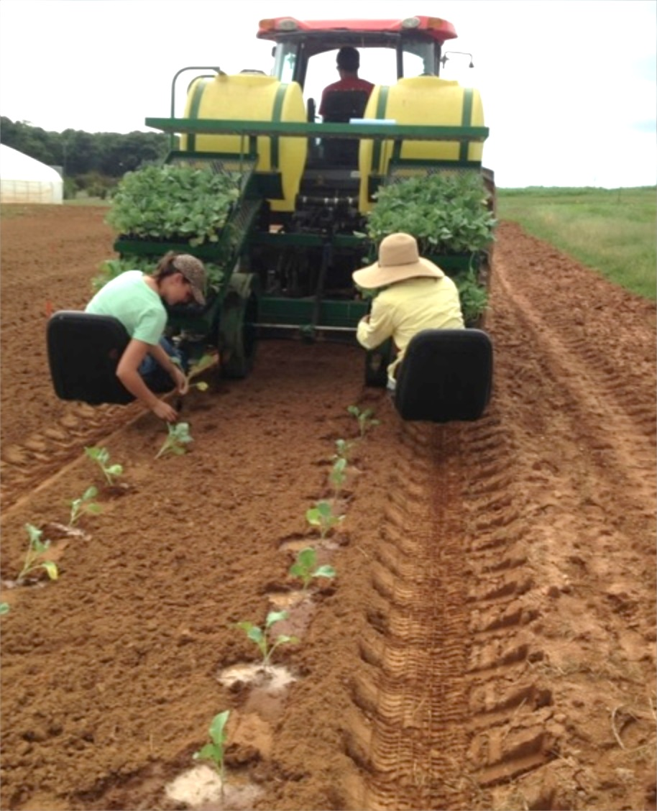
Case Study 3: Mid-scale Farm (14 acres) – Gittin’ There Farms
Planting
Planter
Push seeder
Broadcast seeder for cover crops
Finger style tobacco transplanter
Sprayers
8 row boom sprayer with 200 gallon tank
Backpack sprayer
Photo: Julia Gaskin

Slide 16
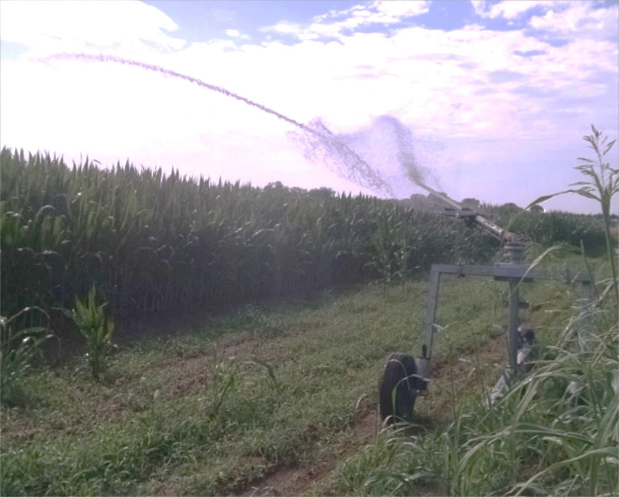
Case Study 3: Mid-scale Farm (14 acres) – Gittin’ There Farms
Irrigation
Well (10 gallons per minute) with small pond for storage
Irrigation pump and big gun reel irrigation
2” PVC pipes to some plots for drip tape
Equipment
75 HP 4wd tractor
Harrow
Rotary spader
Field cultivator
Small plastic layer
8 row boom sprayer with 200 gallon tank
Backpack sprayer and assorted hand tools
Big gun reel
Photo: Katie Chatham

Slide 17
Additional Resources
Use of Tillage in Organic Farming Systems: The Basics - http://articles.extension.org/pages/18634/use-of-tillage-in-organic-farming-systems:-the-basics
Steel in the Field – A Famers Guide to Weed Management Tools - http://www.sare.org/Learning-Center/Books
Equipment and Tools for Small-Scale Intensive Crop Production ATTRA - https://attra.ncat.org/attra-pub/summaries/summary.php?pub=373

Slide 18
This material is based upon work that is supported by the National Institute of Food and Agriculture, U.S. Department of Agriculture, under award number 2015-70017-22861.
Beginning Farmer and Rancher
Development Program
Developing the Next Generation
of Sustainable Farmers in Georgia Grant

