Slide 1
Small Fruit and Vegetable Production

Slide 2
Session 4 Vegetable Growing Seasons in Georgia
Timothy Coolong PhD
Commercial Vegetable Extension Specialist
University of Georgia, Tifton Campus

Slide 3
Georgia Growing Seasons
Georgia can be divided into 3 growing regions
Mountains (Rome, Rabun, Blairsville)
Piedmont (Athens, Atlanta)
Coastal Plain (S. GA, Tifton)
Notes:
This is an introduction slide to get growers thinking about their growing region and how they need to manage their crops. Keep in mind that if you are trying to compete with growers from S. GA, growers in more northern parts of the state will need to have some sort of season extension tactic employed. However, they do have the advantage of being able to produce crops mid summer when it is too hot for much of the southern part of the state.

Slide 4
Georgia Growing Seasons
In the Mountains and Piedmont frost protection provides clear advantages for markets
In S. GA year-round production of vegetables occurs
First/Last Frost Dates
Location | First Frost | Last Frost
Blairsville | 9/23-11/6 | 3/31-5/21
Watkinsville | 10/9-11/25 | 3/5-4/19
Tifton | 11/1-12/21 | 1/26-3/21
Dates gathered from data from 1994-2015 time period
Notes:
Georgia vegetable production really is representative of 3 distinct regions. The mountains have more in common with Northern states such as KY and Ohio, whereas the Piedmont is more closely aligned with the Carolinas and S. GA (Coastal Plain) is more similar to North Florida. Also a table of examples of first and last frost dates are given for 3 regions of GA. These dates illustrate that there is a lot of variability from year to year. To reach the market in time many growers will be planting before danger of frost is gone.

Slide 5
Warm and cool season crops
Many warm season crops are fruiting crops (pepper, cucumber, tomato)
Many cool season crops the leaves are consumed (cabbage, greens, lettuce)
There are exceptions – bulbs and root crops (beets) are cool season
Some root crops (sweet potato) are warm season
While you can grow crops out of season expect to encounter more problems under less than optimal conditions
Season extension techniques
Notes:
These are some general rules and they are not at all exhaustive as there are many exceptions but this is just done to get potential growers thinking about how to recognize cool and warm season crops. Keep in mind that you can grow crops out of season, but problems may be encountered when using season extension techniques. An example of growing tomatoes in winter – light levels are low and fruit take a long time to ripen and often sugars are lower than in summer.

Slide 6
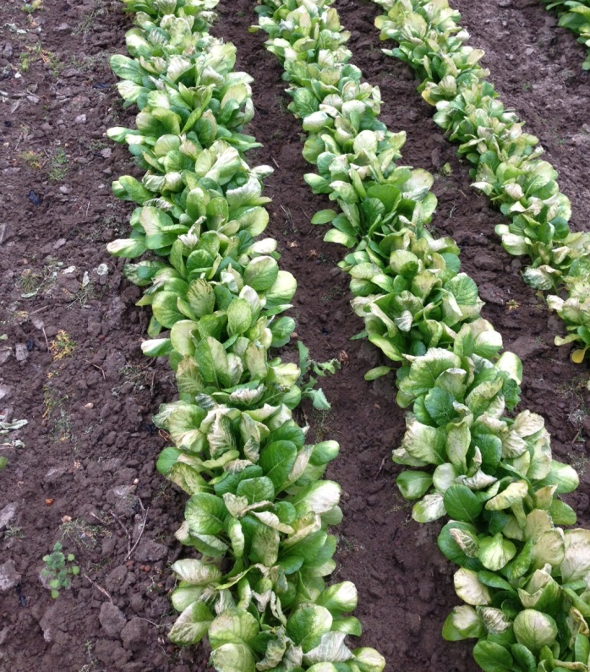
Cool Season Crops
Freeze/frost tolerance is related to species as well as
Growing conditions
Stage of growth
The following crops will tolerate frosts and freezes
Onion (15-18 ºF)
Cabbage (20-22 ºF)
Greens, Spinach (18-24 ºF)
Broccoli/Cauliflower (24-30 ºF)
Carrot (22-24 ºF)
Lettuce (24-28 ºF)
Damage to mustard greens after cultivation and cold weather
Photo: Tim Coolong
Notes:
Cool season crops thrive through the winter in Georgia – some low temperatures for tolerance are listed, but these are not absolutes. Stress that growing conditions and stage of growth has a big impact on survival and damage. For example a broccoli plant will survive temperatures in the low 20s, but if a head is forming then tolerance is only to the upper 20s. Onions that are established can survive temperatures down to 15 F, but those that are just planted will be easily killed to the soil in low temperatures. Cultural practices also can impact tolerance. Example picture of mustard greens that were cultivated the day before a freeze having severe damage, while those that were not cultivated were fine – the cultivation opened up air-pockets in the soil, exposing roots to the freezing air resulting in damage. Understand that cold tolerance is a fluid property based on several factors.

Slide 7
Warm Season crops
Lettuce bolting
All of these crops will be damaged by frost
Solanaceous crops (tomato, pepper, eggplant)
Cucurbits (cucumber, watermelon, cantaloupe, squash)
Sweet corn
Beans, Peas
Okra, sweetpotato
Photo: Tim Coolong
Notes:
These crops will suffer damage from frosts and benefit from season extension technologies. They also will grow slowly in cool soils and many are grown commercially on black plastic mulch. Extreme high temperatures that occur in mid-summer can also negatively impact fruit set (pollination) by these crops. Tomato has poor fruit set at temperatures above 95 oF and this is why most of these crops are not grown in S. Georgia in mid-summer. In addition it should be noted that many heirloom type crops do not set fruit well in hot temperatures. Direct seeded crops such as sweet corn and bean may germinate poorly in cool soils. In spring when temperatures are above freezing but still cool there can be issues with germination. In addition, when seed sit in the soil for an extended period of time fungal and bacterial diseases can cause problems with germination. The attached picture is of lettuce, which is about to flower (bolt). Lettuce, like many cool season crops, will begin to flower when temperatures begin to rise in the late Spring. Many times we have difficulty planting cool season crops in the spring as they mature in hot weather, which can cause problems. There are significant differences between going from cool to hot and hot to cool when planting vegetables. Cool season vegetables do better going from hot to cool, while warm season do better from cool to hot.

Slide 8
Days to maturity
Days to maturity are an estimate only
Ex. Sweet corn in spring and fall can differ by 20 days in maturity
Think in terms of heat units
Most warm season crops use a base temperature of 50 ºF for growth
Days to maturity cont.
Differ based on a direct seeded or transplanted crop
Beans are 50-55 days from seeding to maturity
Peppers may be 70-75 days from transplanting (6 week old transplant)
Notes:
Stress that cool and warm season crops can vary significantly on days to maturity. A warm season crop in the early spring can take 10 days longer than is typically listed for maturity times while in the fall it can be 10 days shorter. It has to do with heat units that the crop is exposed. Most warm season crops use a baseline temperature of 50 oF – below 50 oF they do not grow much. Also just note that days to maturity that are listed for a crop can differ based on if it is traditionally seeded or transplanted – the days to maturity are based on the day that plant or seed is put in the field.

Slide 9
Growing seasons
N. GA Mountains
1 warm season crop
1-2 cool season crops
Planting warm season May 1 (estimate)
Cool season crops planted March and August
Piedmont
1 or 2 warm season crops (2 short season crops such as squash/cucumber
2 cool season crops
Plant warm season early-mid April and early August
Cool season March and August
Notes:
Growing seasons in N. GA and the Piedmont. Typically in the mountains 1 warm season crop can be planted and 1-2 cool season crops. While this is a general rule of thumb, growers can plant sequentially so that they have a continuous supply of a particular crop – although only 1 warm season crop is listed a grower could plant sweet corn daily for 1 month and have a wide range of corn available. It may also be worth discussing some crops which are harvested 1 time (corn, onions, peas) while others such as pepper, squash, tomato can be harvested over several weeks of time. Sequential plantings can really increase the length of season.

Slide 10
Growing season
S. GA
2 warm season crops
2 cool season crops
Warm season planted late Feb-late March and Aug 1-Aug 15
Cool season planted mid Jan-early Feb and Aug 15-Sept 15
In the southern part of the state the second warm season crop will be under severe disease and insect pressure
Disease resistance in varieties is critical
Notes:
In the southern part of the state we have a narrow window for fall warm-season crops. If planted too late the crop may survive but productivity is slowed due to short days in the fall, even if temperatures remain high. We also plant cool season crops for the fall in very hot conditions – however the crop matures under cool conditions so it works out okay. Conversely in the spring if planted too late the cool season crops will mature when the weather is hot, which is problematic. Some growers will produce crops such as greens year-round in the southern part of the state, but issues with quality and insect resistance usually prevent this from occurring.

Slide 11
Transplant production
For many fall crops transplant production can be challenging
Seeded and grown during the hottest time of the year
Germination rates of cool season crops suffer in heat
Direct seeded fall crops (carrot, bean) need to have constant wetting of the soil to prevent crusting and improve germination.
Photo: Tim Coolong
Notes:
Briefly cover transplant production of cool season crops under very hot temperatures. Cabbage and greens for the fall are seeded in early July, which can be problematic for germination – more of this will be covered in transplant production. Also discuss seeding of some crops under high temperatures (already discussed cool temperatures earlier). Under hot temperatures very small seeded crops (carrots) need constant wetting to germinate. Even large seeded crops such as bean (see picture) can have vigor and stand issues when planted under hot temperatures. The beans in the picture have a poor stand as they were seeded when air temperatures were 100 oF and soil surface temperatures approached 125 oF.

Slide 12
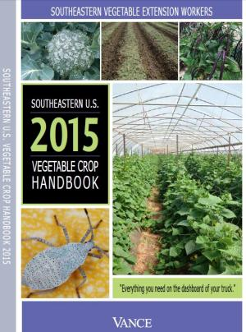
Additional Resources
General planting dates for GA
Vegetable gardening in GA
http://extension.uga.edu/publications/detail.cfm?number=C963
SE Regional Vegetable Production Guide
http://www.thepacker.com/grower/2015-southeastern-us-vegetable-crop-handbook

Slide 13
Supported by
Beginning Farmer Rancher
Development Program
Developing the Next Generation
of Sustainable Farmers in Georgia Grant

