Slide 1
Small Fruit and Vegetable Production

Slide 2
Session 3 Crop Rotation
David Berle, Associate Professor
Horticulture Department
University of Georgia

Slide 3
Learning Objectives
What is crop rotation?
Benefits of a good crop rotation program
Determine best crop rotation for individual situation

Slide 4
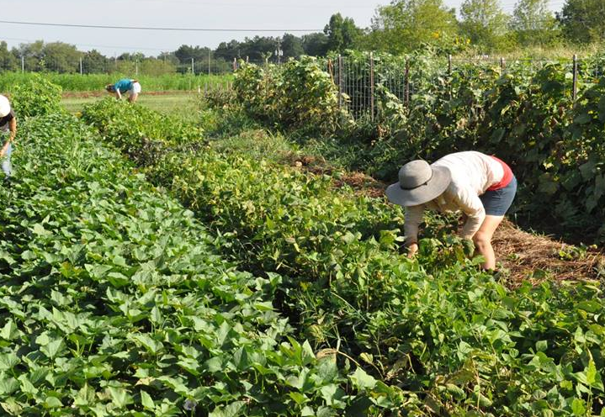
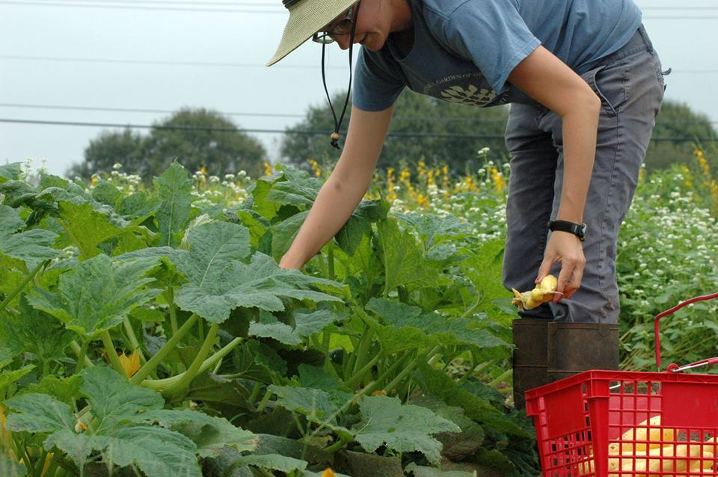
What is crop rotation?
Planting different crops over time
Alternating crops with different growth habits
Growing plants for the benefit the soil
Using plants to help manage a pest
Photo: Noelle Fuller
Photo: Jessica Cudnik
Notes:
Crop rotation is the practice of planting different crops in a field over a period of time. Ideally, those crops will be different enough in growth habit (deep rooted versus shallow rooted), in the diseases and insects they attract, and season of growth. A typical rotation plan will include cash crops- crops grown for sale, and non-cash crops- crops grown for the benefit of the soil, but not sold. These non-cash crops are usually a cover crop. Some crops can be both. A good example of this is the field pea, which is a summer legume crop that fixes Nitrogen but also produces a dry pea that can be harvested and sold.
One simple goal of crop rotation is simply to avoid having bare soil for a long period. This reduces soil erosion and carbon loss from the soil. Another goal may be to increase soil organic matter or increase soil Nitrogen. Another goal might be to grow a cover crop to shade out a noxious weed before planting the next cash crop.

Slide 5
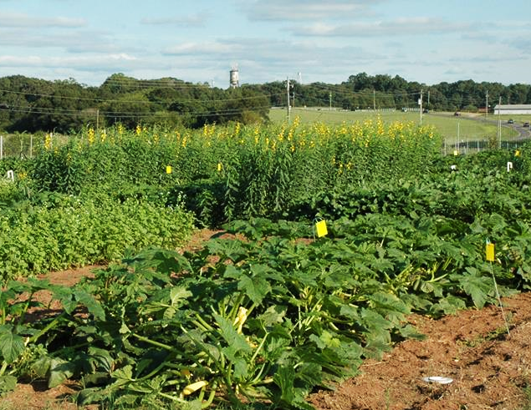
Benefits of crop rotation
Build soil fertility
Covers the soil when not growing cash crop
Increase economic returns
Add to crop and market diversity
Help control of weeds, diseases, and insects
Photo: Julia Gaskin
Photo: Lindsay Davies
Notes:
Crop rotation is a fundamental part of a sustainable farming program. There are many ways to design a crop rotation program, depending on the type of cash crops grown, seasons and amount of land available. While it is not always possible to follow a complete rotation plan, there are clear benefits to rotating crops that make it worth the effort to plan some rotation program. These benefits include:
Improvements to soil fertility
Reducing harmful environmental effects, like soil erosion, water runoff, fertilizer contamination
Increasing economic returns
Adding to crop and possibly market diversity
And probably the most important benefit of all- helping in the management of pests

Slide 6
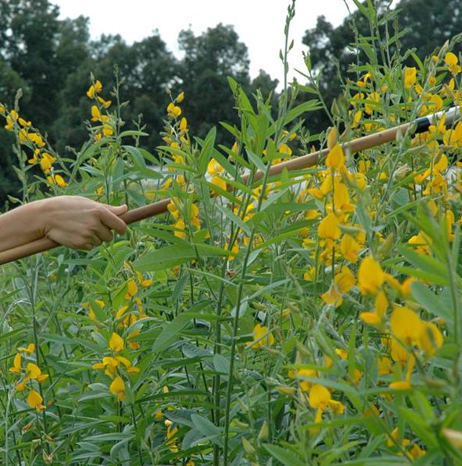
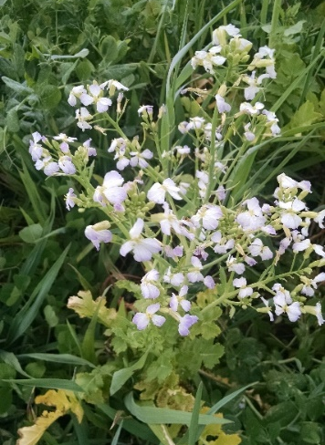
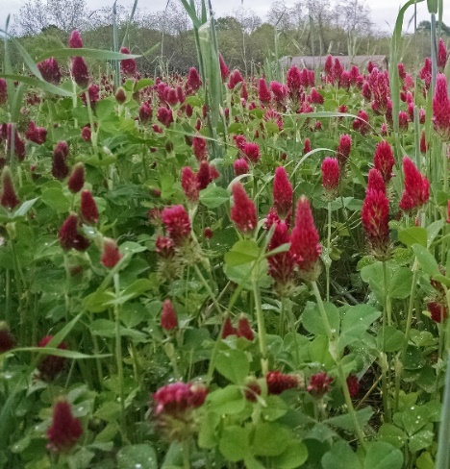
Crop rotation and cover crops
Cover crops as trap crops
Capture leftover nitrogen after harvest of cash crops.
Prevent this nitrogen from leaching or running off
Cover crops help distribute phosphorous and potassium
Photos: Lindsay Davies and Katie Chatham
Notes:
Trap crops like small grains can be used to capture leftover nitrogen in farm fields after harvest of cash crops. Small grains have extensive, fibrous root systems that can effectively mine the soil for available nitrogen. By capturing and storing residual soil nitrogen, these trap crops prevent this nitrogen from leaching or running off farm fields. The effect of crop rotations on soil nitrogen (N), phosphorous (P), potassium (K) and carbon (C) is very complex. Deep rooted cover crops in rotations helps to better distribute phosphorous and potassium from deep within the soil profile to the soil surface, where plant roots have better access to them.

Slide 7
Crop rotation for pest management
Crop rotation is essential to both conventional and organic growers
Farmers who implement a good crop sequence must consider two things at once:
How to deal with pests that are shared by crops in rotation?
How a previous crop can help reduce pests for the next crop?
Photo: Lindsay Davies
Notes:
Crop rotation for pest management is an established practice, even among conventional growers. Any practice that can reduce the need for chemicals saves money. For organc growers, crop rotation is essential.
Farmers who implement a good crop sequence must consider two things at once:
• How one crop can benefit from the crop that precedes it.
• How any pest problems these crops share can be addressed

Slide 8
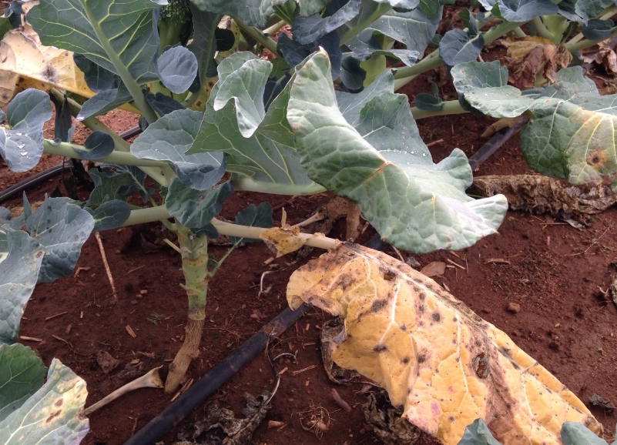
Crop rotation for disease management
Alternating crops helps break disease cycle
General rule: a two-year rotation will reduce the incidence of foliar diseases (leaf)
A four-year rotation that includes a succession of crops not susceptible to the same pathogens will minimize problems from soil borne diseases.
Photo: Jessica Cudnik
Notes:
As a general rule, a two-year rotation will reduce the incidence of foliar (leaf) diseases because a primary source of inoculum for infection is often the infected tissue from previous crops. Generally, that tissue will be well-decomposed in two years, and any inoculum will disappear along with crop residues. For example, most of the inoculum for early blight in tomatoes, leaf spot of cucurbits, and most foliar bacterial diseases can be eliminated by destruction and incorporation of residues and a one-year waiting period before replanting.
Although there are some exceptions, a four-year rotation that includes a succession of crops not susceptible to the same pathogens will generally minimize problems from soil borne diseases. For this strategy to be effective, however, it is important that pathogen-susceptible weeds and volunteer plants be excluded from the field, too.

Slide 9
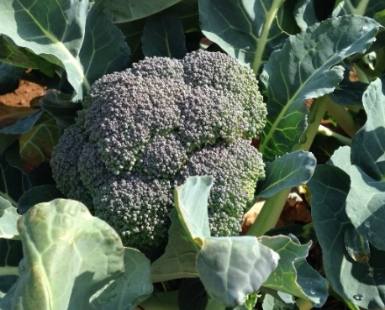
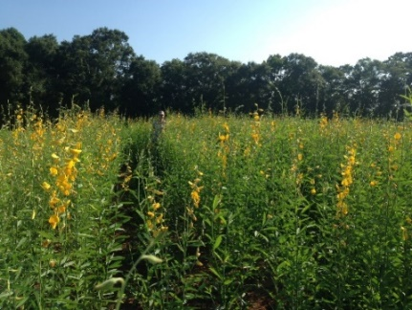
Crop rotation for disease management
Wanna B Farm Crop Rotation
Year 1: Buckwheat> Winter Squash> Oats/Austrian Winter Peas
Year 2: Tomatoes> Oat/Winter Pea> Sunn Hemp> Kale/Broccoli> Rye
Year 3: Field Peas> Oats/Winter Pea> Lettuce> Buckwheat> Okra
Note: Crops in squash family not grown in the same place for three years. This will reduce soil borne disease pressure and leaf diseases. The same principal applies for tomato family and cabbage family.
Photos: Jessica Cudnik, Lindsay Davies, and Katie Chatham

Slide 10
Crop rotation for insect management
Insects have specific environmental requirements to live
Crop rotation disrupts insect habitats
Crop rotation breaks the life cycle of insects
Not all insects are easily managed with crop rotation
Photo: Katie Chatham
Notes:
Managing insect pests in crops even when using pesticides is no easy task. Organic farmers have it tougher and must rely largely on good management practices, such as crop rotations, to keep insect pests in check. Crop rotation disrupts insect habitats by changing the plant, preferably to a plant the insect pest does not prefer. Crop rotation also interferes with the life cycles of insect by either exposing certain insect growth stages to and life cycles. Few insects can live without certain plants, or plant residues to feed on.
Needless to say, rotations will not control all insect pests. The effectiveness of crop rotation as a tool for insect management depends on the life cycle of the target insect. For crop rotation to control an insect pest well, the insect must spend the period from the end of one crop to the beginning of the next in a stage with low mobility and must have a restricted range of host plants. Not many insect pests fit this pattern. Most have a period during the adult stage when they can travel easily across at least a single farm. Often this highly mobile stage comes when insects are emerging from their overwintering stage in the spring, so crop rotation from one year to the next will not affect them. Many pests, including corn earworms, cabbage loopers, and potato leafhoppers, do not even overwinter in the northeast US. Rather, they travel hundreds of miles to re-infest host crops each year.

Slide 11
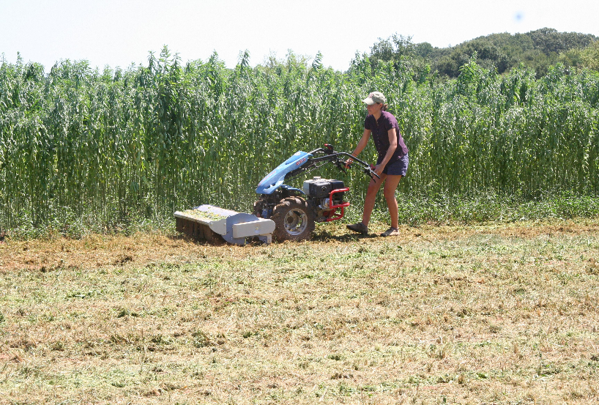
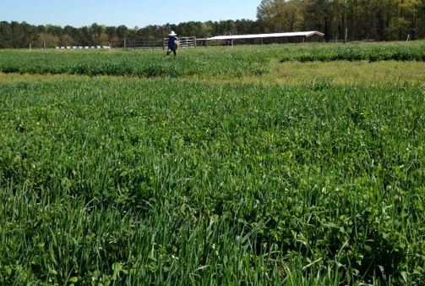
Crop rotation for weed management
Plan rotations to make it difficult for weeds to grow
Disturbing the soil slows weed growth
Certain crops can suppress weeds by out-competing them
Photo: David Berle
Photo: Julia Gaskin
Notes:
Crop rotations should be designed that make it difficult for weeds to grow and reproduce. Disturbing the soil with some sort of timed tillage is a good way to create an inhospitable or unstable setting for weed growth. Certain crops can suppress weeds by out-competing them for water and nutrients, or by shading them so they cannot receive adequate sunshine.

Slide 12
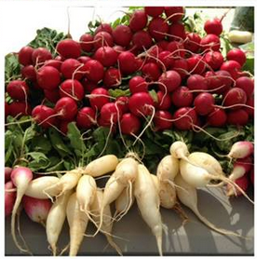
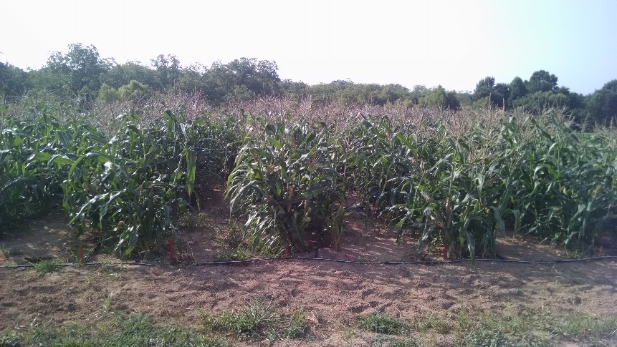
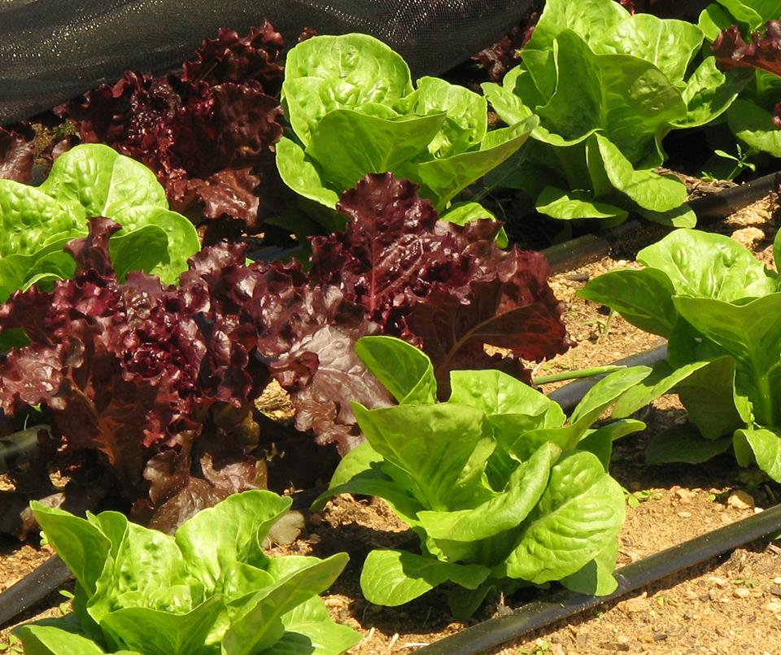
Rotation for pest management
Rule of thumb: Establish a rotation of crops that are hosts to entirely different sets of pests, have different growth habits, and are dissimilar in other respects.
Photos: Kate Munden-Dixon and Katie Chatham
Notes:
A good rule of thumb is to sequence crops in a rotation that are hosts to entirely different sets of pests, have different growth habits, and are dissimilar in other respects. All of this helps to interfere with the normal needs of a pest during its life cycle, such as an insect’s need to find food, a pathogen’s need for a suitable host to infect, or, in the case of weeds, the need for a crop architecture or tillage regime to
exploit.

Slide 13
Crop rotation planning
 | Jan | Feb | Mar | Apr | May | Jun | Jul | Aug | Sep | Oct | Nov | Dec
Year 1
Year 2
Year 3
No hard and fast rules
At a minimum:
Same crop should never follow itself in the same field (or bed)
A cover crop should be planted after vegetables every year
Plan at least a year ahead of time
Don’t worry about solving every problem with each planting- think long term
Notes:
Crop rotation is one of the most effective tools for managing pests and maintaining soil health, but there aren't many specific recommendations for how to go about it. Each farm needs to develop a plan that fits its unique combination of crops, soils, equipment and environmental conditions. A common approach on vegetable farms is to rotate crops by families. Another approach is to alternate vegetable crops with field or forage crops, such as small grains or alfalfa. Some growers try to rotate fields so they are in cash crops one year and cover crops the next year. On farms with limited land available for rotation, sweet corn is a good rotation crop since it hosts very few insects or diseases that affect other vegetables. At a minimum: 1) the same crop should never follow itself in the same field (or bed, in the case of small farms); 2) a winter cover crop should be planted after annual vegetables every year if possible.
Too many growers rotate crops using a seat-of-the-pants technique, relying on memory and making decisions at the time of planting. To get the most benefit from crop rotation it’s better to plan ahead using written records of where crops were grown in the past. It also helps to have a written plan for how crops will be arranged in the future, even if it’s subject to change. Start by making a map of the farm and any available fields including those that are rented. Label the fields or sub-fields with names and acreage. Make photocopies of the map and at the end of each season fill one in for each field and date it, noting what was grown where, and any serious pest or soil problems. Prior to the growing season, fill in a new map with your best guess as to where crops will go in the field.
Its is hard to plan a crop rotation plan to solve all your problems or meet all your goal. Most growers focus on the biggest problems or goals of crop rotation and select crops that fit best with the goal, working cash crops into the plan. A good crop rotation plan would consider what is to be grown in a field for several years into the future, knowing that changes may have to be made as needs change.

Slide 14
Crop rotation planning
Case studies have several examples of crop rotations
These are examples but not applicable to all situations

Slide 15
Additional Resources
Using Cover Crops in the Home Garden (C 1057) (UGA Extension)
Success with Cover Crops (EB 102) ((UGA Extension)
Cover Crops for Sustainable Production (https://growingsmallfarms.ces.ncsu.edu/growingsmallfarms-covcropindex/)

Slide 16
This material is based upon work that is supported by the National Institute of Food and Agriculture, U.S. Department of Agriculture, under award number 2015-70017-22861.
Beginning Farmer and Rancher
Development Program
Developing the Next Generation
of Sustainable Farmers in Georgia Grant

