Slide 1
Cover crop ~Jeopardy~

Slide 2
Summer Cover | Function Junction | Winter Cover | Know the Benefits
10 | 10 | 10 | 10
20 | 20 | 20 | 20
30 | 30 | 30 | 30

Slide 3
Category 1. Question 1.
These plants have a vining growth habit in the summer and are used to supply nitrogen and help suppress weeds.

Slide 4
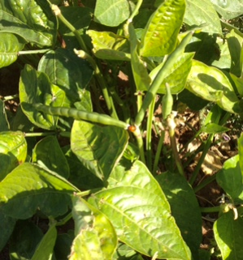
Category 1 Answer 1
What are cowpeas?
Photo: Lindsay Davies

Slide 5
Category 1 Question 2
These plants grow in the summer and will be killed by frost. They have small flowers and are loved by pollinators and beneficial insects.

Slide 6
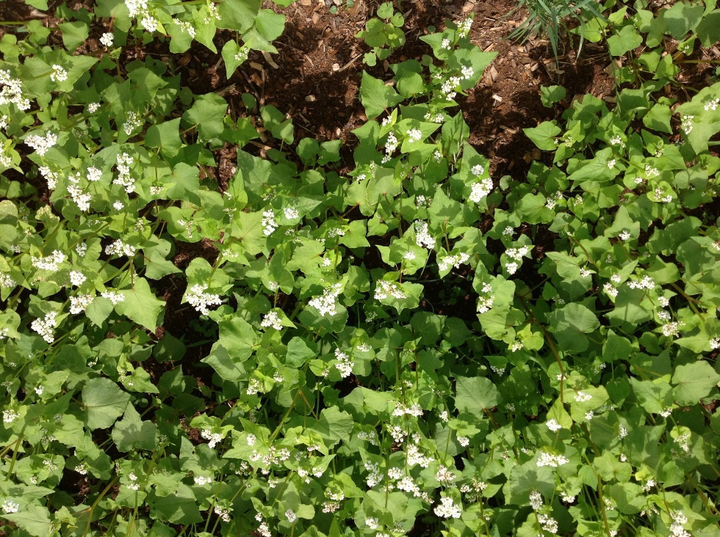
Category 1 Answer 2
What is buckwheat?
Photo: Lindsay Davies

Slide 7
Category 1 Question 3
These plants are grown in the summer and may be useful for farmers without heavy equipment because they produce a moderate amount of biomass.

Slide 8
Category 1 Answer 3
What are millets?
Applause
Explosion

Slide 9
Category 2 Answer 1
Legumes have to have a relationship with this in order to fix N.

Slide 10
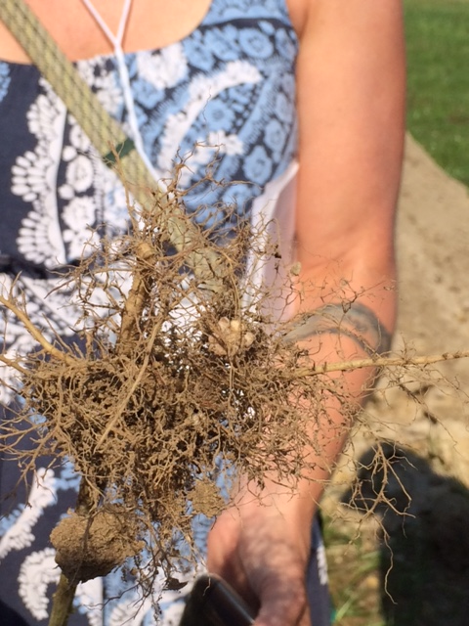
Category 2 Question 1
What is bacteria?
Photo: Jessica Cudnik

Slide 11
Category 2 Answer 2
This tropical summer legume is a good weed suppressant and fixes a large amount of Nitrogen in a short period of time.

Slide 12
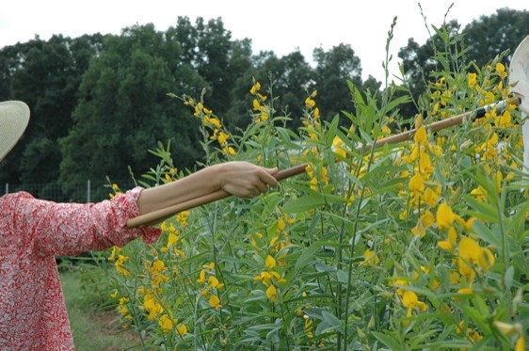
Category 2 Question 2
What is sunnhemp?
Photo: Lindsay Davies

Slide 13
Category 2 Answer 3
This process causes Nitrogen to be released to the soil for crops to use.

Slide 14
Category 2 Question 3
What is mineralization?

Slide 15
Category 3 Answer 1
These plants are the winter cover crop workhorses. They have a large amount of biomass, help suppress weeds, and are deep rooted so can scavenge nutrients.

Slide 16
Category 3 Question 1
What is cereal rye?

Slide 17
Category 3 Answer 2
These plants are grown in the winter and are known to help suppress nematode populations.

Slide 18
Category 3 Question 2
What are brassica cover crops?

Slide 19
Category 3 Answer 3
These plants are planted each year in the fall and grown over the winter to provide nitrogen for spring cash crops. Their scarlet flowers make beautiful fields before the cover is killed.

Slide 20
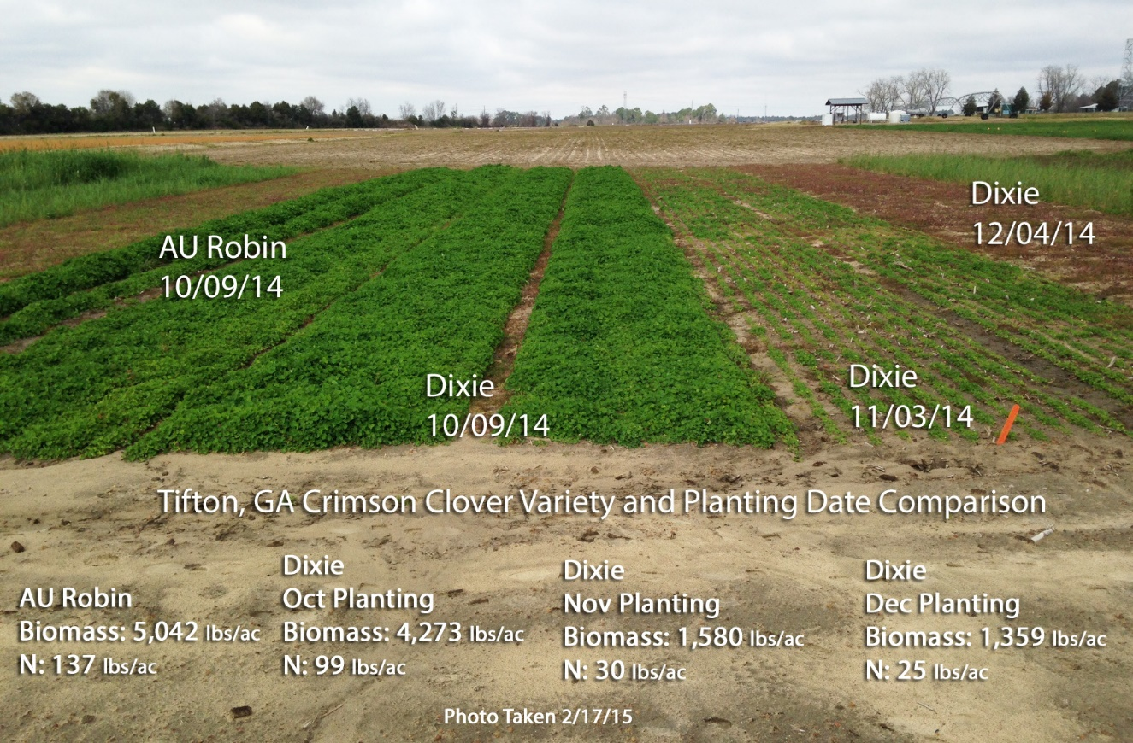
Category 3 Question 3
What is crimson clover?
Photo: Julia Gaskin

Slide 21
Category 4 Answer 1
These plants have large tap roots and are thought to help alleviate soil compaction.

Slide 22
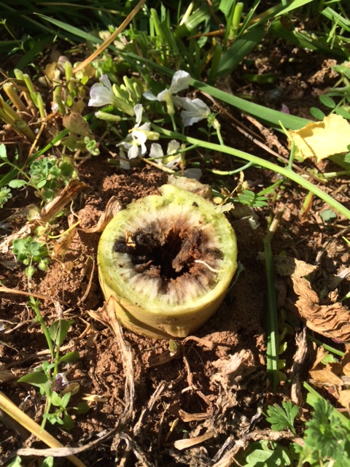
Category 4 Question 1
What is tillage radish?
Photo: Jessica Cudnik

Slide 23
Category 4 Answer 2
Cover crop benefits are maximized by treating them like a cash crop and having good seed/soil contact, timely planting and killing them as late as possible. All these practices maximize a key characteristic of the cover crop.

Slide 24
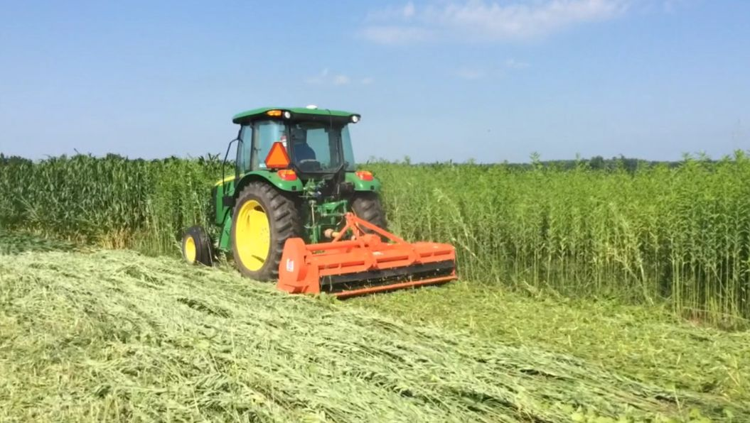
Category 4 Question 2
What is biomass?
Photo: Jessica Cudnik

Slide 25
Category 4 Answer 3
This is a benefit of using a mixture of different cover crops.

Slide 26
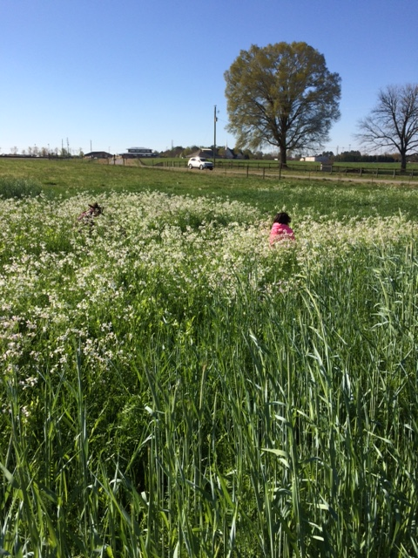
Category 4 Question 3
What are diversity and different functions?
Photo: Jessica Cudnik

