Slide 1
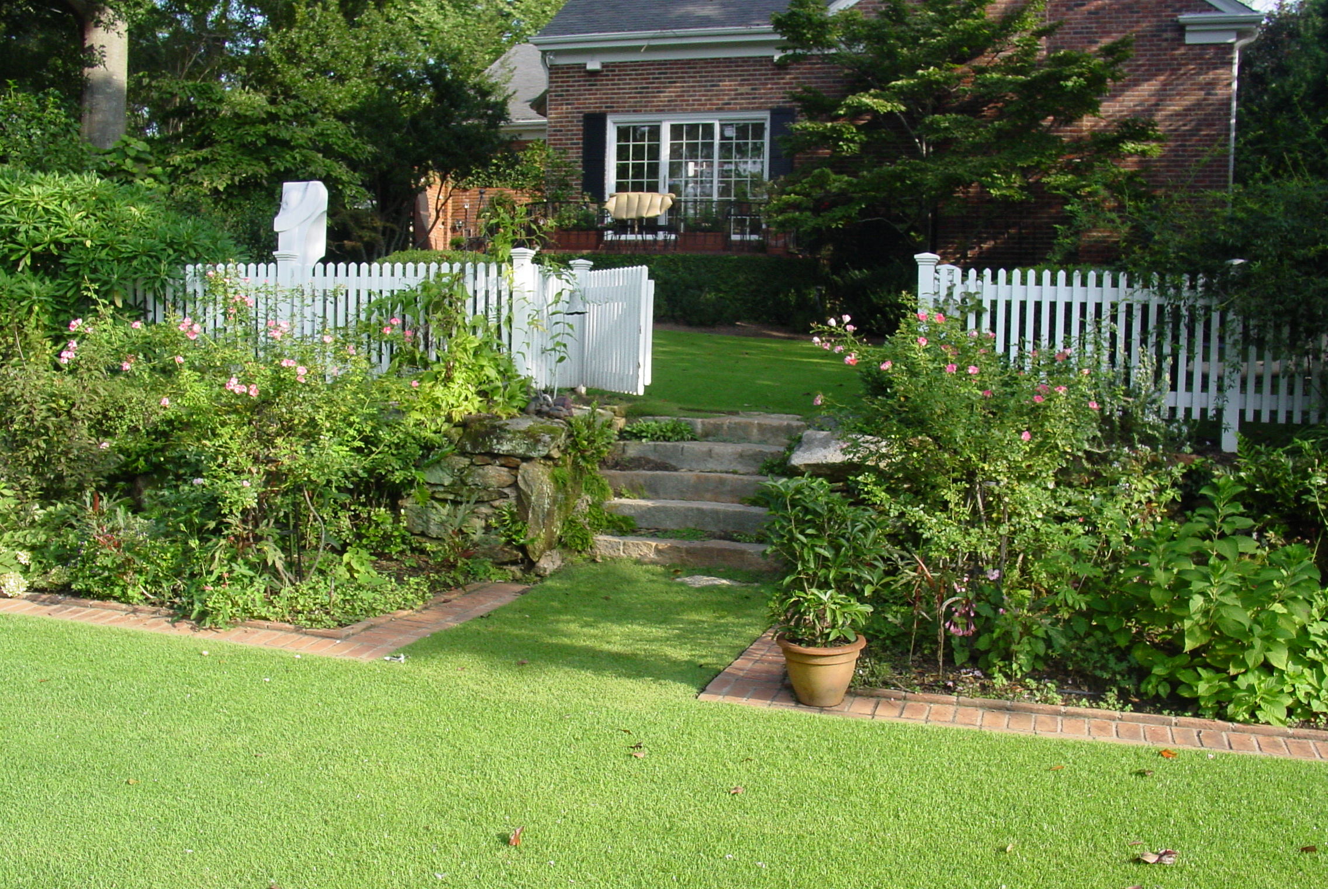
Xeriscaping
Water Wise Landscaping
Notes:
No set template – Plan to talk about principles and concepts of xeriscaping
Introduce you to the idea that plants don’t waste water
Xeriscapes aren’t desert landscapes – We can judiciously utilize water and still have beautiful landscapes
Economics of xeriscaping

Slide 2
Notes:
PROJECTED WATER DEMAND IN NE Georgia. Increasing water demand is not limited to large urban counties. All counties in Georgia project an increasing demand for water in the years ahead. This graph shows the projected demand for water in Barrow, Clarke, Jackson and Oconee counties in the years 2000, 2020 and 2050. This increasing demand parallels projected increases in population and industrial development.

Slide 3
Household Water Use
Source | Amount (GPD)
Toilet | 18.5
Clothes Washer | 15.0
Shower, Bath | 12.8
Sinks, Faucets | 10.9
Leaks | 9.5
Dishwasher | 1.0
Other Sources | 1.6
Total Indoor Water Use | 69.3
Total Outdoor Water Use | 30 – 40
Source: AWWA Research Foundation
Notes:
A large portion of municipal water is used outdoors

Slide 4
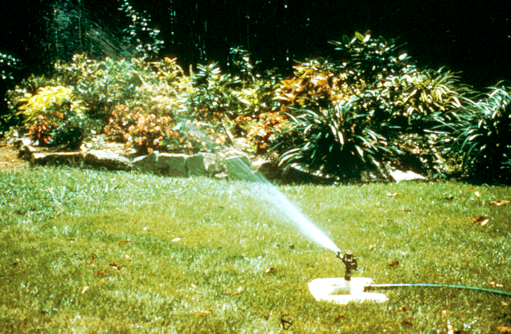
Outdoor Water Use
Outdoor water use is more discretionary
than indoor use
Average residential water use increases 30% - 50% during the summer months when citizens turn on their outdoor irrigation systems
Home-landscape water use can consume up to 59 – 67% of total home water demand (AWWA)
Plants don’t waste water
people do!
Notes:
AVERAGE RESIDENTIAL WATER USE. Average residential water use increases as much as 50% during the summer months when citizens irrigate their outdoor landscape. Unfortunately, much of this water is used unnecessarily to irrigate plants that may not need water, and some of it is simply lost to evaporation when irrigation is done during mid-day.

Slide 5
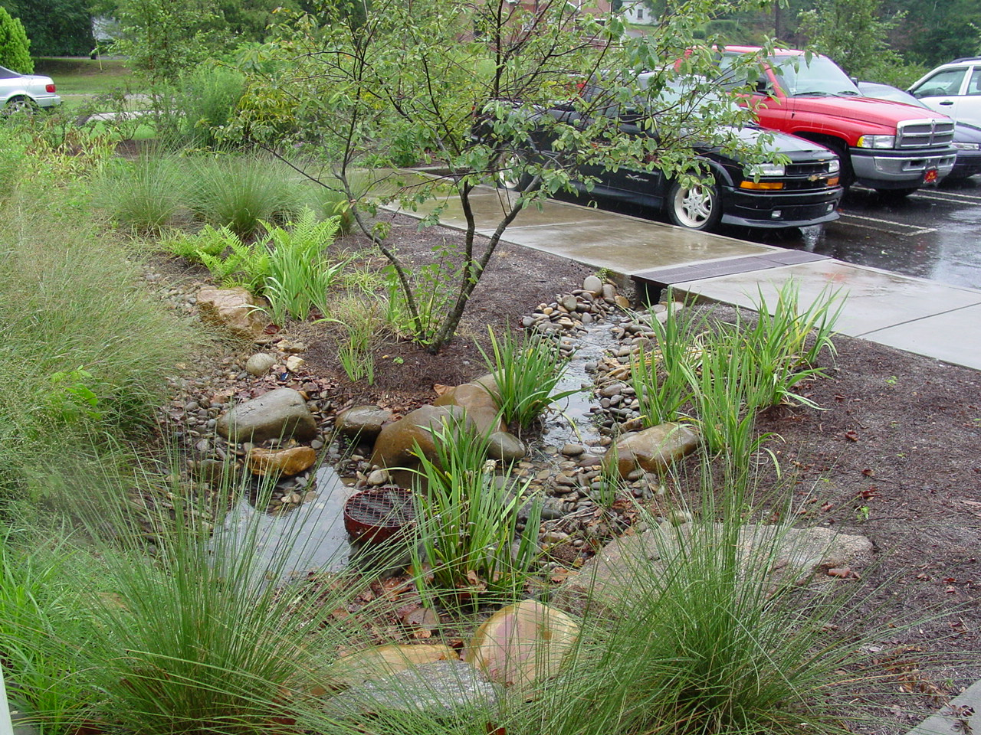
Functional Landscape Benefits
Reduce heat island effect
Filters air and water
Reduce runoff, permit infiltration
Erosion Control
Fire Prevention
Nuisance pest reduction
Notes:
There are many benefits to good landscaping. Water bans may have unexpected or hidden negative effects

Slide 6
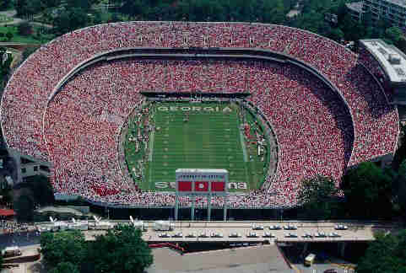
Recreational Benefits
Sports safety
Entertainment
Physical health

Slide 7
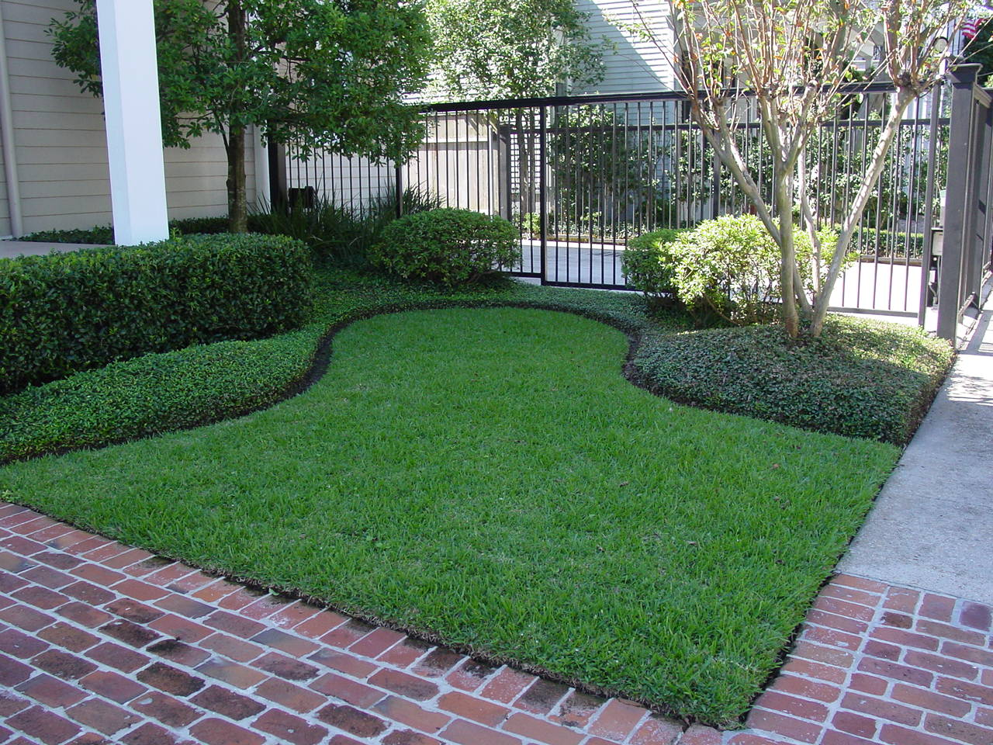
Aesthetic Benefits
Property value increase 7.28-15% (Gallup)
Quality of life
Mental health
Social Harmony
Community pride
Notes:
Quality landscapes increase property values, improve the quality of life, may reduce crime and increase community pride

Slide 8
Principles of Design

Slide 9
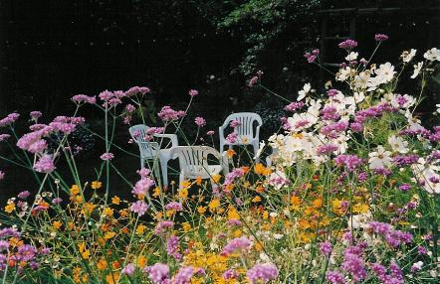
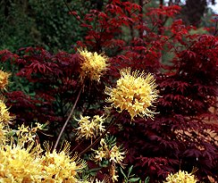
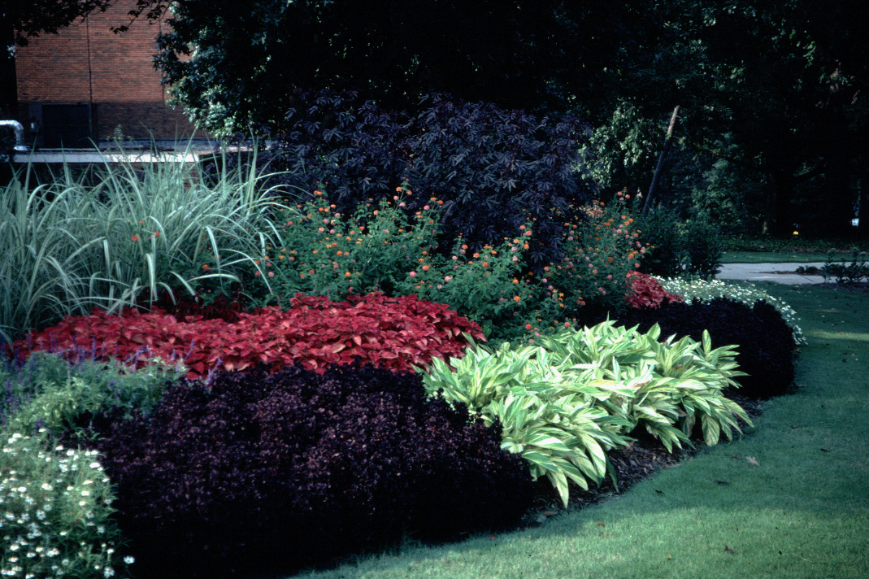
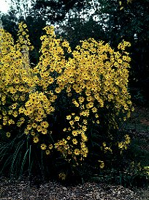
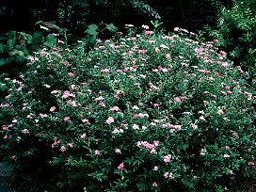
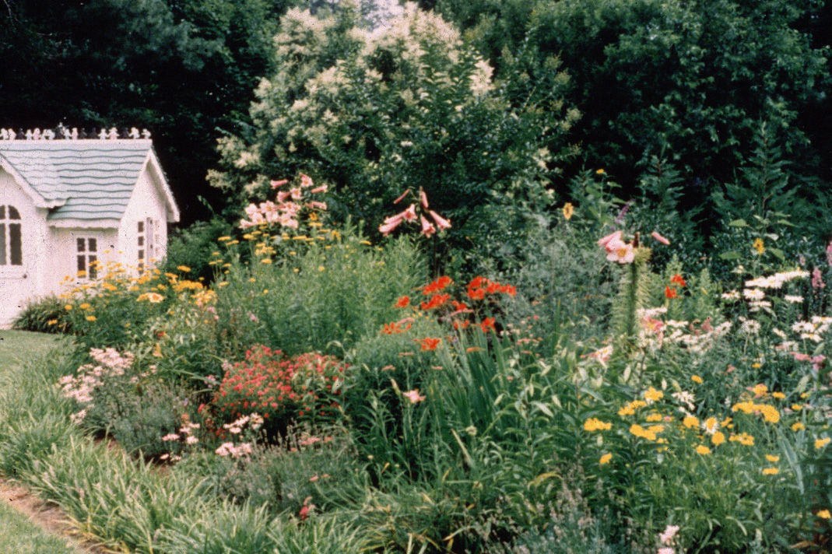
Plant Color
Notes:
Plant color is most commonly expressed with flowers, however some plants have red twigs, green bark, or burgundy buds. It is worth noting that color is often only expressed for a short period during the growing season. This is where knowledge of flowering (or color) season helps when seeking combinations. For example, yellow and blue work well together, but daffodils and butterfly bushes do not bloom at the same time.

Slide 10
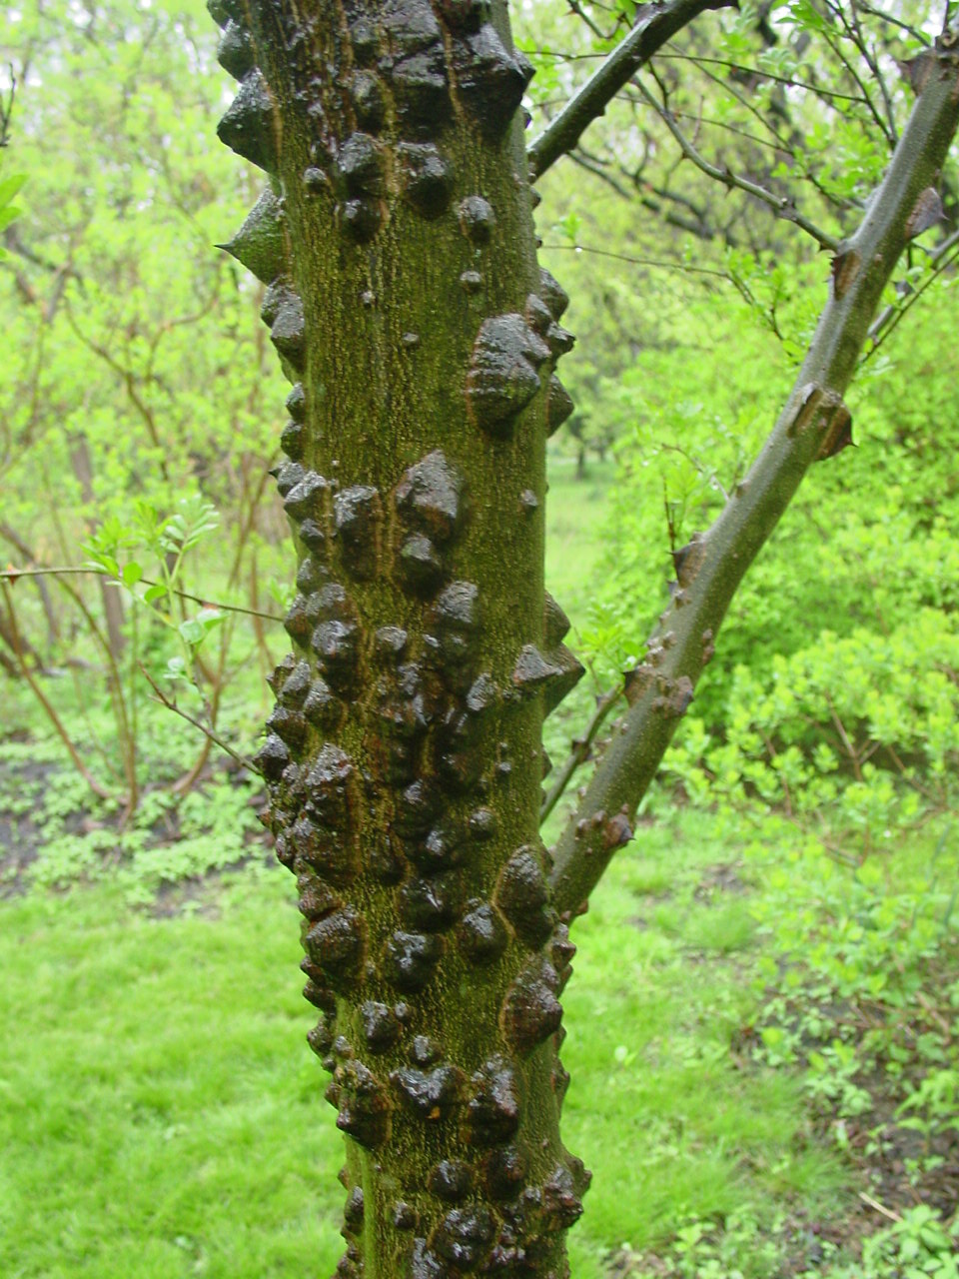
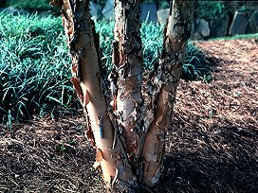
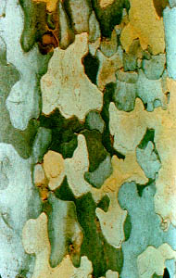
Texture
Notes:
Often, textural differences can be found in bark. Bark characteristics are especially important during seasons when flowers or leaves are not present.

Slide 11
Form
Notes:
This picture shows three different forms of the same plant, yaupon holly (Ilex vomitoria) The plant to the left is the upright form. The plant in the middle is the compact form. The plant on the right is the weeping form, ‘Pendula.’

Slide 12
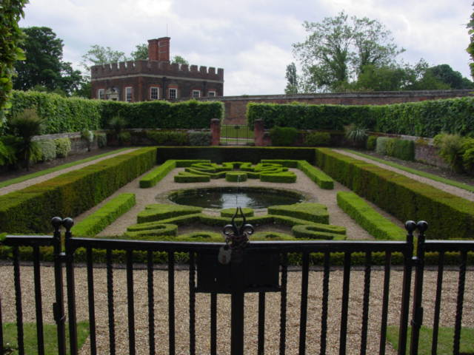
Arrangement
Notes:
The clipped boxwoods (Buxus sempervirens ‘Suffructosa’ ) and yews (Taxus sp.) in this formal English garden create a more formal effect, while still remaining interesting.

Slide 13
Principles of Xeriscape
in a landscape

Slide 14
Start with a plan or design
Notes:
If you don’t know what you want then it’s likely that is what you will get

Slide 15
Include plant water
requirement in design
Moderate
Moderate
High Water-use Zone
Notes:
36. RESIDENCE - WATER USE ZONES. Now let’s look at the existing water-use zones of this property. (#) The azaleas are irrigated “as needed” and are in a moderate water-use zone. (#) The Nandina and Magnolia have very good drought tolerance once established and can be placed in a low water-use zone, (#) as can the spirea. (#) The turfgrass was irrigated regularly to maintain optimum growth and beauty and therefore is a high water-use zone.

Slide 16
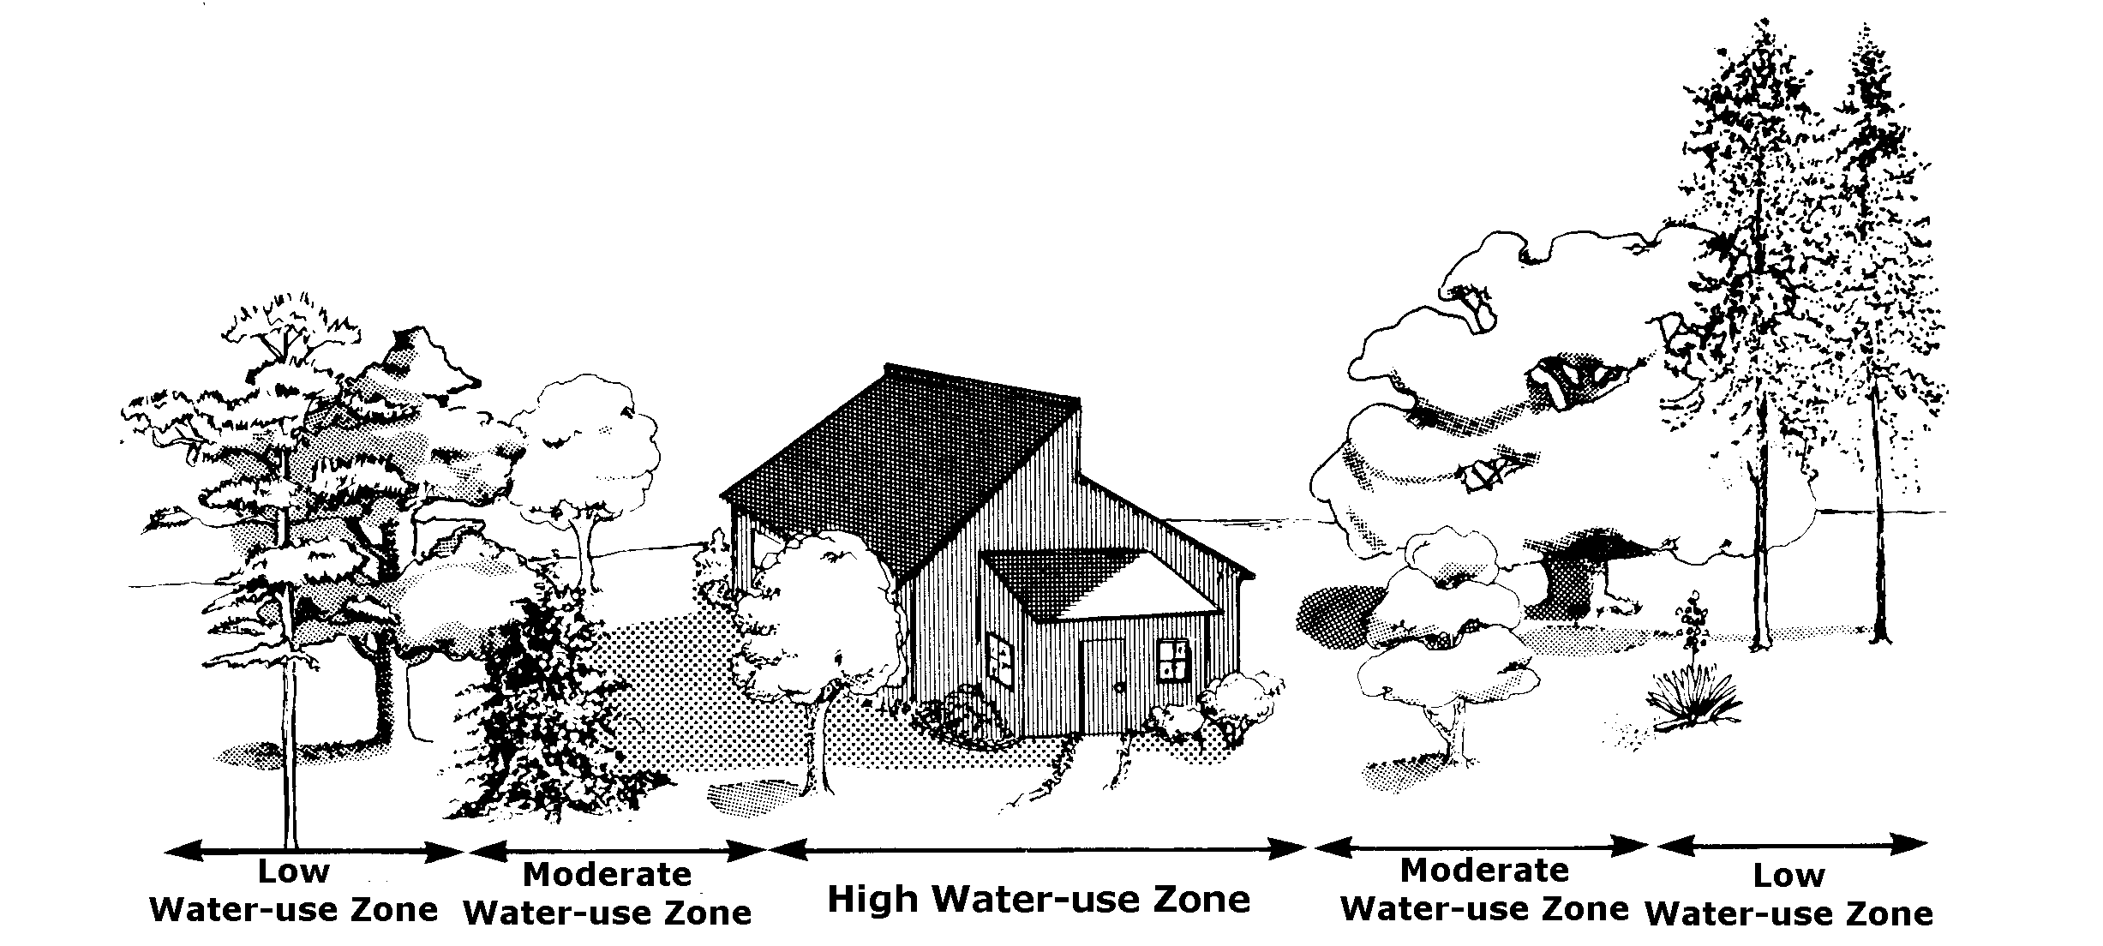
Group plants according to water use
Maximize low water use
wherever possible
Notes:
By grouping plants into high, medium and low water use zones it makes it much simpler to efficiently irrigate the landscape
For instance hydrangea and camellia have different water requirements, Annuals will have a higher requirement than woody plants…

Slide 17
Include plant water
requirement in design
Low
Low
H
H
Moderate Water-use Zone
Notes:
Converted woody plants in natural area into unirrigated low water use zone. Lawn used as a welcome mat, selected drought tollerant
turf that requires minimal water (could convert to a low water use zone if aesthetics acceptable). Groundcover and shrub boarder is
Established and does not require additional irrigation. Added some high water use flower pots in high visibility area near door to add interest

Slide 18
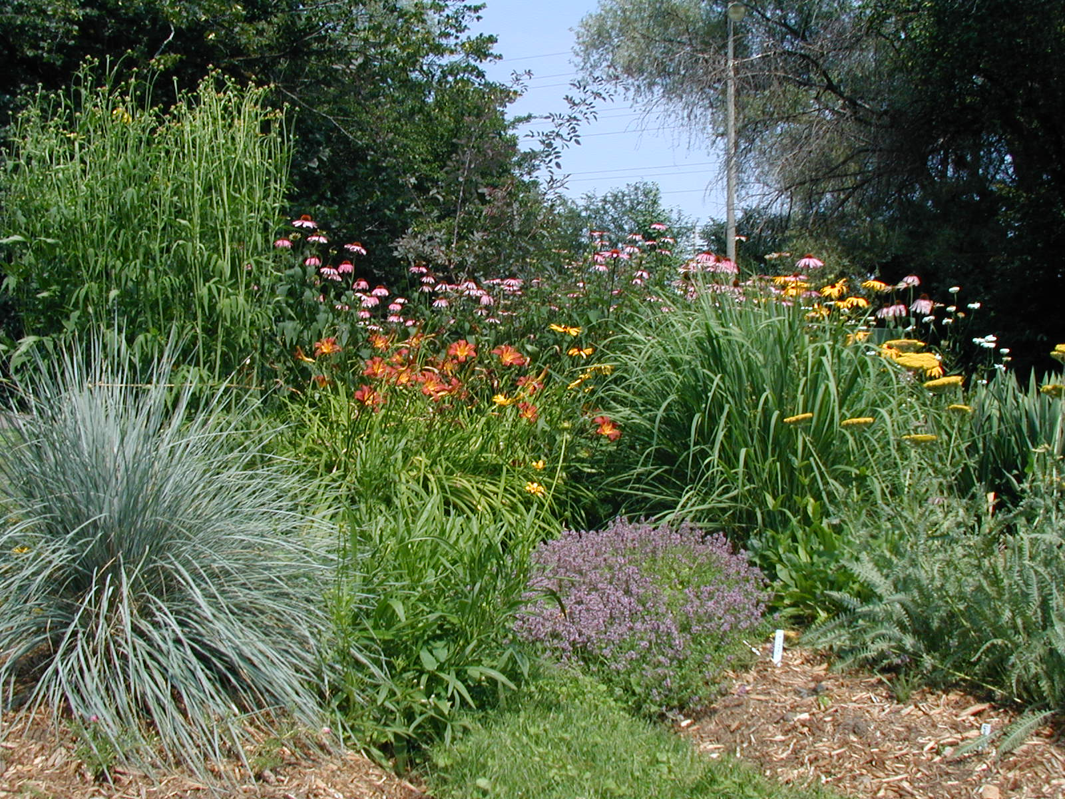
Plant Selection
Notes:
Select plants that have low water usage (drought resistant). They don’t have to be desert plants and should still be attractive
Pay attention to water use in addition to other design criteria – wide selection of plant material is available
Find plants that conform to your design criteria – don’t settle

Slide 19
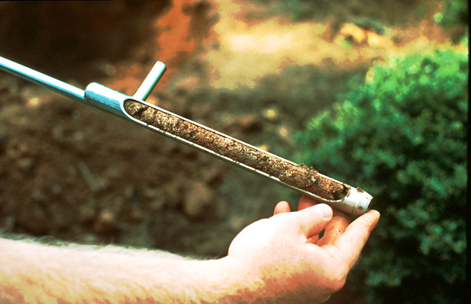
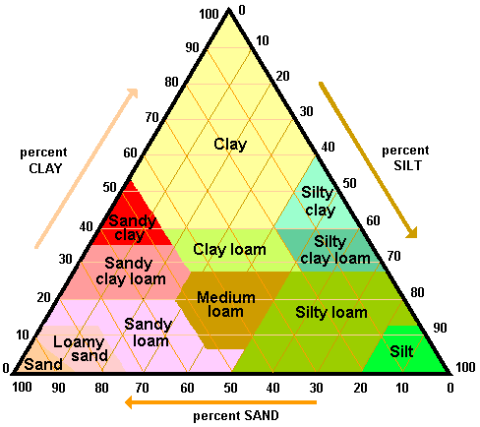
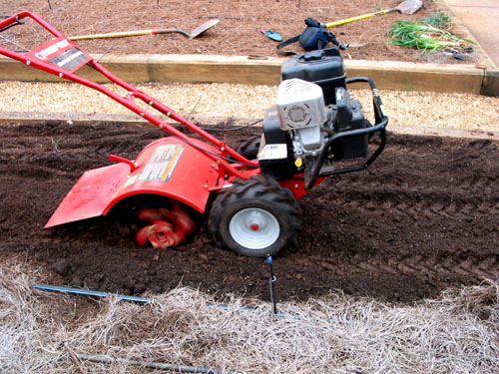
Soil Preparation
Infiltration
Root growth
Slope
Harvest rainfall
pH
Notes:
Often overlooked. Quality soil preparation – promote infiltration, root expansion and efficient use of irrigation and natural water resources
Woody plants – till a large area. Annuals an perennials add lots of organic matter

Slide 20
Evaporation Rates For Athens
*Average from 1953 to 1992
**Average from 1971 to 1992
Start Here!
Evaporative Water Loss - Inches
*
**
Notes:
Evaporation Chart: In Georgia, summer evaporation rates can be quite high and newly planted perennials may not be able to keep up with the heavy water demand. This may also cause a homeowner to use much more water than is necessary in a well-planned perennial planting. Note how the evaporation rates, and hence the water demand, drops off in October. This is the best time to plant!

Slide 21
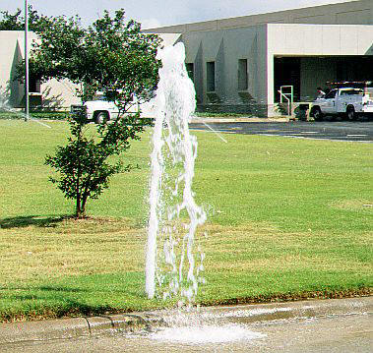
Efficient Irrigation
Timing
Quantity
Pressure
Uniformity
Plant needs
Infiltration
Leaks
Households with inground spinkler systems use 35% more water outdoors (AWWA)
Households with automatic timers use 47% more water outdoors (AWWA)
Notes:
People pay good money for irrigation systems – they want to see these systems run

Slide 22
Appropriate Irrigation
Aesthetics
Foot traffic
Dust
Temperature
Notes:
Irrigation isn’t bad – may be necessary during establishment, during periods of drought or in high visibility or high use areas
Nursery producers may water plants once or more times each day – may need irrigation during establishment
Reduce irrigation when plants are established

Slide 23
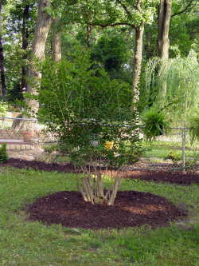
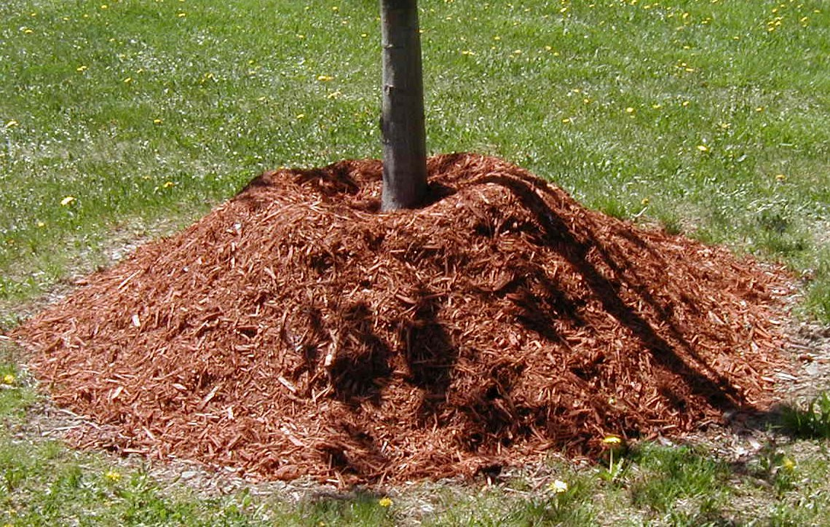
Mulch
Avoid the volcano
Notes:
Mulch can be used to reduces heat fluctuations, improve infiltration/moisture retention, reduces competition, add organic matter
Which will improve the quality of soil

Slide 24
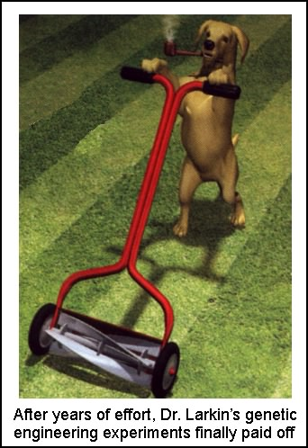
Appropriate Maintenance
Mowing
Pruning
Fertilizing
Pest control
Expectations
Notes:
Mowing at correct height with sharp blade
Avoid shearing or pruning that will create excessive tender growth
Fertilizers are salts, be judicious – promote healthy plants with modest growth
Reduce competition from weeds, avoid insect and disease stress

Slide 25
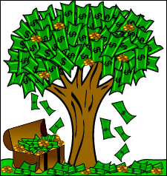
Xeriscape Economics
Notes:
If you can’t find any other reason to xeriscape do it because it saves money

Slide 26
Water/Sewage Rates in Athens/Clarke County
 | $/100 cu. ft. | $/1,000 gal.
Water | $2.10 | $2.81
Sewer | $1.68 | $2.25
Total | $3.78 | $5.06
100 cu. ft. x 7.48 = 748 gal.
$2.10 = x
748 1,000

Slide 27
Assumptions
1 inch of water = 624 gal./1,000 sq. ft.
High Water-use Zone:
1 in. water 4 times/mo: Mar. -Oct., then
1 in. water 1 time/mo: Nov. -Feb. (22,464 gal.)
Moderate Water-use Zone:
1 in. water 2 times/mo: March - Oct;
then no water: Nov. -Feb. (9,984 gal.)
Low Water-use Zone:
No supplemental irrigation (0 gal)

Slide 28
Projected Water Cost/1000 sq. ft.
Water Zone | Water Cost | Sewage Cost | Total Cost
High Water-use Zone | $63.12 | $50.50 | $113.62
Moderate Water-use Zone | $28.06 | $22.45 | $50.51
Low Water-use Zone | $0 | $0 | $0

Slide 29
Potential Water Savings
Convert 1/3 of a ½ acre lot (7,259 sq. ft.)
from High to Low Water Use
SAVE $825.11/yr.
Convert 1/3 of a ½ acre lot from Moderate
to Low Water Use,
SAVE $366.72/yr.
Total Potential Savings: $1,191.83/yr. on water and sewage

Slide 30
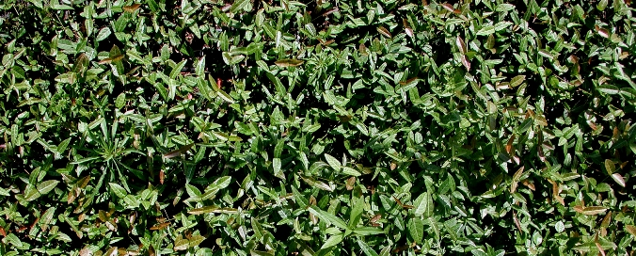
Cost of Converting 1000 sq. ft. to Groundcover Plants
Asiatic Jasmine Groundcover @ 24-inch centers
Liner plants (2 ¼-inch pots) @ $0.75/pot
250 plants/1000 sq. ft. x $0.75/plant = $187.50
+ 20 bales of pine straw (2-inch depth) @ $3/bale = $60
Total Cost = $247.50

Slide 31
Plants Don’t Waste Water
People Do!

