Slide 1

Athens-Clarke County Stormwater

Slide 2

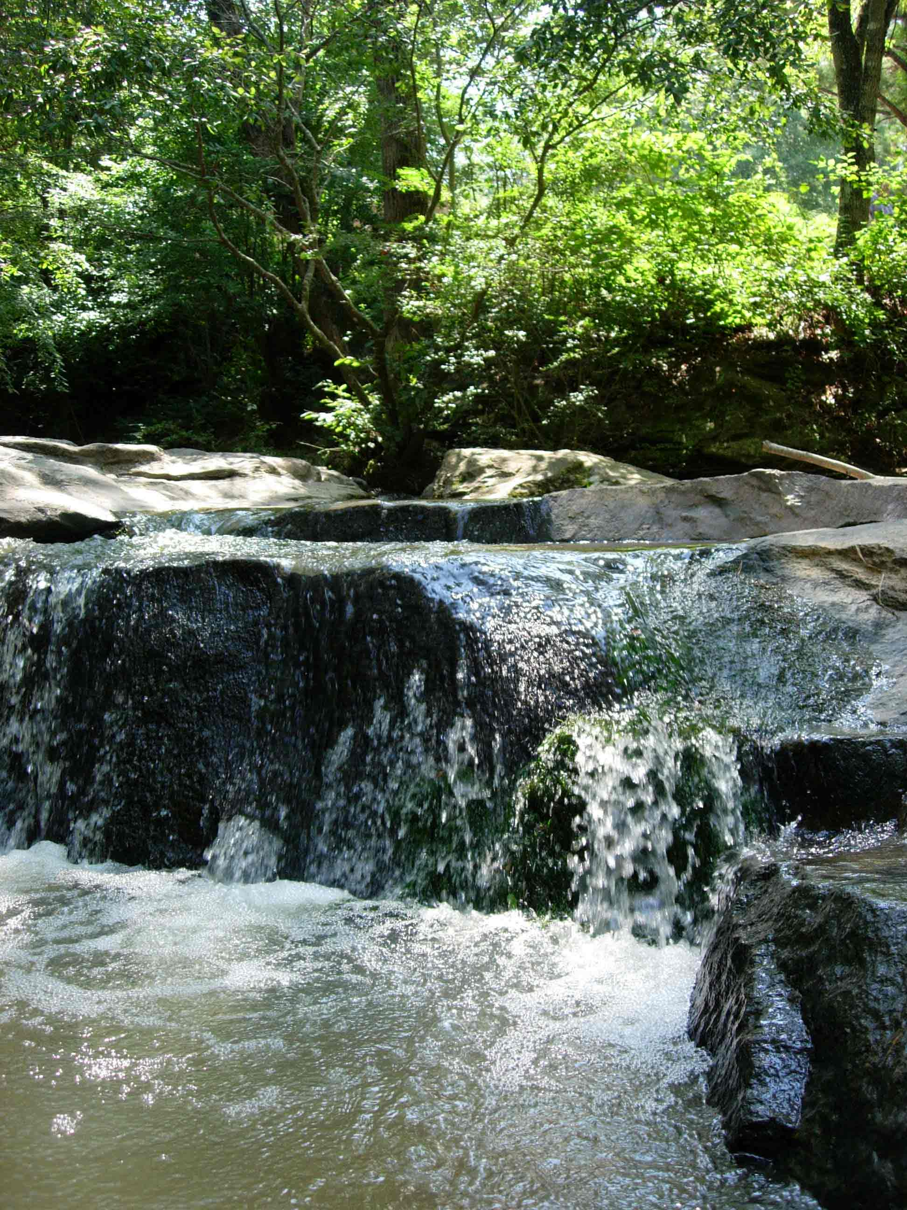
What is Stormwater?
Water that runs off of impervious surfaces such as roads, parking lots, or rooftops.

Slide 3
Stormwater Management
What is the problem with stormwater in Athens-Clarke County?

Slide 4
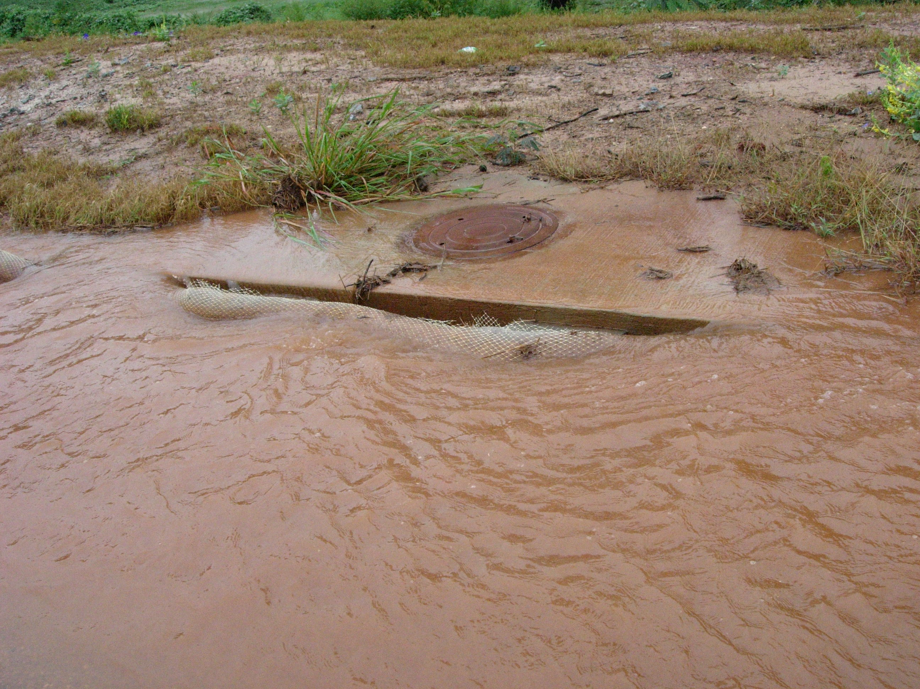

Slide 5
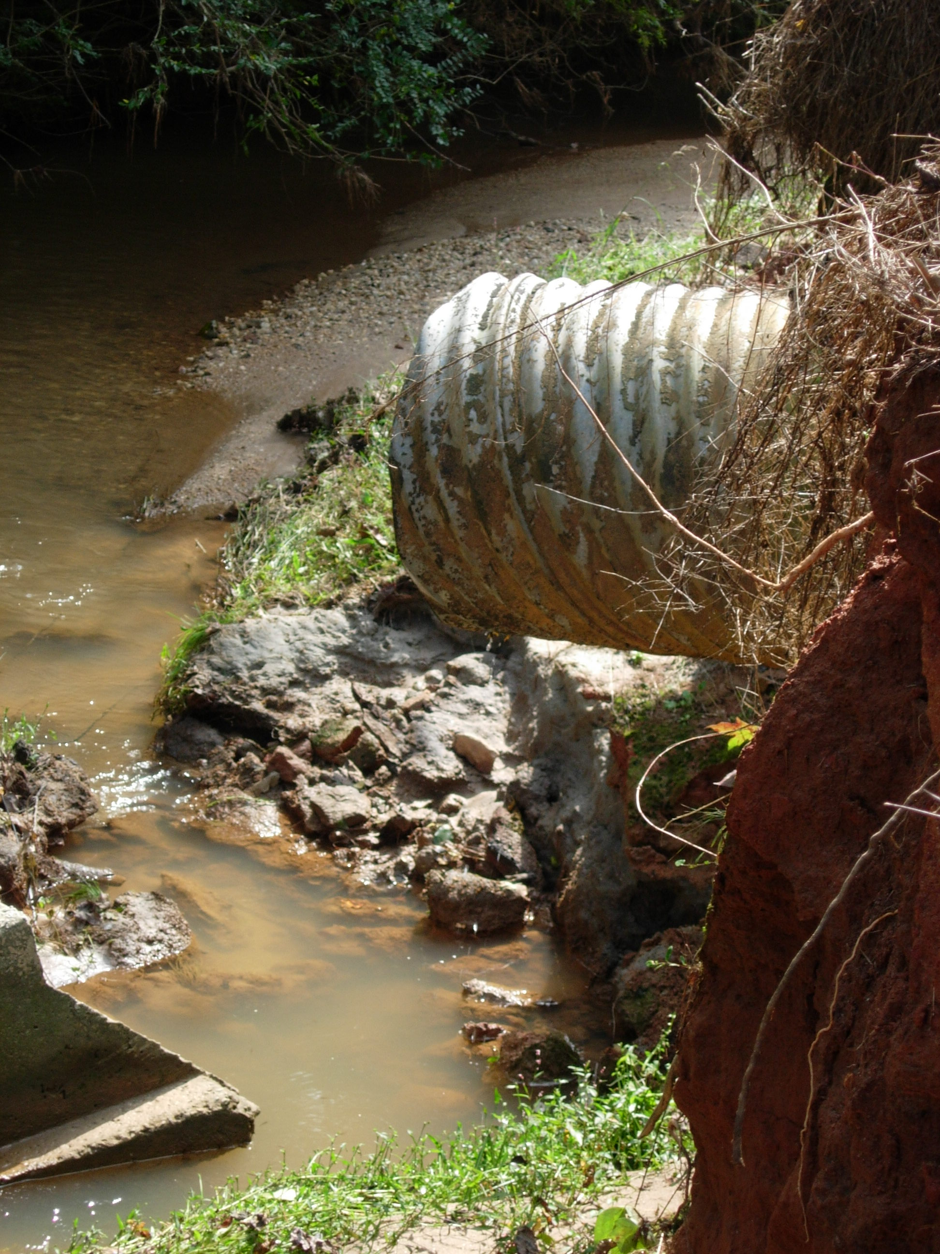

Slide 6
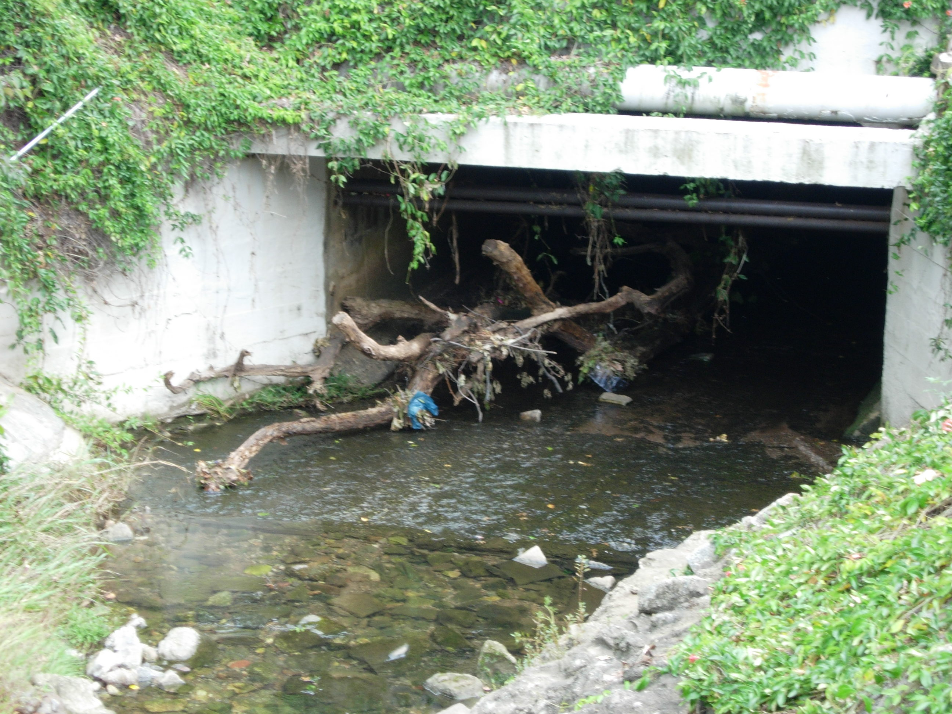

Slide 7
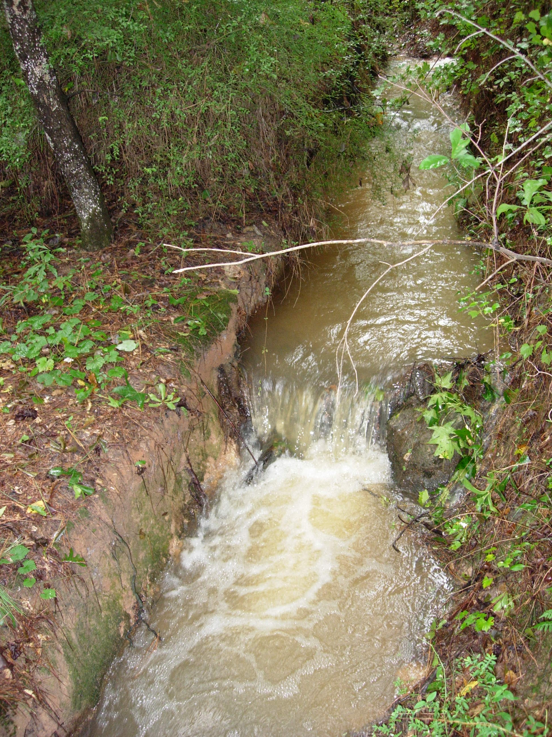

Slide 8
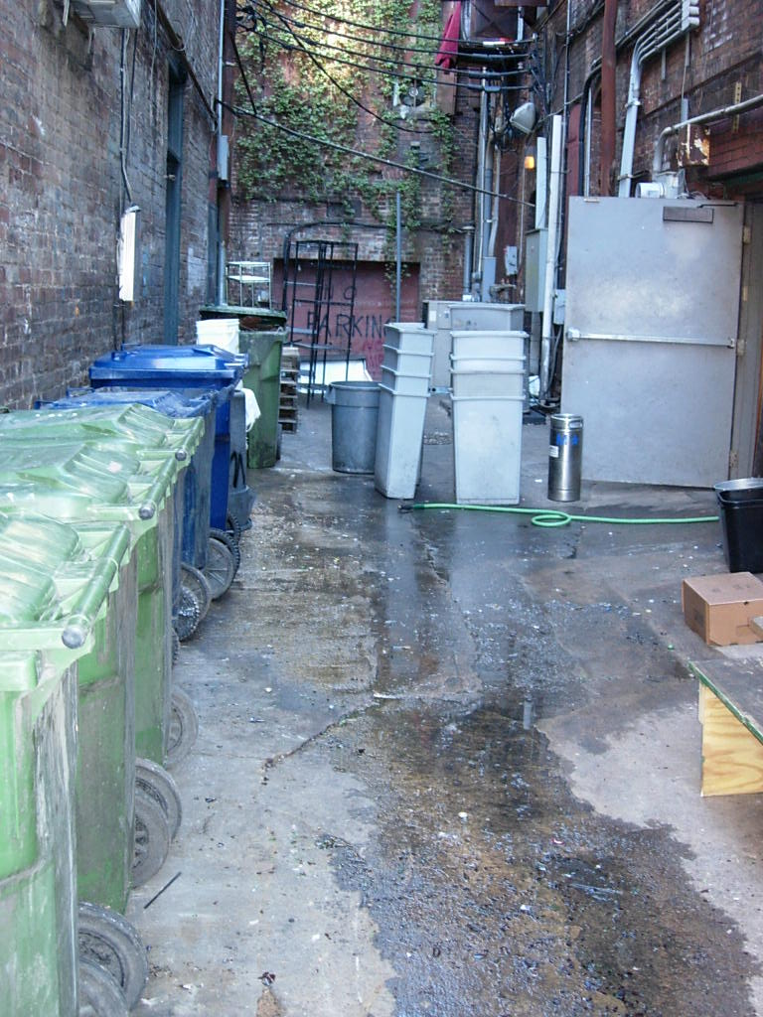

Slide 9
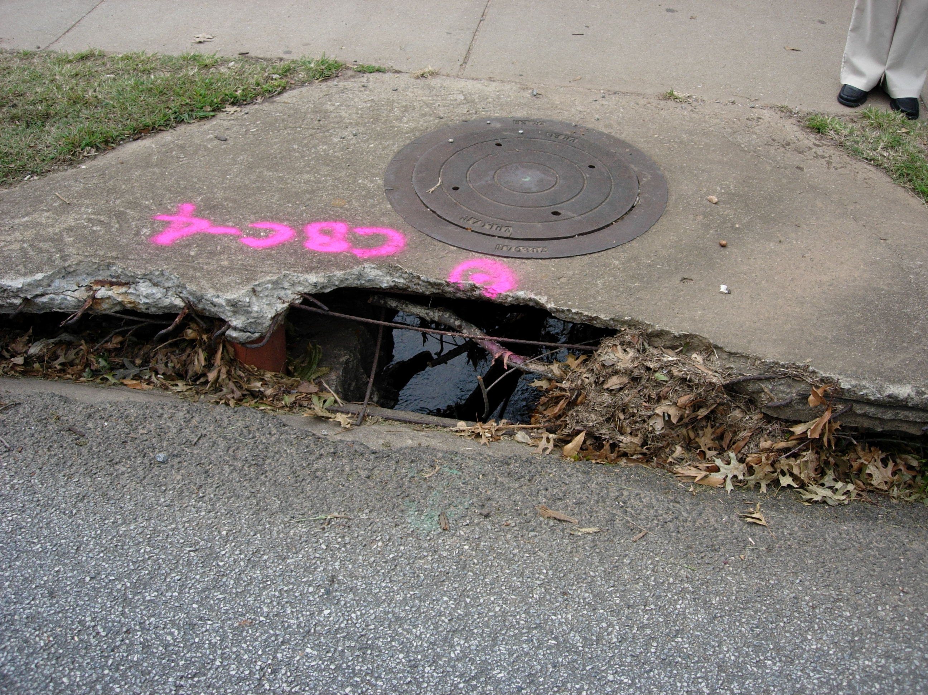

Slide 10
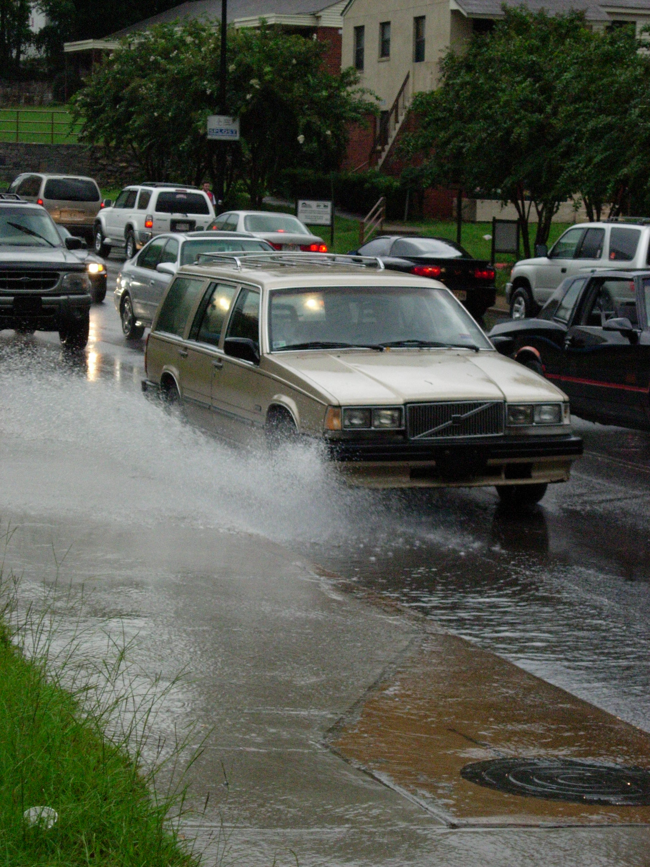

Slide 11
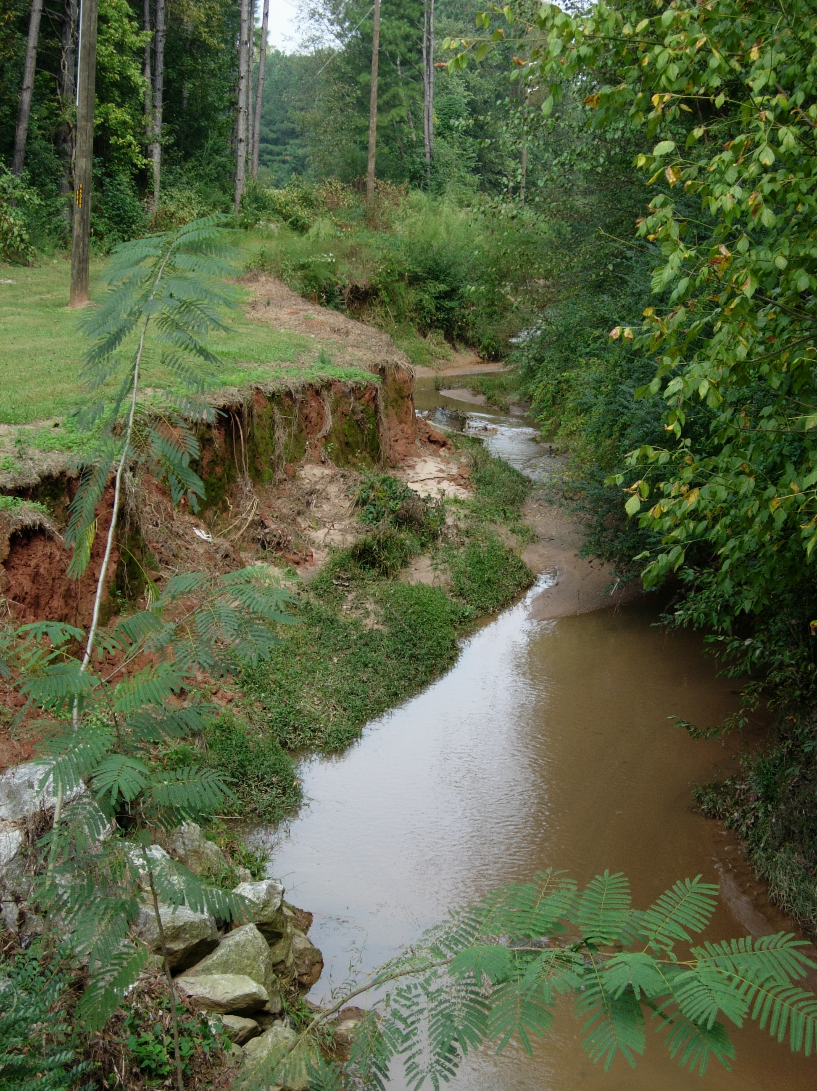

Slide 12
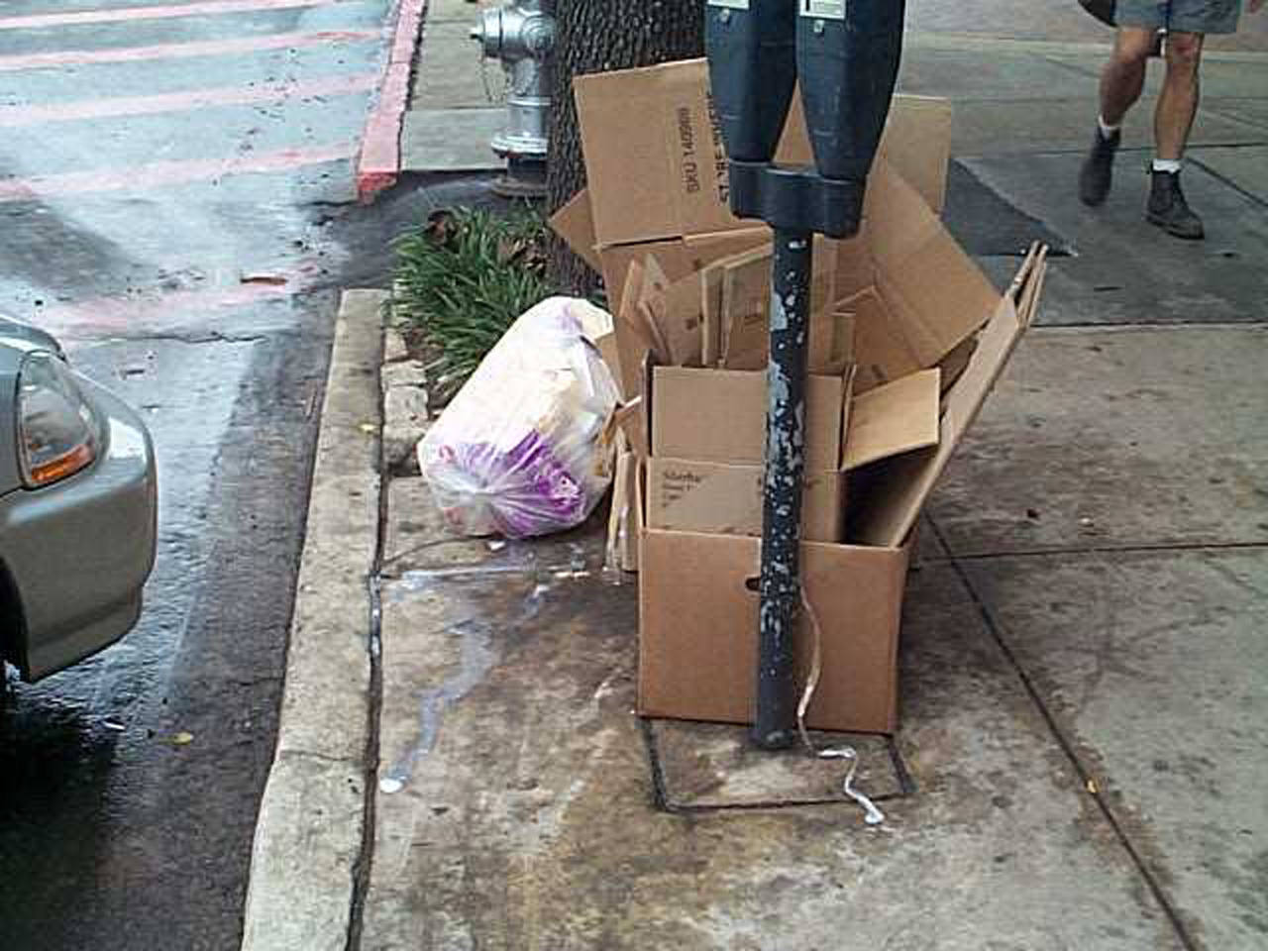

Slide 13
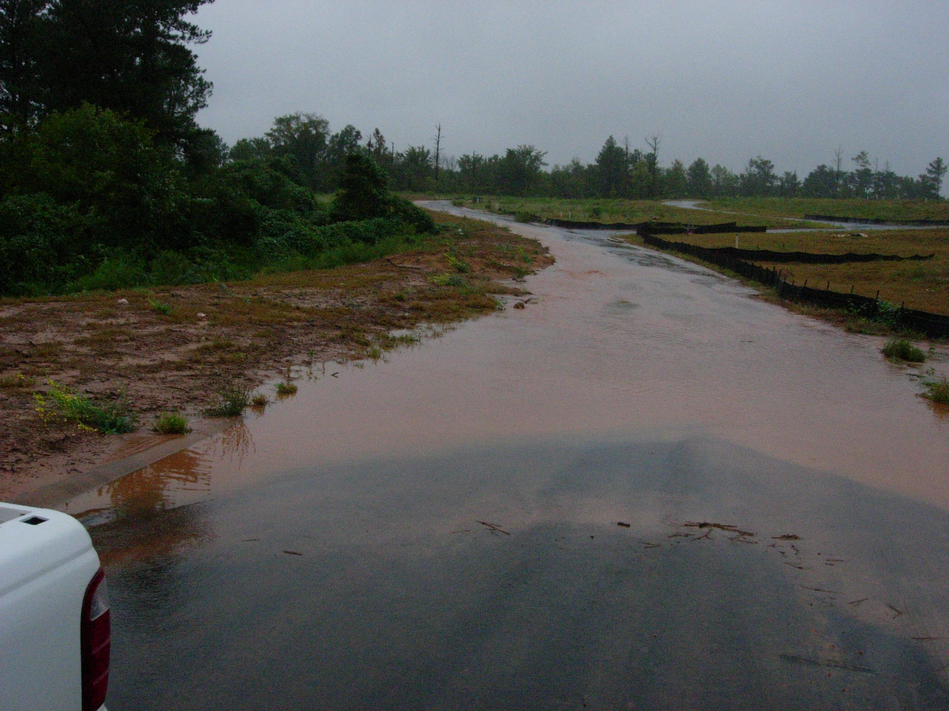

Slide 14
Why is stormwater an issue?
What services does ACC Stormwater provide?
How is stormwater management funded?

Slide 15
Why is stormwater an issue?
What services does ACC Stormwater provide?
How is stormwater management funded?

Slide 16
Infrastructure, Safety, and Security
Improved Water Quality
Quality of Life
Federal Permit Compliance

Slide 17
Infrastructure, Safety, and Security
Improved Water Quality
Quality of Life
Federal Permit Compliance

Slide 18
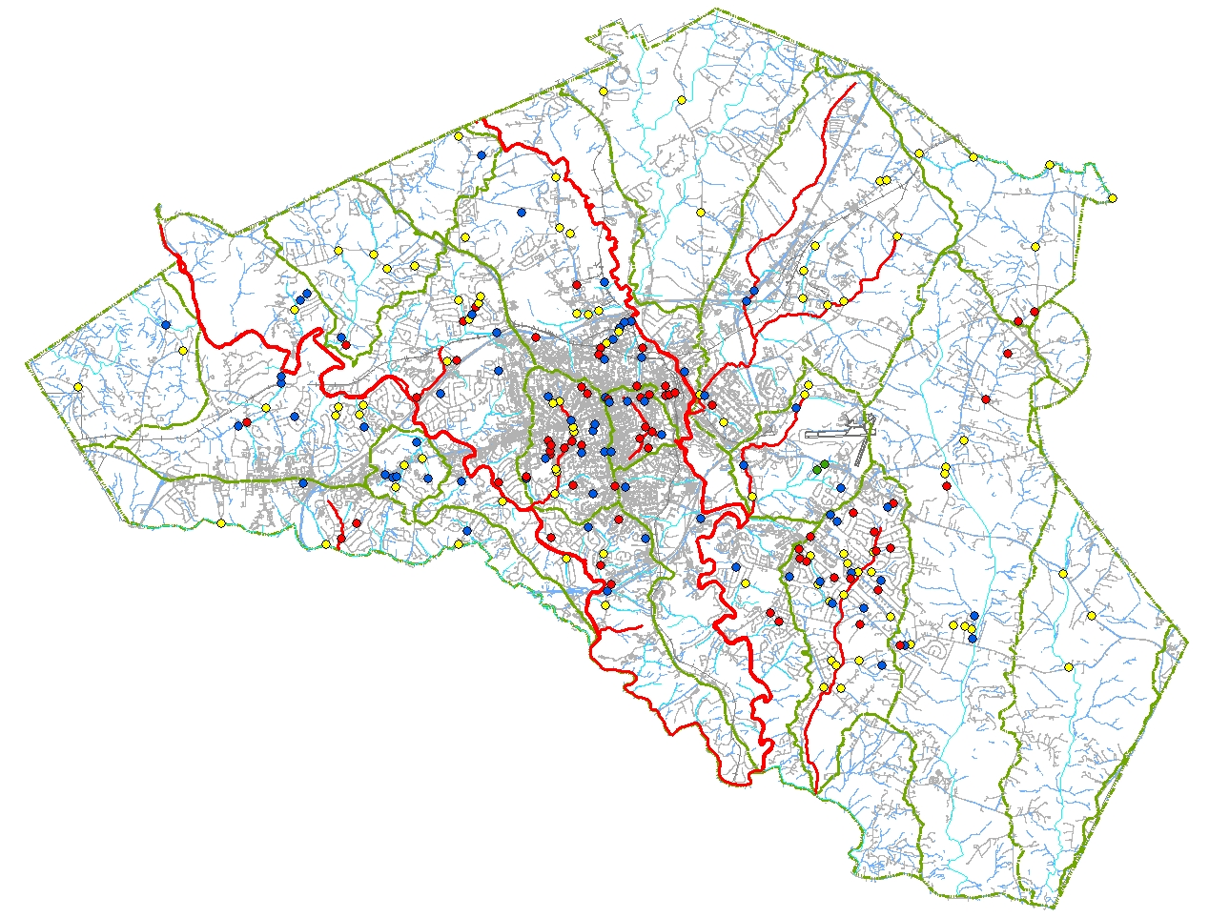
Infrastructure, Safety,
and Security
Flood Protection
Identified Problem Areas
Capital Improvements
Legend
Drainage Problems
Level I
Level II
Level III
Drainage Concerns
Impaired Waters

Slide 19
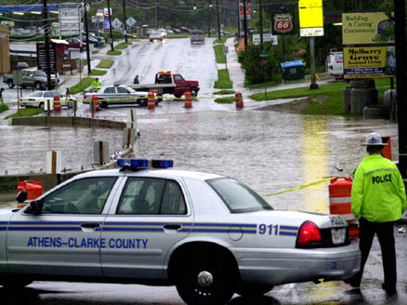
Athens Banner-Herald

Slide 20
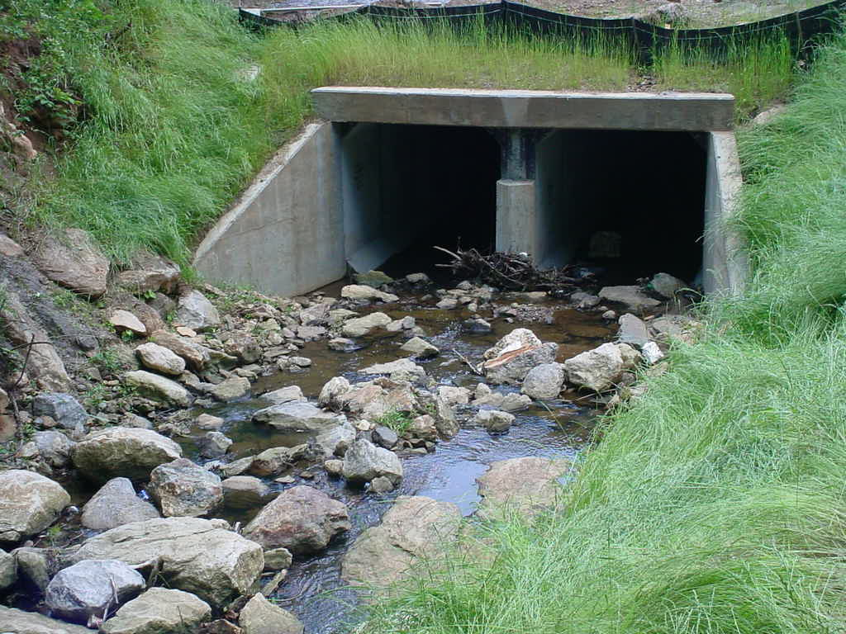
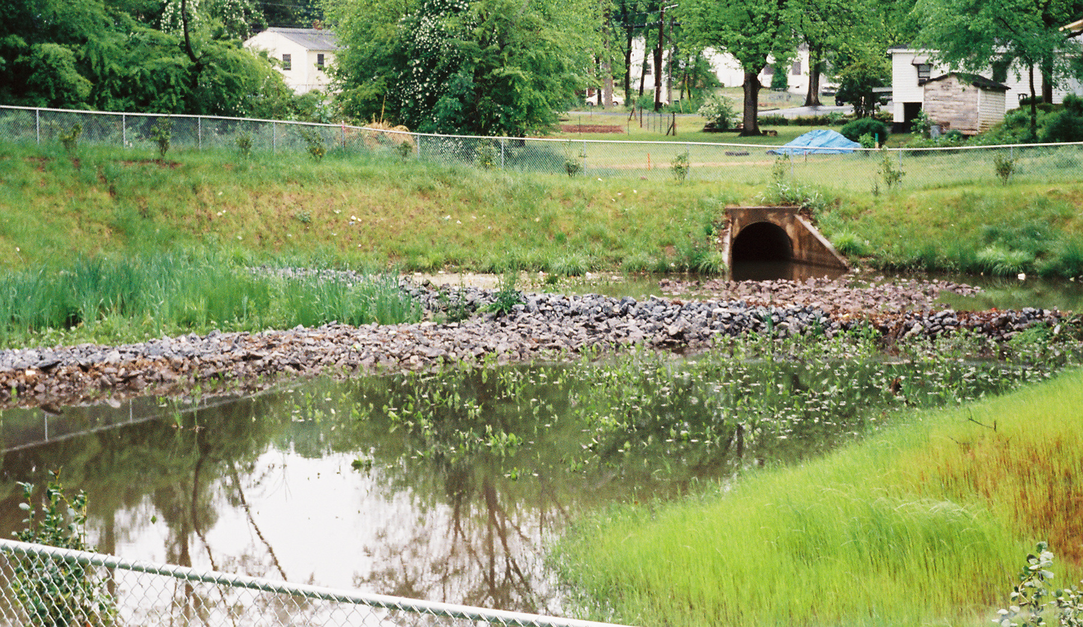
Capital Improvement Projects
Baxter Street

Slide 21
Infrastructure, Safety, and Security
Improved Water Quality
Quality of Life
Federal Permit Compliance

Slide 22
Infrastructure, Safety, and Security
Improved Water Quality
Quality of Life
Federal Permit Compliance

Slide 23
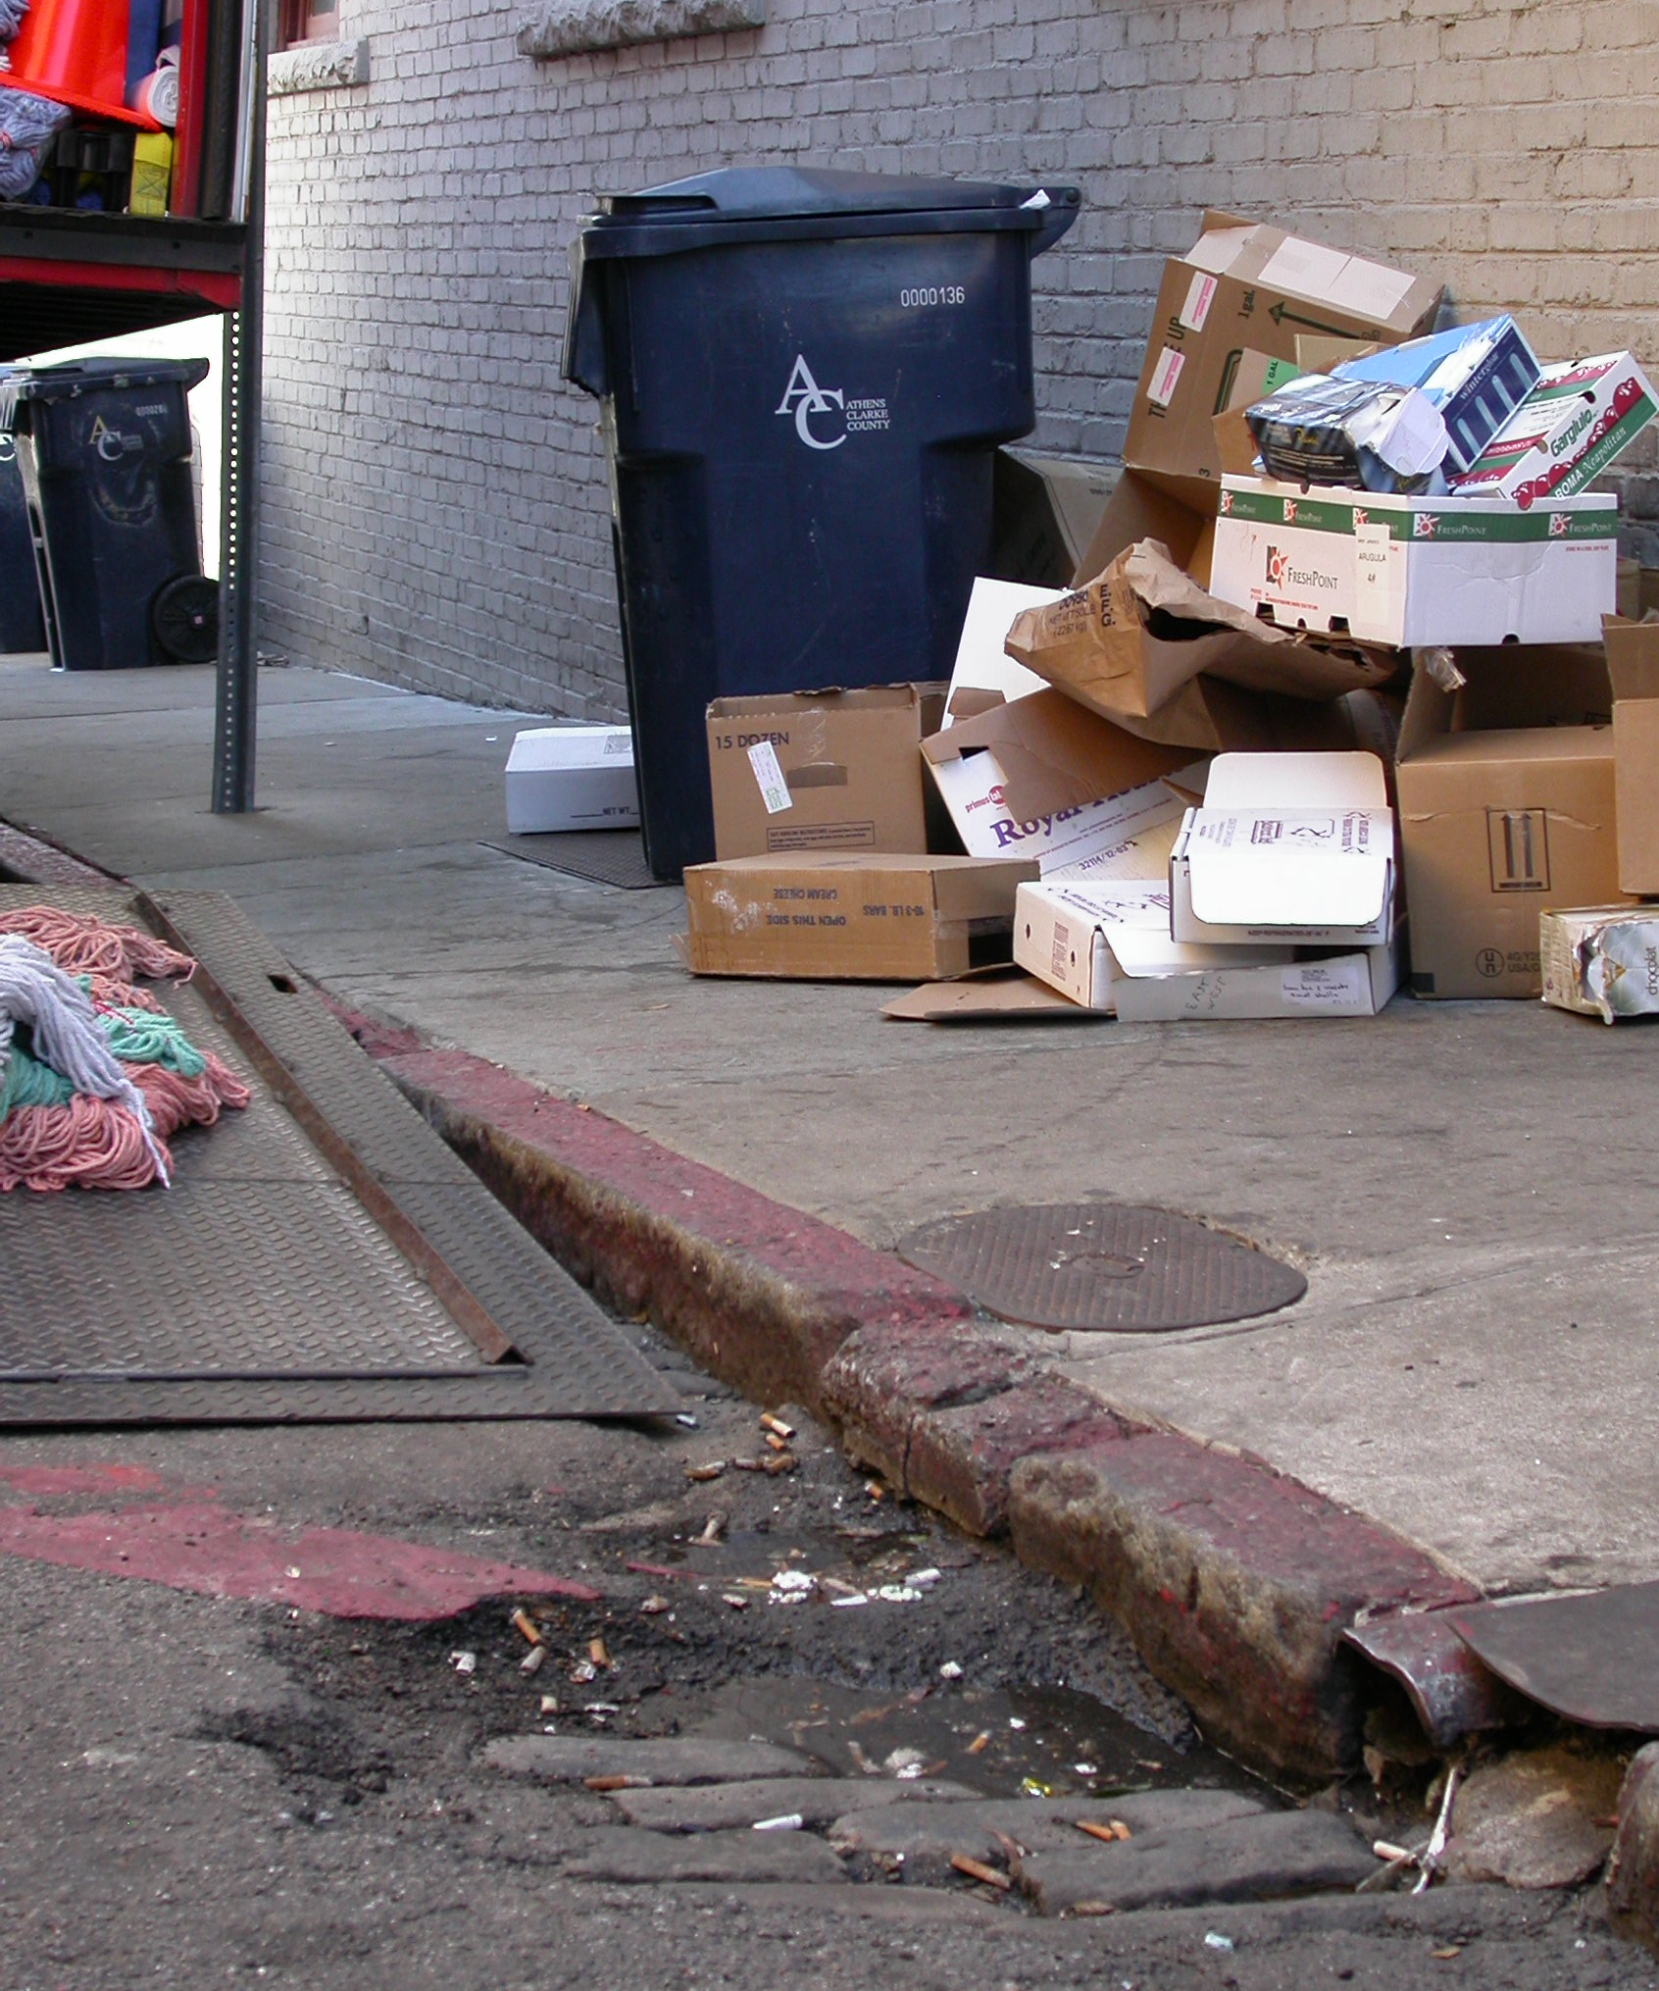
Improved Water Quality
Nonpoint Source Pollution
Pollution that does not come from a single identifiable source.
Motor Oil • Sediment • Cooking Grease • Pet Waste Excess Fertilizer • Yard Waste • Litter • Pesticides Household Hazardous Waste • Detergents • Metals

Slide 24
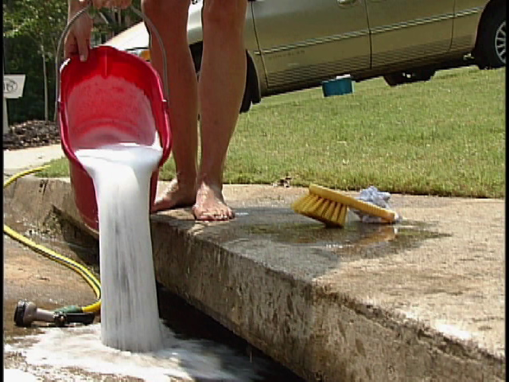

Slide 25
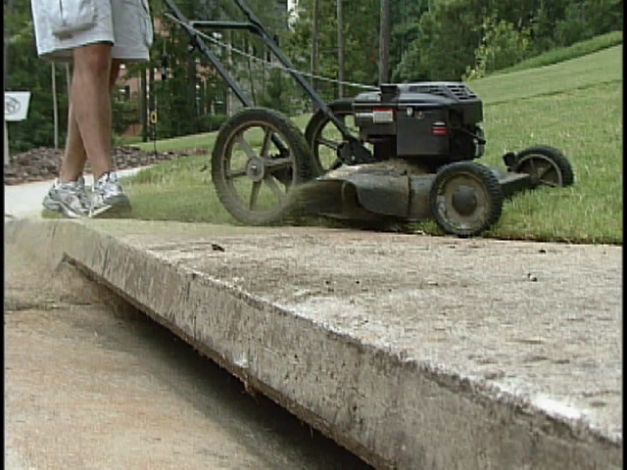

Slide 26
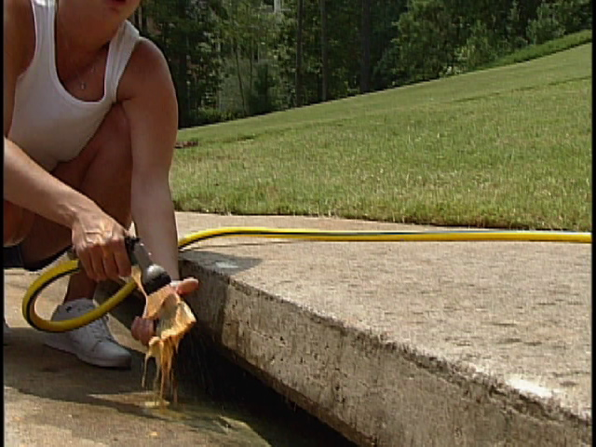

Slide 27
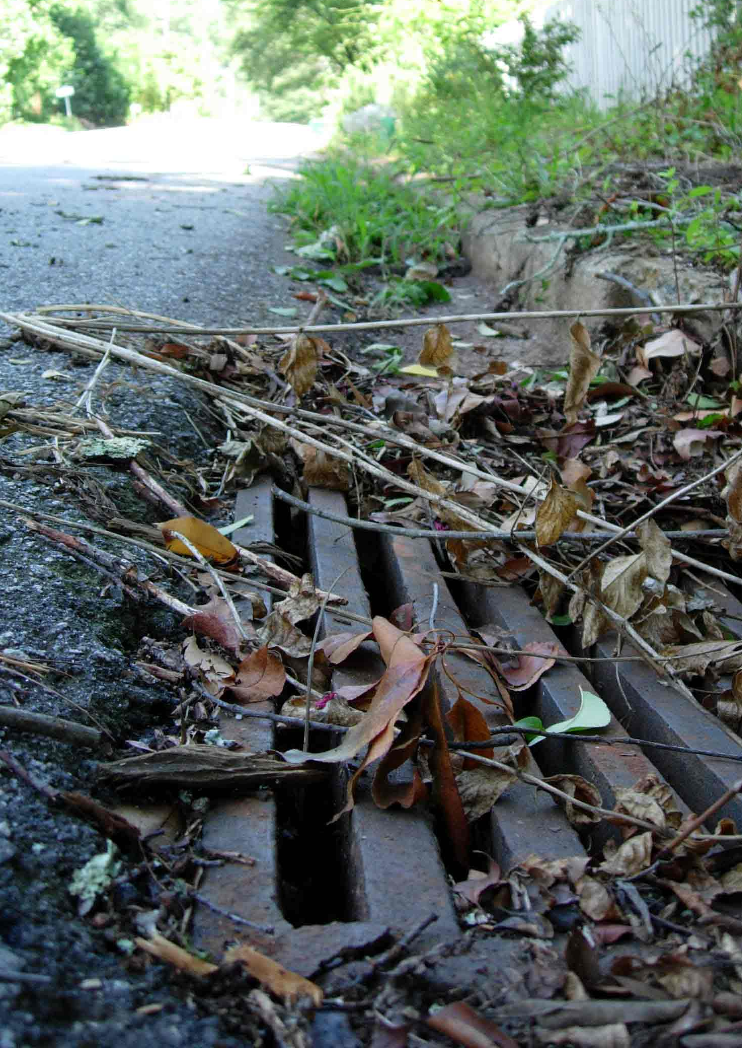
Improved Water Quality
Stormwater runoff carries nonpoint source pollution to our rivers and streams.
Stormdrains lead directly to rivers and streams.

Slide 28
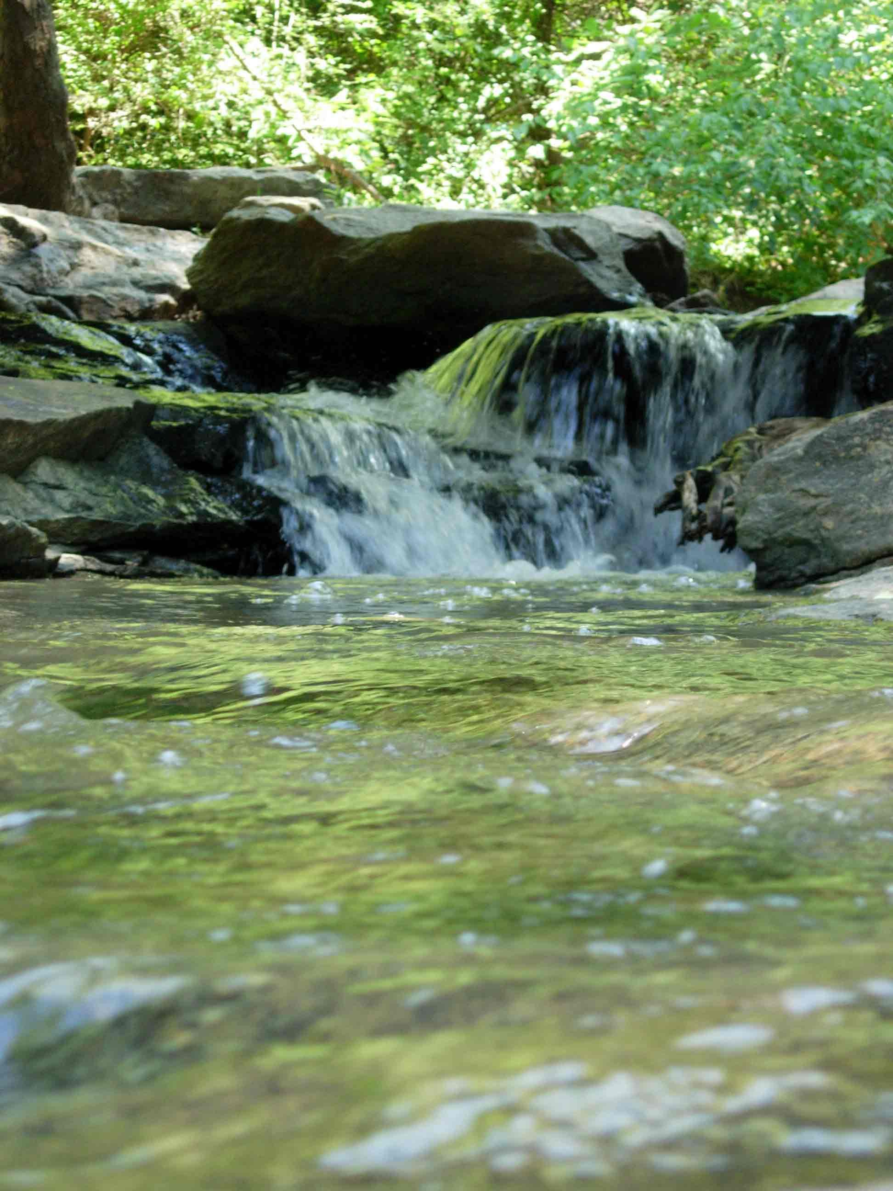
Improved Water Quality
Municipal Services
Street Sweeping
Drain Cleaning
Pollution-Removing Devices
Ordinance Revisions
Stormwater
Erosion and Sedimentation
Environmental Areas
Public Education and Outreach

Slide 29
Infrastructure, Safety, and Security
Improved Water Quality
Quality of Life
Federal Permit Compliance

Slide 30
Infrastructure, Safety, and Security
Improved Water Quality
Quality of Life
Federal Permit Compliance

Slide 31
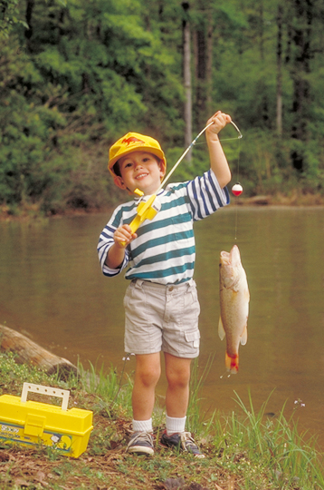
Quality of Life
Drinking Water Treatment
Polluted stormwater increases costs of providing safe drinking water.
Recreation
Fishing • Swimming • Boating
Aesthetics
Litter and other nonpoint source pollutants lessen our enjoyment of natural areas.

Slide 32
Why is stormwater an issue?
Infrastructure, Safety, and Security
Improved Water Quality
Quality of Life
Federal Permit Compliance

Slide 33
Infrastructure, Safety, and Security
Improved Water Quality
Quality of Life
Federal Permit Compliance

Slide 34
Clean Water Act - NPDES Phase II
Public Education and Outreach
Public Participation and Involvement
Elimination of Unlawful Discharges
New Construction Controls
Post-Construction Stormwater Management
Good Housekeeping for Municipalities

Slide 35
Why is stormwater an issue?
What services does ACC Stormwater provide?
How is stormwater management funded?

Slide 36
Stormwater Management in
Athens Clarke County
Why is stormwater an issue?
What services does ACC Stormwater provide?
How is stormwater management funded?

Slide 37
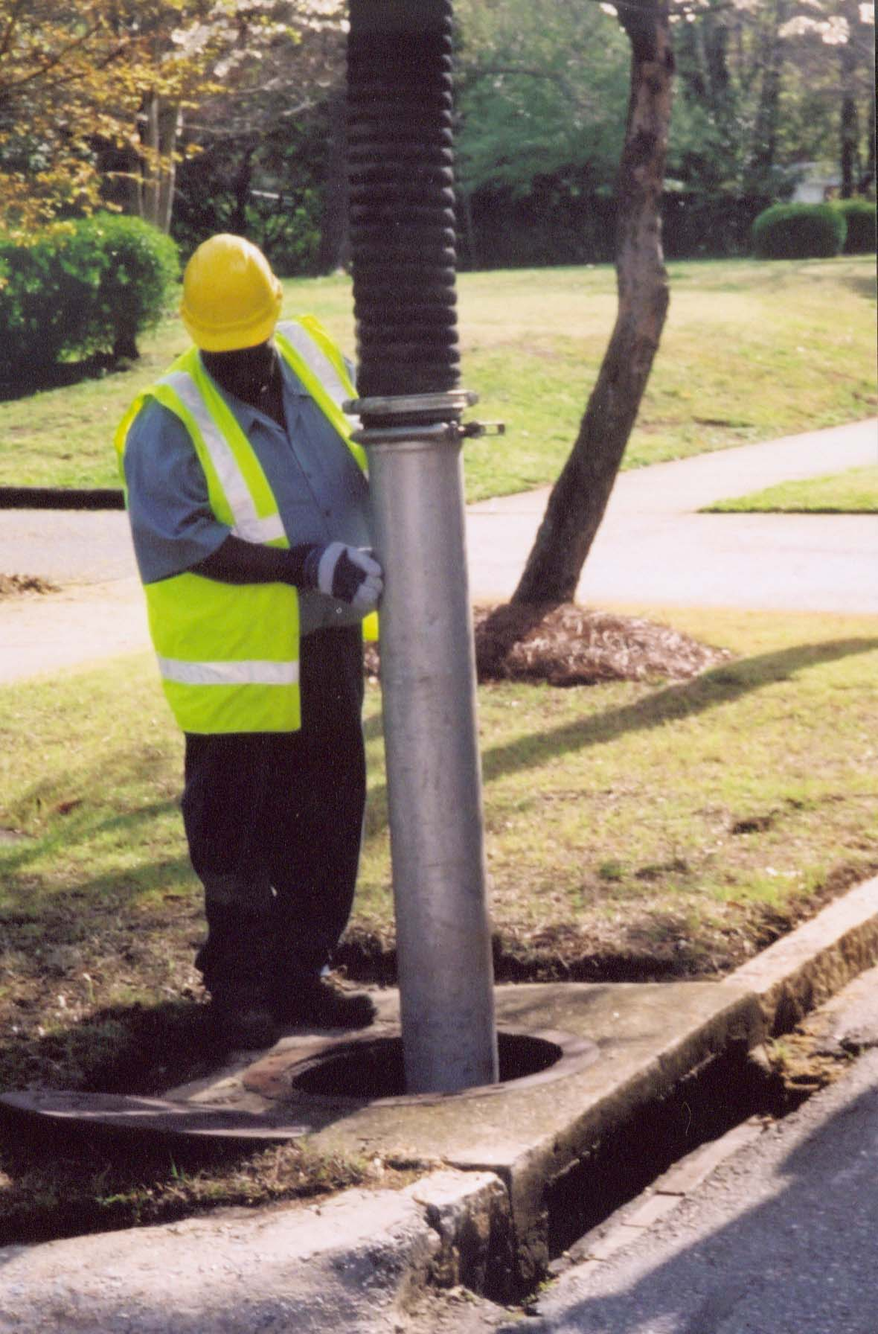
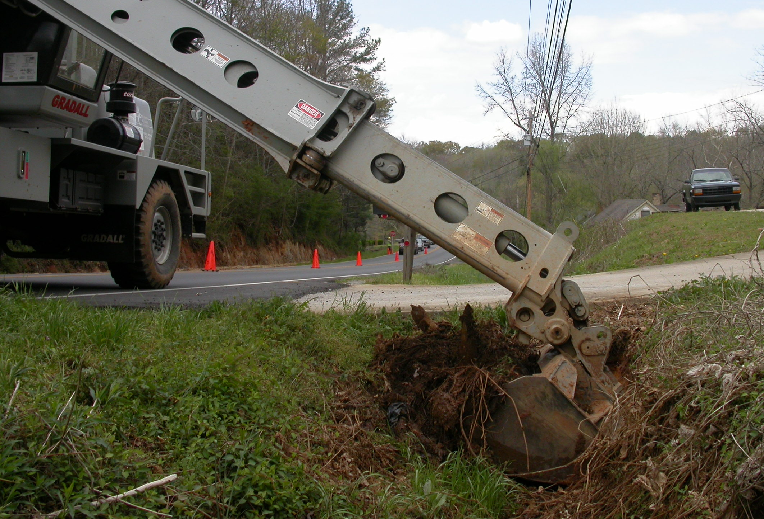
System Maintenance

Slide 38
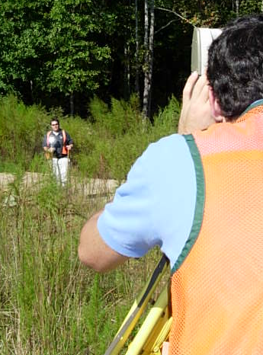
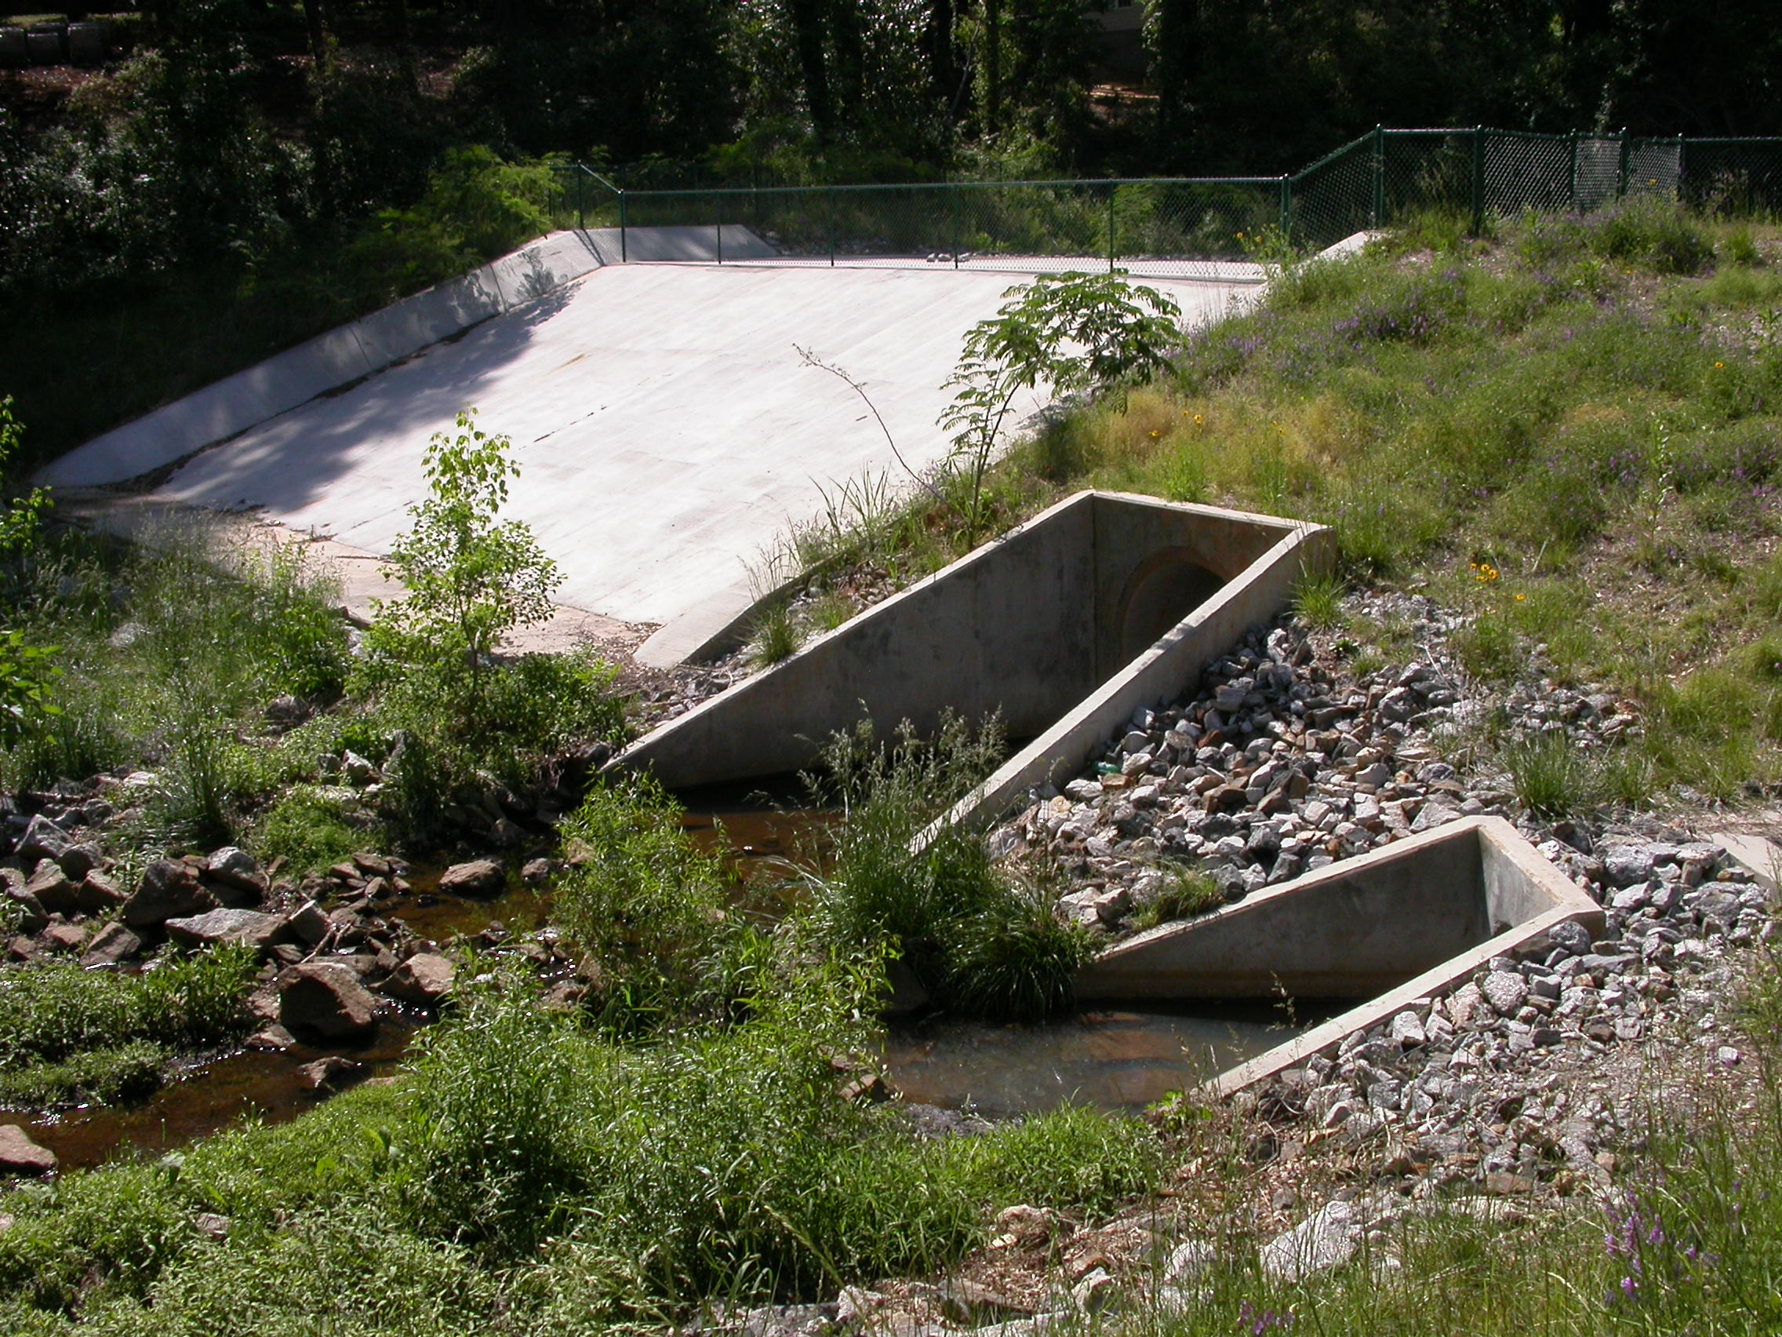
Engineering and Project Management

Slide 39
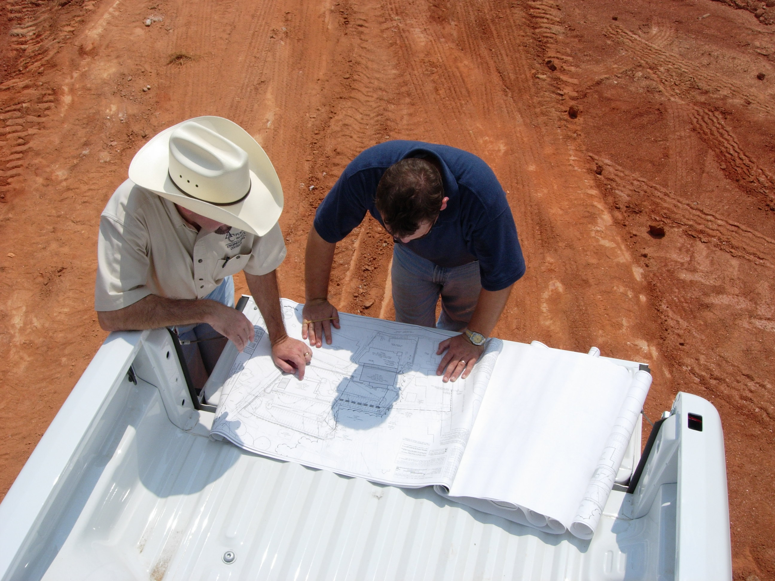
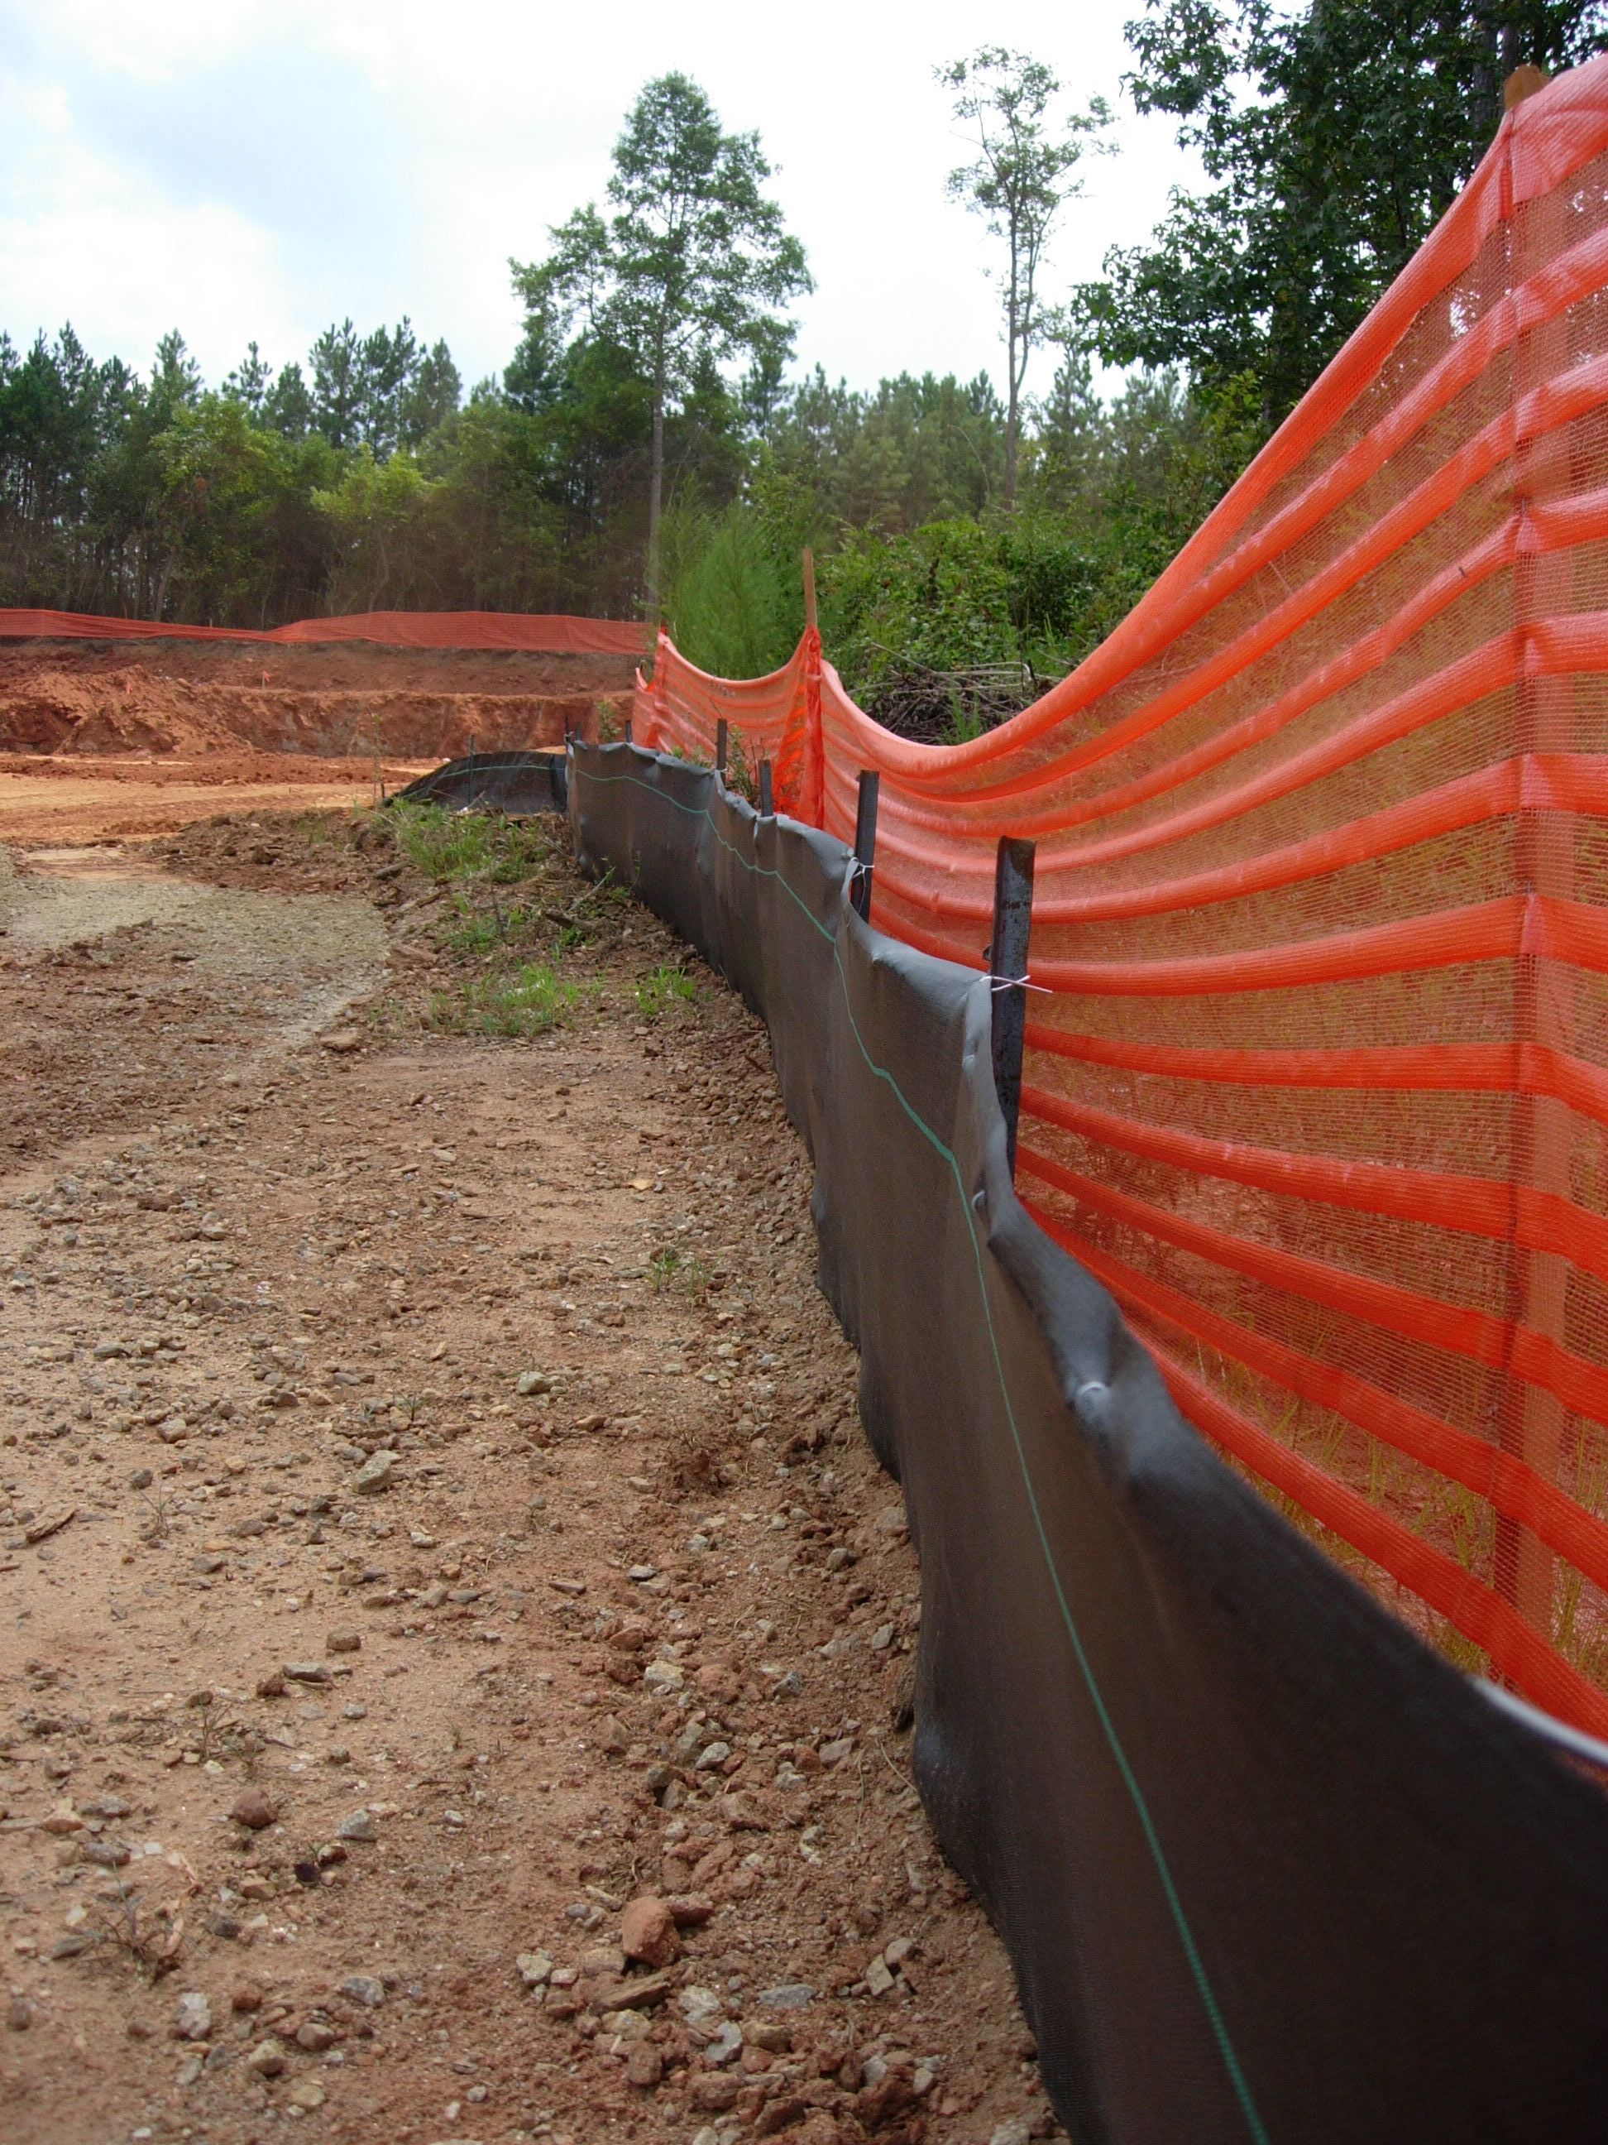
Permits and Inspections

Slide 40
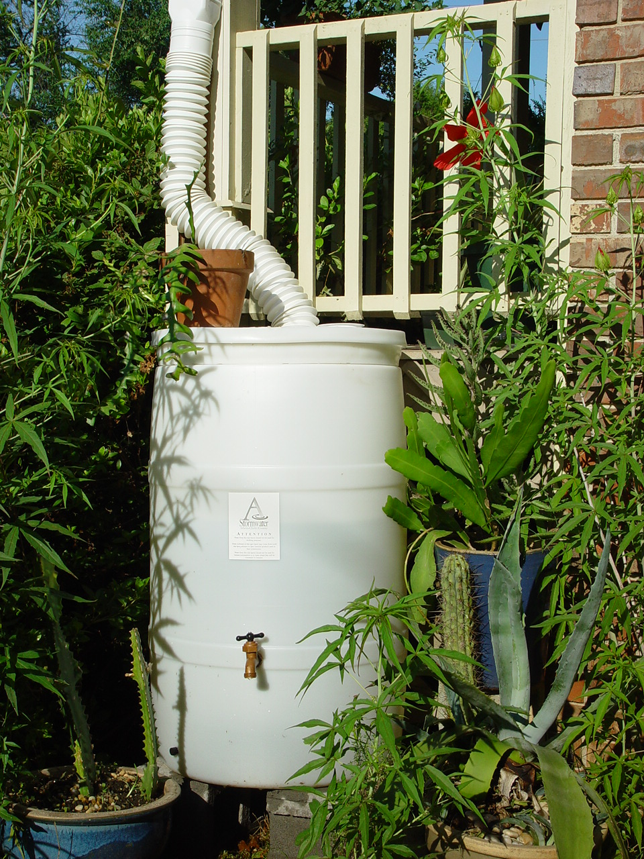
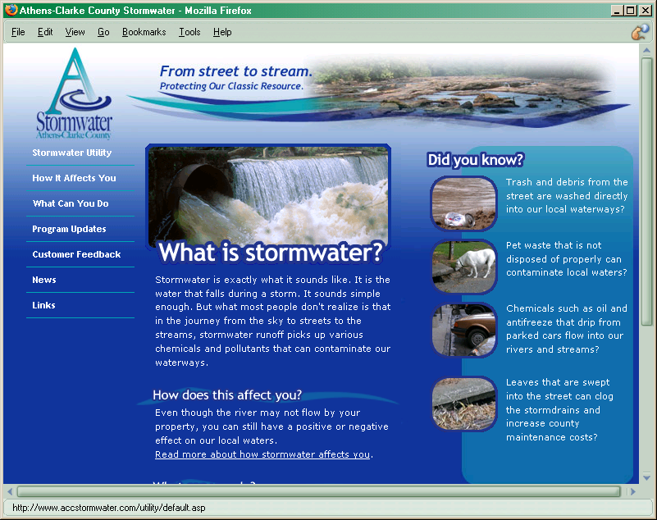
Public Education

Slide 41
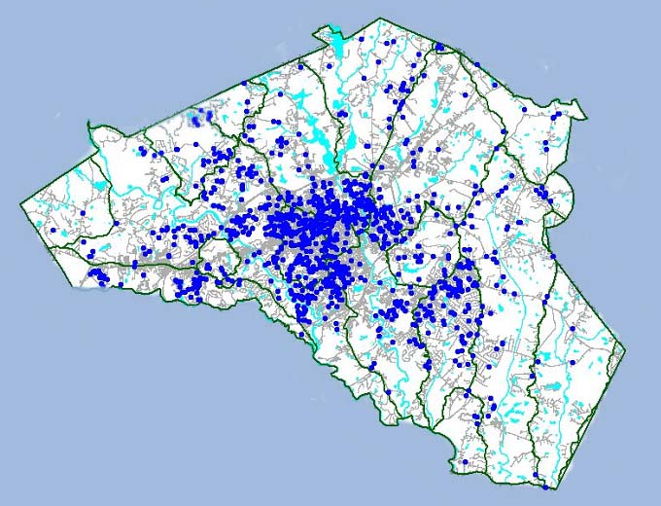
County-Wide
Services

Slide 42
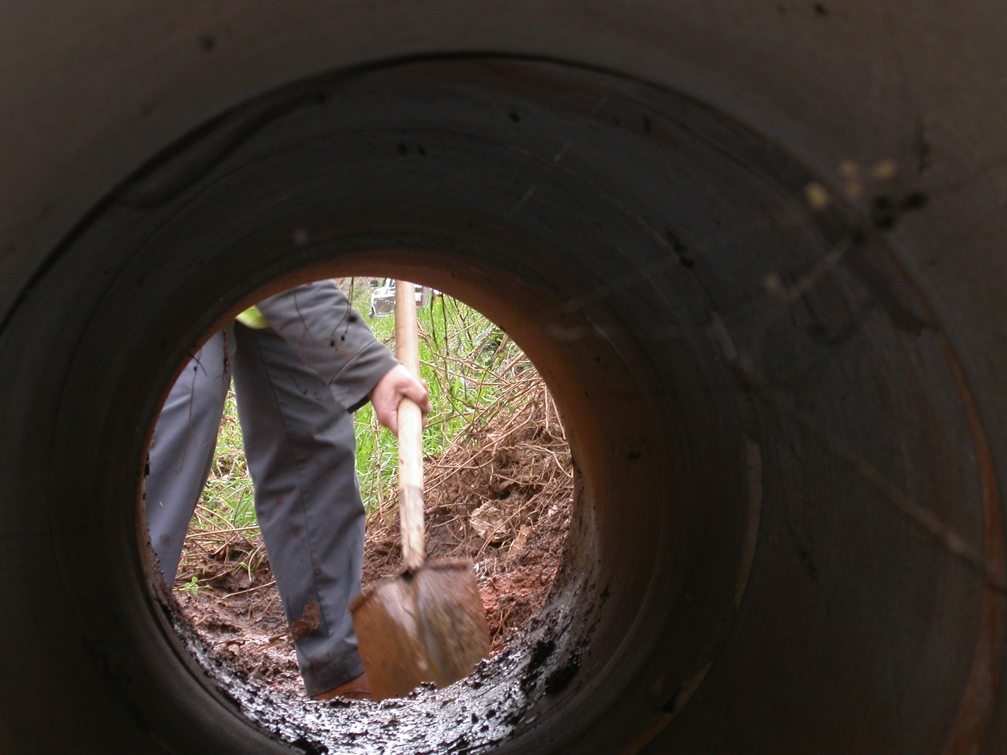

Slide 43
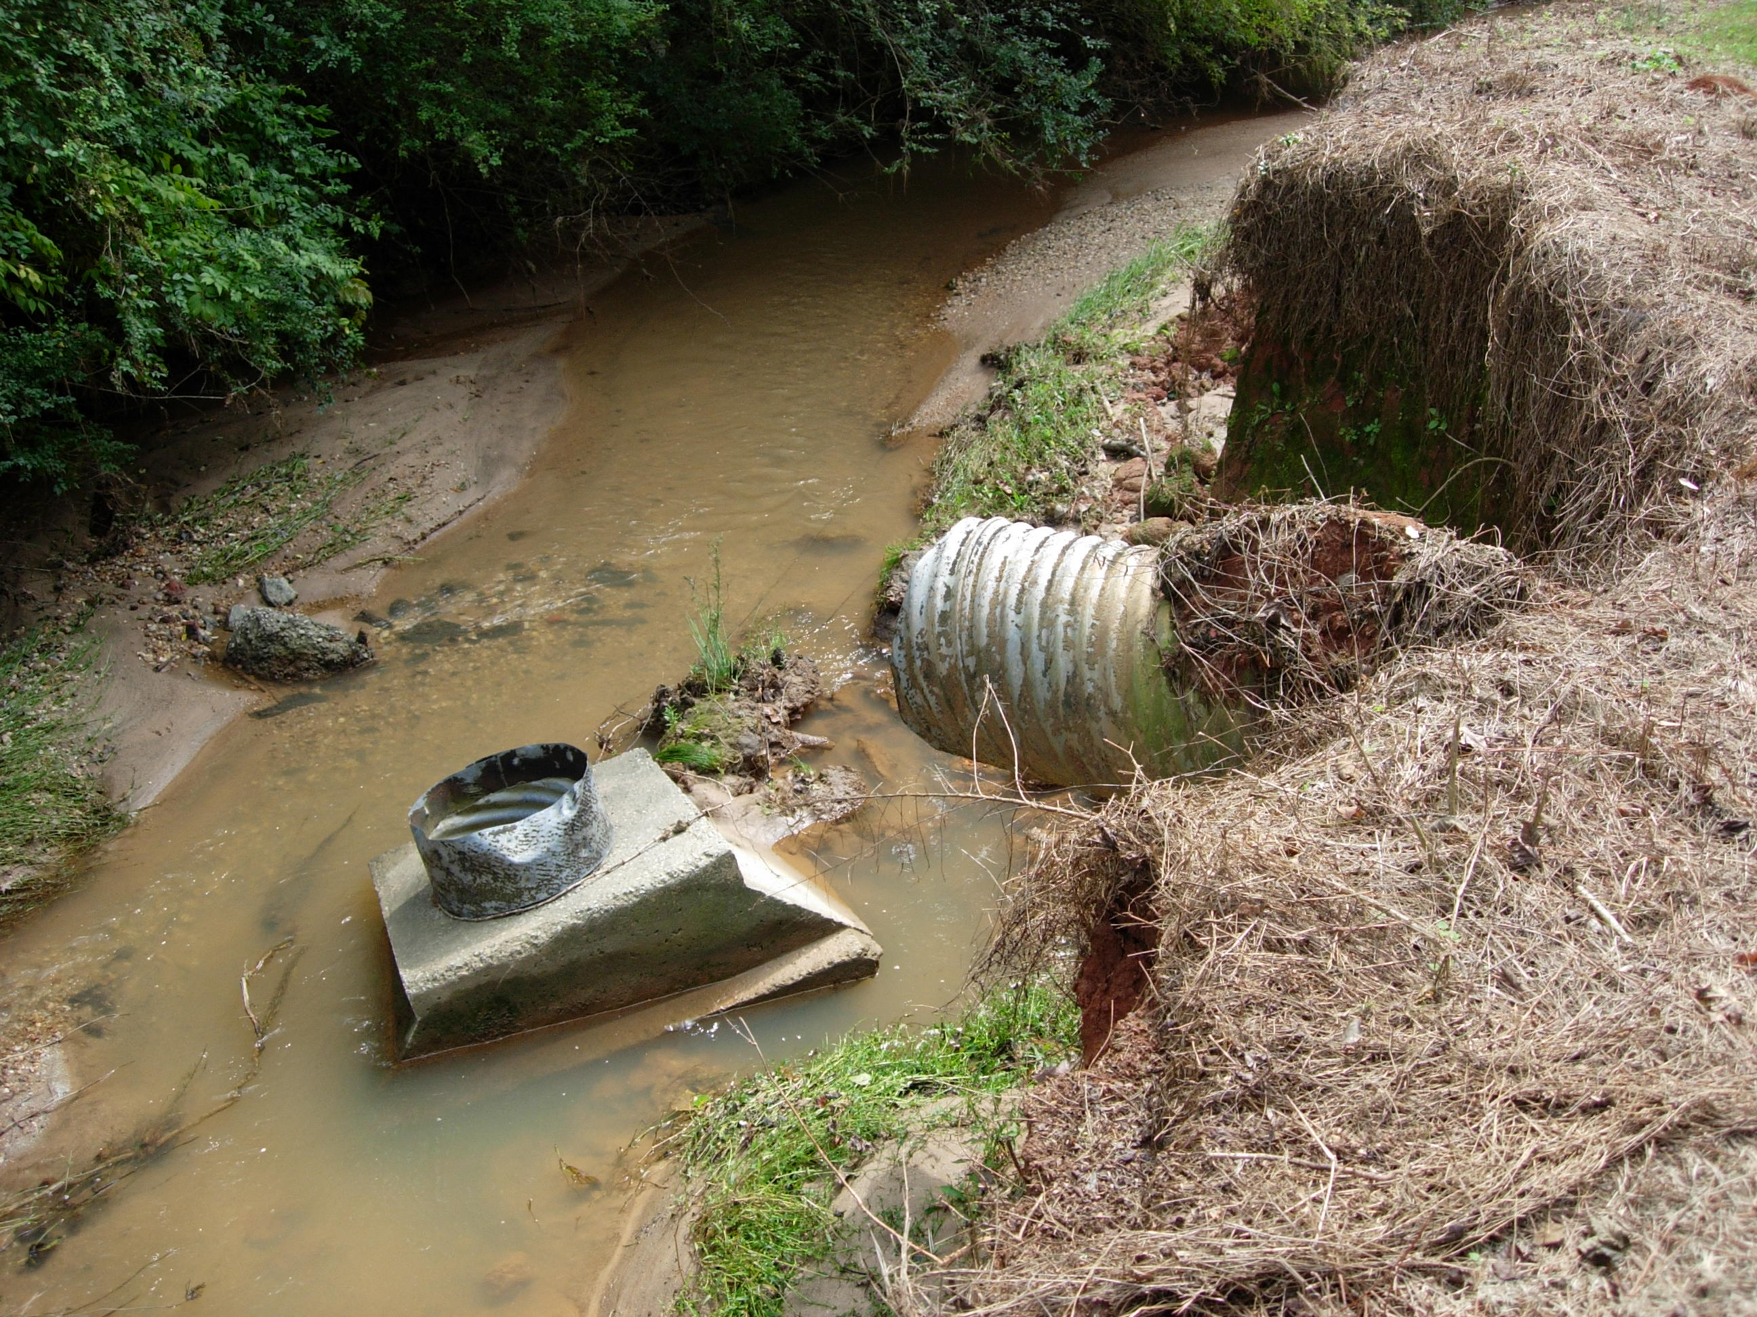

Slide 44
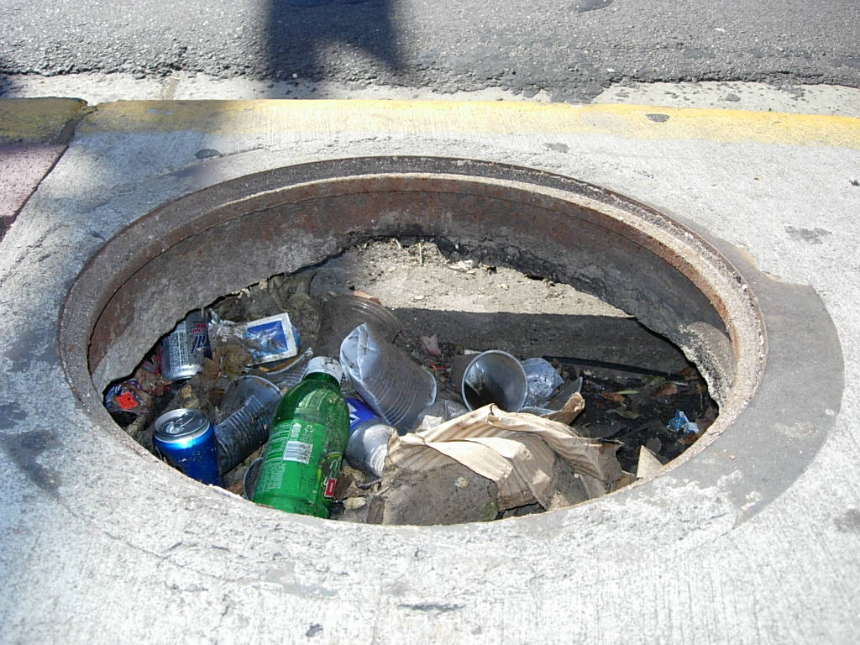

Slide 45
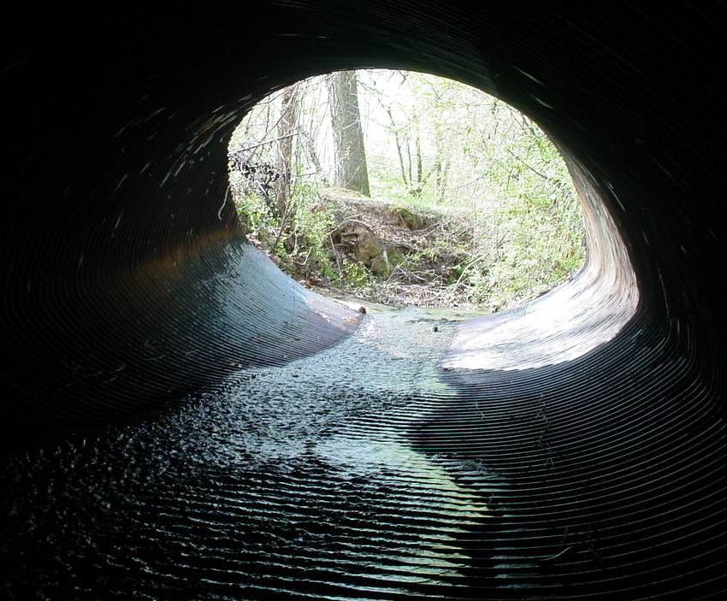
Existing Services
$ 1.7 Million
New Services
(as required by Federal Regulations including capital improvements)
$ 3.9 Million

Slide 46
Why is stormwater an issue?
What services does ACC Stormwater provide?
How is stormwater management funded?

Slide 47
Funding Stormwater Management
In the past . . .
1994 Stormwater Management Program begins. Funded annually through general fund.
2000 SPLOST sales tax dollars fund $5.6 Million in capital improvement projects.
2003 New federal regulations take effect. Temporary funding of $500,000 through general fund.
2004 SPLOST 2005- $2.6 Million per year in proposed capital improvement funding.
2005 $3 Million needed to operate program at mandated level.

Slide 48
Funding Stormwater Management
Funding Options:
General Fund (property tax)
SPLOST (sales tax)
Stormwater Utility

Slide 49
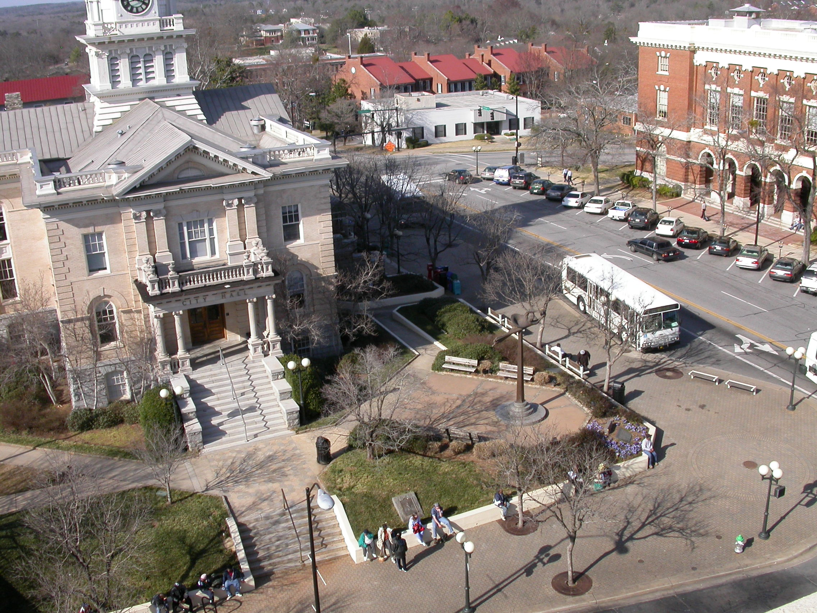
What is a Stormwater Utility?
Fee for Service
Based on Impervious Surface
Charges all contributing properties

Slide 50
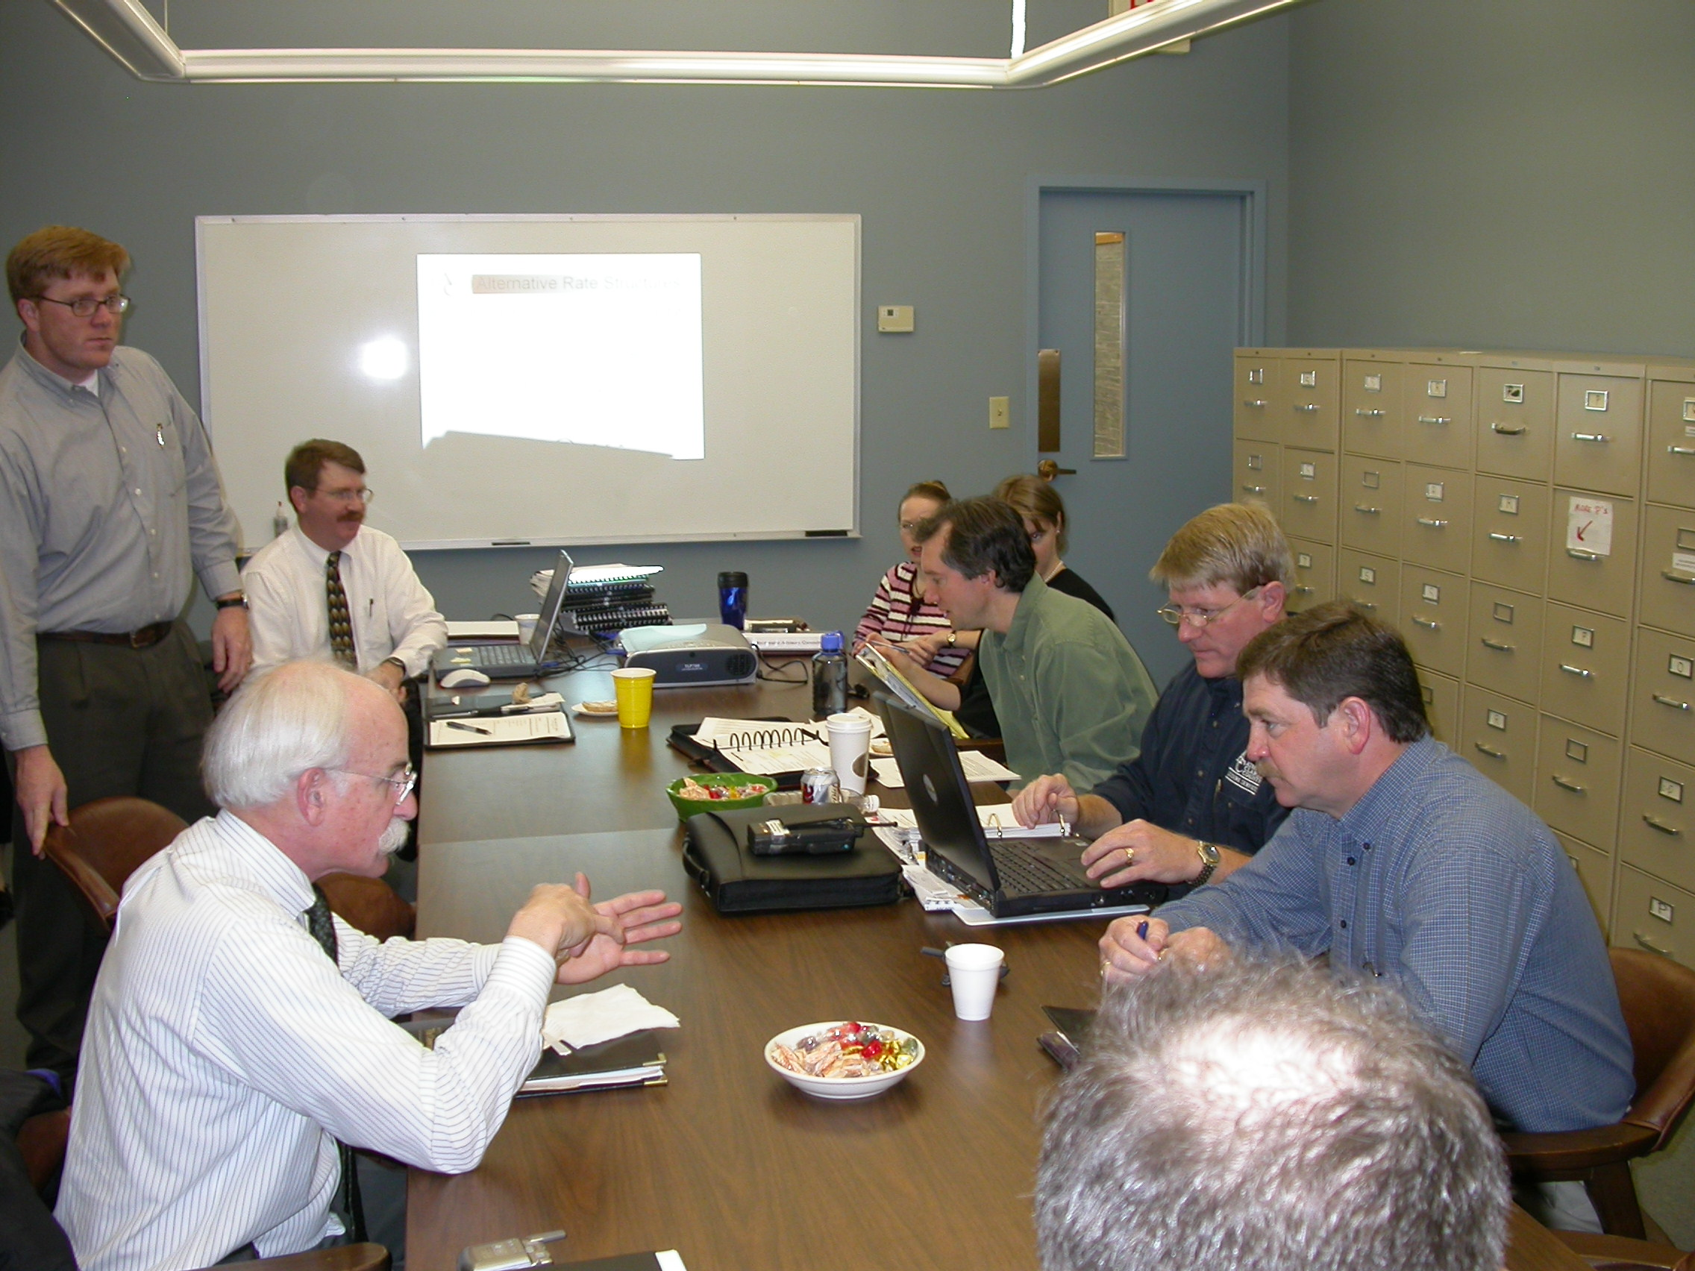
Funding Stormwater Management
Citizen-Staff Stormwater Advisory Committee Recommendation:
Stormwater Utility

Slide 51
What makes up the fee?
Base Rate
Tied to fixed program costs.
Water Quality Rate
Tied to the cost of water quality improvement implementation.
Water Quantity Rate
Tied to the cost of drainage maintenance.

Slide 52
How is the fee calculated?
Equivalent Runoff Unit (ERU)
ERU = 2,628 Square feet of impervious surface
Average single family home = 1 ERU

Slide 53
How is the fee calculated?
Intensity of Development (ID)
ID Factor - Based on Land Use
ERU x ID = Billable ERUs

Slide 54
Sample Calculation
SIZE: 2 acres USE: Commercial
Impervious Area = 60,000 sq.ft.
1 ERU = 2,628 sq.ft.
60,000 sq.ft.
2,628 sq.ft.
= 22.8 ERUs
ID Factor = 1.9 (commercial land use)
22.8 ERUs x 1.9 = 43.3 Billable ERUs

Slide 55
Credit System
“But I can’t turn off the rain!”
Fee Reduction
Issued for proper stormwater management
Detention Ponds • Bioretention • Rain Gardens • Stormwater Wetlands • Swales Infiltration Trenches • Sand Filters

Slide 56
Stormwater Utility
A reduction in impervious surface will always result in a reduced fee.

Slide 57
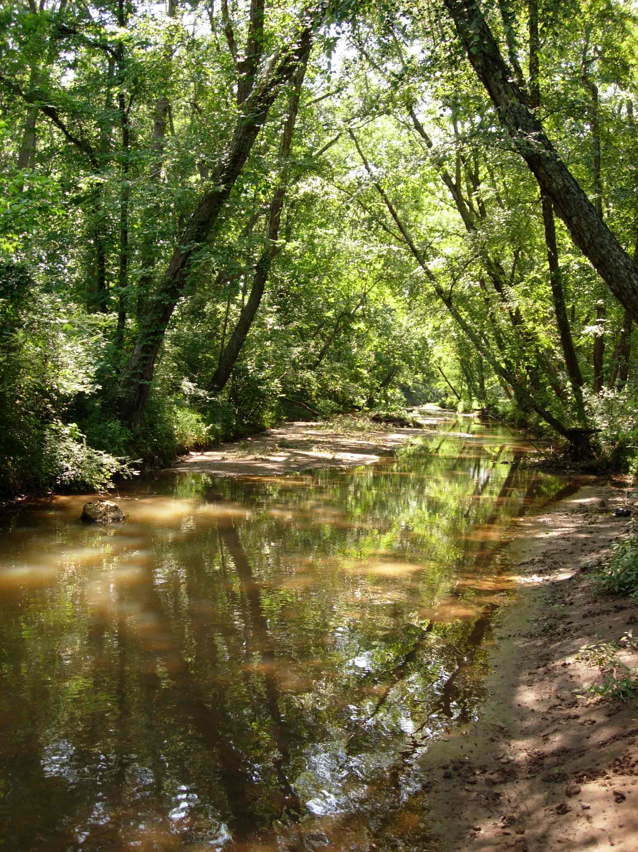
Why manage stormwater?
To prevent flooding during heavy rains.
To keep our rivers and streams healthy.
To meet state and federal requirements.
To provide for future growth and development.

Slide 58
ACC Stormwater
From street to stream.
Protecting our classic resource.

