Slide 1
Why Do We Want to Create Rain Gardens in Our Landscapes?
Rose Mary Seymour
Engineering Extension Specialist
CAES-Griffin Campus
Ag Pollution Prevention Program
Sponsored by P2AD of Georgia

Slide 2
Acknowledgements
Clean Water Campaign Kelley O’Brien
Alpharetta Engineering/Public Works Environmental Education Coordinator Terry Porter
Georgia Cooperative Extension Service County Agent Todd Hurt
UGA Engineering Outreach Specialist Debbie Borden

Slide 3
Development Impacts on the Water Cycle
10%
55%
50%
15%
Notes:
In an undisturbed environment, water falls to the ground, either hitting the surface and running off or percolating through the soil into the groundwater. Through both routes, water makes its way to our streams, ponds, wetlands, rivers, lakes and oceans.
As we develop and alter the landscape, however, this natural cycle is disturbed, impacting both water quantity AND water quality.
- increased runoff
more frequent flooding
more severe flooding
- decreased infiltration
less groundwater recharge
decrease in base flow to streams
- more pollution generated from our uses of the land and delivered to our waterways

Slide 4
Storm Hydrograph
Short, high volume peak discharge
Increased total runoff volume
Baseline peak discharge
Higher base flows
Pre-development
Post-development

Slide 5
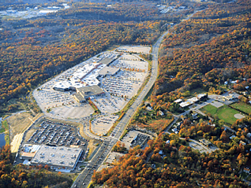
Impervious surfaces
Inhibit recharge of groundwater
Prevent natural processing of pollutants in soil, plants
Provide a surface for accumulation of pollutants
Provide an express route for pollutants to waterways
Notes:
Impervious Surfaces -- not pollutants themselves
The surface is not necessarily a pollutant itself, but it transports pollutants, impedes infiltration, increases the volume of runoff generated, and indicates more intensive & polluting land uses.

Slide 6
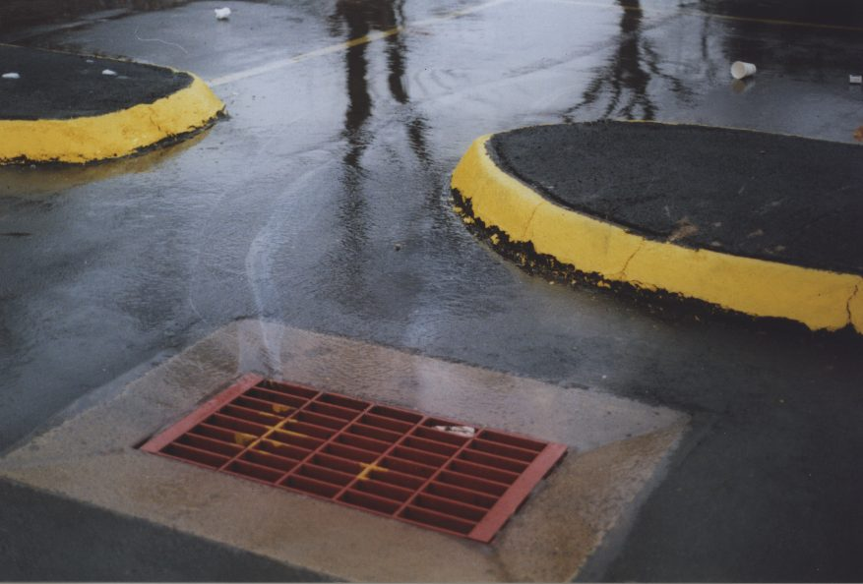
Polluted Runoff is the #1 Water Quality Problem in the U.S.*
* USEPA
Notes:
Nonpoint Source Pollution - Oily water running to storm drain
..."nonpoint source pollution" or polluted runoff, which is created when water washes over the land and picks up all sorts of diffuse pollutants along the way, whether it is oil from our cars, fertilizers from our lawns and parks, or garbage carelessly tossed on the ground. Polluted runoff is what we will focus on today, both because it is such a problem and because it can be difficult to address this diffuse sort of pollution unless we understand where it comes from and strategies to prevent it.

Slide 7
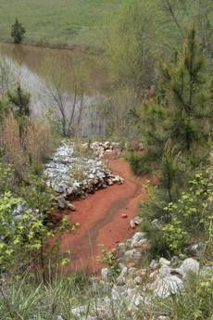
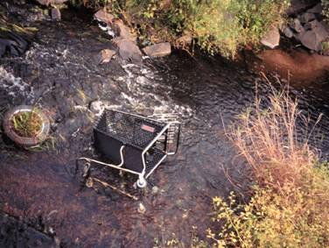
Pollutants To Streams That Result from Development of Land
Nutrients
Pathogens
Sediment
Toxic contaminants
Debris
Thermal Stress
Notes:
The Pollutants in Polluted Runoff (List)
There are a variety of pollutants that can get into our waters. Many officials know about sediment because there has been a lot of guidance and regulation on sediment and erosion control already; however, it's important to know that sediment is just one of several nonpoint pollutants and what we do to control sediment and erosion does not necessarily control for other pollutants as well. Let's take a few minutes to talk about each individual pollutant, and look at examples of how each affects the resources in our local communities.

Slide 8
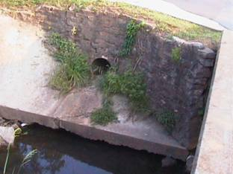
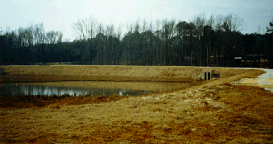
The Traditional Approach
Methods:
Conveyance and detention
Goal:
Minimize flooding
Little water quality control
  Flooding sometimes
  becomes worse
  Detention ponds
  can be ugly

Slide 9
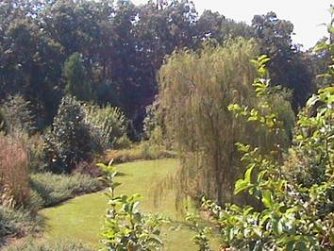
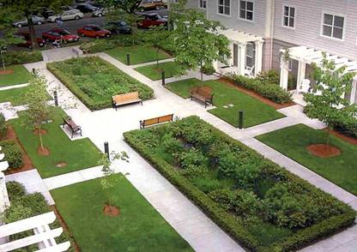
Greenspace & Water Quality
Greenspaces:
Promote infiltration
Decrease runoff
Provide buffers
Filter pollutants
WHERE
Between impervious surfaces and streams
Between impervious areas

Slide 10
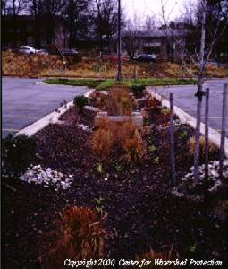
Importance of Infiltration
Preserves natural hydrology
  Reduces runoff and flooding
  Maintains base flows
Cleans water, removing pollutants
  Inexpensive water quality control
  Can be virtually 100% effective
The only sensible method which can solve the stormwater problem

Slide 11
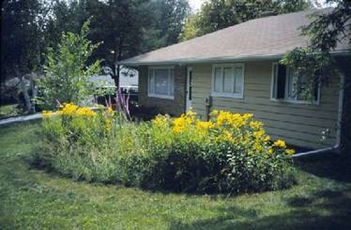
On-site vs. Regional Approaches
On-site: Manage stormwater as close to the source as possible
A residential “rain garden”
Regional: Rely on
large, regional detention facilities
North Griffin Regional Detention Pond

Slide 12
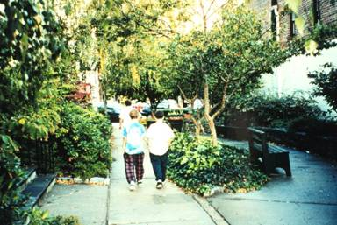
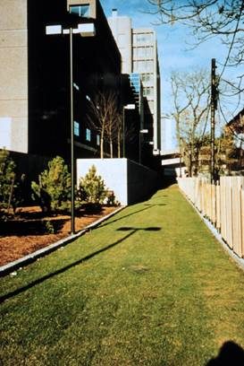
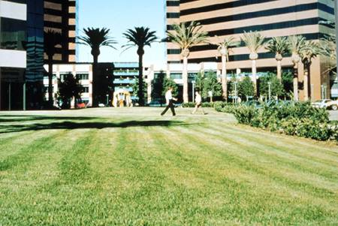
Green is good!
For stormwater mngt.
For psychological health
For aesthetics
Notes:
By encouraging infiltration and reducing impervious surfaces, we accomplish not only the protection of our communities water resources, but improve our urban habatat as well. The green area in the pictures on the left and center are emergency access ways, fully designed to support the weigh of fire trucks or ambulances. However, instead of capping the area with impervious asphalt or concrete, the area was paved with “grass” pavers, and serves the dual function of an access way and a lawn. The picture on the right shows a vest pocket park in the middle of a downtown area. These parks can also be designed to facilitate infiltration.

Slide 13
Lets Talk About How to Make A Rain Garden

Slide 14
Resources Used to Create This Presentation
Photo of Completed Rain Garden Example courtesy of City of Maplewood http://www.ci.maplewood.mn.us/index.asp?Type=B_BASIC&SEC={F2C03470-D6B5-4572-98F0-F79819643C2A}
All slides with this symbol were derived from information from the NEMO website – Nonpoint Source Education for Municipal Officials http://nemo.uconn.edu/
Alliance for Quality Growth http://aqg.ecology.uga.edu/index.html

