Slide 1
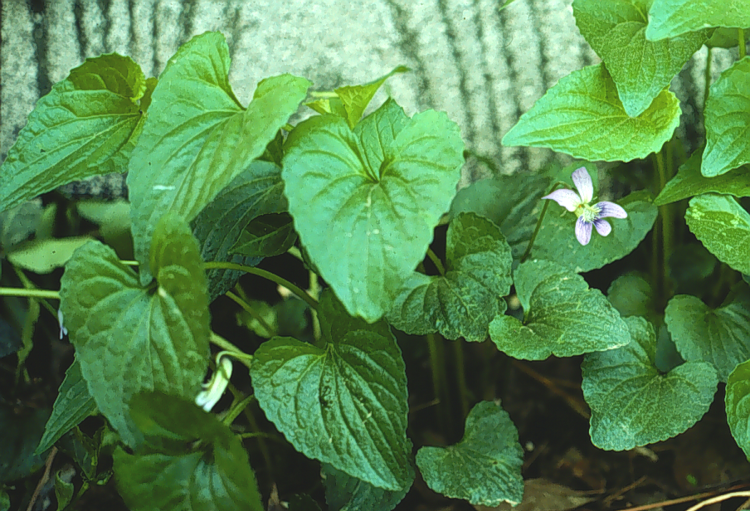
Weed ID Jeopardy
Todd Hurt
Training Coordinator
UGA Center for Urban Agriculture

Slide 2
Broad Leaves
Weedy Terms
Grass/Sedge
Potluck
Herbicides
100
100
100
100
100
200
200
200
200
200
300
300
300
300
300
Jeopardy
400
400
400
400
400
500
500
500
500
500
Final Jeopardy

Slide 3
Broad Leaf Weeds for 100 pts. The Answer is
Henbit

Slide 4
Daily Double
400 Points

Slide 5
Broadleaf Weeds for 400 pts. The Answer is
Dandelion

Slide 6
Broadleaf Weeds for 300 pts. The Answer is
Wild Violets

Slide 7
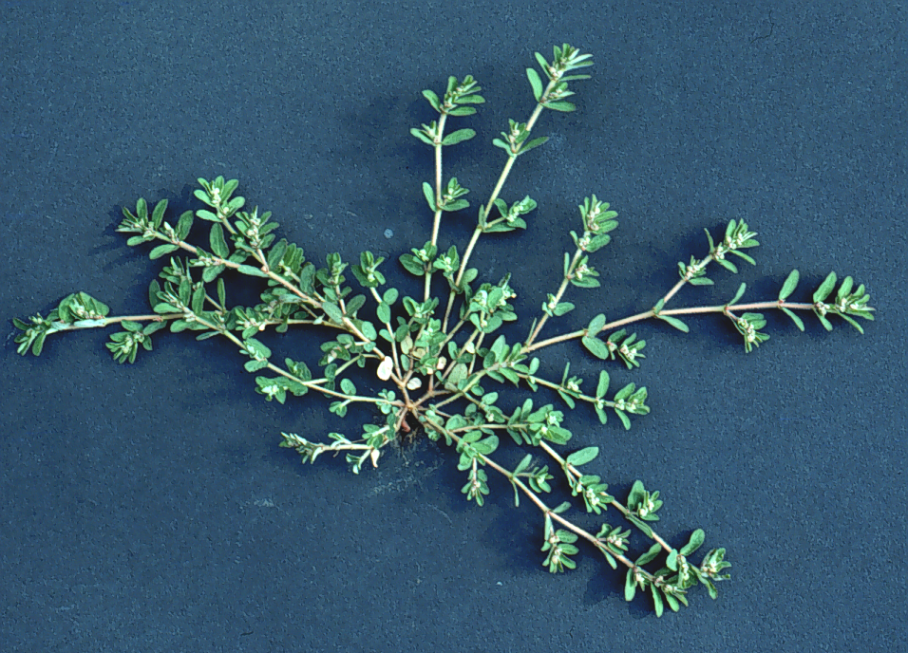
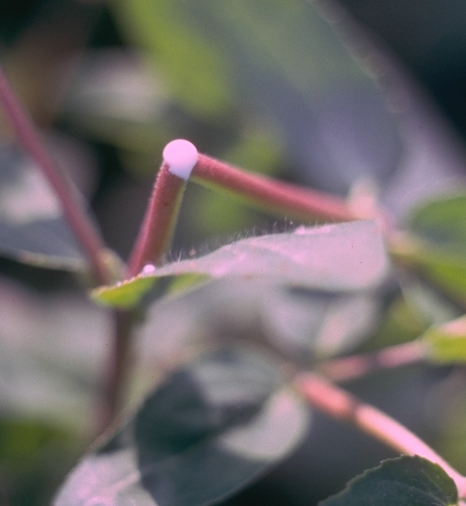
Broadleaf Weeds for 400 pts. The Answer is
Prostrate Spurge

Slide 8
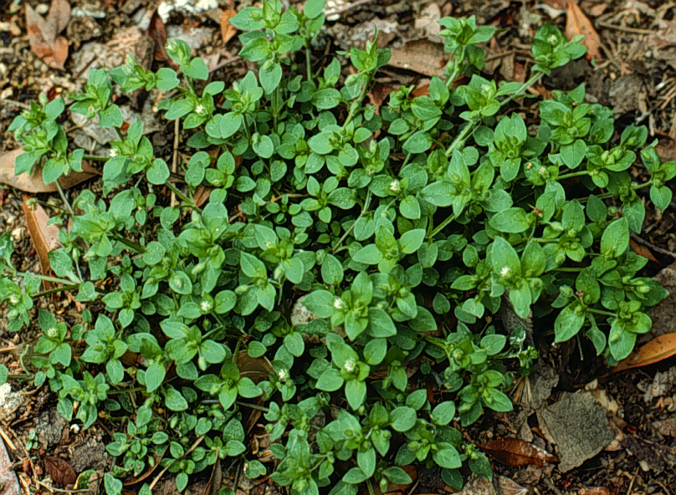
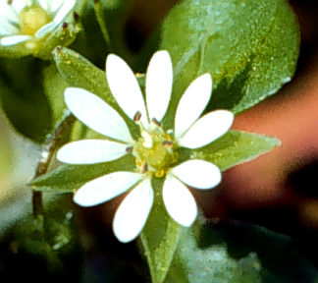
Broadleaf Weeds for 500 pts. The Answer is
Common Chickweed

Slide 9
Weedy Terms for 100 pts. The Answer is
A weed is a plant
“____ ___ _____”
Out of place

Slide 10
Weedy Terms for 200 pts. The Answer is
A weed that completes its lifecycle in one year is a(n) ___________.
Annual

Slide 11
Weedy Terms for 300 pts. The Answer is
_________ weeds have netted veins and showy flowers.
Broadleaf

Slide 12
Weedy Terms for 400 pts. The Answer is
Hoeing, Hand Weeding, and Cultivation are examples of _________ weed Control.
Cultural/physical

Slide 13
Weedy Terms for 500 pts. The Answer is
To control a weed you must first know the _______ of the _____.
The name of the weed

Slide 14
Grasses/Sedges for 100 pts. The Answer is
Crabgrass

Slide 15
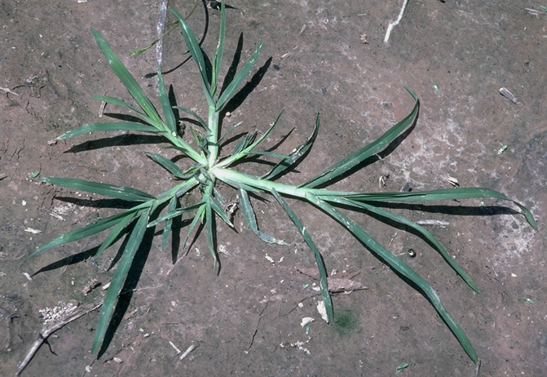
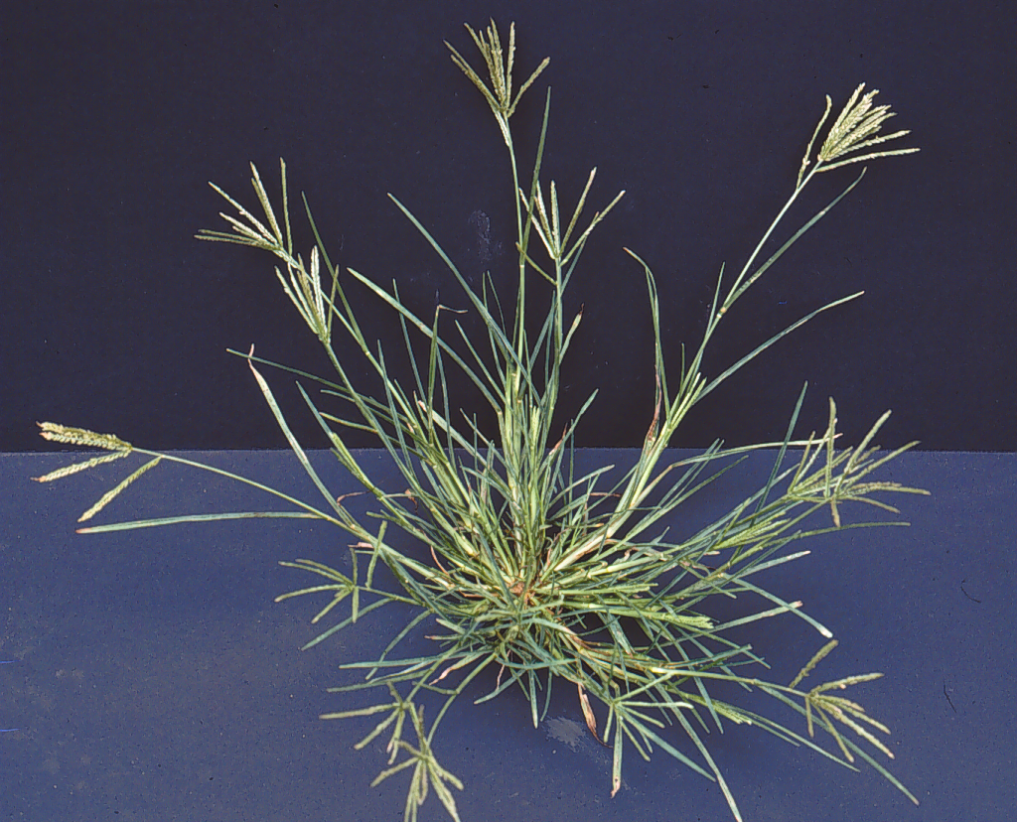
Grasses/Sedges for 200 pts. The Answer is
Goosegrass

Slide 16
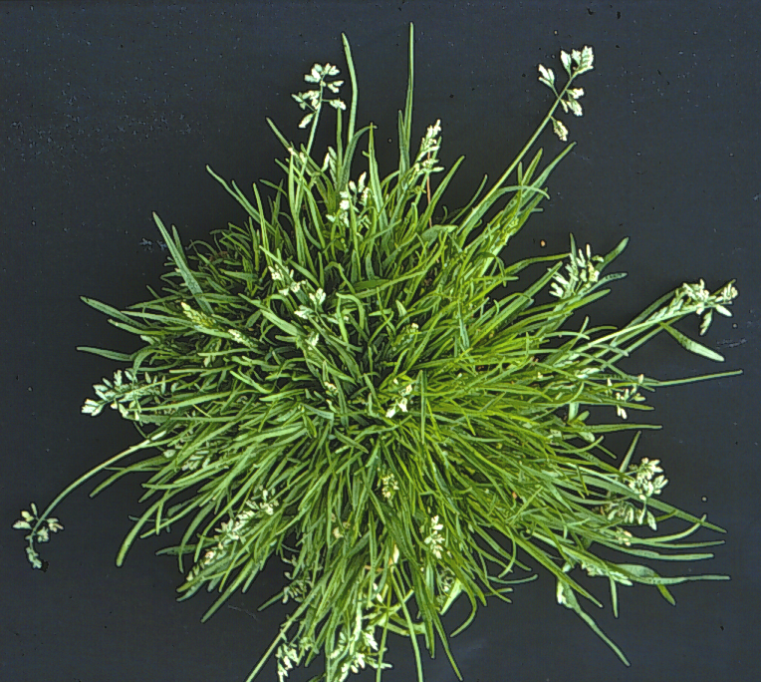
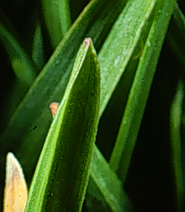
Grasses/Sedges for 300 pts. The Answer is
Annual Bluegrass

Slide 17
Grasses/Sedges for 400 pts. The Answer is
______________ have edges.
Sedges

Slide 18
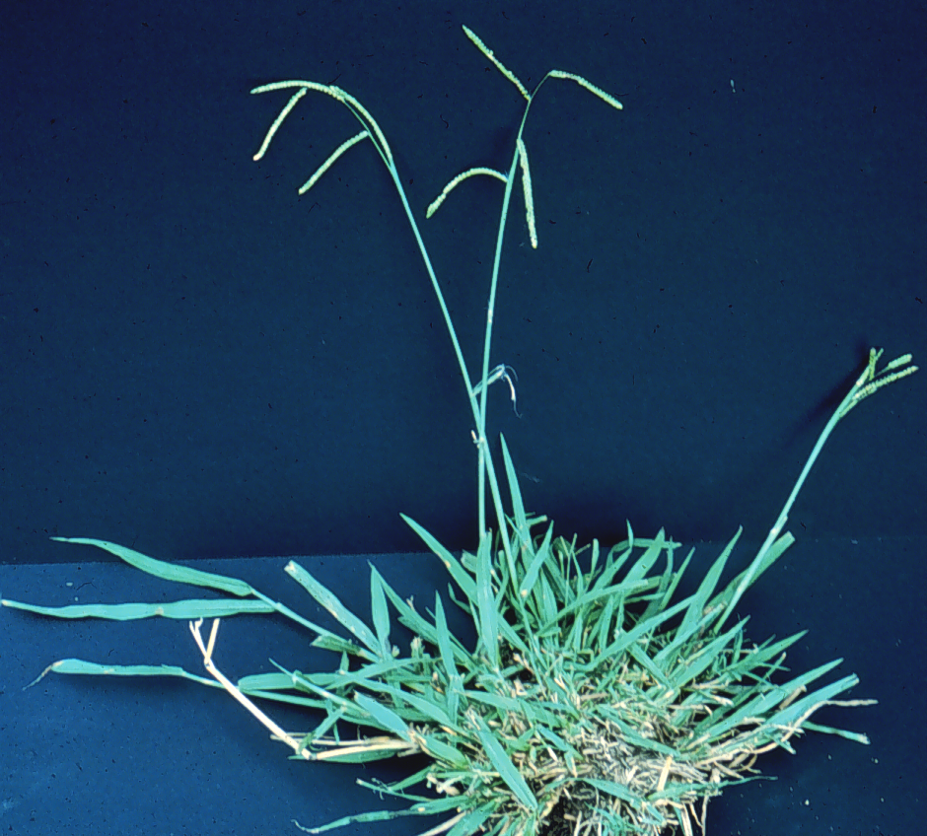
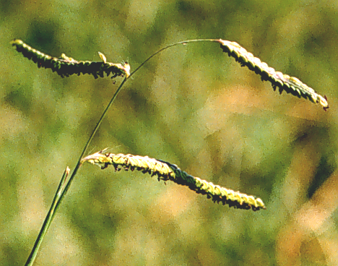
Grasses/Sedges for 500 pts. The Answer is
Dallasgrass

Slide 19
Potluck for 100 pts. The Answer is
___________ weeds like wild carrot (Queen Annes Lace) take 2 years to complete their lifecycle.
Biennial

Slide 20
Potluck for 200 pts. The Answer is
This is an example of ______ weed control.
Physical/mechanical

Slide 21
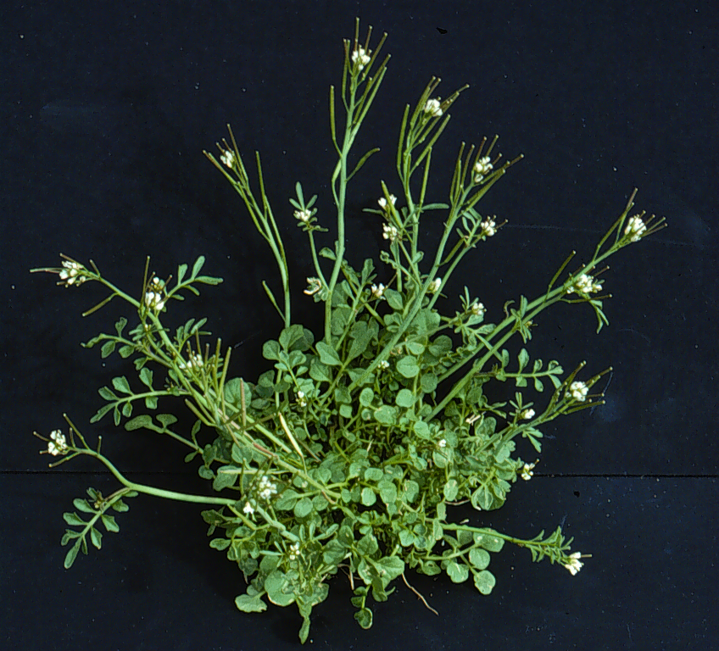
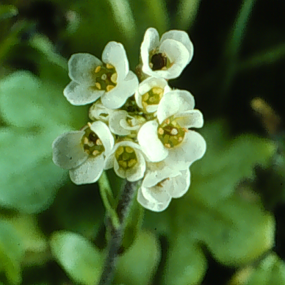
Potluck for 300 pts. The Answer is
Hairy Bittercrest

Slide 22
Potluck for 400 pts. The Answer is
IPM is an acronym for ____ ____ _____.
Integrated Pest Management

Slide 23
Potluck for 500 pts. The Answer is
September 1-15th in North Georgia is the time to apply ______ ______ to control winter annual weeds.
Preemergent Herbicides

Slide 24
Herbicides for 100 pts. The Answer is
Preemergent herbicides are effective on weeds that are already visible.
True or False
False

Slide 25
Herbicides for 200 pts. The Answer is
_____ emergent herbicides can be used after the weeds are visible, spot treatments are often used saving time and money.
Post-

Slide 26
Daily Double
600 Points

Slide 27
Herbicides for 600 pts. The Answer is
Roundup is an example of a(n) ___-_______ Herbicide that controls all green plants that are contacted with the spray.
Non-selective

Slide 28
Herbicides for 400 pts. The Answer is
“Burn Down” or _______ herbicides are not translocated to the roots and are not very effective on perennial type weeds.
contact

Slide 29
Herbicides for 500 pts. The Answer is
Postemergent Herbicides like Roundup are normally applied to the point of “___ ____”. Any excess is wasted.
Run off

Slide 30
Final Jeopardy
Herbicides

Slide 31
Final Jeopardy The Answer is
2,4-D is considered a _______ herbicide which controls broadleaf weeds without killing grasses.
Selective

