Slide 1

Notes:
UGA Logo

Slide 2
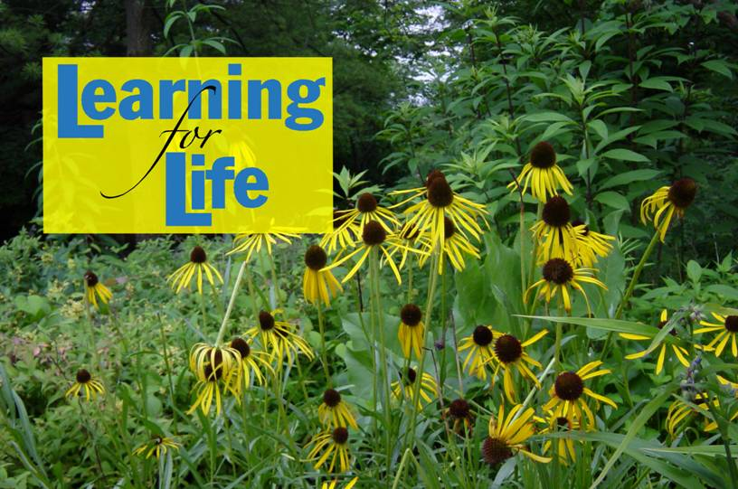
www.ugaextension.com
Notes:
UGA Cooperative Extension Web address www.ugaextension.com

Slide 3

Notes:
Georgia Master Gardener Logo

Slide 4
Weed Control in the Landscape
Developed by
Mark Czarnota and Tim Murphy
The University of Georgia
College of Agricultural and Environmental Sciences
Notes:
Credits
Program brought to you by The University of Georgia Department of Horticulture and Crop and Soil Sciences

Slide 5
Learning objectives
Definition of ‘weed’
Growth characteristics of weeds - growth habit and reproduction
Basic techniques for weed identification and basic weed control methods
Pre-emergent and post-emergent & selective and non-selective herbicides
Notes:
Learning Objectives
Know the definition of ‘weed’
Understand the growth characteristics of weeds including growth habit and reproduction.
Know basic techniques for weed identification and basic weed control methods including mechanical and chemical controls.
Understand the difference between pre-emergent and post-emergent herbicides and the difference between selective and non-selective herbicides.

Slide 6
Most effective use of herbicides & herbicide application methods and equipment
Commonly used herbicides and their classification and nomenclature
Herbicide application methods and equipment
Weed control for vegetable gardens, orchards, turf and landscapes
Notes:
Have an understanding of the most effective use of herbicides and be familiar with herbicide application methods and equipment.
Know the commonly used herbicides and their classification and nomenclature.
Be familiar with herbicide application methods and equipment.
Know methods of weed control for vegetable gardens, orchards, turf and landscapes including acceptable herbicide options and benefits of mechanical weed control.

Slide 7
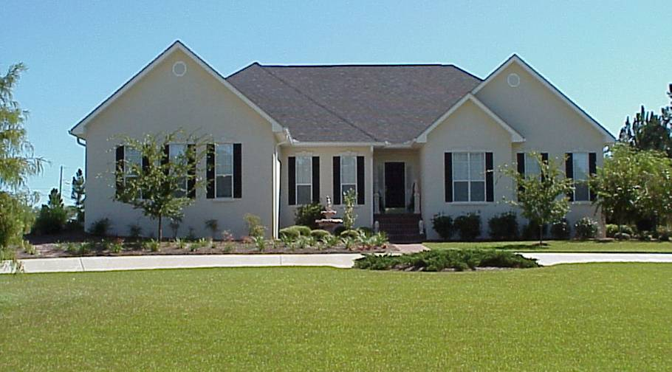
Attractive, Functional Landscape
Notes:
A high quality landscape is desirable and does not happen by accident. It requires well planned and well executed strategies.

Slide 8
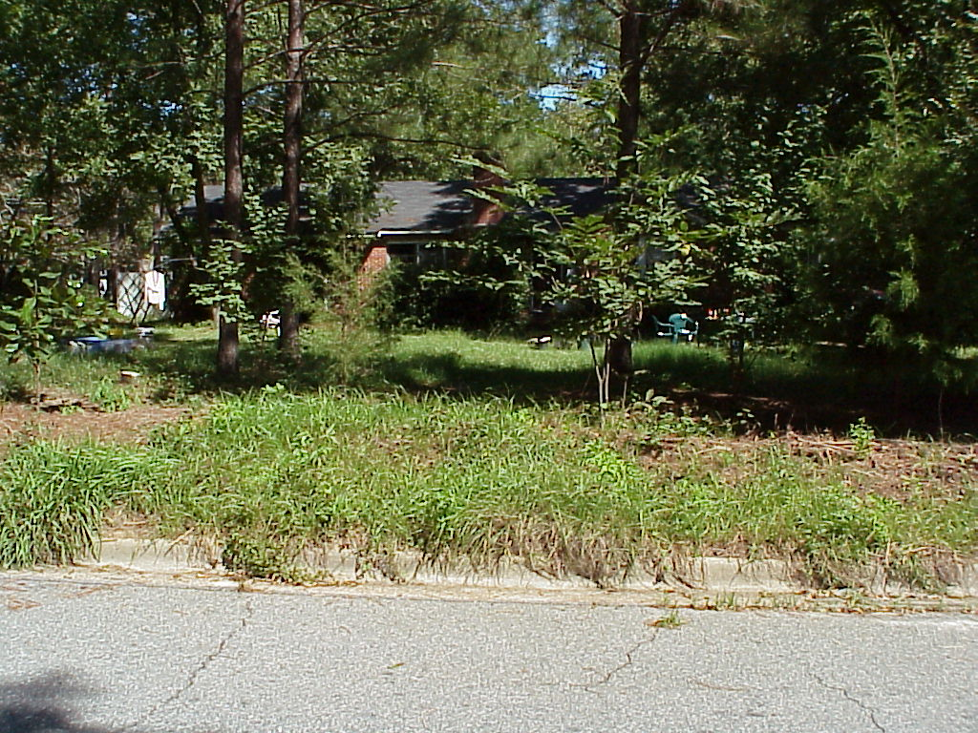
Notes:
Weeds interfere with the health and beauty of landscaped area.

Slide 9
What is a Weed?
Plant out of place
Plants causing economic loss
Non-native plant (Privet, Ligustrum spp.)
Plants whose virtues have not been discovered
Notes:
Classification of a plant as a weed can be difficult. Certain plants growing under certain situations cause economic loss, but in ornamental situations, the idea of a weed can be purely opinion. Major criteria that make a plant a weed are:
Plant out of place
Plants causing economic loss
Non-native plant (Privet, Ligustrum spp.)
Plants whose virtues have not been discovered

Slide 10
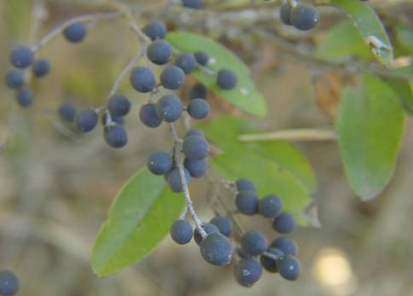
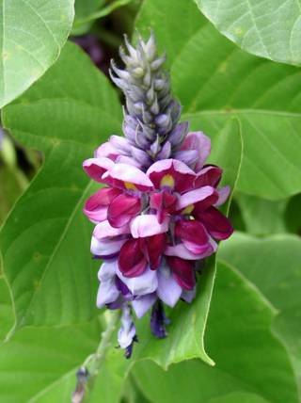
Chinese Privet
(Ligustrum sinense)
Kudza
(Pueraria lobata)
Notes:
Non-native plants brought here as ornamentals can become weeds. There are many great ornamental plants that are not native to North America, and have proven to make outstanding ornamentals with little to no impact to the environment. Some plants, like Chinese privet, were first brought to the North America as an ornamental, but escaped and are considered a weed in many situations.

Slide 11
Why Control?
Plant competition
Prevent economic loss
Hosts for insects and diseases
Maintain landscape beauty
Notes:
Why should weeds be controlled?
Plant competition
Prevent economic loss
Hosts for insects and diseases
Maintain landscape beauty

Slide 12
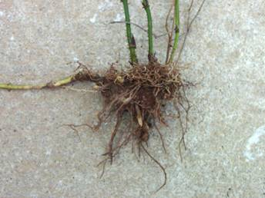
Reason Weeds Survive
Hard seed coat, deep burial, germination inhibitors, prolific seed production
Persistent vegetative structures: Bulbs, tubers, rhizomes, stolons, and corms.
Notes:
There are many characteristics that cause plants to become weeds. Some of the most important characteristics are the ability to produce large amount of seed that germinate very sporadically. Also the ability to produce persistent underground vegetative structures. These characteristics allow plants to lay dormant for years, and germinated over a long period of time.

Slide 13
Common Weeds
Notes:
Lead-in Slide: There are three main life cycles of weeds and we will discuss some of the more common weeds you will find in the landscape.

Slide 14
Weed Life Cycles
Annual: Completes growth cycle in a single growing season (crabgrass).
Perennial: A plant that can persist more than two years, and reproduce through roots or seeds (clover).
Biennial: A plant that normally requires two growing seasons to complete its life cycle, flowering and fruiting in its second year (wild carrot).
Notes:
Annual plants complete their growth cycle in a single growing season (crabgrass).
Perennials are plants that can persist more than two years, and reproduce through roots or seeds (clover).
Biennials normally require two growing seasons to complete their life cycle, flowering and fruiting the second year (wild carrot).

Slide 15
Seed Germination Factors
Temperature
Water
Oxygen
Light
Scarification (physical removal of the seed coat)
Notes:
General seed germination factors that determine whether a seed germinates or not. Seeds may require some or all of these factors to germinate.
Oxygen
Light
Scarification (physical removal of the seed coat
Temperature
Water

Slide 16
Weed Seed Production
Seed / Plant
Pigweed >200,000
Lambsquarters >30,000
Crabgrass 53,000
Annual Bluegrass 2,000
Notes:
Examples of seed production per weedy plant.
Pigweed can produce over 200,000 seeds per plant and Lambsquarters over 30,000 per plant
Crabgrass 53,000
Annual Bluegrass 2,000

Slide 17
Weeds can be a problem 12 months a year!
Notes:
Winter annuals, summer annuals, perennials, woody vines, shrubs, and trees all combine to make weeds a problem 12 months a year.

Slide 18
Summer annual grasses
Notes:
Summer annuals germinate in mid to late spring, and usually complete their life cycle by mid to late fall.

Slide 19
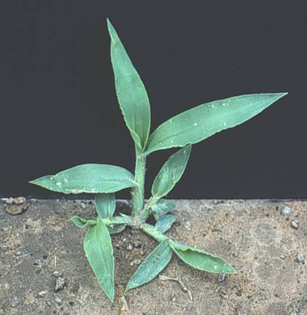
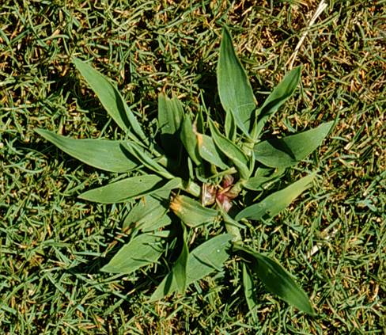
Southern crabgrass
Smooth crabgrass
Notes:
There are several species of crabgrass, but two of the most common are Southern and Smooth crabgrass. They germinate well in moist, warm soils (~60 ºF). Crabgrass control is the same regardless of type.

Slide 20
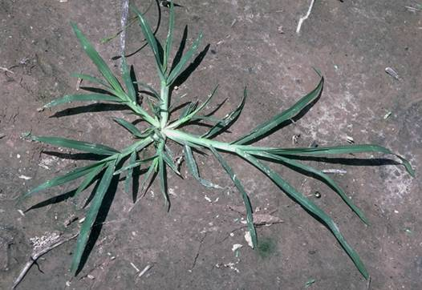
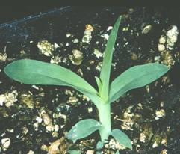
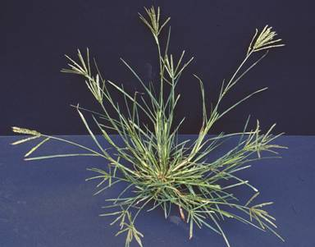
Goosegrass
Notes:
Goosegrass has a flat stem with a silvery center, and prefers compacted soils. It germinates under moist warm conditions. Goosegrasses that are resistance to some pre-emergence herbicides (i.e. Surflan) are present in the southeast.

Slide 21
Winter annuals
Notes:
Winter annuals germinate in late fall to early winter, and complete their life cycle in late spring to early summer.

Slide 22
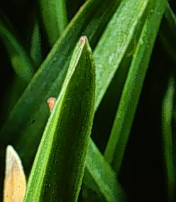
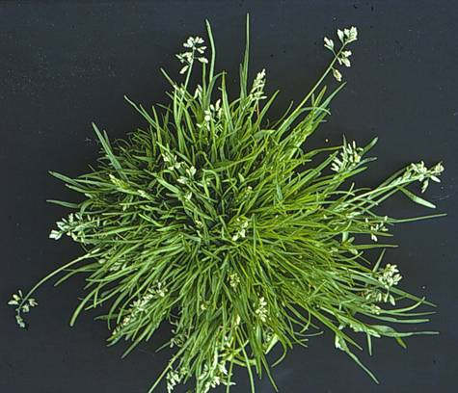
Annual bluegrass
Boat shaped leaf tip
Notes:
Annual bluegrass prefers compacted soils. There are several varieties of annual bluegrass, but most annual bluegrasses germinate from late summer to early fall. An identifying feature of bluegrass are tufted growth and boat-shaped leaf tips. You may also hear this called Poa annua.

Slide 23
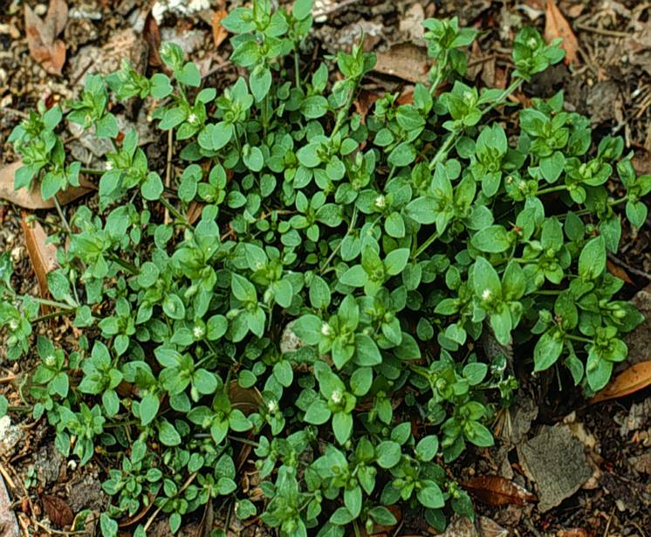
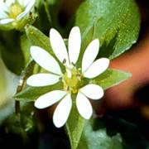
Common chickweed
Notes:
Common chickweed is a common winter annual in most landscapes. Low growing, spreading, with small white flowers.

Slide 24
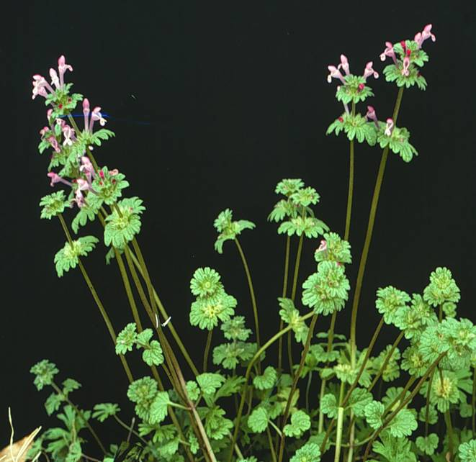
henbit
Henbit
Notes:
Henbit is a common winter annual in most landscapes. It has a square stem and small purple flowers.

Slide 25
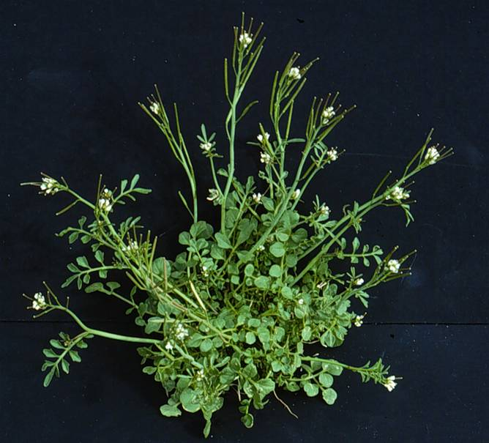
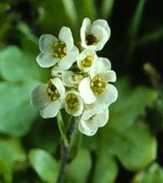
Hairy bittercress
Notes:
Hairy bittercress is a major winter annual throughout the United States. It has a very quick life cycle, able to go from seed to flower in less than ten days. It will grow to about six inches tall, and the seeds can be thrown from the pods up to 20 feet.

Slide 26
Summer annual broadleaf weeds
Notes:
Summer annuals germinate in mid to late spring, and usually complete their life cycle by mid to late fall.

Slide 27
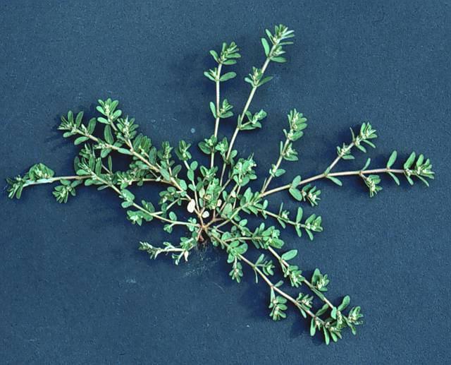
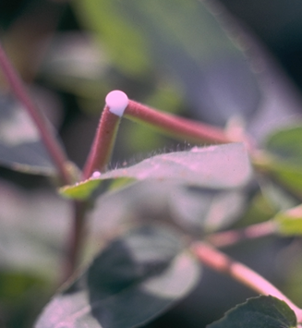
Prostrate spurge
Milky sap
Notes:
Prostrate spurge is a difficult-to-control summer annual that germinates in warmer soils. There are several species and they are identified by their low growing habit and milky sap that is produced when the stem is broken. It is tolerant to several common pre-emergent herbicides (i.e. Surflan, Treflan).

Slide 28
Perennial broadleaf weeds
Notes:
As you recall, a perennial plant can persist more than two years, and can reproduce through either seeds or vegetative structure (roots, tubers, rhizomes, stolons, etc.)

Slide 29
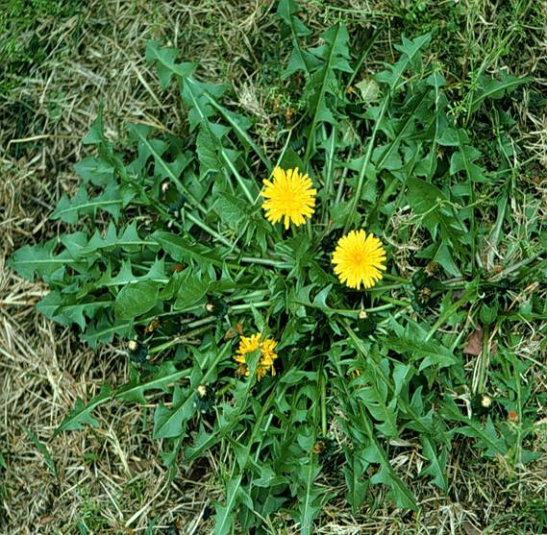
Dandelion
Notes:
Dandelion is a very common perennial, noted for yellow flower and wind blown seed. The tap-root makes this plant difficult to control. Young leaves are commonly eaten, and flower buds make great wine!

Slide 30
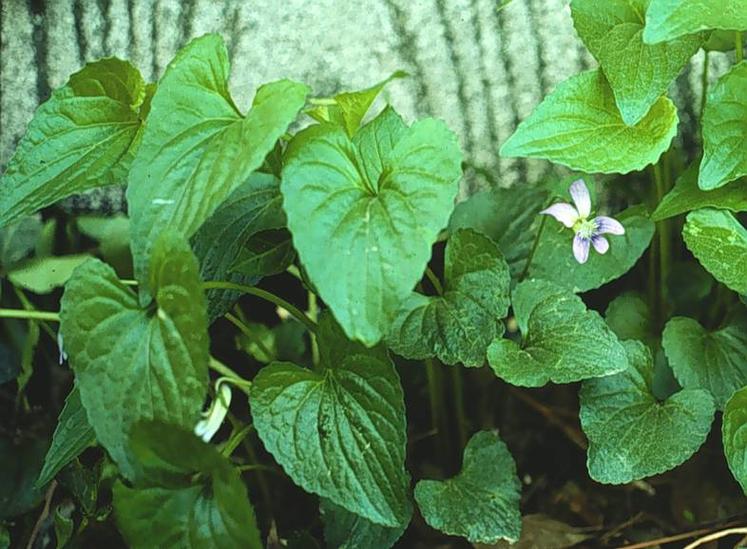
Wild violet
Notes:
Wild violet is extremely hard to selectively control in turfgrass. It is a well known wild flower, but can be invasive under certain situations. Flowers can be purple, pink, or white.

Slide 31
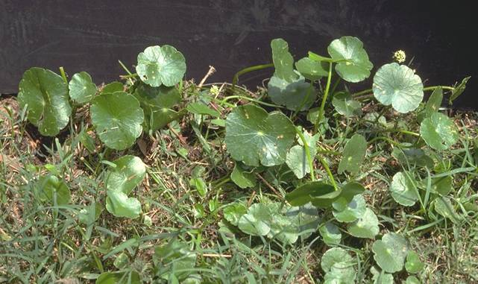
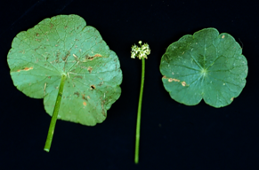
Pennywort or Dollarweed
Notes:
An invasive creeping perennial, Pennywort or Dollarweed is mostly found in moist and / or shady location. Shiny round leaves, spreads by rhizomes and stolons, flower are inconspicuous.

Slide 32
Perennial grassy weeds
Notes:
Perennial grassy weeds

Slide 33
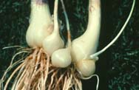
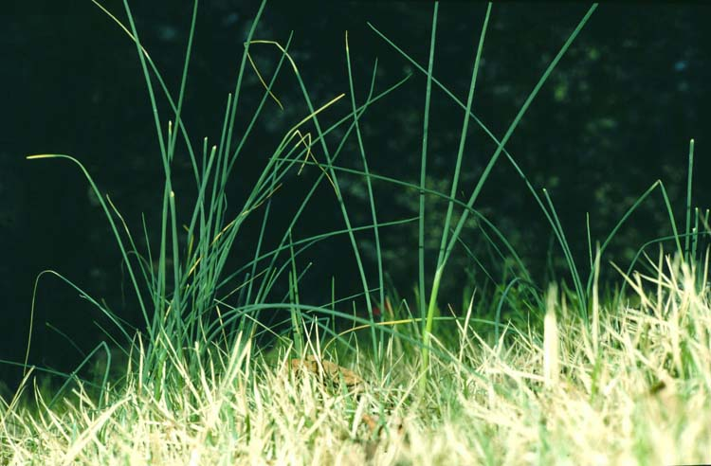
Wild garlic
bulbs and bulblets
Notes:
Wild garlic appears in winter and / or early spring. Mainly originates from bulbs. This plant is difficult to control because of short window of growth. Flowers can produce seeds, bulbs, or live plants. Wild onion can also be a problem, and is difficult to tell from wild garlic. Wild onion leaves tend to be flatter, the leaves are hollow, and the bulbs have a net like membrane covering the bulb. Wild onion is much less prevalent than wild garlic. One should not worry about the differences because herbicides used to wild garlic will also control wild onion.

Slide 34
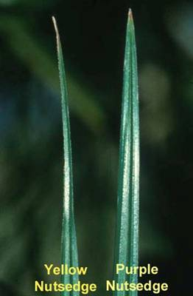
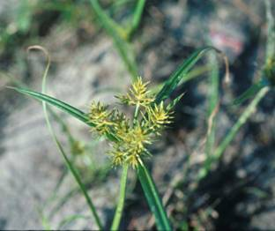
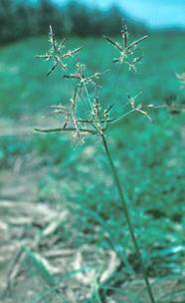
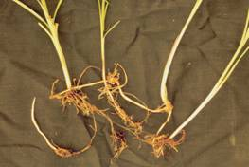
Purple and Yellow Nutsedge
Yellow nutsedge flower
Purple nutsedge flower
Leaf tips differ
Purple nutsedge rhizome tuber system
Notes:
Yellow and purple nutsedge are difficult to control sedges because of their tuber and rhizome systems. If plants are not in flower, they can be identified by their different leaf tips. Both nutsedge species can grow under diverse conditions (wet to dry) and are among the top 10 world’s worst weeds, with purple nutsedge being number one!

Slide 35
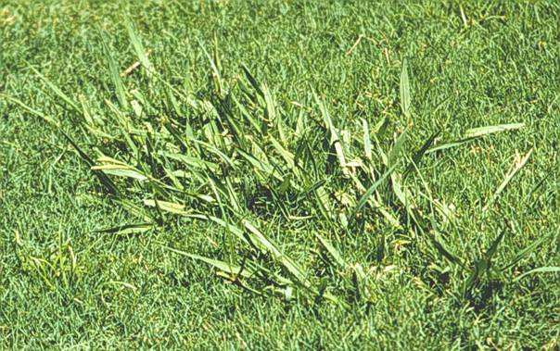
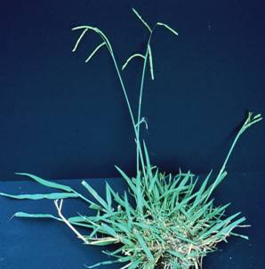
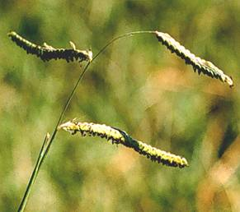
Dallisgrass
Notes:
Dallisgrass is a warm-season perennial grass that reproduces by seed and very short rhizomes. It can be difficult to control with herbicides.

Slide 36
Control vs. Eradication
Control - Process of limiting a weed infestation to a desirable level.
Eradication - Elimination of all plants and plant parts.
Notes:
There is a difference between controlling and eradicating a plant. Control bringing a weed control problem to a desirable or tolerable level. Eradication is extremely difficult, and simple means the elimination of all plants and plant parts.

Slide 37
Weed Management Strategy
Identify weed, life cycle, habitat
Integrated Pest Management
  Preventive
  Physical
  Cultural
  Biological
  Chemical
Notes:
To control weeds, it is very important that you understand all aspects of the weeds that you are trying to control. This will allow you to choose proper control methods. Integrated Pest Management (IPM) is an excellent process to follow in order to control weeds. IPM employs many strategies to control weeds, and they include
Identify weed, life cycle, habitat
Integrated Pest Management method
Preventive
Physical
Cultural
Biological
Chemical

Slide 38
Preventive Methods
Weed-free seed and plant material
Screened and sterilized topsoil and soil amendments
Keep equipment clean
Notes:
Methods for preventing weeds include: using weed free seed and plant material. Use only screened and sterilized topsoil and soil amendments. By keeping equipment clean, you eliminate weed seeds that may be hanging on.

Slide 39
Physical Removal and Barriers
Hoeing and hand removal
Mowing
Cultivation
Mulches and landscape fabrics
Notes:
Physical removal and barriers are good ways to control weeds in many instances. These methods include:
Hoeing and hand removal
Mowing
Cultivation
Using mulches and landscape fabrics

Slide 40
Hand Pulling and Hoeing
Good control method for small weeds
Generally easier to control annuals
Notes:
Hand pulling and hoeing are a good method of control for small weeds. Annual weeds are easier to control than perennials using this method.

Slide 41
Mowing
Useful in turf and pastures
Mowing reduces seed production of weeds if done before flowering.
Notes:
Mowing is useful in turf and pastures. Mowing also reduces seed production of weeds if done before flowering.

Slide 42
Cultivation
Advantages: Controls most weeds quickly and easily
Disadvantages: Can be expensive, delayed by weather, and may prune crop roots
Notes:
Cultivation can be hand hoeing, tilling, or any other means of breaking up the soil surface so that vegetation is removed or destroyed.

Slide 43
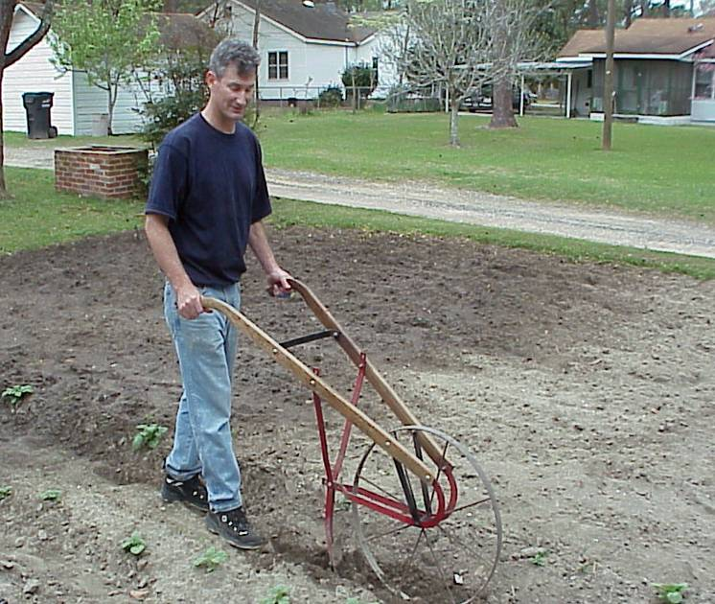
Repeat cultivation
to control each flush
of weeds.
Notes:
The picture, if some of you can remember, is a high wheel tiller. This and other cultivation methods can be employed at each weed flush. Generally you would want to use cultivation at the initiation of an ornamental garden or a turfgrass planting. Maintaining bare soil plantings is difficult, and very time consuming.

Slide 44
Mulches and Landscape Fabrics
Fabrics type affects the degree of weed suppression.
Straw, wood chips, pine straw, newsprint, and other organic materials prevent the emergence of weeds and enhance the organic matter content.
Notes:
Fabrics are made of several different materials, all with different degrees of longevity. Fabrics and mulches allow for water penetration, weed suppression, and maintain even soil temperatures.

Slide 45
Cultural Methods
Adapted plants
Fertility and pH
Water management
Insect and disease control
Notes:
Anything that can be done in order to get healthier ornamentals or turf should be employed. Planting the right plants in the right spot, and making sure that those plants are properly taken care of can greatly increase the ability of desirable plants out compete weeds.
Choose adapted plants
Make sure fertility and pH are correct
Practice good water management
Keeps insect and diseases under control

Slide 46
Biological Methods
Living organisms for weed control
Insect (thistle weevil)
Grazing animals (Geese)
Fish (Grass carp)
Notes:
Biological methods for weed control that are available are :
Insect (thistle weevil)
Grazing animals (Geese, sheep, goats)
Fish (Grass carp)
Other biological means of weed control are being researched such as using pathogens that control or kill weeds and plants that make their own herbicides (Black Walnut).

Slide 47
Chemical Methods
Herbicide - chemical that is used to control, suppress or kill weeds.
Notes:
An herbicide is a chemical that is used to control, suppress or kill weeds.

Slide 48
Herbicide Classification
Preemergence: Applied before weed seed germination (trifluralin). Generally no control of emerged weeds.
Postemergence: Applied after weed emergence. Generally no control of unemerged weeds.
Notes:
Herbicides are usually classified as being either preemergence or postemergence. Preemergence is applied before weed seed germination (trifluralin) and generally provides no control of emerged weeds. Postemergence herbicides are applied after weed has sprouted. Generally these provide no control of weed seeds that have not sprouted.

Slide 49
Herbicide Classification
Contact: Causes localized plant tissue injury. Does not readily move through the plant (glufosinate)
Systemic: Readily moves through the plant tissue (glyphosate)
Notes:
Another way that herbicides are classified is by how they work on the plant. This usually applies to post-emergence herbicides. Contact herbicides cause localized plant tissue injury and do not readily move through the plant (glufosinate). Systemic herbicides, on the other hand, readily move through the plant tissue and disrupt the plant’s normal growth processes (glyphosate).

Slide 50
Herbicide Classification
Selective: Kills some plant species, but does not damage others (2,4-D)
Nonselective: Generally kills all plant species (glyphosate)
Notes:
Herbicides may also be classified as selective or nonselective. Selective herbicides may kill some plant species but does not damage others. A good example of this is 2,4-D which kills broadleaf weeds but not most grasses. Nonselective herbicides like glyphosate will generally kill all plant species.

Slide 51
Preemergence Herbicide Application Dates
Fall - Sept 1 – Oct 1, N.GA
- Oct 1 – Nov 1, S.GA
Spring - Mar 1 – Apr 1, N.GA
- Feb 15 - Mar 15, S.GA
Notes:
Exact application dates of preemergent herbicides can vary greatly. These dates are meant as a guideline only. Above Macon is North Georgia, and below Macon is South Georgia.

Slide 52
Advantages
Postemergence Herbicides
Flexible application time
Spot treatment
Small containers
Fits well into IPM programs
Notes:
Postemergent herbicides can be used whenever a plant is actively growing, there is no window of application as with preemergent herbicides. You can treat small areas of vegetation very easily. There are many more formulations of postemergent herbicides available to the homeowner. IPM programs favor postemergents because you are treating a problem that already exists. With preemergent herbicides, you have to make a herbicide application because you think that you will have a weed problem. Many people consider this a waste of herbicide, but in situations where no weeds can be tolerated (i.e. a golf course green) this may be the only alternative.
Some advantages of using postemergence herbicides are:
Flexible application time
Spot treatment
Small containers
Fits well into IPM programs

Slide 53
Postemergence
Herbicide Precautions
Avoid windy days (spray drift)
Do not apply dicamba mixtures over the root zone of ornamental trees and shrubs
Read the label
Notes:
Avoid applications of postemergent herbicides on windy days (gust greater than 10 mph). Do not apply dicamba mixtures within the drip line of trees. Dicamba is a broadleaf herbicide found in many turfgrass herbicides. Dicamba can be taken up by tree roots under certain situations. Trees that take up dicamba can be damaged or killed. Of course, always read the label.

Slide 54
Before You Use Herbicide
Identify weed.
Read and UNDERSTAND label .
Follow directions carefully.
Use only recommended amount!
Maintain and calibrate equipment.
Do not use on desirable plants not listed on label.
Notes:
Before you use any herbicide, you should:
Identify the weed.
Read and UNDERSTAND the label .
Follow all directions carefully.
Use only the recommended amount!
Maintain and calibrate your equipment.
Do not use on desirable plants not listed on label.

Slide 55
Turfgrass Herbicides
Notes:
Lead in slide- Turfgrass Herbicides

Slide 56
Preemergent Turfgrass Herbicides
Annual grass control in all turfgrasses
  Balan (benefin)
  Surflan (oryzalin)
  XL (benefin + oryzalin)
  Team Pro (benefin + trifluralin)
  Halts (pendimethalin)
  Dimension (dithiopyr)
Notes:
There are many preemergent turfgrass herbicides available, even for homeowners. Some that you will commonly find for sale are:
Balan (benefin)
Surflan (oryzalin)
XL (benefin + oryzalin)
Team Pro (benefin + trifluralin)
Halts (pendimethalin)
Dimension (dithiopyr)

Slide 57
Postemergent Turfgrass Herbicides
Notes:
Postemergent Turfgrass Herbicides

Slide 58
2,4-D Mixtures
Does not control weedy grasses
Good - dandelion, plantains, wild garlic
Poor to fair – common chickweed, henbit
Use on all turfgrasses except St. Augustine
Example = Weed-B-Gon
Notes:
2,4-D Mixtures are available in many formulations (sprayable and granular). Be sure to keep spray drift off of desirable plants. 2,4-D does not control weedy grasses, provides good control on dandelion, plantains, and wild garlic and only poor to fair control on common chickweed and henbit. 2,4-D can be used on all turfgrasses except St. Augustine. You will often find it sold as a Broad leaf Weed Killer; a common brand name is Weed-B-Gon.

Slide 59
MSMA DSMA CMA
Postemergence control of weedy grasses
Use in tall fescue, zoysia, bermuda
Initially discolor tolerant turfgrass species
Avoid application above 90º F
Do not use on centipede and St. Augustine
Example = Ortho Crabgrass Killer Formula II
Notes:
MSMA DSMA CMA provide postemergence control of weedy grasses. They are generally used in in tall fescue, zoysia, bermuda. They may initially discolor tolerant turfgrass species but this is usually only temporary. Avoid using these when temperatures exceed 90 degrees F. They are also not safe to use on centipede and St. Augustine. One common brand name is Ortho Crabgrass Killer Formula II.
Only available in sprayable formulations. These herbicides may be removed from the market in the near future, because of the arsenic in their formulations. However this arsenic is in a very unavailable form, and these products have been on the market for 30+ years. There are no other herbicides that can replace these herbicides in many situations!

Slide 60
Sethoxydim
Controls crabgrass, goosegrass, and sandbur
Suppresses bahiagrass
Use only on centipedegrass
Example = Vantage
Notes:
Sethoxydim is a useful postemergence herbicide labeled only for use on centipedegrass. It works well for suppressing bahiagrass and controls crabgrass, goosegrass and sandbur. It is commonly sold as Vantage.

Slide 61
Atrazine
Can be used on: Centipede, St. Augustine, Zoysia
Dormant bermudagrass
Cool-season grasses and bahiagrass are not tolerant
Comes in both sprayable and granular formulations
Depending on the weed, atrazine has both pre and post emergence activity
Notes:
Atrazine can be used on: Centipede, St. Augustine and Zoysia. It can also be used on dormant bermudagrass. Do not use on cool season grasses or bahiagrass. It is commonly available in sprayable liquid and dry granular formulations. Depending on the weed species, atrazine actually has postemergent and preemergent properties.

Slide 62
Turfgrass Fertilizer/Herbicide
Combinations
Fertilizers can be combined with either pre- or postemergence herbicides.
Created so you don’t have to make separate applications of fertilizers and herbicides.
Products available from many manufactures selling nearly identical products.
Notes:
Turfgrass Fertilizer/Herbicide Combinations- Pendimethalin is probably the most commonly used preemergent herbicide combined with fertilizers (Example: Scott’s Halts plus II) . 2,4-D, dicamba, and MCPP are probably the commonly used postemergent herbicides combined with fertilizers (Example: Scott’s Weed and Feed). Atrazine is also commonly combined with fertilizers for pre- and post emergent weed control on Southern grasses. However, there are many manufacturers who combine a wide array of herbicide / fertilizer combinations.

Slide 63
Herbicides for use in Ornamentals
Notes:
Refer to slide!

Slide 64
Preemergent Herbicides
Surflan (oryzalin)
Treflan (trifluralin)
Snapshot (trifluralin and isoxaben)
XL (benefin and oryzalin)
Casoron (dichlobenil)
Notes:
Preemergent Herbicides Surflan is only available as a sprayable. Treflan is available primarily as a granular, and both Treflan and Surflan control a similar spectrum of weeds. Snapshot and XL are both granular herbicides that control a broad spectrum of annual grass and broadleaf weeds. Both of Snapshot and XL contain two preemergent herbicides to give the products a broader spectrum of weed control. Casoron can only be used in certain woody ornamentals, but provides excellent control of many difficult to control winter weeds (Example = Florida Betony). All of these herbicides can be acquired at your local farm supply store, but may have to be ordered.

Slide 65
Postemergent Herbicides
Vantage (sethoxydim)
Grass-B-Gon (fluazifop-P)
Roundup (glyphosate)
Finale (glufosinate)
Sharpshooter (Potassium salts of fatty acids)
Notes:
Postemergent Herbicides Vantage and Grass-B-Gon are herbicides that control only grasses (graminicides), and can be used over the top of most established ornamentals. Roundup, Finale, and Sharpshooter are non-selective post emergent herbicides that are meant to be used as post directed application (spot weed control) or for clearing an area of all vegetation. Roundup is very good at getting in to the plants vascular system, and is much better at controlling perennial weeds with large underground storage organs (rhizomes, tubers, etc.) than Finale and Sharpshooter. Roundup, Finale, and Sharpshooter are all good at controlling annual type weeds.

Slide 66
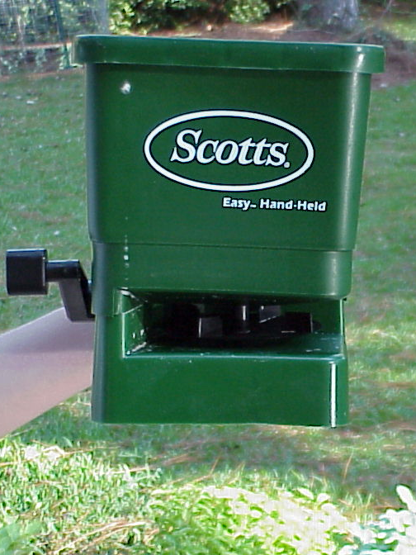
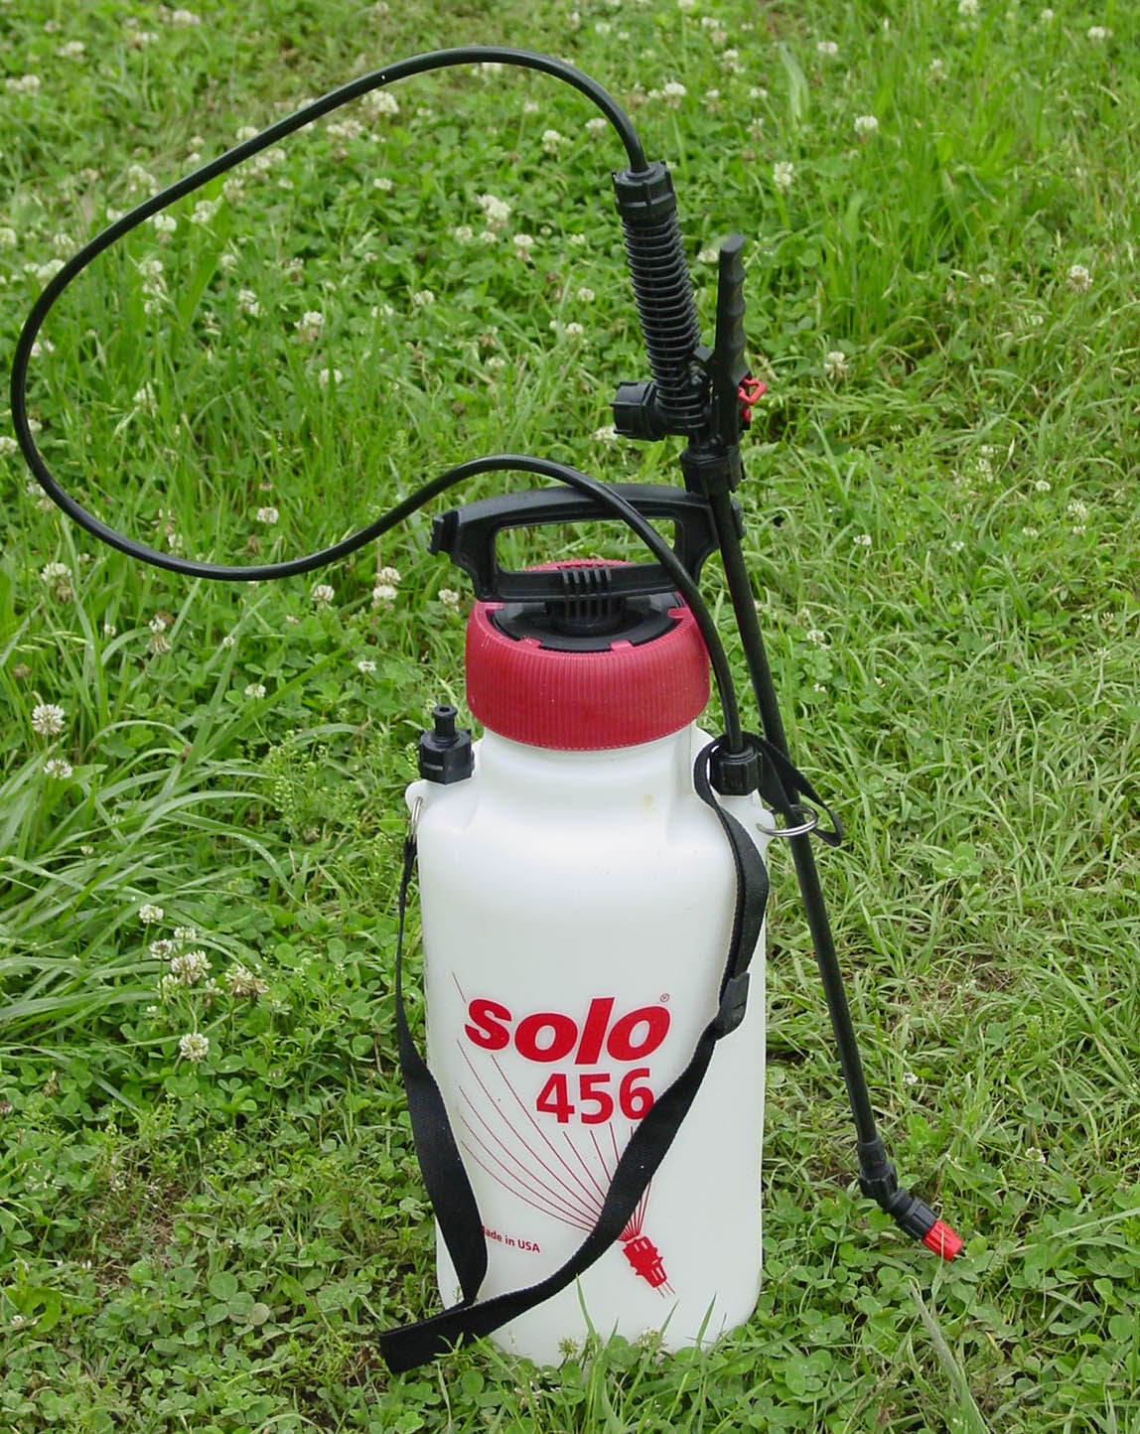
Equipment
Hand pump Sprayer
Handheld rotary spreader
Notes:
There is a myriad of pesticide application equipment on the market. Some of the most common are backpack sprayers for liquid application, and hand held rotary spreaders for granular herbicides.

Slide 67
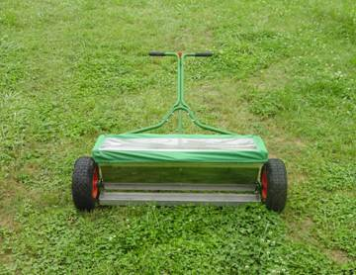
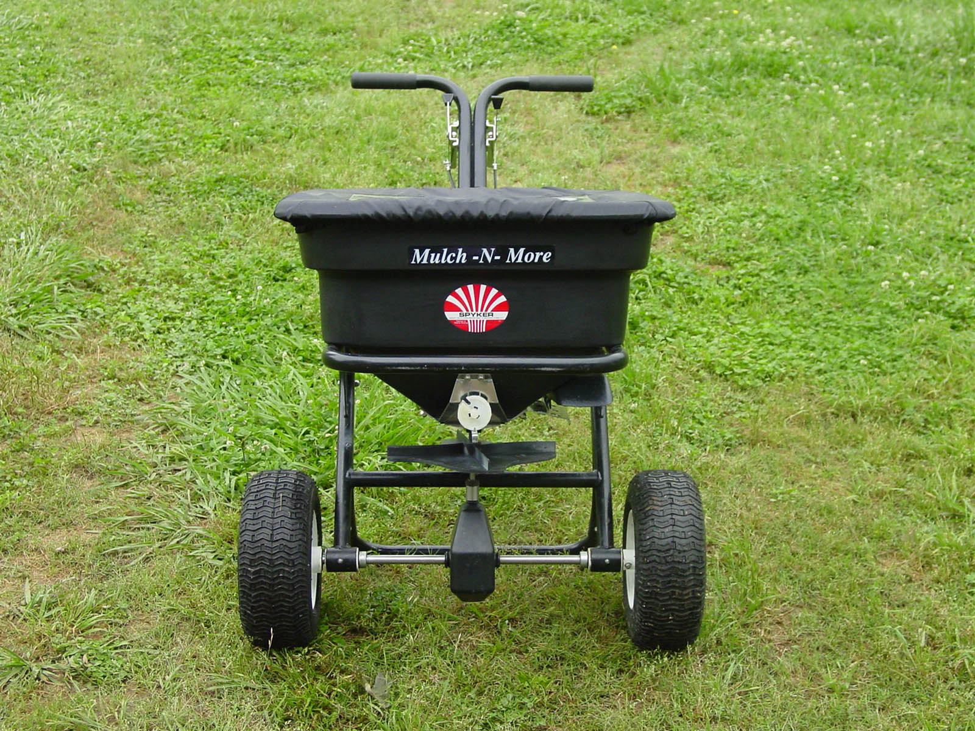
Equipment
Drop spreader
Broadcast spreader
Notes:
Other common push type spreaders are drop spreaders and broadcast spreaders.

Slide 68
Calibration
Hand held granular spreaders:
Know the size of the area to be treated
Weight out granular herbicide needed for that area
Uniformly apply the pre-weighted granular herbicide to the designated area
Notes:
Applying a herbicide at too high or too low a rate can be a waste of your time and money, as well as cause injury to desirable plants. Taking a few minutes to figure out how much area you are trying to treat with a granular herbicide. From the directions on the herbicide label, determine how much herbicide that you will need to treat this predetermined area. Weigh out this amount of herbicide, and uniformly apply it to the designated area.

Slide 69
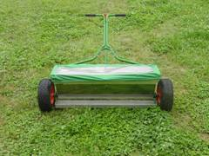
Calibration
Push type drop and broadcast spreaders:
Many companies sell spreaders to go along with there granular herbicides (i.e. Scott’s, Lesco, etc.).
There granular herbicide products will have the appropriate spreader setting listed on the bag.
Notes:
Most companies sell a spreader to go along with their product. Try to purchase a product with your spreader setting information on the bag. If this information is not present, it can be very difficult to determine if you are applying the herbicide at the correct rate. The spreader can be calibrated to apply the correct amount, but can be messy and require special equipment. Check with you county extension agent for information on calibrating your drop or broadcast spreader.

Slide 70
Calibration and Application
Pump type sprayers:
Measure the area to be treated.
Using the herbicide label, determine the amount of herbicide needed.
Measure out herbicide.
Mix water and herbicide concentrate.
Pressurize sprayer, and uniformly apply herbicide solution to the are.
Hand pump sprayer
Notes:
Calibration and Application There are many brands of hand held pressurized sprayers on the market. All of them allow you to spray a pesticide / water solutions. Many herbicides concentrates that will be applied as a spray can be formulated as a liquid and/or solid. Care should be taken to make sure that the herbicide concentrate and water are combined before spraying. Make sure to add a small amount of water before adding the herbicide concentrate. Agitate or shake the herbicide solution before applying. Usually postemergent herbicides will be applied as a spray, and you will be required to spray until wet or runoff begins. Preemergent herbicides are also formulated as a spray, but generally for large producers with special application equipment. Homeowners are encouraged to apply their preemergent herbicides in the form of granular applications.

Slide 71
Weed management program
Diagnose problem
Evaluate methods
Select method
Initiate program
Notes:
In summary, if you follow these four management strategies you will effectively control weeds in your landscape.
Diagnose the problem.
Evaluate methods of control that are available.
Select method that best suits the situation.
Initiate program following all label directions and safety precautions.

Slide 72
Always read and follow the herbicide label!
Notes:
Refer to slide

Slide 73
Questions?
Notes:
1. What is the definition of a weed?
2. What are the 3 weed types?
3. Why is it important to know the difference between the life cycles of annual, perennial, and biennial weeds?
4. How can ornamental plants become weeds?
5. Tell how preventative practices can be effective in controlling weeds in the garden or landscape.
6. Discuss the difference between contact and systemic herbicides.
7. In what instances would preemergence herbicides be most effective in controlling weeds?
8. When are postemergence herbicides commonly used?
9. Name the factors that influence how well a herbicide will work.
10. Discuss how proper timing is important when using a herbicide for weed control.
11. What is the difference between selective and nonselective herbicide?

Slide 74
Turfgrass Web Page
www.georgiaturf.com or .org
Photographs of major weeds
Control recommendations
Popular articles, fact sheets
Links to pertinent sites
Notes:
Refer to slide

Slide 75

Notes:
Many thanks to Nina Eckberg for her help in completing this slide set!

